Slide 1
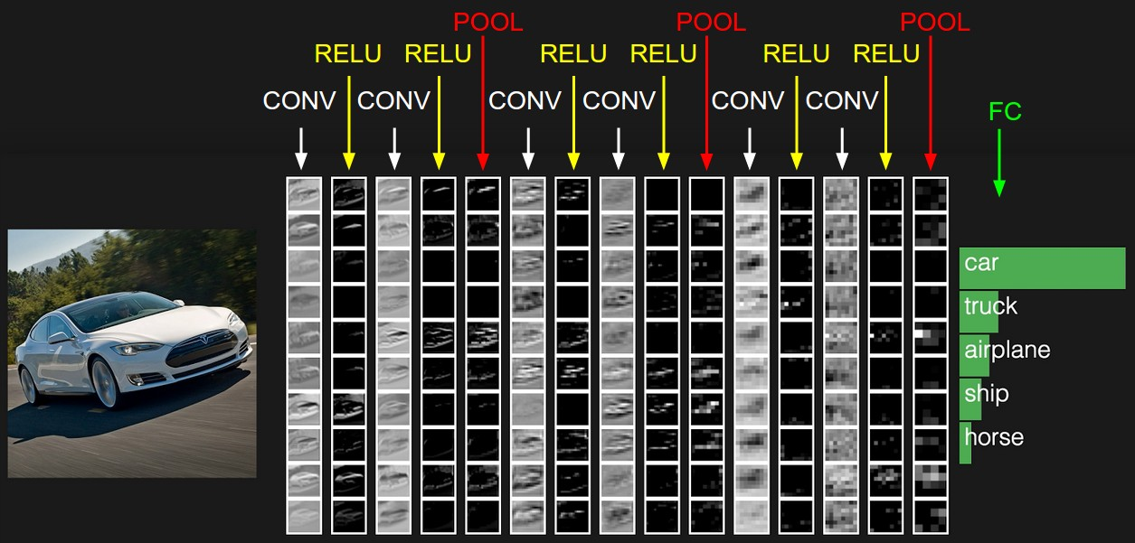
Convolutional Neural Network Architectures:
from LeNet to ResNet
Lana Lazebnik
Figure source: A. Karpathy

Slide 2
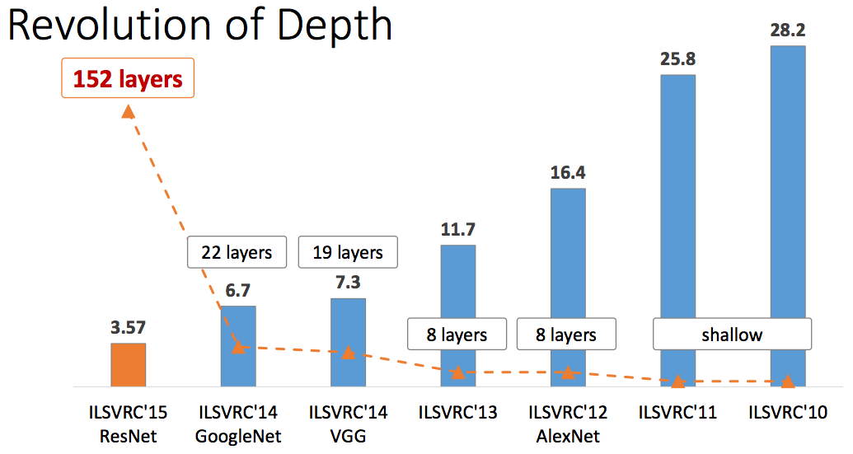
What happened to my field?
Classification: ImageNet Challenge top-5 error
Figure source: Kaiming He

Slide 3
What happened to my field?
Object Detection: PASCAL VOC mean Average Precision (mAP)
Before deep convnets
Using deep convnets
Figure source: Ross Girshick
Notes:
We’re in the midst of an object detection renaissance and it’s brought about by the successful application of deep convnets to the problem.

Slide 4
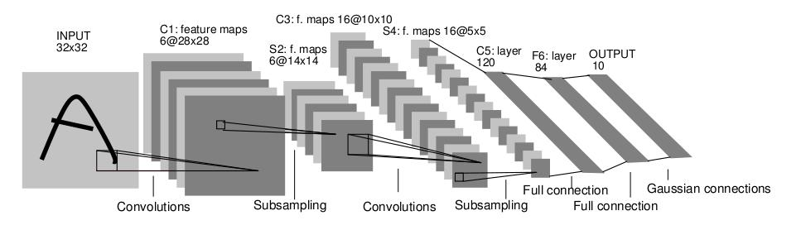
Actually, it happened a while ago…
LeNet 5
Y. LeCun, L. Bottou, Y. Bengio, and P. Haffner, Gradient-based learning applied to document recognition, Proc. IEEE 86(11): 2278–2324, 1998.

Slide 5
Let’s back up even more…
The Perceptron
Input
Weights
x₁
w₁
x₂
w₂
Output: sgn(w⋅x + b)
x₃
w₃
.
.
.
w_{D}
x_{D}
Rosenblatt, Frank (1958), The Perceptron: A Probabilistic Model for Information Storage and Organization in the Brain, Cornell Aeronautical Laboratory, Psychological Review, v65, No. 6, pp. 386–408.

Slide 6
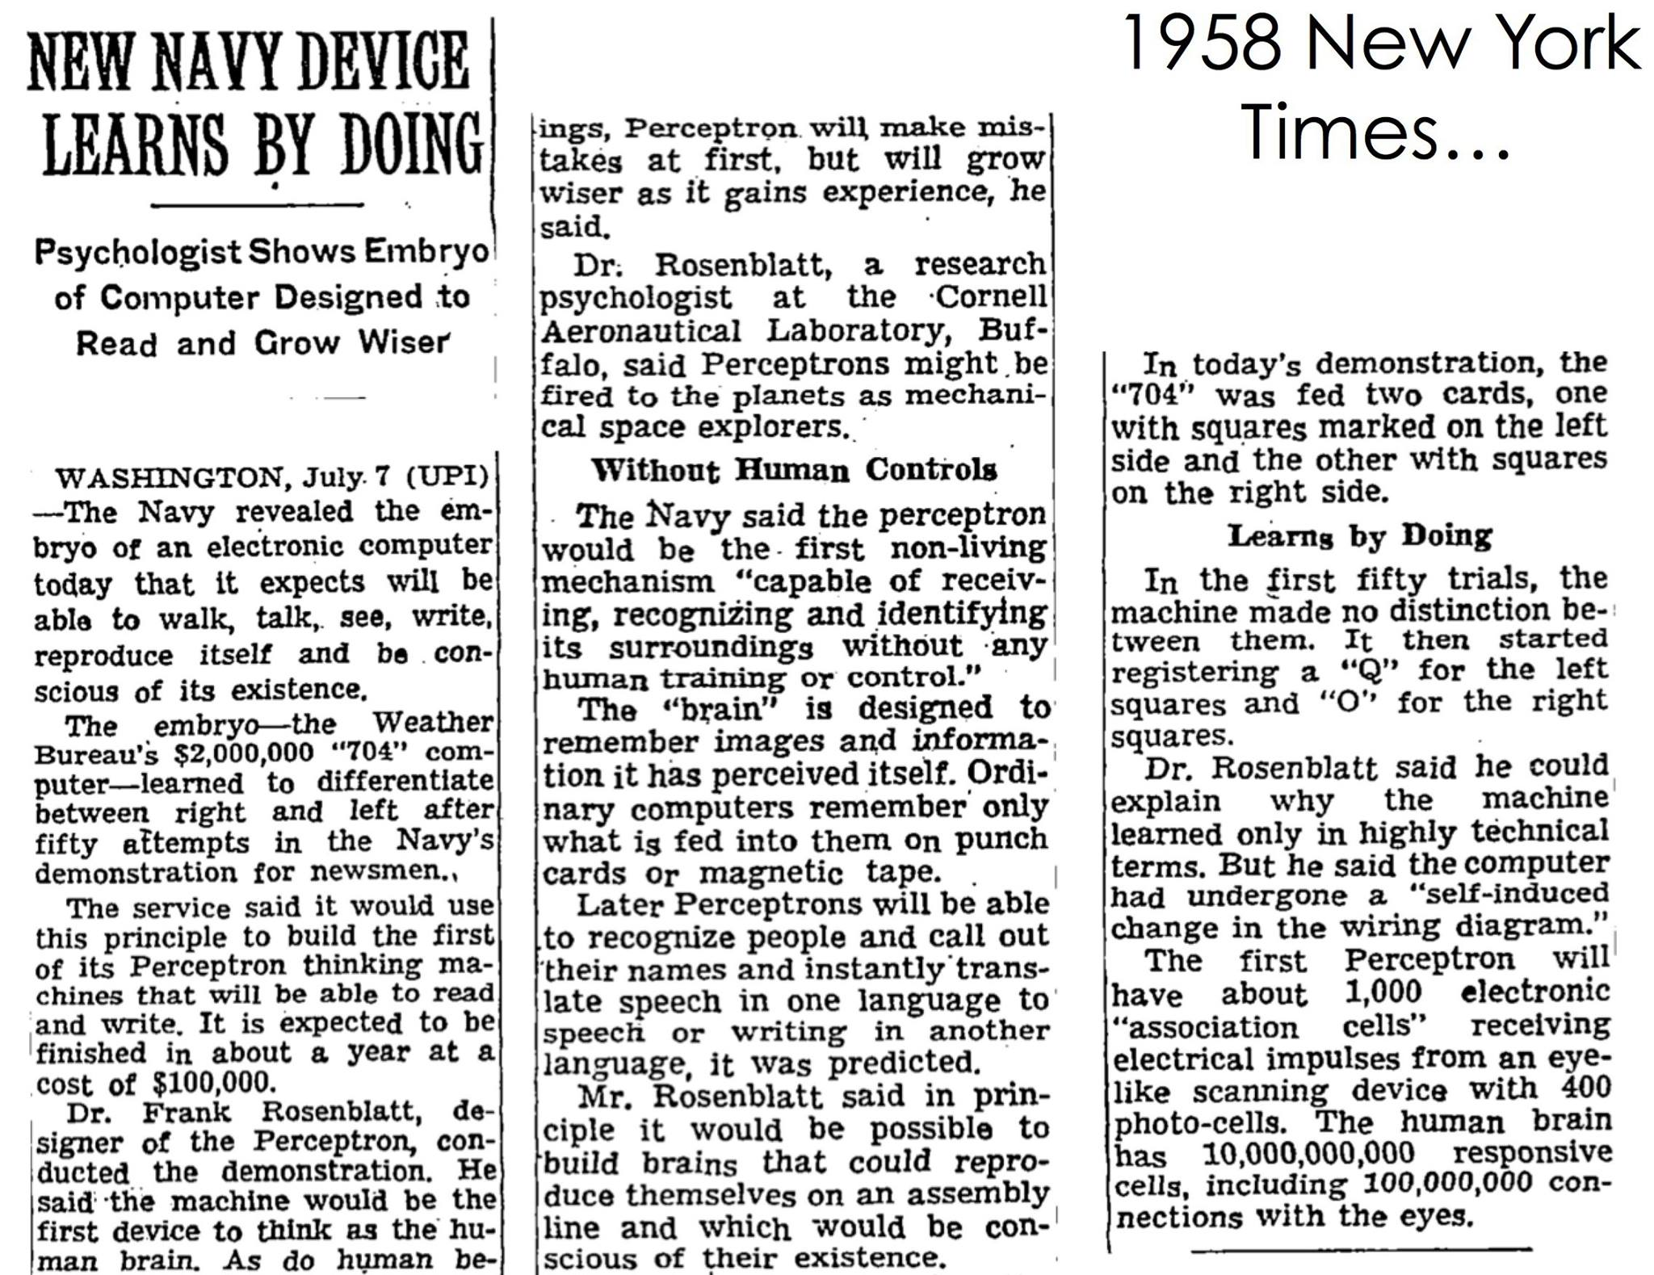
Let’s back up even more…

Slide 7
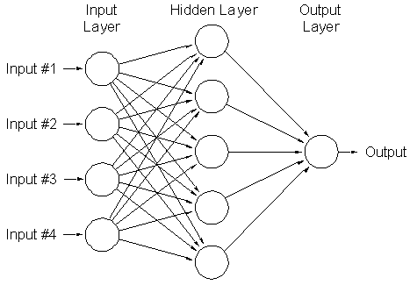
Two-layer neural network
Can learn nonlinear functions provided each perceptron has a differentiable nonlinearity
Sigmoid:

Slide 8
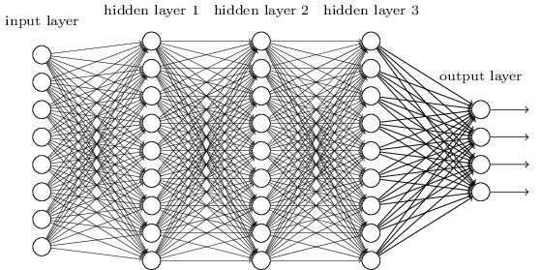
Multi-layer neural network

Slide 9
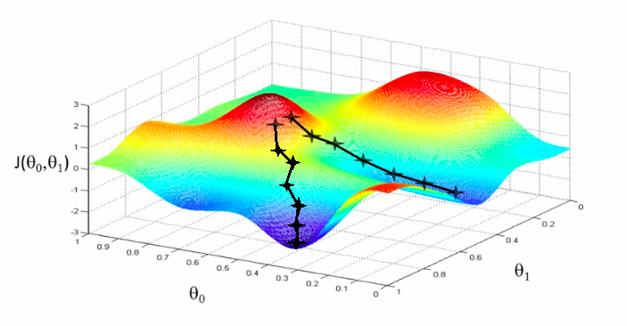
Training of multi-layer networks
Find network weights to minimize the training error between true and estimated labels of training examples, e.g.:
Update weights by gradient descent:
w₂
w₁

Slide 10
Training of multi-layer networks
Find network weights to minimize the training error between true and estimated labels of training examples, e.g.:
Update weights by gradient descent:
Back-propagation: gradients are computed in the direction from output to input layers and combined using chain rule
Stochastic gradient descent: compute the weight update w.r.t. one training example (or a small batch of examples) at a time, cycle through training examples in random order in multiple epochs

Slide 11
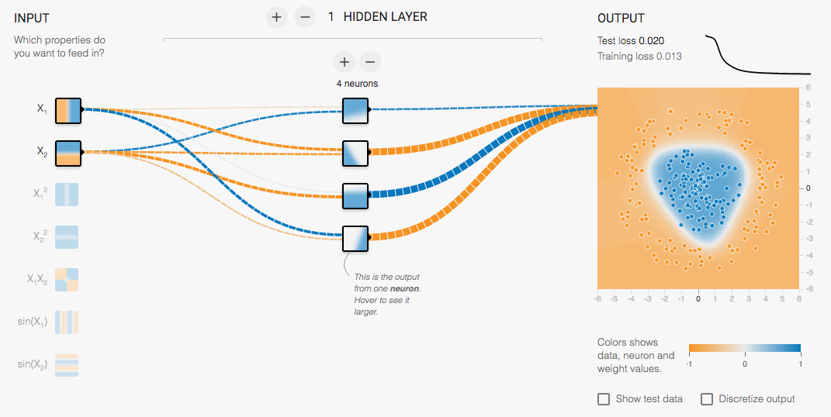
Multi-Layer Network Demo
http://playground.tensorflow.org/

Slide 12
From fully connected to convolutional networks
image
Fully connected layer

Slide 13
From fully connected to convolutional networks
image
Convolutional layer

Slide 14
From fully connected to convolutional networks
feature map
learned weights
image
Convolutional layer

Slide 15
From fully connected to convolutional networks
feature map
learned weights
image
Convolutional layer

Slide 16
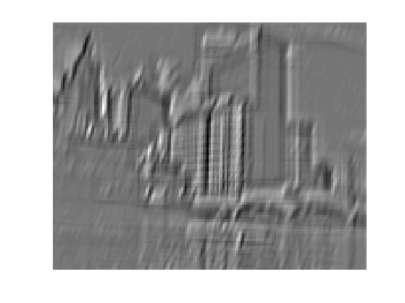
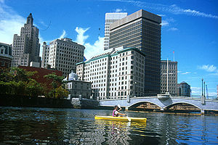
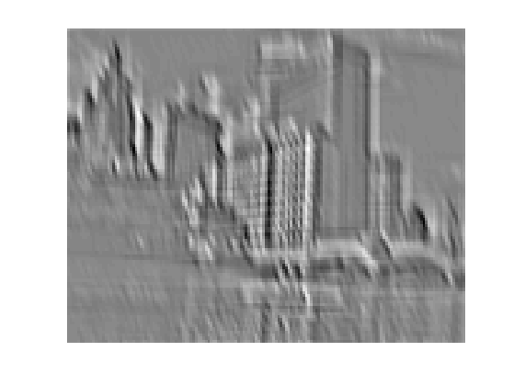
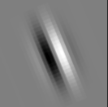
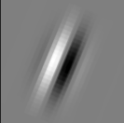
Convolution as feature extraction
...
Input
Feature Map

Slide 17
From fully connected to convolutional networks
feature map
learned weights
image
Convolutional layer

Slide 18
From fully connected to convolutional networks
next layer
image
Convolutional layer

Slide 19
Key operations in a CNN
Feature maps
Spatial pooling
Non-linearity
Convolution (Learned)
...
Input Image
Input
Feature Map
Source: R. Fergus, Y. LeCun

Slide 20
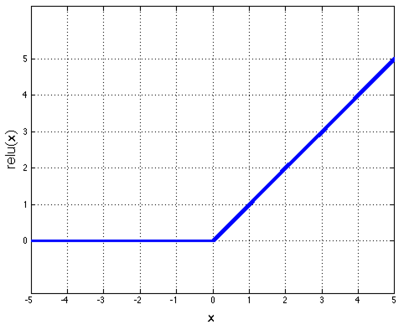
Key operations
Feature maps
Spatial pooling
Rectified Linear Unit (ReLU)
Non-linearity
Convolution (Learned)
Input Image
Source: R. Fergus, Y. LeCun

Slide 21
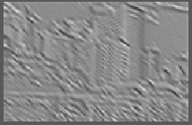
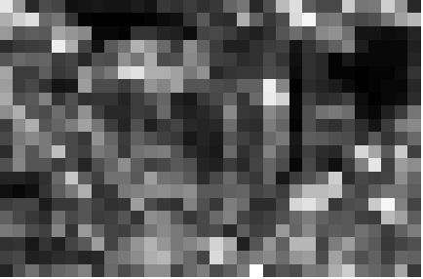
Key operations
Feature maps
Spatial pooling
  Max
Non-linearity
Convolution (Learned)
Input Image
Source: R. Fergus, Y. LeCun

Slide 22
LeNet-5
Average pooling
Sigmoid or tanh nonlinearity
Fully connected layers at the end
Trained on MNIST digit dataset with 60K training examples
Y. LeCun, L. Bottou, Y. Bengio, and P. Haffner, Gradient-based learning applied to document recognition, Proc. IEEE 86(11): 2278–2324, 1998.

Slide 23
Fast forward to the arrival of big visual data…
~14 million labeled images, 20k classes
Images gathered from Internet
Human labels via Amazon MTurk
ImageNet Large-Scale Visual Recognition Challenge (ILSVRC):
1.2 million training images, 1000 classes
www.image-net.org/challenges/LSVRC/

Slide 24
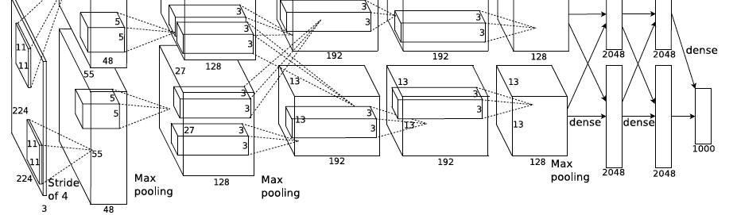
AlexNet: ILSVRC 2012 winner
Similar framework to LeNet but:
  Max pooling, ReLU nonlinearity
  More data and bigger model (7 hidden layers, 650K units, 60M params)
  GPU implementation (50x speedup over CPU)
    Trained on two GPUs for a week
  Dropout regularization
A. Krizhevsky, I. Sutskever, and G. Hinton, ImageNet Classification with Deep Convolutional Neural Networks, NIPS 2012
Notes:
Two-GPU architecture

Slide 25
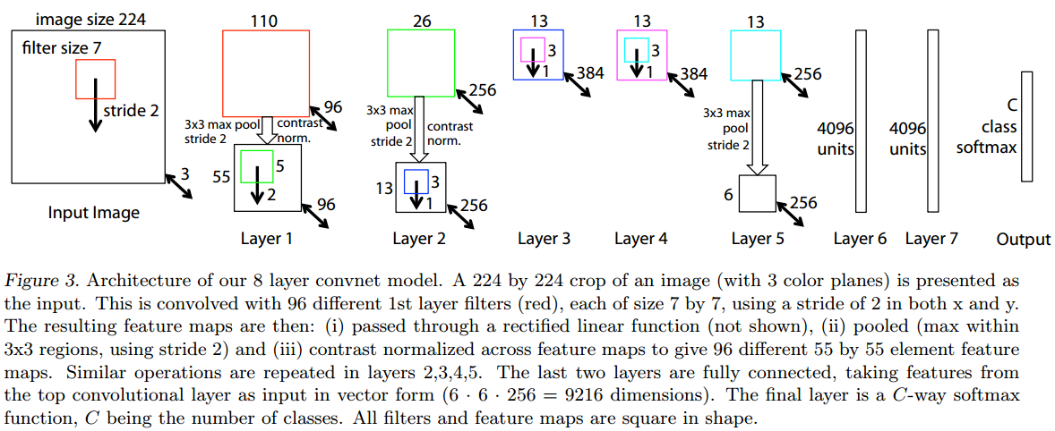
Clarifai: ILSVRC 2013 winner
Refinement of AlexNet
M. Zeiler and R. Fergus, Visualizing and Understanding Convolutional Networks,
ECCV 2014 (Best Paper Award winner)

Slide 26
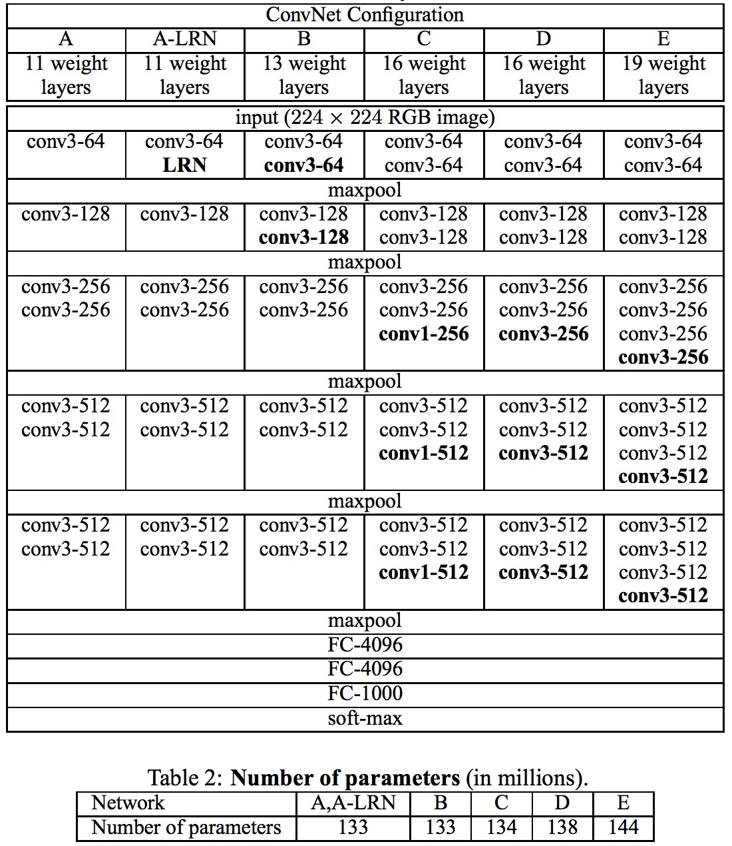
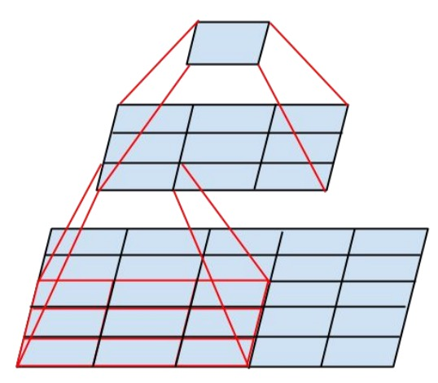
VGGNet: ILSVRC 2014 2nd place
Sequence of deeper networks trained progressively
Large receptive fields replaced by successive layers of 3x3 convolutions (with ReLU in between)
One 7x7 conv layer with C feature maps needs 49C² weights, three 3x3 conv layers need only 27C² weights
Experimented with 1x1 convolutions
K. Simonyan and A. Zisserman, Very Deep Convolutional Networks for Large-Scale Image Recognition, ICLR 2015

Slide 27
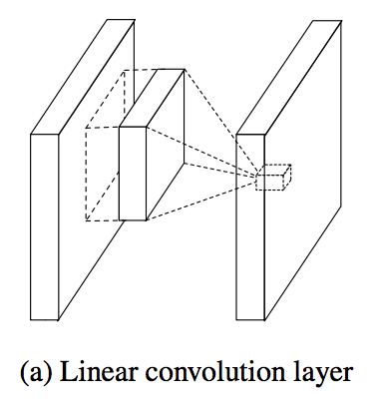
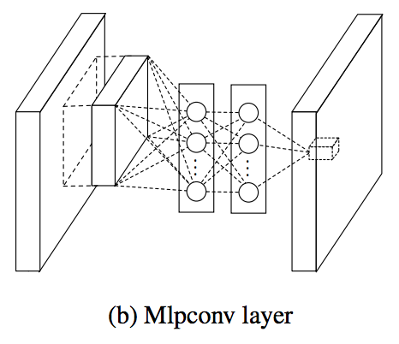
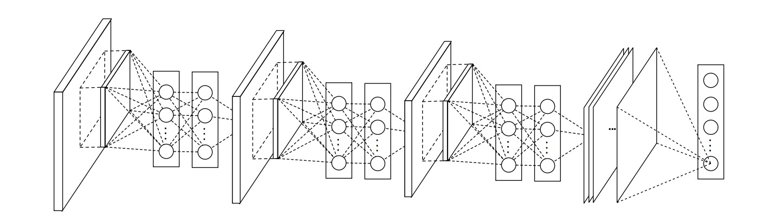
Network in network
M. Lin, Q. Chen, and S. Yan, Network in network, ICLR 2014

Slide 28
1x1 convolutions
conv layer

Slide 29
1x1 convolutions
1x1 conv layer

Slide 30
1x1 convolutions
1x1 conv layer

Slide 31

GoogLeNet: ILSVRC 2014 winner
The Inception Module
http://knowyourmeme.com/memes/we-need-to-go-deeper
C. Szegedy et al., Going deeper with convolutions, CVPR 2015

Slide 32
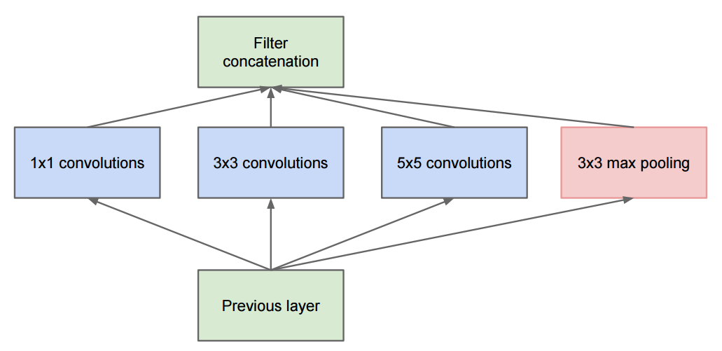
GoogLeNet
The Inception Module
  Parallel paths with different receptive field sizes and operations are meant to capture sparse patterns of correlations in the stack of feature maps
C. Szegedy et al., Going deeper with convolutions, CVPR 2015

Slide 33
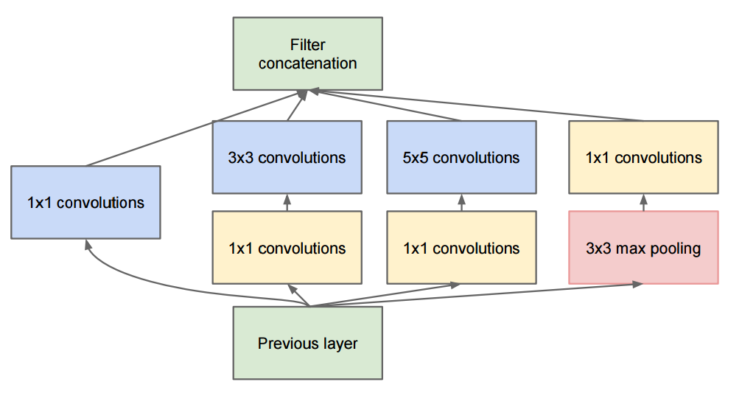
GoogLeNet
The Inception Module
  Parallel paths with different receptive field sizes and operations are meant to capture sparse patterns of correlations in the stack of feature maps
  Use 1x1 convolutions for dimensionality reduction before expensive convolutions
C. Szegedy et al., Going deeper with convolutions, CVPR 2015

Slide 34
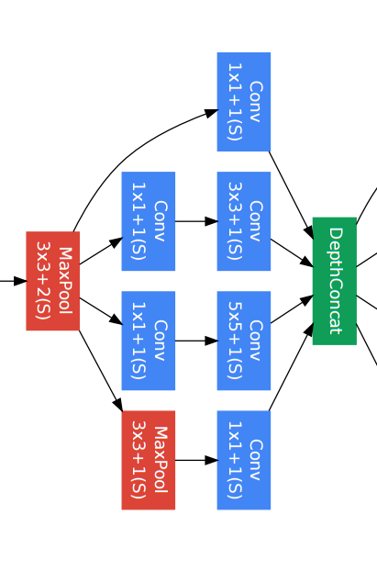
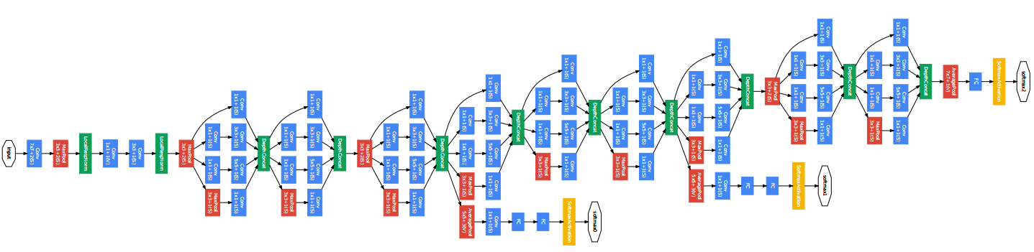
GoogLeNet
Inception module
C. Szegedy et al., Going deeper with convolutions, CVPR 2015

Slide 35
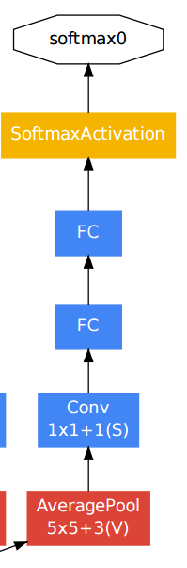
GoogLeNet
Auxiliary classifier
C. Szegedy et al., Going deeper with convolutions, CVPR 2015

Slide 36
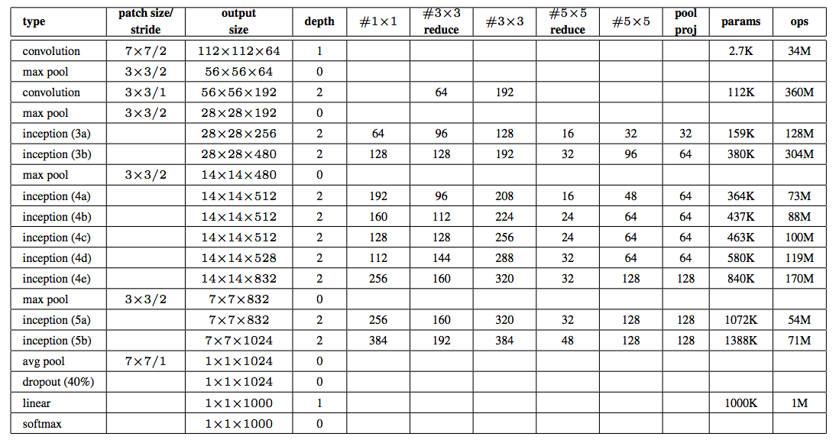
GoogLeNet
An alternative view:
C. Szegedy et al., Going deeper with convolutions, CVPR 2015

Slide 37
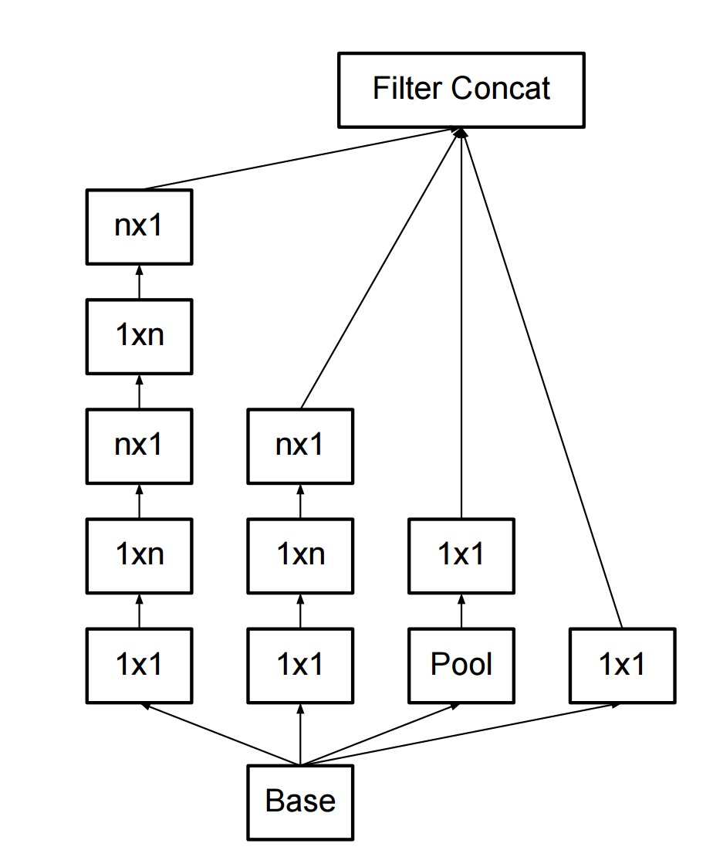
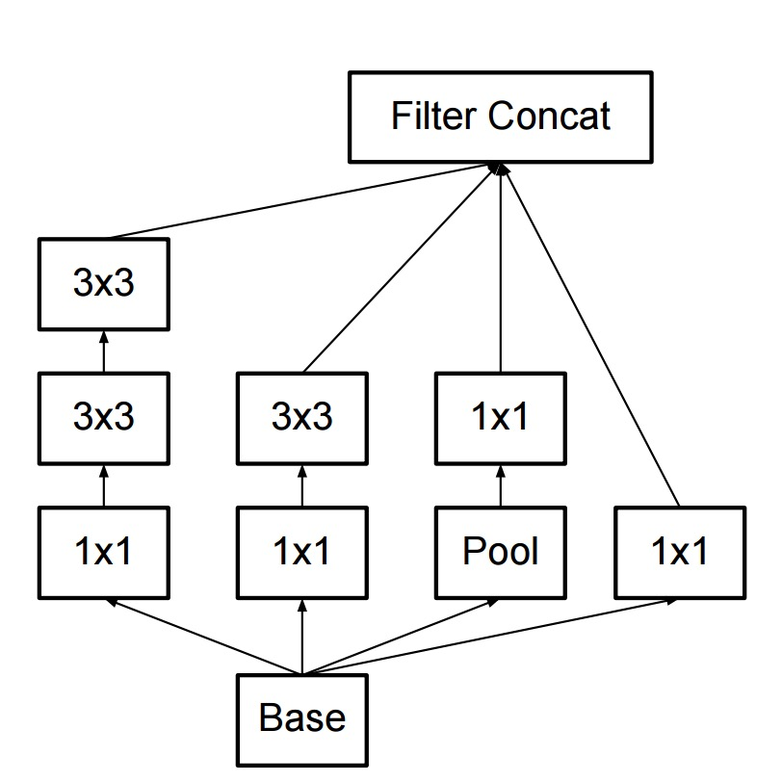
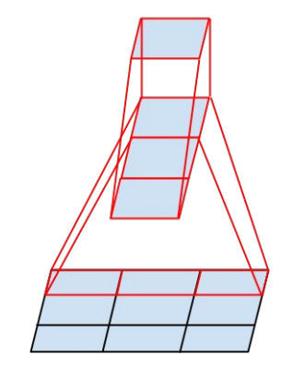
Inception v2, v3
Regularize training with batch normalization, reducing importance of auxiliary classifiers
More variants of inception modules with aggressive factorization of filters
C. Szegedy et al., Rethinking the inception architecture for computer vision, CVPR 2016

Slide 38
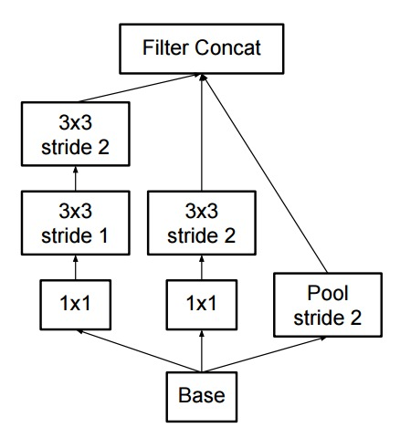
Inception v2, v3
Regularize training with batch normalization, reducing importance of auxiliary classifiers
More variants of inception modules with aggressive factorization of filters
Increase the number of feature maps while decreasing spatial resolution (pooling)
C. Szegedy et al., Rethinking the inception architecture for computer vision, CVPR 2016

Slide 39
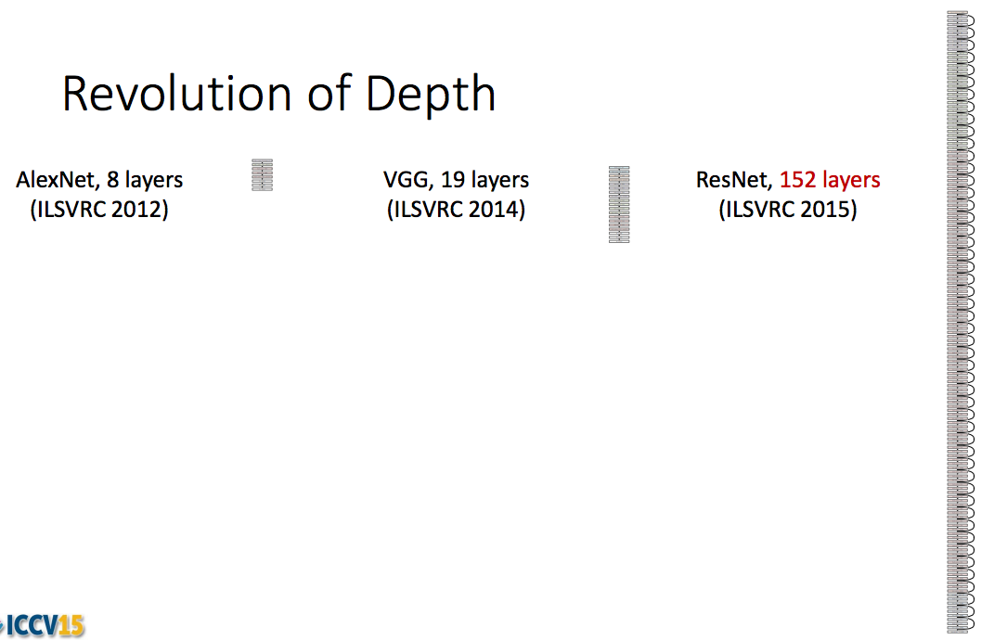
ResNet: ILSVRC 2015 winner
Kaiming He, Xiangyu Zhang, Shaoqing Ren, and Jian Sun, Deep Residual Learning for Image Recognition, CVPR 2016

Slide 40
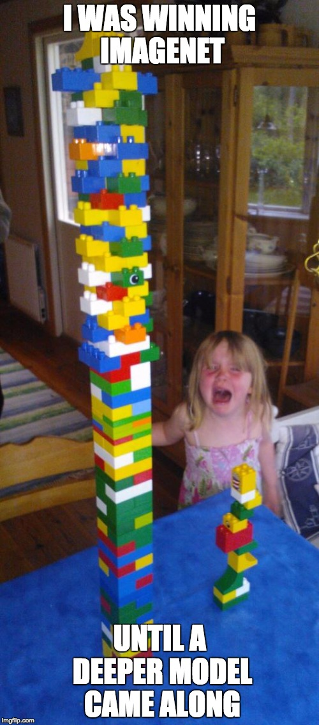
Source (?)

Slide 41
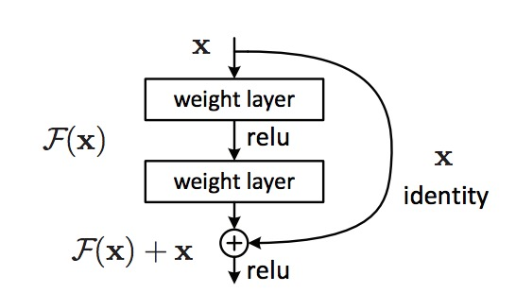
ResNet
The residual module
  Introduce skip or shortcut connections (existing before in various forms in literature)
  Make it easy for network layers to represent the identity mapping
  For some reason, need to skip at least two layers
Kaiming He, Xiangyu Zhang, Shaoqing Ren, and Jian Sun, Deep Residual Learning for Image Recognition, CVPR 2016 (Best Paper)

Slide 42
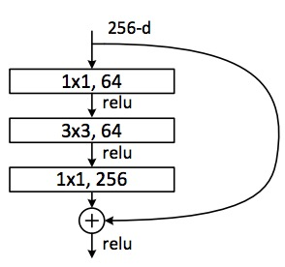
ResNet
Deeper residual module (bottleneck)
  Directly performing 3x3 convolutions with 256 feature maps at input and output:
  256 x 256 x 3 x 3 ~ 600K operations
  Using 1x1 convolutions to reduce 256 to 64 feature maps, followed by 3x3 convolutions, followed by 1x1 convolutions to expand back to 256 maps:
  256 x 64 x 1 x 1 ~ 16K
  64 x 64 x 3 x 3 ~ 36K
  64 x 256 x 1 x 1 ~ 16K
  Total: ~70K
Kaiming He, Xiangyu Zhang, Shaoqing Ren, and Jian Sun, Deep Residual Learning for Image Recognition, CVPR 2016 (Best Paper)

Slide 43
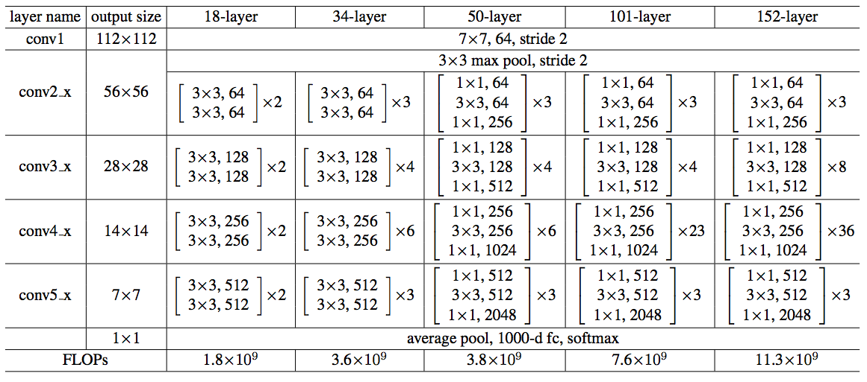
ResNet
Architectures for ImageNet:
Kaiming He, Xiangyu Zhang, Shaoqing Ren, and Jian Sun, Deep Residual Learning for Image Recognition, CVPR 2016 (Best Paper)

Slide 44
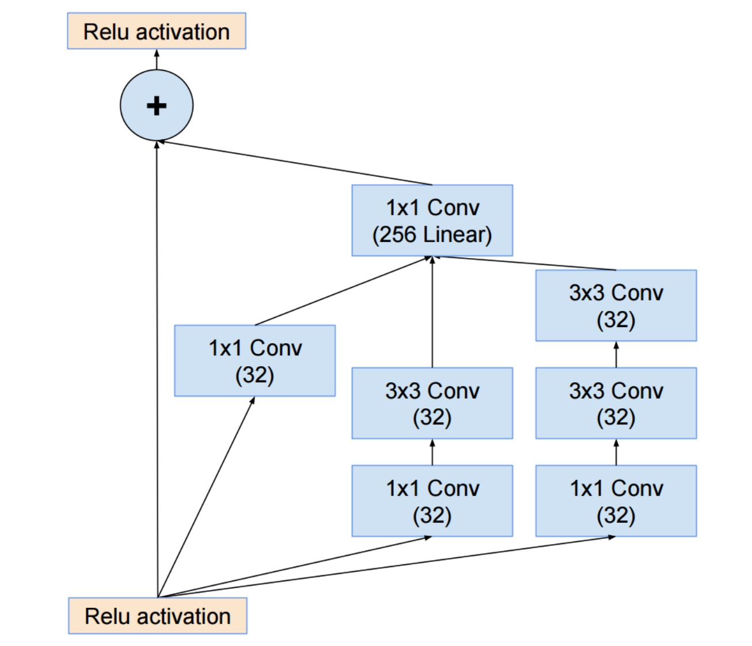
Inception v4
C. Szegedy et al., Inception-v4, Inception-ResNet and the Impact of Residual Connections on Learning, arXiv 2016

Slide 45
Summary: ILSVRC 2012-2015
Team | Year | Place | Error (top-5) | External data
SuperVision – Toronto (AlexNet, 7 layers) | 2012 | - | 16.4% | no
SuperVision | 2012 | 1st | 15.3% | ImageNet 22k
Clarifai – NYU (7 layers) | 2013 | - | 11.7% | no
Clarifai | 2013 | 1st | 11.2% | ImageNet 22k
VGG – Oxford (16 layers) | 2014 | 2nd | 7.32% | no
GoogLeNet (19 layers) | 2014 | 1st | 6.67% | no
ResNet (152 layers) | 2015 | 1st | 3.57%
Human expert* |  |  | 5.1%
http://karpathy.github.io/2014/09/02/what-i-learned-from-competing-against-a-convnet-on-imagenet/

Slide 46
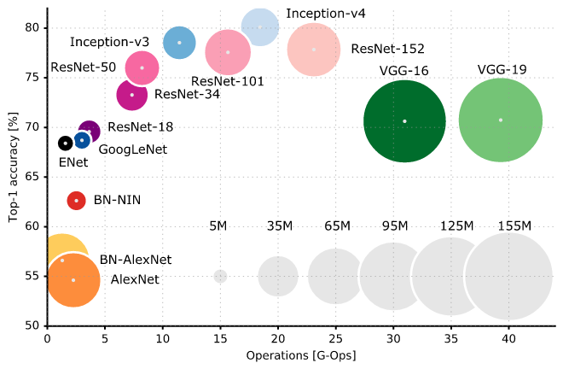
Accuracy vs. efficiency
https://culurciello.github.io/tech/2016/06/04/nets.html

Slide 47
Design principles
Reduce filter sizes (except possibly at the lowest layer), factorize filters aggressively
Use 1x1 convolutions to reduce and expand the number of feature maps judiciously
Use skip connections and/or create multiple paths through the network

Slide 48
What’s missing from the picture?
Training tricks and details: initialization, regularization, normalization
Training data augmentation
Averaging classifier outputs over multiple crops/flips
Ensembles of networks
What about ILSVRC 2016?
  No more ImageNet classification
  No breakthroughs comparable to ResNet

Slide 49
Reading list
https://culurciello.github.io/tech/2016/06/04/nets.html
Y. LeCun, L. Bottou, Y. Bengio, and P. Haffner, Gradient-based learning applied to document recognition, Proc. IEEE 86(11):
2278–2324, 1998.
A. Krizhevsky, I. Sutskever, and G. Hinton, ImageNet Classification with Deep Convolutional Neural Networks, NIPS 2012
M. Zeiler and R. Fergus, Visualizing and Understanding Convolutional Networks,
ECCV 2014
K. Simonyan and A. Zisserman, Very Deep Convolutional Networks for Large-Scale Image Recognition, ICLR 2015
M. Lin, Q. Chen, and S. Yan, Network in network, ICLR 2014
C. Szegedy et al., Going deeper with convolutions, CVPR 2015
C. Szegedy et al., Rethinking the inception architecture for computer vision,
CVPR 2016
K. He, X. Zhang, S. Ren, and J. Sun, Deep Residual Learning for Image Recognition, CVPR 2016

