Slide 1
Advanced CNN Architectures
Akshay Mishra, Hong Cheng

Slide 2
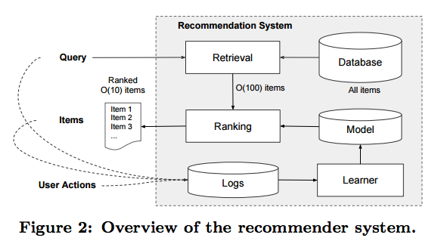
CNNs are everywhere...
Recommendation Systems
Drug Discovery
Physics simulations
Heng-Tze Cheng, Levent Koc, Jeremiah Harmsen, Tal Shaked, Tushar Chandra, Hrishi Aradhye, Glen Anderson, Greg Corrado, Wei Chai, Mustafa Ispir, Rohan Anil, Zakaria Haque, Lichan Hong, Vihan Jain, Xiaobing Liu, Hemal Shah, Wide & Deep Learning for Recommender Systems, arxiv 2016

Slide 3
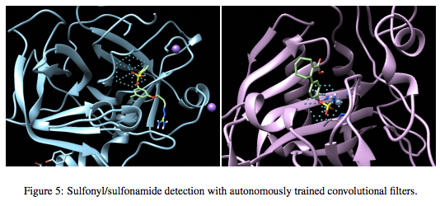
CNNs are everywhere...
Recommendation Systems
Drug Discovery
Physics simulations
Izhar Wallach, Michael Dzamba, Abraham Heifets, AtomNet: A Deep Convolutional Neural Network for Bioactivity Prediction in Structure-based Drug Discovery, arxiv 2016

Slide 4
CNNs are everywhere...
Recommendation Systems
Drug Discovery
Physics simulations
Jonathan Tompson, Kristofer Schlachter, Pablo Sprechmann, Ken Perlin, Accelerating Eulerian Fluid Simulation With Convolutional Networks, arxiv 2016

Slide 5
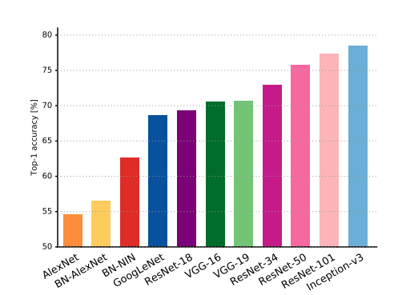
We’re focusing on ImageNet
Gives us a common task to compare architectures
Networks trained on ImageNet are often starting points for other vision tasks
Architectures that perform well on ImageNet have been successful in other domains
Alfredo Canziani & Eugenio Culurciello, An Analysis of Deep Neural Network Models for Practical Applications, arXiv 2016

Slide 6
We’re focusing on ImageNet
Gives us a common task to compare architectures
Networks trained on ImageNet are often starting points for other vision tasks
Architectures that perform well on ImageNet have been successful in other domains
Example applications:
Object detection
Action recognition
Human pose estimation
Semantic segmentation
Image captioning

Slide 7
We’re focusing on ImageNet
Gives us a common task to compare architectures
Networks trained on ImageNet are often starting points for other vision tasks
Architectures that perform well on ImageNet have been successful in other domains
Novel ResNet Applications:
Volumetric Brain Segmentation (VoxResNet)
City-Wide Crowd Flow Prediction: (ST-ResNet)
Generating Realistic Voices (WaveNet)

Slide 8
Overview
We’ve organized our presentation into three stages:
A more detailed coverage of the building blocks of CNNs
Attempts to explain how and why Residual Networks work
Survey extensions to ResNets and other notable architectures
Topics covered:
Alternative activation functions
Relationship between fully connected layers and convolutional layers
Ways to convert fully connected layers to convolutional layers
Global Average Pooling

Slide 9
Overview
We’ve organized our presentation into three stages:
A more detailed coverage of the building blocks of CNNs
Attempts to explain how and why Residual Networks work
Survey extensions to ResNets and other notable architectures
Topics covered:
ResNets as implicit ensembles
ResNets as learning iterative refinements
Connections to recurrent networks and the brain

Slide 10
Overview
We’ve organized our presentation into three stages:
A more detailed coverage of the building blocks of CNNs
Attempts to explain how and why Residual Networks work
Survey extensions to ResNets and other notable architectures
Motivation:
Many architectures using residuals
WaveNets
InceptionResNet
XceptionNet
Tweaks can further improve performance

Slide 11
Overview
We’ve organized our presentation into three stages:
A more detailed coverage of the building blocks of CNNs
Attempts to explain how and why Residual Networks work
Survey extensions to ResNets and other notable architectures
Motivation:
Get a sense of what people have tried
Show that residuals aren’t necessary for state-of-the art results
By doing this towards the end, we can point out interesting connections to ResNets

Slide 12
Stage 1: Revisiting the Basics
Alternative activation functions
Relationship between fully connected layers and convolutional layers
Ways to convert fully connected layers to convolutional layers
Global Average Pooling

Slide 13
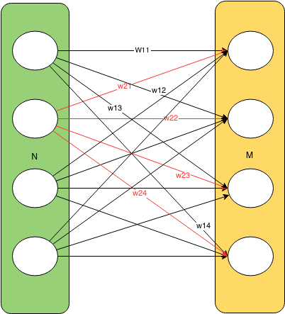
Review: Fully Connected Layers
Takes N inputs, and outputs M units
Each output is a linear combination of inputs
Usually implemented as multiplication by an (N x M) matrix
An example of fully connected layer.

Slide 14
Review: Fully Connected Layers
Takes N inputs, and outputs M units
Each output is a linear combination of inputs
Usually implemented as multiplication by an (N x M) matrix
An example of fully connected layer.
Notes:
Adjust Width

Slide 15
Review: Fully Connected Layers
Takes N inputs, and outputs M units
Each output is a linear combination of inputs
Usually implemented as multiplication by an (N x M) matrix
An example of fully connected layer.

Slide 16
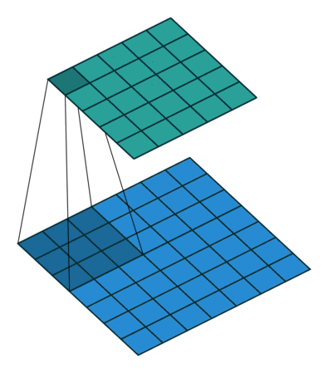
How fully connected layers fix input size
Convolutions can be thought of as sliding fully connected layers
When the inputs to a convolutional layer are larger feature maps, outputs are larger feature maps
Fully connected layers have a fixed number of inputs/outputs, forcing the entire network’s input shape to be fixed
Think of this as fully connected layer that takes n x n inputs sliding across the input
Image source: http://deeplearning.net/software/theano_versions/dev/tutorial/conv_arithmetic.html
Notes:
Adjust font size for refer.. Change title..
Shift 3 to 1. Fully - > Cnn

Slide 17
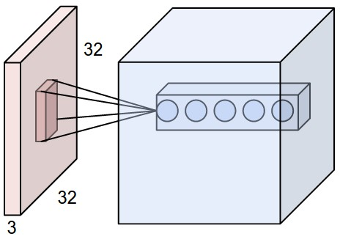
How fully connected layers fix input size
Convolutions can be thought of as sliding fully connected layers
When the inputs to a convolutional layer are larger feature maps, outputs are larger feature maps
Fully connected layers have a fixed number of inputs/outputs, forcing the entire network’s input shape to be fixed
The number of output feature maps corresponds to the number of outputs of this fully connected layer
Image source: http://cs231n.github.io/convolutional-networks/

Slide 18
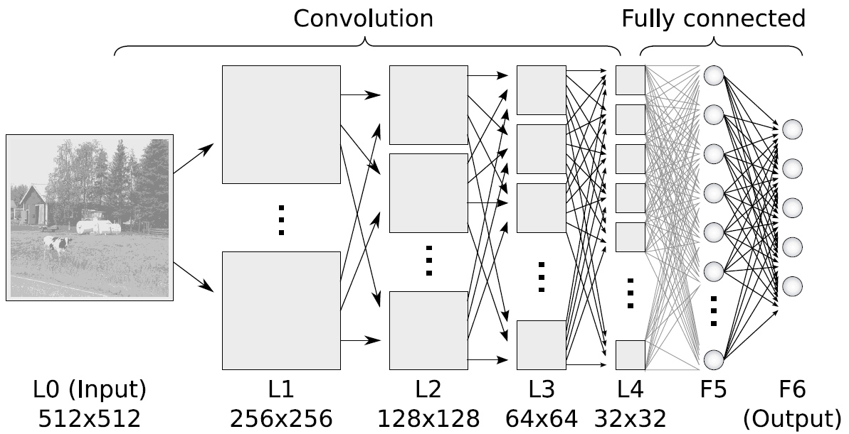
How fully connected layers fix input size
Convolutions can be thought of as sliding fully connected layers
When the inputs to a convolutional layer are larger feature maps, outputs are larger feature maps
Fully connected layers have a fixed number of inputs/outputs, forcing the entire network’s input shape to be fixed
256x256 128x128 32x32 16x16 4x4
What are the spatial resolutions of feature maps if we input a 512 x 512 images?
Image source: http://www.ais.uni-bonn.de/deep_learning/

Slide 19
How fully connected layers fix input size
Convolutions can be thought of as sliding fully connected layers
When the inputs to a convolutional layer are larger feature maps, outputs are larger feature maps
Fully connected layers have a fixed number of inputs/outputs, forcing the entire network’s input shape to be fixed
256x256 128x128 32x32 16x16 4x4
What are the spatial resolutions of feature maps if we input a 512 x 512 images?
Image source: http://www.ais.uni-bonn.de/deep_learning/

Slide 20
How fully connected layers fix input size
Convolutions can be thought of as sliding fully connected layers
When the inputs to a convolutional layer are larger feature maps, outputs are larger feature maps
Fully connected layers have a fixed number of inputs/outputs, forcing the entire network’s input shape to be fixed
512x512 256x256 64x64 32x32 8x8
The spatial resolutions are doubled in both dimensions for all feature maps.
Image source: http://www.ais.uni-bonn.de/deep_learning/

Slide 21
How fully connected layers fix input size
Convolutions can be thought of as sliding fully connected layers
When the inputs to a convolutional layer are larger feature maps, outputs are larger feature maps
Fully connected layers have a fixed number of inputs/outputs, forcing the entire network’s input shape to be fixed
512x512 256x256 64x64 32x32 8x8
What happens to to the fully connected layers when input dimensions are doubled?
Image source: http://www.ais.uni-bonn.de/deep_learning/

Slide 22
How fully connected layers fix input size
Convolutions can be thought of as sliding fully connected layers
When the inputs to a convolutional layer are larger feature maps, outputs are larger feature maps
Fully connected layers have a fixed number of inputs/outputs, forcing the entire network’s input shape to be fixed
512x512 256x256 64x64 32x32 8x8
It becomes unclear how the larger feature maps should feed into the fully connected layers.
Image source: http://www.ais.uni-bonn.de/deep_learning/

Slide 23
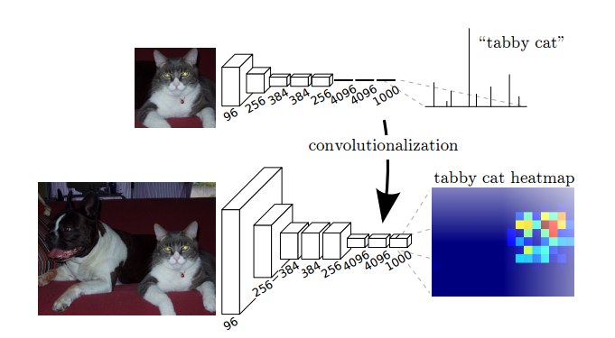
Fully Connected Layers => Convolutions
Based on the relationships between fully connected layers and convolutions we just discussed, can you think of a way to convert fully connected layers to convolutions?
By replacing fully connected layers with convolutions, we will be able to output heatmaps of class probabilities
Jonathan Long, Evan Shelhamer, Trevor Darrell, Fully Convolutional Networks for Semantic Segmentation, arXiv preprint 2016

Slide 24
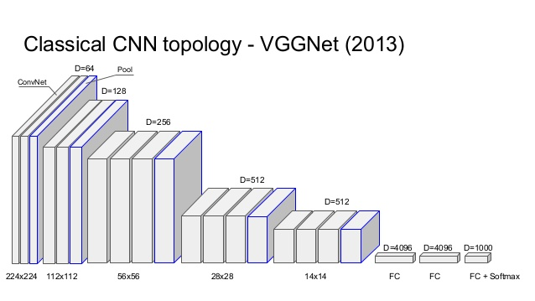
Convolutionize VGG-Net
VGG-Net’s final pooling layer outputs 7x7 feature maps
VGG-Net’s first fully connected layer ouputs 4096 units
What should the spatial size of the convolutional kernel be?
How many output feature maps should we have?
Image source: http://www.robots.ox.ac.uk/~vgg/research/very_deep/
Notes:
Why use 3*3 is important

Slide 25
Convolutionize VGG-Net
VGG-Net’s final pooling layer outputs 7x7 feature maps
VGG-Net’s first fully connected layer ouputs 4096 units
What should the spatial size of the convolutional kernel be?
How many output feature maps should we have?
Image source: http://www.robots.ox.ac.uk/~vgg/research/very_deep/

Slide 26
Convolutionize VGG-Net
VGG-Net’s final pooling layer outputs 7x7 feature maps
VGG-Net’s first fully connected layer ouputs 4096 units
What should the spatial size of the convolutional kernel be?
How many output feature maps should we have?
Convolutional kernel should be 7 x 7 with no padding
Image source: http://www.robots.ox.ac.uk/~vgg/research/very_deep/

Slide 27
Convolutionize VGG-Net
VGG-Net’s final pooling layer outputs 7x7 feature maps
VGG-Net’s first fully connected layer ouputs 4096 units
What should the spatial size of the convolutional kernel be?
How many output feature maps should we have?
Convolutional kernel should be 7 x 7 with no padding
Image source: http://www.robots.ox.ac.uk/~vgg/research/very_deep/

Slide 28
Convolutionize VGG-Net
VGG-Net’s final pooling layer outputs 7x7 feature maps
VGG-Net’s first fully connected layer ouputs 4096 units
What should the spatial size of the convolutional kernel be?
How many output feature maps should we have?
Convolutional kernel should be 7 x 7 with no padding to correspond to a non-sliding fully connected layer
There should be 4096 output feature maps to correspond to each of the fully connected layers outputs
Image source: http://www.robots.ox.ac.uk/~vgg/research/very_deep/

Slide 29
Convolutionize VGG-Net
What just happened?
The final pooling layer still outputs 7x7 feature maps
But the first fully connected layer has been replaced by a 7x7 convolution outputting 4096 feature maps
The spatial resolution of these feature maps is 1x1
First and hardest step towards convolutionalization is complete!
Jonathan Long, Evan Shelhamer, Trevor Darrell, Fully Convolutional Networks for Semantic Segmentation, arXiv preprint 2016

Slide 30
Convolutionize VGG-Net
How do we convolutionalize the second fully connected layer?
The input to this layer is 1x1 with 4096 feature maps
What is the spatial resolution of the convolution used?
How many output feature maps should be used?
Jonathan Long, Evan Shelhamer, Trevor Darrell, Fully Convolutional Networks for Semantic Segmentation, arXiv preprint 2016

Slide 31
Convolutionize VGG-Net
How do we convolutionalize the second fully connected layer?
The input to this layer is 1x1 with 4096 feature maps
What is the spatial resolution of the convolution used?
How many output feature maps should be used?
Same idea used for the final fully connected layer
Jonathan Long, Evan Shelhamer, Trevor Darrell, Fully Convolutional Networks for Semantic Segmentation, arXiv preprint 2016

Slide 32
Results
Now, all the fully connected layers have been replaced with convolutions
When larger inputs are fed into the network, network outputs grid of values
The grid can be interpreted as class conditional heatmaps
Jonathan Long, Evan Shelhamer, Trevor Darrell, Fully Convolutional Networks for Semantic Segmentation, arXiv preprint 2016

Slide 33
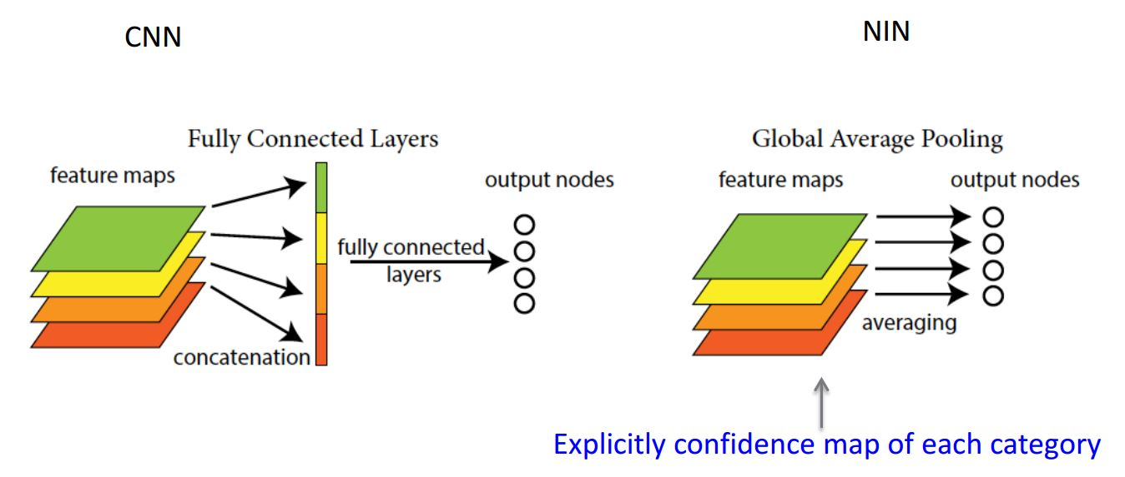
Global Average Pooling
Take the average of each feature map and feed the resulting vector directly into the softmax layer
Advantages:
More native to the convolutional structure
No parameter to optimize. Overfitting is avoided at this layer.
More robust to spatial translations of input
Allows for flexibility in input size
Min Lin, Qiang Chen, Shuicheng Yan
Network In Network
Notes:
So let’s see one technique that has been introduced after AlexNet. One of them is global average pooling.
Suppose we have a CIFAR-10 problem. Before we put everything into the final layer - softmax layer to tell which category it is in, we flatten what we have into a 1D vector.
Why are we doing this?
One advantage of global average pooling over the fully connected layers is that it is more native to the convolution structure by enforcing correspondences between feature maps and categories. Thus the feature maps can be easily interpreted as categories confidence maps. Before we have 3*3*10, now we have a 1D (10,1) vector.
Another advantage is that there is no parameter to optimize in the global average pooling thus overfitting is avoided at this layer. We are not changing anything here.
Futhermore, global average pooling sums out the spatial information, thus it is more robust to spatial translations of the input. So we don’t have to fix our size at, say, 227*227, but any number we can use since we can just take an average.

Slide 34
Global Average Pooling
In practice, the global average pooling outputs aren’t sent directly to softmax
It’s more common to send the filter wise averages to a fully connected layer before softmax
Used in some top performing architectures including ResNets and InceptionNets
Min Lin, Qiang Chen, Shuicheng Yan Network In Network
Notes:
Read it.

Slide 35
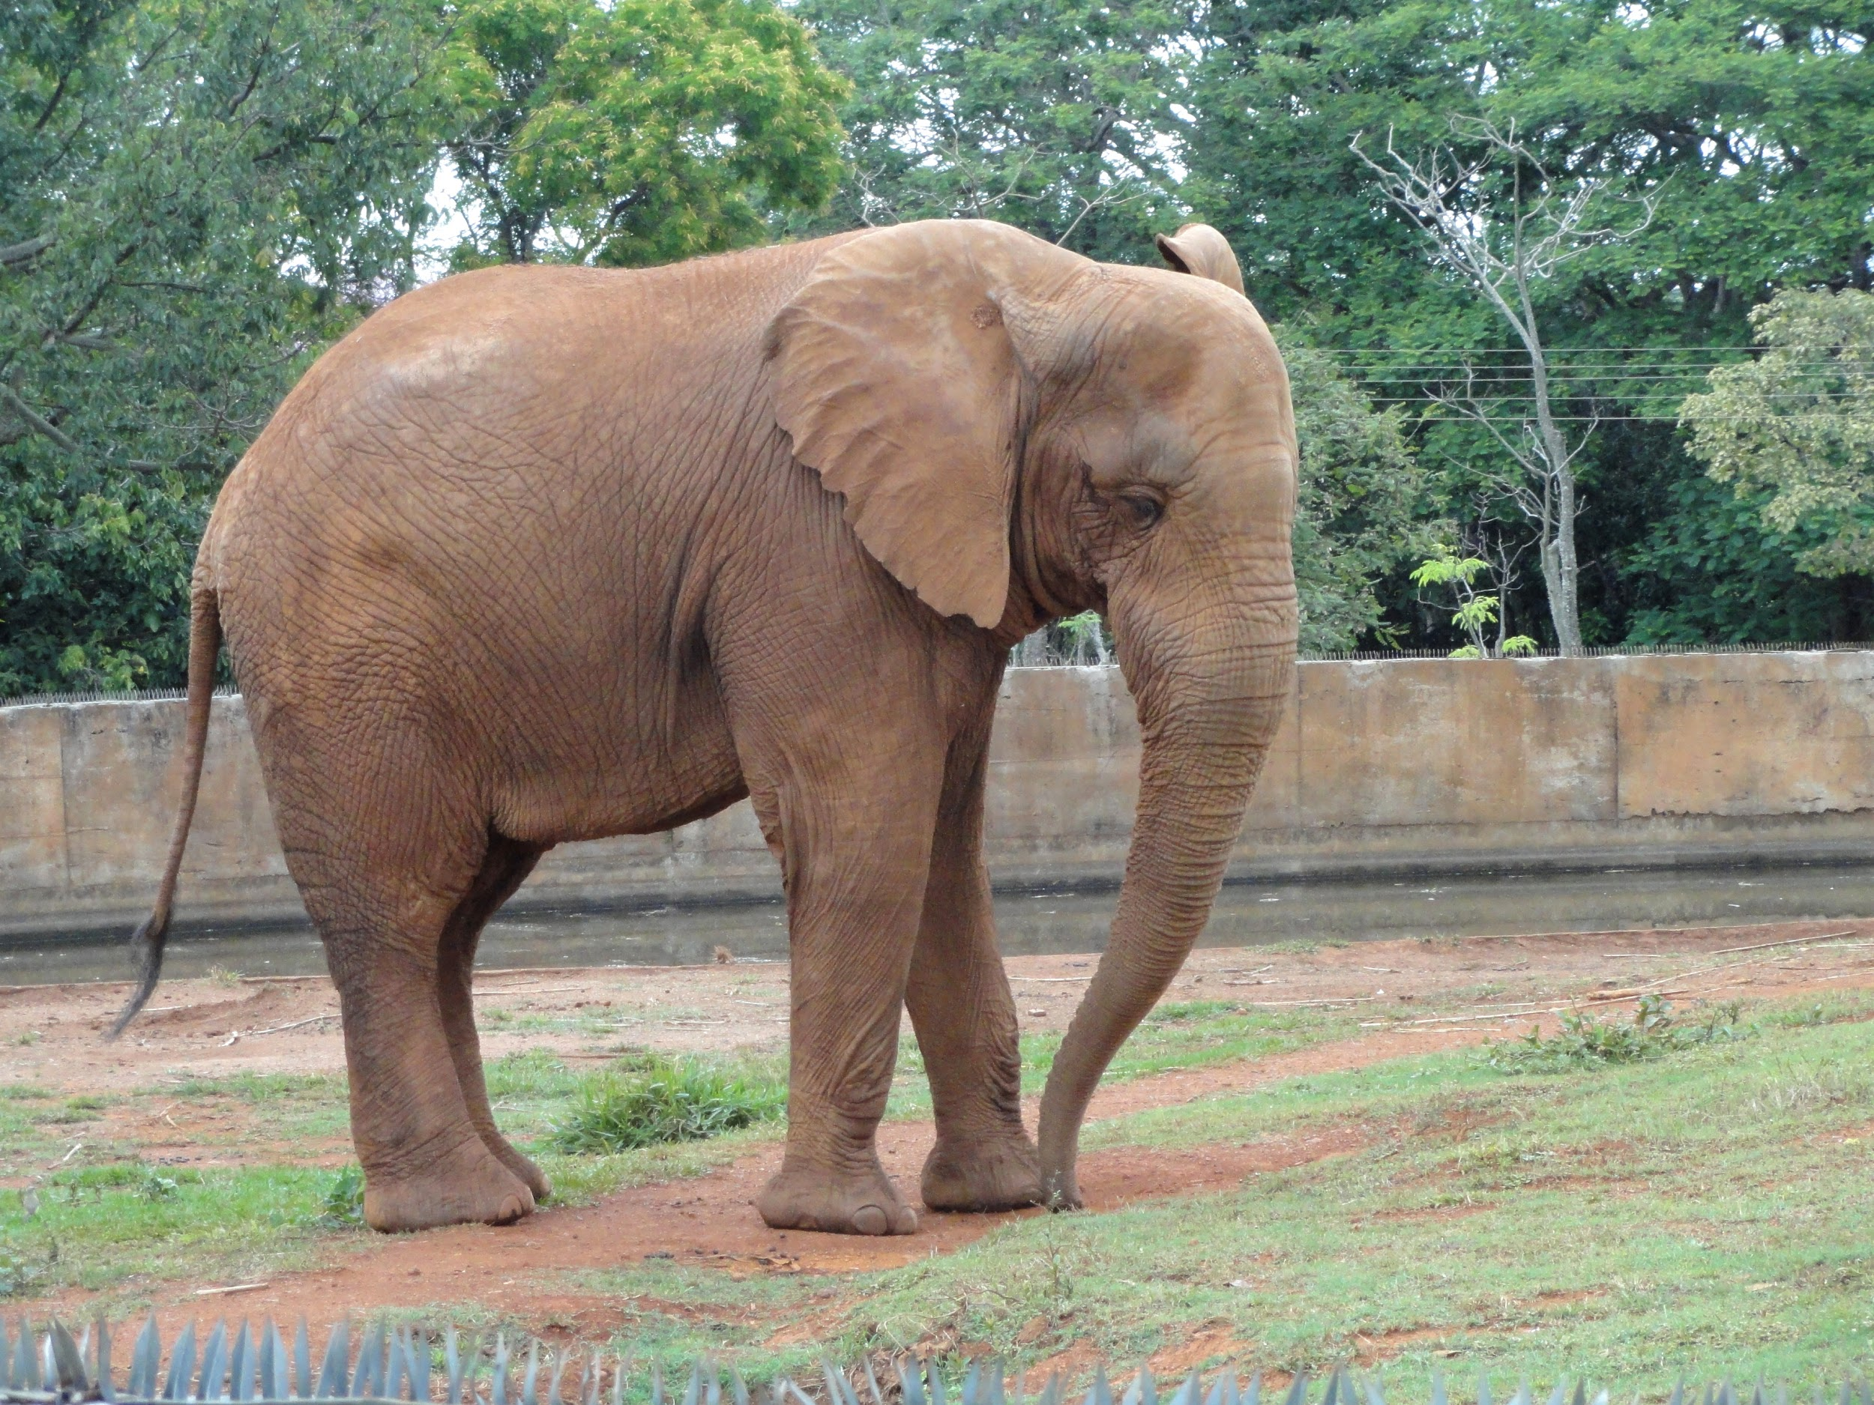
Rescaling Demo:
I fed this picture of an elephant to ResNet-50 at various scales
ResNet was trained on 224x224 images
How much bigger can I make the image before the elephant is misclassified?

Slide 36
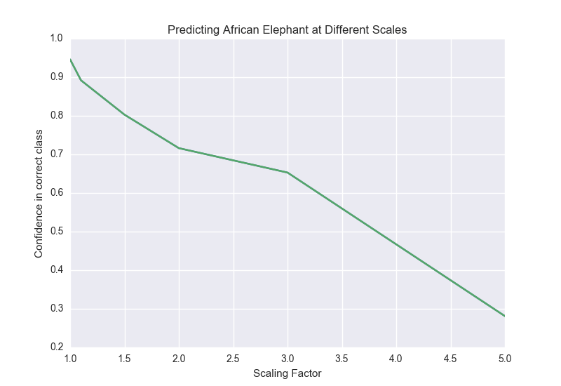
Rescaling Demo:
I tried rescales of [1.1, 1.5,3,5,10]
Elephant was correctly classified up till 5x scaling
Input size was 1120x1120
Confidence of classification decays slowly
At rescale factor of 10, ‘African Elephant’ is no longer in the top 3

Slide 37
Rescaling Demo:
Raw predictions:

Slide 38
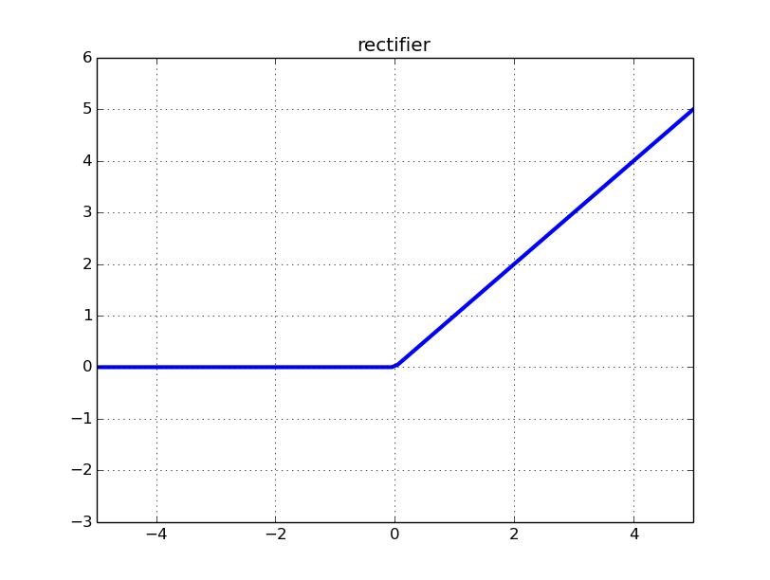
Review: Rectified Linear Units (ReLU)
ReLU: max(0,x)
What’s the gradient in negative region?
Is there a problem?
Notes:
Another popular topic comes up after AlexNet is ReLU being imporoved..
the rectifier is an activation function defined as shown. It is commonly used. Is there a problem?

Slide 39
Notes:
Quick sand. If it becomes negative, it will never come back again. It will never activate or update.
Show picture. Show left side.

Slide 40
Dying ReLU Problem
If input to ReLU is negative for the dataset, ReLU dies
Brief burst of research into addressing dying ReLUs
General idea is to have non-zero gradients even for negative inputs
Dead
Notes:
This is called a "dead" ReLU problem. A dead ReLU always outputs the same value (zero as it happens, but that is not important) for any input. Probably this is arrived at by learning a large negative bias term for its weights.
In turn, that means that it takes no role in discriminating between inputs. For classification, you could visualise this as a decision plane outside of all possible input data.
Once a ReLU ends up in this state, it is unlikely to recover, because the function gradient at 0 is also 0, so gradient descent learning will not alter the weights.
So, how can we resolve the problem? Or at least, is there a way we can alleviate the problem?

Slide 41
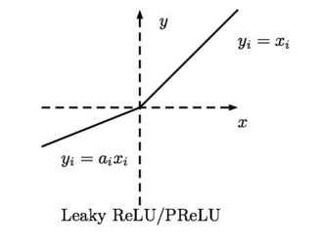
Leaky ReLU & Parameterized ReLU
In Leaky ReLU, a is a hyperparameter.
In Parameterized ReLU, a is learned.
Djork-Arné Clevert, Thomas Unterthiner, Sepp Hochreiter Fast and Accurate Deep Network Learning by Exponential Linear Units
Notes:
Let me introduce two Rectified linear units. Leaky ReLU & Parameterized ReLU. "Leaky" ReLUs has a small positive gradient for negative inputs (y=0.01x when x < 0 say) are one attempt to address this issue and give a chance to recover. In Parameterized ReLU, a is learnt.
However, we won’t be satisfied with this.. We are going to introduce a more recent paper regarding ELU. What is ELU?

Slide 42
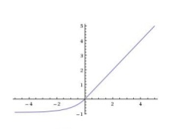
Exponential Linear Units (ELUs)
Djork-Arné Clevert, Thomas Unterthiner, Sepp Hochreiter Fast and Accurate Deep Network Learning by Exponential Linear Units
Notes:
ELUs have negative values which allows them to push mean unit activations closer to zero like batch normalization but with lower computational complexity. ELU ensures a noise-robust deactivation state. ELUs saturate to a negative value with smaller inputs and thereby decrease the forward propagated variation and information.

Slide 43
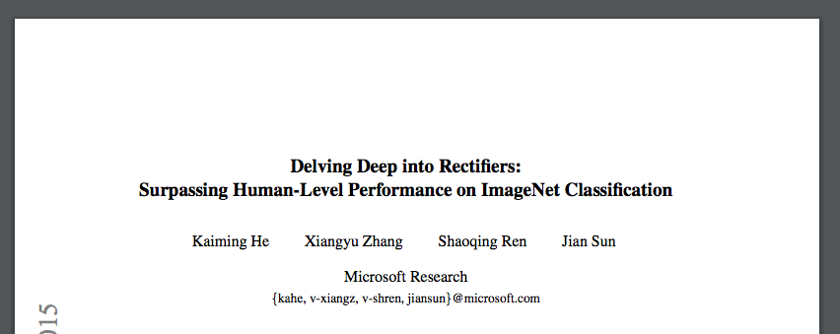
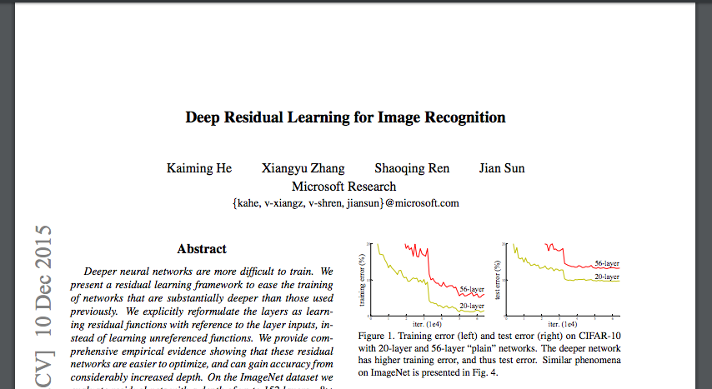
A tale of two papers...
Top right: paper that introduced PReLUs
Bottom right: paper that introduced Residual Networks
What do you notice about these papers?
Screenshots of both papers were taken from arXiv
Notes:
Improvements! Make summaries.. VGG Global average pooling LUs. ideas..

Slide 44
Contextualizing
Same team that introduced PReLU created ResNet
Went back to ReLUs for ResNet
Focus shifted from activations to overall network design
Screenshots of both papers were taken from arXiv
Notes:
Improvements! Make summaries.. VGG Global average pooling LUs. ideas..

Slide 45
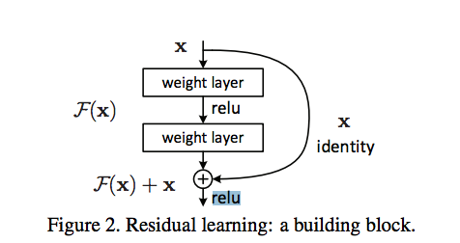
Contextualizing
Same team that introduced PReLU created ResNet
Went back to ReLUs for ResNet
Focus shifted from activations to overall network design
Notes:
Improvements! Make summaries.. VGG Global average pooling LUs. ideas..

Slide 46
Contextualizing
Same team that introduced PReLU created ResNet
Went back to ReLUs for ResNet
Focus shifted from activations to overall network design
Notes:
Improvements! Make summaries.. VGG Global average pooling LUs. ideas..

Slide 47
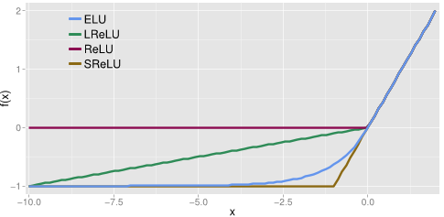
In conclusion
The papers introducing each alternative activations claim they work well
ReLU still most popular
All the architectures we are about to discuss used ReLUs (and batch norm)
Djork-Arné Clevert, Thomas Unterthiner, Sepp Hochreiter Fast and Accurate Deep Network Learning by Exponential Linear Units
Notes:
batch normalization will be introduced on thursday

Slide 48
Stage 2:
“Understanding” ResNets

Slide 49
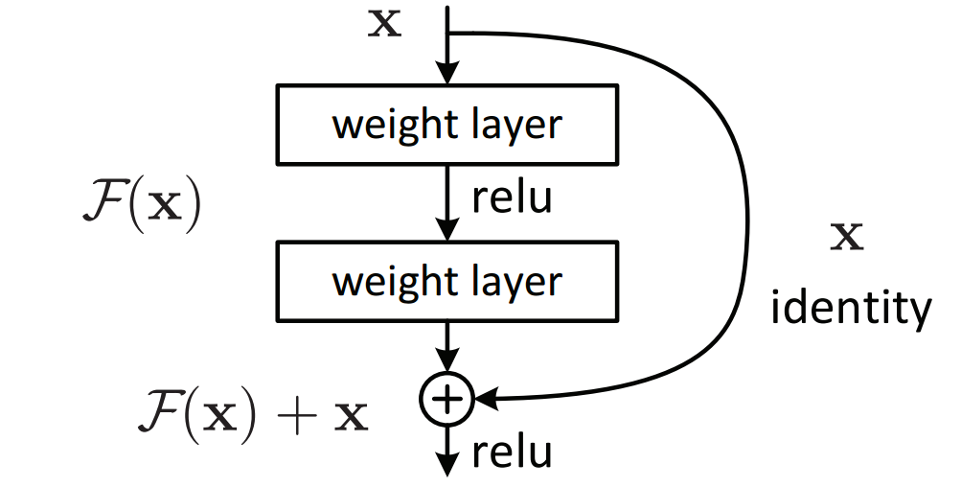
Review
What is going on inside a Residual Block? (shown to the right)
Why are there two weight layers?
What advantage do they have over plain networks?
Kaiming He, Xiangyu Zhang, Shaoqing Ren, and Jian Sun, Deep Residual Learning for Image Recognition, CVPR 2016

Slide 50
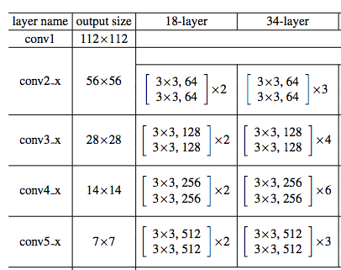
Going deeper without residuals
Consider two non-residual networks
We call the 18 layer variant ‘plain-18’
We call the 34 layer variant ‘plain-34’
The ‘plain-18’ network outperformed `plain-34` on the validation set
Why do you think this was the case?
Kaiming He, Xiangyu Zhang, Shaoqing Ren, and Jian Sun, Deep Residual Learning for Image Recognition, CVPR 2016

Slide 51
18 vs 34 layer ‘plain’ network
Vanishing gradients weren’t the issue
Overfitting wasn’t the issue
Representation power wasn’t the issue
Quote from ResNet paper:
We argue that this optimization difficulty is unlikely to be caused by vanishing gradients. These plain networks are trained with BN, which ensures forward propagated signals to have non-zero variances. We also verify that the backward propagated gradients exhibit healthy norms with BN. So neither forward nor backward signals vanish.
Kaiming He, Xiangyu Zhang, Shaoqing Ren, and Jian Sun, Deep Residual Learning for Image Recognition, CVPR 2016

Slide 52
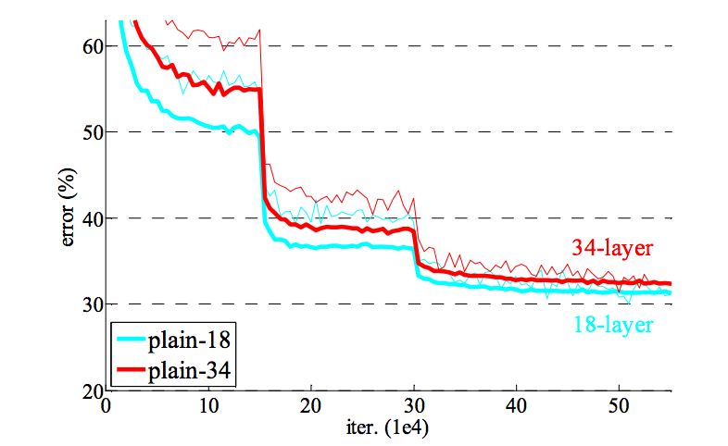
18 vs 34 layer ‘plain’ network
Vanishing gradients weren’t the issue
Overfitting wasn’t the issue
Representation power wasn’t the issue
Even the training error is higher with the 34 layer network
Kaiming He, Xiangyu Zhang, Shaoqing Ren, and Jian Sun, Deep Residual Learning for Image Recognition, CVPR 2016

Slide 53
18 vs 34 layer ‘plain’ network
Vanishing gradients weren’t the issue
Overfitting wasn’t the issue
Representation power wasn’t the issue
The 34 network has more representative power than the 18 layer network
We can choose padding and a specific convolutional filter to “embed” shallower networks
With “SAME” padding, what 3x3 convolutional kernel can produce the identity?
Kaiming He, Xiangyu Zhang, Shaoqing Ren, and Jian Sun, Deep Residual Learning for Image Recognition, CVPR 2016

Slide 54
18 vs 34 layer ‘plain’ network
Vanishing gradient wasn’t the issue
Overfitting wasn’t the issue
Representation power wasn’t the issue
The 34 network has more representative power than the 18 layer network
We can choose padding and a specific convolutional filter to “embed” shallower networks
With “SAME” padding, what 3x3 convolutional kernel can produce the identity?
? | ? | ?
? | ? | ?
? | ? | ?
What should the weights be?

Slide 55
18 vs 34 layer ‘plain’ network
Vanishing gradient wasn’t the issue
Overfitting wasn’t the issue
Representation power wasn’t the issue
The 34 network has more representative power than the 18 layer network
We can choose padding and a specific convolutional filter to “embed” shallower networks
With “SAME” padding, what 3x3 convolutional kernel can produce the identity?
0 | 0 | 0
0 | 1 | 0
0 | 0 | 0
With ‘SAME’ padding, this will output the same feature map it receives as input

Slide 56
Optimization issues
Although identity is representable, learning it proves difficult for optimization methods
Intution: Tweak the network so it doesn’t have to learn identity connections
0 | 0 | 0
0 | 1 | 0
0 | 0 | 0
With ‘SAME’ padding, this will output the same feature map it receives as input

Slide 57
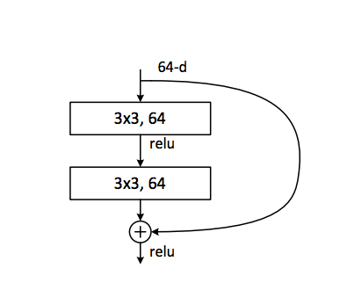
Optimization issues
Although identity is representable, learning it proves difficult for optimization methods
Intution: Tweak the network so it doesn’t have to learn identity connections
Kaiming He, Xiangyu Zhang, Shaoqing Ren, and Jian Sun, Deep Residual Learning for Image Recognition, CVPR 2016

Slide 58
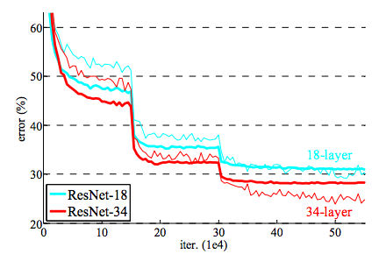
Optimization issues
Although identity is representable, learning it proves difficult for optimization methods
Intution: Tweak the network so it doesn’t have to learn identity connections
Result: Going deeper makes things better!
With residuals, the 34-layer network outperforms the 18 layer.
Kaiming He, Xiangyu Zhang, Shaoqing Ren, and Jian Sun, Deep Residual Learning for Image Recognition, CVPR 2016

Slide 59
Optimization issues
Although identity is representable, learning it proves difficult for optimization methods
Intution: Tweak the network so it doesn’t have to learn identity connections
Result: Going deeper makes things better!
The architecture of the plain and residual networks were identical except for the skip connections
Kaiming He, Xiangyu Zhang, Shaoqing Ren, and Jian Sun, Deep Residual Learning for Image Recognition, CVPR 2016

Slide 60
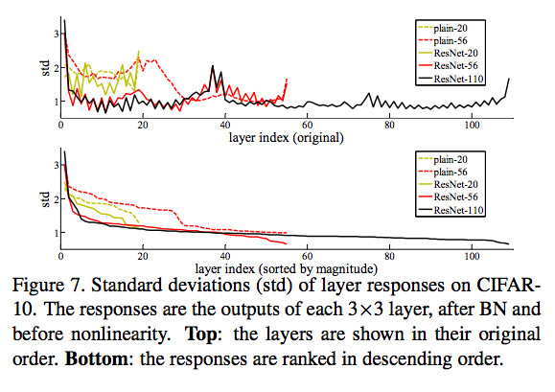
Interesting Finding
Less variation in activations for Residual Networks
Kaiming He, Xiangyu Zhang, Shaoqing Ren, and Jian Sun, Deep Residual Learning for Image Recognition, CVPR 2016

Slide 61
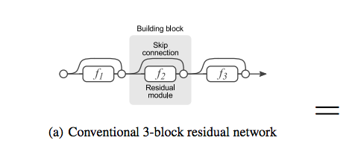
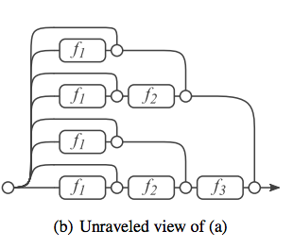
Why do ResNets work? Some ideas:
They can be seen as implicitly ensembling shallower networks
They are able to learn unrolled iterative refinements
Can model recurrent computations necessary for recognition
Andreas Veit, Michael Wilber, Serge Belongie, Residual Networks Behave Like Ensembles of Relatively Shallow Networks, arxiv 2016

Slide 62
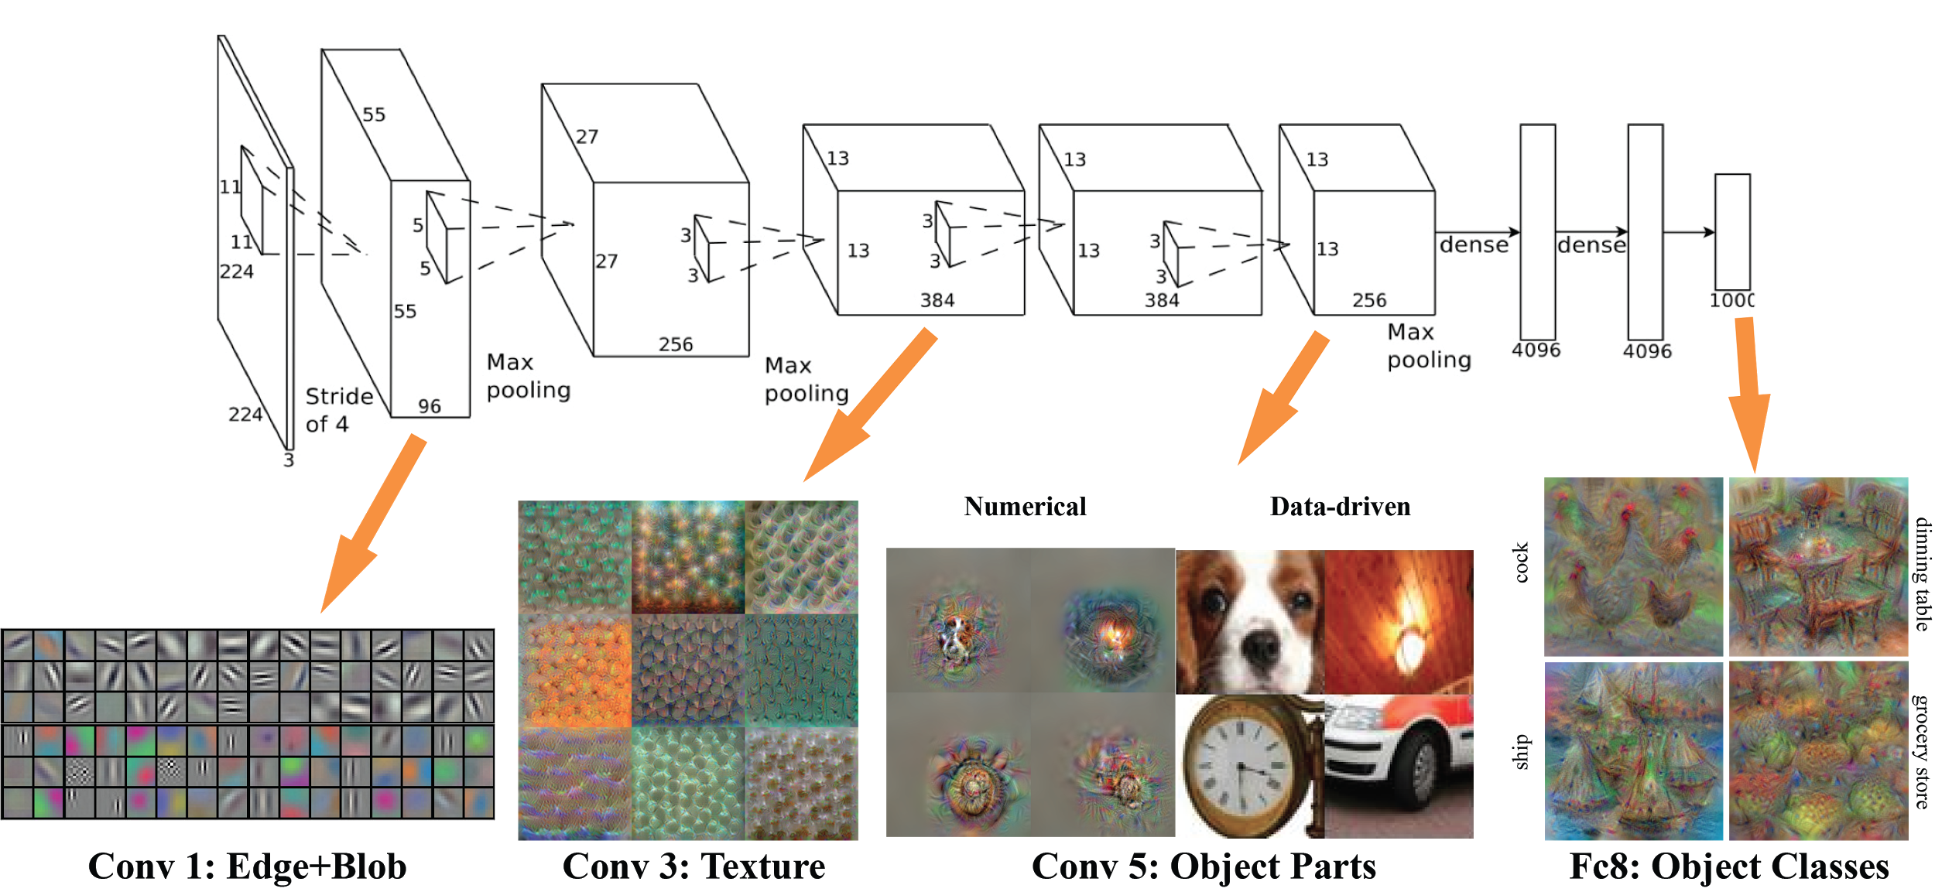
Why do ResNets work? Some ideas:
They can be seen as implicitly ensembling shallower networks
They are able to learn unrolled iterative estimation
Can model recurrent computations necessary for recognition
Challenges the “representation view”
Image source: http://vision03.csail.mit.edu/cnn_art/

Slide 63
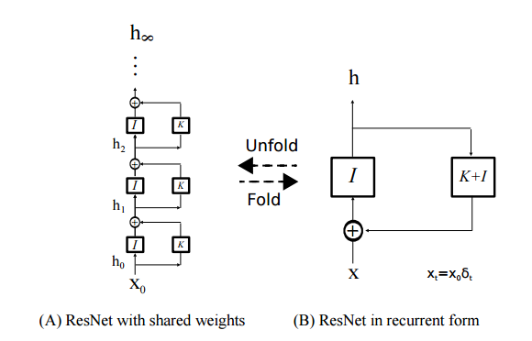
Why do ResNets work? Some ideas:
They can be seen as implicitly ensembling shallower networks
They are able to learn unrolled iterative estimation
Can model recurrent computations useful for recognition
Qianli Liao, Tomaso Poggio,Bridging the Gaps Between Residual Learning, Recurrent Neural Networks and Visual Cortex,

Slide 64
ResNets as Ensembles
Can think of ResNets as ensembling subsets of residual modules
With L residual modules there are 2^{L} possible subsets of modules
If one of modules is removed, there are still 2^{L-1} possible subsets of modules
For each residual module, we can choose whether we include it
There are 2 options per module (include/exclude) for L modules
Total of 2^{L} modules in the implicit ensemble

Slide 65
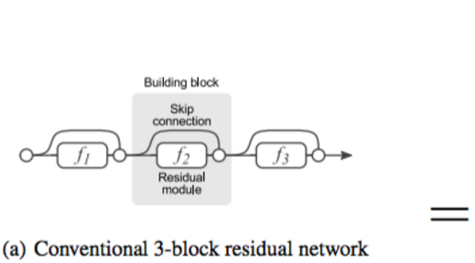
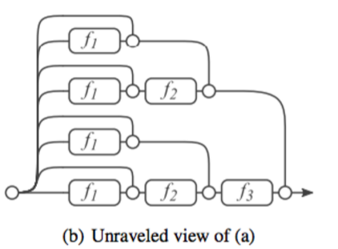
ResNets as Ensembles
Can think of ResNets as ensembling subsets of residual modules
With L residual modules there are 2^{L} possible subsets of modules
If one of modules is removed, there are still 2^{L-1} possible subsets of modules
Andreas Veit, Michael Wilber, Serge Belongie, Residual Networks Behave Like Ensembles of Relatively Shallow Networks, arxiv 2016

Slide 66
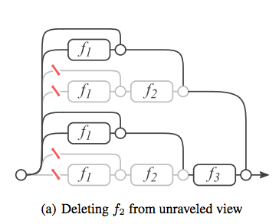
ResNets as Ensembles
Can think of ResNets as ensembling subsets of residual modules
With L residual modules there are 2^{L} possible subsets of modules
If one of modules is removed, there are still 2^{L-1} possible subsets of modules
Andreas Veit, Michael Wilber, Serge Belongie, Residual Networks Behave Like Ensembles of Relatively Shallow Networks, arxiv 2016

Slide 67
ResNets as Ensembles
Wanted to test this explanation
Tried dropping layers
Tried reordering layers
Found effective paths during training are relatively shallow
Andreas Veit, Michael Wilber, Serge Belongie, Residual Networks Behave Like Ensembles of Relatively Shallow Networks, arxiv 2016
Andreas Veit, Michael Wilber, Serge Belongie, Residual Networks Behave Like Ensembles of Relatively Shallow Networks, arxiv 2016

Slide 68
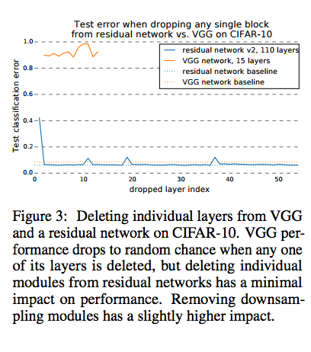
ResNets as Ensembles
Wanted to test this explanation
Tried dropping layers
Tried reordering layers
Found effective paths during training are relatively shallow
Dropping layers on VGG-Net is disastorous...
Andreas Veit, Michael Wilber, Serge Belongie, Residual Networks Behave Like Ensembles of Relatively Shallow Networks, arxiv 2016
Andreas Veit, Michael Wilber, Serge Belongie, Residual Networks Behave Like Ensembles of Relatively Shallow Networks, arxiv 2016

Slide 69
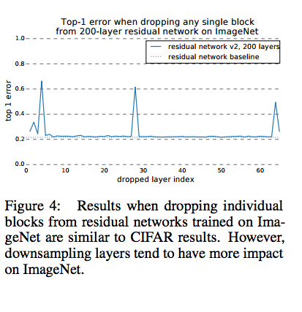
ResNets as Ensembles
Wanted to test this explanation
Tried dropping layers
Tried reordering layers
Found effective paths during training are relatively shallow
Dropping layers on ResNet is no big deal
Andreas Veit, Michael Wilber, Serge Belongie, Residual Networks Behave Like Ensembles of Relatively Shallow Networks, arxiv 2016
Andreas Veit, Michael Wilber, Serge Belongie, Residual Networks Behave Like Ensembles of Relatively Shallow Networks, arxiv 2016

Slide 70
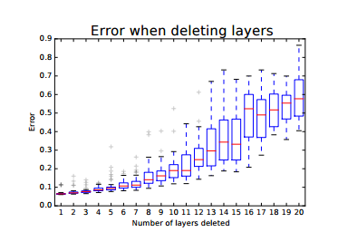
ResNets as Ensembles
Wanted to test this explanation
Tried dropping layers
Tried reordering layers
Found effective paths during training are relatively shallow
Performance degrades smoothly as layers are removed
Andreas Veit, Michael Wilber, Serge Belongie, Residual Networks Behave Like Ensembles of Relatively Shallow Networks, arxiv 2016
Andreas Veit, Michael Wilber, Serge Belongie, Residual Networks Behave Like Ensembles of Relatively Shallow Networks, arxiv 2016

Slide 71
ResNets as Ensembles
Wanted to test this explanation
Tried dropping layers
Tried reordering layers
Found effective paths during training are relatively shallow
Though the total network has 54 modules; more than 95% of paths go through 19 to 35 modules
Andreas Veit, Michael Wilber, Serge Belongie, Residual Networks Behave Like Ensembles of Relatively Shallow Networks, arxiv 2016
Andreas Veit, Michael Wilber, Serge Belongie, Residual Networks Behave Like Ensembles of Relatively Shallow Networks, arxiv 2016

Slide 72
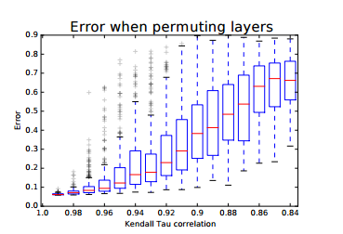
ResNets as Ensembles
Wanted to test this explanation
Tried dropping layers
Tried reordering layers
Found effective paths during training are relatively shallow
The Kendall Tau correlation coefficient measures the degree of reordering
Andreas Veit, Michael Wilber, Serge Belongie, Residual Networks Behave Like Ensembles of Relatively Shallow Networks, arxiv 2016
Andreas Veit, Michael Wilber, Serge Belongie, Residual Networks Behave Like Ensembles of Relatively Shallow Networks, arxiv 2016

Slide 73
ResNets as Ensembles
Wanted to test this explanation
Tried dropping layers
Tried reordering layers
Found effective paths during training are relatively shallow
[W]e show most gradient during training comes from paths that are even shorter, i.e., 10-34 layers deep.
Andreas Veit, Michael Wilber, Serge Belongie, Residual Networks Behave Like Ensembles of Relatively Shallow Networks, arxiv 2016
Andreas Veit, Michael Wilber, Serge Belongie, Residual Networks Behave Like Ensembles of Relatively Shallow Networks, arxiv 2016

Slide 74
Summary
ResNets seem to work because they facilitate the training of deeper networks
Are suprisingly robust to layers being dropped or reordered
Seem to be function approximations using iterative refinement

Slide 75
Stage 3:
Survey of Architectures

Slide 76
Recap (General Principles in NN Design)
Reduce filter sizes (except possibly at the lowest layer), factorize filters aggressively
Use 1x1 convolutions to reduce and expand the number of feature maps judiciously
Use skip connections and/or create multiple paths through the network
(Professor Lazebnik’s slides)

Slide 77
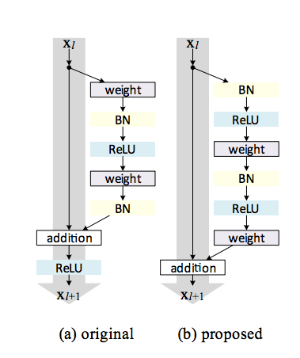
What are the current trends?
Some make minor modifications to ResNets
Biggest trend is to split of into several branches, and merge through summation
A couple architectures go crazy with branch & merge, without explicit identity connections
Identity Mappings in Deep Residual Networks Kaiming He, Xiangyu Zhang, Shaoqing Ren, Jian Sun
Notes:
Add Animation.. Adjust..

Slide 78
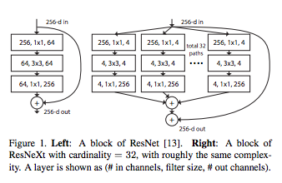
What are the current trends?
Some make minor modifications to ResNets
Biggest trend is to split of into several branches, and merge through summation
A couple architectures go crazy with branch & merge, without explicit identity connections
Saining Xie, Ross Girshick, Piotr Dollár, Zhuowen Tu, Kaiming He. Aggregated Residual Transformations for Deep Neural Networks
Notes:
Add Animation.. Adjust..

Slide 79
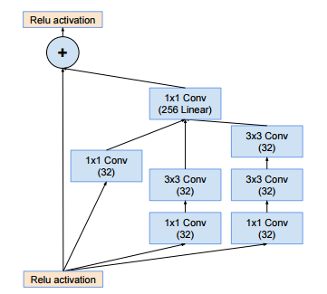
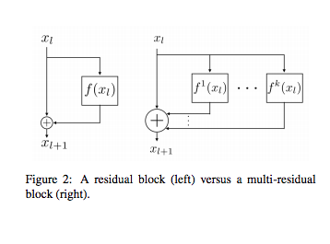
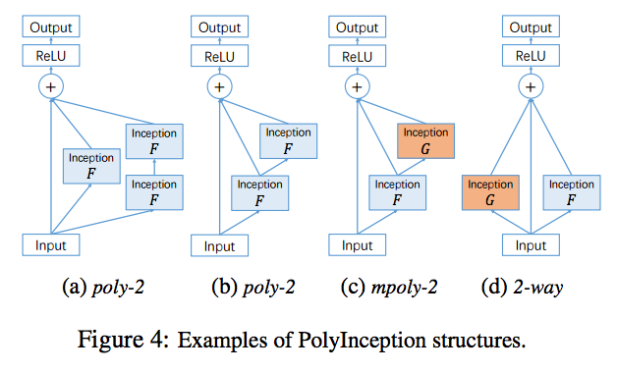
What are the current trends?
Inception ResNet
ResNeXt
MultiResNet
PolyNet
Saining Xie, Ross Girshick, Piotr Dollár, Zhuowen Tu, Kaiming He. Aggregated Residual Transformations for Deep Neural Networks
Masoud Abdi, Saeid Nahavandi. Multi-Residual Networks: Improving the Speed and Accuracy of Residual Networks
Xingcheng Zhang, Zhizhong Li, Chen Change Loy, Dahua Lin. PolyNet: A Pursuit of Structural Diversity in Very Deep Networks
C. Szegedy et al., Inception-v4, Inception-ResNet and the Impact of Residual Connections on Learning

Slide 80
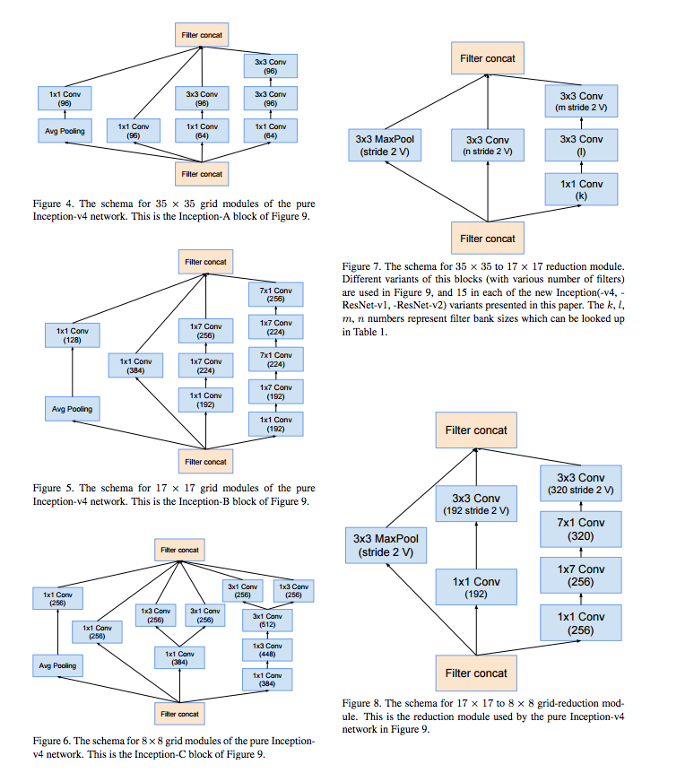
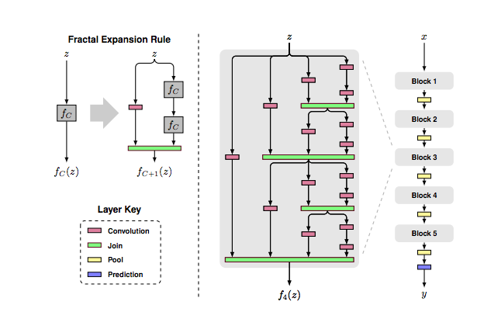
What are the current trends?
Some make minor modifications to ResNets
Biggest trend is to split of into several branches, and merge through summation
A couple architectures go crazy with branch & merge, without explicit identity connections
Gustav Larsson, Michael Maire, Gregory Shakhnarovich FractalNet: Ultra-Deep Neural Networks without Residuals
C. Szegedy et al., Inception-v4, Inception-ResNet and the Impact of Residual Connections on Learning
Notes:
Add Animation.. Adjust..

Slide 81
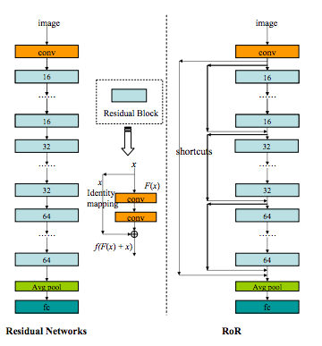
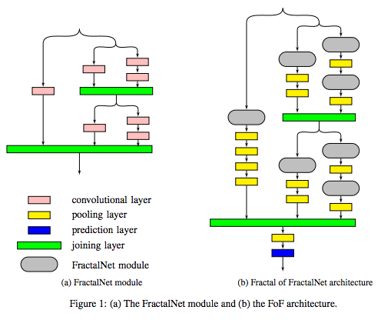
Some try going meta..
Fractal of Fractals
Residuals of Residuals
Leslie N. Smith, Nicholay Topin, Deep Convolutional Neural Network Design Patterns
Notes:
Only tried in CIFAR- 10, not even tested in other areas...

Slide 82
ResNet tweaks: Change order
Pre-activation ResNets
Same components as original, order of BN, ReLU, and conv changed
Idea is to have more direct path for input identity to propagate
Resulted in deeper, more accurate networks on ImageNet/CIFAR
Identity Mappings in Deep Residual Networks Kaiming He, Xiangyu Zhang, Shaoqing Ren, Jian Sun

Slide 83
ResNet tweaks: Change order
Pre-activation ResNets
Same components as original, order of BN, ReLU, and conv changed
Idea is to have more direct path for input identity to propagate
Resulted in deeper, more accurate networks on ImageNet/CIFAR
Identity Mappings in Deep Residual Networks Kaiming He, Xiangyu Zhang, Shaoqing Ren, Jian Sun

Slide 84
ResNet tweaks: Change order
Pre-activation ResNets
Same components as original, order of BN, ReLU, and conv changed
Idea is to have more direct path for input identity to propagate
Resulted in deeper, more accurate networks on ImageNet/CIFAR
ImageNet performance
Identity Mappings in Deep Residual Networks Kaiming He, Xiangyu Zhang, Shaoqing Ren, Jian Sun

Slide 85
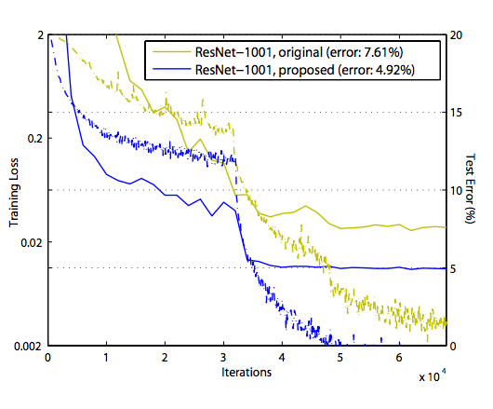
ResNet tweaks: Change order
Pre-activation ResNets
Same components as original, order of BN, ReLU, and conv changed
Idea is to have more direct path for input identity to propagate
Resulted in deeper, more accurate networks on ImageNet/CIFAR
CIFAR-10 performance
Identity Mappings in Deep Residual Networks Kaiming He, Xiangyu Zhang, Shaoqing Ren, Jian Sun

Slide 86
ResNet tweaks: Wide ResNets
Use pre-activation ResNet’s basic block with more feature maps
Used parameter “k” to encode width
Investigated relationship between width and depth to find a good tradeoff
Sergey Zagoruyko, Nikos Komodakis Wide Residual Networks
Notes:
Adjust

Slide 87
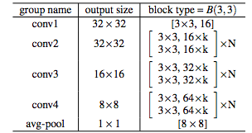
ResNet tweaks: Wide ResNets
Use pre-activation ResNet’s basic block with more feature maps
Used parameter “k” to encode width
Investigated relationship between width and depth to find a good tradeoff
Sergey Zagoruyko, Nikos Komodakis Wide Residual Networks
Notes:
Adjust

Slide 88
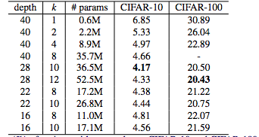
ResNet tweaks: Wide ResNets
Use pre-activation ResNet’s basic block with more feature maps
Used parameter “k” to encode width
Investigated relationship between width and depth to find a good tradeoff
Sergey Zagoruyko, Nikos Komodakis Wide Residual Networks
Notes:
Adjust

Slide 89
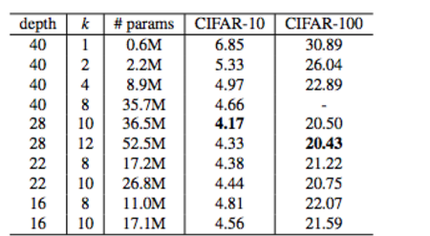
ResNet tweaks: Wide ResNets
Use pre-activation ResNet’s basic block with more feature maps
Used parameter “k” to encode width
Investigated relationship between width and depth to find a good tradeoff
Sergey Zagoruyko, Nikos Komodakis Wide Residual Networks
Notes:
Adjust

Slide 90
ResNet tweaks: Wide ResNets
These obtained state of the art results on CIFAR datasets
Were outperformed by bottlenecked networks on ImageNet
Best results on ImageNet were obtained by widening ResNet-50
Sergey Zagoruyko, Nikos Komodakis Wide Residual Networks
Notes:
Adjust

Slide 91
ResNet tweaks: Wide ResNets
These obtained state of the art results on CIFAR datasets
Were outperformed by bottlenecked networks on ImageNet
Best results on ImageNet were obtained by widening ResNet-50
Sergey Zagoruyko, Nikos Komodakis Wide Residual Networks
Notes:
Adjust

Slide 92
ResNet tweaks: Wide ResNets
These obtained state of the art results on CIFAR datasets
Were outperformed by bottlenecked networks on ImageNet
Best results on ImageNet were obtained by widening ResNet-50
“With widening factor of 2.0 the resulting WRN-50-2-bottleneck outperforms ResNet- 152 having 3 times less layers, and being significantly faster.”
Sergey Zagoruyko, Nikos Komodakis Wide Residual Networks
Notes:
Adjust

Slide 93
Aside from ResNets
FractalNet and DenseNet
Notes:
We have been talking a lot about ResNets, but CNN is not just about residuals. We have residuals

Slide 94
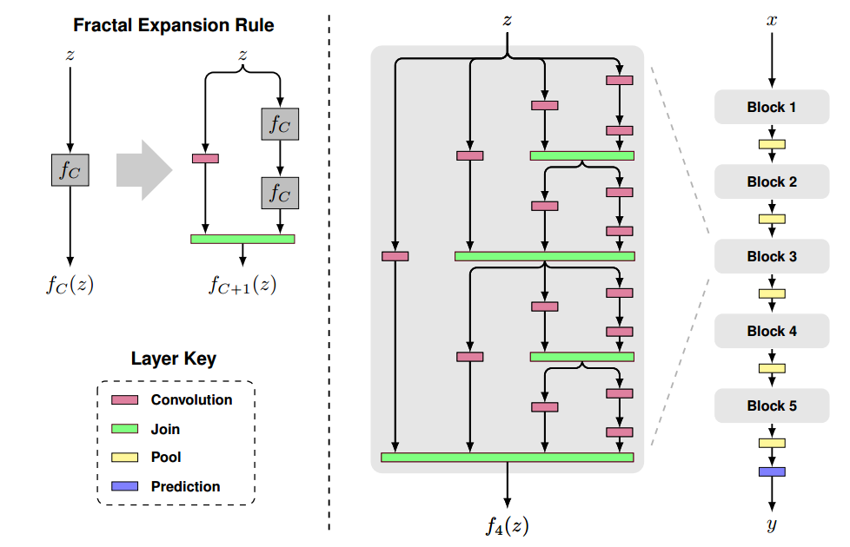
FractalNet
A competitive extremely deep architecture that does not rely on residuals
Gustav Larsson, Michael Maire, Gregory Shakhnarovich
FractalNet: Ultra-Deep Neural Networks without Residuals
Notes:
Left: A simple expansion rule generates a fractal architecture with C intertwined columns. The base case, f1(z), has a single layer of the chosen type (e.g. convolutional) between input and output. Join layers compute element-wise mean. Right: Deep convolutional networks periodically reduce spatial resolution via pooling. A fractal version uses fC as a building block between pooling layers. Stacking B such blocks yields a network whose total depth, measured in terms of convolution layers, is B ¨ 2 C´1 . This example has depth 40 (B “ 5, C “ 4).

Slide 95
FractalNet
A competitive extremely deep architecture that does not rely on residuals
Interestingly, its architecture is similar to an unfolded ResNet
Gustav Larsson, Michael Maire, Gregory Shakhnarovich
FractalNet: Ultra-Deep Neural Networks without Residuals
Andreas Veit, Michael Wilber, Serge Belongie, Residual Networks Behave Like Ensembles of Relatively Shallow Networks, arxiv 2016
Notes:
Left: A simple expansion rule generates a fractal architecture with C intertwined columns. The base case, f1(z), has a single layer of the chosen type (e.g. convolutional) between input and output. Join layers compute element-wise mean. Right: Deep convolutional networks periodically reduce spatial resolution via pooling. A fractal version uses fC as a building block between pooling layers. Stacking B such blocks yields a network whose total depth, measured in terms of convolution layers, is B ¨ 2 C´1 . This example has depth 40 (B “ 5, C “ 4).

Slide 96
DenseNet (Within a DenseBlock)
Every layer is connected to all other layers.
For each layer, the feature-maps of all preceding layers are used as inputs, and its own feature-maps are used as inputs into all subsequent layers.

Slide 97
DenseNet
Alleviate the vanishing-gradient problem.
Strengthen feature propagation.
Encourage feature reuse.
Substantially reduce the number of parameters.

Slide 98
Bonus Material!
We’ll cover spatial transformer networks (briefly)

Slide 99
Spatial Transformer Networks
A module to provide spatial transformation capabilities on individual data samples.
Idea:
Function mapping pixel coordinates of output to pixel coordinates of input.
Max Jaderberg, Karen Simonyan, Andrew Zisserman, Koray Kavukcuoglu
Spatial Transformer Networks

Slide 100
Spatial transform by how much?
The localisation network function can take any form, such as a fully-connected network or a convolutional network, but should include a final regression layer to produce the transformation parameters θ.

Slide 101
Notes:
some errors

Slide 102
Concluding Remarks
At surface level, there’s tons of new architectures that are very different
Upon closer inspection, most of them are reapplying well established principles
Universal principles seem to be having shorter subpaths through the networks
Identity propagation (Residuals, Dense Blocks) seem to make training easier

Slide 103
References
Sergey Ioffe,Christian Szegedy,Batch Normalization: Accelerating Deep Network Training by Reducing Internal Covariate Shift, http://jmlr.org/proceedings/papers/v37/ioffe15.pdf
K. He, X. Zhang, S. Ren, and J. Sun, Deep Residual Learning for Image Recognition, CVPR 2016 https://arxiv.org/abs/1512.03385
Kaiming He, Xiangyu Zhang, Shaoqing Ren, Jian Sun, Identity Mappings in Deep Residual Networks https://arxiv.org/abs/1603.05027
Saining Xie, Ross Girshick, Piotr Dollár, Zhuowen Tu, Kaiming He, Aggregated Residual Transformations for Deep Neural Networks, https://arxiv.org/pdf/1611.05431v1.pdf
Max Jaderberg, Karen Simonyan, Andrew Zisserman, Koray Kavukcuoglu: Spatial Transformer Networks https://arxiv.org/abs/1506.02025
Leslie N. Smith, Nicholay Topin, Deep Convolutional Neural Network Design Patterns, https://arxiv.org/abs/1611.00847
Christian Szegedy, Sergey Ioffe, Vincent Vanhoucke, Alex Alemi: Inception-v4, Inception-ResNet and the Impact of Residual Connections on Learning https://arxiv.org/abs/1602.07261
Gustav Larsson, Michael Maire, Gregory Shakhnarovich, FractalNet: Ultra-Deep Neural Networks without Residuals https://arxiv.org/abs/1605.07648
Gao Huang, Zhuang Liu, Kilian Q. Weinberger, Laurens van der Maaten: Densely Connected Convolutional Networks https://arxiv.org/pdf/1608.06993v3.pdf
Rupesh Kumar Srivastava, Klaus Greff, Jürgen Schmidhuber: Highway Networks https://arxiv.org/abs/1505.00387
Xingcheng Zhang, Zhizhong Li, Chen Change Loy, Dahua Lin, PolyNet: A Pursuit of Structural Diversity in Very Deep Networks, https://arxiv.org/abs/1611.05725
Jost Tobias Springenberg, Alexey Dosovitskiy, Thomas Brox, and Martin Riedmiller. Striving for simplicity: The all convolutional net. https://arxiv.org/abs/1412.6806
Andreas Veit, Michael Wilber, Serge Belongie, Residual Networks Behave Like Ensembles of Relatively Shallow Networks, https://arxiv.org/pdf/1605.06431v2.pdf
Klaus Greff, Rupesh K. Srivastava & Jürgen Schmidhuber, Highway and Residual Networks Learn Unrolled Iterative Estimation,https://arxiv.org/pdf/1612.07771v1.pdf
Min Lin, Qiang Chen, Shuicheng Yan, Network In Network, https://arxiv.org/abs/1312.4400
Brian Chu, Daylen Yang, Ravi Tadinada, Visualizing Residual Networks, https://arxiv.org/abs/1701.02362
Djork-Arné Clevert, Thomas Unterthiner, Sepp Hochreiter: Fast and Accurate Deep Network Learning by Exponential Linear Units (ELUs) https://arxiv.org/abs/1511.07289
Kaiming He, Xiangyu Zhang, Shaoqing Ren, Jian Sun, Delving Deep into Rectifiers: Surpassing Human-Level Performance on ImageNet Classification, https://arxiv.org/abs/1502.01852
Anish Shah, Eashan Kadam, Hena Shah, Sameer Shinde, Sandip Shingade, Deep Residual Networks with Exponential Linear Unit, https://arxiv.org/abs/1604.04112
Notes:
Jost Tobias Springenberg, Alexey Dosovitskiy, Thomas Brox, and Martin Riedmiller. Striving for simplicity: The all convolutional net. arXiv preprint arXiv:1412.6806, 2014.
Christian Szegedy, Wei Liu, Yangqing Jia, Pierre Sermanet, Scott Reed, Dragomir Anguelov, Dumitru Erhan, Vincent Vanhoucke, and Andrew Rabinovich. Going deeper with convolutions. In Proceedings of the IEEE Conference on Computer Vision and Pattern Recognition, pp. 1–9, 2015a

