Slide 1
Semantic Segmentation, Dense Labeling
Liwei Wang
CS@UIUC

Slide 2
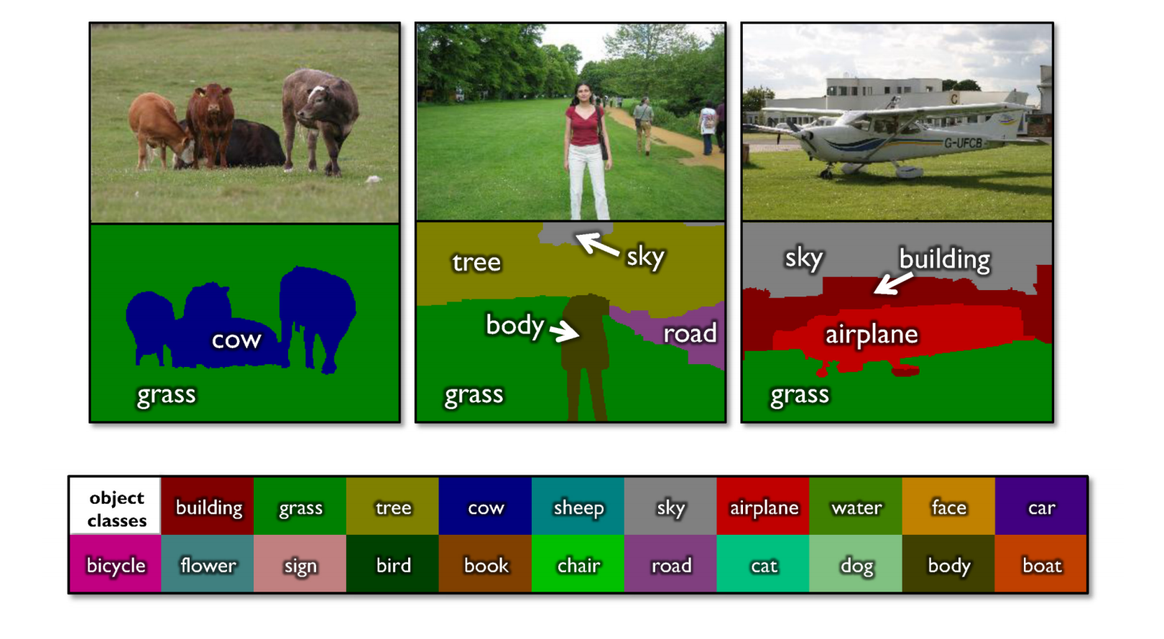
Semantic segmentation
From CS543 LAZ

Slide 3
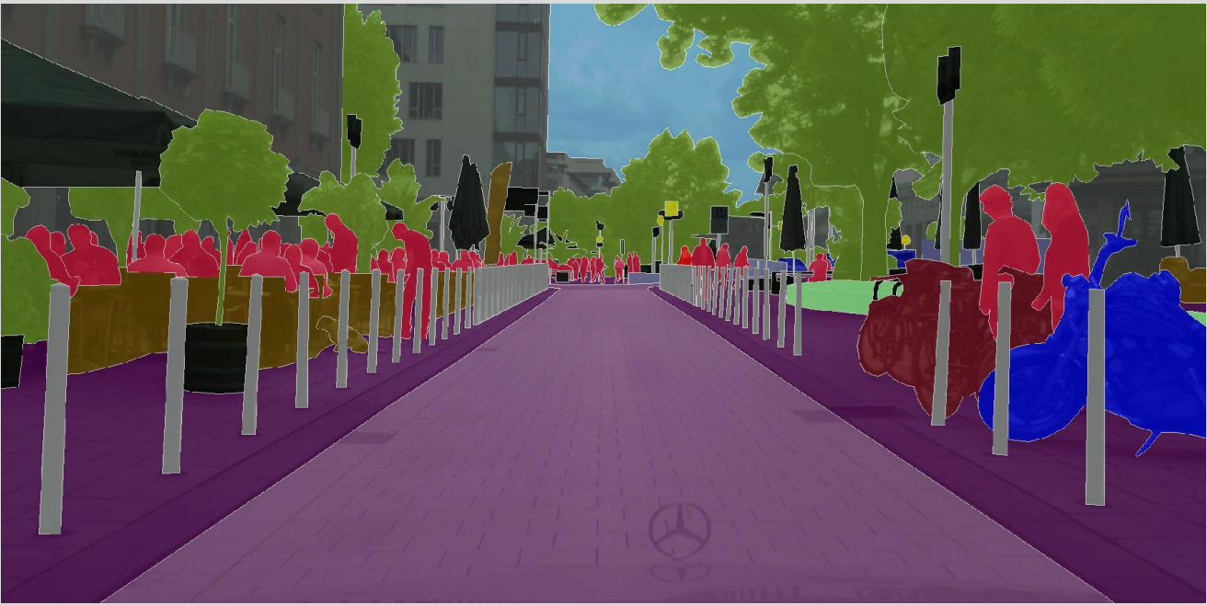
Why Semantic Segmentation ?
Road Scene Understanding
Useful for Self-Driving Car and autonomous drones
From cityscape dataset

Slide 4
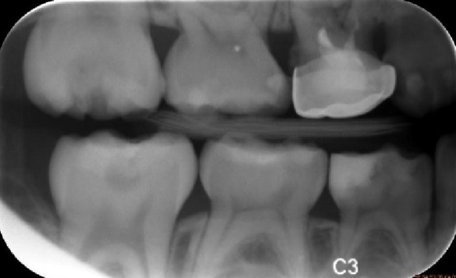
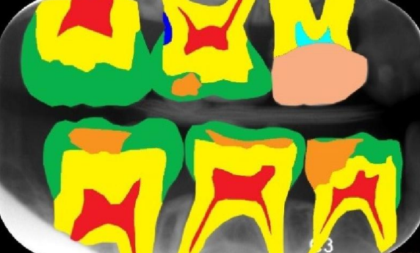
Why Semantic Segmentation ?
Medical Image Analysis
From web

Slide 5
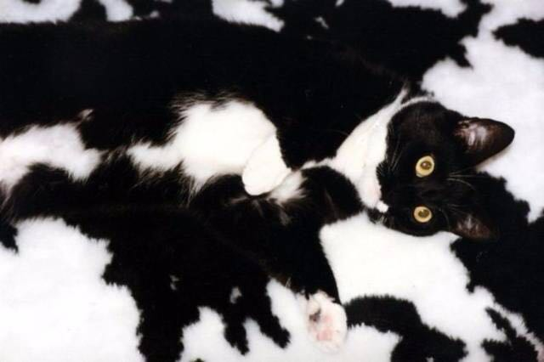
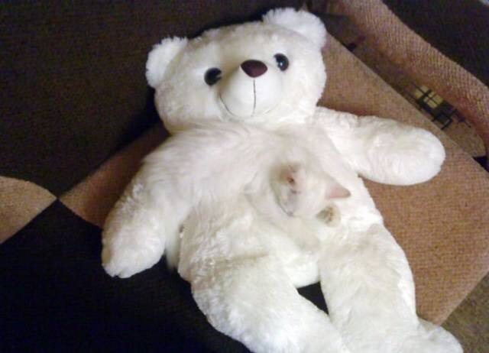
Very Challenging Problem

Slide 6
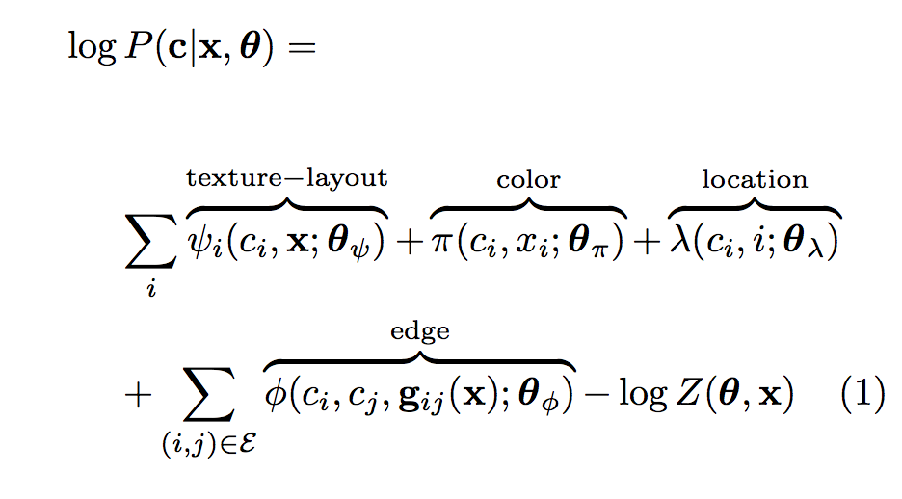
History
Problem: label each pixel by one of C classes
Define an energy function where unaries correspond to local classifier responses and smoothing potentials correspond to contextual terms
Solve a multi-class graph cut problem
From TextonBoost, ECCV 2006

Slide 7
History
CRF energy function is defined on super-pixels:
Unaries are based on nearest neighbor retrieval
Pairwise potentials capture class co-occurrence statistics
J. Tighe and S. Lazebnik, SuperParsing, ECCV 2010

Slide 8
Now, what is happening
How deep neural networks can be used for Semantic Segmentation ?
How to model local and contextual information with Deep Nets ?
Differences and Similarities among methods ?

Slide 9
Zoom-out Features
A simple Feed-Forward Network
Feature Concatenation from Different Scales
Strong features + Softmax Classification

Slide 10
Zoom-out Features
Sub-scene Level Features
Bounding box of superpixels within radius three from the superpixel at hand
Warp bounding box to 256 x 256 pixels
Activations of the last fully connected layer
Scene Level Features
Warp image to 256 x 256 pixels
Activations of the last fully connected layer

Slide 11
Zoom-out Features

Slide 12
Zoom-out Features
Feedforward Semantic Segmentation With Zoom-Out Features, CVPR 2015

Slide 13
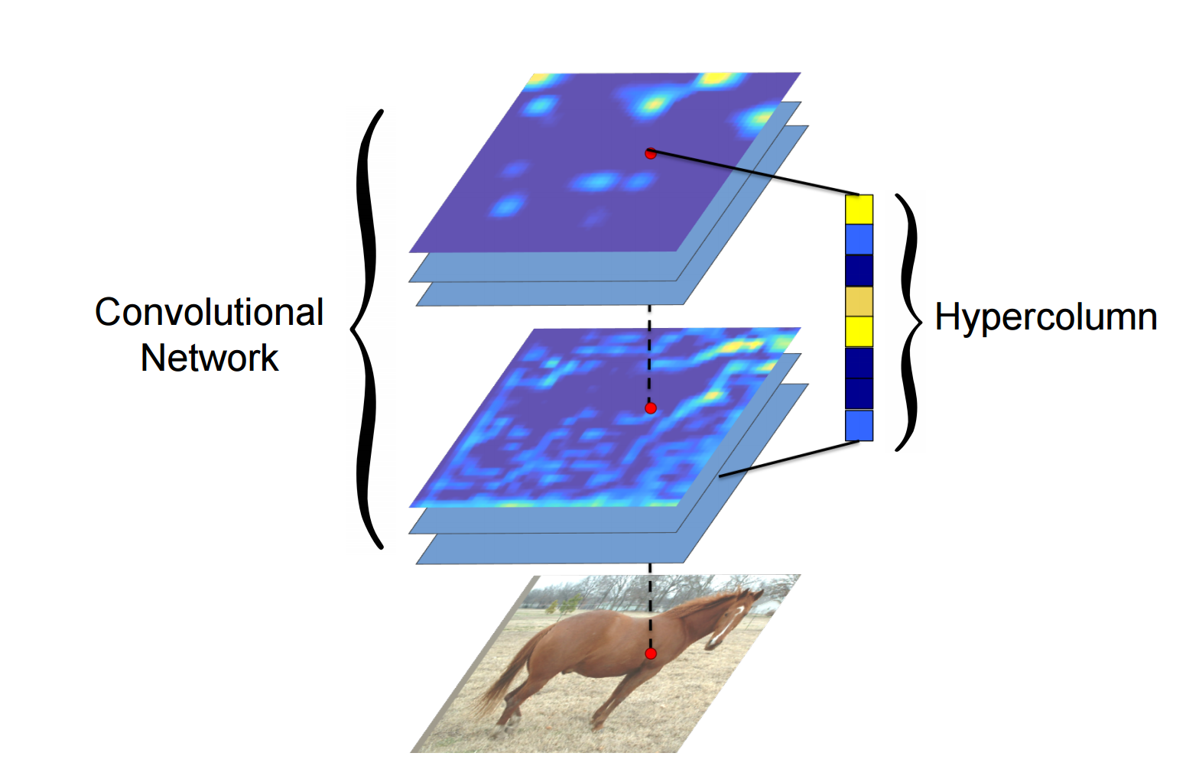
Hypercolumns Representation
Hypercolumns for object segmentation and fine-grained localization CVPR 2015

Slide 14
Hypercolumn Representation
upsampling
Hypercolumns for object segmentation and fine-grained localization CVPR 2015

Slide 15
Hypercolumn Representation
Hypercolumns for object segmentation and fine-grained localization CVPR 2015

Slide 16
Evaluation
Mean IoU
Per-class evaluation: an intersection of the predicted and true sets
of pixels for a given class, divided by their union (IoU)
 | VOC 2012
Zoom-out | 69.6
Hypercolumn | 62.6

Slide 17
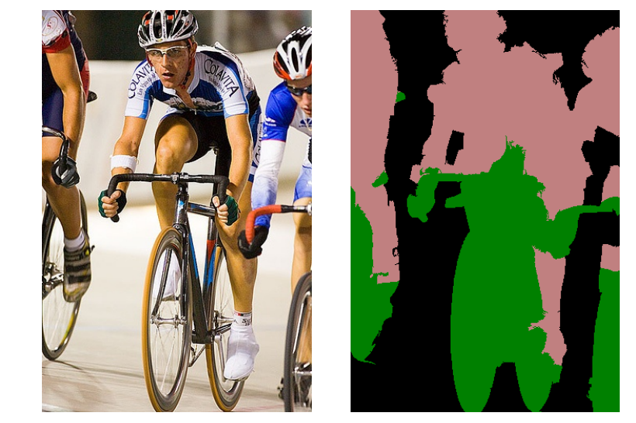
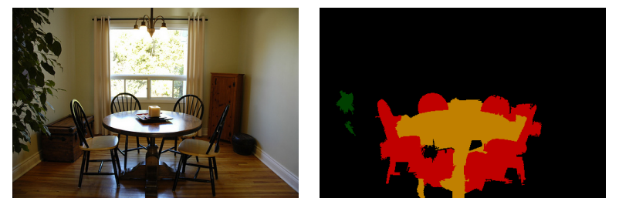
Evaluation
Zoom-out Method on Pascal VOC2012

Slide 18
Hypercolumn and Zoom out
Both uses the multi-scale features from intermediate layers in CNN
Both use upsampling operations for each scale
Any Pixel to Pixel ways ?
Can upsampling be learned ?

Slide 19
FCN for Semantic Segmentation
Fully convolutional Networks for Semantic Segmentation, CVPR 2015

Slide 20
Convnets for Classification
Fully convolutional Networks for Semantic Segmentation, CVPR 2015

Slide 21
Convnets for Segmentation ?
Fully convolutional Networks for Semantic Segmentation, CVPR 2015

Slide 22
From Convnets to FCN
Fully convolutional Networks for Semantic Segmentation, CVPR 2015

Slide 23
Pixel in , Pixel out
Upsampling is backwards strided convolution

Slide 24
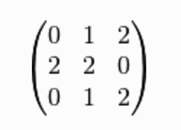
How does convolution works ?
Kernel/filter:

Slide 25
How does convolution works ?
Kernel/filter:

Slide 26
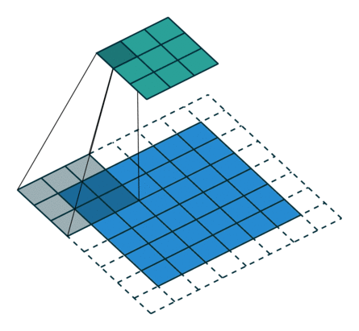
How does convolution works ?

Slide 27
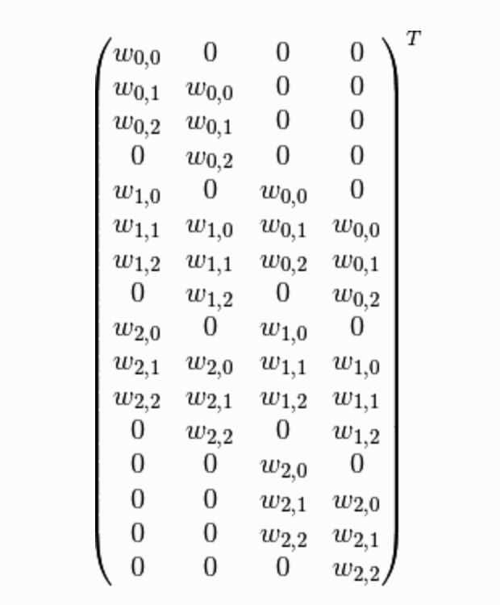
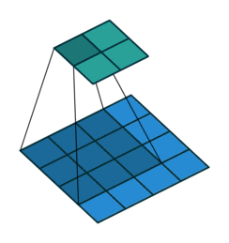
How does convolution works ?
Convolution as a matrix operation
From Theano Document Website

Slide 28
Upsampling is backwards strided convolution
Transposed convolution
From Theano Document Website

Slide 29
Actually, we can build deconv networks…
DCGAN

Slide 30
Deconv Layers for generating image !

Slide 31
Framework of FCN

Slide 32
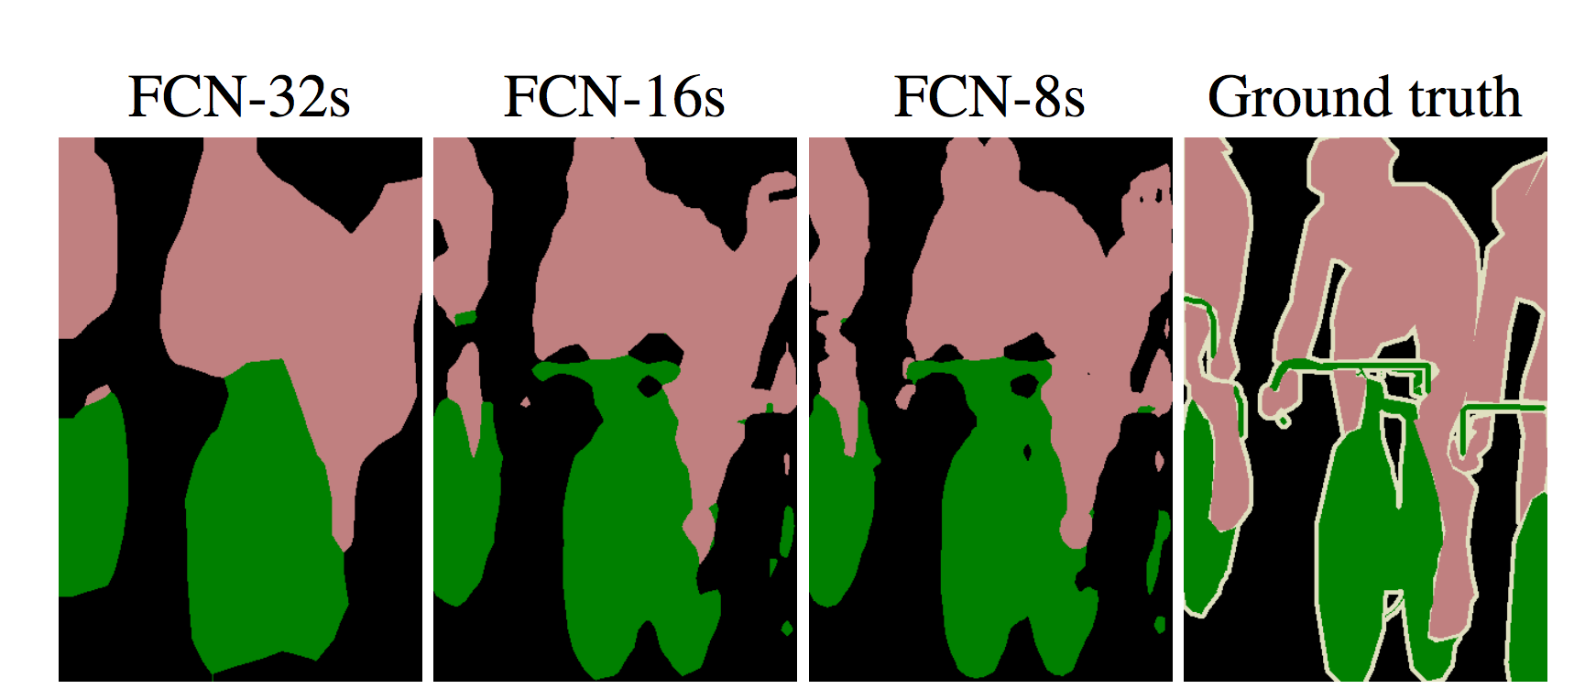
Framework of FCN

Slide 33
More than one upsampling layer
Noh et al, “Learning Deconvolution Network for Semantic Segmentation”, ICCV 2015

Slide 34
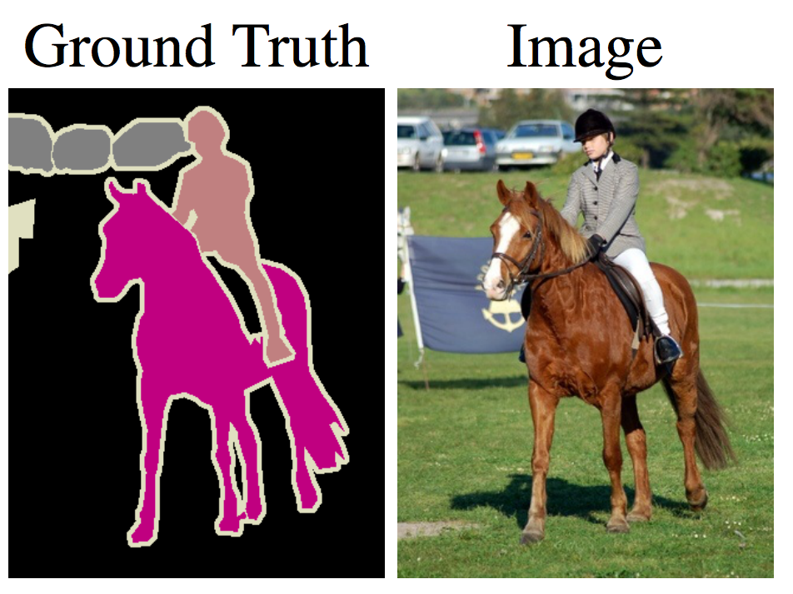
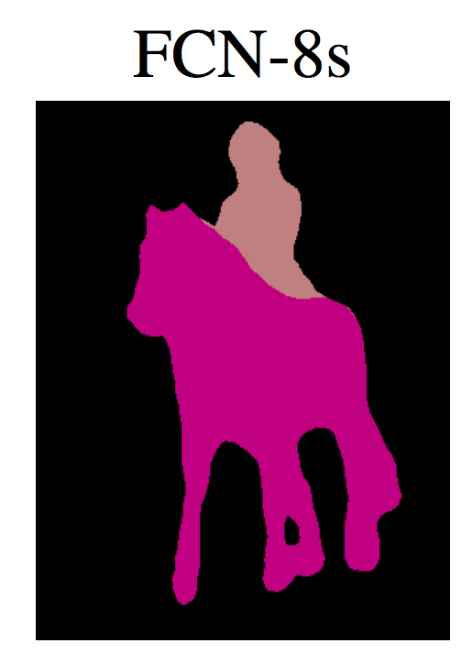
FCN is still not good ?
Very coarse feature maps --- FCN-8s is still very coarse

Slide 35
Dilated Convolution
Discrete Convolution Operation:
Dilated Convolution Operation:

Slide 36
Dilated Convolution

Slide 37
Dilated Convolution

Slide 38
Network with Dilated Convolution
Following FCN structure
Using VGG-16 networks with modifications
Called Front End and greatly improve performance

Slide 39
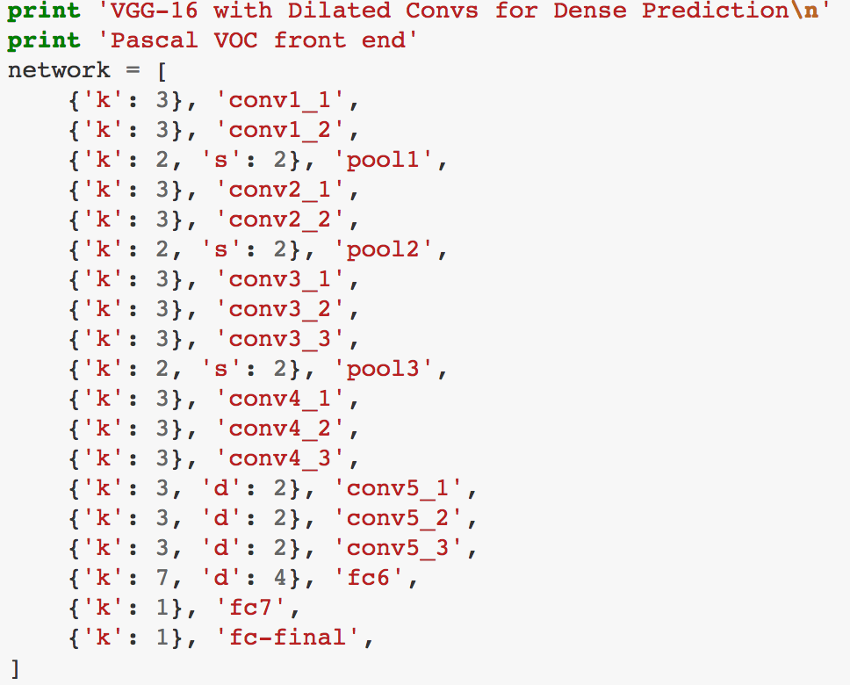
Network with Dilated Convolution
From arunmallya

Slide 40
Network with Dilated Convolution

Slide 41
Network with Dilated Convolution

Slide 42
Multi-scale Context Aggregation

Slide 43
Multi-scale Context Aggregation
From arunmallya

Slide 44
Front End + Context Net

Slide 45
Front End + Context Net

Slide 46
Top to Down Refinement
Learning to refine object segments, ECCV 2016

Slide 47
Refine Deep Mask
Learning to refine object segments, ECCV 2016

Slide 48
Dense Labeling Task: Learning Optical Flow
FlowNet: Learning Optical Flow with Convolutional Networks

Slide 49
FlowNetSimple
FlowNet: Learning Optical Flow with Convolutional Networks

Slide 50
FlowNetCorr
FlowNet: Learning Optical Flow with Convolutional Networks
Notes:
Sismes networks.

Slide 51
Refinement of the coarse feature maps
FlowNet: Learning Optical Flow with Convolutional Networks

Slide 52
Examples of Data Pairs
FlowNet: Learning Optical Flow with Convolutional Networks

Slide 53
Results
FlowNet: Learning Optical Flow with Convolutional Networks

