Slide 1
Deep Reinforcement Learning: Q-Learning
Garima Lalwani Karan Ganju Unnat Jain

Slide 2
Today’s takeaways
Bonus RL recap
Functional Approximation
Deep Q Network
Double Deep Q Network
Dueling Networks
Recurrent DQN
Solving “Doom”
Hierarchical DQN

Slide 3
Today’s takeaways
Bonus RL recap
Functional Approximation
Deep Q Network
Double Deep Q Network
Dueling Networks
Recurrent DQN
Solving “Doom”
Hierarchical DQN

Slide 4
Q-Learning
David Silver’s Introduction to RL lectures
Peter Abbeel’s Artificial Intelligence - Berkeley (Spring 2015)
Notes:
Q and V kya hote hain?

Slide 5
Q-Learning
David Silver’s Introduction to RL lectures
Peter Abbeel’s Artificial Intelligence - Berkeley (Spring 2015)

Slide 6
Q-Learning
David Silver’s Introduction to RL lectures
Peter Abbeel’s Artificial Intelligence - Berkeley (Spring 2015)

Slide 7
Today’s takeaways
Bonus RL recap
Functional Approximation
Deep Q Network
Double Deep Q Network
Dueling Networks
Recurrent DQN
Solving “Doom”
Hierarchical DQN

Slide 8
Function Approximation - Why?
Value functions
Every state s has an entry V(s)
Every state-action pair (s, a) has an entry Q(s, a)
How to get Q(s,a) → Table lookup
What about large MDPs?
Estimate value function with function approximation
Generalise from seen states to unseen states
Notes:
Pi likh le yaar!

Slide 9
Function Approximation - How?
Why Q?
How to approximate?
Features for state s | s,a → x(s,a)
Linear model | Q(s,a) = w^{T}x(s,a)
Deep Neural Nets - CS598 | Q(s,a) = NN(s,a)

Slide 10
Function Approximation - Demo

Slide 11
Today’s takeaways
Bonus RL recap
Functional Approximation
Deep Q Network
Double Deep Q Network
Dueling Networks
Recurrent DQN
Solving “Doom”
Hierarchical DQN

Slide 12
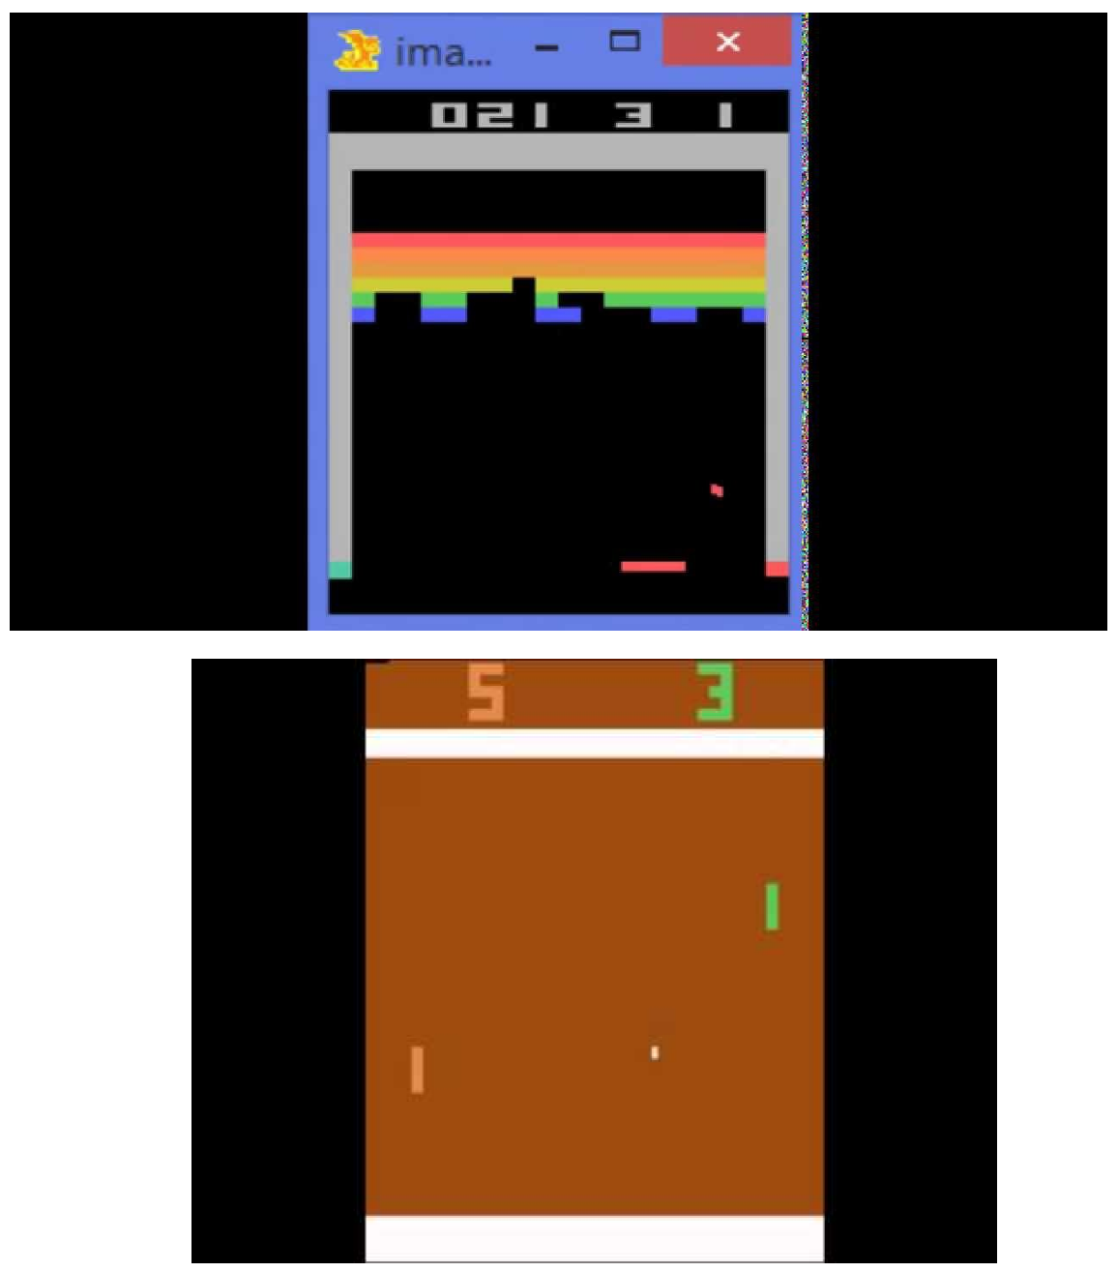
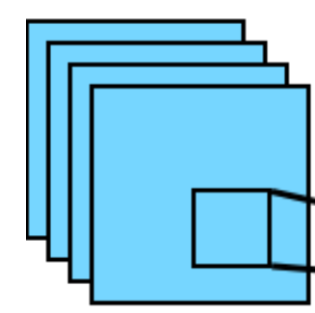
Deep Q Network
2) Output: Q(s,a_{i})
Q(s,a₁)
Q(s,a₂)
Q(s,a₃)
.
.
.
.
.
.
.
.
.
Q(s,a₁₈)
1) Input: 4 images = current frame + 3 previous
Mnih, Volodymyr, et al. "Human-level control through deep reinforcement learning." Nature 518.7540 (2015): 529-533.

Slide 13
Deep Q Network
2) Output: Q(s,a_{i})
Q(s,a₁)
Q(s,a₂)
Q(s,a₃)
.
.
.
.
.
.
.
.
.
Q(s,a₁₈)
1) Input: 4 images = current frame + 3 previous
Mnih, Volodymyr, et al. "Human-level control through deep reinforcement learning." Nature 518.7540 (2015): 529-533.

Slide 14
Deep Q Network
2) Output: Q(s,a_{i})
Q(s,a₁)
Q(s,a₂)
Q(s,a₃)
.
.
.
.
.
.
.
.
.
Q(s,a₁₈)
1) Input: 4 images = current frame + 3 previous
?
Mnih, Volodymyr, et al. "Human-level control through deep reinforcement learning." Nature 518.7540 (2015): 529-533.

Slide 15
Deep Q Network
2) Output: Q(s,a_{i})
Q(s,a₁)
Q(s,a₂)
Q(s,a₃)
.
.
.
.
.
.
.
.
.
Q(s,a₁₈)
1) Input: 4 images = current frame + 3 previous
𝝓(s)
Mnih, Volodymyr, et al. "Human-level control through deep reinforcement learning." Nature 518.7540 (2015): 529-533.

Slide 16
Deep Q Network
2) Output: Q(s,a_{i})
Q(s,a₁)
Q(s,a₂)
Q(s,a₃)
.
.
.
.
.
.
.
.
.
Q(s,a₁₈)
1) Input: 4 images = current frame + 3 previous
𝝓(s)
Mnih, Volodymyr, et al. "Human-level control through deep reinforcement learning." Nature 518.7540 (2015): 529-533.

Slide 17
Deep Q Network
2) Output: Q(s,a_{i})
Q(s,a₁)
Q(s,a₂)
Q(s,a₃)
.
.
.
.
.
.
.
.
.
Q(s,a₁₈)
1) Input: 4 images = current frame + 3 previous
𝝓(s)
Mnih, Volodymyr, et al. "Human-level control through deep reinforcement learning." Nature 518.7540 (2015): 529-533.

Slide 18
Supervised SGD (lec2) vs Q-Learning SGD
SGD update assuming supervision
David Silver’s Deep Learning Tutorial, ICML 2016

Slide 19
Supervised SGD (lec2) vs Q-Learning SGD
SGD update assuming supervision
David Silver’s Deep Learning Tutorial, ICML 2016

Slide 20
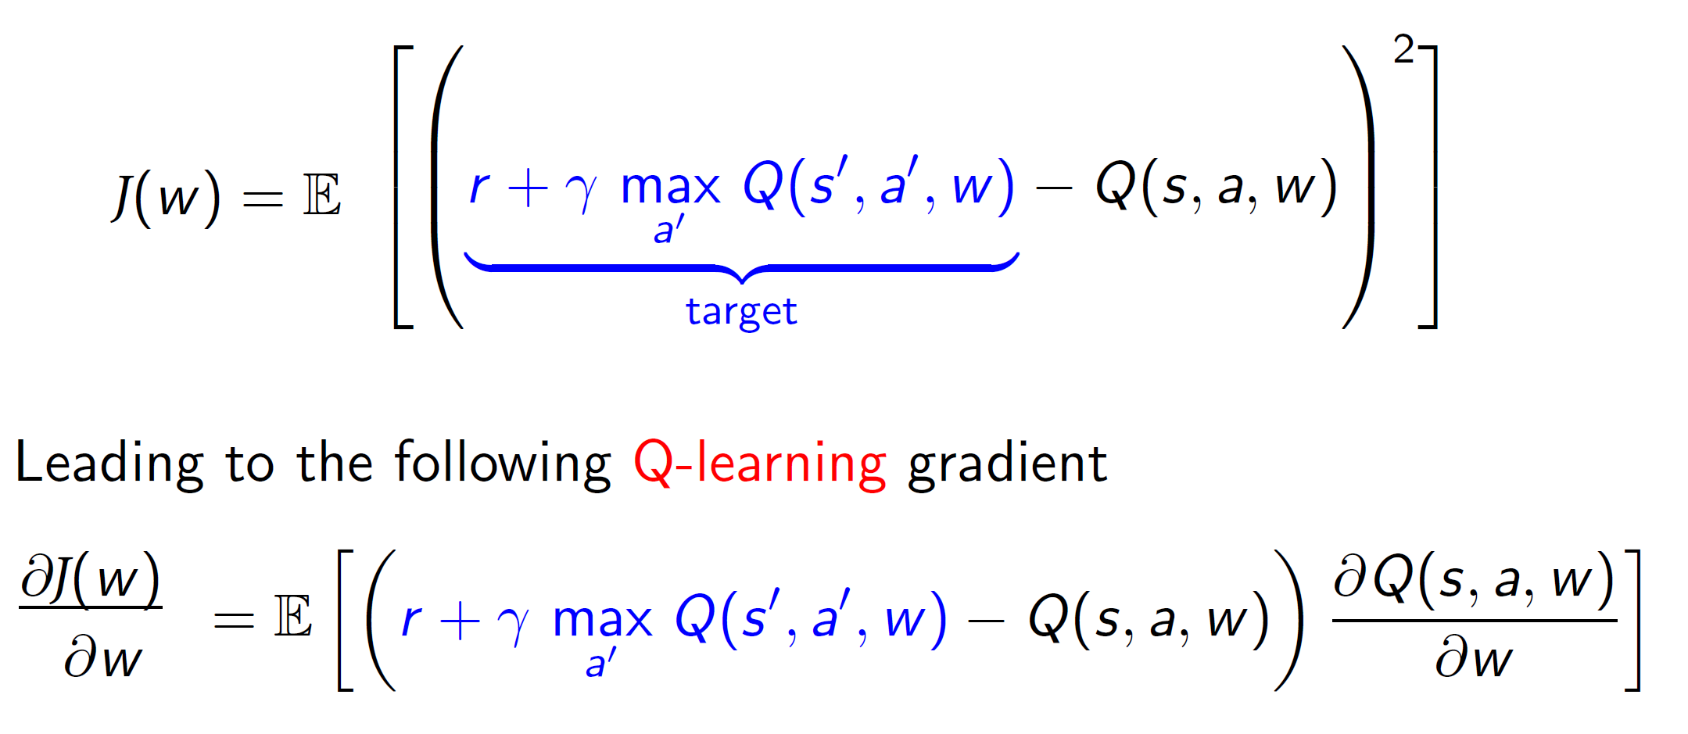
Supervised SGD (lec2) vs Q-Learning SGD
SGD update assuming supervision
SGD update for Q-Learning
David Silver’s Deep Learning Tutorial, ICML 2016

Slide 21
Training tricks
Issues:
Data is sequential
Successive samples are correlated, non-iid
An experience is visited only once in online learning
Policy changes rapidly with slight changes to Q-values
Policy may oscillate
Mnih, Volodymyr, et al. "Human-level control through deep reinforcement learning." Nature 518.7540 (2015): 529-533.

Slide 22
Training tricks
Issues:
Data is sequential
Successive samples are correlated, non-iid
An experience is visited only once in online learning
Mnih, Volodymyr, et al. "Human-level control through deep reinforcement learning." Nature 518.7540 (2015): 529-533.

Slide 23
Training tricks
Issues:
Data is sequential
Successive samples are correlated, non-iid
An experience is visited only once in online learning
Solution: ‘Experience Replay’ : Work on a dataset - Sample randomly and repeatedly
Build dataset
Take action a_{t} according to 𝛆-greedy policy
Store transition/experience (s_{t} , a_{t} ,r_{t+1},s_{t+1}) in dataset D (‘replay memory’)
Sample randomly mini-batch (32 experiences) of (s, a, r, s’)) from D
Mnih, Volodymyr, et al. "Human-level control through deep reinforcement learning." Nature 518.7540 (2015): 529-533.
Notes:
Animate the dataset buildup Text remove

Slide 24
Training tricks
Issues:
Data is sequential
Successive samples are correlated, non-iid
An experience is visited only once in online learning
Solution: ‘Experience Replay’ : Work on a dataset - Sample randomly and repeatedly
Build dataset
Take action a_{t} according to 𝛆-greedy policy
Store transition/experience (s_{t} , a_{t} ,r_{t+1},s_{t+1}) in dataset D (‘replay memory’)
Sample randomly mini-batch (32 experiences) of (s, a, r, s’)) from D
Mnih, Volodymyr, et al. "Human-level control through deep reinforcement learning." Nature 518.7540 (2015): 529-533.
Notes:
Animate the dataset buildup Text remove

Slide 25
Training tricks
Issues:
Data is sequential Experience replay
Successive samples are correlated, non-iid
An experience is visited only once in online learning
Policy changes rapidly with slight changes to Q-values
Policy may oscillate
Mnih, Volodymyr, et al. "Human-level control through deep reinforcement learning." Nature 518.7540 (2015): 529-533.

Slide 26
Training tricks
Network 1
Issues:
Data is sequential Experience replay
Successive samples are correlated, non-iid
An experience is visited only once in online learning
Policy changes rapidly with slight changes to Q-values
Policy may oscillate
Solution: ‘Target Network’ : Stale updates
C step delay between update of Q and its use as targets
Tells me Q(s,a) targets
(w_{i -1})
Network 2
Q values are updated every SGD step
(w_{i} )
Mnih, Volodymyr, et al. "Human-level control through deep reinforcement learning." Nature 518.7540 (2015): 529-533.
WikiCommons [Img link]

Slide 27
Training tricks
Network 1
Issues:
Data is sequential Experience replay
Successive samples are correlated, non-iid
An experience is visited only once in online learning
Policy changes rapidly with slight changes to Q-values
Policy may oscillate
Solution: ‘Target Network’ : Stale updates
C step delay between update of Q and its use as targets
Tells me Q(s,a) targets
(w_{i} )
After 10,000 SGD updates
Network 2
Q values are updated every SGD step
(w_{i +1})
Mnih, Volodymyr, et al. "Human-level control through deep reinforcement learning." Nature 518.7540 (2015): 529-533.
WikiCommons [Img link]

Slide 28
Training tricks
Issues:
Data is sequential Experience replay
Successive samples are correlated, non-iid
An experience is visited only once in online learning
Policy changes rapidly with slight changes to Q-values Target Network
Policy may oscillate
Mnih, Volodymyr, et al. "Human-level control through deep reinforcement learning." Nature 518.7540 (2015): 529-533.
Notes:
Remove clipped rewards

Slide 29
Training tricks
Issues:
Data is sequential Experience replay
Successive samples are correlated, non-iid
An experience is visited only once in online learning
Policy changes rapidly with slight changes to Q-values Target Network
Policy may oscillate
Mnih, Volodymyr, et al. "Human-level control through deep reinforcement learning." Nature 518.7540 (2015): 529-533.
Notes:
Remove clipped rewards

Slide 30
DQN: Results
Why not just use VGGNet features?
Mnih, Volodymyr, et al. "Human-level control through deep reinforcement learning." Nature 518.7540 (2015): 529-533.
Notes:
Remove TSne

Slide 31
DQN: Results
Mnih, Volodymyr, et al. "Human-level control through deep reinforcement learning." Nature 518.7540 (2015): 529-533.
Notes:
Training data trivia

Slide 32
Today’s takeaways
Bonus RL recap
Functional Approximation
Deep Q Network
Double Deep Q Network
Dueling Networks
Recurrent DQN
Solving “Doom”
Hierarchical DQN

Slide 33
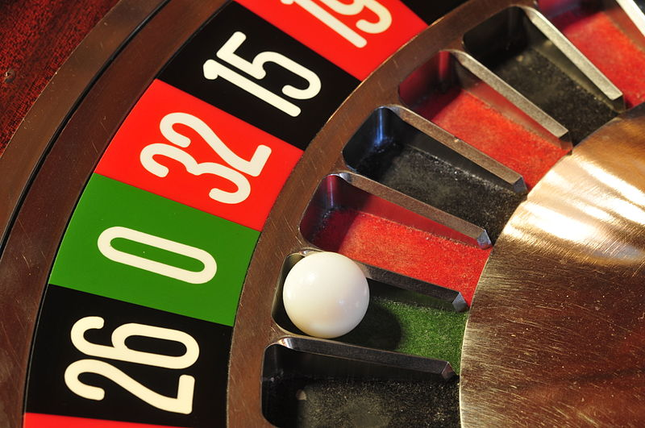
Q-Learning for Roulette
Hasselt, Hado V. "Double Q-learning." In Advances in Neural Information Processing Systems, pp. 2613-2621. 2010.
https://en.wikipedia.org/wiki/File:13-02-27-spielbank-wiesbaden-by-RalfR-094.jpg

Slide 34
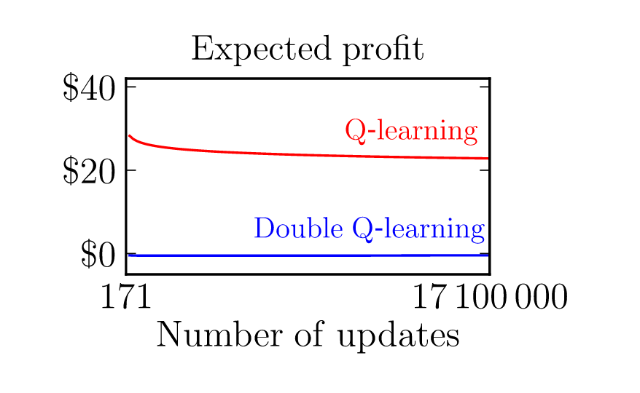
Q-Learning for Roulette
Hasselt, Hado V. "Double Q-learning." In Advances in Neural Information Processing Systems, pp. 2613-2621. 2010.
https://en.wikipedia.org/wiki/File:13-02-27-spielbank-wiesbaden-by-RalfR-094.jpg

Slide 35
Q-Learning for Roulette
Hasselt, Hado V. "Double Q-learning." In Advances in Neural Information Processing Systems, pp. 2613-2621. 2010.
https://en.wikipedia.org/wiki/File:13-02-27-spielbank-wiesbaden-by-RalfR-094.jpg

Slide 36
Q-Learning Overestimation : Function Approximation
Q Estimate
Actual Q Value
Van Hasselt, Hado, Arthur Guez, and David Silver. "Deep Reinforcement Learning with Double Q-Learning." In AAAI, pp. 2094-2100. 2016.

Slide 37
Q-Learning Overestimation : Function Approximation
Van Hasselt, Hado, Arthur Guez, and David Silver. "Deep Reinforcement Learning with Double Q-Learning." In AAAI, pp. 2094-2100. 2016.

Slide 38
One (Estimator) Isn’t Good Enough?

Slide 39
One (Estimator) Isn’t Good Enough?
Use Two.
https://pbs.twimg.com/media/C5ymV2tVMAYtAev.jpg

Slide 40
Double Q-Learning
Two estimators:
Estimator Q₁ : Obtain best action
Estimator Q₂ : Evaluate Q for the above action
Chances of both estimators overestimating at same action is lesser
Van Hasselt, Hado, Arthur Guez, and David Silver. "Deep Reinforcement Learning with Double Q-Learning." In AAAI, pp. 2094-2100. 2016.
Notes:
Q1 and Q2 everywhere
Use DQN network image in rectangle

Slide 41
Double Q-Learning
Two estimators:
Estimator Q₁ : Obtain best action
Estimator Q₂ : Evaluate Q for the above action
Q Target
Van Hasselt, Hado, Arthur Guez, and David Silver. "Deep Reinforcement Learning with Double Q-Learning." In AAAI, pp. 2094-2100. 2016.
Notes:
Q1 and Q2 everywhere
Use DQN network image in rectangle

Slide 42
Double Q-Learning
Two estimators:
Estimator Q₁ : Obtain best action
Estimator Q₂ : Evaluate Q for the above action
Q Target
Double Q Target
Van Hasselt, Hado, Arthur Guez, and David Silver. "Deep Reinforcement Learning with Double Q-Learning." In AAAI, pp. 2094-2100. 2016.
Notes:
Q1 and Q2 everywhere
Use DQN network image in rectangle

Slide 43
Double Q-Learning
Two estimators:
Estimator Q₁ : Obtain best action
Estimator Q₂ : Evaluate Q for the above action
Q1
Q2
Van Hasselt, Hado, Arthur Guez, and David Silver. "Deep Reinforcement Learning with Double Q-Learning." In AAAI, pp. 2094-2100. 2016.
Notes:
Q1 and Q2 everywhere
Use DQN network image in rectangle

Slide 44
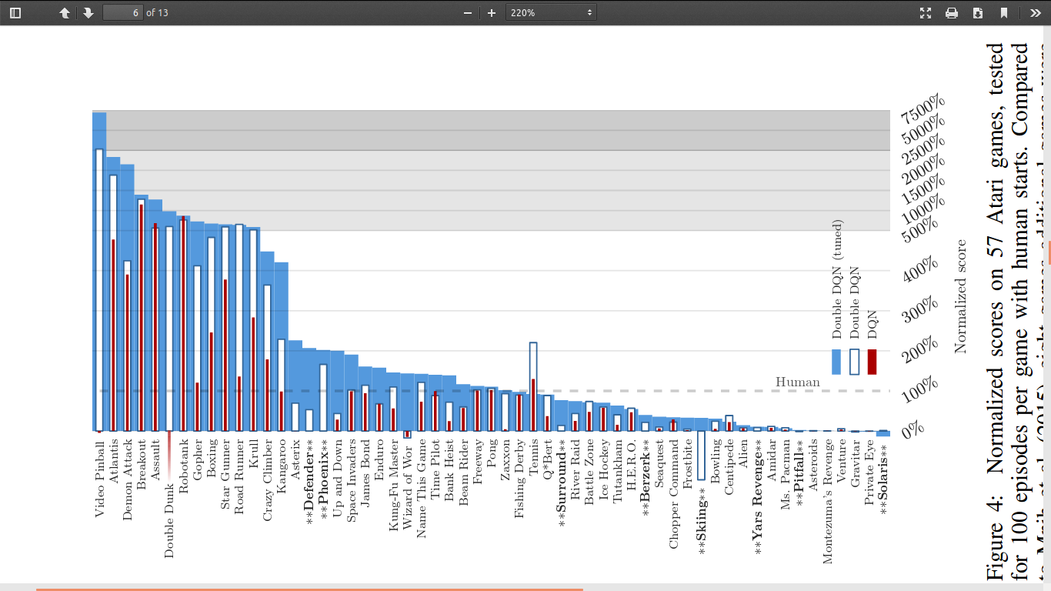
Results - All Atari Games
Van Hasselt, Hado, Arthur Guez, and David Silver. "Deep Reinforcement Learning with Double Q-Learning." In AAAI, pp. 2094-2100. 2016.

Slide 45
Results - Solves Overestimations
Van Hasselt, Hado, Arthur Guez, and David Silver. "Deep Reinforcement Learning with Double Q-Learning." In AAAI, pp. 2094-2100. 2016.

Slide 46
Today’s takeaways
Bonus RL recap
Functional Approximation
Deep Q Network
Double Deep Q Network
Dueling Networks
Recurrent DQN
Solving “Doom”
Hierarchical DQN

Slide 47
Pong - Up or Down
Mnih, Volodymyr, et al. "Human-level control through deep reinforcement learning." Nature 518.7540 (2015): 529-533.

Slide 48
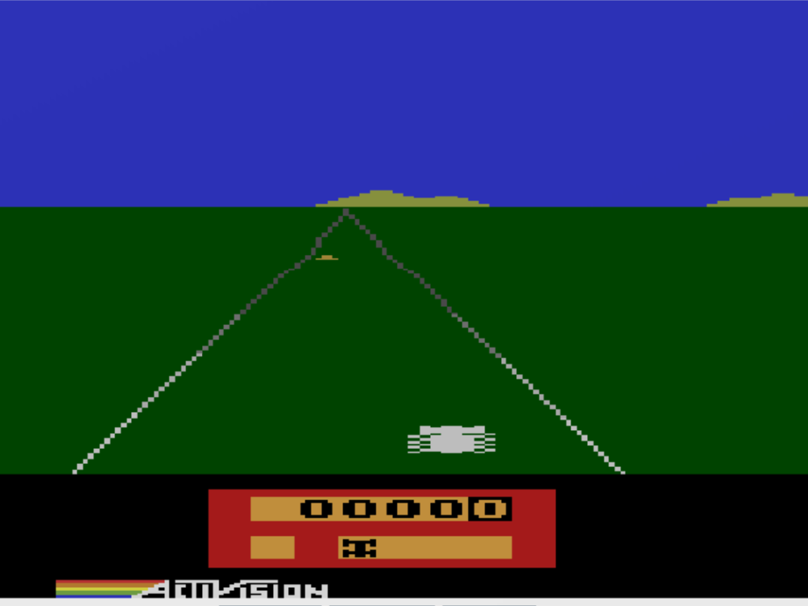
Enduro - Left or Right?
http://img.vivaolinux.com.br/imagens/dicas/comunidade/Enduro.png

Slide 49
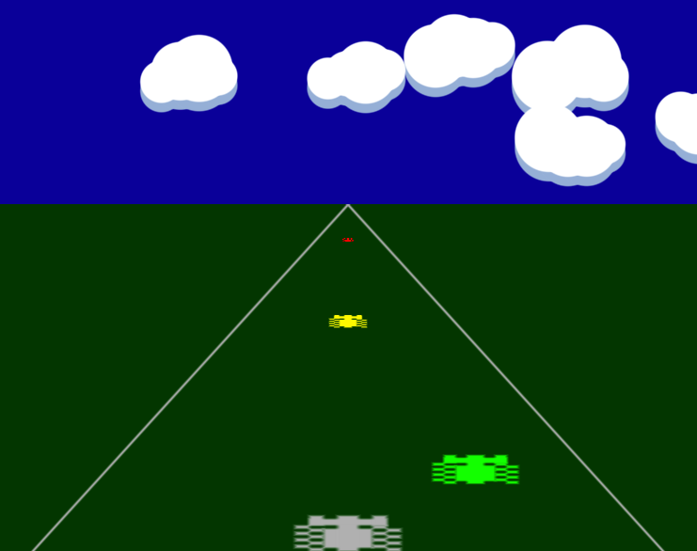
Enduro - Left or Right?
http://twolivesleft.com/Codea/User/enduro.png

Slide 50
Advantage Function
Learning action values ≈ Inherently learning both state values and relative value of the action in that state!
We can use this to help generalize learning for the state values.
Wang, Ziyu, Tom Schaul, Matteo Hessel, Hado van Hasselt, Marc Lanctot, and Nando de Freitas. "Dueling network architectures for deep reinforcement learning." arXiv preprint arXiv:1511.06581 (2015).

Slide 51
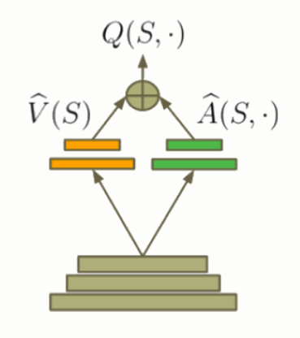
Dueling Architecture
Aggregating Module
http://torch.ch/blog/2016/04/30/dueling_dqn.html

Slide 52
Dueling Architecture
Aggregating Module
http://torch.ch/blog/2016/04/30/dueling_dqn.html

Slide 53
Dueling Architecture
Aggregating Module
http://torch.ch/blog/2016/04/30/dueling_dqn.html

Slide 54
Results
Where does V(s) attend to?
Where does A(s,a) attend to?
Wang, Ziyu, Tom Schaul, Matteo Hessel, Hado van Hasselt, Marc Lanctot, and Nando de Freitas. "Dueling network architectures for deep reinforcement learning." arXiv preprint arXiv:1511.06581 (2015).

Slide 55
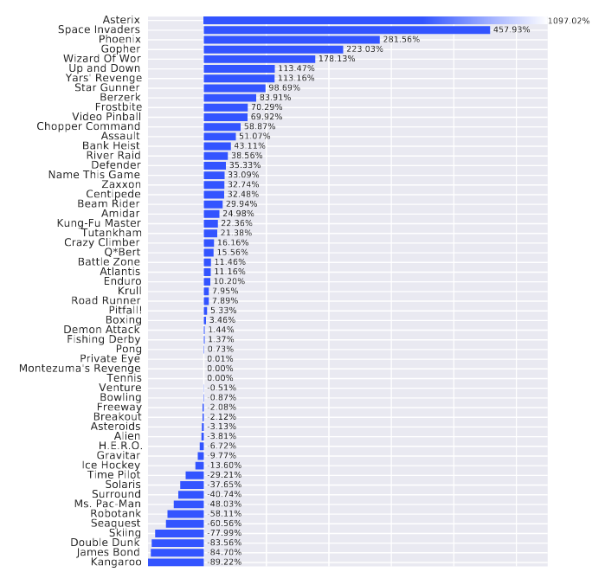
Results
Improvements of dueling architecture over Prioritized DDQN baseline measured by metric above over 57 Atari games
Wang, Ziyu, Tom Schaul, Matteo Hessel, Hado van Hasselt, Marc Lanctot, and Nando de Freitas. "Dueling network architectures for deep reinforcement learning." arXiv preprint arXiv:1511.06581 (2015).

Slide 56
Today’s takeaways
Bonus RL recap
Functional Approximation
Deep Q Network
Double Deep Q Network
Dueling Networks
Recurrent DQN
Solving “Doom”
Hierarchical DQN

Slide 57
Moving to more General and Complex Games
All games may not be representable using MDPs; some may be POMDPs
FPS shooter games
Scrabble
Even Atari games
Entire history a solution?

Slide 58
Moving to more General and Complex Games
All games may not be representable using MDPs; some may be POMDPs
FPS shooter games
Scrabble
Even Atari games
Entire history a solution?
LSTMs !

Slide 59
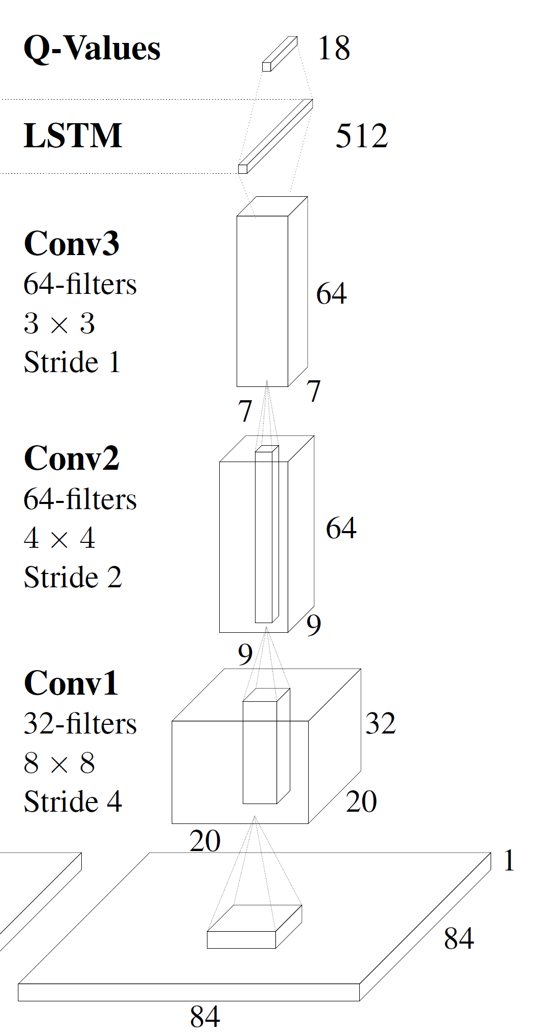
Deep Recurrent Q-Learning
FC
Hausknecht, Matthew, and Peter Stone. "Deep recurrent q-learning for partially observable mdps." arXiv preprint arXiv:1507.06527 (2015).

Slide 60
Deep Recurrent Q-Learning
Hausknecht, Matthew, and Peter Stone. "Deep recurrent q-learning for partially observable mdps." arXiv preprint arXiv:1507.06527 (2015).

Slide 61
Deep Recurrent Q-Learning
h₁
h₂
h₃
Hausknecht, Matthew, and Peter Stone. "Deep recurrent q-learning for partially observable mdps." arXiv preprint arXiv:1507.06527 (2015).

Slide 62
DRQN Results
Misses
Hausknecht, Matthew, and Peter Stone. "Deep recurrent q-learning for partially observable mdps." arXiv preprint arXiv:1507.06527 (2015).

Slide 63
DRQN Results
Paddle Deflection
Hausknecht, Matthew, and Peter Stone. "Deep recurrent q-learning for partially observable mdps." arXiv preprint arXiv:1507.06527 (2015).

Slide 64
DRQN Results
Wall Deflections
Hausknecht, Matthew, and Peter Stone. "Deep recurrent q-learning for partially observable mdps." arXiv preprint arXiv:1507.06527 (2015).

Slide 65
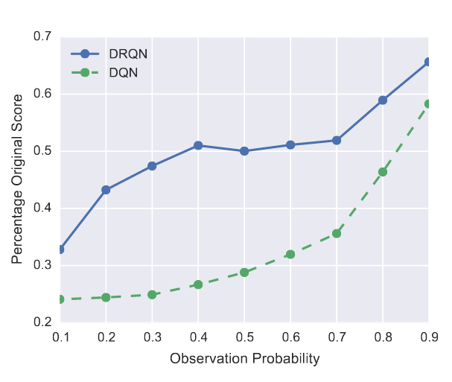
Results - Robustness to partial observability
Hausknecht, Matthew, and Peter Stone. "Deep recurrent q-learning for partially observable mdps." arXiv preprint arXiv:1507.06527 (2015).
POMDP
MDP

Slide 66
Today’s takeaways
Bonus RL recap
Functional Approximation
Deep Q Network
Double Deep Q Network
Dueling Networks
Recurrent DQN
Solving “Doom”
Hierarchical DQN

Slide 67
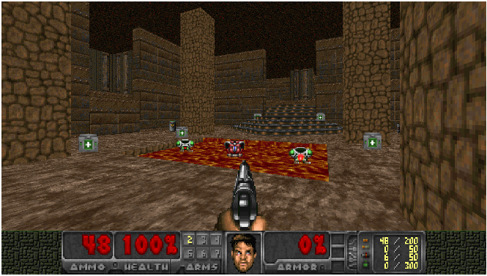
Application of DRQN: Playing ‘Doom’
Lample, Guillaume, and Devendra Singh Chaplot. "Playing FPS games with deep reinforcement learning."
Notes:
Mention here about differences wrt Atari Games.
2d environment and visual game frames as input where FPS is a 3d
Hence atari games have full knowledge about the current state of environment , not so much the case with this game. We have partially observable states for this game
This game involves various skills : navigating through a map to collect items, find enemies and killing enemies,
First person perspective and thus more suitable for real world robotics applications

Slide 68
Doom Demo

Slide 69
How does DRQN help ?
Observe o_{t} instead of s_{t}
Limited field of view
Instead of estimating Q(s_{t}, a_{t}), estimate Q(h_{t,}a_{t}) where h_{t} = LSTM(h_{t-1},o_{t})

Slide 70
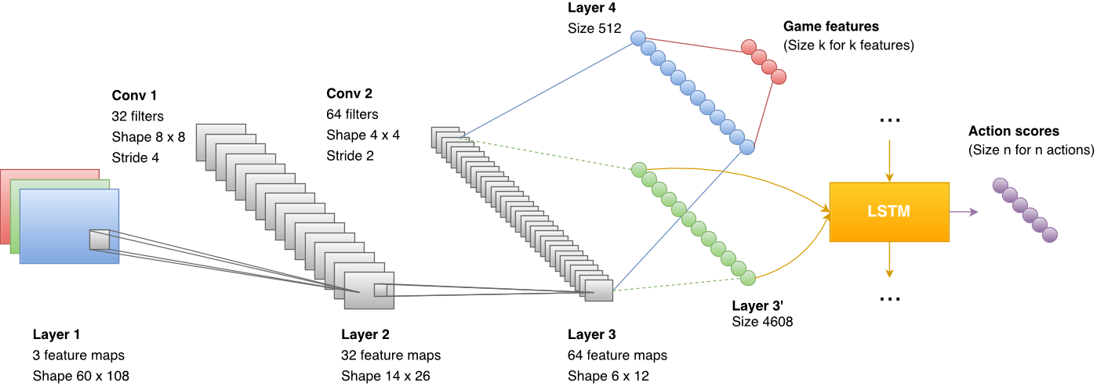
Architecture: Comparison with Baseline DRQN
Notes:
Here compare it with baseline DRQN model.
Baseline performed well on simpler scenarios , turn or attack but not deathmatches (here objective is to maximize the number of kills by agent/player
It was just waiting for an enemy to come under their lines of fire
Explain baseline drqn a bit : output of CNNs is given to LSTM that predicts a score for each action based on current frame and its hidden state.
Detect entities using ViZDoom environment APIs during Training
Two Fully Connected Layers of size 512 and k (number of game features/entities we want to detect)
Loss function is combination of normal DRQN cost and cross entropy cost

Slide 71
Training Tricks
Jointly training DRQN model and game feature detection
Notes:
Sharing convultion layers between predicting game features and Q learning objective
Faster training
Important information about features captured based on what actions are optimal if such features are present instead of independently learning about these features like in an object detection problem (confirm with Unnat) and then providing them as input to LSTM

Slide 72
Training Tricks
Jointly training DRQN model and game feature detection
What do you think is the advantage of this ?
Notes:
Sharing convultion layers between predicting game features and Q learning objective
Faster training
Important information about features captured based on what actions are optimal if such features are present instead of independently learning about these features like in an object detection problem (confirm with Unnat) and then providing them as input to LSTM

Slide 73
Training Tricks
Jointly training DRQN model and game feature detection
What do you think is the advantage of this ?
CNN layers capture relevant information about features of the game that maximise action value scores
Notes:
Sharing convultion layers between predicting game features and Q learning objective
Faster training
Important information about features captured based on what actions are optimal if such features are present instead of independently learning about these features like in an object detection problem (confirm with Unnat) and then providing them as input to LSTM

Slide 74
Modular Architecture
Enemy spotted
Action Network (DRQN)
All clear!
Notes:
Navigation phase only requires three actions (move forward, turn left and turn right) )

Slide 75
Modular Architecture
DRQN
Enemy spotted
Action Network (DRQN)
All clear!
DQN
Notes:
Navigation phase only requires three actions (move forward, turn left and turn right) )

Slide 76
Modular Network : Advantages
Can be trained and tested independently
Both can be trained in parallel
Reduces the state-action pairs space : Faster Training
Mitigates camper behavior : “Tendency to stay in one area of the map and wait for enemies”
Notes:
Navigation phase only requires three actions (move forward, turn left and turn right) )

Slide 77
Rewards Formulation for DOOM
What do you think ?
Notes:
Small intermediate rewards for shaping the reward function

Slide 78
Rewards Formulation for DOOM
What do you think ?
Positive rewards for Kills and Negative rewards for suicides
Small Intermediate Rewards :
Positive Reward for object pickup
Negative Reward for losing health
Negative Reward for shooting or losing ammo
Small Positive Rewards proportional to the distance travelled since last step (Agent avoids running in circles)
Notes:
Small intermediate rewards for shaping the reward function
(health, weapons and ammo)
(attacked by enemies or walking on lava)

Slide 79
Performance with Separate Navigation Network
Notes:
Navigation phase only requires three actions (move forward, turn left and turn right) )

Slide 80
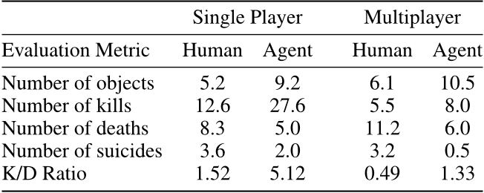
Results

Slide 81
Today’s takeaways
Bonus RL recap
Functional Approximation
Deep Q Network
Double Deep Q Network
Dueling Networks
Recurrent DQN
Solving “Doom”
Hierarchical DQN

Slide 82
h-DQN

Slide 83
Double DQN
Van Hasselt, Hado, Arthur Guez, and David Silver. "Deep Reinforcement Learning with Double Q-Learning." In AAAI, pp. 2094-2100. 2016.

Slide 84
Dueling Networks
Van Hasselt, Hado, Arthur Guez, and David Silver. "Deep Reinforcement Learning with Double Q-Learning." In AAAI, pp. 2094-2100. 2016.

Slide 85
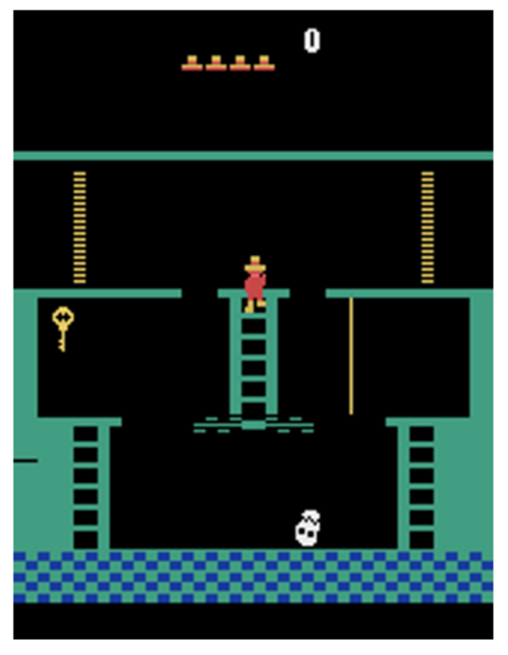
How is this game different ?
Complex Game Environment
Sparse and Longer Range Delayed Rewards
Insufficient Exploration : We need temporally extended exploration
Kulkarni, Tejas D., Karthik Narasimhan, Ardavan Saeedi and Joshua B. Tenenbaum. “Hierarchical Deep Reinforcement Learning: Integrating Temporal Abstraction and Intrinsic Motivation.” NIPS 2016
Notes:
Read more about this game??
Describe the rewards
Exploration is difficult because :
Your state space is huge and you get feedback after a long time
Epsilon greedy tends to be biased towards local exploration (in one subbranch of state space tree) give example of montezuma’s game, it might get stuck in the beginning
Hence this could take a very long time to explore every possible are of the environment
There are other methods also like Thompson Sampling and Boltzmann Exploration better than epsilon greedy but still they are impractical for complicated environments such as these (read more ?? )

Slide 86
How is this game different ?
Complex Game Environment
Sparse and Longer Range Delayed Rewards
Insufficient Exploration : We need temporally extended exploration
Dividing Extrinsic Goal into Hierarchical Intrinsic Subgoals
Notes:
Talk about Intrinsic Motivation here (Example like Acing the Class)
Read more about this game??
Exploration is difficult because :
Your state space is huge and you get feedback after a long time
Epsilon greedy tends to be biased towards local exploration (in one subbranch of state space tree) give example of montezuma’s game, it might get stuck in the beginning
Hence this could take a very long time to explore every possible are of the environment
There are other methods also like Thompson Sampling and Boltzmann Exploration better than epsilon greedy but still they are impractical for complicated environments such as these (read more ?? )

Slide 87
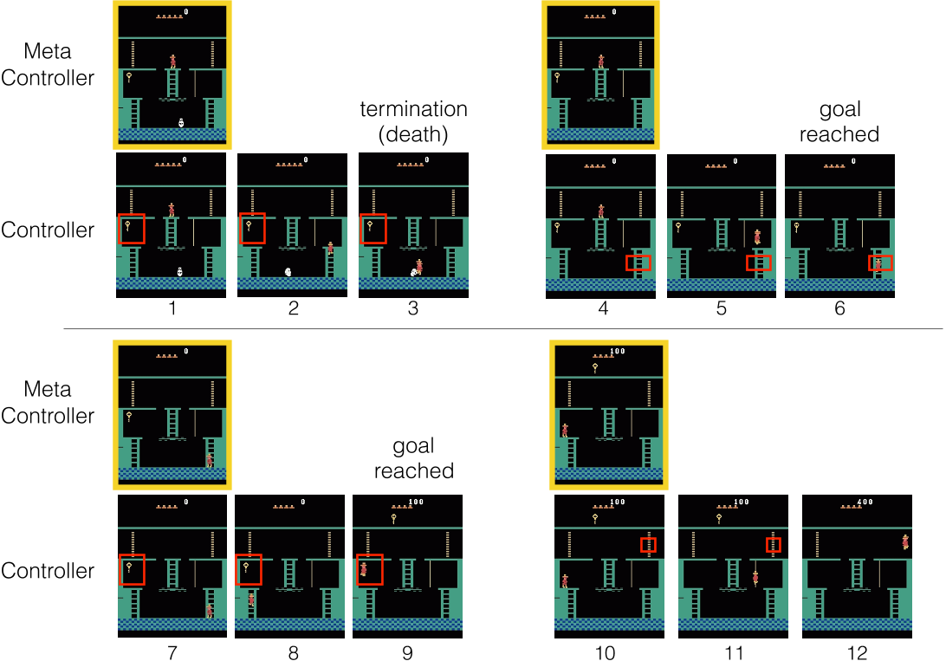
Intrinsic Goals in Montezuma’s Revenge
Kulkarni, Tejas D., Karthik Narasimhan, Ardavan Saeedi and Joshua B. Tenenbaum. “Hierarchical Deep Reinforcement Learning: Integrating Temporal Abstraction and Intrinsic Motivation.” NIPS 2016
Notes:
Goals are defined as functions over different entities/objects in the task

Slide 88
Hierarchy of DQNs
Environment
Agent

Slide 89
Hierarchy of DQNs
Environment
Agent

Slide 90
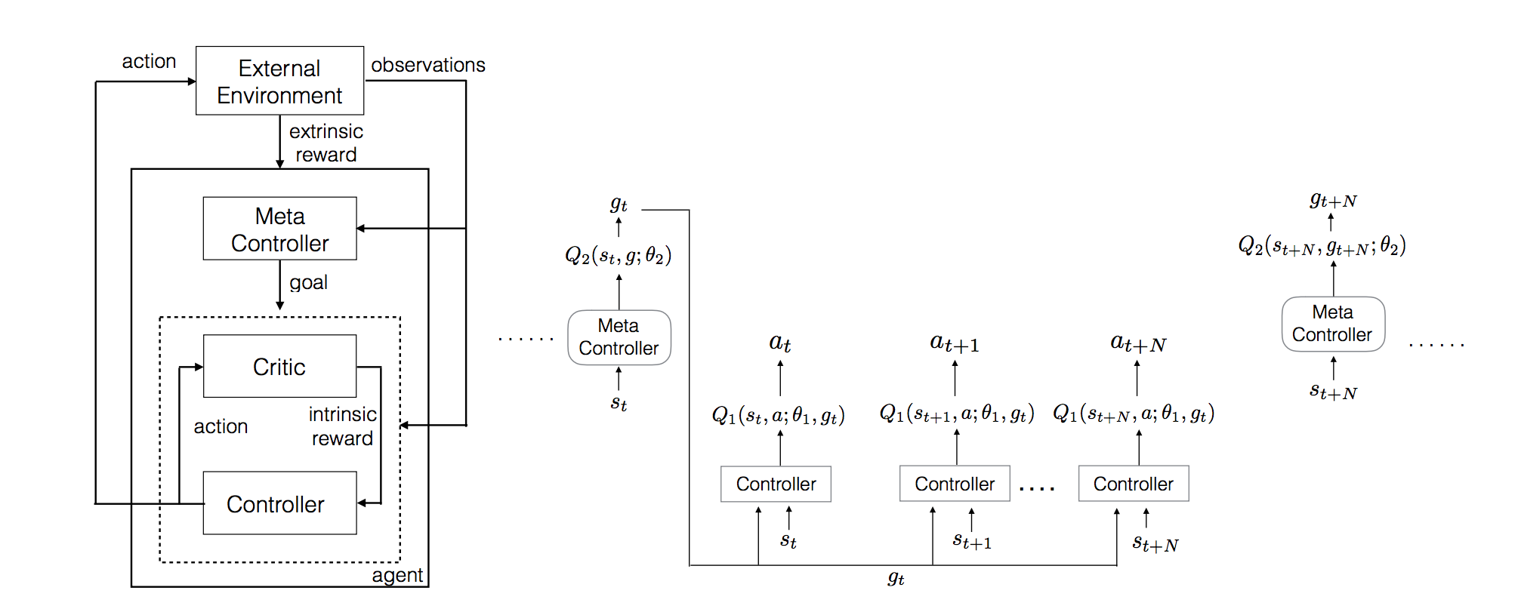
Architecture Block for h-DQN
Kulkarni, Tejas D., Karthik Narasimhan, Ardavan Saeedi and Joshua B. Tenenbaum. “Hierarchical Deep Reinforcement Learning: Integrating Temporal Abstraction and Intrinsic Motivation.” NIPS 2016
Notes:
Define Intrinsic Goals for a specific task (G)
A top-level q value function learns a policy over intrinsic goals
A lower-level q value function learns a policy over atomic actions to satisfy the given goals
Two Stage Hierarchy
Meta Controller
Receives a state s_{t} and chooses a goal g_{t} ∈ G to be achieved by the controller
Receives feedback from the Environment as usual, i.e., Extrinsic Reward f_{t}
Controller
Selects actions based on state s_{t} and goal g_{t}
The goal g_{t} remains in place for the next few time steps either until it is achieved or a terminal state is reached
Receives feedback from the internal critic, i.e. Intrinsic Reward r_{t} (g)
This is a binary reward based on whether a particular goal is achieved or not
This results in efficient exploration in the space of intrinsic goals

Slide 91
h-DQN Learning Framework (1)
V(s,g) : Value function of a state for achieving the given goal g ∈ G
Option :
A multi-step action policy to achieve these intrinsic goals g ∈ G
Can also be primitive actions
𝚷_{g} : Policy Over Options to achieve goal g
Agents learns
which Intrinsic goals are important
𝚷_{g}
correct sequence of such policies 𝚷_{g}
Kulkarni, Tejas D., Karthik Narasimhan, Ardavan Saeedi and Joshua B. Tenenbaum. “Hierarchical Deep Reinforcement Learning: Integrating Temporal Abstraction and Intrinsic Motivation.” NIPS 2016
Notes:
Why Semi-Markov Decision Process ?
For a given state

Slide 92
h-DQN Learning Framework (2)
Objective Function for Meta-Controller :
Maximise Cumulative Extrinsic Reward
F_{t} =
Objective Function for Controller :
Maximise Cumulative Intrinsic Reward
R_{t} =
Kulkarni, Tejas D., Karthik Narasimhan, Ardavan Saeedi and Joshua B. Tenenbaum. “Hierarchical Deep Reinforcement Learning: Integrating Temporal Abstraction and Intrinsic Motivation.” NIPS 2016
Notes:
Two DQN Networks learnt Q1 and Q2

Slide 93
Training
Two disjoint memories D₁ and D₂ for Experience Replay
Experiences (s_{t} , g_{t} , f_{t} , s_{t+N}) for Q₂ are stored in D₂
Experiences (s_{t} , a_{t} , g_{t} , r_{t} , s_{t+1}) for Q₁ are stored in D₁
Different time scales
Transitions from Controller (Q₁) are picked at every time step
Transitions from Meta-Controller (Q₂) are picked only when controller terminates on reaching the intrinsic goal or epsiode ends
Kulkarni, Tejas D., Karthik Narasimhan, Ardavan Saeedi and Joshua B. Tenenbaum. “Hierarchical Deep Reinforcement Learning: Integrating Temporal Abstraction and Intrinsic Motivation.” NIPS 2016

Slide 94
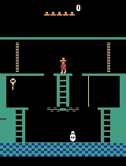
Results :
Kulkarni, Tejas D., Karthik Narasimhan, Ardavan Saeedi and Joshua B. Tenenbaum. “Hierarchical Deep Reinforcement Learning: Integrating Temporal Abstraction and Intrinsic Motivation.” NIPS 2016

Slide 95
Today’s takeaways
Bonus RL recap
Functional Approximation
Deep Q Network
Double Deep Q Network
Dueling Networks
Recurrent DQN
Solving “Doom”
Hierarchical DQN

Slide 96
References
Basic RL
David Silver’s Introduction to RL lectures
Peter Abbeel’s Artificial Intelligence - Berkeley (Spring 2015)
DQN
Mnih, Volodymyr, et al. "Human-level control through deep reinforcement learning." Nature 518.7540 (2015): 529-533.
Mnih, Volodymyr, et al. "Playing atari with deep reinforcement learning." arXiv preprint arXiv:1312.5602 (2013).
DDQN
Hasselt, Hado V. "Double Q-learning." In Advances in Neural Information Processing Systems, pp. 2613-2621. 2010.
Van Hasselt, Hado, Arthur Guez, and David Silver. "Deep Reinforcement Learning with Double Q-Learning." In AAAI, pp. 2094-2100. 2016.
Dueling DQN
Wang, Ziyu, Tom Schaul, Matteo Hessel, Hado van Hasselt, Marc Lanctot, and Nando de Freitas. "Dueling network architectures for deep reinforcement learning." arXiv preprint arXiv:1511.06581 (2015).

Slide 97
References
DRQN
Hausknecht, Matthew, and Peter Stone. "Deep recurrent q-learning for partially observable mdps." arXiv preprint arXiv:1507.06527 (2015).
Doom
Lample, Guillaume, and Devendra Singh Chaplot. "Playing FPS games with deep reinforcement learning."
h-DQN
Kulkarni, Tejas D., Karthik Narasimhan, Ardavan Saeedi and Joshua B. Tenenbaum. “Hierarchical Deep Reinforcement Learning: Integrating Temporal Abstraction and Intrinsic Motivation.” NIPS 2016
Additional NLP/Vision applications
Narasimhan, Karthik, Tejas Kulkarni, and Regina Barzilay. "Language understanding for text-based games using deep reinforcement learning." EMNLP 20155
Caicedo, Juan C., and Svetlana Lazebnik. "Active object localization with deep reinforcement learning." Proceedings of the IEEE International Conference on Computer Vision. 2015.
Zhu, Yuke, et al. "Target-driven visual navigation in indoor scenes using deep reinforcement learning." arXiv preprint arXiv:1609.05143 (2016).

Slide 98
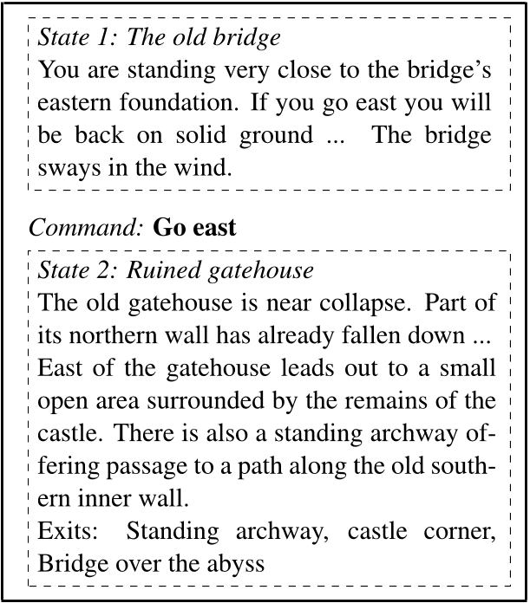
Deep Q Learning for text-based games
Narasimhan, Karthik, Tejas Kulkarni, and Regina Barzilay. "Language understanding for text-based games using deep reinforcement learning." EMNLP 2015

Slide 99
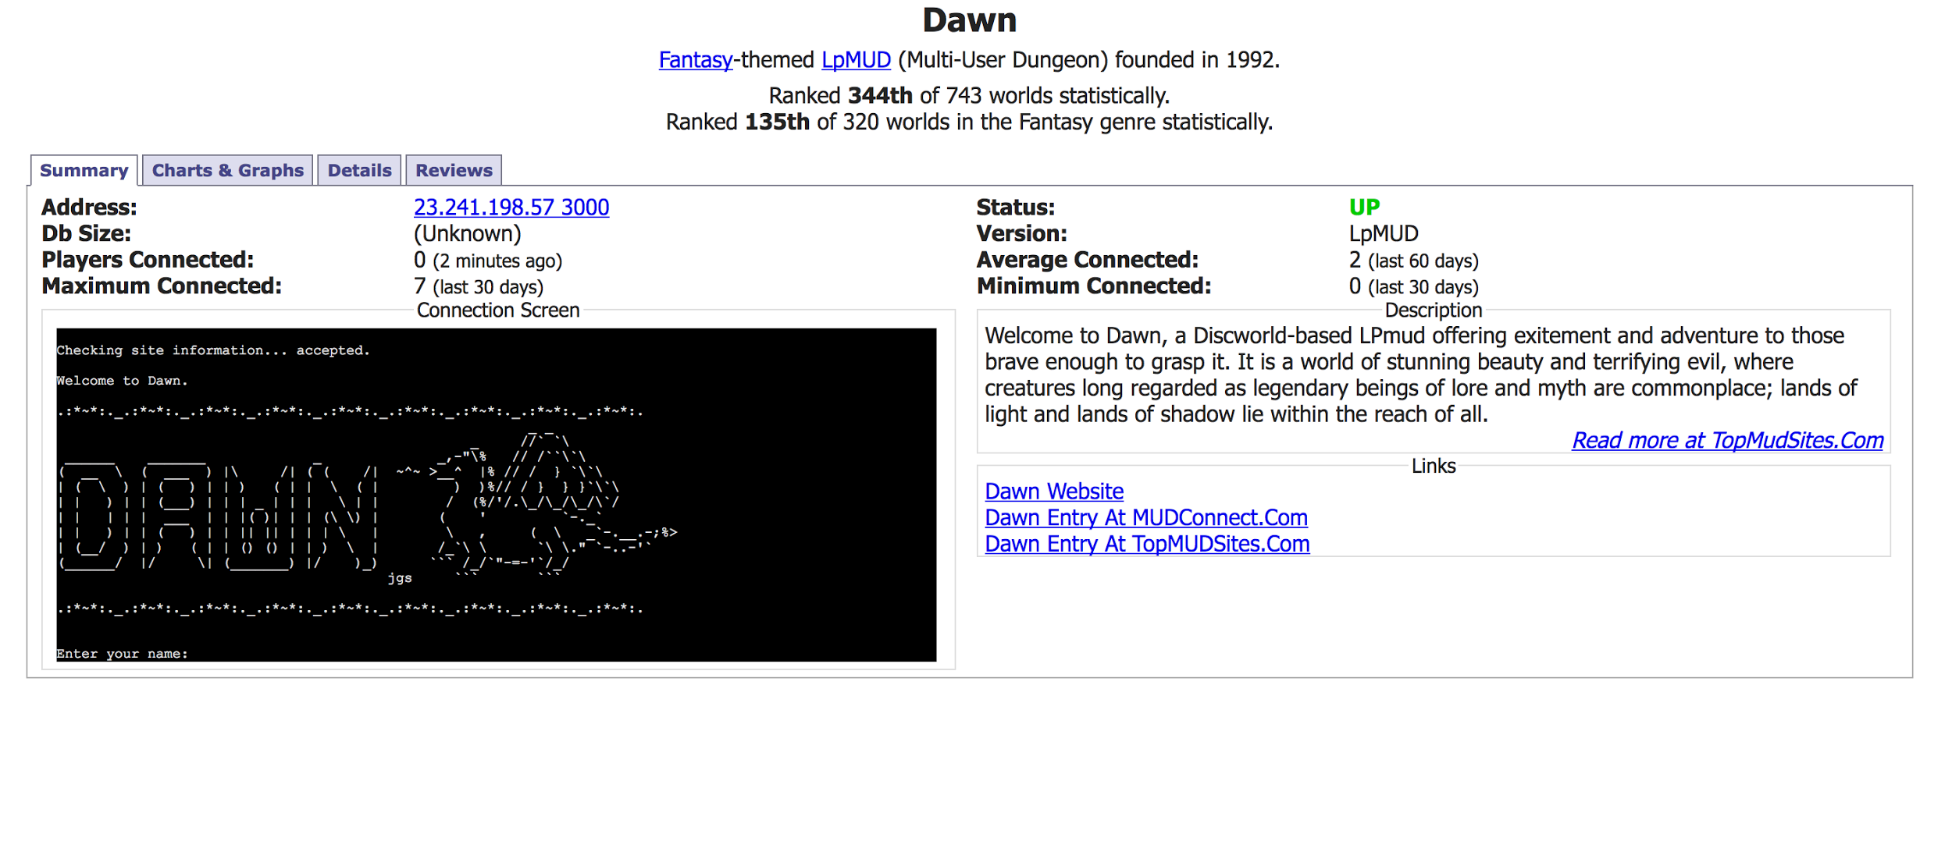
Text Based Games : Back in 1970’s
Predecessors to Modern Graphical Games
MUD (Multi User Dungeon Games) still prevalent
Narasimhan, Karthik, Tejas Kulkarni, and Regina Barzilay. "Language understanding for text-based games using deep reinforcement learning." EMNLP 2015
Notes:
Interactions in the virtual world through text
Example Applications like interpreting help documentation for software or robotic navigation with directions in human language

Slide 100
State Spaces and Action Spaces
Hidden state space h ∈ H but given textual description
{ ψ : H ➡ S}
Actions are commands (action-object pairs) A = {(a,o)}
T_{hh’}^{(a,o)} : Transition Probabilities
Jointly learn state representations and control policies as learned Strategy/Policy directly builds on the text interpretation
Narasimhan, Karthik, Tejas Kulkarni, and Regina Barzilay. "Language understanding for text-based games using deep reinforcement learning." EMNLP 2015

Slide 101
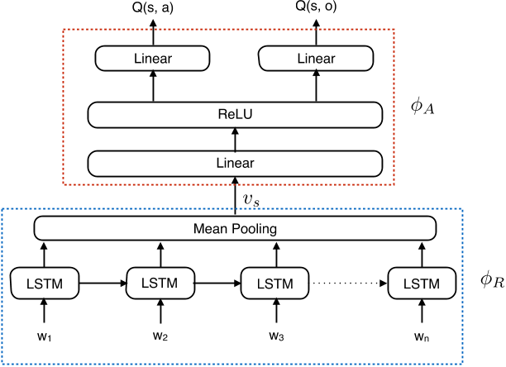
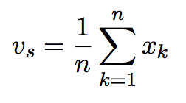
Learning Representations and Control Policies
Narasimhan, Karthik, Tejas Kulkarni, and Regina Barzilay. "Language understanding for text-based games using deep reinforcement learning." EMNLP 2015
Notes:
Representation Generator
LSTM Network to take sequences of words in the state description as input
Final state representation v_{s} by Mean Pooling of the output vectors x_{k}
Action Scorer
Produces Q scores for the set of all possible action-object pairs predicted simultaneously
Trained using DQN with Prioritised Sampling
Advantages of Decomposing into Two Modules :
The learnt representations can be used to new game scenarios
Mean pooling leads to faster learning
Didnt understand the average concept while looking at actions and objects --- ?

Slide 102
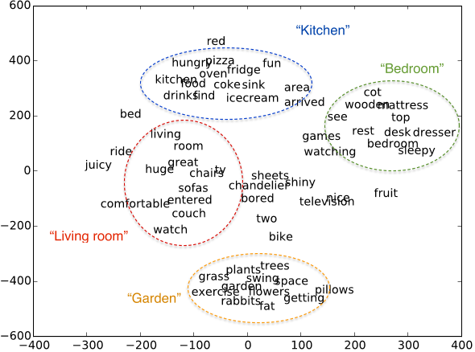
Results (1) :
Learnt Useful Representations for the Game
Narasimhan, Karthik, Tejas Kulkarni, and Regina Barzilay. "Language understanding for text-based games using deep reinforcement learning." EMNLP 2015

Slide 103
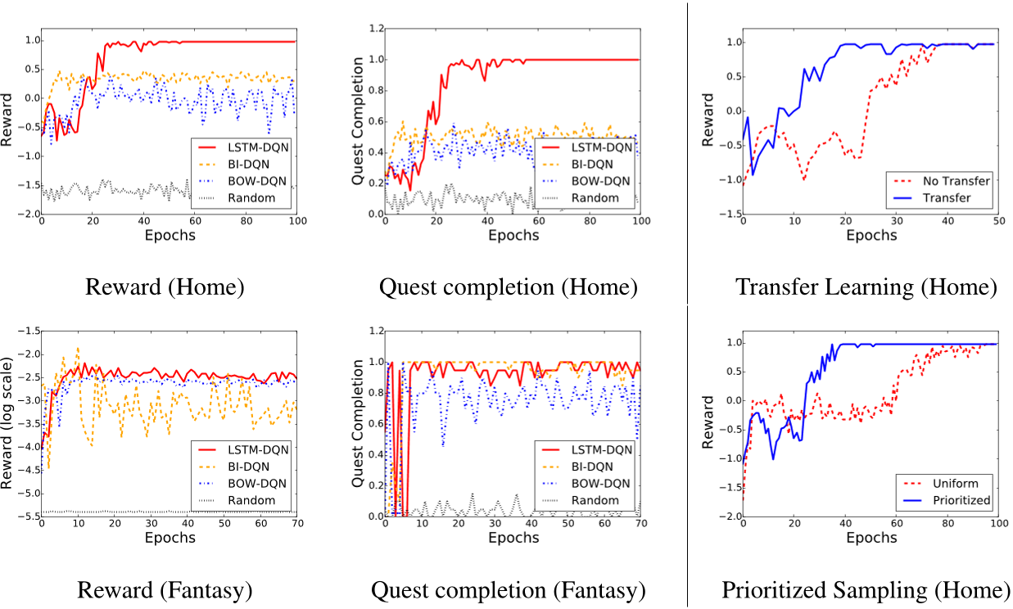
Results (2) :
Narasimhan, Karthik, Tejas Kulkarni, and Regina Barzilay. "Language understanding for text-based games using deep reinforcement learning." EMNLP 2015

Slide 104
Today’s takeaways
Bonus RL recap
Functional Approximation
Deep Q Network
Double Deep Q Network
Dueling Networks
Recurrent DQN
Solving “Doom”
Hierarchical DQN
More applications:
Text based games
Object Detection
Indoor Navigation

Slide 105
Object Detection as a RL problem?
States:
Actions:

Slide 106
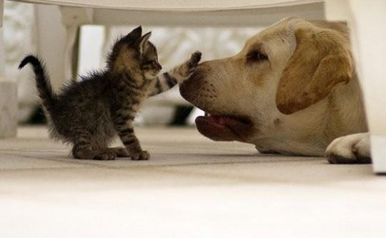
Object detection as a RL problem?
States:
Actions:
[image-link]

Slide 107
Object detection as a RL problem?
States:
Actions:
[image-link]

Slide 108
Object detection as a RL problem?
States:
Actions:
[image-link]

Slide 109
Object detection as a RL problem?
States:
Actions:
[image-link]

Slide 110
Object detection as a RL problem?
States:
Actions:
[image-link]

Slide 111
Object detection as a RL problem?
States:
Actions: - c*(x2-x1) , c*(y2-y1) relative translation - scale - aspect ratio - trigger when IoU is high
[image-link]
[image-link]
J. Caicedo and S. Lazebnik, ICCV 2015

Slide 112
Object detection as a RL problem?
States: fc6 feature of pretrained VGG19
Actions: - c*(x2-x1) , c*(y2-y1) relative translation - scale - aspect ratio - trigger when IoU is high
[image-link]
J. Caicedo and S. Lazebnik, ICCV 2015

Slide 113
Object detection as a RL problem?
States: fc6 feature of pretrained VGG19
Actions: - c*(x2-x1) , c*(y2-y1) relative translation - scale - aspect ratio - trigger when IoU is high
Reward:
[image-link]
J. Caicedo and S. Lazebnik, ICCV 2015

Slide 114
Object detection as a RL problem?
States: fc6 feature of pretrained VGG19
Actions: - c*(x2-x1) , c*(y2-y1) relative translation - scale - aspect ratio - trigger when IoU is high
Reward:
[image-link]
J. Caicedo and S. Lazebnik, ICCV 2015

Slide 115
Object detection as a RL problem?
Q(s,a₁=scale up)
State(s) Current bounding box
Q(s,a₂=scale down)
Q(s,a₃=shift left)
Q(s,a₉=trigger)
J. Caicedo and S. Lazebnik, ICCV 2015

Slide 116
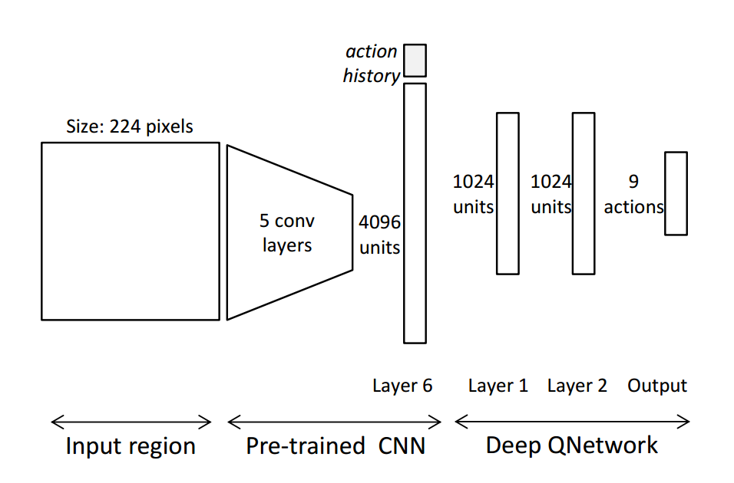
Object detection as a RL problem?
Q(s,a₁=scale up)
State(s) Current bounding box
Q(s,a₂=scale down)
Q(s,a₃=shift left)
Q(s,a₉=trigger)
J. Caicedo and S. Lazebnik, ICCV 2015

Slide 117
Object detection as a RL problem?
History
Q(s,a₁=scale up)
State(s) Current bounding box
Q(s,a₂=scale down)
Q(s,a₃=shift left)
Q(s,a₉=trigger)
J. Caicedo and S. Lazebnik, ICCV 2015

Slide 118
Object detection as a RL problem?
Fine details: - Class specific, attention-action model - Does not follow a fixed sliding window trajectory, image dependent trajectory - Use 16 pixel neighbourhood to incorporate context
J. Caicedo and S. Lazebnik, ICCV 2015

Slide 119
Object detection as a RL problem?
J. Caicedo and S. Lazebnik, ICCV 2015

Slide 120
Today’s takeaways
Bonus RL recap
Functional Approximation
Deep Q Network
Double Deep Q Network
Dueling Networks
Recurrent DQN
Solving “Doom”
Hierarchical DQN
More applications:
Text based games
Object detection
Indoor Navigation

Slide 121
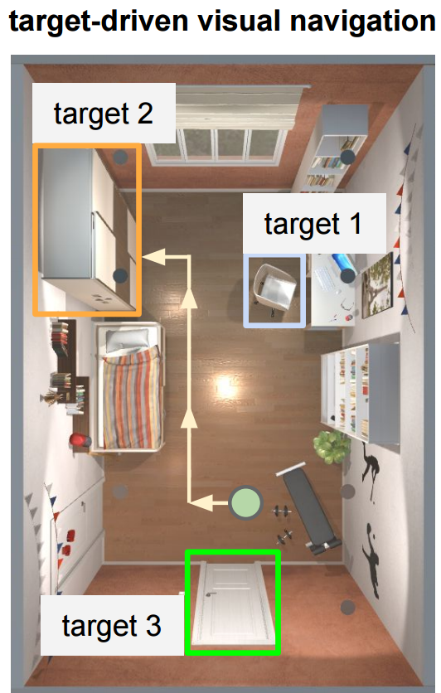
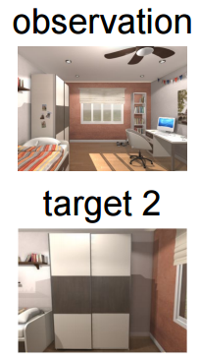
Navigation as a RL problem?
- States: - Actions:
“Target-driven Visual Navigation in Indoor Scenes using Deep Reinforcement Learning” Yuke Zhu, Roozbeh Mottaghi, Eric Kolve, Joseph J. Lim, Abhinav Gupta, Li Fei-Fei, Ali Farhadi

Slide 122
Navigation as a RL problem?
- States: ResNet-50 features - Actions:
“Target-driven Visual Navigation in Indoor Scenes using Deep Reinforcement Learning” Yuke Zhu, Roozbeh Mottaghi, Eric Kolve, Joseph J. Lim, Abhinav Gupta, Li Fei-Fei, Ali Farhadi

Slide 123
Navigation as a RL problem?
- States: ResNet-50 feature - Actions:
“Target-driven Visual Navigation in Indoor Scenes using Deep Reinforcement Learning” Yuke Zhu, Roozbeh Mottaghi, Eric Kolve, Joseph J. Lim, Abhinav Gupta, Li Fei-Fei, Ali Farhadi

Slide 124
Navigation as a RL problem?
- States: ResNet-50 feature - Actions: - Forward/backward 0.5 m - Turn left/right 90 deg - Trigger
“Target-driven Visual Navigation in Indoor Scenes using Deep Reinforcement Learning” Yuke Zhu, Roozbeh Mottaghi, Eric Kolve, Joseph J. Lim, Abhinav Gupta, Li Fei-Fei, Ali Farhadi

Slide 125
Navigation as a RL problem?
Q(s,a₁=forward)
State (s) Current frame and the target frame
Q(s,a₂=backward)
Q(s,a₃=turn left)
Q(s,a₂=turn right)
Q(s,a₆=trigger)
“Target-driven Visual Navigation in Indoor Scenes using Deep Reinforcement Learning” Yuke Zhu, Roozbeh Mottaghi, Eric Kolve, Joseph J. Lim, Abhinav Gupta, Li Fei-Fei, Ali Farhadi

Slide 126
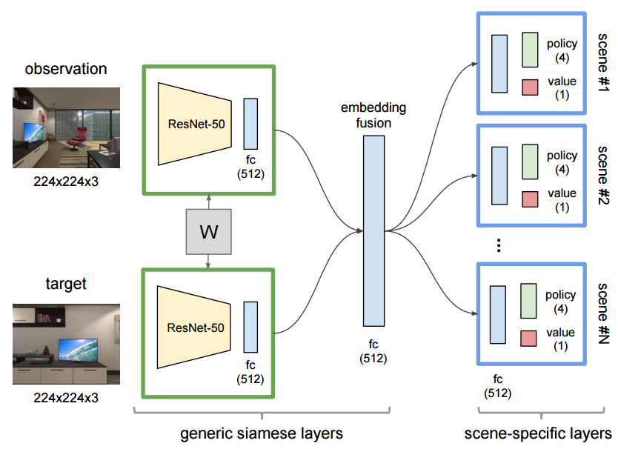
Navigation as a RL problem?
Q(s,a₁=forward)
State (s) Current frame and the target frame
Q(s,a₂=backward)
Q(s,a₃=turn left)
Q(s,a₂=turn right)
Q(s,a₆=trigger)
“Target-driven Visual Navigation in Indoor Scenes using Deep Reinforcement Learning” Yuke Zhu, Roozbeh Mottaghi, Eric Kolve, Joseph J. Lim, Abhinav Gupta, Li Fei-Fei, Ali Farhadi

Slide 127
Navigation as a RL problem?
Simulated environment
Real environment

Slide 128
Today’s takeaways
Bonus RL recap
Functional Approximation
Deep Q Network
Double Deep Q Network
Dueling Networks
Recurrent DQN
Solving “Doom”
Hierarchical DQN
More applications:
Text based games
Object detection
Indoor Navigation

Slide 129
Q-Learning Overestimation : Function Approximation
Van Hasselt, Hado, Arthur Guez, and David Silver. "Deep Reinforcement Learning with Double Q-Learning." In AAAI, pp. 2094-2100. 2016.

Slide 130
Q-Learning Overestimation : Intuition
[Jensen’s Inequality]
https://hadovanhasselt.files.wordpress.com/2015/12/doubleqposter.pdf
Notes:
Change style

Slide 131
Q-Learning Overestimation : Intuition
[Jensen’s Inequality]
What we want
https://hadovanhasselt.files.wordpress.com/2015/12/doubleqposter.pdf
Notes:
Change style

Slide 132
Q-Learning Overestimation : Intuition
[Jensen’s Inequality]
What we estimate in Q-Learning
What we want
https://hadovanhasselt.files.wordpress.com/2015/12/doubleqposter.pdf
Notes:
Change style

Slide 133
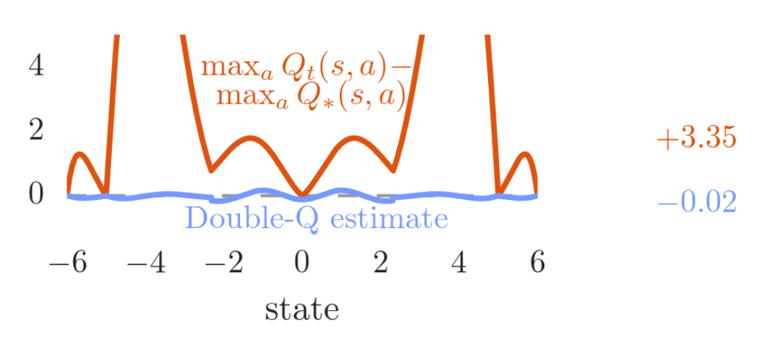
Double Q-Learning : Function Approximation
Van Hasselt, Hado, Arthur Guez, and David Silver. "Deep Reinforcement Learning with Double Q-Learning." In AAAI, pp. 2094-2100. 2016.

Slide 134
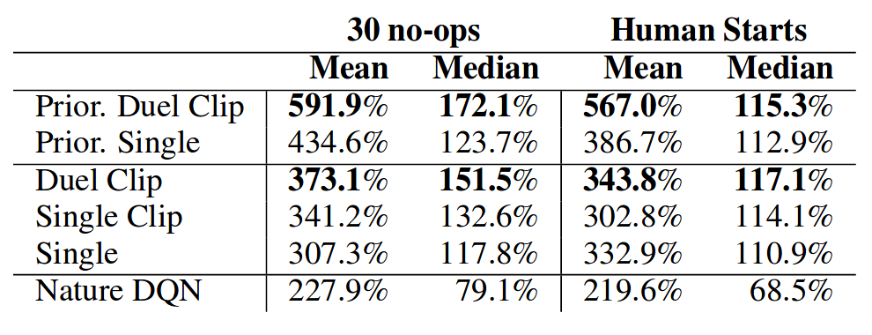
Results
Mean and median scores across all 57 Atari games, measured in percentages of human performance
Wang, Ziyu, Tom Schaul, Matteo Hessel, Hado van Hasselt, Marc Lanctot, and Nando de Freitas. "Dueling network architectures for deep reinforcement learning." arXiv preprint arXiv:1511.06581 (2015).

Slide 135
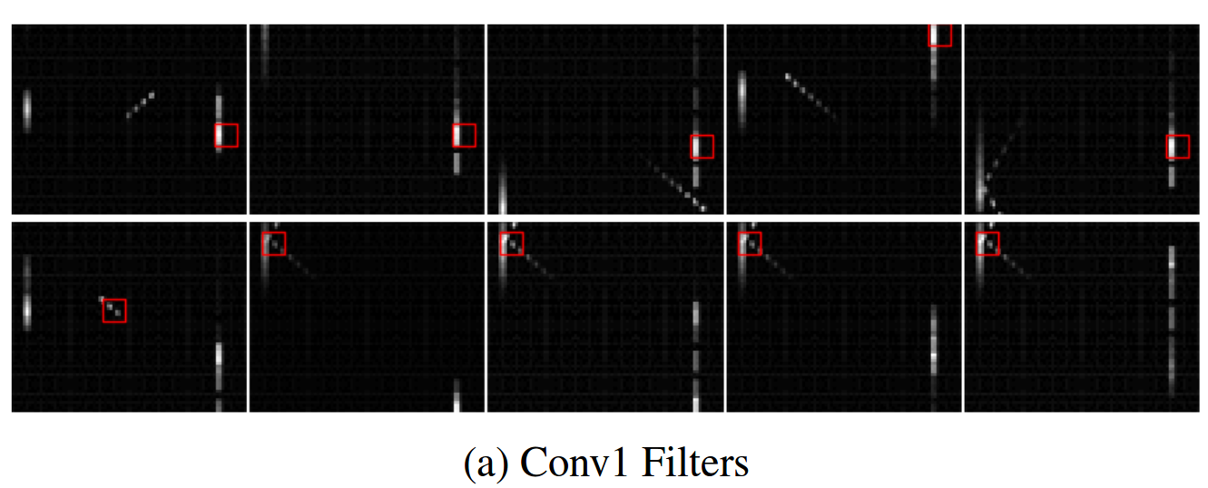
Results : Comparison to 10 frame DQN
Captures in one frame (and history state) what DQN captures in a stack of 10 for Flickering Pong
10 frame DQN conv-1 captures paddle information
Hausknecht, Matthew, and Peter Stone. "Deep recurrent q-learning for partially observable mdps." arXiv preprint arXiv:1507.06527 (2015).

Slide 136
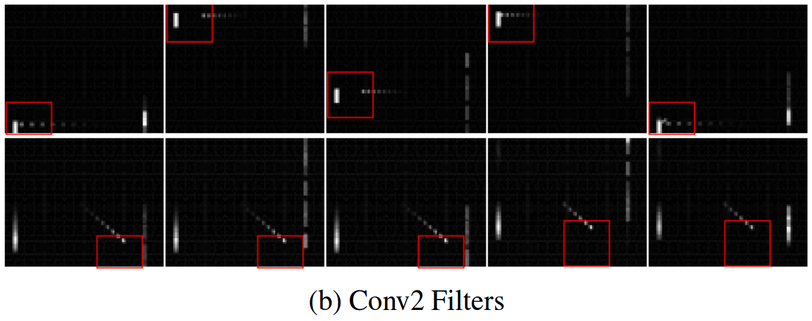
Results : Comparison to 10 frame DQN
Captures in one frame (and history state) what DQN captures in a stack of 10 for Flickering Pong
10 frame DQN conv-2 captures paddle and ball direction information
Hausknecht, Matthew, and Peter Stone. "Deep recurrent q-learning for partially observable mdps." arXiv preprint arXiv:1507.06527 (2015).

Slide 137
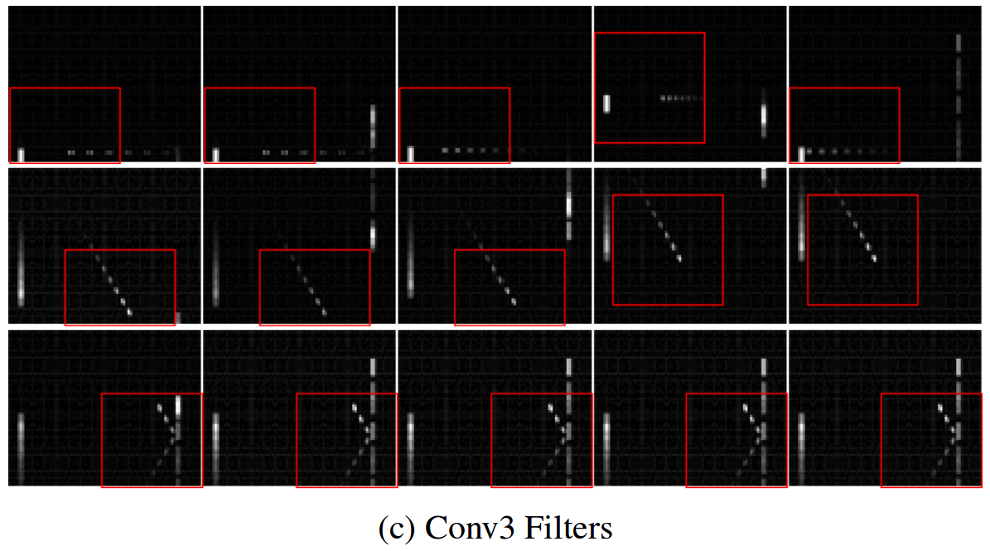
Results : Comparison to 10 frame DQN
Captures in one frame (and history state) what DQN captures in a stack of 10 for Flickering Pong
10 frame DQN conv-3 captures paddle, ball direction, velocity and deflection information
Hausknecht, Matthew, and Peter Stone. "Deep recurrent q-learning for partially observable mdps." arXiv preprint arXiv:1507.06527 (2015).

Slide 138
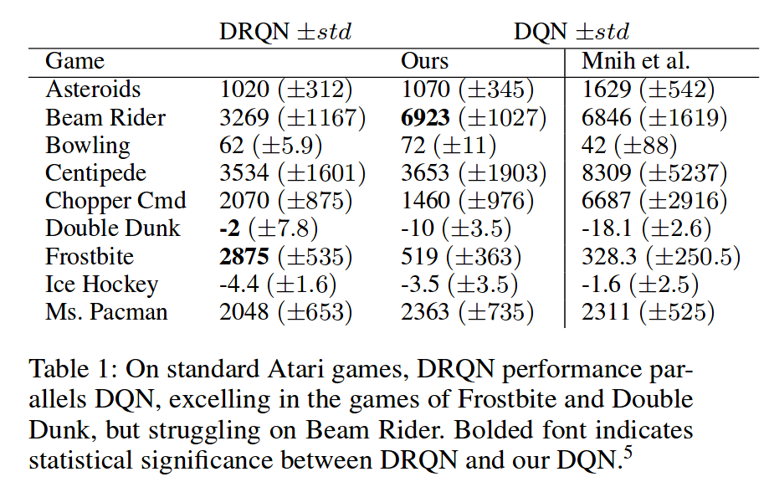
Results : Comparison to 10 frame DQN
Scores are comparable to 10-frame DQN - outperforming in some and losing in some
Hausknecht, Matthew, and Peter Stone. "Deep recurrent q-learning for partially observable mdps." arXiv preprint arXiv:1507.06527 (2015).

