Slide 1
Deep Learning for Manipulation and Navigation
Andrey Zaytsev and Tanmay Gangwani

Slide 2
Outline
Learning from Demonstrations
Imitation Learning
Optimal Control and Planning
Manipulation and Navigation
Learning using Physical Interactions
Navigation using Auxiliary Supervision

Slide 3
Notations
Trajectory
State
Time

Slide 4
Notations
Trajectory Distribution
A few samples from the distribution
State
Time

Slide 5
Notations
Trajectory Distribution
MDP
State
Time

Slide 6
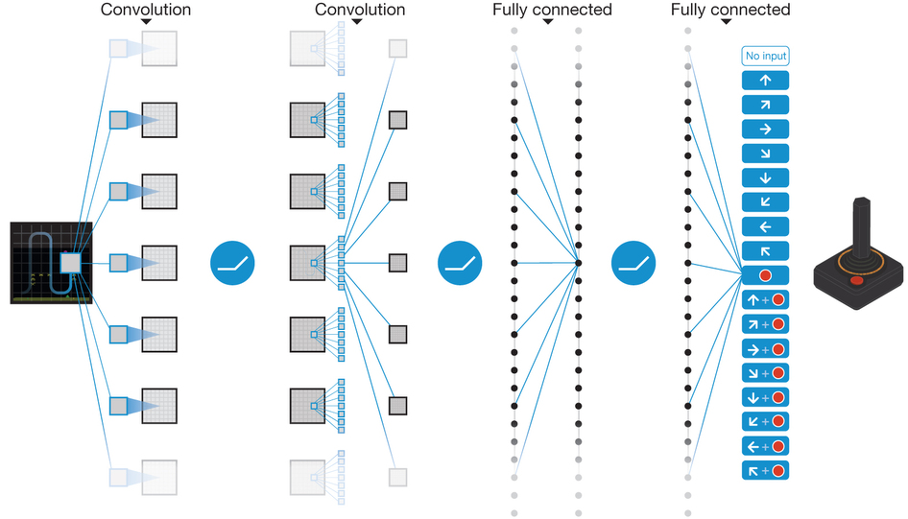
RL with Rewards
Policy gradient, Q-learning depend on frequent rewards

Slide 7
RL with Rewards
Policy gradient, Q-learning depend on frequent rewards
High reward
State
Rollouts, random initially!
Low reward
Time

Slide 8
Sparse Rewards
State
Time

Slide 9
Sparse Rewards
State
Time
High dimensional policy
Most random trajectories don’t yield positive reward

Slide 10
Sparse Rewards
State
Time
High dimensional policy
Most random trajectories don’t yield positive reward
May be expensive to evaluate action on physical system
Failure may not be an option

Slide 11
Sparse Rewards
State
Time
High dimensional policy
Most random trajectories don’t yield positive reward
May be expensive to evaluate action on physical system
Failure may not be an option
Use an expert (teacher) to guide the learning process!
Learning from demonstrations!

Slide 12
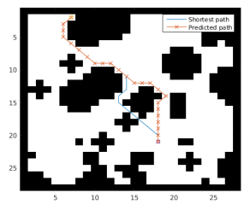
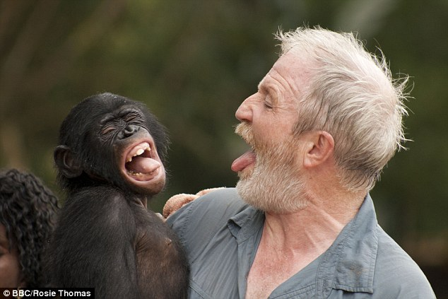
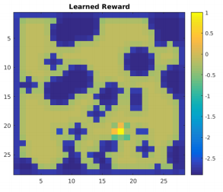
Learning from Demonstrations
Imitation Learning
Directly copy the expert
Supervised learning
Inverse RL
Infer the goal of the expert
Learn the reward function r
Learn optimal policy under r
This talk!

Slide 13
Expert Guidance
Expert provides trajectories from a good trajectory distribution
State
Time

Slide 14
Expert Guidance
Expert provides trajectories from a good trajectory distribution
State
Time
Learner imitates the trajectories - supervised learning

Slide 15
Expert Guidance
Expert provides trajectories from a good trajectory distribution
State
Time
Learner imitates the trajectories - supervised learning
Policy should produce trajectory distribution close to expert’s

Slide 16
Expert Guidance
Expert provides trajectories from a good trajectory distribution
Who’s an expert ??
Clone demonstrations shown by humans
Machine provides demonstrations
Optimal control / planning / trajectory optimization
State
Time

Slide 17
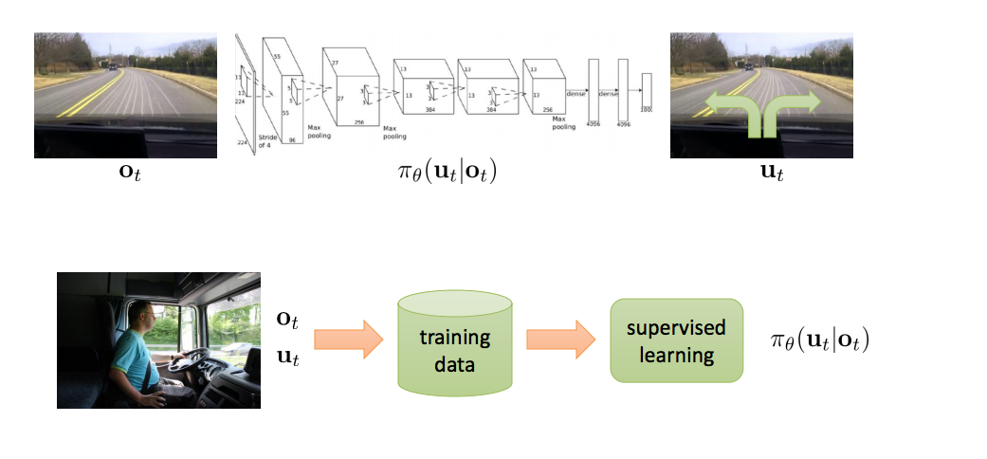
Imitation Learning for Driving
Stochastic policy for predicting steering wheel angle from observations
End to End Learning for Self-Driving Cars

Slide 18
Missing Supervision
: On-road trajectories by the expert
: Trajectories by the autonomous vehicle
State
Time

Slide 19
Missing Supervision
: On-road trajectories by the expert
: Trajectories by the autonomous vehicle
?
State
Time

Slide 20
Missing Supervision
: On-road trajectories by the expert
: Trajectories by the autonomous vehicle
Compounding Errors!
State
Time

Slide 21
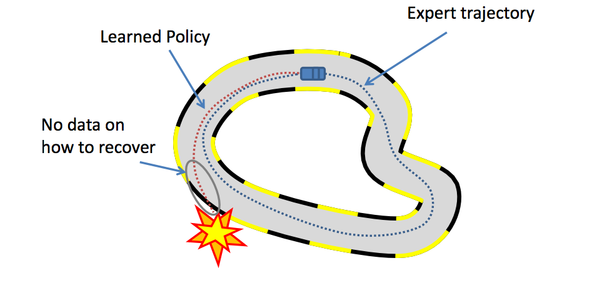
Trajectory Distribution Mismatch
Image source : https://katefvision.github.io

Slide 22
A Hacky Solution
Demonstration Augmentation - Include extra supervision in expert trajectories for states that the policy is likely to visit during test time
State
Time

Slide 23
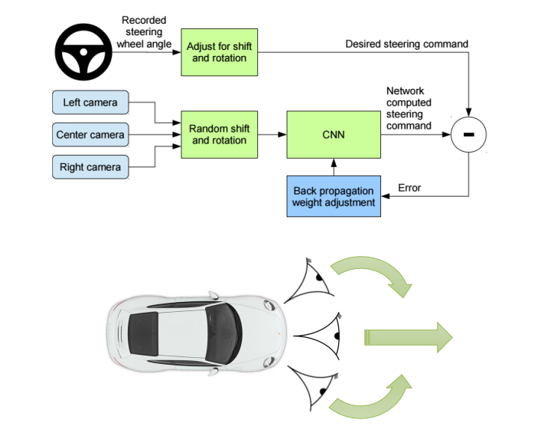
A Hacky Solution
Labelled data from left and right camera to recover from mistakes
End to End Learning for Self-Driving Cars

Slide 24
Imitation Learning for Driving
End to End Learning for Self-Driving Cars

Slide 26
DAgger
Solving missing supervision or the trajectory distribution mismatch problem using on-policy data
Algorithm:

Slide 27
DAgger
Solving missing supervision or the trajectory distribution mismatch problem using on-policy data
Algorithm:
Throw out the actions!

Slide 28
DAgger
Solving missing supervision or the trajectory distribution mismatch problem using on-policy data
Algorithm:

Slide 29
DAgger
Solving missing supervision or the trajectory distribution mismatch problem using on-policy data
Algorithm:
DAgger paper

Slide 30
DAgger in Practice
Predict a steering angle, given RGB images from drone camera
Learning Monocular Reactive UAV Control in Cluttered Natural Environments

Slide 31
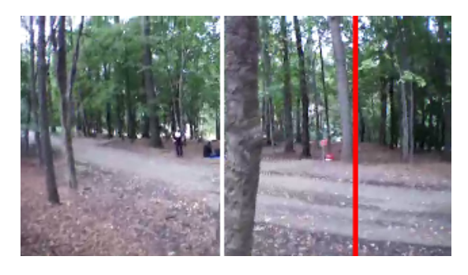
Imitation with Human Expert
Who’s an expert ??
Clone demonstrations shown by humans
Unnatural / hard in some cases (e.g. steering angle from images)
Not scalable - continuous improvements not possible

Slide 32
Imitation with Human Expert
Who’s an expert ??
Clone demonstrations shown by humans
Unnatural / hard in some cases (e.g. steering angle from images)
Not scalable - continuous improvements not possible
Machine provides demonstrations
Optimal control / planning / trajectory optimization

Slide 33
Imitating Optimal Control
Expert provides trajectories from a good trajectory distribution
Supervised Learning

Slide 34
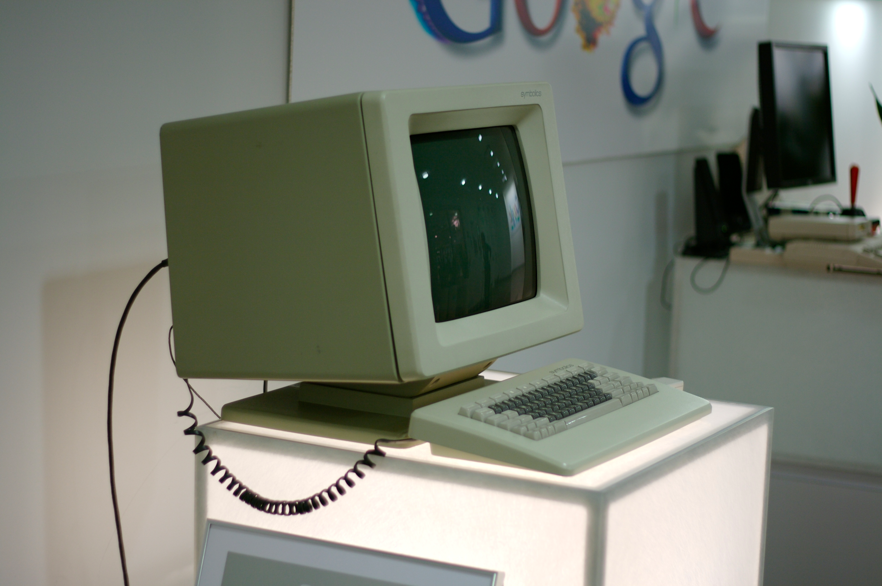
Imitating Optimal Control
Expert provides trajectories from a good trajectory distribution
Supervised Learning

Slide 35
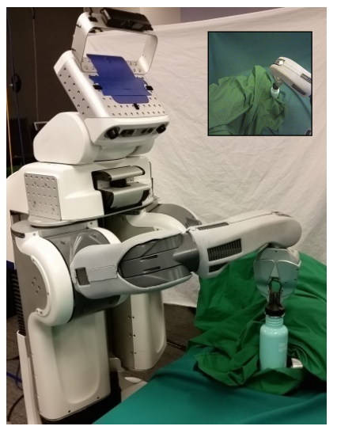
Imitating Optimal Control
Learn policies for various robotics tasks using only camera images
Use Guided Policy Search as expert
End-to-End Training of Deep Visuomotor Policies

Slide 36
Imitating GPS
End-to-End Training of Deep Visuomotor Policies

Slide 37
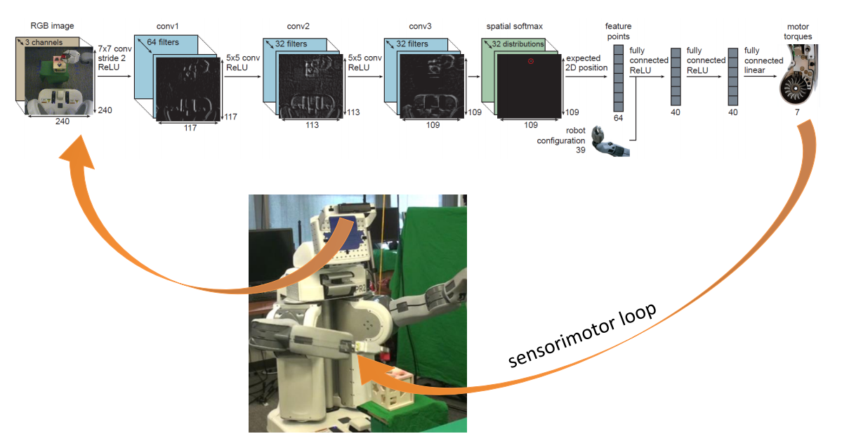
Neural Net Architecture
End-to-End Training of Deep Visuomotor Policies

Slide 38
Vision layers to localize target and end-effector
Policy layers with expert supervision
End-to-End Training of Deep Visuomotor Policies

Slide 39
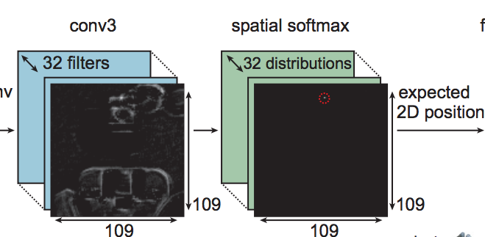
Localize Target and End-effector
Conv3 feature maps
Spatial softmax on each feature map
Get coordinates in image-space

Slide 40
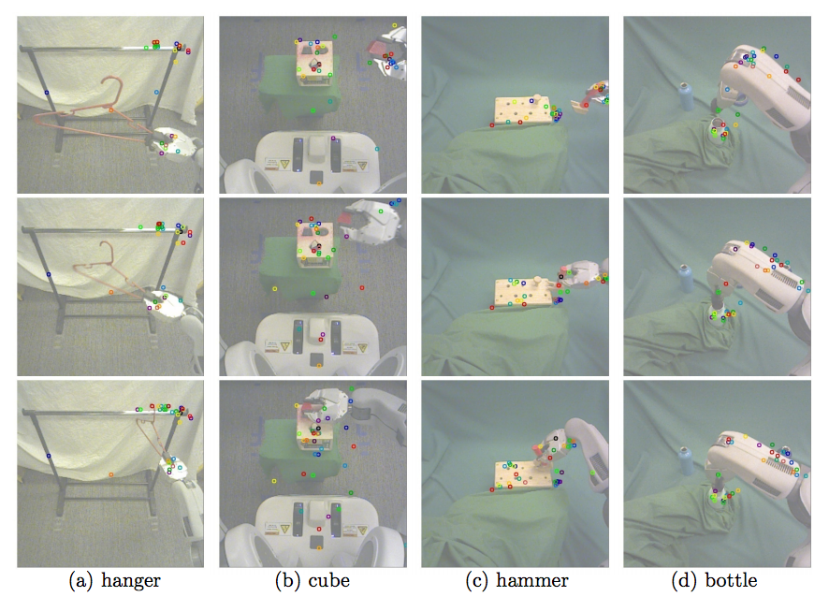
Localize Target and End-effector
Conv3 feature maps
Spatial softmax on each feature map
Get coordinates in image-space

Slide 41
End-to-End Training
Conv3 feature maps
Spatial softmax on each feature map
Get coordinates in image-space
Robot Configs (Angle of joints, velocity)
Fully Connected Layers
Supervised Learning
Motor Torques

Slide 42
Guided Policy Search (Teacher) - 10k feet view
Dynamics Model
Reward Function R
LQR feedback controller
Good trajectory distribution

Slide 43
GPS Challenges
Unknown!
Dynamics Model
Hand-crafted!
Reward Function R
LQR feedback controller
Good trajectory distribution

Slide 44
GPS Challenges
Unknown!
Dynamics Model
Hand-crafted!
Reward Function R
LQR feedback controller
Good trajectory distribution
LQR controller - approach similar to value iteration / dynamic programming!

Slide 45
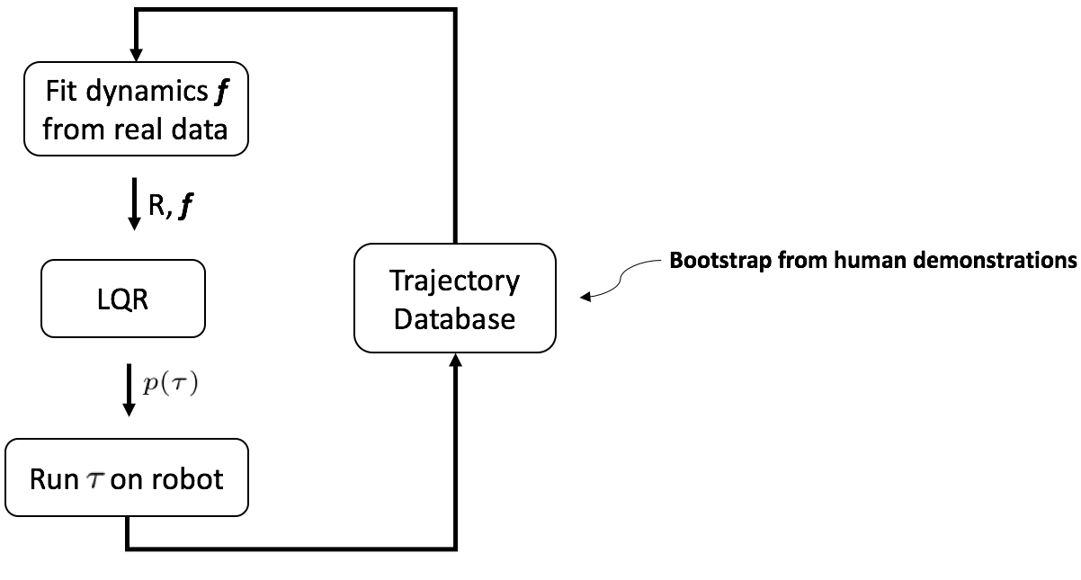
GPS loop

Slide 46
End-to-End Training with GPS
Conv3 feature maps
Spatial softmax on each feature map
Get coordinates in image-space
Robot Configs (Angle of joints, velocity)
Fully Connected Layers
Supervision
Motor Torques

Slide 47
End-to-End Training with GPS
Conv3 feature maps
Spatial softmax on each feature map
Get coordinates in image-space
Robot Configs (Angle of joints, velocity)
Fully Connected Layers
Not covered:
Fit dynamics using local linear models
LQR constraints to obtain good trajectory distributions in every iteration
Feedback from NN policy to GPS for improved stability
Supervision
Motor Torques

Slide 48
Manipulation and Navigation Overview

Slide 49
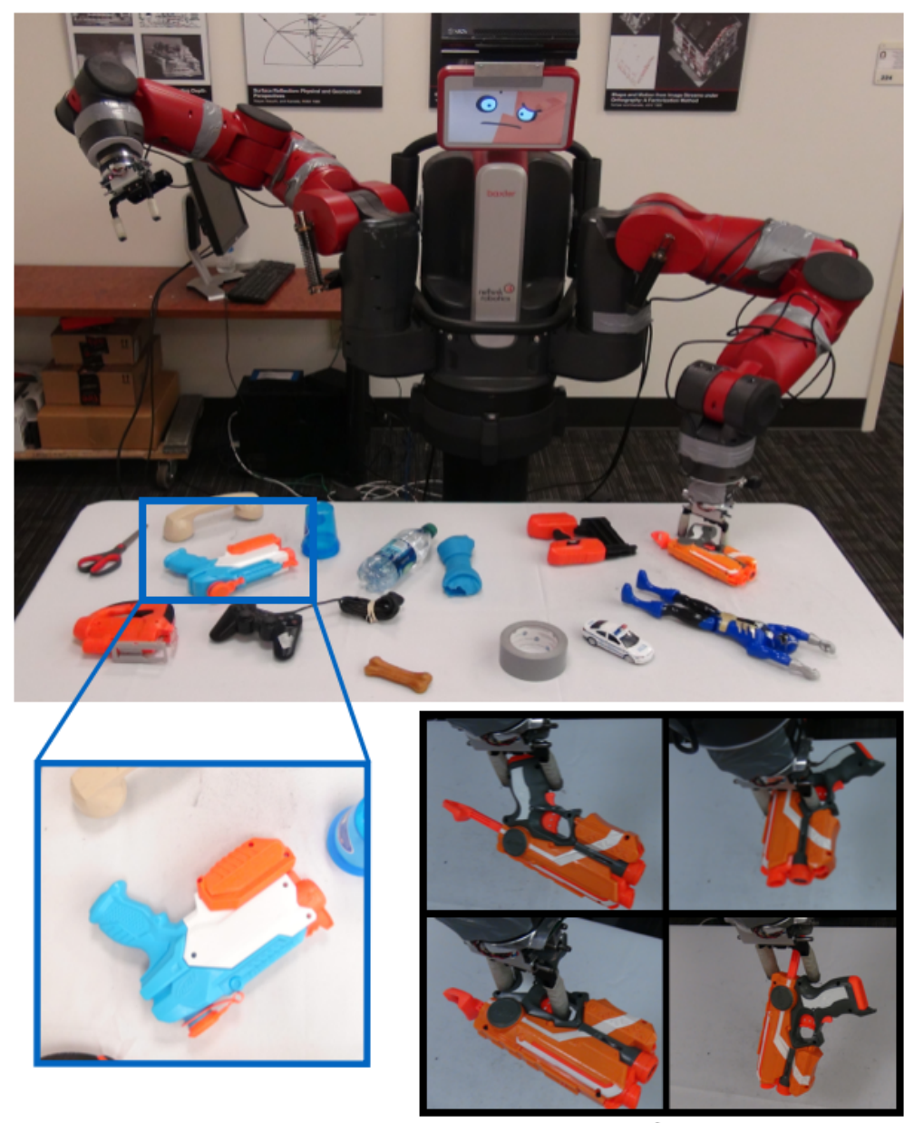
Manipulation
Tasks
Grasping
Pushing
Poking
Tactile sensing
Pose invariance
Hand-eye coordination
Image taken from Supersizing Self-supervision by Pinto et. al., arXiv 2015

Slide 50
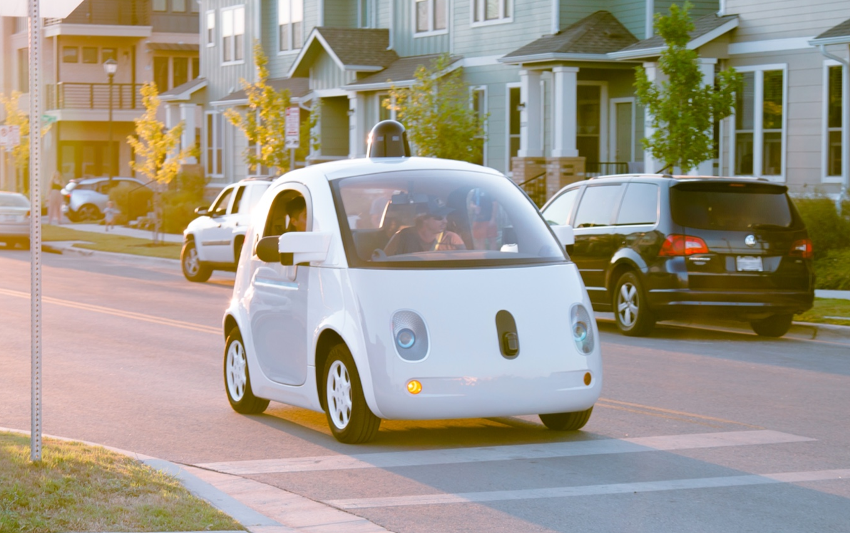
Navigation
Self-driving cars
Flying robots, quadcopters
Tasks
Collision avoidance
Navigation in mazes
Dynamic environments
Reinforcement Learning
Image taken from Waymo

Slide 51
Manipulation

Slide 52
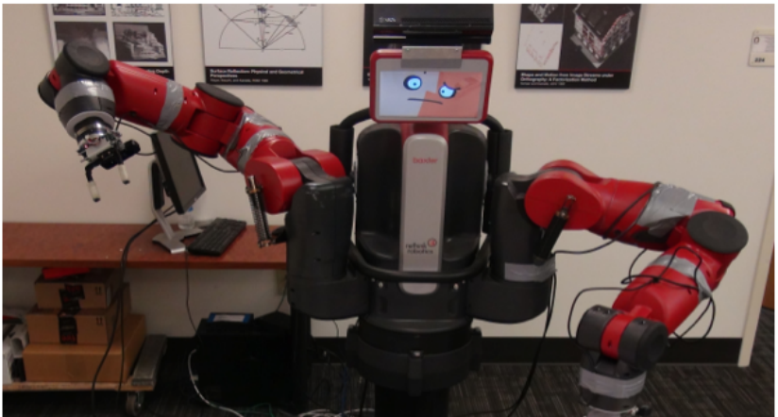
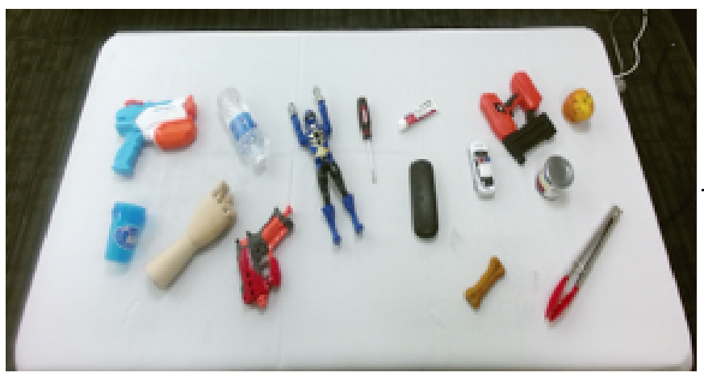
Grasping — Setup
Robot with arms and camera
Can control grasp angle and position
No human interaction besides placing objects
Given an image want to be able to predict a successful grasping configuration
Supersizing Self-supervision by Pinto et. al., arXiv 2015

Slide 53
Grasping — Execution
Use Mixture of Gaussians (MOG) subtraction algorithm to identify objects
Determine arm placement (next slide) and grasp
Verify that the grasp was successful using force sensors
Supersizing Self-supervision by Pinto et. al., arXiv 2015

Slide 54
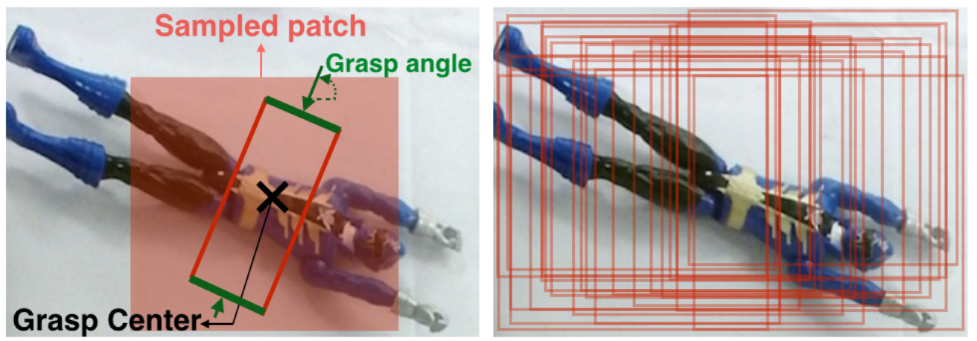
Grasping — Execution
18-way binary classification problem
Determine probability of a successful grasp at each angle
Patches are sampled uniformly from the region of interest
Supersizing Self-supervision by Pinto et. al., arXiv 2015

Slide 55
Grasping — Architecture
First 5 layers pre-trained on ImageNet
Supersizing Self-supervision by Pinto et. al., arXiv 2015

Slide 56
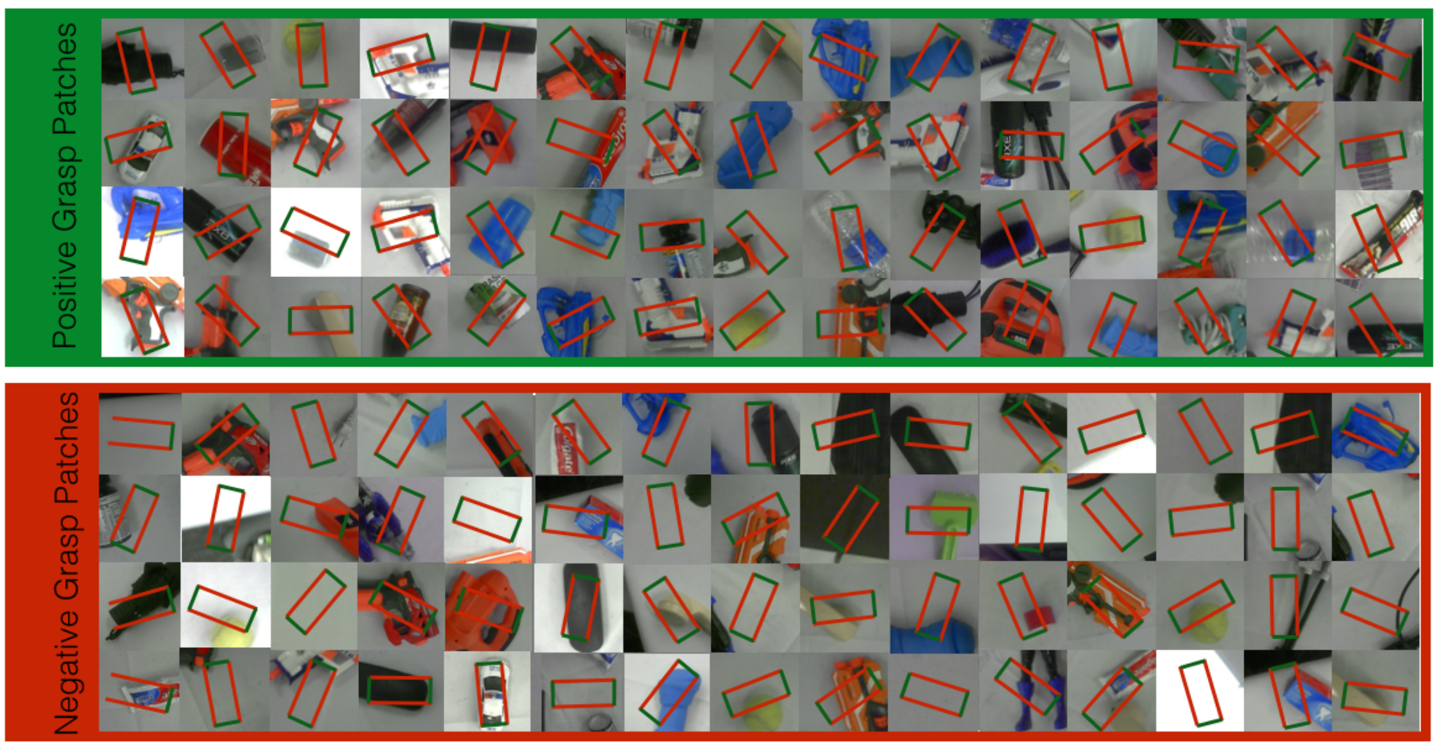
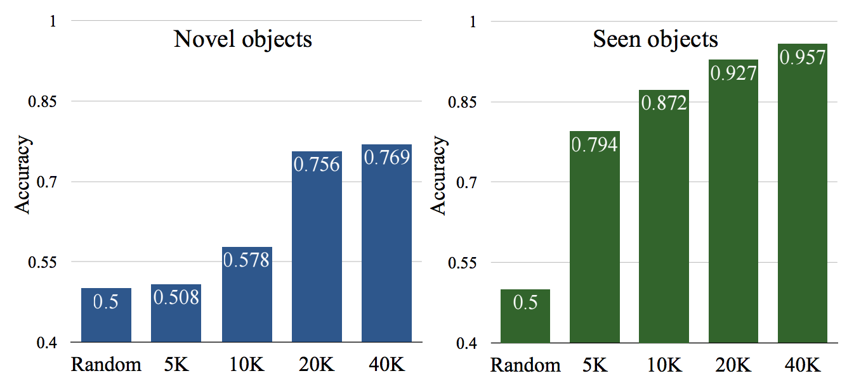
Grasping — Results
Generated dataset for future studies (hint: we’ll see it again soon)
Over 50K grasp attempts with random, staged, and training-test splits
Supersizing Self-supervision by Pinto et. al., arXiv 2015

Slide 57
Grasping — Demo
Supersizing Self-supervision Video on YouTube by Pinto et. al., arXiv 2015

Slide 58
Grasping — Takeaway
An example of self-supervised robotic system
DeepNet performs better than similar methods/heuristics
Not based on reinforcement learning
Predicts the way an object is grasped entirely based on one image

Slide 59
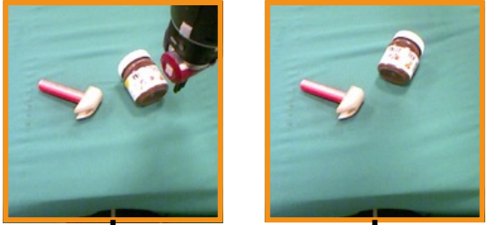
Poking — Setup
Given a robot with arms and camera
Forward problem: given a state and some actions, determine the outcome
Inverse problem: given 2 states, determine actions to transition between them
Joint training of forward and inverse models
Learning to Poke by Poking: Experiential Learning of Intuitive Physics by Agrawal et.al., arXiv 2017

Slide 60
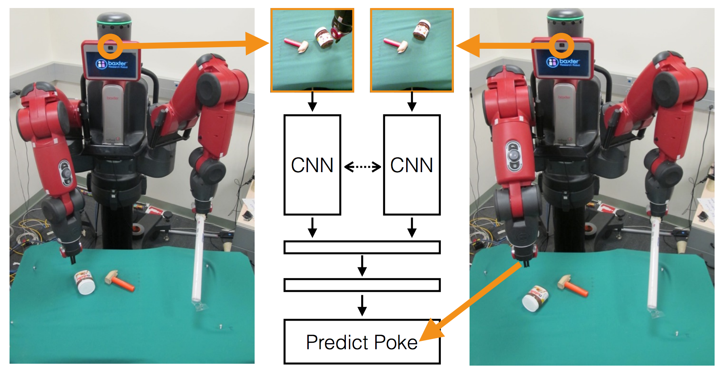
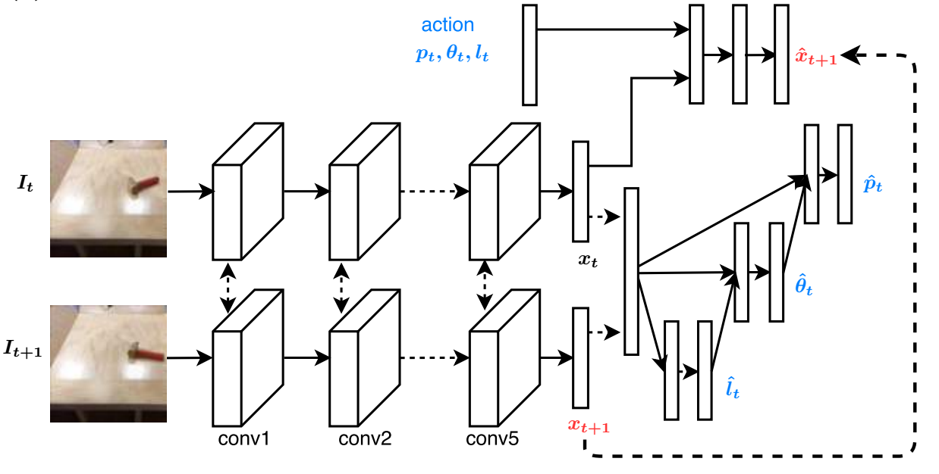
Poking — Architecture
Siamese CNN; first 5 layers are AlexNet
The output of inverse model (2 images) is used as an input to the forward one
Learning to Poke by Poking: Experiential Learning of Intuitive Physics by Agrawal et.al., arXiv 2017
Notes:
Self-supervised, application of a Siamese network

Slide 61
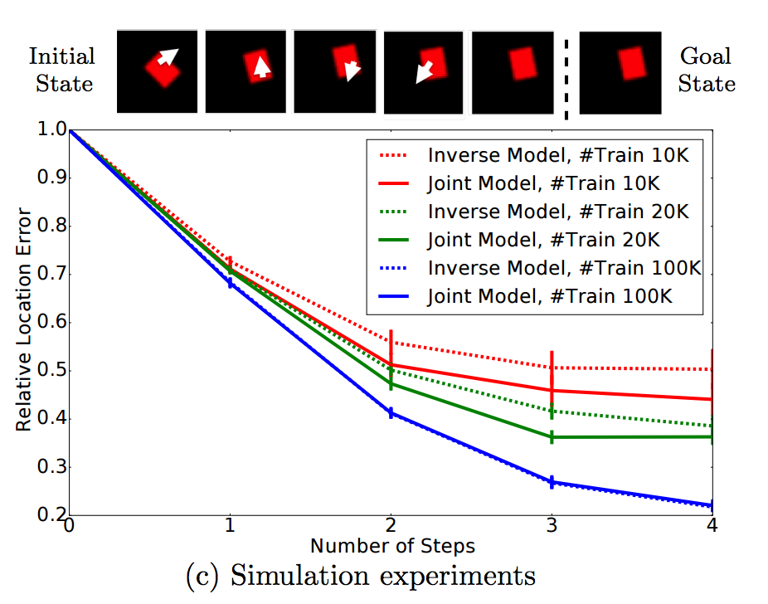
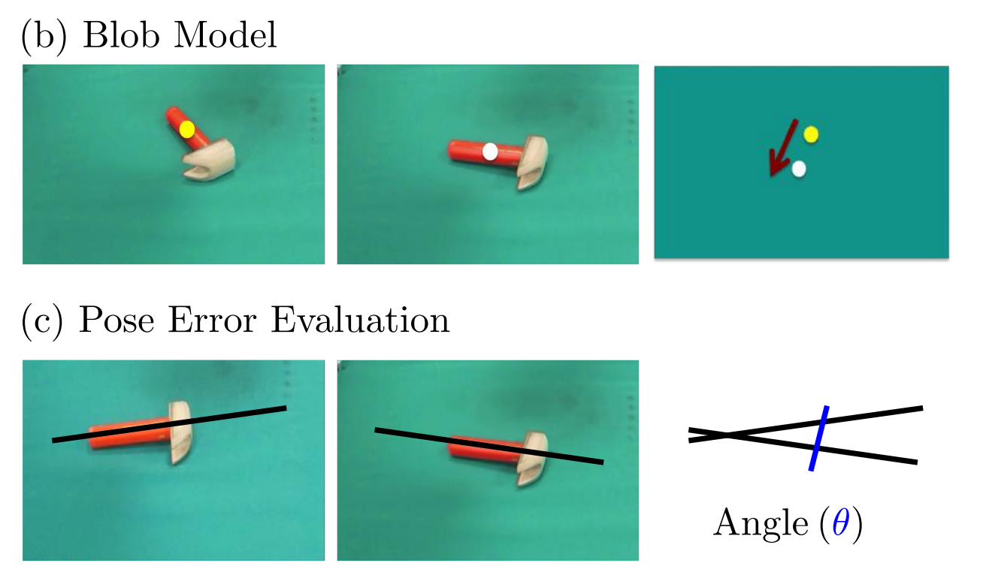
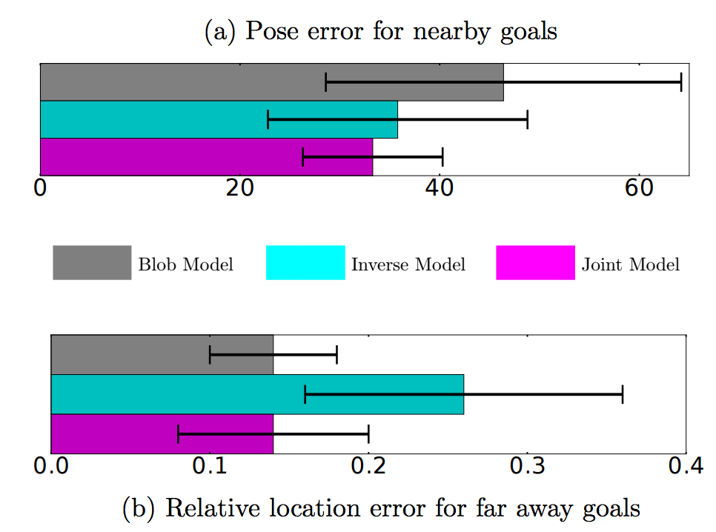
Poking — Results
Joint model outperforms both the inverse and the naive one
Learning to Poke by Poking: Experiential Learning of Intuitive Physics by Agrawal et.al., arXiv 2017

Slide 62
Poking — Demo
Learning to Poke by Poking Video on YouTube

Slide 63
Poking — Takeaway
Practical application of a Siamese network
Self-supervised robotic system
Training two complementary models at the same time is beneficial
Predicts how to move the objects given only 2 images

Slide 64
Learning through Physical Interactions
Notes:
Change this title

Slide 65
Question
Is a picture always enough?
Can we somehow use physical access to the object?

Slide 66
Key Idea
Given an image we can predict some physical properties
How and where to grasp the object
How to move it
How hard/soft the object is
Those are high level features
Let’s use them to classify images better!
The Curious Robot: Learning Visual Representations via Physical Interactions by Pinto et.al., arXiv 2016
Notes:
Should be part of motivation for everything

Slide 67
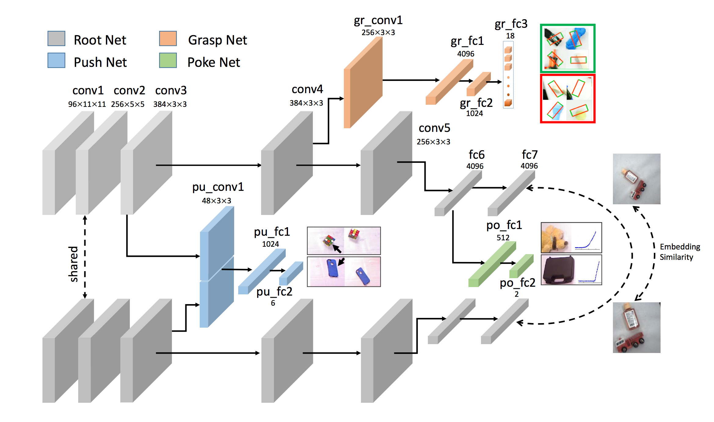
Architecture — Bringing It All Together
Root Net is AlexNet
Poke Net uses a tactile sensor to predict how hard/soft an object is
Pose invariance
The Curious Robot: Learning Visual Representations via Physical Interactions by Pinto et.al., arXiv 2016

Slide 68
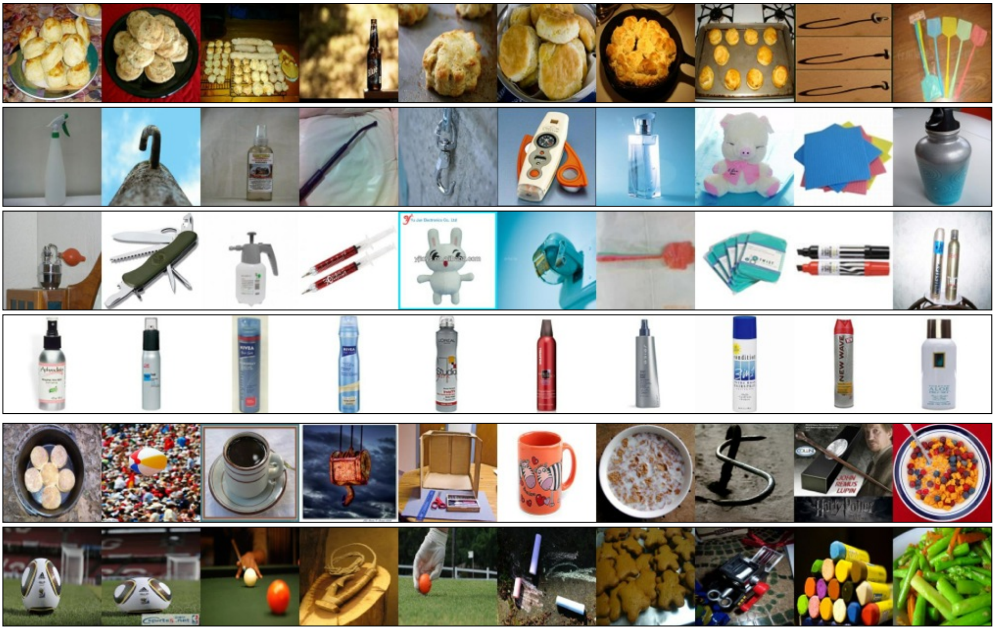
Learning Visual Representations — Results
Better performance than AlexNet, but not consistently
Further research into integrating this with vision is needed
The Curious Robot: Learning Visual Representations via Physical Interactions by Pinto et.al., arXiv 2016
Notes:
Add explanations for numbers. Focus on classification, add representative picture from the datasets. Look at the datasets, find out if there is sufficient # for deep cnn
Just focus on classification! Skip the second

Slide 69
Navigation and Auxiliary Supervision

Slide 70
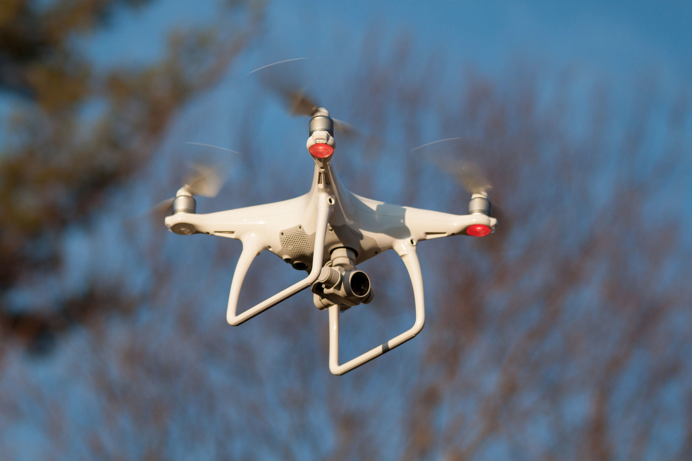
Flight Controller — Challenges
What are they?
Image from Wikipedia

Slide 71
Flight Controller — Challenges
Real world training is expensive
Takes up a lot of time
Requires human supervision
Limited number of physical robots
Collision may be deadly…
Is there a better way?
Image from Wikipedia

Slide 72
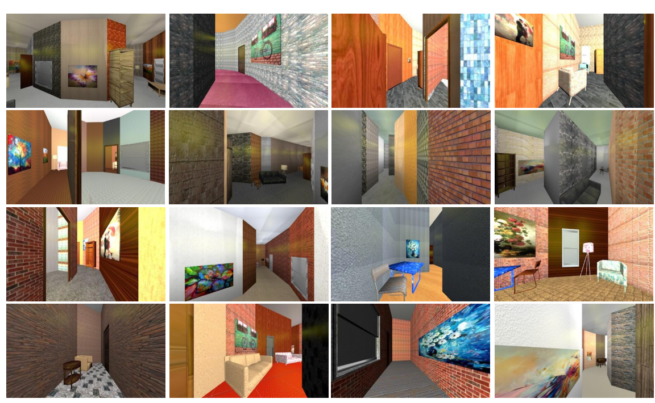
Indoor Flight Controller — Approach
Train in a simulated environment!
Modeled with CAD
A reinforcement learning problem
Single image input
Predict discounted collision probability and pick direction with the lowest one
(CAD)2RL: Real Single-Image Flight without a Single Real Image by Sadeghi et.al., arXiv 2016

Slide 73
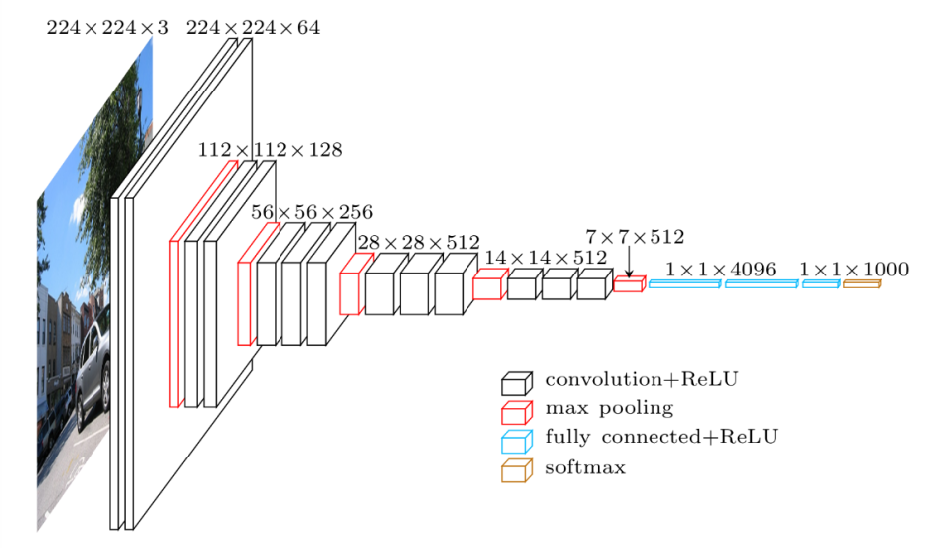
Indoor Flight Controller — Architecture
Q-function represented by VGG16
Pre-trained on ImageNet
Output is 41x41 grid
Action-space
Initialize training on the free-space prediction task
Flying 1 meter forward
Image from Heuritech Blog, 2016

Slide 74
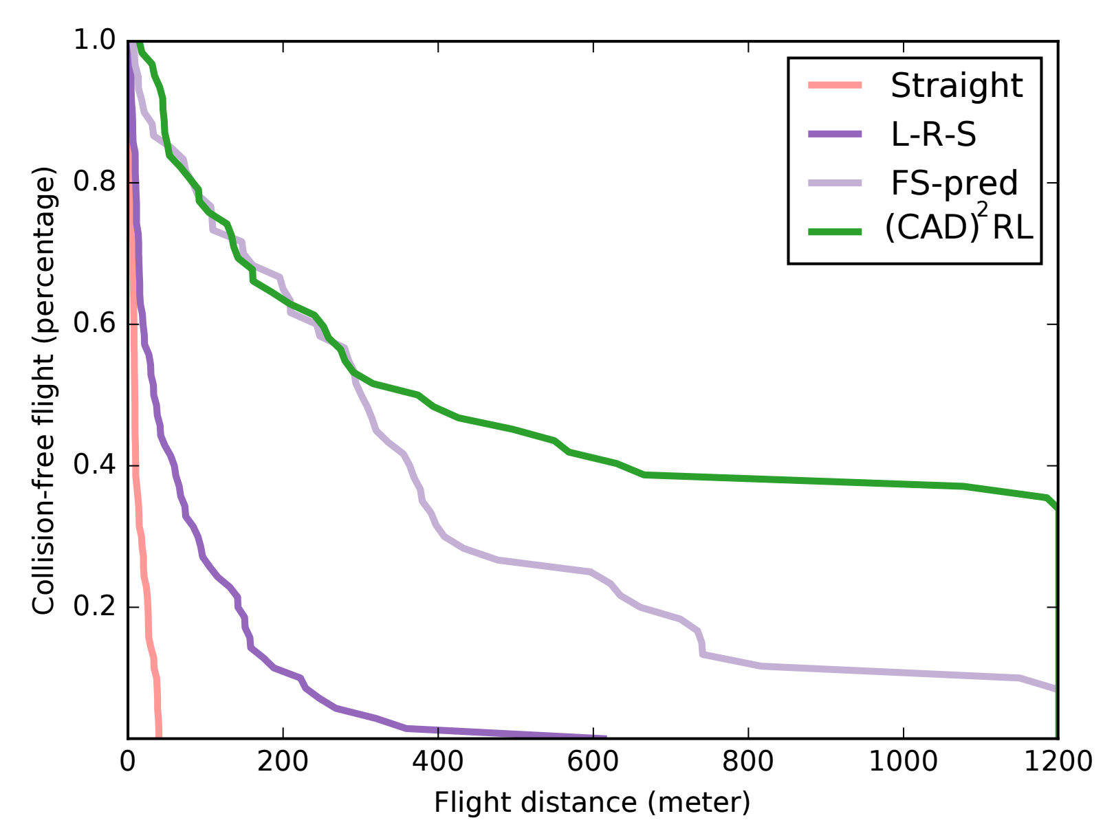
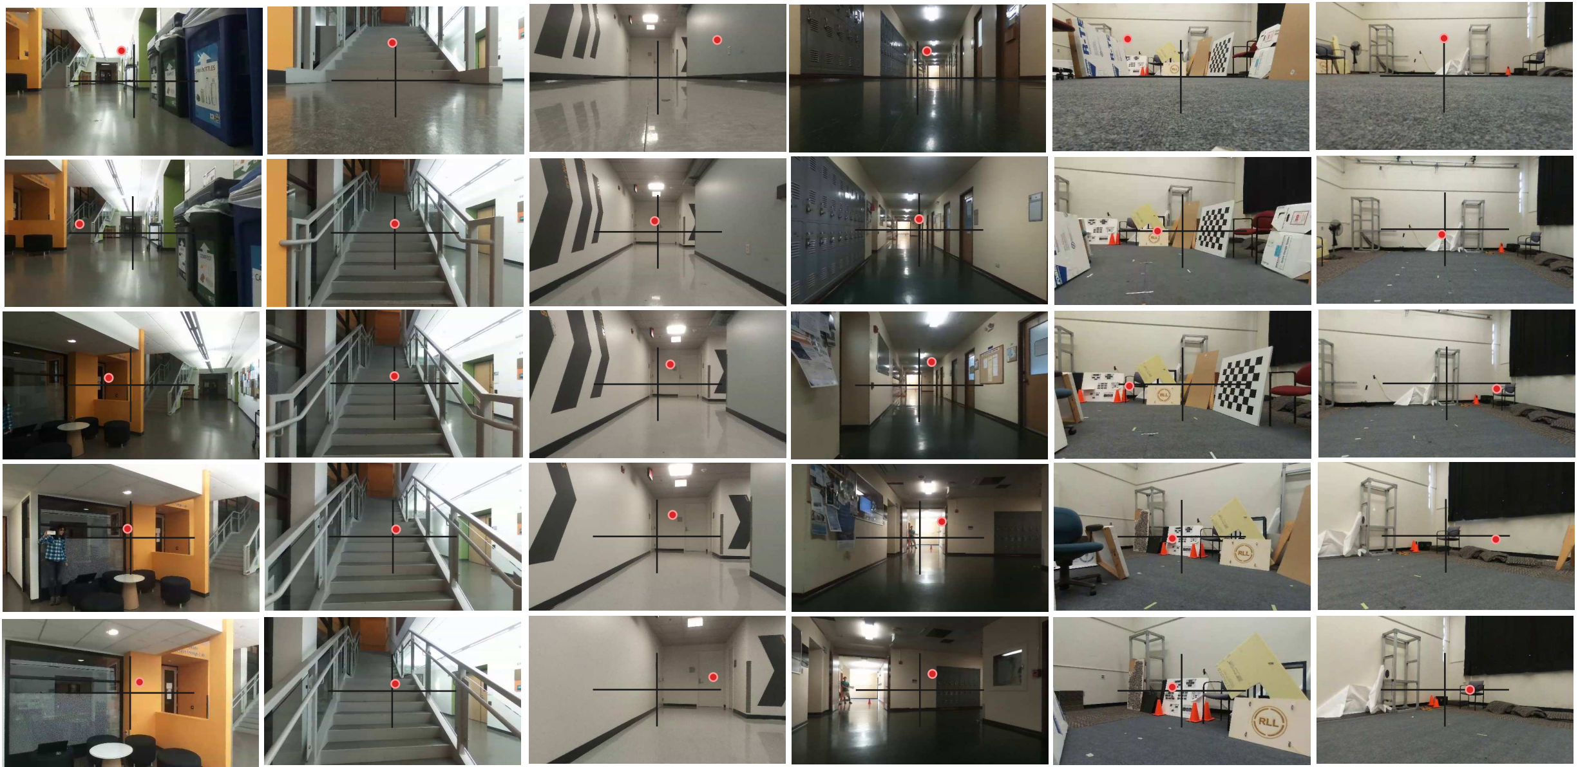
Indoor Flight Controller — Results
Demonstrates better performance than heuristic algorithms
Generalizes to work on a real drone
(CAD)2RL: Real Single-Image Flight without a Single Real Image by Sadeghi et.al., arXiv 2016

Slide 75
Indoor Flight Controller — Demo
(CAD)2RL: Real Single-Image Flight without a Single Real Image Video on YouTube

Slide 76
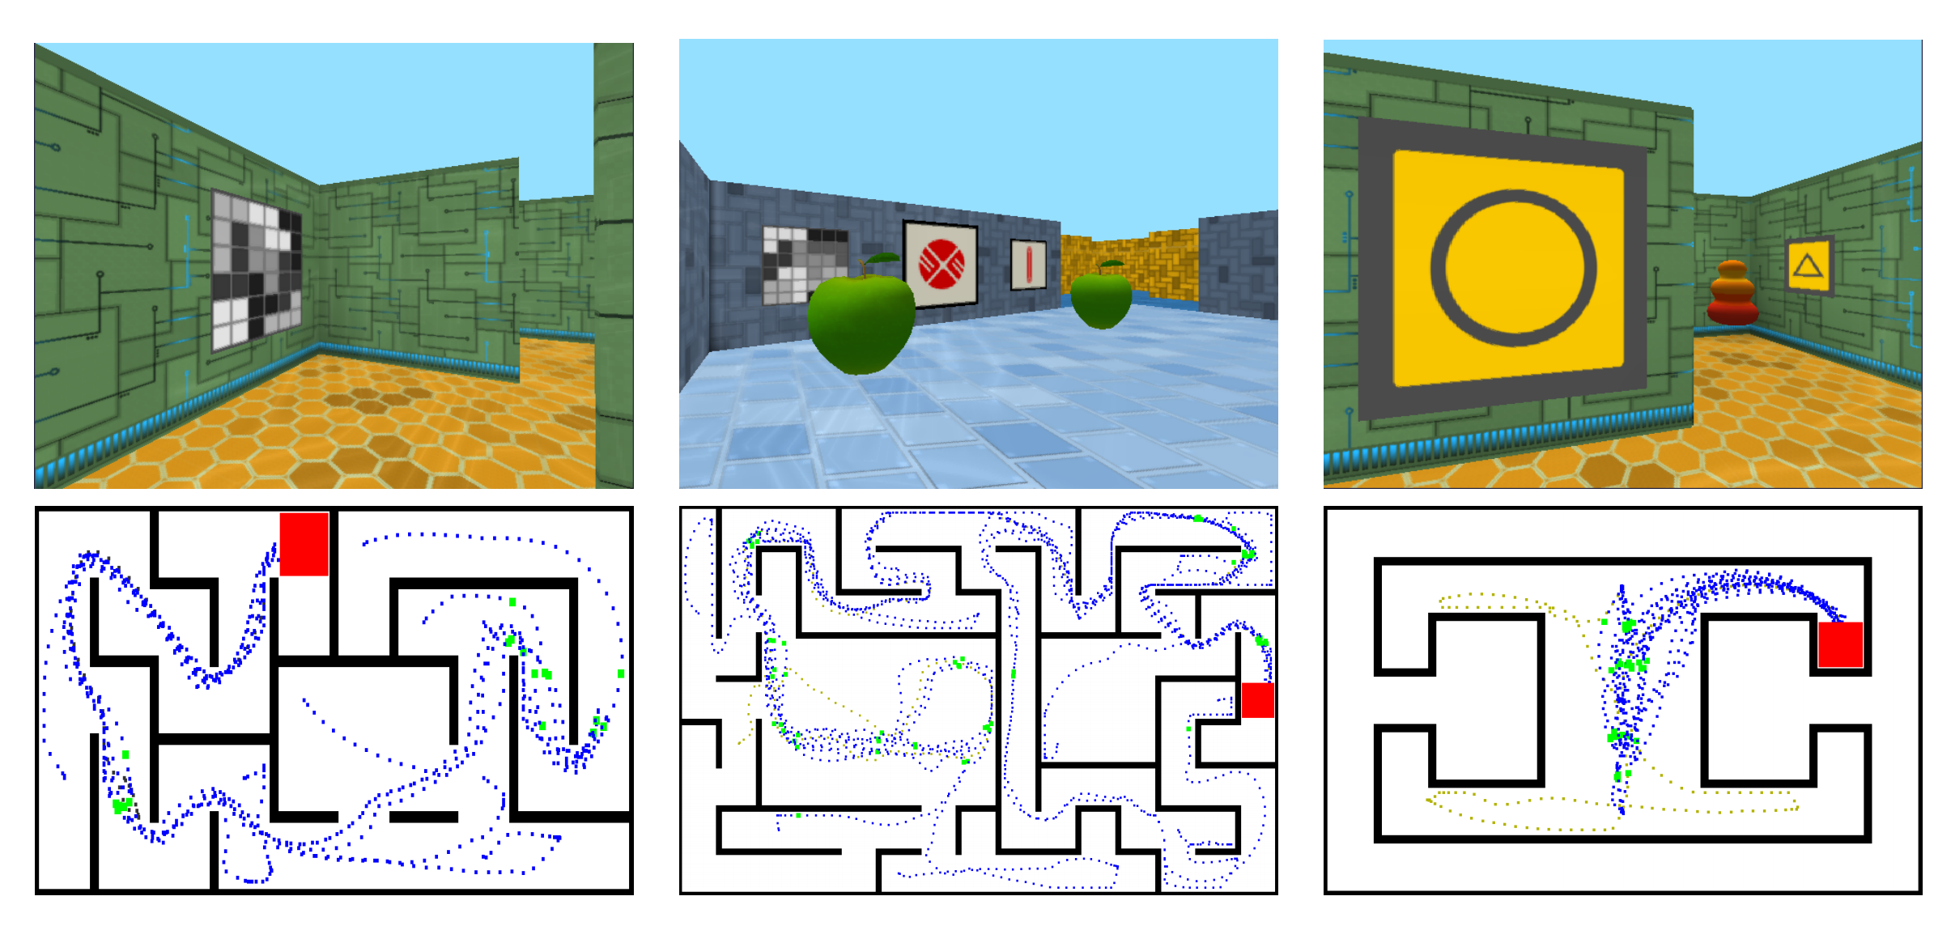
Dynamic Maze Navigation
First-person view
Related to the problem of indoor navigation
Landscape may change in the real world
Rewards are sparse
Learning to Navigate in Complex Environments by Mirowski et.al., ICLR 2017

Slide 77
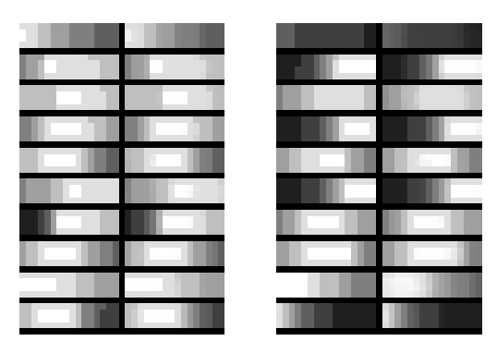
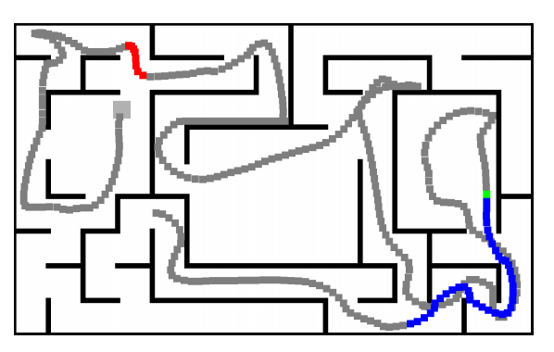
Dynamic Maze Navigation — Auxiliary Goals
Bootstrap reinforcement learning with auxiliary tasks
Depth prediction
Loop closure prediction
Use those as tasks as opposed to features for better performance
Depth as a classification problem with 4x16 map
Learning to Navigate in Complex Environments by Mirowski et.al., ICLR 2017

Slide 78
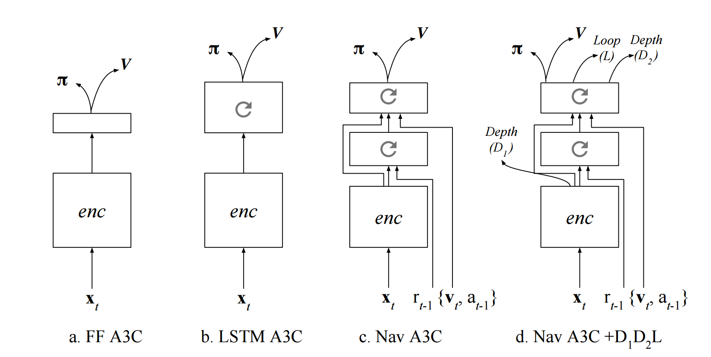
Dynamic Maze Navigation — Architecture
Stacked LSTM architecture that outputs policy and value function
Incorporates auxiliary depth and loop closure loss both on the feed-forward stage and LSTM stage and compute loss with both
Learning to Navigate in Complex Environments by Mirowski et.al., ICLR 2017
Notes:
Add a legend explaining letters on the figure

Slide 79
Dynamic Maze Navigation — Results
Performs better than humans on static mazes
Around 70-80% of human performance on dynamic ones
The model with LSTM depth only performs the best (marginally)
Learning to Navigate in Complex Environments by Mirowski et.al., ICLR 2017

Slide 80
Dynamic Maze Navigation — Demo
Learning to Navigate in Complex Environments YouTube Video

Slide 81
Questions?
Thank you for your attention!

Slide 82
Reading List
End to End Learning for Self-Driving Cars by Bojarski et.al.
A Machine Learning Approach to Visual Perception of Forest Trails for Mobile Robots by Giusti et.al.
A Reduction of Imitation Learning and Structured Prediction to No-Regret Online Learning by Ross et.al.
Learning Monocular Reactive UAV Control in Cluttered Natural Environments by Ross et.al.
End-to-End Training of Deep Visuomotor Policies by Levine et.al.
Supersizing Self-supervision by Pinto et. al.
Learning to Poke by Poking: Experiential Learning of Intuitive Physics by Agrawal et.al.
The Curious Robot: Learning Visual Representations via Physical Interactions by Pinto et.al.
(CAD)2RL: Real Single-Image Flight without a Single Real Image by Sadeghi et.al.
Learning to Navigate in Complex Environments by Mirowski et.al.

Slide 83
Backup Slides

Slide 84
Imitation with LSTMs
Learning real manipulation tasks from virtual demonstrations using LSTM

Slide 85
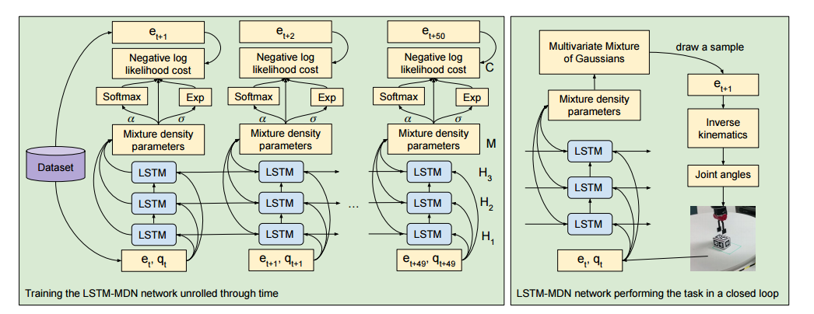
Imitation with LSTMs
Learning real manipulation tasks from virtual demonstrations using LSTM
Notes:
Add reference - Learning real manipulation tasks from virtual demonstrations using LSTM

Slide 86
Optimal Control
Obtain “good” trajectories for supervised learning
Known deterministic system dynamics f

Slide 87
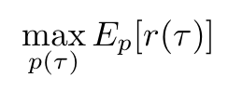
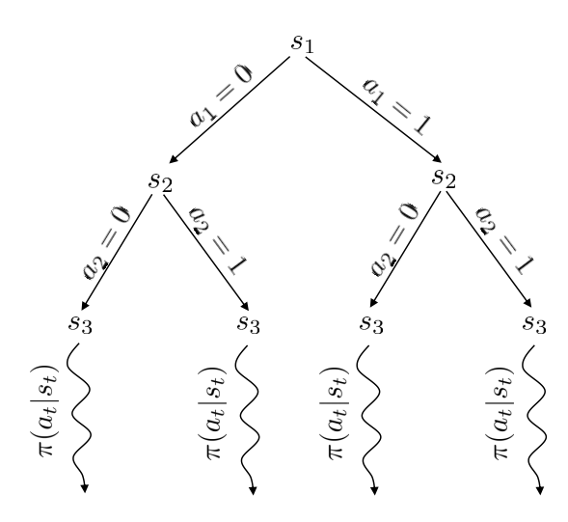
Optimal Control in Discrete Space
Obtain “good” trajectories under known discrete dynamics f
Monte Carlo tree search (MCTS) for Atari
Obtain “good” action for a given state under known dynamics
function get_best_action_from_root():
Find a suitable leaf node from root
Evaluate the leaf using random policy; get reward
Update score of all nodes between leaf and root
Take action from root leading to highest score

Slide 88
Atari Games by MCTS
Directly using MCTS to play game
MCTS | DQN
Model-based; need access to simulator for tree rollouts | Model-free; no information about game dynamics; can generalize better under POMDP
Choosing action is slow (tree expansion) | Choosing action is fast
High scores | Lower scores than MCTS

Slide 89
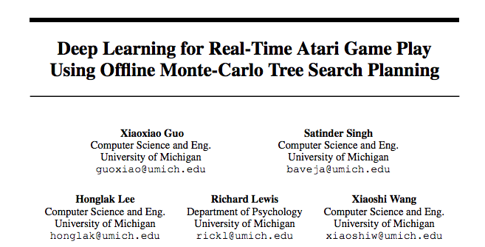
Atari Games by Imitating MCTS
Imitating optimal control (MCTS) with DAgger
Replace the human with MCTS
Train NN policy on pixels using supervision from MCTS at training time
No MCTS at test time, NN is fast!
Reduce distribution mismatch by getting on-policy data

Slide 90
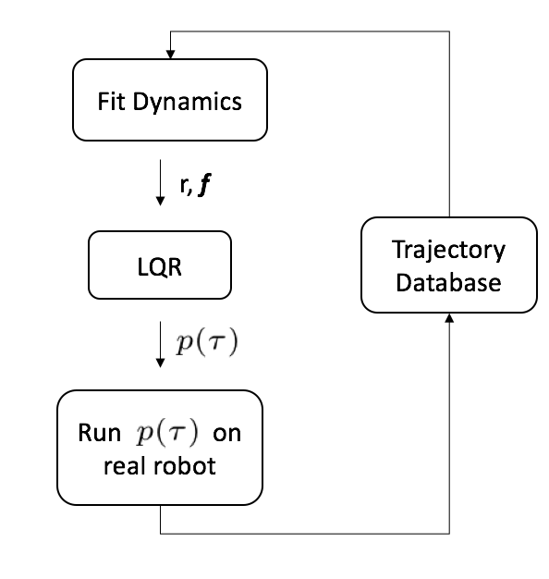
GPS loop
A policy search method that scales to high dimensional policies
Contrast with gradient methods like REINFORCE
GPS details
Fit local linear models
is stochastic so that we get a trajectory distribution
Bound D_{KL} between trajectory distributions at consecutive iterations

Slide 91
Optimal Control in Continuous Space
Obtain “good” trajectories under known continuous dynamics f
r, f
Linear Quadratic Regulator (LQR)
Notes:
LQR - linearize your dynamics, quadratize your cost, give to LQR, it emits the optimal trajectory from an initial state. Dynamic programming, a bit like value iteration.

Slide 92
Unknown Dynamics
Obtain “good” trajectories under unknown continuous dynamics
Learning the dynamics model using regression
Deep nets, GP etc.

Slide 93
Imitating Optimal Control
GPS obtains “good” trajectories under unknown continuous dynamics

Slide 94
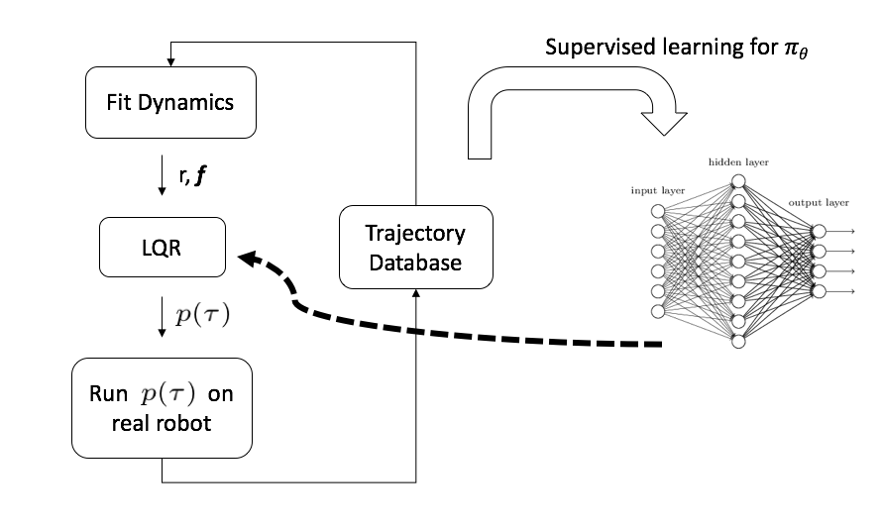
Imitating Optimal Control
GPS obtains “good” trajectories under unknown continuous dynamics
Adaptive Teacher
Notes:
One main difference between DAgger and GPS is that GPS has an adaptive teacher

Slide 95
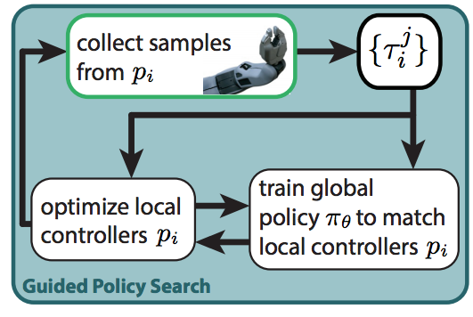
GPS in action

