Slide 1
Recurrent Neural Network Architectures
Abhishek Narwekar, Anusri Pampari
CS 598: Deep Learning and Recognition, Fall 2016

Slide 2
Lecture Outline
Introduction
Learning Long Term Dependencies
Regularization
Visualization for RNNs

Slide 3
Section 1: Introduction
Notes:
Where they have seen RNN’s?

Slide 4

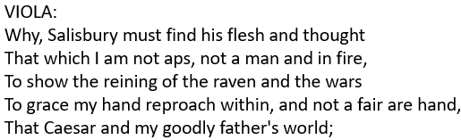

Applications of RNNs
Write like Shakespeare [reference]
Image Captioning [reference]
… and more!
.. and Trump [reference]

Slide 5
Applications of RNNs
Technically, an RNN models sequences
Time series
Natural Language, Speech
We can even convert non-sequences to sequences, eg: feed an image as a sequence of pixels!

Slide 6
Applications of RNNs
RNN Generated TED Talks
  YouTube Link
RNN Generated Eminem rapper
  RNN Shady
RNN Generated Music
  Music Link

Slide 7
Why RNNs?
Can model sequences having variable length
Efficient: Weights shared across time-steps
They work!
  SOTA in several speech, NLP tasks
Notes:
CNN implementation as RNN

Slide 8
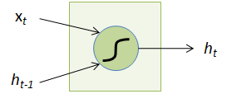

The Recurrent Neuron
x_{t}: Input at time t
h_{t-1}: State at time t-1
next time step
Source: Slides by Arun

Slide 9
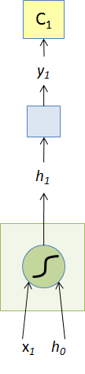
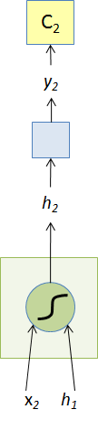
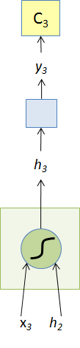
Unfolding an RNN
Weights shared over time!
Source: Slides by Arun

Slide 10
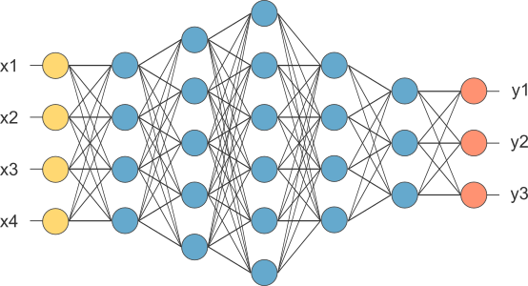
Making Feedforward Neural Networks Deep
Source: http://www.opennn.net/images/deep_neural_network.png

Slide 11
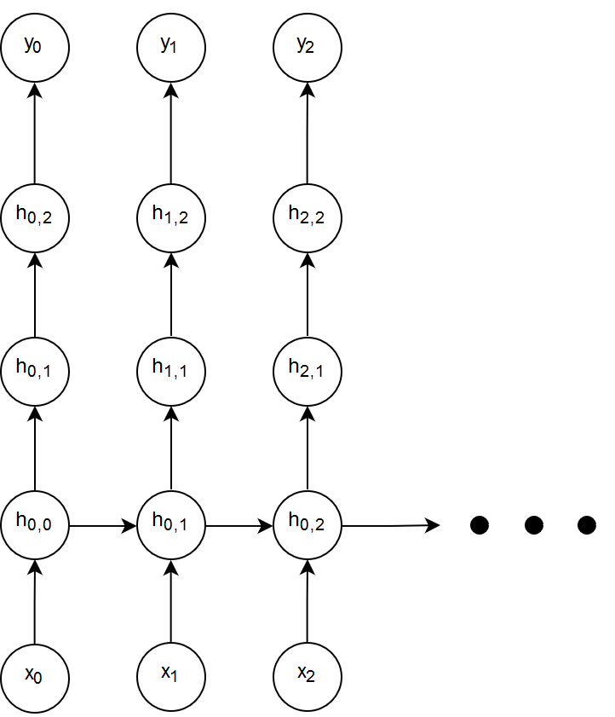
Option 1: Feedforward Depth (d_{f})
Notation: h_{0,1} ⇒ time step 0, neuron #1
High level feature!
Feedforward depth: longest path
between an input and output at the
same timestep
Feedforward depth = 4

Slide 12
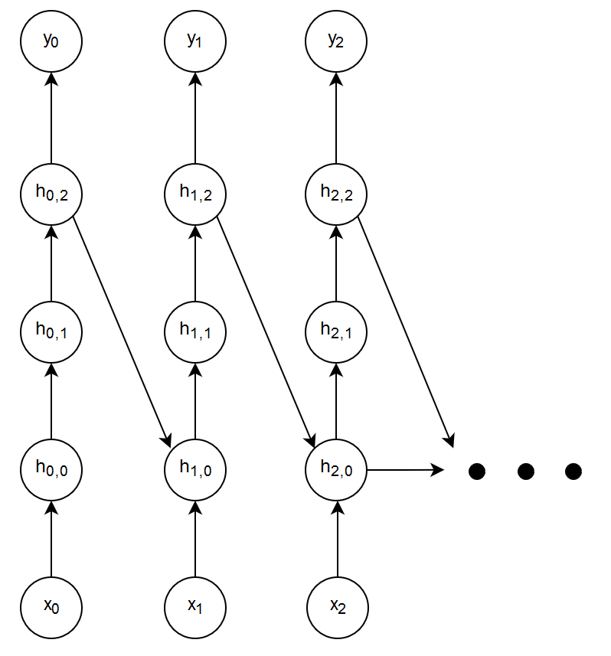
Option 2: Recurrent Depth (d_{r})
Recurrent depth: Longest path between same hidden state in successive timesteps
Recurrent depth = 3

Slide 13
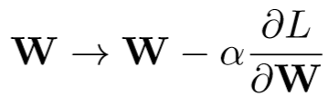
Backpropagation Through Time (BPTT)
Objective is to update the weight matrix:
Issue: W occurs each timestep
Every path from W to L is one dependency
Find all paths from W to L!
(note: dropping subscript h from W_{h} for brevity)

Slide 14
Systematically Finding All Paths
How many paths exist from W to L through L₁?
Just 1. Originating at h₀.

Slide 15
Systematically Finding All Paths
How many paths from W to L through L₂?
2. Originating at h₀ and h₁.

Slide 16
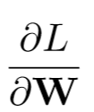
Systematically Finding All Paths
And 3 in this case.
Origin of path = basis for Σ
The gradient has two summations:
1: Over L_{j}
2: Over h_{k}
To skip proof, click here.

Slide 17
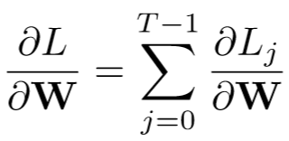
Backpropagation as two summations
First summation over L

Slide 18
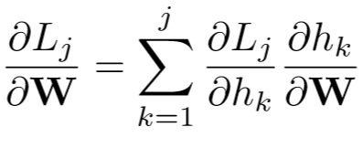
Backpropagation as two summations
Second summation over h: Each L_{j} depends on the weight matrices before it
L_{j} depends on all h_{k} before it.

Slide 19
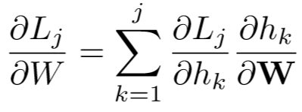
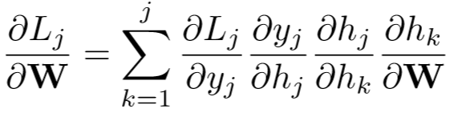
Backpropagation as two summations
j
No explicit of L_{j} on h_{k}
Use chain rule to fill missing steps
k

Slide 20
Backpropagation as two summations
j
No explicit of L_{j} on h_{k}
Use chain rule to fill missing steps
k

Slide 21
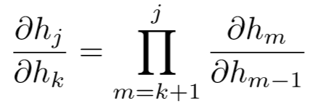
The Jacobian
j
Indirect dependency. One final use of the chain rule gives:
k
“The Jacobian”

Slide 22
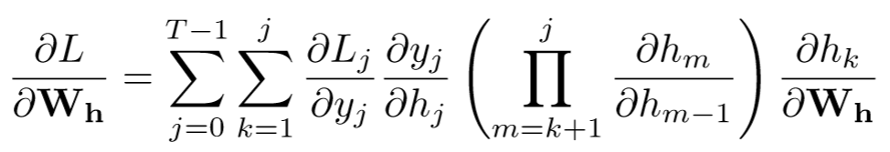
The Final Backpropagation Equation

Slide 23
Backpropagation as two summations
j
Often, to reduce memory requirement, we truncate the network
Inner summation runs from j-p to j for some p ==> truncated BPTT
k

Slide 24
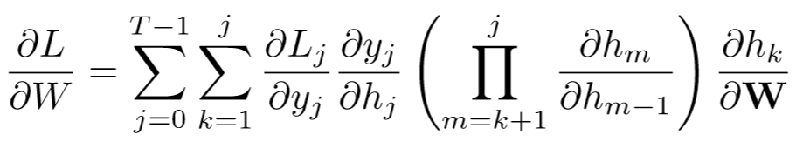

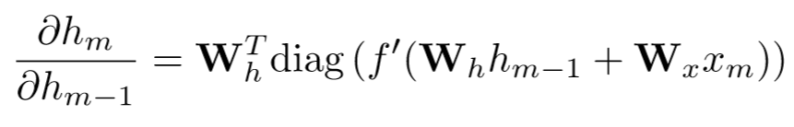
Expanding the Jacobian

Slide 25
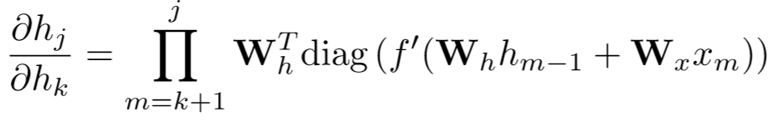
The Issue with the Jacobian
Weight Matrix
Derivative of activation function
Repeated matrix multiplications leads to vanishing and exploding gradients.
How? Let’s take a slight detour.

Slide 26

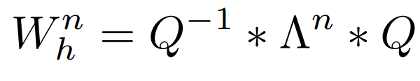
Eigenvalues and Stability
Q matrix composed of eigenvectors of W_{h}
Consider identity activation function
If Recurrent Matrix W_{h} is a diagonalizable:
Λ is a diagonal matrix with eigenvalues placed on the diagonals
Computing powers of W_{h} is simple:
Bengio et al, "On the difficulty of training recurrent neural networks." (2012)

Slide 27
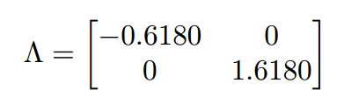
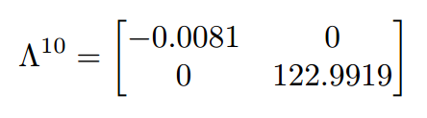
Eigenvalues and stability
Vanishing gradients
Exploding gradients
Notes:
Why is this a problem ? sign change

Slide 28
All Eigenvalues < 1 Eigenvalues > 1
Blog on “Explaining and illustrating orthogonal initialization for recurrent neural network”

Slide 29
2. Learning Long Term Dependencies

Slide 30
Outline
Vanishing/Exploding Gradients in RNN
Weight Initialization Methods
Constant Error Carousel
Hessian Free Optimization
Echo State Networks
Identity-RNN
np-RNN
LSTM
GRU
Notes:
Make organization clear, and make headings precise

Slide 31
Outline
Vanishing/Exploding Gradients in RNN
Weight Initialization Methods
Constant Error Carousel
Hessian Free Optimization
Echo State Networks
Identity-RNN
np-RNN
LSTM
GRU
Notes:
Make organization clear, and make headings precise

Slide 32
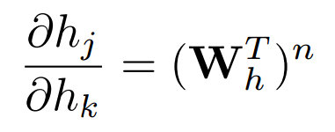

Weight Initialization Methods
Activation function : ReLU
Bengio et al,. "On the difficulty of training recurrent neural networks." (2012)

Slide 33
Weight Initialization Methods
Random W_{h} initialization of RNN has no constraint on eigenvalues
⇒ vanishing or exploding gradients in the initial epoch

Slide 34
Weight Initialization Methods
Careful initialization of W_{h} with suitable eigenvalues
⇒ allows the RNN to learn in the initial epochs
⇒ hence can generalize well for further iterations

Slide 35
Weight Initialization Trick #1: IRNN
W_{h} initialized to Identity
Activation function: ReLU
Geoffrey et al, “A Simple Way to Initialize Recurrent Networks of Rectified Linear Units”

Slide 36
Weight Initialization Trick #2: np-RNN
W_{h} positive definite (+ve real eigenvalues)
At least one eigenvalue is 1, others all less than equal to one
Activation function: ReLU
Geoffrey et al, “Improving Performance of Recurrent Neural Network with ReLU nonlinearity””

Slide 37
np-RNN vs IRNN
Sequence Classification Task
RNN Type | Accuracy Test | Parameter Complexity Compared to RNN | Sensitivity to parameters
IRNN | 67 % | x1 | high
np-RNN | 75.2 % | x1 | low
LSTM | 78.5 % | x4 | low
Geoffrey et al, “Improving Perfomance of Recurrent Neural Network with ReLU nonlinearity””

Slide 38
Summary
np-RNNs work as well as LSTMs utilizing 4 times less parameters than a LSTM

Slide 39
Outline
Vanishing/Exploding Gradients in RNN
Weight Initialization Methods
Constant Error Carousel
Hessian Free Optimization
Echo State Networks
Identity-RNN
np-RNN
LSTM
GRU
Notes:
Make organization clear, and make headings precise

Slide 40
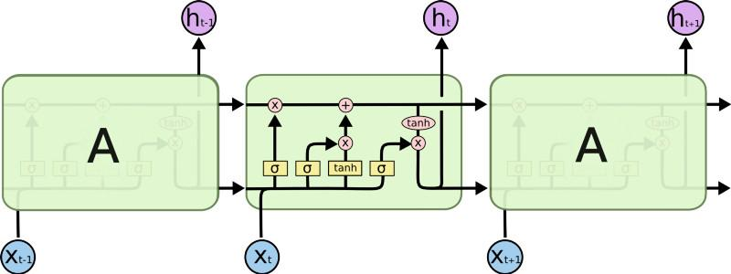
The LSTM Network
Source: http://colah.github.io/posts/2015-08-Understanding-LSTMs/

Slide 41
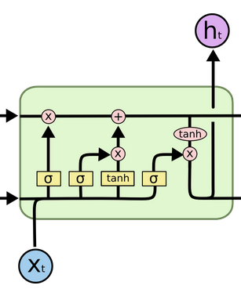
The LSTM Cell
σ(): sigmoid non-linearity
x : element-wise multiplication
Candidate state(g)
Forget gate(f)
Output gate(g)
Input gate(i)

Slide 42
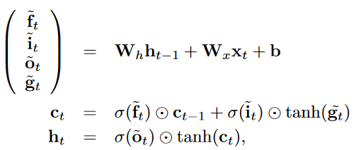
The LSTM Cell
Forget old state
Remember new state

Slide 43
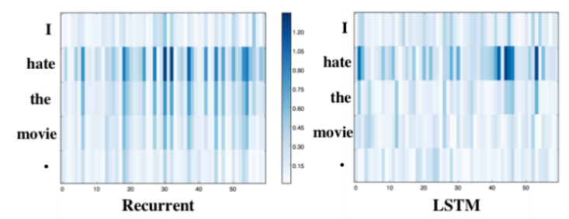
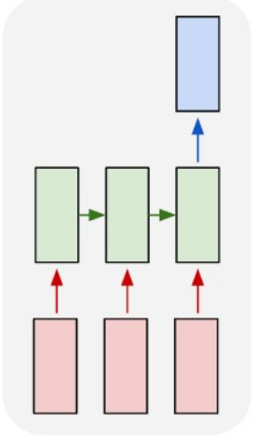
Long Term Dependencies with LSTM
Sentiment Analysis
Saliency Heatmap
Recent words more salient
Many-one network
LSTM captures long term dependencies
“Jiwei LI et al, “Visualizing and Understanding Neural Models in NLP”
”

Slide 44
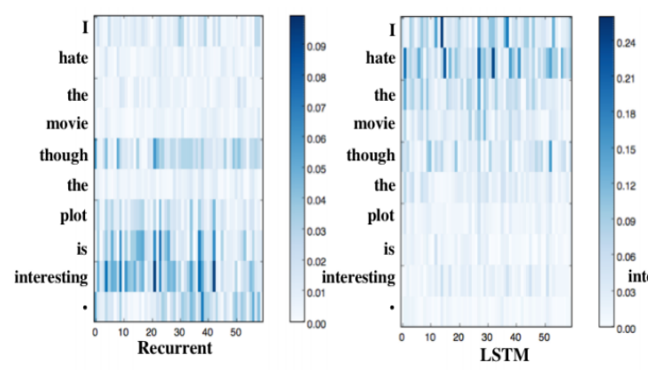
Long Term Dependencies with LSTM
Sentiment Analysis
Saliency Heatmap
Many-one network
LSTM captures long term dependencies
“Jiwei LI et al, “Visualizing and Understanding Neural Models in NLP”
”

Slide 45
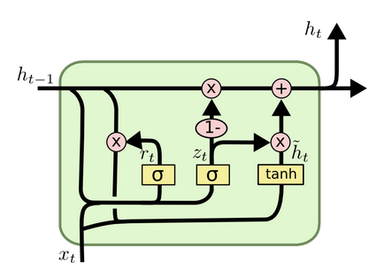
Gated Recurrent Unit
Replace forget (f) and input (i) gates with an update gate (z)
Introduce a reset gate (r ) that modifies h_{t-1}
Eliminate internal memory c_{t}
Source: http://colah.github.io/posts/2015-08-Understanding-LSTMs/

Slide 46
Comparing GRU and LSTM
Both GRU and LSTM better than RNN with tanh on music and speech modeling
GRU performs comparably to LSTM
No clear consensus between GRU and LSTM
Source: Empirical evaluation of GRUs on sequence modeling, 2014

Slide 47
3. Regularization in RNNs

Slide 48
Outline
Batch Normalization
Dropout

Slide 49
Recurrent Batch Normalization

Slide 50
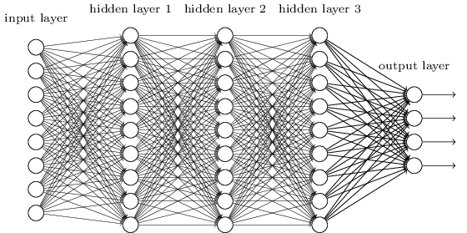
Internal Covariate Shift
If these weights are updated...
the distributions change in layers above!
The model needs to learn parameters while adapting to the changing input distribution
⇒ slower model convergence!
Source: https://i.stack.imgur.com/1bCQl.png

Slide 51
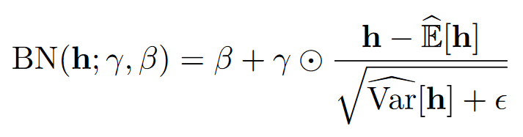
Solution: Batch Normalization
Batch Normalization Equation:
Hidden state, h
Bias, Std Dev: To be learned
Cooijmans, Tim, et al. "Recurrent batch normalization."(2016).

Slide 52
Extension of BN to RNNs: Trivial?
RNNs deepest along temporal dimension
Must be careful: repeated scaling could cause exploding gradients

Slide 53
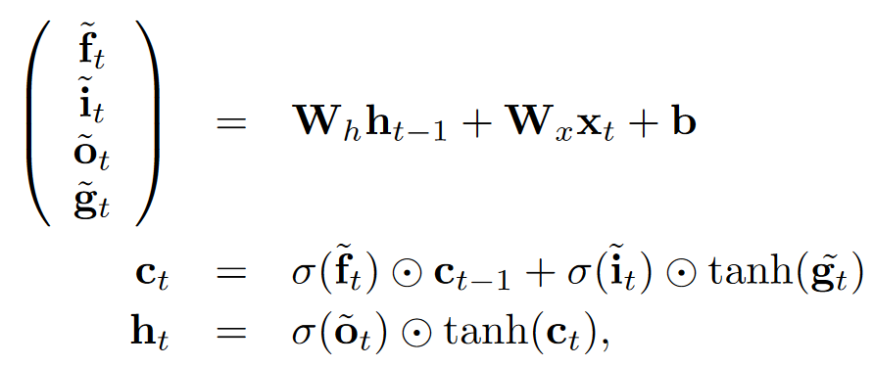
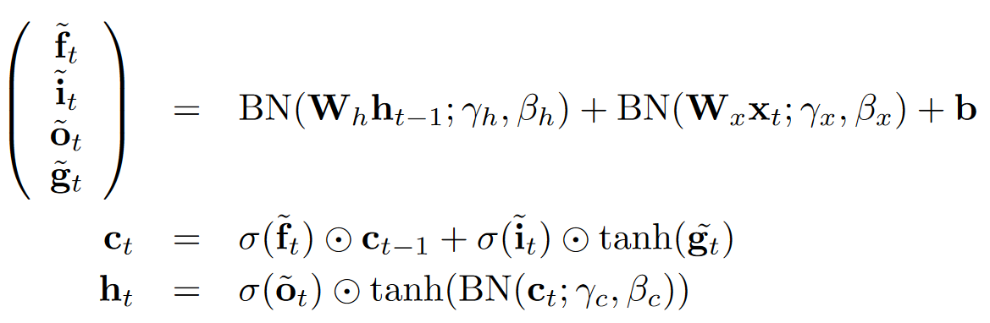
The method that’s effective
Original LSTM Equations
Batch Normalized LSTM
Cooijmans, Tim, et al. "Recurrent batch normalization."(2016).
Notes:
Gradient flow comment: Let’s say there’s a severe decline in the all values of c_{t} for some t. But due to normalization, this effect does not show up ⇒ it can affect the gradient flow severely.

Slide 54
Observations
x, h_{t-1} normalized separately
c_{t} not normalized
(doing so may disrupt gradient flow) How?
New state (h_{t}) normalized
Cooijmans, Tim, et al. "Recurrent batch normalization."(2016).
Notes:
Gradient flow comment: Let’s say there’s a severe decline in the all values of c_{t} for some t. But due to normalization, this effect does not show up ⇒ it can affect the gradient flow severely.

Slide 55

Additional Guidelines
Initialize β to 0, γ to a small value such as ~0.1. Else vanishing gradients (think of the tanh plot!)
Learn statistics for each time step independently till some time step T. Beyond T, use statistics for T
Cooijmans, Tim, et al. "Recurrent batch normalization."(2016).

Slide 56
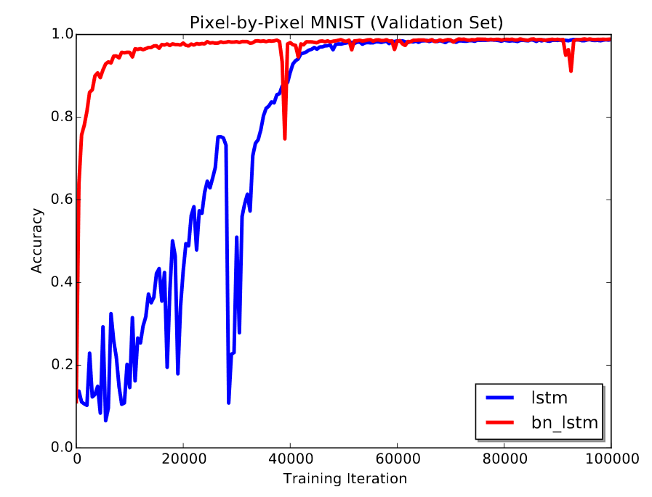
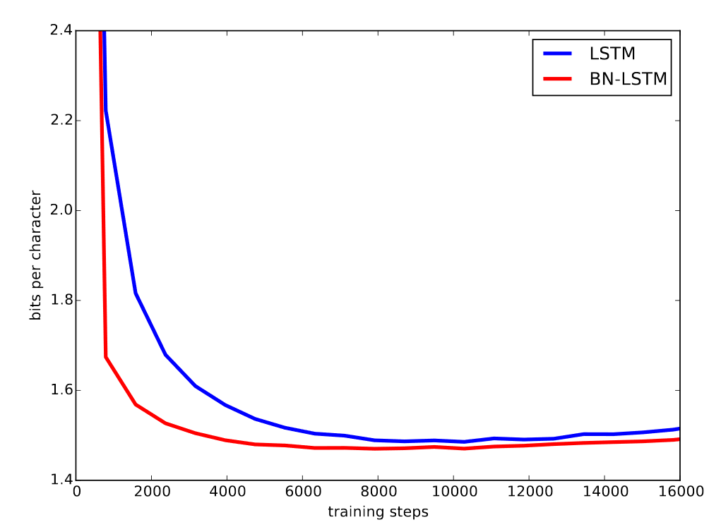
Results
A: Faster convergence due to Batch Norm
B: Performance as good as (if not better than) unnormalized LSTM
Bits per character for Penn Treebank
Cooijmans, Tim, et al. "Recurrent batch normalization."(2016).

Slide 57
Dropout In RNN

Slide 58
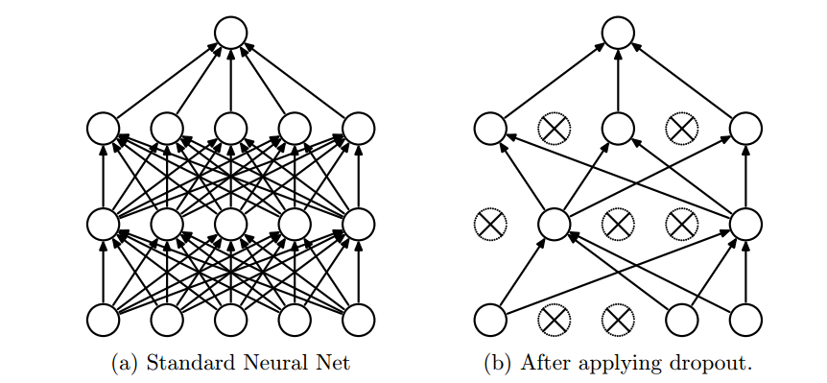
Recap: Dropout In Neural Networks
Srivastava et al. 2014. “Dropout: a simple way to prevent neural networks from overfitting”

Slide 59
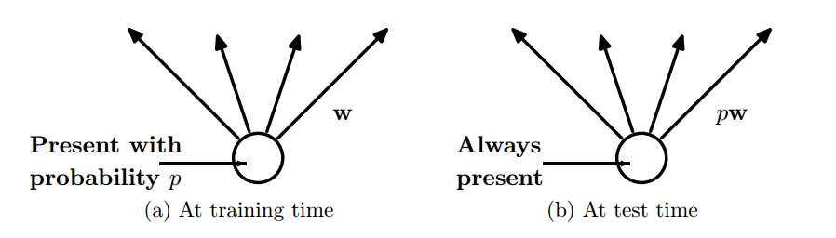
Recap: Dropout In Neural Networks
Srivastava et al. 2014. “Dropout: a simple way to prevent neural networks from overfitting”

Slide 60
Dropout
To prevent over confident models
High Level Intuition: Ensemble of thinned networks sampled through dropout
Interested in a theoretical proof ?
  A Probabilistic Theory of Deep Learning, Ankit B. Patel, Tan Nguyen, Richard G. Baraniuk
Skip Proof Slides

Slide 61
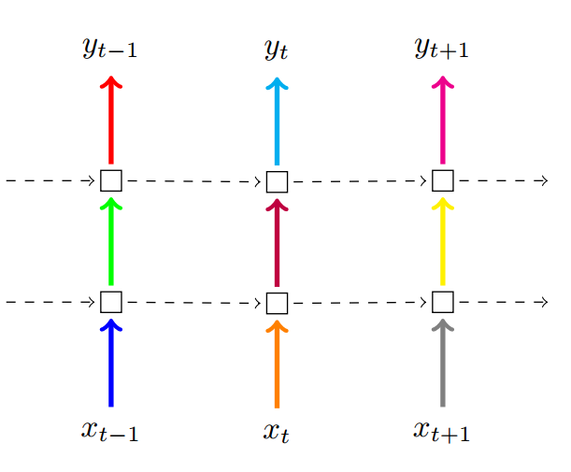
RNN Feedforward Dropout
Beneficial to use it once in correct spot rather than put it everywhere
Each color represents a different mask
Dropout hidden to output
Per-step mask sampling
Dropout input to hidden
Zaremba et al. 2014. “Recurrent neural network regularization”

Slide 62
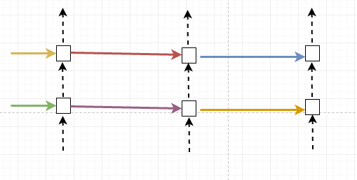
RNN Recurrent Dropout
MEMORY LOSS !
Only tends to retain short term dependencies

Slide 63
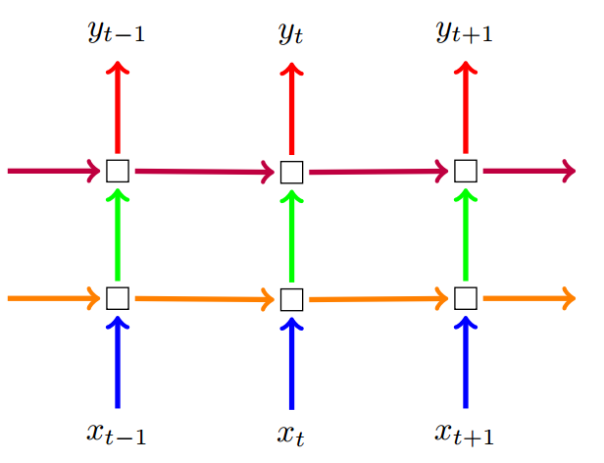
RNN Recurrent+Feedforward Dropout
Per-sequence mask sampling
Drop the time dependency of an entire feature
Gal 2015. “A theoretically grounded application of dropout in recurrent neural networks”

Slide 64
Dropout in LSTMs
Dropout on cell state (c_{t})
  Inefficient
Dropout on cell state update (tanh(g)_{t}) or (h_{t-1})
  Optimal
Barth (2016) : “Semenuita et al. 2016. “Recurrent dropout without memory loss”
Skip to Visualization

Slide 65
Some Results: Language Modelling Task
Model | Perplexity Scores
Original | 125.2
Forward Dropout + Drop (tanh(g_{t})) | 87 (-37)
Forward Dropout + Drop (h_{t-1}) | 88.4 (-36)
Forward Dropout | 89.5 (-35)
Forward Dropout + Drop (c_{t}) | 99.9 (-25)
Lower perplexity score is better !
Barth (2016) : “Semenuita et al. 2016. “Recurrent dropout without memory loss”

Slide 66
Section 4: Visualizing and Understanding Recurrent Networks

Slide 67
Visualization outline
Observe evolution of features during training
Visualize output predictions
Visualize neuron activations
Character Level Language Modelling task

Slide 68
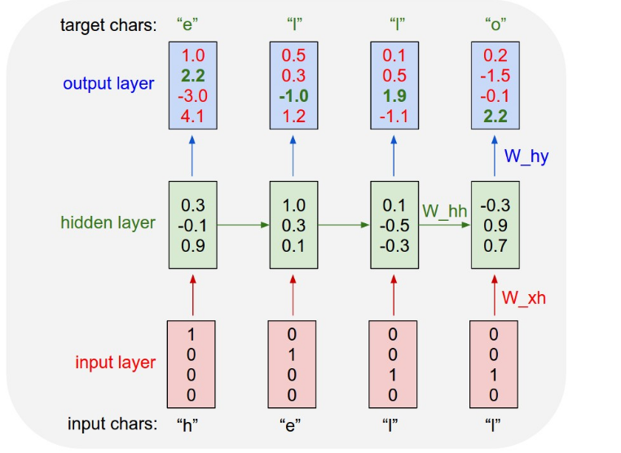
Character Level Language Modelling
Task: Predicting the next character given the current character
Andrej Karpathy, Blog on “Unreasonable Effectiveness of Recurrent Neural Networks”

Slide 69

Generated Text:
Remembers to close a bracket
Capitalize nouns
404 Page Not Found! :P The LSTM hallucinates it.
Andrej Karpathy, Blog on “Unreasonable Effectiveness of Recurrent Neural Networks”

Slide 70
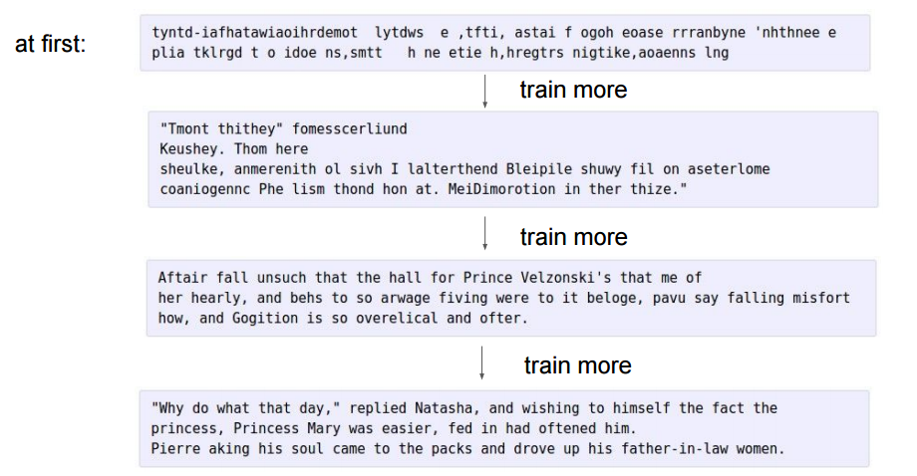
100 th
iteration
300 th
iteration
700 th
iteration
2000 th
iteration
Andrej Karpathy, Blog on “Unreasonable Effectiveness of Recurrent Neural Networks”

Slide 71
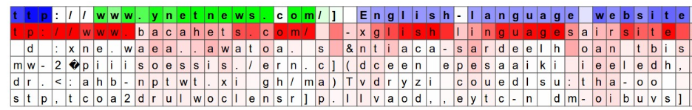
Visualizing Predictions and Neuron “firings”
Likely prediction
Not a likely prediction
Excited neuron in url
Not excited neuron outside url
Andrej Karpathy, Blog on “Unreasonable Effectiveness of Recurrent Neural Networks”

Slide 72
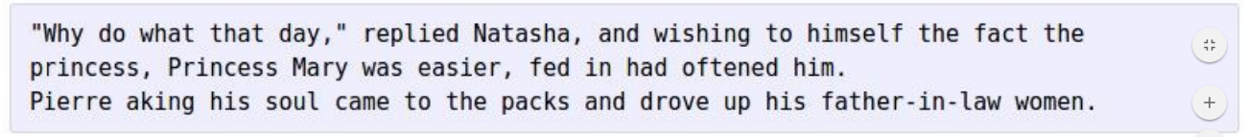
Features RNN Captures in Common Language ?

Slide 73
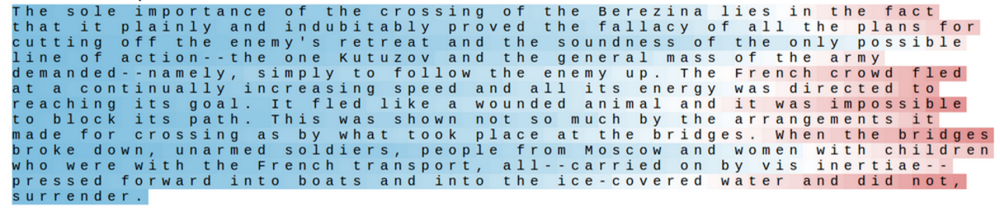
Cell Sensitive to Position in Line
Can be interpreted as tracking the line length
Andrej Karpathy, Blog on “Unreasonable Effectiveness of Recurrent Neural Networks”

Slide 74
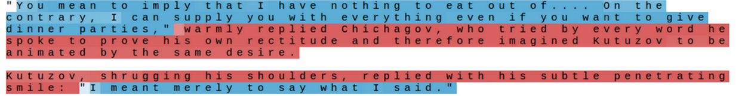
Cell That Turns On Inside Quotes
Andrej Karpathy, Blog on “Unreasonable Effectiveness of Recurrent Neural Networks”

Slide 75
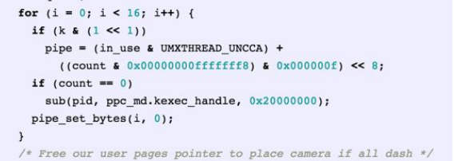
Features RNN Captures in C Language?

Slide 76
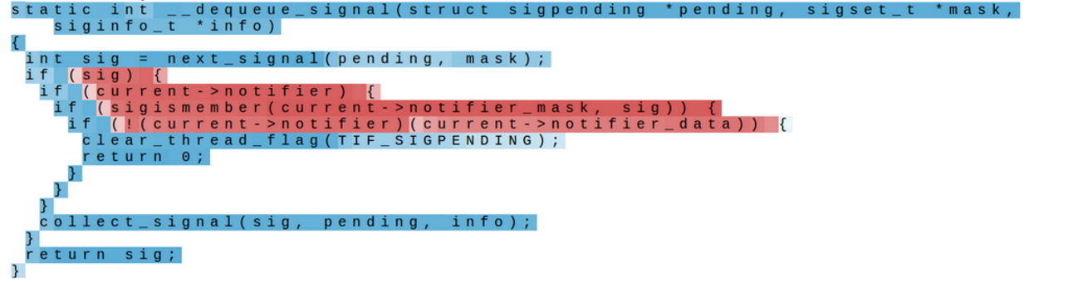
Cell That Activates Inside IF Statements
Andrej Karpathy, Blog on “Unreasonable Effectiveness of Recurrent Neural Networks”

Slide 77
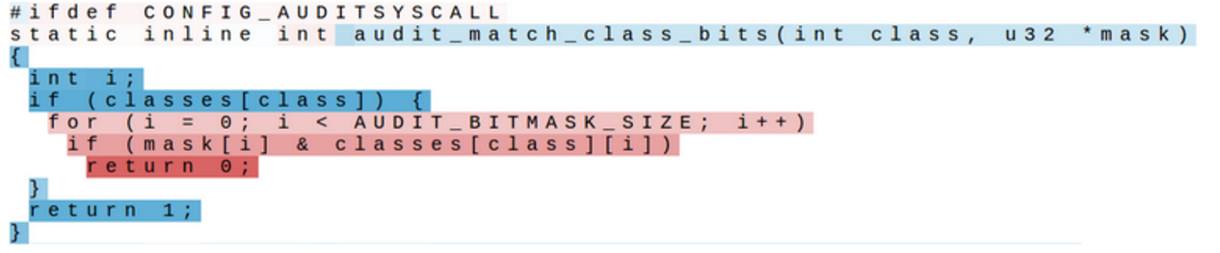
Cell That Is Sensitive To Indentation
Can be interpreted as tracking indentation of code.
Increasing strength as indentation increases
Andrej Karpathy, Blog on “Unreasonable Effectiveness of Recurrent Neural Networks”

Slide 78

Non-Interpretable Cells
Only 5% of the cells show such interesting properties
Large portion of the cells are not interpretable by themselves
Andrej Karpathy, Blog on “Unreasonable Effectiveness of Recurrent Neural Networks”

Slide 79
Visualizing Hidden State Dynamics
Observe changes in hidden state representation overtime
Tool : LSTMVis
Hendrick et al, “Visual Analysis of Hidden State Dynamics in Recurrent Neural Networks”

Slide 80

Visualizing Hidden State Dynamics
Hendrick et al, “Visual Analysis of Hidden State Dynamics in Recurrent Neural Networks”

Slide 81


Visualizing Hidden State Dynamics
Hendrick et al, “Visual Analysis of Hidden State Dynamics in Recurrent Neural Networks”

Slide 82
Key Takeaways
Deeper RNNs are more expressive
  Feedforward depth
  Recurrent depth
Long term dependencies are a major problem in RNNs. Solutions:
  Intelligent weight initialization
  LSTMs / GRUs
Regularization helps
  Batch Norm: faster convergence
  Dropout: better generalization
Visualization helps
  Analyze finer details of features produced by RNNs

Slide 83
References
Survey Papers
  Lipton, Zachary C., John Berkowitz, and Charles Elkan. A critical review of recurrent neural networks for sequence learning, arXiv preprint arXiv:1506.00019 (2015).
  Goodfellow, Ian, Yoshua Bengio, and Aaron Courville. Chapter 10: Sequence Modeling: Recurrent and Recursive Nets. MIT Press, 2016.
Training
  Semeniuta, Stanislau, Aliaksei Severyn, and Erhardt Barth. Recurrent dropout without memory loss. arXiv preprint arXiv:1603.05118 (2016).
  Arjovsky, Martin, Amar Shah, and Yoshua Bengio. Unitary evolution recurrent neural networks. arXiv preprint arXiv:1511.06464 (2015).
  Le, Quoc V., Navdeep Jaitly, and Geoffrey E. Hinton. A simple way to initialize recurrent networks of rectified linear units. arXiv preprint arXiv:1504.00941 (2015).
  Cooijmans, Tim, et al. Recurrent batch normalization. arXiv preprint arXiv:1603.09025 (2016).

Slide 84
References (contd)
Architectural Complexity Measures
  Zhang, Saizheng, et al, Architectural Complexity Measures of Recurrent Neural Networks. Advances in Neural Information Processing Systems. 2016.
  Pascanu, Razvan, et al. How to construct deep recurrent neural networks. arXiv preprint arXiv:1312.6026 (2013).
RNN Variants
  Zilly, Julian Georg, et al. Recurrent highway networks. arXiv preprint arXiv:1607.03474 (2016)
  Chung, Junyoung, Sungjin Ahn, and Yoshua Bengio. Hierarchical multiscale recurrent neural networks, arXiv preprint arXiv:1609.01704 (2016).
Visualization
  Karpathy, Andrej, Justin Johnson, and Li Fei-Fei. Visualizing and understanding recurrent networks. arXiv preprint arXiv:1506.02078 (2015).
  Hendrik Strobelt, Sebastian Gehrmann, Bernd Huber, Hanspeter Pfister, Alexander M. Rush. LSTMVis: Visual Analysis for RNN, arXiv preprint arXiv:1606.07461 (2016).

Slide 85
Appendix

Slide 86
Why go deep?

Slide 87
Another Perspective of the RNN
Affine transformation + element-wise non-linearity
It is equivalent to one fully connected layer feedforward NN
Shallow transformation

Slide 88


Visualizing Shallow Transformations
The Fully Connected Layer does 2 things:
1: Stretch / Rotate (affine)
2: Distort (non-linearity)
Linear separability is achieved!
Source: http://colah.github.io/posts/2014-03-NN-Manifolds-Topology/
Notes:
Affine Transformation
Preserves collinearity (i.e., points on a line remain on a line)
Preserves ratios of distances (i.e. midpoint of a line segment remains so after transformation)
Examples: rotation, scaling, reflection

Slide 89

Shallow isn’t always enough
Linear Separability may not be achieved for more complex datasets using just one layer ⇒ NN isn’t expressive enough!
Need more layers.

Slide 90

Visualizing Deep Transformations
4 layers, tanh activation
Linear separability!
Deeper networks utilize high level features ⇒ more expressive!
Can you tell apart the effect of each layer?
Source: http://colah.github.io/posts/2014-03-NN-Manifolds-Topology/

Slide 91
Which is more expressive?
Higher level features passed on ⇒ win!
Recurrent depth = 1
Feedforward depth = 4
Recurrent depth = 3
Feedforward depth = 4
Notes:
delete

Slide 92
Gershgorin Circle Theorem (GCT)

Slide 93


Gershgorin Circle Theorem (GCT)
A =
For any square matrix: The set of all eigenvalues is the union of of circles whose centers are a_{ii} and the radii are ∑_{i≠j} |a_{ij}|
Zilly, Julian Georg, et al. "Recurrent highway networks." arXiv preprint arXiv:1607.03474 (2016).

Slide 94


Implications of GCT
Nearly diagonal matrix
Source: https://de.mathworks.com/products/demos/machine-learning/handwriting_recognition/handwriting_recognition.html
Diffused matrix (strong off-diagonal terms), mean of all terms = 0
Source: https://i.stack.imgur.com/9inAk.png
Zilly, Julian Georg, et al. "Recurrent highway networks." arXiv preprint arXiv:1607.03474 (2016).

Slide 95
More Weight Initialization Methods

Slide 96

Weight Initialization Trick #2: np-RNN
W_{h} positive semi-definite (+ve real eigenvalues)
At least one eigenvalue is 1, others all less than equal to one
.
Activation Function: ReLU
R: standard normal matrix, values drawn from a Gaussian distribution with mean zero and unit variance
N: size of R
<,> dot product
e: Maximum eigenvalue of (A+I)
Geoffrey et al, “Improving Perfomance of Recurrent Neural Network with ReLU nonlinearity””
Notes:
Orthogonal Matrix: UU^{T} = I ?

Slide 97
Weight Initialization Trick #3: Unitary Matrix
Unitary Matrix: W_{h}W_{h}* = I (note: weight matrix is now complex!)
  (W_{h}* is the complex conjugate matrix of W_{h})
All eigenvalues of W_{h} have absolute value 1
Arjovsky, Martin, Amar Shah, and Yoshua Bengio. "Unitary evolution recurrent neural networks." 2015).

Slide 98

Challenge: Keeping a Matrix Unitary over time
Efficient Solution: Parametrize the matrix
Rank 1 Matrices derived from vectors
Storage and updates: O(n): efficient!
Arjovsky, Martin, Amar Shah, and Yoshua Bengio. "Unitary evolution recurrent neural networks." 2015).

Slide 99

Results for the Copying Memory Problem
Input:
a₁ a₂ …… a₁₀ 0 0 0 0 0 0… 0
10 symbols
T zeros
Output: a₁ … a₁₀
Challenge: Remembering symbols over an arbitrarily large time gap
uRNNs: Perfect!
Cross entropy for the copying memory problem
Arjovsky, Martin, Amar Shah, and Yoshua Bengio. "Unitary evolution recurrent neural networks." 2015).

Slide 100
Summary
Model | I-RNN | np-RNN | Unitary-RNN
Activation Function | ReLu | ReLu | ReLu
Initialization | Identity Matrix | Positive Semi-definite (normalized eigenvalues) | Unitary Matrix
Performance compared to LSTM | Less than or equal | Equal | Greater
Benchmark Tasks | Action Recognition, Addition, MNIST | Action Recognition, Addition MNIST | Copying Problem, Adding Problem
Sensitivity to hyper-parameters | High | Low | Low

Slide 101
Dropout

Slide 102




Model Moon (2015)
Moon (2015)
Able to learn long term dependencies, not capable of exploiting them during test phase
Test time equations for GRU,
P is the probability to not drop a neuron
For large t, hidden state contribution is close to zero during test

Slide 103


Model Barth (2016)
Barth (2016)
Drop differences that are added to the network, not the actual values
Allows to use per-step dropout
Test time equation after recursion,
P is the probability to not drop a neuron
For large t, hidden state contribution is retained as at train time

Slide 104
Visualization

Slide 105

Visualize gradients: Saliency maps
Categorize phrase/sentence into (v.positive, positive, neutral, negative, v.negative)
How much each unit contributes to the decision ?
  Magnitude of derivative if the loss with respect to each dimension of all word inputs
“Jiwei LI et al, “Visualizing and Understanding Neural Models in NLP”
”

Slide 106

Visualize gradients: Saliency maps
“Jiwei LI et al, “Visualizing and Understanding Neural Models in NLP”
”

Slide 107
Error Analysis
N-gram Errors
Dynamic n-long memory Errors
Rare word Errors
Word model Errors
Punctuation Errors
Boost Errors
“Karpathy et al, Visualizing and Understanding Recurrent Networks”

Slide 108
 | 50K -> 500K parameter model
Reduced Total Errors | 44K (184K-140K)
N-gram Error | 81% (36K/44K)
Dynamic n-long memory Errors | 1.7% (0.75K/44k)
Rare words Error | 1,7% (0.75K/44K)
Word model Error | 1.7% (0.75K/44k)
Punctuation Error | 1,7% (0.75K/44K)
Boost Error | 11.36% (5K/44K)

Slide 109
Error Analysis: Conclusions
N-gram Errors
  Scale model
Dynamic n-long memory
  Memory Networks
Rare words
  Increase training size
Word Level Predictions/ Punctuations:
  Hierarchical context models
    Stacked Models
    GF RNN, CW RNN
“Karpathy et al, Visualizing and Understanding Recurrent Networks”

Slide 110
Recurrent Highway Networks

Slide 111
Understanding Long Term Dependencies from Jacobian
Learning long term dependencies is a challenge because:
If the Jacobian has a spectral radius (absolute largest eigenvalue) < 1 ,the network faces vanishing gradients. Here it happens if γσ_{max} < 1
  Hence, ReLU’s are an attractive option! They have σ_{max}= 1 (given at least one positive element)
If the Jacobian has a spectral radius > 1 ,the network faces exploding gradients

Slide 112

Recurrent Highway Networks (RHN)
LSTM!
Recurrence
Zilly, Julian Georg, et al. "Recurrent highway networks." arXiv preprint arXiv:1607.03474 (2016).

Slide 113





RHN Equations
RHN:
  Recurrent depth
  Feedforward depth (not shown)
Input transformations:
  T, C: Transform, Carry operators
RHN Output:
State update equation for RHN with recurrence depth L:
Note: h is transformed input, y is state
Indicator function
Recurrence layer Index
Zilly, Julian Georg, et al. "Recurrent highway networks." arXiv preprint arXiv:1607.03474 (2016).

Slide 114





Gradient Equations in RHN
For an RHN with recurrence depth 1, RHN Output is:
Jacobian is simple:
But the gradient of A is not:
where:
Using the above and GCT, the centers of the circles are:
The radii are:
The eigenvalues lie within these circles

Slide 115
Analysis
Centers: , radii:
If we wish to completely remember the previous state: c = 1, t = 0
  Saturation ⇒ T’ = C’ = 0_{nxn}
  Thus, centers (λ) are 1, radii are 0
If we wish to completely forget the previous state: c = 0, t = 1
  Eigenvalues are those of H’
Possible to span the spectrum between these two cases by adjusting the Jacobian A
(*) Increasing depth improves expressivity

Slide 116



Results
BPC on Penn Treebank
BPC on enwiki8 (Hutter Prize)
BPC on text8 (Hutter Prize)

Slide 117
LSTMs for Language Models

Slide 118
LSTMs are Very Effective!
Application: Language Model
Task: Predicting the next character given the current character

Slide 119
Train Input: Wikipedia Data
Hutter Prize 100 MB Dataset of raw wikipedia, 96 MB for training
Trained overnight on a LSTM

Slide 120
Generated Text:
Remembers to close a bracket
Capitalize nouns
404 Page Not Found! :P The LSTM hallucinates it.

Slide 121
Train Input:
Test Output
16MB of Latex source of algebraic stacks/geometry
Trained on Multi-Layer LSTM
Generated Latex files “almost” compile, the authors had to fix some issues manually
We will look at some of these errors

Slide 122

Generated Latex Source Code
Begins with a proof but ends with a lemma
Begins enumerate but does not end it
Likely because of the long term dependency.
Can be reduced with larger/better models

Slide 123

Compiled Latex Files: Hallucinated Algebra
Generates Lemmas and their proofs
Equations with correct latex structure
No, they dont mean anything yet !

Slide 124


Compiled Latex Files: Hallucinated Algebra
Nice try on the diagrams !

