Slide 1
Deep Learning for Audio
Yuchen Fan, Matt Potok, Christopher Shroba

Slide 2
Motivation
Text-to-Speech
Accessibility features for people with little to no vision, or people in situations where they cannot look at a screen or other textual source
Natural language interfaces for a more fluid and natural way to interact with computers
Voice Assistants (Siri, etc.), GPS, Screen Readers, Automated telephony systems
Automatic Speech Recognition
Again, natural language interfaces
Alternative input medium for accessibility purposes
Voice Assistants (Siri, etc.), Automated telephony systems, Hands-free phone control in the car
Music Generation
Mostly for fun
Possible applications in music production software

Slide 3
Outline
Automatic Speech Recognition (ASR)
Deep models with HMMs
Connectionist Temporal Classification (CTC)
Attention based models
Text to Speech (TTS)
WaveNet
DeepVoice
Tacotron
Bonus: Music Generation

Slide 4
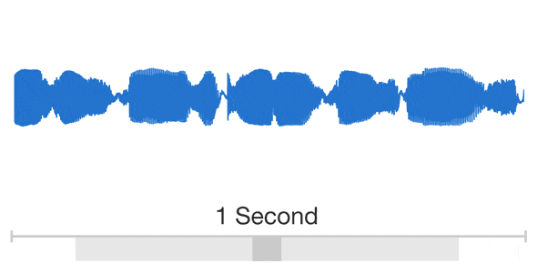
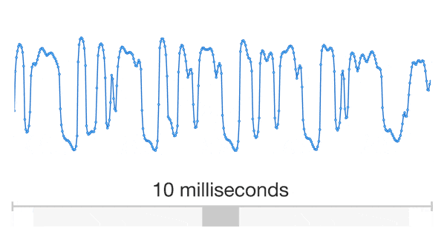
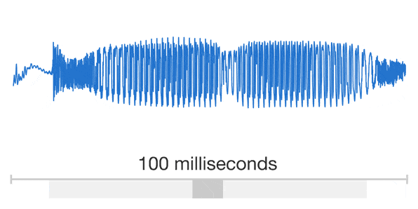

Slide 5
Automatic Speech Recognition (ASR)

Slide 6
Outline
History of Automatic Speech Recognition
Hidden Markov Model (HMM) based Automatic Speech Recognition
Gaussian mixture models with HMMs
Deep models with HMMs
End-to-End Deep Models based Automatic Speech Recognition
Connectionist Temporal Classification (CTC)
Attention based models

Slide 7
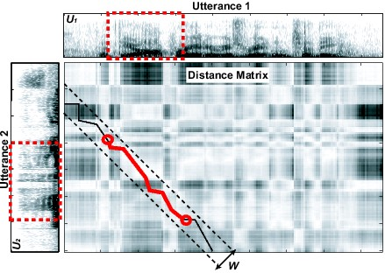
History of Automatic Speech Recognition
Early 1970s: Dynamic Time Warping (DTW) to handle time variability
Distance measure for spectral variability
http://publications.csail.mit.edu/abstracts/abstracts06/malex/seg_dtw.jpg

Slide 8
History of Automatic Speech Recognition
Mid-Late 1970s: Hidden Markov Models (HMMs) – statistical models of spectral variations, for discrete speech.
Mid 1980s: HMMs become the dominant technique for all ASR
sil
a
i
sil
0
1
2
(kHz)
3
4
5
http://hts.sp.nitech.ac.jp/archives/2.3/HTS_Slides.zip

Slide 9
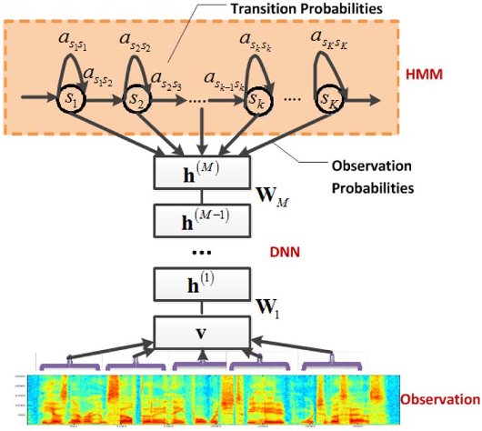
History of Automatic Speech Recognition
1990s: Large vocabulary continuous dictation
2000s: Discriminative training (minimize word/phone error rate)
2010s: Deep learning significantly reduce error rate
George E. Dahl, et al. Context-Dependent Pre-Trained Deep Neural Networks for Large-Vocabulary Speech Recognition. IEEE Trans. Audio, Speech & Language Processing, 2012.

Slide 10
Aim of Automatic Speech Recognition
Find the most likely sentence (word sequence) $W$, which transcribes the speech audio $A$:
$$\hat{W}=\underset{W}{argmax}{P\left(W | A\right)}=\underset{W}{argmax}{P\left(A | W\right)P(W)}$$
Acoustic model $P\left(A | W\right)$
Language model $P(W)$
Training: find parameters for acoustic and language model separately
Speech Corpus: speech waveform and human-annotated transcriptions
Language model: with extra data (prefer daily expressions corpus for spontaneous speech)

Slide 11
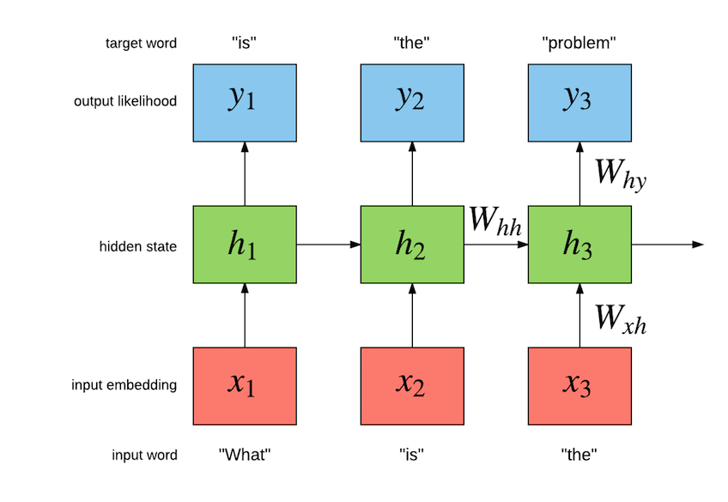
Language model
Language model is a probabilistic model used to
Guide the search algorithm (predict next word given history)
Disambiguate between phrases which are acoustically similar
Great wine vs Grey twine
It assigns probability to a sequence of tokens to be finally recognized
N-gram model $P\left(w_{N} | w_{1},w_{2},⋯,w_{N−1}\right)$
Recurrent neural network
Recurrent neural network based Language model
http://torch.ch/blog/2016/07/25/nce.html

Slide 12
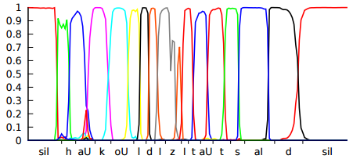
Architecture of Speech Recognition
$\hat{W}=\underset{W}{argmax}{P\left(W | O\right)}=\underset{W}{argmax}{P\left(A | O\right)P\left(O | Q\right)P\left(Q | L\right)P\left(L | W\right)P(W)}$
$$P\left(A | O\right)$$
$$P\left(O | Q\right)$$
$$P\left(Q | L\right)$$
$$P\left(L | W\right)$$
$$P(W)$$
Feature
Extraction
Frame
Classification
Sequence
Model
Lexicon
Model
Language
Model
t ah m aa t ow
$$A$$
$$O$$
$$Q$$
$$L$$
$$W$$
Speech Audio
Feature Frames
Sequence States
Phonemes
Words
Sentence

Slide 13
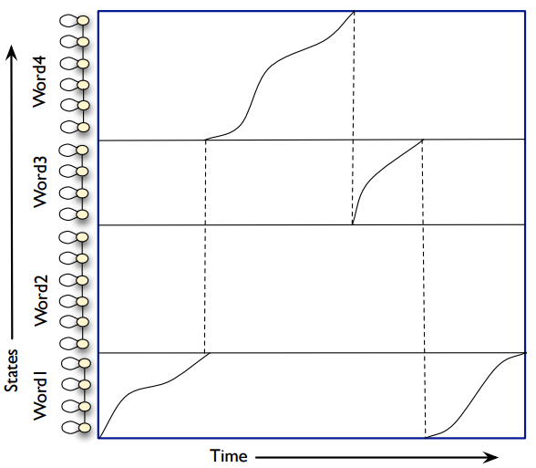
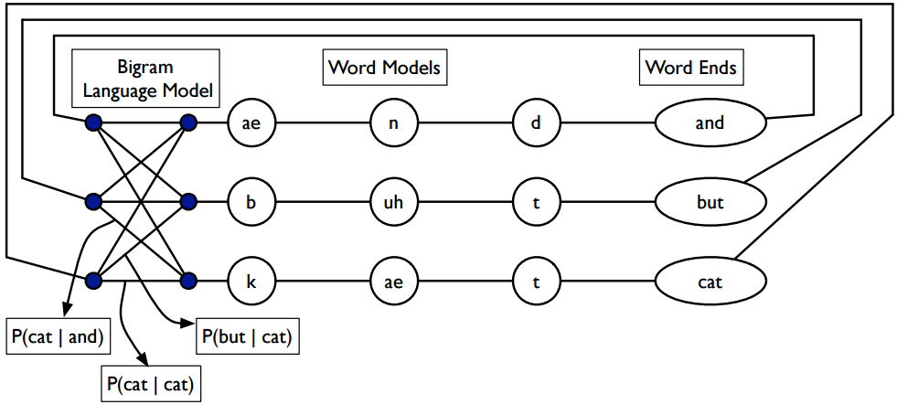
Decoding in Speech Recognition
Find most likely word sequence of audio input
Without language models
With language models
https://www.inf.ed.ac.uk/teaching/courses/asr/2011-12/asr-search-nup4.pdf

Slide 14
Architecture of Speech Recognition
$\hat{W}=\underset{W}{argmax}{P\left(W | O\right)}=\underset{W}{argmax}{P\left(A | O\right)P\left(O | Q\right)P\left(Q | L\right)P\left(L | W\right)P(W)}$
$$P\left(A | O\right)$$
$$P\left(O | Q\right)$$
$$P\left(Q | L\right)$$
$$P\left(L | W\right)$$
$$P(W)$$
Feature
Extraction
Frame
Classification
Sequence
Model
Lexicon
Model
Language
Model
t ah m aa t ow
$$A$$
$$O$$
$$Q$$
$$L$$
$$W$$
Speech Audio
Feature Frames
Sequence States
Phonemes
Words
Sentence
deterministic

Slide 15
Architecture of Speech Recognition
$\hat{W}=\underset{W}{argmax}{P\left(W | O\right)}=\underset{W}{argmax}{P\left(A | O\right)P\left(O | Q\right)P\left(Q | L\right)P\left(L | W\right)P(W)}$
$$P\left(A | O\right)$$
$$P\left(O | Q\right)$$
$$P\left(Q | L\right)$$
$$P\left(L | W\right)$$
$$P(W)$$
Feature
Extraction
Frame
Classification
Sequence
Model
Lexicon
Model
Language
Model
t ah m aa t ow
$$A$$
$$O$$
$$Q$$
$$L$$
$$W$$
Speech Audio
Feature Frames
Sequence States
Phonemes
Words
Sentence

Slide 16
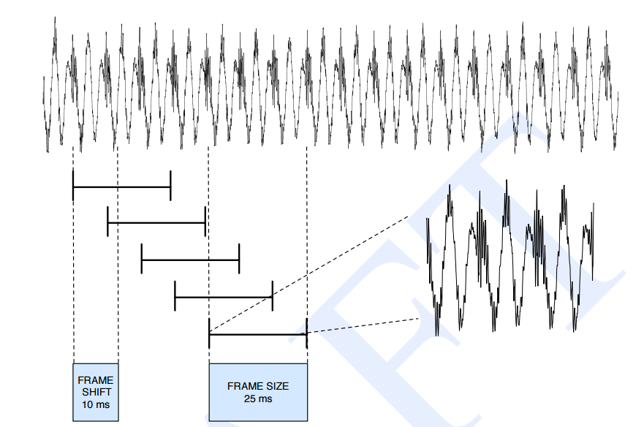
Feature Extraction
Raw waveforms are transformed into a sequence of feature vectors using signal processing approaches
Time domain to frequency domain
Feature extraction is a deterministic process
$$P\left(A | O\right)=δ(A,\hat{A}(O))$$
Reduce information rate but keep useful information
Remove noise and other irrelevant information
Extracted in 25ms windows and shifted with 10ms
Still useful for deep models
http://www2.cmpe.boun.edu.tr/courses/cmpe362/spring2014/files/projects/MFCC%20Feature%20Extraction.pdf

Slide 17
Different Level Features
Better for deep models
Better for shallow models
http://music.ece.drexel.edu/research/voiceID/researchday2007

Slide 18
Architecture of Speech Recognition
$\hat{W}=\underset{W}{argmax}{P\left(W | O\right)}=\underset{W}{argmax}{P\left(A | O\right)P\left(O | Q\right)P\left(Q | L\right)P\left(L | W\right)P(W)}$
$$P\left(A | O\right)$$
$$P\left(O | Q\right)$$
$$P\left(Q | L\right)$$
$$P\left(L | W\right)$$
$$P(W)$$
Feature
Extraction
Frame
Classification
Sequence
Model
Lexicon
Model
Language
Model
t ah m aa t ow
$$A$$
$$O$$
$$Q$$
$$L$$
$$W$$
Speech Audio
Feature Frames
Sequence States
Phonemes
Words
Sentence

Slide 19
Lexical model
Lexical modelling forms the bridge between the acoustic and language models
Prior knowledge of language
Mapping between words and the acoustic units (phoneme is most common)
Deterministic Probabilistic
Word | Pronunciation
TOMATO | t ah m aa t ow
 | t ah m ey t ow
COVERAGE | k ah v er ah jh
 | k ah v r ah jh
Word | Pronunciation | Probability
TOMATO | t ah m aa t ow | 0.45
 | t ah m ey t ow | 0.55
COVERAGE | k ah v er ah jh | 0.65
 | k ah v r ah jh | 0.35

Slide 20
GMM-HMM in Speech Recognition
GMMs: Gaussian Mixture Models
HMMs: Hidden Markov Models
$$GMMs$$
HMMs
Feature
Extraction
Frame
Classification
Sequence
Model
Lexicon
Model
Language
Model
t ah m aa t ow
$$A$$
$$O$$
$$Q$$
$$L$$
$$W$$
Speech Audio
Feature Frames
Sequence States
Phonemes
Words
Sentence

Slide 21
GMM-HMM in Speech Recognition
GMMs: Gaussian Mixture Models
HMMs: Hidden Markov Models
$$GMMs$$
HMMs
Feature
Extraction
Frame
Classification
Sequence
Model
Lexicon
Model
Language
Model
t ah m aa t ow
$$A$$
$$O$$
$$Q$$
$$L$$
$$W$$
Speech Audio
Feature Frames
Sequence States
Phonemes
Words
Sentence

Slide 22
Hidden Markov Models
The Markov chain whose state sequence is unknown
: State transition probability
: Output probability
Observation
sequence
State sequence
http://hts.sp.nitech.ac.jp/archives/2.3/HTS_Slides.zip

Slide 23
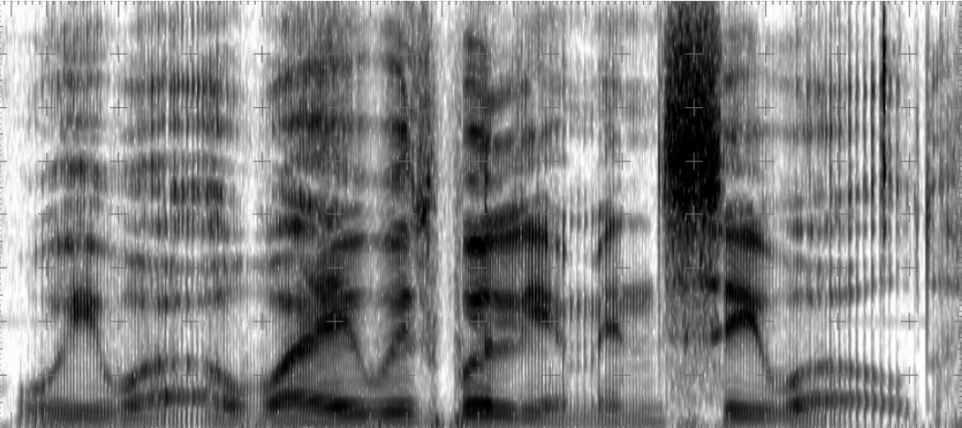
Context Dependent Model
We were away with William in Sea World
Realization of w varies but similar patterns occur in the similar context

Slide 24
Context Dependent Model
Phoneme
sequence
In English
#Monophone : 46
#Biphone: 2116
#Triphone: 97336
s a cl p a r i w a k a r a n a i
s-a-cl
p-a-r
n-a-i
Context-dependent HMMs
http://hts.sp.nitech.ac.jp/archives/2.3/HTS_Slides.zip

Slide 25
Decision Tree-based State Clustering
Each state separated automatically by the optimum question
L=voice?
k-a+b
yes
no
t-a+h
L=“w”?
R=silence?
yes
no
yes
no
s-i+n
R=silence?
L=“gy”?
…
…
yes
no
yes
no
C=unvoice?
C=vowel?
R=silence?
R=“cl”?
L=“gy”?
L=voice?
…
…
Sharing the parameter of HMMs in same leaf node
http://hts.sp.nitech.ac.jp/archives/2.3/HTS_Slides.zip

Slide 26
GMM-HMM in Speech Recognition
GMMs: Gaussian Mixture Models
HMMs: Hidden Markov Models
$$GMMs$$
HMMs
Feature
Extraction
Frame
Classification
Sequence
Model
Lexicon
Model
Language
Model
t ah m aa t ow
$$A$$
$$O$$
$$Q$$
$$L$$
$$W$$
Speech Audio
Feature Frames
Sequence States
Phonemes
Words
Sentence

Slide 27
Gaussian Mixture Models
Output probability is modeled by Gaussian mixture models
$$b_{q}\left(o_{t}\right)=b\left(o_{t} | q_{t}\right)$$
$$=\sum_{m=1}^{M}{w_{q_{t},m}N\left(o_{t} | μ_{m},Σ_{m}\right)}$$
http://hts.sp.nitech.ac.jp/archives/2.3/HTS_Slides.zip

Slide 28
GMM-HMM in Speech Recognition
GMMs: Gaussian Mixture Models
HMMs: Hidden Markov Models
$$GMMs$$
HMMs
Feature
Extraction
Frame
Classification
Sequence
Model
Lexicon
Model
Language
Model
t ah m aa t ow
$$A$$
$$O$$
$$Q$$
$$L$$
$$W$$
Speech Audio
Feature Frames
Sequence States
Phonemes
Words
Sentence

Slide 29
DNN-HMM in Speech Recognition
DNN: Deep Neural Networks
HMMs: Hidden Markov Models
$$DNNs$$
HMMs
Feature
Extraction
Frame
Classification
Sequence
Model
Lexicon
Model
Language
Model
t ah m aa t ow
$$A$$
$$O$$
$$Q$$
$$L$$
$$W$$
Speech Audio
Feature Frames
Sequence States
Phonemes
Words
Sentence

Slide 30
Ingredients for Deep Learning
Acoustic features
Frequency domain features extracted from waveform
10ms interval between frames
~40 dimensions for each frame
State alignments
Tied-state of context-dependent HMMs
Mapping between acoustic features and states

Slide 31
DNN-HMM in Speech Recognition
DNN: Deep Neural Networks
HMMs: Hidden Markov Models
$$DNNs$$
HMMs
Feature
Extraction
Frame
Classification
Sequence
Model
Lexicon
Model
Language
Model
t ah m aa t ow
$$A$$
$$O$$
$$Q$$
$$L$$
$$W$$
Speech Audio
Feature Frames
Sequence States
Phonemes
Words
Sentence

Slide 32
Deep Models in HMM-based ASR
Classify acoustic features for state labels
Take softmax output as a posterior $P\left(state | o_{t}\right)=P\left(q_{t} | o_{t}\right)$
Work as output probability in HMM
$$b_{q}\left(o_{t}\right)=b\left(o_{t} | q_{t}\right)=\frac{P\left(q_{t} | o_{t}\right)P(o_{t})}{P(q_{t})}$$
where $P(q_{t})$ is the prior probability for states

Slide 33
Fully Connected Networks
Features including 2 X 5 neighboring frames
1D convolution with kernel size 11
Classify 9,304 tied states
7 hidden layers X 2048 units with sigmoid activation
G. Hinton, et al. Deep Neural Networks for Acoustic Modeling in Speech Recognition. Signal Processing Magazine (2012).

Slide 34
Fully Connected Networks
Pre-training
Unsupervised: stacked restricted Boltzmann machine (RBM)
Supervised: iteratively adding layers from shallow model
Training
Maximum cross entropy for frames
Fine-tuning
Maximum mutual information for sequences
G. Hinton, et al. Deep Neural Networks for Acoustic Modeling in Speech Recognition. Signal Processing Magazine (2012).

Slide 35
Fully Connected Networks
Comparison on different large datasets
G. Hinton, et al. Deep Neural Networks for Acoustic Modeling in Speech Recognition. Signal Processing Magazine (2012).

Slide 36
DNN-HMM vs. GMM-HMM
Deep models are more powerful
GMM assumes data is generated from single component of mixture model
GMM with diagonal variance matrix ignores correlation between dimensions
Deep models take data more efficiently
GMM consists with many components and each learns from a small fraction of data
Deep models can be further improved by recent advances in deep learning

Slide 37
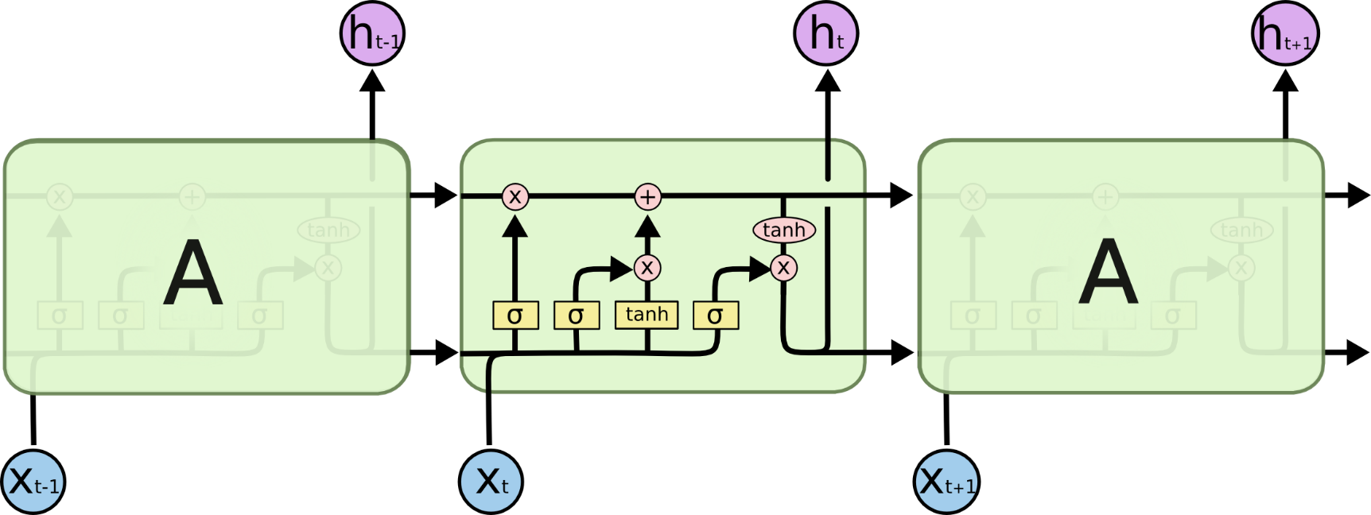
Recurrent Networks
Long Short Term Memory networks
http://colah.github.io/posts/2015-08-Understanding-LSTMs/

Slide 38
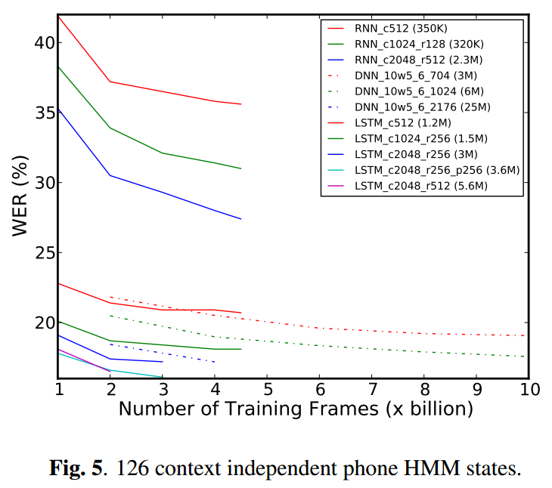
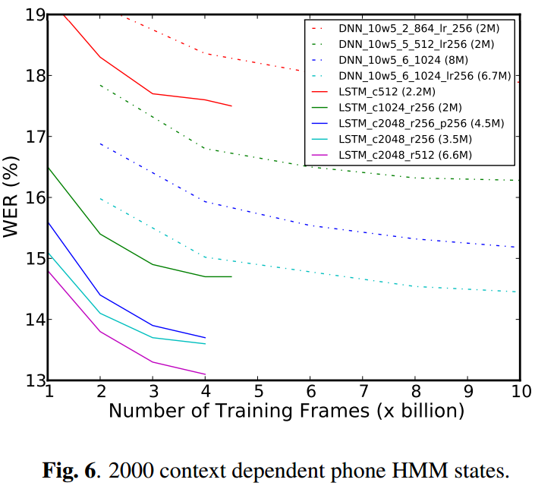
Recurrent Networks
H. Sak, A. Senior, and F. Beaufays. Long Short-Term Memory Recurrent Neural Network Architectures for Large Scale Acoustic Modeling. arXiv preprint arXiv:1402.1128v1 (2014).

Slide 39
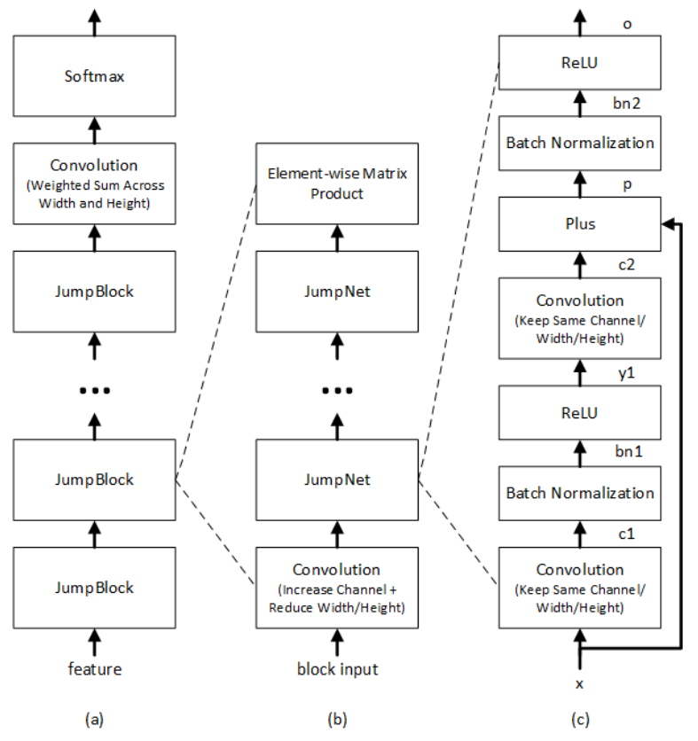
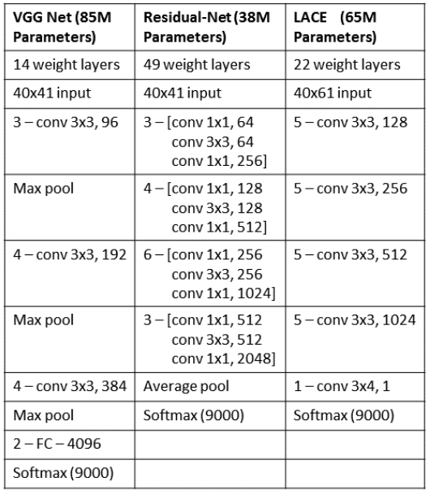
Very Deep Networks
LACE
W. Xiong, et al. Achieving Human Parity in Conversational Speech Recognition. arXiv preprint arXiv:1610.05256 (2016).

Slide 40
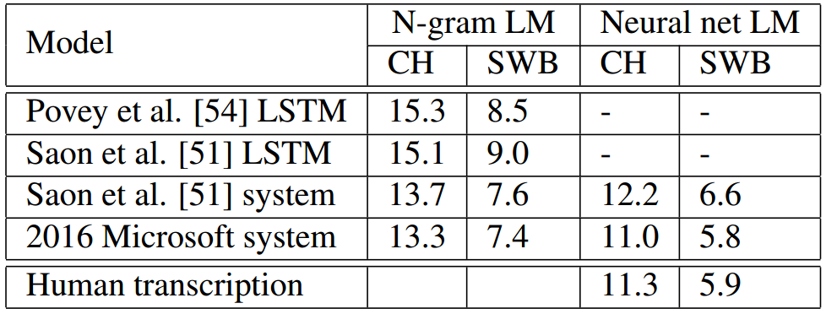
Very Deep Networks
Speaker adaptive training
Addition speaker id embedded vector as input
Language model with LSTM
System combination
Greedy-searched weight to combine multiple model system
Reuslts on the test set: CH and SWB Exceed human accuracy
Word error rates | CH | SWB
ResNet | 14.8 | 8.6
VGG | 15.7 | 9.1
LACE | 15.0 | 8.4

Slide 41
Limitations of DNN-HMM
Markov models only depend one previous states
History is discretely represented by 10k states
Decoding is slow to keep all 10k state in dynamic programing
Decoding with dynamic programing

Slide 42
DNN-HMM in Speech Recognition
DNN: Deep Neural Networks
HMMs: Hidden Markov Models
$$DNNs$$
HMMs
Feature
Extraction
Frame
Classification
Sequence
Model
Lexicon
Model
Language
Model
t ah m aa t ow
$$A$$
$$O$$
$$Q$$
$$L$$
$$W$$
Speech Audio
Feature Frames
Sequence States
Phonemes
Words
Sentence

Slide 43
End-to-End Deep Models based Automatic Speech Recognition
Connectionist Temporal Classification (CTC) based models
LSTM CTC models
Deep speech 2
Attention based models

Slide 44
CTC in Speech Recognition
RNN: Recurrent Neural Networks
CTC: Connectionist Temporal Classification
$$RNNs$$
CTC
Feature
Extraction
Frame
Classification
Sequence
Model
Lexicon
Model
Language
Model
t ah m aa t ow
$$A$$
$$O$$
$$Q$$
$$L$$
$$W$$
Speech Audio
Feature Frames
Sequence States
Phonemes
Words
Sentence

Slide 45
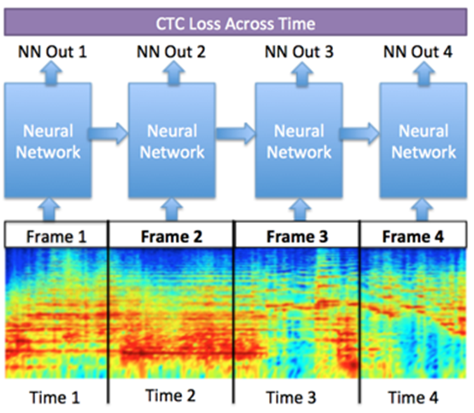
Connectionist Temporal Classification (CTC)
Method for labeling unsegmented data sequences
Raw waveforms and text transcription
Differentiable objective function
Gradient based training
$O^{ML}\left(S, 𝒩_{w}\right)=−\sum_{\left(x,z\right)∈S}{\ln\left(p\left(z | x\right)\right)}$
Used in various ASR and TTS architectures
DeepSpeech (ASR)
DeepVoice(TTS)
https://gab41.lab41.org/speech-recognition-you-down-with-ctc-8d3b558943f0, ftp://ftp.idsia.ch/pub/juergen/icml2006.pdf
Notes:
Show an image of some waveform and the corresponding text to make problem clearer
Papers that use CTC:
-- DeepVoice
--DeepSpeech

Slide 46
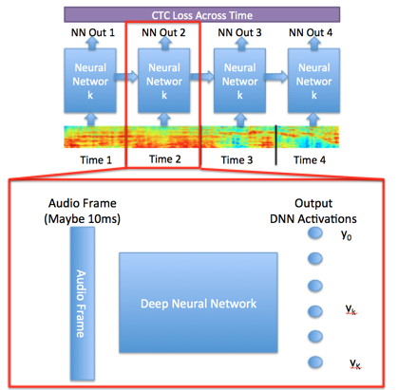
CTC Problem
Training examples $S=\left\{\left(x_{1},z_{1}\right), …\left\{x_{N}, z_{N}\right\}\right)∈𝒟_{𝒳×𝒵}$
$x∈𝒳$ are waveforms
$z∈𝒵$ are text transcripts
Goal: train temporal classifier $h : 𝒳 → 𝒵$
Architecture
Input layer accepts audio frame
Some network (usually CNN or RNN)
Softmax output over phones
https://gab41.lab41.org/speech-recognition-you-down-with-ctc-8d3b558943f0, ftp://ftp.idsia.ch/pub/juergen/icml2006.pdf
Notes:
Formalization of problem

Slide 47
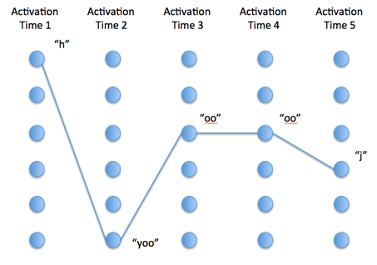
CTC Description
Let $𝒩_{w}\left(x\right)=\{y_{k}^{t}\}$ be NN with a softmax output
$y_{k}^{t}$ is activation of output unit $k$ at time frame $t$
Activations over time define distribution over $L^{T}$
Sequences over $L^{T}≜π=\{π_{1}, …, π_{T}\}$ are paths
Optimize for best path:
$$P\left(π | x\right)= \prod_{t=1}^{T}{y_{π_{t}}^{t}, ∀π∈L^{T}}$$
Output Activations
https://gab41.lab41.org/speech-recognition-you-down-with-ctc-8d3b558943f0, ftp://ftp.idsia.ch/pub/juergen/icml2006.pdf
Notes:
Show an image of some waveform and the corresponding text to make problem clearer

Slide 48
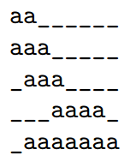
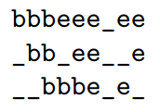
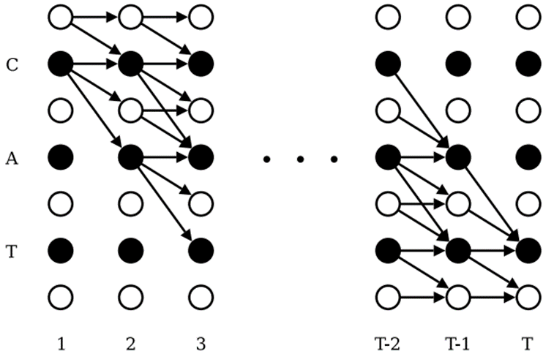
CTC Objective
Paths are not equivalent to the label, $π≠l$
Optimize for best label:
$$P\left(l | x\right)=\sum_{π}{P\left(l | π\right)P\left(π | x\right)}$$
Solve objective above with dynamic time warping
Forward-backward algorithm
Forward variables $α$
Backward variables $β$
$$P\left(l | x\right)=\sum_{s=1}^{|l|}{\frac{α_{t}\left(s\right)β_{t}\left(s\right)}{y_{l_{s}}^{t}}}$$
Maps and searches only paths that correspond to target label
$$l=\{a\}$$
$$l=\{bee\}$$
https://github.com/yiwangbaidu/notes/blob/master/CTC/CTC.pdf, ftp://ftp.idsia.ch/pub/juergen/icml2006.pdf
Notes:
Problem setup so far is classic classification problem

Slide 49
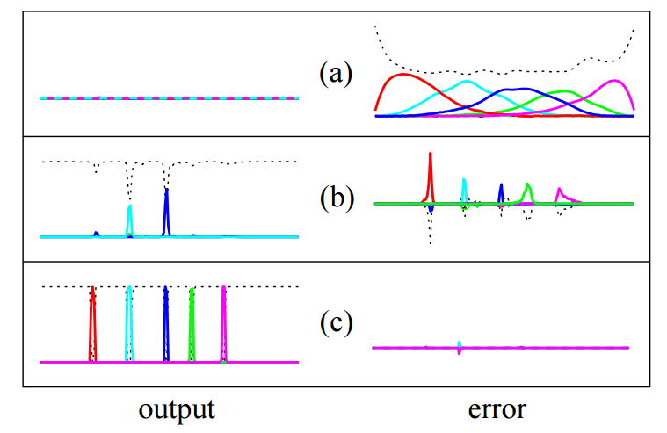
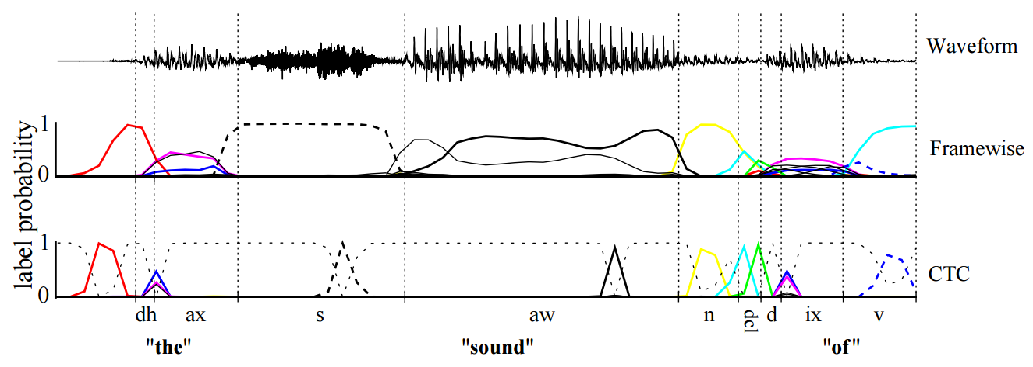
CTC Objective and Gradient
Objective function:
$$O^{ML}\left(S, 𝒩_{w}\right)=−\sum_{\left(x,z\right)∈S}{\ln\left(p\left(z | x\right)\right)}$$
Gradient:
$$\frac{∂O^{ML}\left(\{\left(x,z\right)\}, 𝒩_{w}\right)}{∂u_{k}^{t}}=y_{k}^{t}−\frac{1}{y_{k}^{t}Z_{t}}\sum_{s∈lab\left(z,k\right)}{{\hat{α}}_{t}\left(s\right){\hat{β}}_{t}\left(s\right)}$$
$$\text{where} Z_{t}≜\sum_{s=1}^{|l^{′}|}{\frac{α_{t}\left(s\right)β_{t}\left(s\right)}{y_{l_{s}^{′}}^{t}}}$$
ftp://ftp.idsia.ch/pub/juergen/icml2006.pdf
Notes:
Show an image of some waveform and the corresponding text to make problem clearer

Slide 50
LSTM CTC Models
Word error rate compared with HMM based models
Bi-direction LSTM is more essential for CTC
 | Context | Error Rate (%)
LSTM-HMM | Uni | 8.9
 | Bi | 9.1
LSTM-CTC | Uni | 9.4
 | Bi | 8.5
Sak, Haşim, et al. "Learning acoustic frame labeling for speech recognition with recurrent neural networks." ICASSP, 2015.

Slide 51
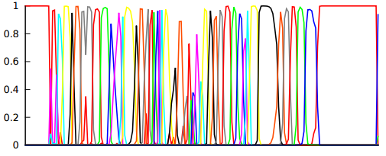
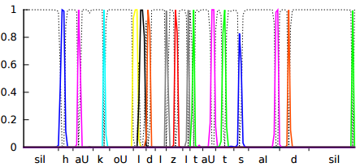
CTC vs HMM
Output probability of LSTM
HMM CTC
CTC embeds history in continuous hidden space, more capable than HMM
CTC has spiky predictions, more discriminable between states than HMM
CTC with less states (40) is significantly faster for decoding than HMM (10k states)
Sak, Haşim, et al. "Learning acoustic frame labeling for speech recognition with recurrent neural networks." ICASSP, 2015.

Slide 52
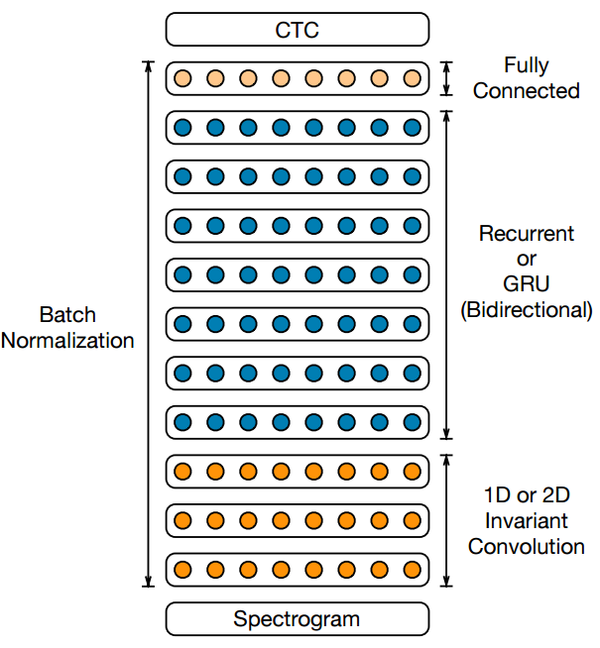
Deep Speech 2
3 layers of 2D-invariant convolution
7 layers of bidirectional simple recurrence
100M parameters
Word error rates
Test set | Deep speech 2 | Human
WSJ eval’92 | 3.60 | 5.03
WSJ eval’93 | 4.98 | 8.08
LibriSpeech test-clean | 5.33 | 5.83
LibriSpeech test-other | 13.25 | 12.69
Amodei, Dario, et al. "Deep speech 2: End-to-end speech recognition in english and mandarin." arXiv preprint arXiv:1512.02595 (2015).

Slide 53
CTC in Speech Recognition
RNN: Recurrent Neural Networks
CTC: Connectionist Temporal Classification
$$RNNs$$
CTC
Feature
Extraction
Frame
Classification
Sequence
Model
Lexicon
Model
Language
Model
t ah m aa t ow
$$A$$
$$O$$
$$Q$$
$$L$$
$$W$$
Speech Audio
Feature Frames
Sequence States
Phonemes
Words
Sentence

Slide 54
Attention in Speech Recognition
Predict character sequence directly
Feature
Extraction
Frame
Classification
Sequence
Model
Lexicon
Model
Language
Model
t ah m aa t ow
$$A$$
$$O$$
$$Q$$
$$L$$
$$W$$
Speech Audio
Feature Frames
Sequence States
Phonemes
Words
Sentence

Slide 55
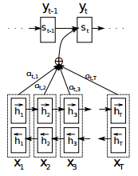
Attention based Models
Recall previous lecture
Image generation
Image text embedding
Question answering
Machine translation
Weighted sum of previous history
$α_{tj}=softmax\left(e_{tj}\right)=\frac{exp⁡(e_{tj})}{\sum_{k=1}^{T}{\exp{(e_{tk})}}}$
Essential for modeling long sequences like speech

Slide 56
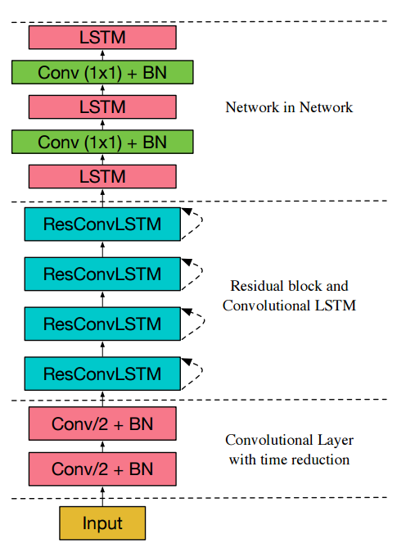
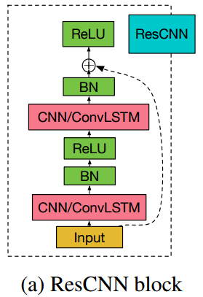
Attention based Models
Word error rate w/o language models on Wall Street Journal test eval92
 | WER
CTC | 30.1
Proposed | 10.53
Encoder Network
Zhang, Yu, William Chan, and Navdeep Jaitly. "Very deep convolutional networks for end-to-end speech recognition." arXiv preprint arXiv:1610.03022 (2016).

Slide 57
Deep learning in Speech Recognition
Attention
RNN-CTC
DNN-HMMs
$$GMMs$$
HMMs
Feature
Extraction
Frame
Classification
Sequence
Model
Lexicon
Model
Language
Model
t ah m aa t ow
$$A$$
$$O$$
$$Q$$
$$L$$
$$W$$
Speech Audio
Feature Frames
Sequence States
Phonemes
Words
Sentence

Slide 58
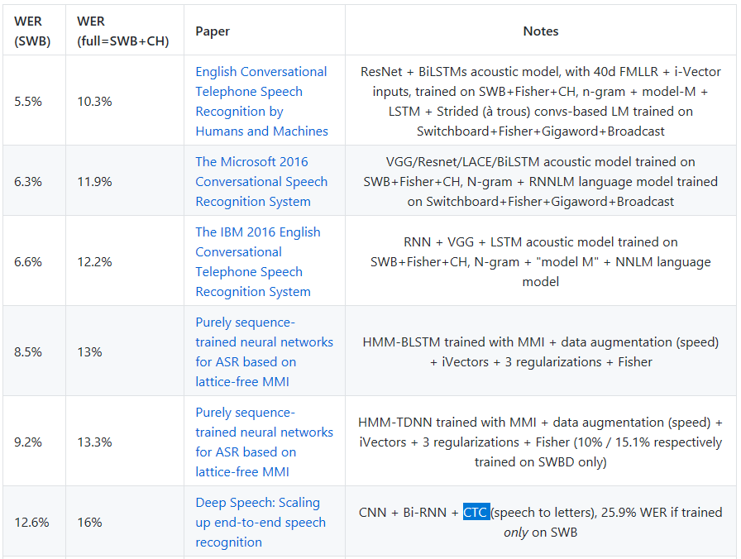
Deep learning in Speech Recognition
Top systems on dataset Switchboard
HMM based system still performs better than End-to-End system on large scale dataset
https://github.com/syhw/wer_are_we

Slide 59
Text to Speech (TTS)

Slide 60
Outline
Automatic Speech Recognition (ASR)
Deep models with HMMs
Connectionist Temporal Classification (CTC)
Attention based models
Text to Speech (TTS)
WaveNet
DeepVoice
Tacotron
Bonus: Music Generation

Slide 61
Traditional Methods
Concatenative approaches vs. Statistical Parametric approach
Concatenative: More natural sounding, Less flexible, Take up more space
Statistical Parametric: Muffled, more flexible, Smaller models
Traditionally, two stages: frontend and backend
Frontend analyzes text and determines phonemes, stresses, pitch, etc.
Backend generates the audio
Moving towards models which can convert directly from text to audio, with the model itself learning any intermediate representations necessary

Slide 62
WaveNet: A Generative Model for Raw Audio (2016)
Operates on Raw Waveform and generates a raw waveform (audio samples)
Each audio sample’s predictive distribution conditioned on all previous ones
Problems to overcome:
Tons of samples: 16kHz = 16,000 samples per second
Correlations in both small time scales and large time scales
16 bit audio means 65,536 probabilities per time step

Slide 63
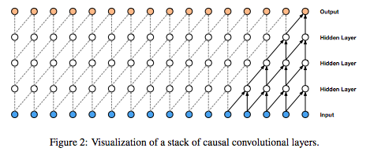
Problem: Too many samples, and different time scales of correlation
Solution: Causal Convolutions
https://arxiv.org/pdf/1609.03499.pdf

Slide 64
Causal Convolutions
Prediction of an audio sample can only depend on timestamps before it (nothing from the future)
No recurrent connections (Not an RNN) => Faster to train than RNN’s
Especially with very long sequences
Glaring problem: Requires many layers to increase the receptive field
https://arxiv.org/pdf/1609.03499.pdf

Slide 65
Dilated Causal Convolutions
https://arxiv.org/pdf/1609.03499.pdf

Slide 66
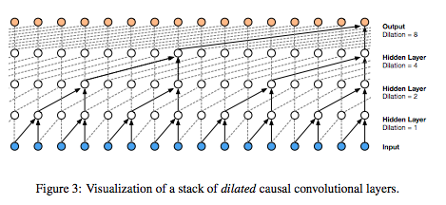
Dilated Causal Convolutions
Filter is applied to area much larger than its length by skipping inputs at each layer: Large receptive field
Allows information to be gleaned from both temporally close and far samples
https://arxiv.org/pdf/1609.03499.pdf

Slide 67
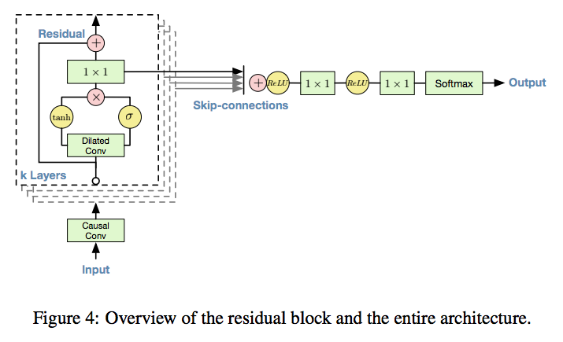
Skip connections are used throughout the network
Speeds up convergence
Enables training of deeper models
https://arxiv.org/pdf/1609.03499.pdf

Slide 68
Where are we now?
No input => Generic framework
https://deepmind.com/blog/wavenet-generative-model-raw-audio/

Slide 69
Add in other input
Generic enough to allow for both universal and local input
Universal: Speaker Identity
Local: Phonemes, inflection, stress

Slide 70
Results
https://deepmind.com/blog/wavenet-generative-model-raw-audio/

Slide 71
SampleRNN
How to deal with different time scales? Modularize.
Use different modules operating at different clock rates to deal with varying levels of abstraction
Sample-Level Modules and Frame-Level Modules

Slide 72
https://arxiv.org/abs/1612.07837

Slide 73
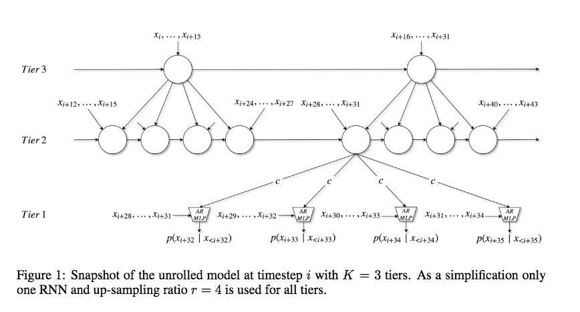
Frame-Level Modules
“Each frame-level module is a deep RNN which summarizes the history of its inputs into a conditioning vector for the next module downward.”
Each module takes as input its corresponding frame, as well as the conditioning vector of the layer above it.

Slide 74
Sample Level Modules
Conditioned on the conditioning vector from the frame above it, and on some number of preceding samples.
Since this number is generally small, they use a multilayer perceptron here instead of an RNN, to speed up training
“When processing an audio sequence, the MLP is convolved over the sequence, processing each window of samples and predicting the next sample.”
“At generation time, the MLP is run repeatedly to generate one sample at a time.”

Slide 75
Other aspects of SampleRNN
Linear Quantization with q=256
RNN’s (not used in WaveNet) are powerful if they can be trained efficiently
Truncated Back Propagation Through Time (BPTT)
Split sequence into subsequences and only propagate gradient to beginning of subsequence
Interestingly, able to train well on subsequences of only 32ms

Slide 76
Results
https://soundcloud.com/samplernn

Slide 77
DeepVoice: Real-time Neural TTS
Composed end-to-end TTS pipeline by Baidu
Composed of five individual components
Segmentation model
Grapheme-to-phone conversion model
Phoneme duration prediction model
Fundamental frequency prediction model
Audio synthesis model
Few hours of manual effort minus training time
Real-time audio synthesis
https://arxiv.org/abs/1702.07825
Notes:
It takes WaveNet several minutes to generate a single second of output

Slide 78
DeepVoice Grapheme-to-Phoneme Model
Encoder-decoder architecture from “Sequence-to-Sequence Neural Net Models for Grapheme-to-Phoneme Conversion”
Architecture
Trained with teacher forcing
Decode phonemes with beam search of width 5
1024 GRU Units
1024 GRU Units
1024 GRU Units
1024 GRU Units
1024 GRU Units
1024 GRU Units
Text Input
Phonemes
Bidirectional encoder
Unidirectional decoder
https://arxiv.org/abs/1702.07825

Slide 79
DeepVoice Segmentation Model
Convolutional recurrent neural network architecture from “DeepSpeech 2: End-to-End Speech Recognition in English and Mandarin”
Architecture
2D convolutions in time and frequency
Softmax layer uses CTC to predict phoneme pairs
Output spikes from CTC close to phoneme boundaries
Decode phoneme boundaries with beam search of width 50
512 GRU Units
512 GRU Units
Softmax output w/ CTC
Featurized Audio
20 MFCC
Phoneme Durations
10 ms
Convolutional layers
Bidirectional RNN layers
https://arxiv.org/abs/1702.07825

Slide 80
DeepVoice Phoneme Duration and Fundamental Frequency Model
Outputs
Phoneme duration
Probability phoneme is voiced (has F0)
20 time-dependent F0 values
Loss
$$L_{n}=\left|{\hat{t}}_{n}−t_{n}\right|+λ_{1}\text{CE}\left({\hat{p}}_{n}, p_{n}\right)+λ_{2}\sum_{t=0}^{T−1}{\left|{\hat{F0}}_{n,t}−F0_{n,t}\right|} \\ +λ_{3}\sum_{t=0}^{T−2}{|{\hat{F0}}_{n,t+1}−F0_{n,t}|}$$
$λ_{i}$ are tradeoff constants
${\hat{t}}_{n}, t_{n}$ are durations of $n^{th}$ phoneme
${\hat{p}}_{n}, p_{n}$ are probabilities $n^{th}$ phoneme is voiced
${\hat{F0}}_{n,t}$, $F0_{n,t}$ are fundamental frequency of $n^{th}$ phoneme
256 Units
256 Units
128 GRU Units
128 GRU Units
One-hot phoneme w/ stress vector
FC Outputs
Fully connected layers
Unidirectional layers
https://arxiv.org/abs/1702.07825

Slide 81
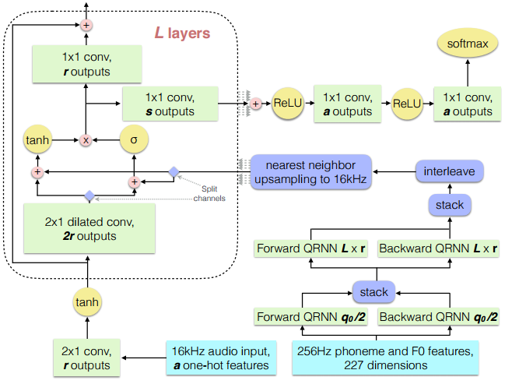
DeepVoice Audio Synthesis Model
Architecture
Red WaveNet
Same structure, different $l, r, s$ values
Blue Conditioning network
Two bidirectional QRNN layers
Interleave channels
Upsample to 16kHZ
https://arxiv.org/abs/1702.07825

Slide 82
DeepVoice Training
Grapheme-to-Phoneme model used as backup to phoneme dictionary (CMUdict)
https://arxiv.org/abs/1702.07825

Slide 83
DeepVoice Inference
Segmentation model only annotates data in training and not used in inference
https://arxiv.org/abs/1702.07825

Slide 84
DeepVoice Results
Audio Synthesis Results
Inference Results
Type | Model Size | MOS $±$ CI
Ground Truth (48 kHz) | None | 4.75 $±$ 0.12
Ground Truth (16 kHz) | None | 4.45 $±$ 0.16
Synthesized (Audio only) | $$l=40, r=64, s=256$$ | 3.94 $±$ 0.26
Synthesized (Synthesized Duration & F0) | $$l=40, r=64, s=256$$ | 2.00 $±$ 0.23
Synthesized (2x real-time inference, audio only) | $$l=20, r=32, s=128$$ | 2.74 $±$ 0.32
Synthesized (1x real-time inference, audio only) | $$l=20, r=64, s=128$$ | 3.35 $±$ 0.31
Model | Platform | Data Type | # of Threads | Speed-up Over Real Time
$$l=20, r=32, s=128$$ | CPU | Float32 | 6 | 2.7
$$l=40, r=64, s=128$$ | CPU | Float32 | 6 | 1.11
$$l=20, r=32, s=128$$ | GPU | Float32 | N/A | 0.39
https://arxiv.org/abs/1702.07825
Notes:
Talk about the results
Talk about implementation details

Slide 85
DeepVoice Implementation Details
CPU implementation
Parallelizing work via multithreading
Pinning threads to physical cores (or disabling hyperthreading)
Replacing nonlinearities with high-accuracy approximations (only during inference)
$$\text{tanh}\left(x\right)≈\text{sign}\left(x\right)\frac{\tilde{e}\left(x\right)−\frac{1}{\tilde{e}\left(x\right)}}{\tilde{e}\left(x\right)+\frac{1}{\tilde{e}\left(x\right)}} \text{and} σ\left(x\right)≈\left\{\begin{matrix}\frac{\tilde{e}\left(x\right)}{1+\tilde{e}\left(x\right)} & x≥0 \\ \frac{1}{1+\tilde{e}\left(x\right)} & x≤0\end{matrix}\right. \text{where} e^{\left|x\right|}≈\tilde{e}\left(x\right)=1+\left|x\right|+0.5658x^{2}+0.143x^{4}$$
Weight matrices quantized to int16
Custom AVX assembly kernels for matrix-vector multiplication
GPU implementation
Persistant RNNs to generate all samples in one kernel launch
Split model across register file of SMs
Round robin execution of kernels
https://arxiv.org/abs/1702.07825

Slide 86
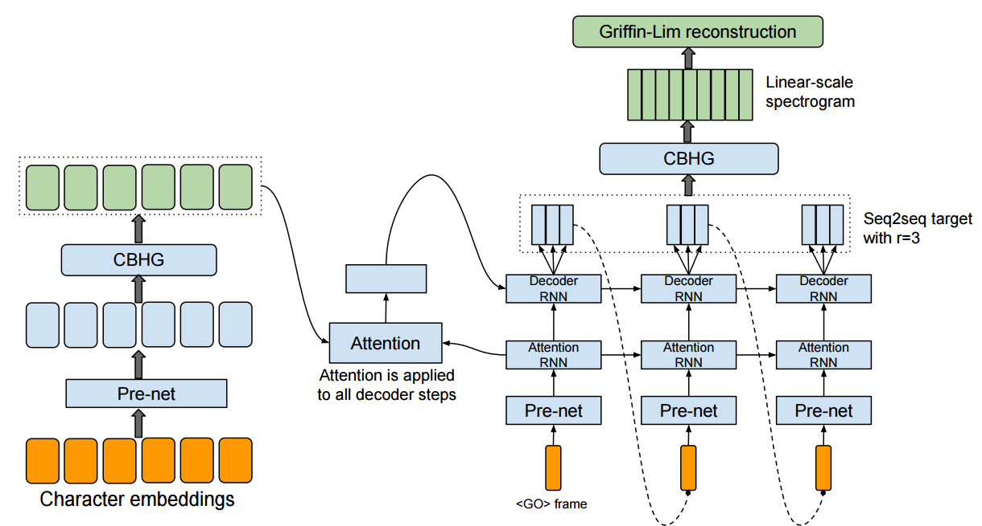
Tacotron: Towards End-to-End Speech Synthesis
Truly end-to-end TTS pipeline by Google
Reduces feature engineering
Allows conditioning on various attributes
Architecture
One network based on the sequence-to-sequence with attention paradigm
Red Encoder
Blue Decoder
Green Post-processing net
https://arxiv.org/abs/1703.10135

Slide 87
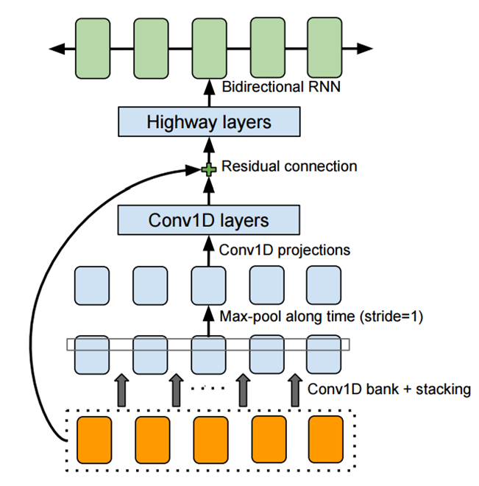
Tacotron CBHG Module
1D Convolutional Bank + highway network + bidirectional GRU (CBHG)
Module for extracting representations from sequences
Inspired by work from “Fully Character-Level Neural Machine Translation without Explicit Segmentation”
Architecture
Bank of 1D convolutional filters
Highway networks
Gating unit learn to regulate flow of information through network
Bidirectional GRU RNN
https://arxiv.org/abs/1703.10135

Slide 88
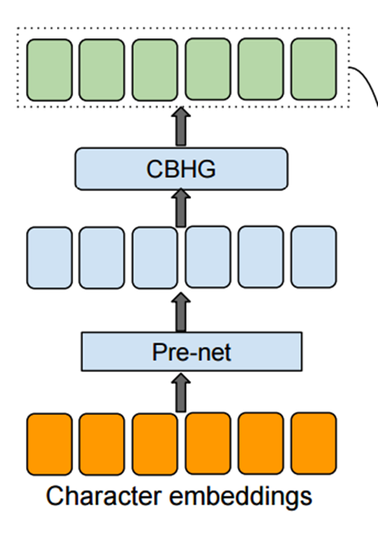
Tacotron Encoder
Extracts robust sequential representation of text
Architecture
Input: one-hot vector of characters embedded into a continuous sequence
Pre-Net, a set of on non-linear transformations
CBHG module
https://arxiv.org/abs/1703.10135

Slide 89
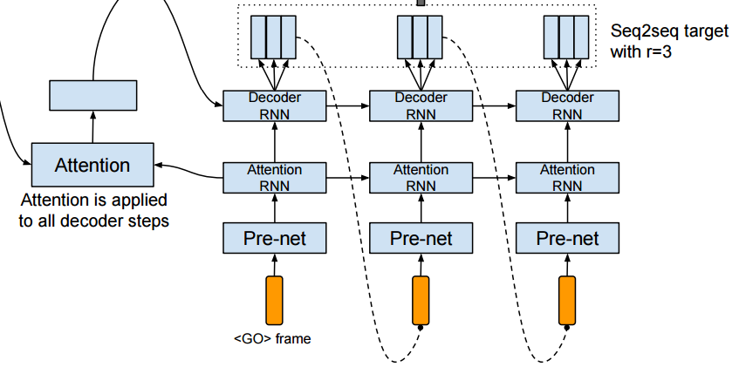
Tacotron Decoder
Target is 80-band mel-scale spectrogram rather than raw waveform
Waveform is highly redundant representation
Architecture
Attention RNN: 1 layer 256 GRU cells
Decoder RNN: 2 layer residual 256 GRU cells
Fully connected output layer
https://arxiv.org/abs/1703.10135

Slide 90
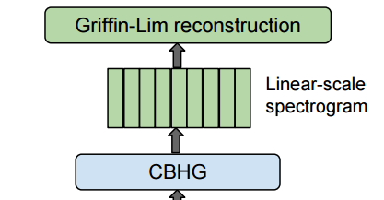
Tacotron Post-Processing Network
Convert sequence-to-sequence target to waveform though can be used to predict alternative targets
Architecture
CBHG
Griffin-Lim algorithm
Estimates waveform from spectrogram
Uses an iterative algorithm to decrease MSE
Used for simplicity
https://arxiv.org/abs/1703.10135

Slide 91
Tacotron Results
Tacotron results
DeepVoice results
1)
Model | MOS $±$ CI
Tacotron | 3.82 $±$ 0.085
Parametric | 3.69 $±$ 0.109
Concatenative | 4.09 $±$ 0.119
The quick brown fox jumps over the lazy dog
1)
Generative adversarial network or variational autoencoder
3)
Type | Model Size | MOS $±$ CI
Ground Truth (48 kHz) | None | 4.75 $±$ 0.12
Ground Truth (16 kHz) | None | 4.45 $±$ 0.16
Synthesized (Audio only) | $$l=40, r=64, s=256$$ | 3.94 $±$ 0.26
Synthesized (Synthesized Duration & F0) | $$l=40, r=64, s=256$$ | 2.00 $±$ 0.23
Synthesized (2x real-time inference, audio only) | $$l=20, r=32, s=128$$ | 2.74 $±$ 0.32
Synthesized (1x real-time inference, audio only) | $$l=20, r=64, s=128$$ | 3.35 $±$ 0.31
Either way you should shoot very slowly
She set out to change the world and to change us
2)
3)
2)
She set out to change the world and to change us
https://arxiv.org/abs/1702.0782, https://arxiv.org/abs/1703.10135

Slide 92
Summary
Automatic Speech Recognition (ASR)
Deep models with HMMs
Connectionist Temporal Classification (CTC)
Method for labeling unsegmented data
Attention based models
Text to Speech (TTS)
WaveNet
Audio synthesis network with intermediate representation
DeepVoice
Composed end-to-end learning
Tacotron
Truly end-to-end learning

Slide 93
Thank you! Questions?

Slide 94
Bonus: Music Generation

Slide 95
WaveNet, revisited
Train on 60 hours of Solo YouTube Piano music in one experiment
Train on MagnaTagATune dataset: 29 second clips, 188 tags. No published results unfortunately.
https://deepmind.com/blog/wavenet-generative-model-raw-audio/

Slide 96
“Deep Learning for Music"
Aims to create pleasant music with deep neural nets alone
Questions:
“Is there a meaningful way to represent notes in music as a vector?” (like word2vec)
“Can we build interesting generative neural network architectures that effectively express the
notions of harmony and melody?”
Input
Midi Data
Piano Roll data (which notes are on?)

Slide 97
The Network
2 Layer LSTM
Map tokens (either MIDI messages or note combinations) to a learned vector respresentation
Feed output into softmax layer
Allows user to adjust hyperparamters including number of layers, hidden unit size, sequence length, batch size, and learning rate.
Input a “seed” sequence
Two approaches to generation:
Choose maximum from softmax
Choose anything from the softmax distribution

Slide 98
Results
Music trained solely on Bach was better than a mix of classical pianists
Music trained using the Piano Roll format was better than that of the MIDI messages
No published audio, unfortunately

Slide 99
References
Text to Speech (TTS)
A. van den Oord, S. Dieleman, H. Zen, K. Simonyan, O. Vinyals, A. Graves, N. Kalchbrenner, A. Senior, and K. Kavukcuoglu. WaveNet: A Generative Model for Raw Audio. arXiv preprint arXiv:1609.03499 (2016).
S. Mehri, K. Kumar, I. Gulrajani, R. Kumar, S. Jain, J. Sotelo, A. Courville, and Y. Bengio. SampleRNN: An Unconditional End-to-End Neural Audio Generation Model. arXiv preprint arXiv:1612.07837v2 (2017).
J. Sotelo, S. Mehri, K. Kumar, J. Santos, K. Kastner, A. Courville, and Y. Bengio. Char2Wav: End-to-End Speech Synthesis. ICLR (2017).
S. Arik, M. Chrzanowski, A. Coates, G. Diamos, A. Gibiansky, Y. Kang, X. Li, J. Miller, A. Ng, J. Raiman, S. Sengupta, and M. Shoeybi. Deep Voice: Real-time Neural Text-to-Speech. arXiv preprint arXiv:1702.07825v2 (2017).
Y. Wang, and et al. Tacotron: A Fully End-to-End Text-to-Speech Synthesis Model. arXiv preprint arXiv:1703.10135v1 (2017).

Slide 100
References
Automatic Speech Recognition (ASR)
A. Graves, S. Fernandez, F. Gomez, and J. Schmidhuber. Connectionist Temporal Classification: Labelling Unsegmented Sequence Data with Recurrent Neural Networks. ICML (2006).
G. Hinton, et al. Deep Neural Networks for Acoustic Modeling in Speech Recognition. Signal Processing Magazine (2012).
A. Graves, A. Mohamed, and G. Hinton. Speech Recognition with Deep Recurrent Neural Networks. arXiv preprint arXiv:1303.5778v1 (2013).
H. Sak, A. Senior, and F. Beaufays. Long Short-Term Memory Recurrent Neural Network Architectures for Large Scale Acoustic Modeling.. rXiv preprint arXiv:1402.1128v1 (2014).
O.Abdel-Hamid, et al. Convolutional Neural Networks for Speech Recognition. IEEE/ACM Transactions on Audio, Speech, and Language Processing (2014).
A. Hannun, C. Case, J. Casper, B. Catanzaro, G. Diamos, E. Elsen, R. Prenger, S. Satheesh, S. Sengupta, A. Coates, and A. Ng. Deep Speech: Scaling up end-to-end speech recognition. arXiv preprint arXiv:1412.5567v2 (2014).
D. Amodei, et al. Deep Speech 2: End-to-End Speech Recognition in English and Mandarin. arXiv preprint arXiv:1512.02595v1 (2015).
Y. Wang. Connectionist Temporal Classification: A Tutorial with Gritty Details. Github (2015).
D. Bahdanau, et al. End-to-End Attention-based Large Vocabulary Speech Recognition. arXiv preprint arXiv:1508.04395 (2015).
W. Xiong, et al. Achieving Human Parity in Conversational Speech Recognition. arXiv preprint arXiv:1610.05256 (2016).

Slide 101
References
Music Generation
A. Huang, and R. Wu. Deep Learning for Music. arXiv preprint arXiv:1606.04930v1 (2016).
V. Kaligeri, and S. Grandhe. Music Generation Using Deep Learning. arXiv:1612.04928v1 (2016).

