Slide 1
Computer Vision: Looking Back to Look Forward
image source
Svetlana Lazebnik
IRIM Short Course
Spring 2020

Slide 2
Outline of lectures
Tues. 1/28: Where are we going, where have we been?
Wed. 1/29: Stepping back: What is the nature of visual perception?
Thurs. 1/30: History of ideas in recognition – Part I
Tues. 2/4: History of ideas in recognition – Part II
Wed. 2/5: Emerging trends – or, what should we be working on?
Thurs. 2/6: Ethical issues for computer vision researchers

Slide 3
Where are we now?
Glass is half full?
Current methods actually work and are better than older methods in most ways
Good methodologies: standard benchmarks, quantitative comparisons, ablation studies
Good infrastructure: deep learning packages, cloud services, etc.
Culture of code sharing and reproducibility
Glass is half empty?
People are too focused on the benchmarks
Number of papers is exploding but diversity of topics is not increasing
Cutting-edge research is prohibitively resource-intensive
Core benchmarks (ImageNet, COCO) are likely saturating but bigger datasets (or larger amounts of computing power) are not yet in sight

Slide 4
What’s wrong with ImageNet classification?
Performance has saturated – further advances in architectures by looking at ImageNet unlikely
Figure source
ILSVRC Challenge

Slide 5
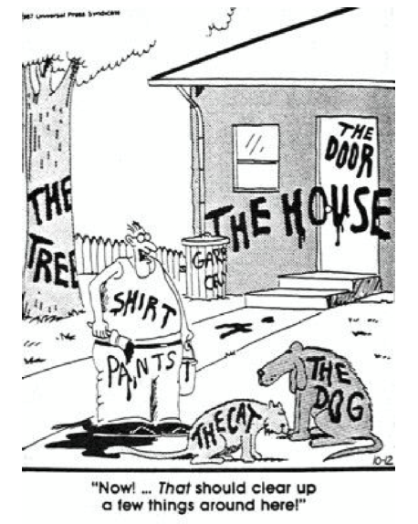
What’s wrong with ImageNet classification?
Nobody believes that attaching labels to images is the right task
Favorite cartoon of Jan Koenderink
Favorite cartoon of David Forsyth

Slide 6
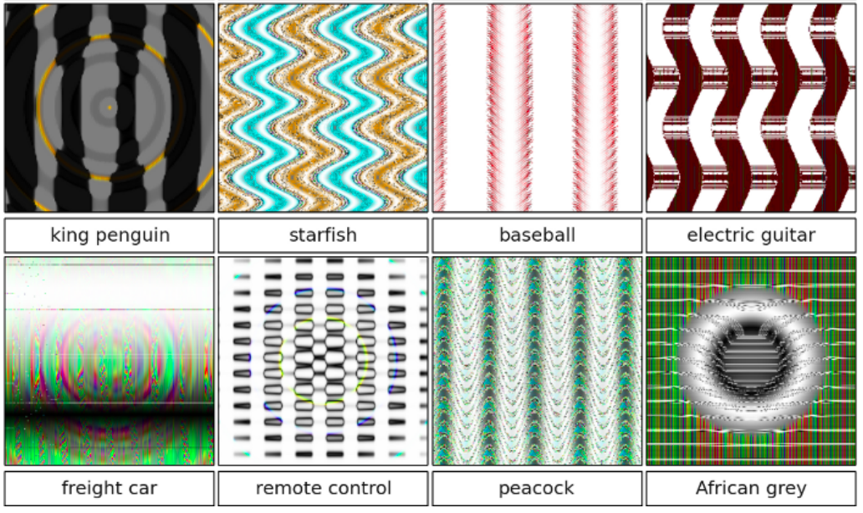
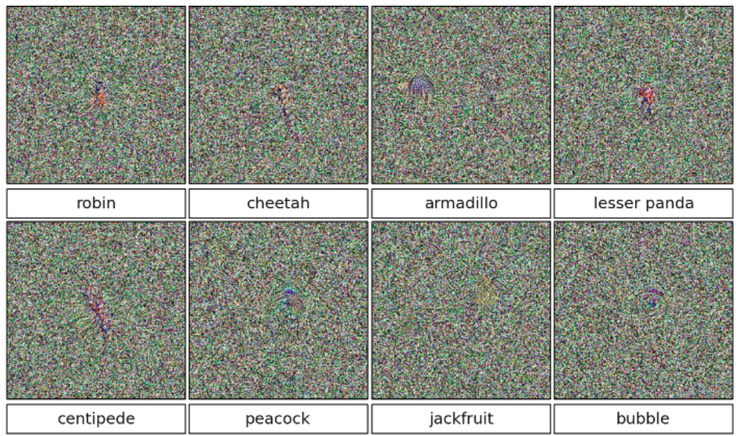
What’s wrong with ImageNet classification?
Image classification models are too easy to “hack”
A. Nguyen, J. Yosinski, J. Clune, Deep Neural Networks are Easily Fooled: High Confidence Predictions for Unrecognizable Images, CVPR 2015

Slide 7
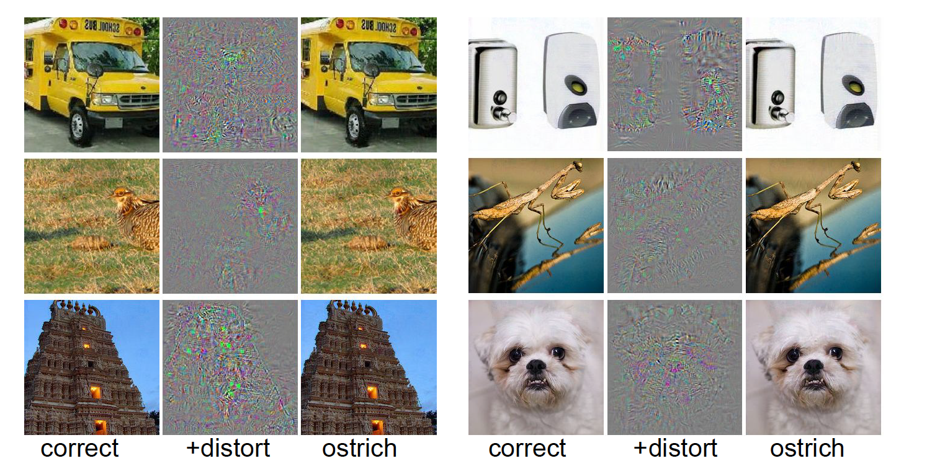
What’s wrong with ImageNet classification?
Image classification models are too easy to “hack”
Input
Perturbation
x 10
“Ostrich”
Input
Perturbation
x 10
“Ostrich”
C. Szegedy, W. Zaremba, I. Sutskever, J. Bruna, D. Erhan, I. Goodfellow, R. Fergus, Intriguing properties of neural networks, ICLR 2014

Slide 8
How can we move forward?
Focus on tasks beyond image classification
“Rich” prediction tasks

Slide 9
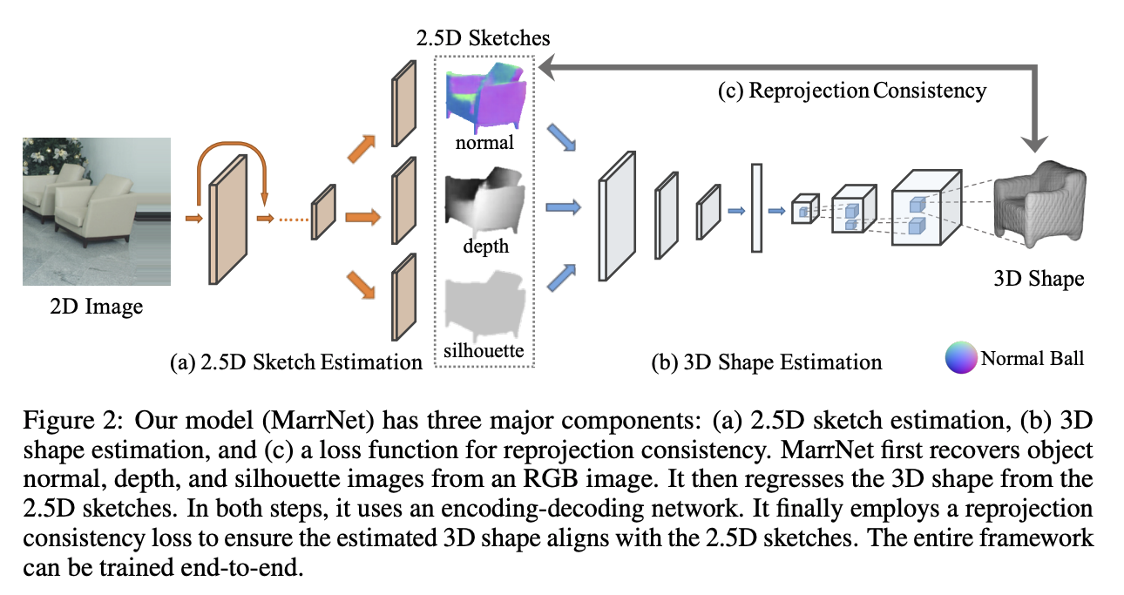
Learning 3D structure
J. Wu, Y. Wang, T. Xue, X. Sun, W. Freeman, J. Tenenbaum, MarrNet: 3D Shape Reconstruction via 2.5D Sketches, NeurIPS 2017

Slide 10
Learning 3D structure
F. Bogo, A. Kanazawa, C. Lassner, P. Gehler, J. Romero and M. Black, Keep it SMPL: Automatic Estimation of 3D Human Pose and Shape from a Single Image, ECCV 2016
A. Kanazawa, J. Zhang, P. Felsen, J. Malik, Learning 3D Human Dynamics from Video, CVPR 2019

Slide 11
Learning controllers
Video
X. B. Peng, A. Kanazawa, J. Malik, P. Abbeel, S. Levine, SFV: Reinforcement Learning of Physical Skills from Videos, SIGGRAPH Asia 2018

Slide 12
Learning 3D structure: Beyond humans
S. Zuffi, A. Kanazawa, M. Black, Lions and Tigers and Bears: Capturing Non-Rigid, 3D, Articulated Shape from Images, CVPR 2018

Slide 13
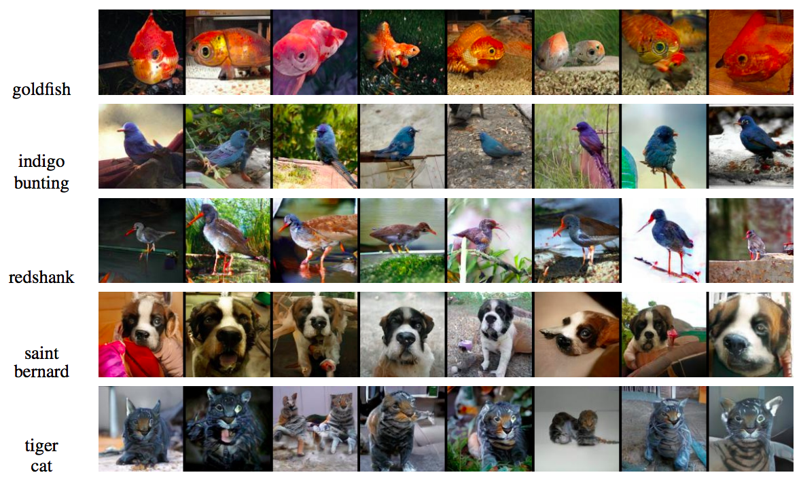
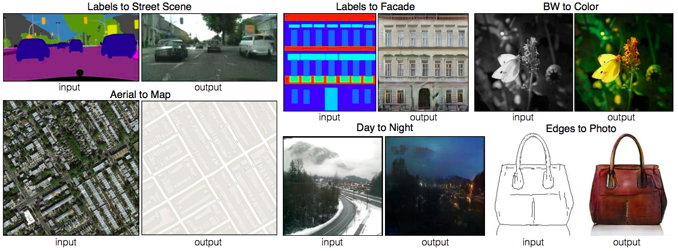
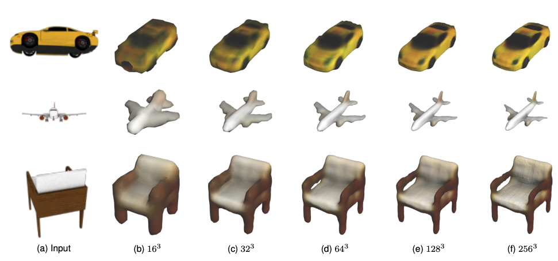
“Rich” prediction problems
Class label to image
Text to image
Qiao et al. (2019)
Zhang et al. (2019)
Image to image
Image to 3D
Isola et al. (2017)
Hane et al. (2019)

Slide 14
Image-to-image translation
P. Isola, J.-Y. Zhu, T. Zhou, A. Efros, Image-to-Image Translation with Conditional Adversarial Networks, CVPR 2017

Slide 15
Challenge: Diverse prediction
J.Y. Zhu, R. Zhang, D. Pathak, T. Darrell, A. A. Efros, O. Wang, E. Shechtman, Toward Multimodal Image-to-Image Translation, NIPS 2017

Slide 16
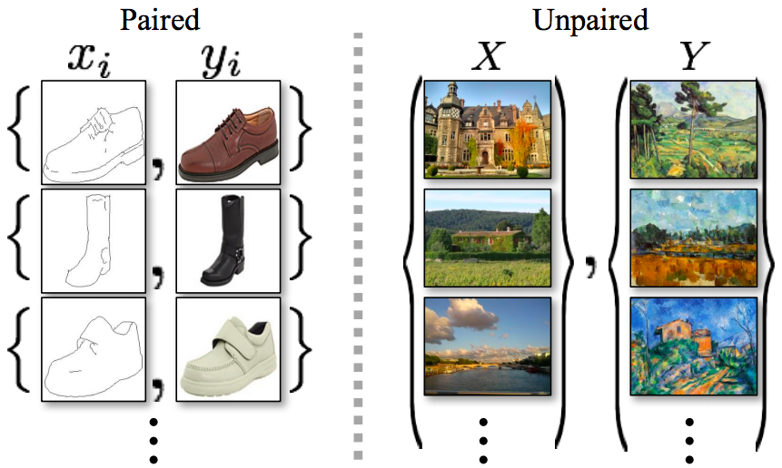
Unpaired image-to-image translation
Given two unordered image collections $X$ and $Y$, learn to “translate” an image from one into the other and vice versa
J.-Y. Zhu, T. Park, P. Isola, A. Efros, Unpaired Image-to-Image Translation Using Cycle-Consistent Adversarial Networks, ICCV 2017

Slide 17
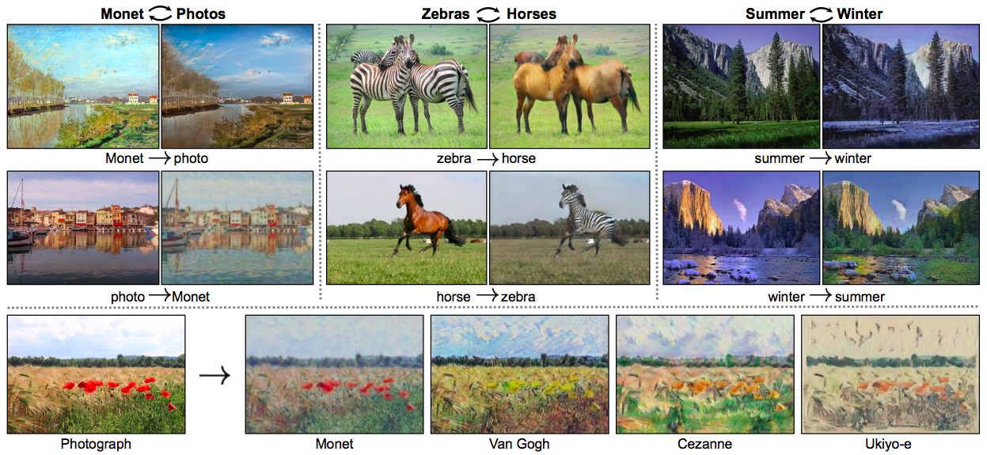
Unpaired image-to-image translation
Given two unordered image collections $X$ and $Y$, learn to “translate” an image from one into the other and vice versa
J.-Y. Zhu, T. Park, P. Isola, A. Efros, Unpaired Image-to-Image Translation Using Cycle-Consistent Adversarial Networks, ICCV 2017

Slide 18
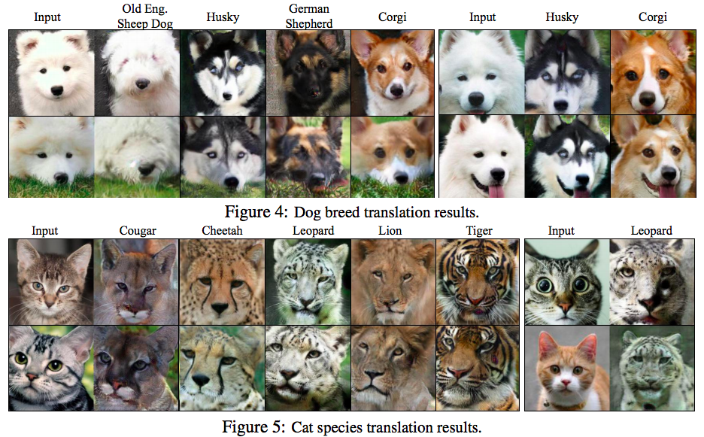
Unsupervised image-to-image translation
M.-Y. Liu, T. Breuel, and J. Kautz, Unsupervised Image-to-Image Translation Networks, NIPS 2017

Slide 19
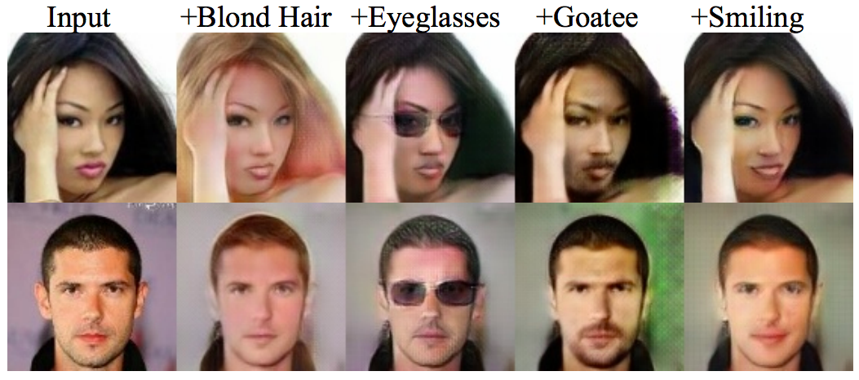
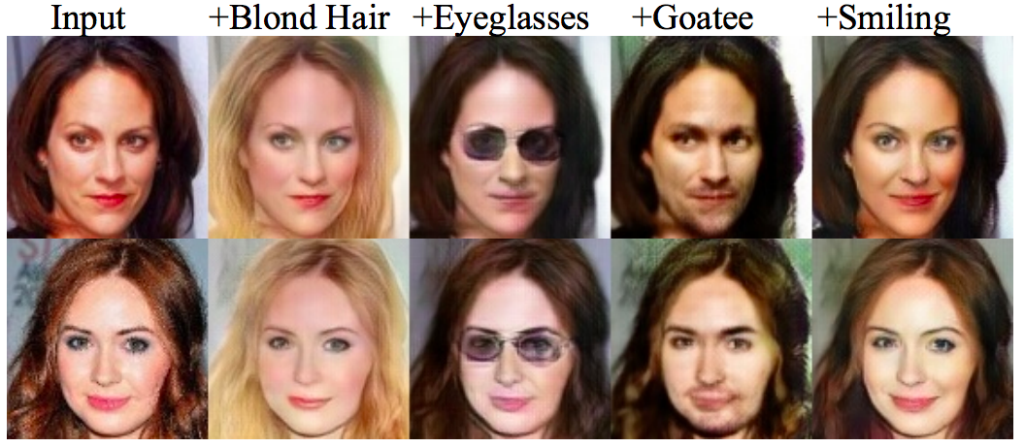
Unsupervised image-to-image translation
M.-Y. Liu, T. Breuel, and J. Kautz, Unsupervised Image-to-Image Translation Networks, NIPS 2017

Slide 20
How can we move forward?
Focus on tasks beyond image classification
“Rich” prediction tasks
Generation

Slide 21
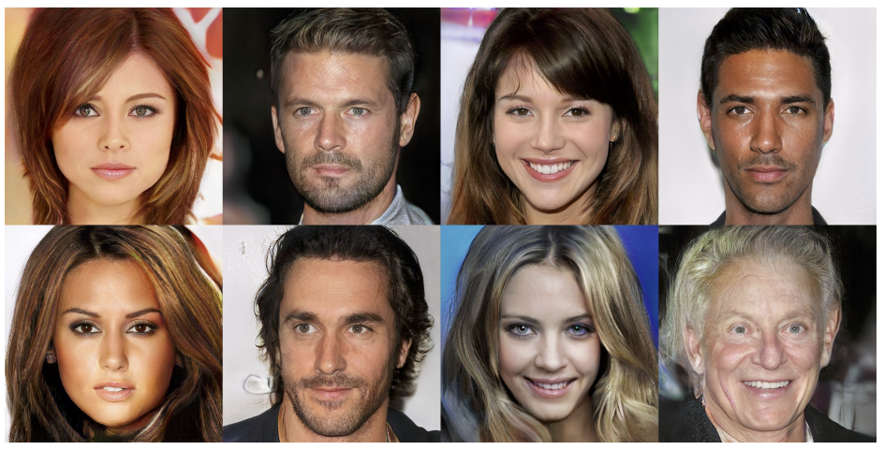
State-of-the-art GANs
Faces: 1024x1024 resolution, CelebA-HQ dataset
T. Karras, T. Aila, S. Laine, and J. Lehtinen, Progressive Growing of GANs for Improved Quality, Stability, and Variation, ICLR 2018
Follow-up work

Slide 22
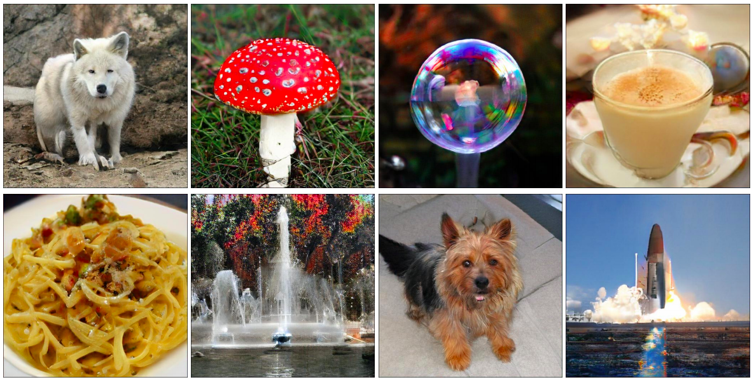
State-of-the-art GANs
May shed light on important open questions, such as:
Do we need explicitly compositional (part-based) representations?
A. Brock, J. Donahue, K. Simonyan, Large scale GAN training for high fidelity natural image synthesis, ICLR 2019

Slide 23
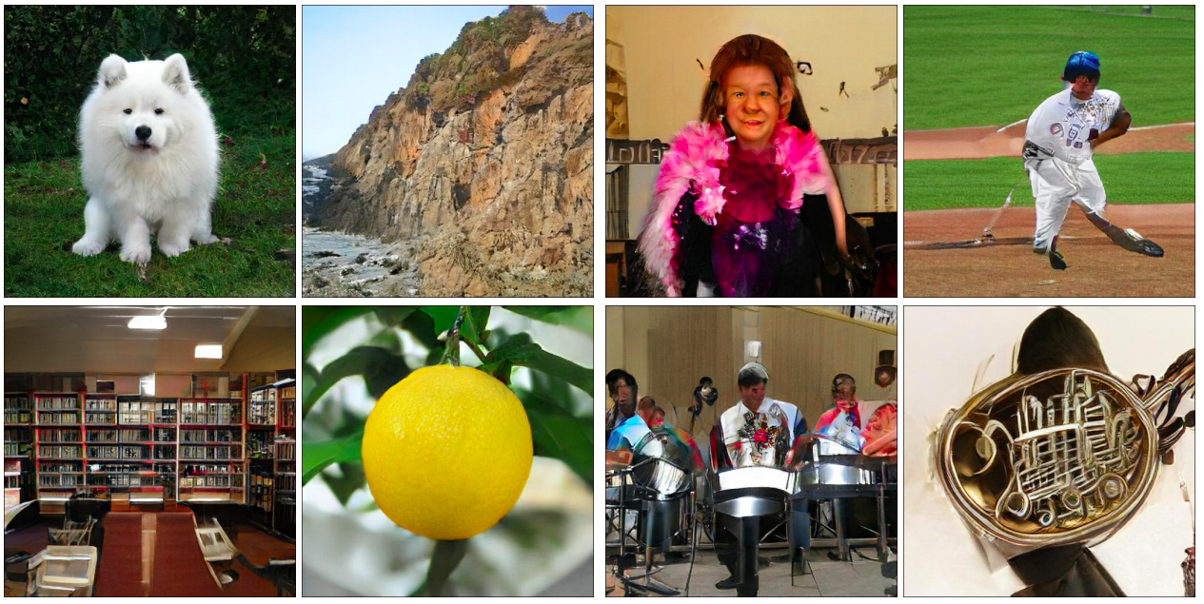
State-of-the-art GANs
May shed light on important open questions, such as:
Do we need explicitly compositional (part-based) representations?
Easy classes
Difficult classes
A. Brock, J. Donahue, K. Simonyan, Large scale GAN training for high fidelity natural image synthesis, ICLR 2019

Slide 24
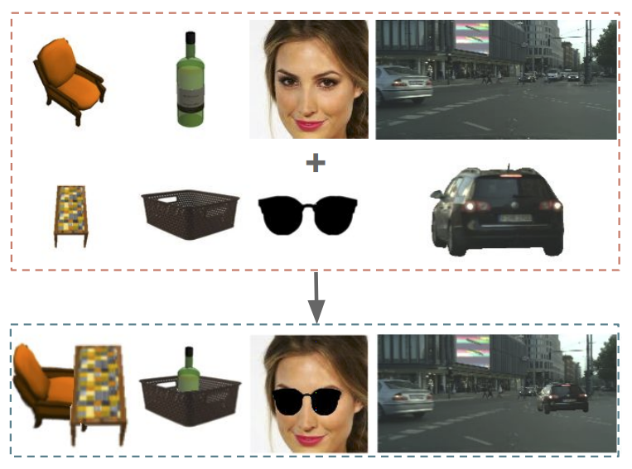
State-of-the-art GANs
May shed light on important open questions, such as:
Do we need explicitly compositional (part-based) representations?
S. Azadi, D. Pathak, S. Ebrahimi, T. Darrell, Compositional GAN: Learning Conditional Image Composition, arXiv 2019

Slide 25
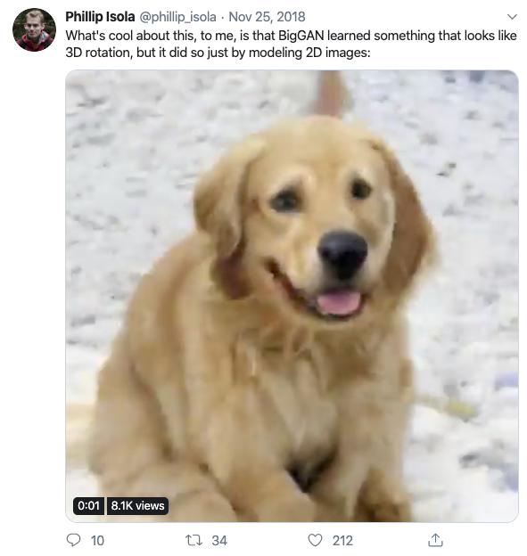
State-of-the-art GANs
May shed light on important open questions, such as:
Do we need explicit 3D representations?
https://twitter.com/phillip_isola/status/1066574964793458689

Slide 26
State-of-the-art GANs
May shed light on important open questions, such as:
Do we need explicit 3D representations?
T. Nguyen-Phuoc et al., HoloGAN: Unsupervised Learning of 3D Representations From Natural Images, 2019

Slide 27
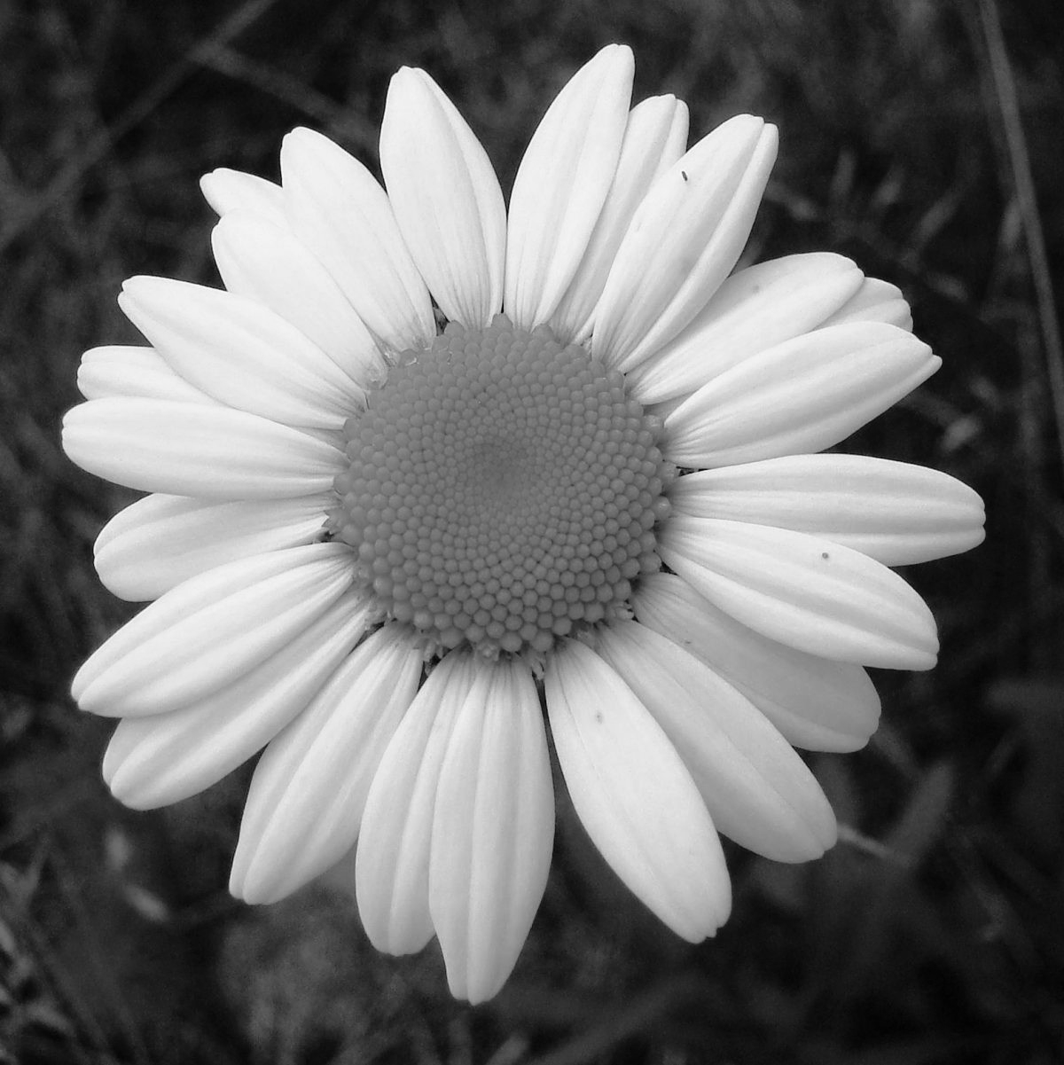
Integrating discriminative and generative models?
Discriminative model
Generative model
Label
Noise
Encoder-decoder architecture

Slide 28
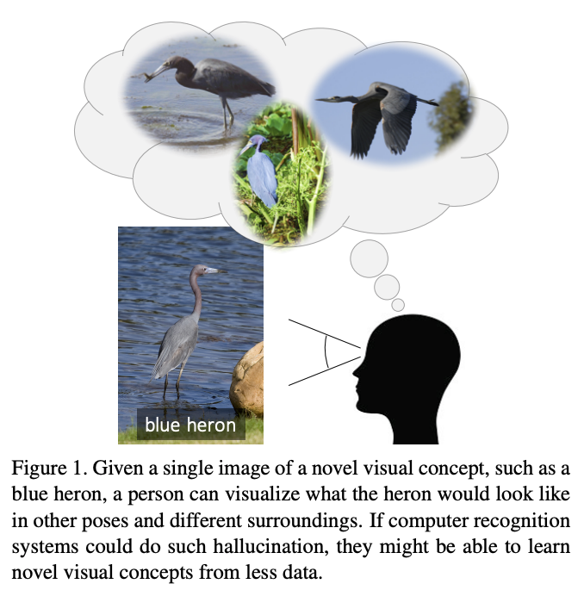
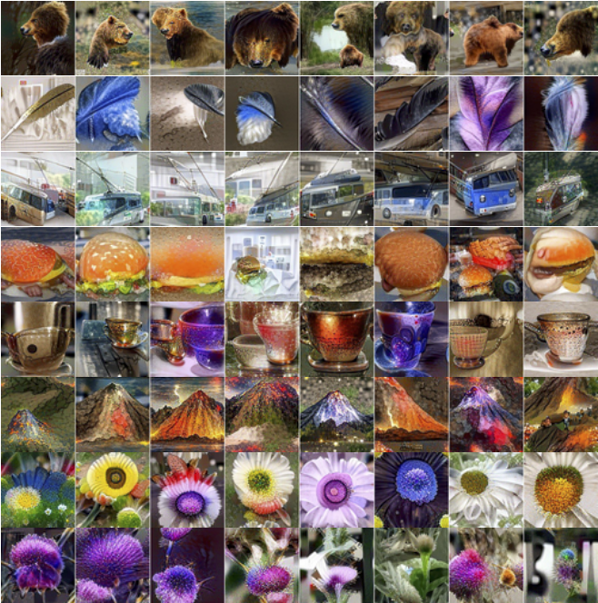
Integrating discriminative and generative models?
Can “hallucination” help with recognition?
Low-shot learning, incremental learning, transfer learning
High-quality images synthesized by “inverting” an ImageNet-pretrained network
Wang et al. (2018)
Yin et al. (2019)

Slide 29
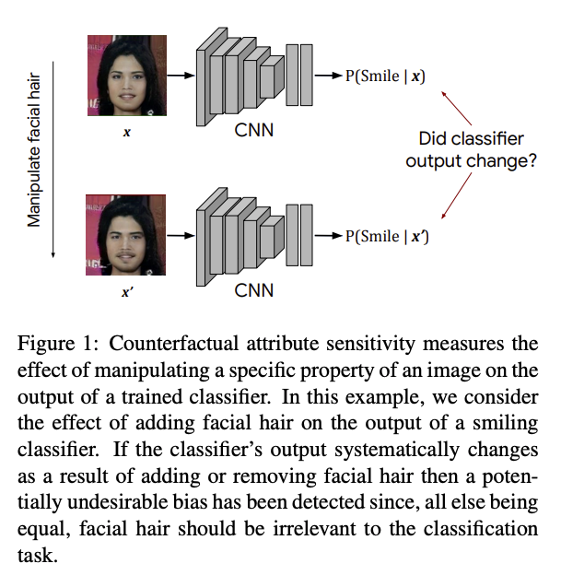
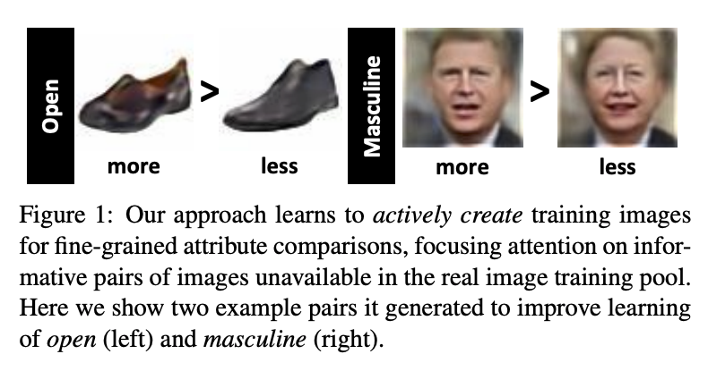
Integrating discriminative and generative models?
Can attribute-based manipulation of training examples help to train more accurate or less biased models?
Yu and Grauman (2019)
Denton et al. (2019)

Slide 30
Possible ways forward
Focus on tasks beyond image classification
“Rich” prediction tasks
Generation
Move away from full supervision
Self-supervised learning

Slide 31
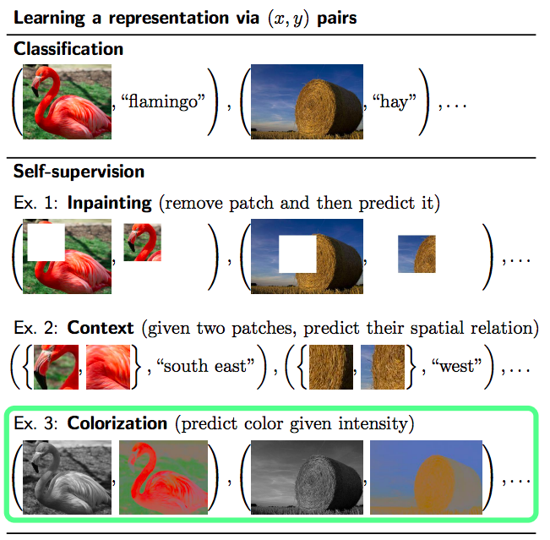
Self-supervised learning
Key idea: Use one part of the data to predict another part of the data
Contrast with unsupervised learning, where you use data to predict itself
Motivation (in traditional recognition settings): learn feature representations that could match the accuracy of ImageNet-trained networks without requiring large amounts of labeled training data
G. Larsson, M. Maire, and G. Shakhnarovich, Colorization as a Proxy Task for Visual Understanding, CVPR 2017

Slide 32
Self-supervision for traditional recognition tasks
Carefully designed self-supervised representations may be able to beat fully supervised ones for “non-semantic” tasks (e.g., surface normal estimation) and even PASCAL detection
P. Goyal, D. Mahajan, A. Gupta, I. Misra, Scaling and Benchmarking Self-Supervised Visual Representation Learning, ICCV 2019
I. Misra and L. van der Maaten, Self-Supervised Learning of Pretext-Invariant Representations, arXiv 2019
If there is enough supervised data available for the target task (e.g., COCO) one may not need to pre-train at all:
K. He, R. Girshick, P. Dollar, Rethinking ImageNet Pre-training, ICCV 2019

Slide 33
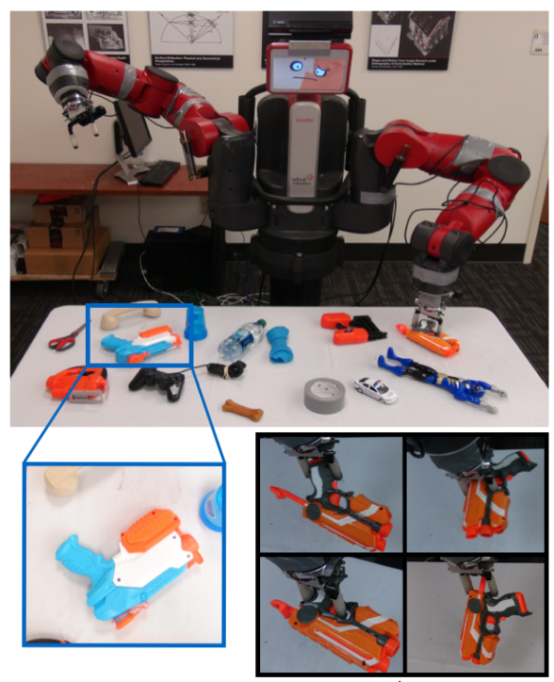
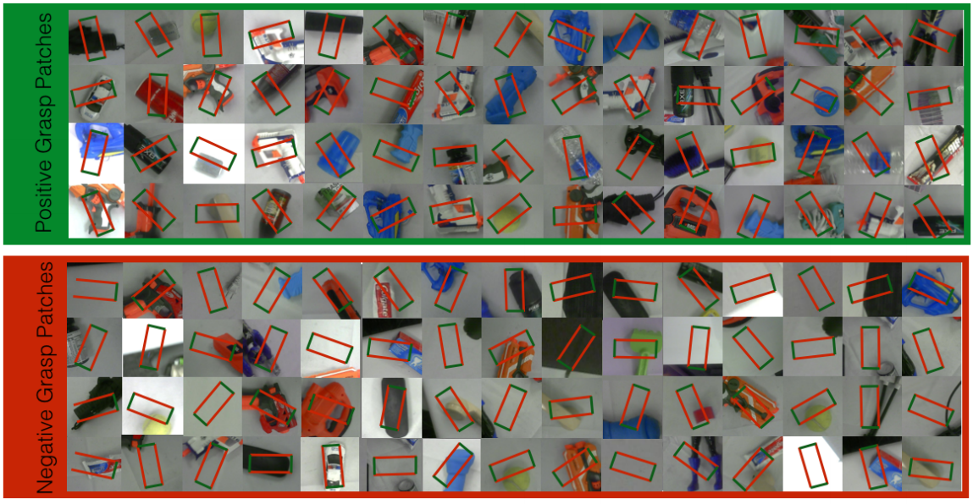
Robot grasping
L. Pinto and A. Gupta, Supersizing self-supervision: Learning to grasp from 50K tries and 700 robot hours, ICRA 2016
YouTube video

Slide 34
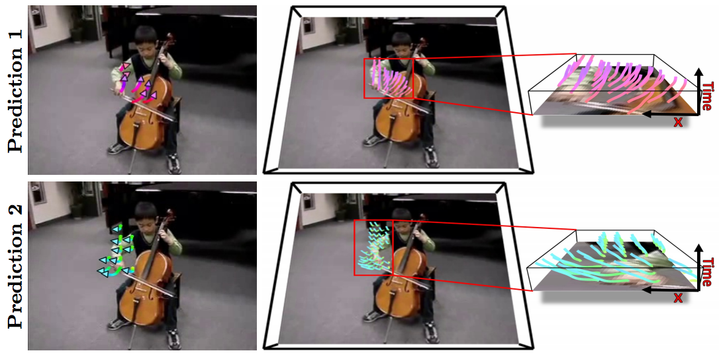
Future prediction
J. Walker, C. Doersch, A. Gupta, and M. Hebert, An Uncertain Future: Forecasting from Static Images Using Variational Autoencoders, ECCV 2016

Slide 35
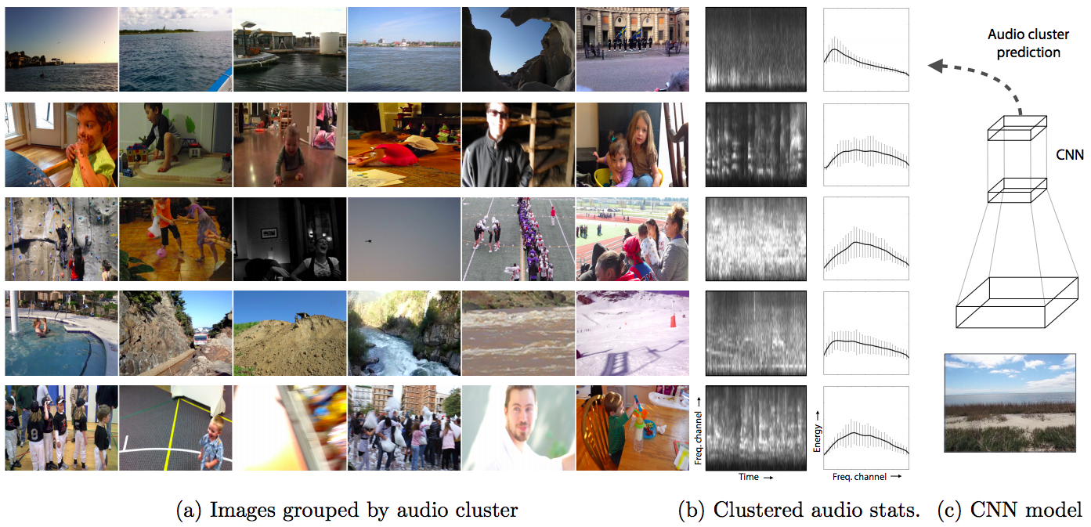
Sound prediction
A. Owens, J. Wu, J. McDermott, W. Freeman, and A. Torralba, Ambient Sound Provides Supervision for Visual Learning, ECCV 2016

Slide 36
Self-supervision for exploration
Learning to play a video game with sparse or non-existent rewards
Video
D. Pathak, P. Agrawal, A. Efros, T. Darrell, Curiosity-driven Exploration by Self-supervised Prediction, ICML 2017

Slide 37
Self-supervision: Discussion
For traditional recognition benchmarks, self-supervision is not as effective (so far) as getting enough supervised training data
However, self-supervision is very attractive (and possibly unavoidable) in scenarios that go beyond still images: video, video + audio, and sensorimotor learning

Slide 38
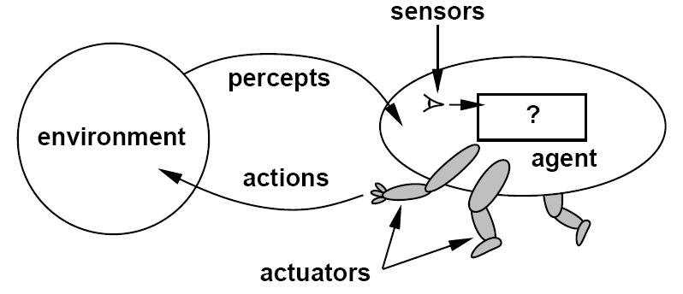
Possible ways forward
Focus on tasks beyond image classification
“Rich” prediction tasks
Generation
Move away from full supervision
Self-supervised learning
Focus on embodied vision, sensorimotor learning

Slide 39
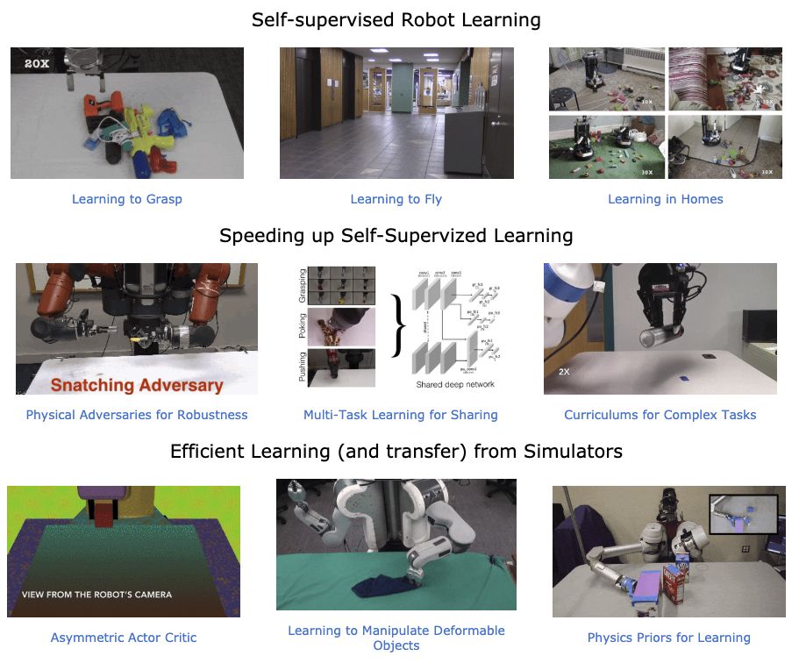
Embodied vision
A cross-section of topics from one representative researcher:
Lerrel Pinto
See also: Abhinav Gupta, Pieter Abbeel, Sergey Levine, Chelsea Finn

Slide 40
Embodied vision platforms
Simulation: AI2Thor, Habitat
Real robots: PyRobot

Slide 41
Simulation vs. reality
A. Kadian, J. Truong, A. Gokaslan, A. Clegg, E. Wijmans, S. Lee, M. Savva, S. Chernova, D. Batra, Are We Making Real Progress in Simulated Environments? Measuring the Sim2Real Gap in Embodied Visual Navigation, arXiv 2019

Slide 42
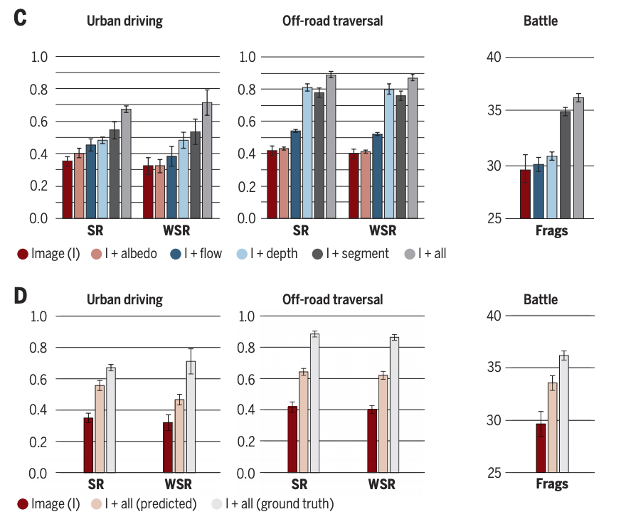
Does computer vision matter for action?
“Our main finding is that computer vision does matter. Models equipped with intermediate representations train faster, achieve higher task performance, and generalize better to previously unseen environments.”
B. Zhou, P. Krähenbühl, and V. Koltun, Does Computer Vision Matter for Action? Science Robotics, 4(30), 2019 (video)
Notes:
Assessing the utility of intermediate representations for sensorimotor control. (A) Sensorimotor tasks. From left to right: urban driving, off-road trail traversal, and battle. (B) Intermediate representations. Clockwise from top left: semantic segmentation, intrinsic surface color (albedo), optical flow, and depth. (Albedo not used in battle.) (C) Main results. For each task, we compare an image-only agent with an agent that is also provided with groundtruth intermediate representations. The agent observes the intermediate representations during both training and testing. Success rate (‘SR’) is the fraction of scenarios in which the agent successfully reached the target location; weighted success rate (‘WSR’) is weighted by track length; ‘frags’ is the number of enemies killed in a battle episode. We show mean and standard deviation in each condition. (D) Supporting experiments. In the ‘Image + All (predicted)’ condition, the intermediate representations are predicted in situ by a convolutional network; the agent is not given ground-truth representations at test time. The results indicate that even predicted vision modalities confer a significant advantage.

Slide 43
Challenges for embodied vision
Speed and cost of doing experiments
Training faster, generalizing from one task to another
Multi-agent interactions, communication
Planning and reasoning
Integrating memory, knowledge

Slide 44
Parting thoughts
The next breakthroughs are not likely to come cheaply
Access to data, computation, and platforms will be key
The next few years will make it clearer which problems have been truly solved and which ones have been underestimated
The hard problems are getting into “AI-complete” territory

Slide 45
What wasn’t on my list?
Adversarial examples
Few-shot learning
Vision and language, vision and knowledge
Explainability
Reasoning
Lifelong learning

