Slide 1
Visualizing and explaining neural networks
https://deepdreamgenerator.com/

Slide 2
Outline
Overview of visualization techniques
Mapping activations back to the image
Synthesizing images to maximize activation
Saliency maps
Quantifying interpretability of units
Pitfalls of visualization research

Slide 3
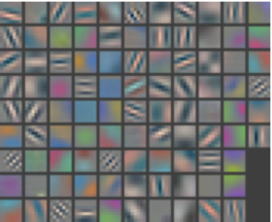
Overview and basic visualization techniques
Visualize first-layer weights directly

Slide 4
Overview and basic visualization techniques
Not too helpful for subsequent layers
Features from a CIFAR10 network, via Stanford CS231n

Slide 5
Overview and basic visualization techniques
Visualize maximally activating patches: pick a unit; run many images through the network; visualize patches that produce the highest output values

Slide 6
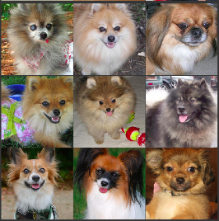
Overview and basic visualization techniques
Visualize maximally activating patches

Slide 7
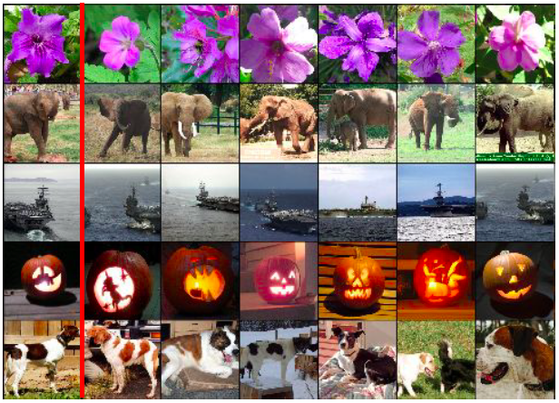
Overview and basic visualization techniques
What about FC layers?
Visualize nearest neighbor images according to activation vectors
Source: Stanford CS231n

Slide 8
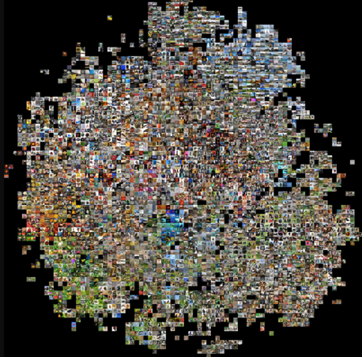
Overview and basic visualization techniques
What about FC layers?
Fancy dimensionality reduction, e.g., t-SNE
Source: Andrej Karpathy

Slide 9
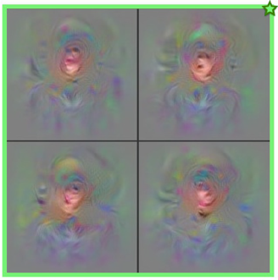
Overview and basic visualization techniques
“Model inversion”:
Synthesize images to maximize activation

Slide 10
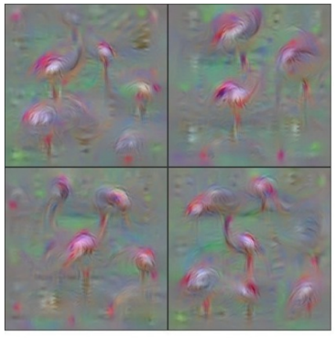
Overview and basic visualization techniques
“flamingo”
“Model inversion”:
Synthesize images to maximize activation

Slide 11
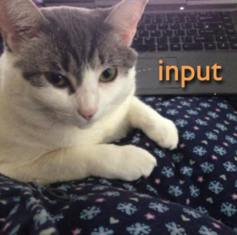
Overview and basic visualization techniques
Given: a particular input image
“cat”

Slide 12
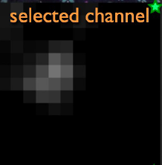
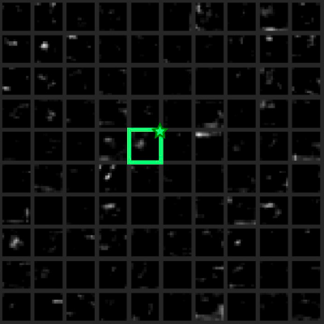
Overview and basic visualization techniques
Given: a particular input image
“cat”
Visualize activations for this image
Source

Slide 13
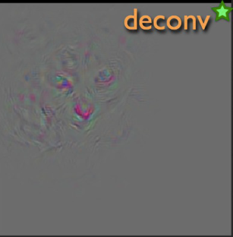
Overview and basic visualization techniques
Given: a particular input image
“cat”
Visualize activations for this image
Visualize pixel values responsible for the activation
Source

Slide 14
Deep visualization toolbox
YouTube video
J. Yosinski, J. Clune, A. Nguyen, T. Fuchs, and H. Lipson, Understanding neural networks through deep visualization, ICML DL workshop, 2015

Slide 15
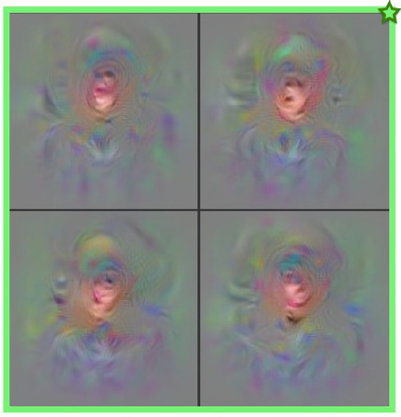
Two visualization techniques
How to synthesize images to maximize activation?
How to find image values responsible for the activation?

Slide 16
Outline
Overview of visualization techniques
Mapping activations back to the image

Slide 17
Mapping activations back to pixels
“cat”
Let’s take a single value in an intermediate feature map and propagate its gradient back to the original image pixels
What does this tell us?

Slide 18
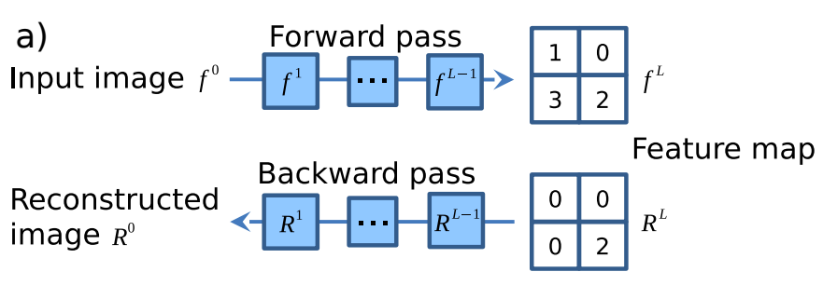
Mapping activations back to pixels
Forward an image through the network
Choose a feature map and an activation
Zero out all values except for the one of interest
Propagate that value back to the image
Figure source

Slide 19
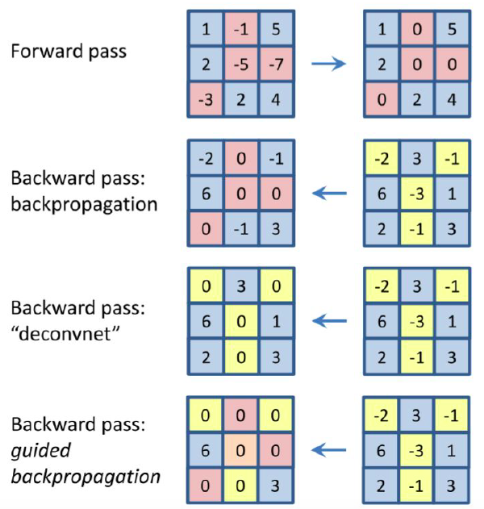
Mapping activations back to pixels
Commonly used methods differ in how they treat the ReLU
Propagating back negative gradients bad for visualization
Zeiler and Fergus (2014)
Does not work well for architectures w/o max pooling, for high layers
Springenberg et al. (2015)
J. Springenberg, A. Dosovitskiy, T. Brox, M. Riedmiller, Striving for simplicity: The all convolutional net, ICLR workshop, 2015
Notes:
From the Springenberg paper: We call this method guided backpropagation, because it adds an additional guidance signal from the higher layers to usual backpropagation. This prevents backward flow of negative gradients, corresponding to the neurons which decrease the activation of the higher layer unit we aim to visualize.

Slide 20
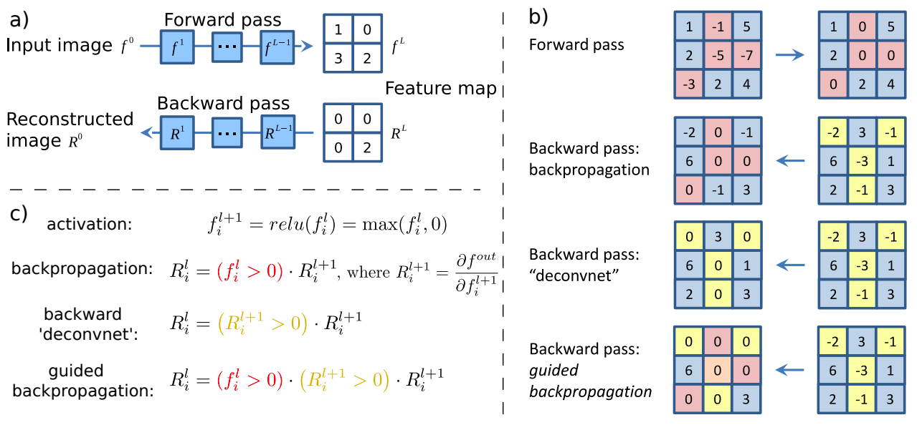
Guided backpropagation
J. Springenberg, A. Dosovitskiy, T. Brox, M. Riedmiller, Striving for simplicity: The all convolutional net, ICLR workshop, 2015

Slide 21
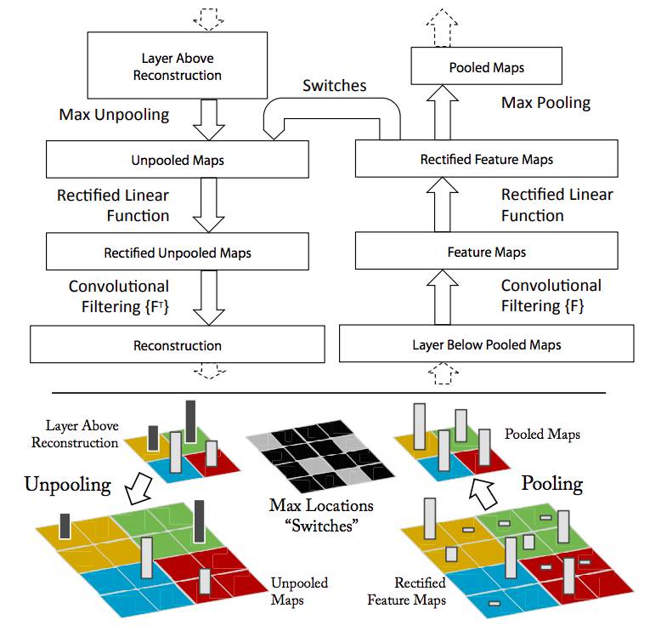
Deconvnet
M. Zeiler and R. Fergus, Visualizing and Understanding Convolutional Networks, ECCV 2014

Slide 22
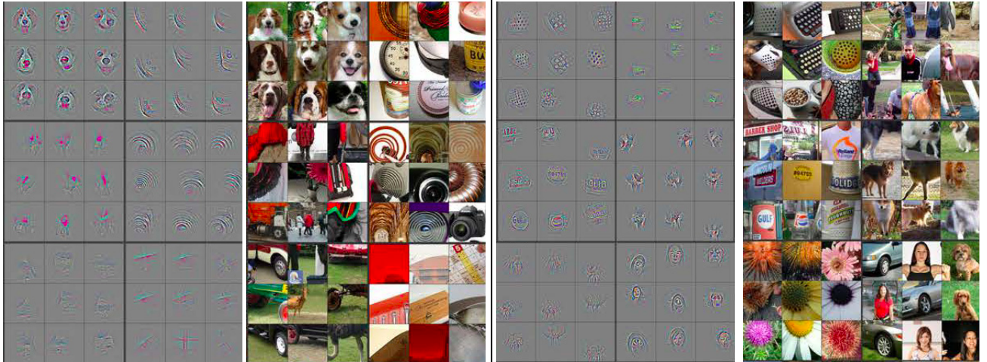
Deconvnet visualization
AlexNet Layer 4
AlexNet Layer 5
M. Zeiler and R. Fergus, Visualizing and Understanding Convolutional Networks, ECCV 2014

Slide 23
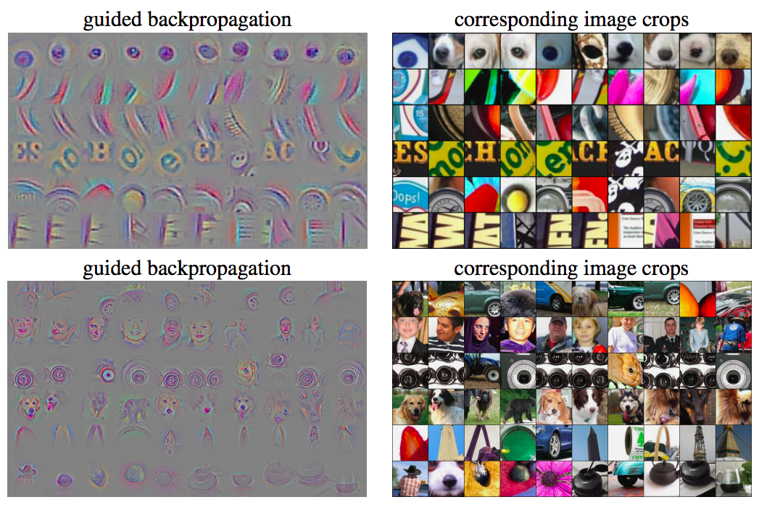
Guided backpropagation visualization
J. Springenberg, A. Dosovitskiy, T. Brox, M. Riedmiller, Striving for simplicity: The all convolutional net, ICLR workshop, 2015
Notes:
From the Springenberg paper: We call this method guided backpropagation, because it adds an additional guidance signal from the higher layers to usual backpropagation. This prevents backward flow of negative gradients, corresponding to the neurons which decrease the activation of the higher layer unit we aim to visualize.

Slide 24
Google DeepDream
Idea: adjust image to amplify existing activations
https://ai.googleblog.com/2015/06/inceptionism-going-deeper-into-neural.html

Slide 25
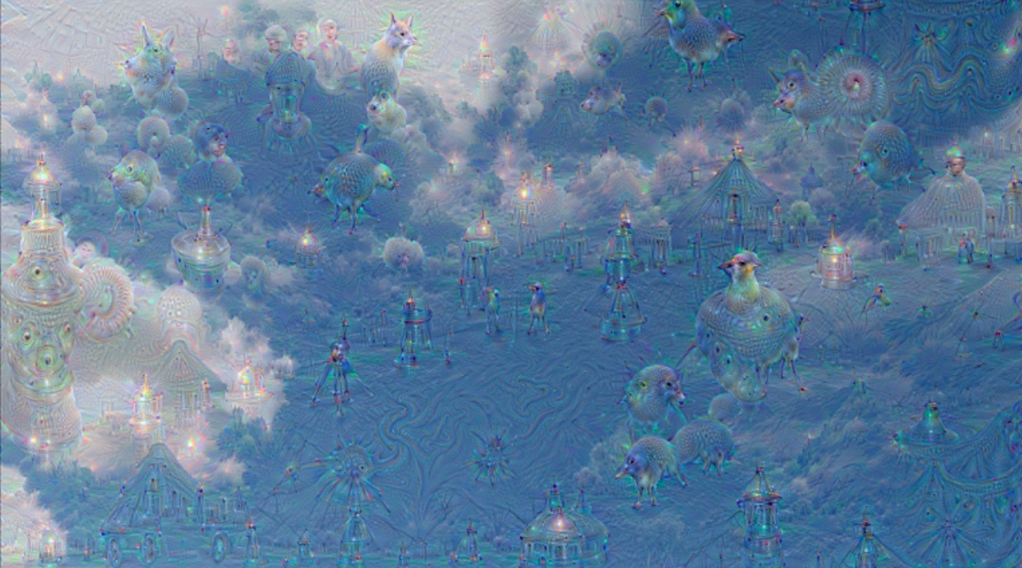
Google DeepDream
Idea: adjust image to amplify existing activations
https://ai.googleblog.com/2015/06/inceptionism-going-deeper-into-neural.html

Slide 26
Google DeepDream
Choose an image and a layer in a CNN; repeat:
Forward: compute activations at chosen layer
Set gradient of chosen layer equal to its activation
Equivalent to maximizing $\sum_{i}{f_{i}^{2}(x)}$
Backward: Compute gradient w.r.t. image
Update image (with some tricks)
Source: Stanford CS231n
https://ai.googleblog.com/2015/06/inceptionism-going-deeper-into-neural.html
https://deepdreamgenerator.com/

Slide 27
Google DeepDream
Using different target layers enhances different patterns
https://ai.googleblog.com/2015/06/inceptionism-going-deeper-into-neural.html
https://deepdreamgenerator.com/

Slide 28
Outline
Overview of visualization techniques
Mapping activations back to the image
Synthesizing images to maximize activation

Slide 29
Visualization by optimization (model inversion)
How can we synthesize images that maximize activation of a given neuron?
Basic approach: find image $x$ maximizing target activation $f\left(x\right)$subject to natural image regularization penalty $R(x)$:
$$x^{∗}={arg max}_{x} f\left(x\right)−λR(x)$$

Slide 30
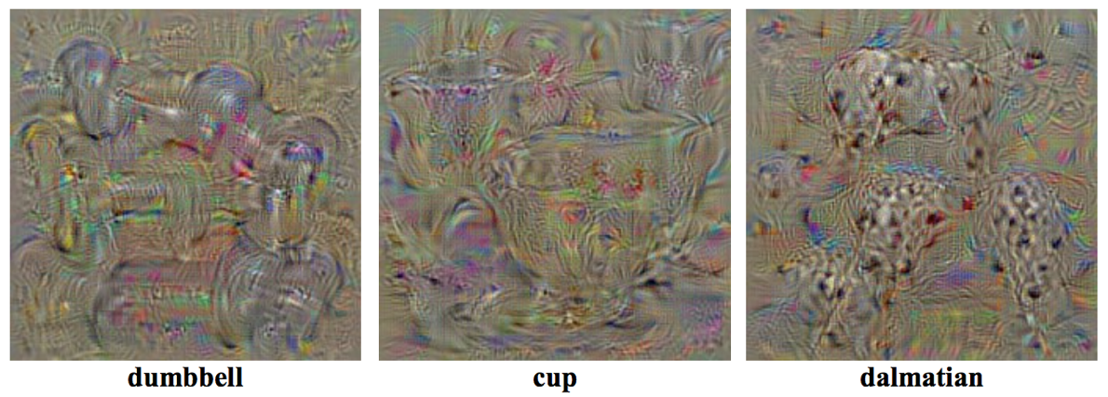
Visualization by optimization (model inversion)
Maximize $f\left(x\right)−λR(x)$
$f\left(x\right)$ is score for a category before softmax
$R(x)$ is L2 regularization
Perform gradient ascent starting with zero image, add dataset mean to result
K. Simonyan, A. Vedaldi, and A. Zisserman, Deep Inside Convolutional Networks: Visualising Image Classification Models and Saliency Maps, ICLR 2014

Slide 31
Visualization by optimization (model inversion)
Alternative approach to regularization: at each step of gradient ascent, apply operator $r$ that regularizes the image:
$$x←r\left(x+η\frac{∂f}{∂x}\right)$$
Combination that gives good-looking results:
L2 decay
Gaussian blur (every few iterations)
Clip pixel values with small magnitude
Clip pixel values with small contribution to the activation (estimated by product of pixel value and gradient)
J. Yosinski, J. Clune, A. Nguyen, T. Fuchs, and H. Lipson, Understanding neural networks through deep visualization, ICML DL workshop, 2015
Notes:
From Yosinski paper: One way of computing a pixel’s contribution to an activation is to measure how much the activation increases or decreases when the pixel is set to zero… This approach is straightforward but prohibitively slow, requiring a forward pass for every pixel. Instead, we approximate this process by linearizing f(x) around x, in which case the contribution of each dimension of x can be estimated as the elementwise product of x and the gradient. We then sum over all three channels and take the absolute value

Slide 32
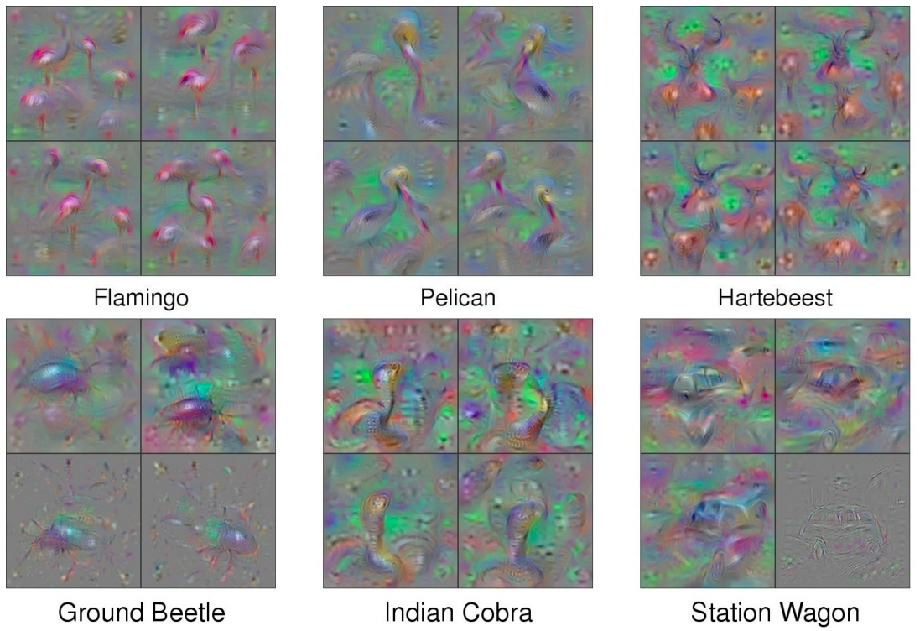
Visualization by optimization (model inversion)
Example visualizations:
J. Yosinski, J. Clune, A. Nguyen, T. Fuchs, and H. Lipson, Understanding neural networks through deep visualization, ICML DL workshop, 2015
Notes:
From Yosinski paper: One way of computing a pixel’s contribution to an activation is to measure how much the activation increases or decreases when the pixel is set to zero… This approach is straightforward but prohibitively slow, requiring a forward pass for every pixel. Instead, we approximate this process by linearizing f(x) around x, in which case the contribution of each dimension of x can be estimated as the elementwise product of x and the gradient. We then sum over all three channels and take the absolute value

Slide 33
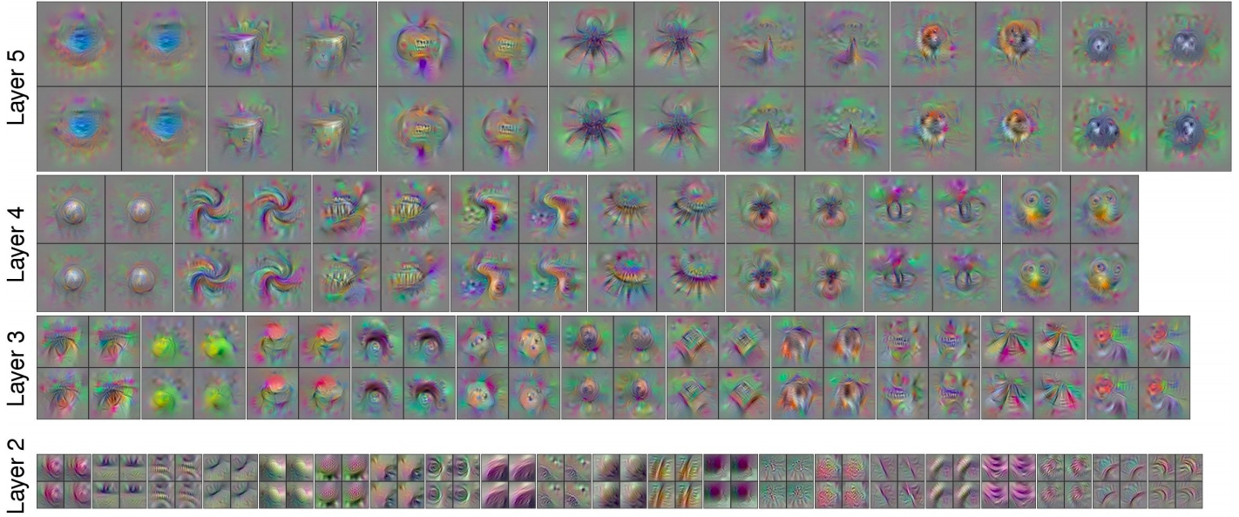
Visualization by optimization (model inversion)
Example visualizations of intermediate features:
J. Yosinski, J. Clune, A. Nguyen, T. Fuchs, and H. Lipson, Understanding neural networks through deep visualization, ICML DL workshop, 2015
Notes:
From Yosinski paper: One way of computing a pixel’s contribution to an activation is to measure how much the activation increases or decreases when the pixel is set to zero… This approach is straightforward but prohibitively slow, requiring a forward pass for every pixel. Instead, we approximate this process by linearizing f(x) around x, in which case the contribution of each dimension of x can be estimated as the elementwise product of x and the gradient. We then sum over all three channels and take the absolute value

Slide 34
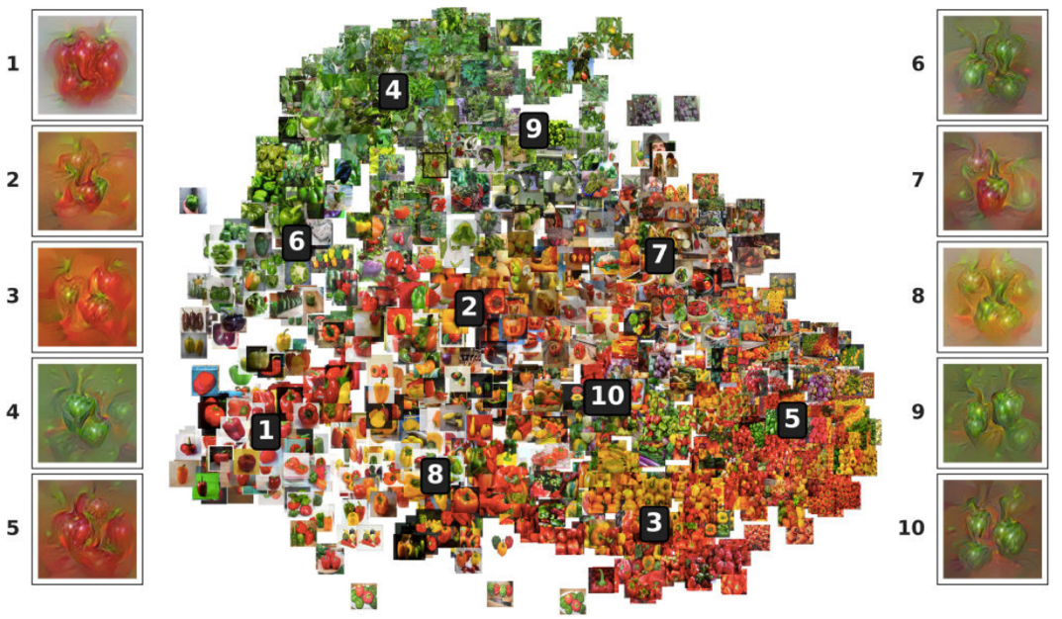
Multifaceted feature visualization
Key idea: most neurons in high layers respond to a mix of different patterns or “facets”
For coherent visualizations, zero in on individual facets
A. Nguyen, J. Yosinski, J. Clune, Multifaceted Feature Visualization: Uncovering the Different Types of Features Learned By Each Neuron in Deep Neural Networks, ICML workshop, 2016

Slide 35
Multifaceted feature visualization
Key idea: most neurons in high layers respond to a mix of different patterns or “facets”
For coherent visualizations, zero in on individual facets
Algorithm:
Cluster FC activations of training images to identify facets
For each facet, initialize optimization with mean image of that facet
To attempt to produce image of a single object, use center-biased regularization (start with blurry image, gradually increase resolution and update center pixels more than edge pixels)
A. Nguyen, J. Yosinski, J. Clune, Multifaceted Feature Visualization: Uncovering the Different Types of Features Learned By Each Neuron in Deep Neural Networks, ICML workshop, 2016

Slide 36
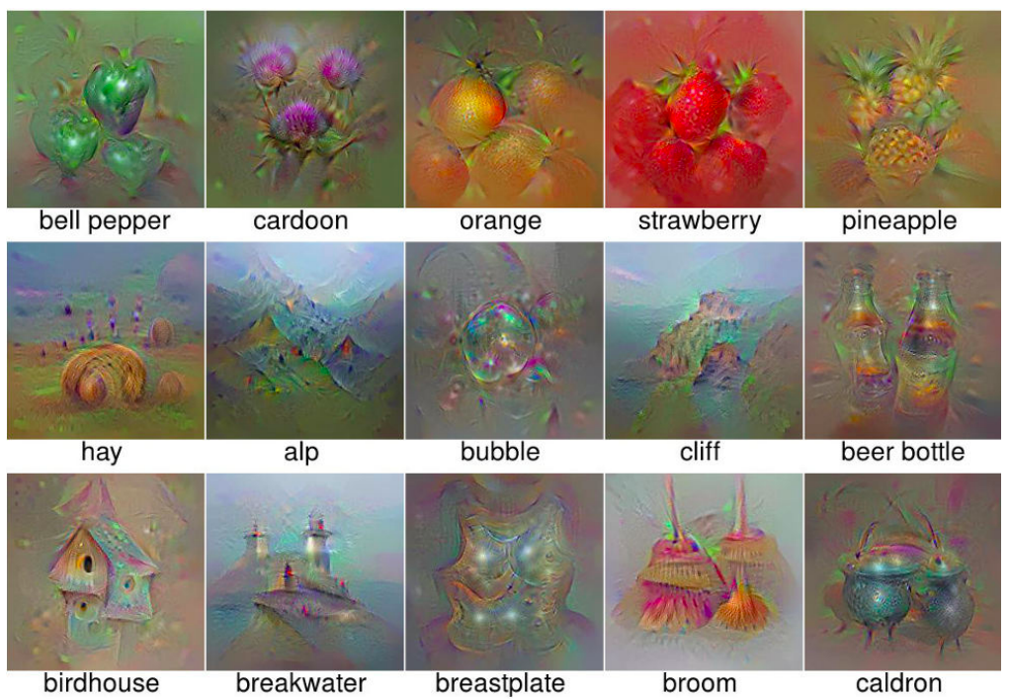
Multifaceted feature visualization
A. Nguyen, J. Yosinski, J. Clune, Multifaceted Feature Visualization: Uncovering the Different Types of Features Learned By Each Neuron in Deep Neural Networks, ICML workshop, 2016

Slide 37
Dreaming to distill
Key idea: add regularization terms to encourage the mean and variance of values in intermediate feature maps to match batchnorm statistics of the network
H. Yin et al. Dreaming to Distill: Data-free Knowledge Transfer via DeepInversion. CVPR 2020

Slide 38
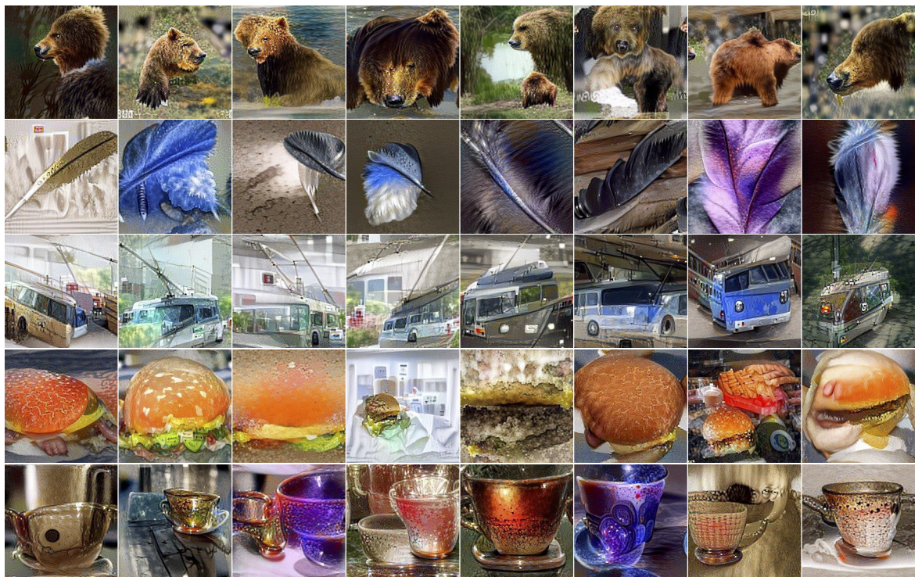
Dreaming to distill: Results
H. Yin et al. Dreaming to Distill: Data-free Knowledge Transfer via DeepInversion. CVPR 2020

Slide 39
Outline
Overview of visualization techniques
Mapping activations back to the image
Synthesizing images to maximize activation
Saliency maps

Slide 40
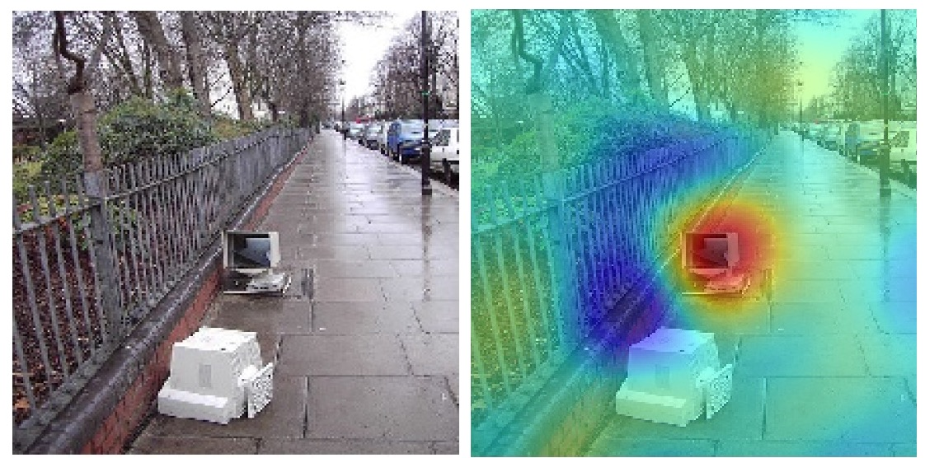
Saliency maps
Which parts of the image played the most important role in the network’s decision?
Prediction: “car” 64%
Explanation for “car”
Cars parked
actual reason is a monitor and street context
Source: K. Saenko

Slide 41
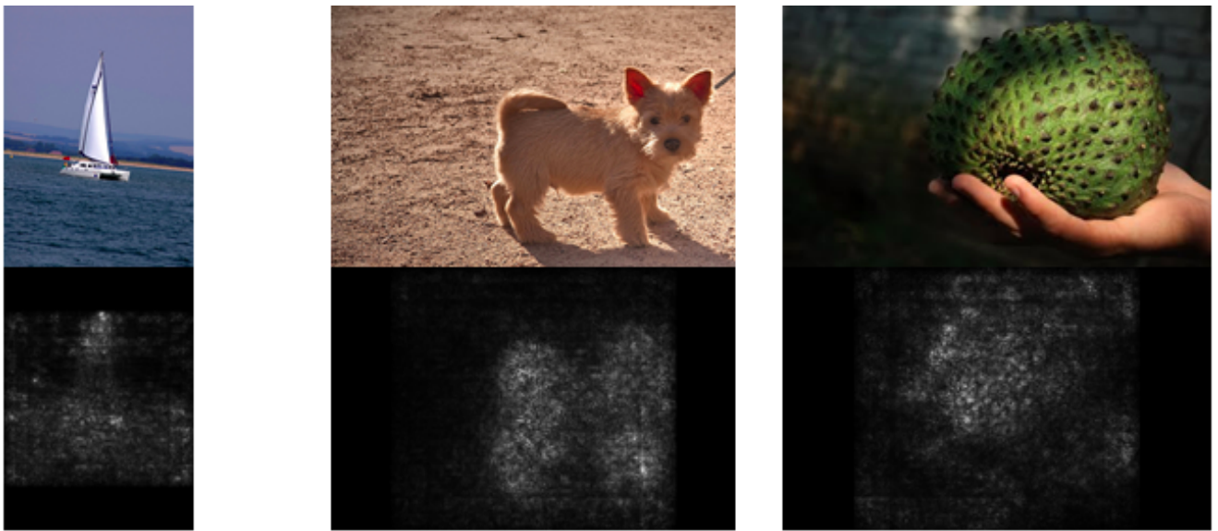
“White box” saliency via gradients
Backpropagate gradient of class score (before softmax) to the image, display max of absolute values across color channels
K. Simonyan, A. Vedaldi, and A. Zisserman, Deep Inside Convolutional Networks: Visualising Image Classification Models and Saliency Maps, ICLR 2014

Slide 42
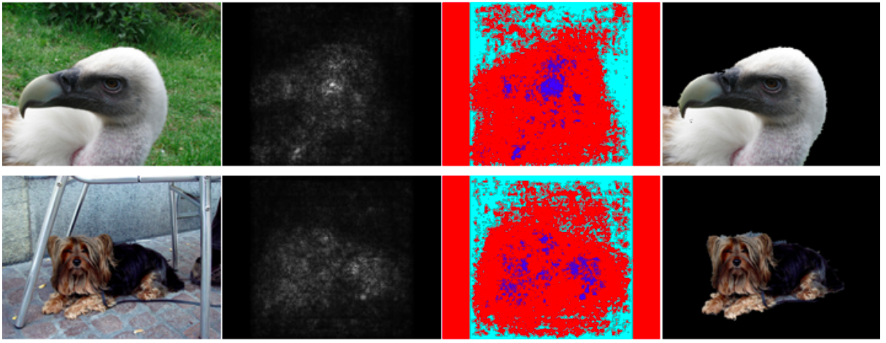
“White box” saliency via gradients
Can be used for weakly supervised segmentation:
Foreground (blue)
Background (cyan)
Input
Saliency map
GrabCut result
K. Simonyan, A. Vedaldi, and A. Zisserman, Deep Inside Convolutional Networks: Visualising Image Classification Models and Saliency Maps, ICLR 2014

Slide 43
Gradient-weighted class activation mapping (Grad-CAM)
R. Selvaraju et al. Grad-CAM: Visual Explanations from Deep Networks via Gradient-based Localization. ICCV 2017

Slide 44
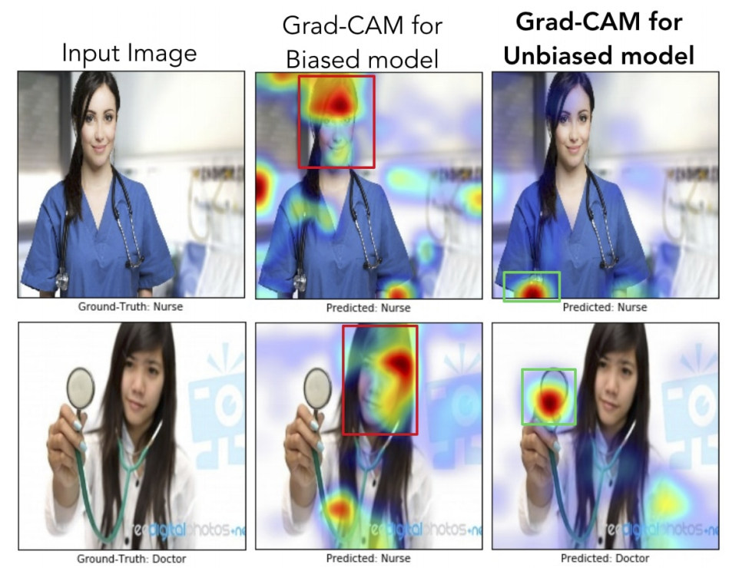
Gradient-weighted class activation mapping (Grad-CAM)
Application: detecting model/dataset bias
R. Selvaraju et al. Grad-CAM: Visual Explanations from Deep Networks via Gradient-based Localization. ICCV 2017

Slide 45
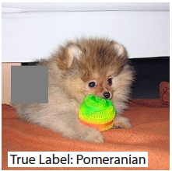
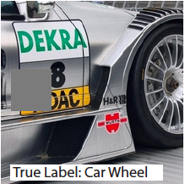
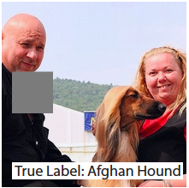
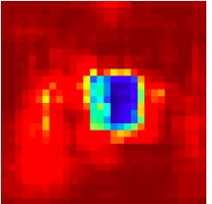
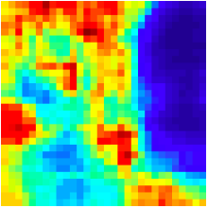
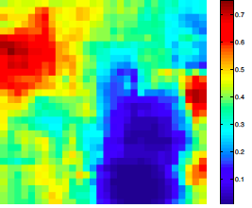
“Black box” saliency via masking
Slide square occluder across image, see how class score changes
Input image
Correct class probability as function of occluder position
M. Zeiler and R. Fergus, Visualizing and Understanding Convolutional Networks, ECCV 2014

Slide 46
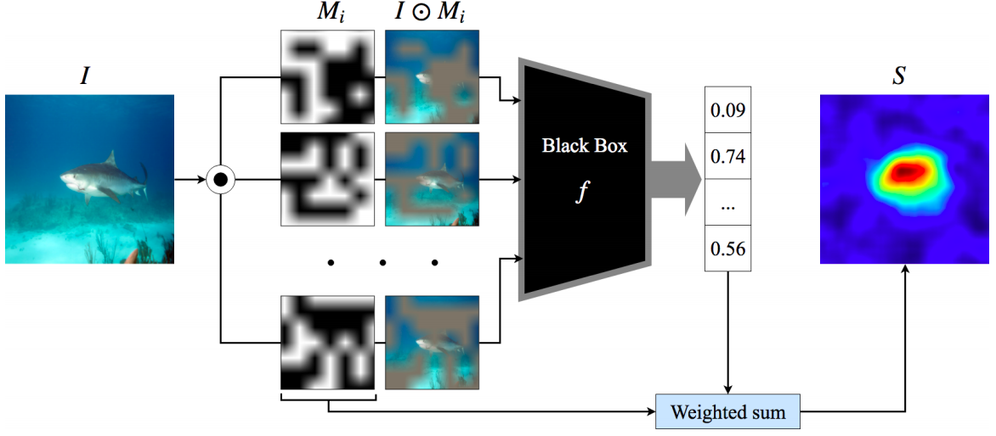
“Black box” saliency via masking
Saliency of a class at a pixel is expected score for that class over all masks where the pixel is visible
V. Petsiuk, A. Das, K. Saenko, RISE: Randomized Input Sampling for Explanation of Black-box Models, BMVC 2018
Notes:
Input image I is element-wise multiplied with random masks Mi and the masked images are fed to the base model. The saliency map is a linear combination of the masks where the weights come from the score of the target class corresponding to the respective masked inputs.

Slide 47
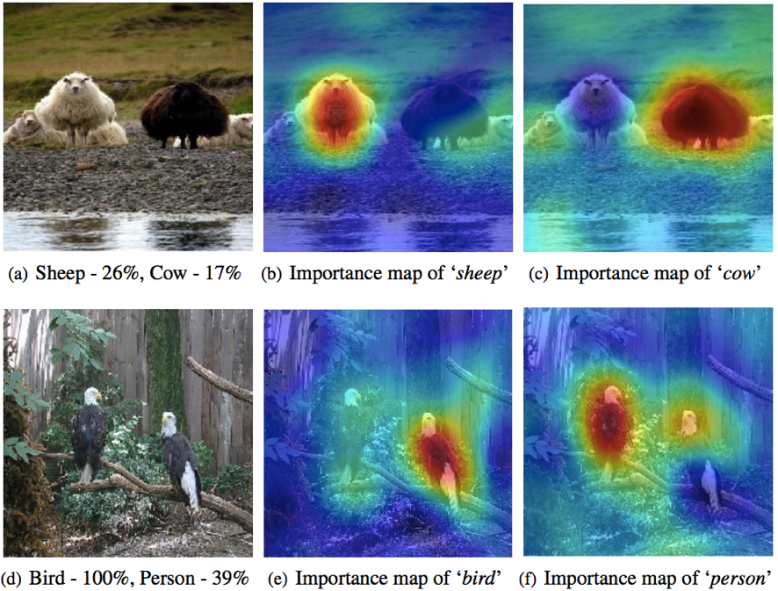
“Black box” saliency via masking
Saliency of a class at a pixel is expected score for that class over all masks where the pixel is visible
V. Petsiuk, A. Das, K. Saenko, RISE: Randomized Input Sampling for Explanation of Black-box Models, BMVC 2018

Slide 48
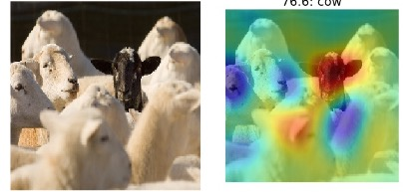
“Black box” saliency via masking
Application: detecting model/dataset bias
Prediction: “cow” 76%
Explanation for “cow”
MODEL BIAS: most sheep are white, so model mistakes black sheep for cows
Source: K. Saenko

Slide 49
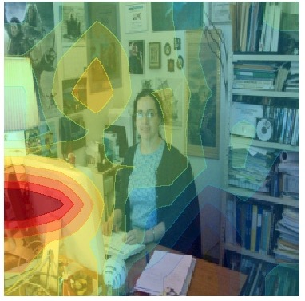
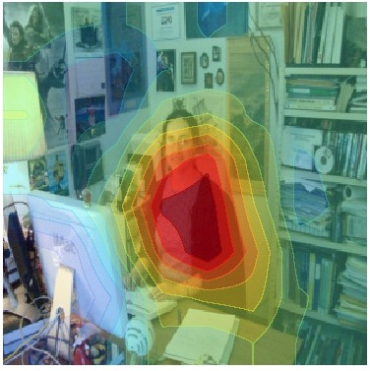
“Black box” saliency via masking
Application: detecting model/dataset bias
Baseline: A man sitting at a desk with a laptop computer.
Improved model: A woman sitting in front of a laptop computer.
L. Hendricks, K. Burns, K. Saenko, T. Darrell, A. Rohrbach, Women Also Snowboard: Overcoming Bias in Captioning Models, ECCV 2018

Slide 50
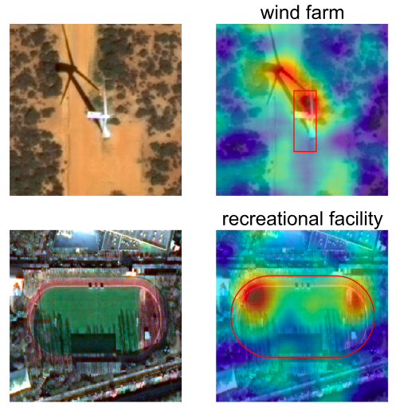
“Black box” saliency via masking
Application: detecting model/dataset bias
RISE applied to satellite image classification model shows that shadows have great influence on the model
Source: RISE poster

Slide 51
Outline
Overview of visualization techniques
Mapping activations back to the image
Synthesizing images to maximize activation
Saliency maps
Quantifying interpretability of units

Slide 52
Review: Visualizing and explaining neural networks
Mapping activations back to the image

Slide 53
Review: Visualizing and explaining neural networks
Mapping activations back to the image
Synthesizing images to maximize activation

Slide 54
Review: Visualizing and explaining neural networks
Mapping activations back to the image
Synthesizing images to maximize activation
Saliency maps

Slide 55
Review: Visualizing and explaining neural networks
Mapping activations back to the image
Synthesizing images to maximize activation
Saliency maps
Quantifying interpretability of units

Slide 56
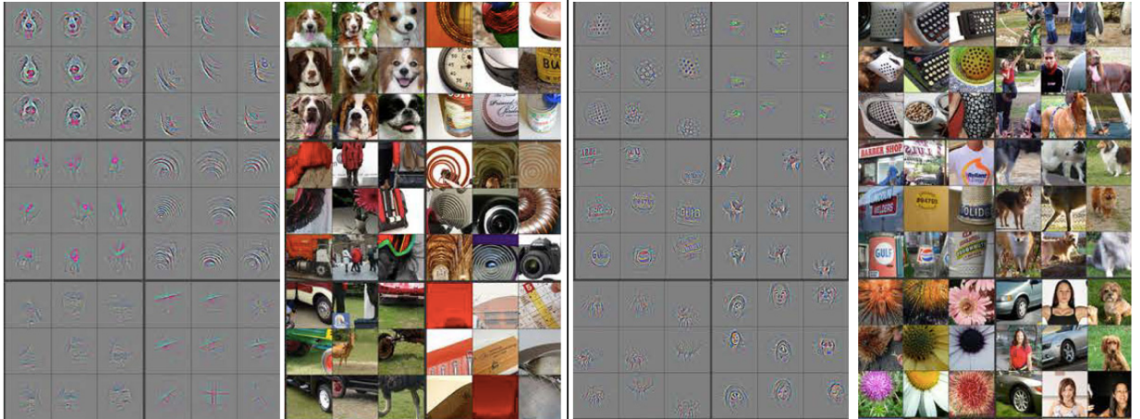
Quantifying interpretability of units
From the beginning, people have observed that many units in higher layers seem to fire on meaningful concepts
But how can we quantify this?
AlexNet Layer 4
AlexNet Layer 5
Figure: Zeiler & Fergus

Slide 57
Quantifying interpretability of units
For a given unit, measure the overlap between areas of high activation and semantic segmentations for a large set of visual concepts
AlexNet
Unit 1
Top Activated Images
Lamp Intersection over Union (IoU) = 0.12
D. Bau, B. Zhou, A. Khosla, A. Oliva, A. Torralba, Network Dissection: Quantifying Interpretability of Deep Visual Representations, CVPR 2017

Slide 58
Quantifying interpretability of units
For a given unit, measure the overlap between areas of high activation and semantic segmentations for a large set of visual concepts
Forward pass
Network trained for image classification on ImageNet or Places
Dataset with semantic segmentations for ~1200 visual concepts
D. Bau, B. Zhou, A. Khosla, A. Oliva, A. Torralba, Network Dissection: Quantifying Interpretability of Deep Visual Representations, CVPR 2017

Slide 59
Quantifying interpretability of units
Histogram of object detectors for Places AlexNet conv5 units
81/256 units with IoU > 0.04
conv5 unit 79 car (object) IoU=0.13
conv5 unit 107 road (object) IoU=0.15
D. Bau, B. Zhou, A. Khosla, A. Oliva, A. Torralba, Network Dissection: Quantifying Interpretability of Deep Visual Representations, CVPR 2017

Slide 60
Quantifying interpretability of units
Comparison of number of unique detectors across architectures
Supervised VGG, GoogLeNet, ResNet
Supervised AlexNet
Self-supervised AlexNet
D. Bau, B. Zhou, A. Khosla, A. Oliva, A. Torralba, Network Dissection: Quantifying Interpretability of Deep Visual Representations, CVPR 2017

Slide 61
Interpretability of colorization network
Conv5 units of self-supervised colorization network (Zhang et al., 2016):
sky
faces
dog
faces
trees
water
flowers
Source: A. Efros

Slide 62
Pitfalls of visualization and interpretability research
Do saliency maps of an image w.r.t. different models depend on the models, or merely on the image itself (e.g., mainly focusing on edges)?
Do visualizations actually help humans better predict or understand a network’s outputs?
Does the existence of selective units imply that they are necessary for good performance? Need studies ablating selective units or training networks with objectives that discourage selectivity
Need more techniques for understanding properties of distributed, high-dimensional representations
M. Leavitt and A. Morcos, Towards falsifiable interpretability research, arXiv 2020

Slide 63
Summary
Basic visualization techniques
Showing weights, top activated patches, nearest neighbors
Mapping activations back to the image
Deconvolution
Guided back-propagation
Synthesizing images to maximize activation
Gradient ascent with natural image regularization
Saliency maps
“White box” vs. “black box”
Explainability/interpretability
Explaining network decisions, detecting bias
Quantifying interpretability of intermediate units

