Slide 1
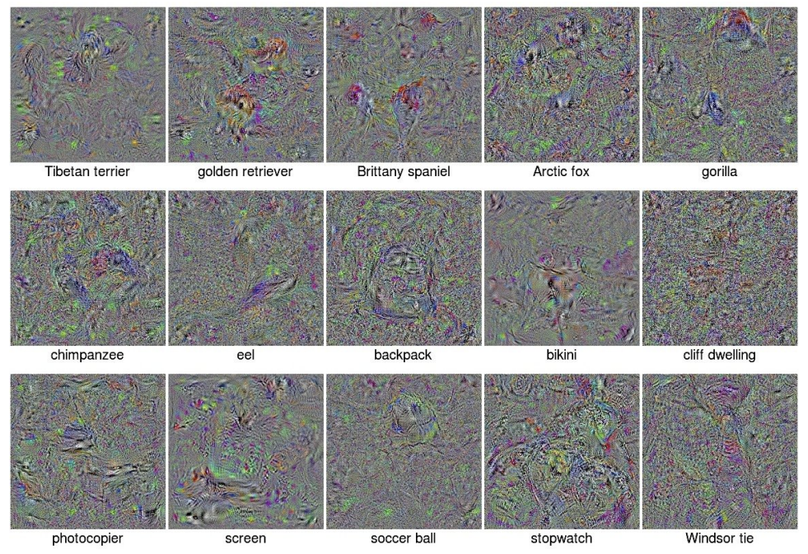
Fooling neural networks
Image source

Slide 2
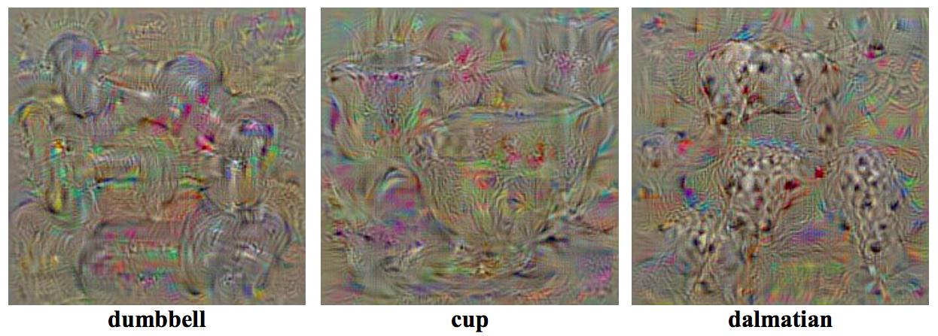
Last time: Generation of preferred inputs
K. Simonyan, A. Vedaldi, and A. Zisserman, Deep Inside Convolutional Networks: Visualising Image Classification Models and Saliency Maps, ICLR 2014

Slide 3
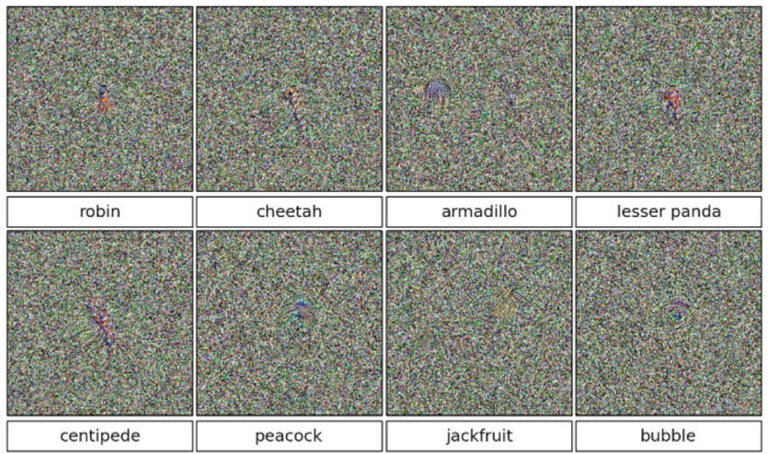
Last time: Generation of preferred inputs
Actually, it is easy to generate perceptually incoherent or totally meaningless images that will be classified as any given class with high confidence
A. Nguyen, J. Yosinski, J. Clune, Deep Neural Networks are Easily Fooled: High Confidence Predictions for Unrecognizable Images, CVPR 2015

Slide 4
Adversarial examples
We can “fool” a neural network by imperceptibly perturbing an input image so it is misclassified
Source: Stanford CS231n

Slide 5
Adversarial examples: Outline
Basic definition, analysis of fooling linear classifiers
Generating adversarial examples
Fast gradient sign, iterative variants
Universal adversarial perturbations
Why are neural networks easy to fool?
Defending against adversarial examples
Adversarial training
Learning to reject adversarial examples
Robust architectures
Image pre-processing
Trends and open questions
Broadening the scope of adversarial examples
Adversarial examples and human perception

Slide 6
Finding the smallest adversarial perturbation
Start with correctly classified image $x$
Find perturbation $r$ minimizing ${\left\|r\right\|}_{2}$ such that
$x+r$ is misclassified (or classified as specific target class)
All values of $x+r$ are in the valid range
This is constrained non-convex optimization, which the authors solve with L-BFGS
C. Szegedy, W. Zaremba, I. Sutskever, J. Bruna, D. Erhan, I. Goodfellow, R. Fergus, Intriguing properties of neural networks, ICLR 2014

Slide 7
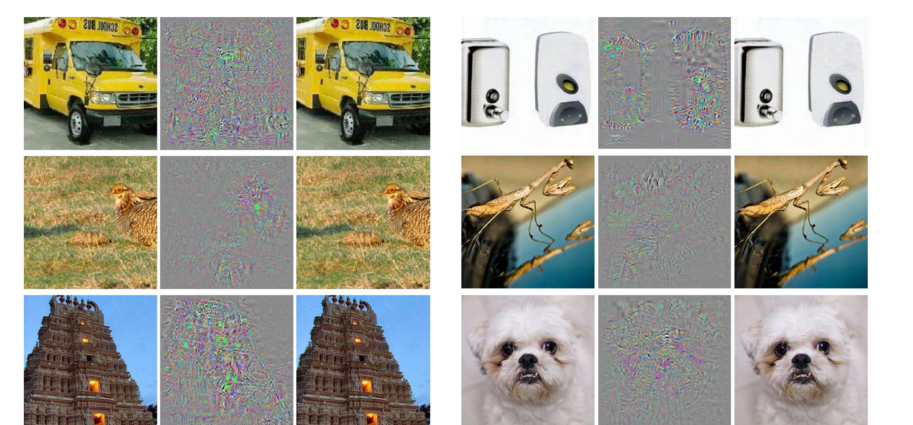
Finding the smallest adversarial perturbation
Sample results:
Input
Perturbation
x 10
“Ostrich”
Input
Perturbation
x 10
“Ostrich”
C. Szegedy, W. Zaremba, I. Sutskever, J. Bruna, D. Erhan, I. Goodfellow, R. Fergus, Intriguing properties of neural networks, ICLR 2014

Slide 8
Gradient ascent
Rather than searching for the smallest possible perturbation, it is easier to take small gradient steps in desired direction
Decrease score (increase loss) of correct class $y^{∗}$:
$x←x−η⁡\frac{∂f(x,y^{∗}) }{∂x}$ or $x←x+η⁡\frac{∂L(x,y^{∗}) }{∂x}$
Increase score (decrease loss) of incorrect target class $\hat{y}$:
$x←x+η⁡\frac{∂f(x,\hat{y}) }{∂x}$ or $x←x−η⁡\frac{∂L(x,\hat{y}) }{∂x}$

Slide 9
Fooling a linear classifier
Increase score of target class $\hat{y}$:
$$x←x+η⁡\frac{∂f(x,\hat{y}) }{∂x}$$
For a linear classifier with $f\left(x,\hat{y}\right)={\hat{w}}^{T}x$:
$$x←x+η \hat{w}$$
To fool a linear classifier, add a small multiple of the target class weights to the test example

Slide 10
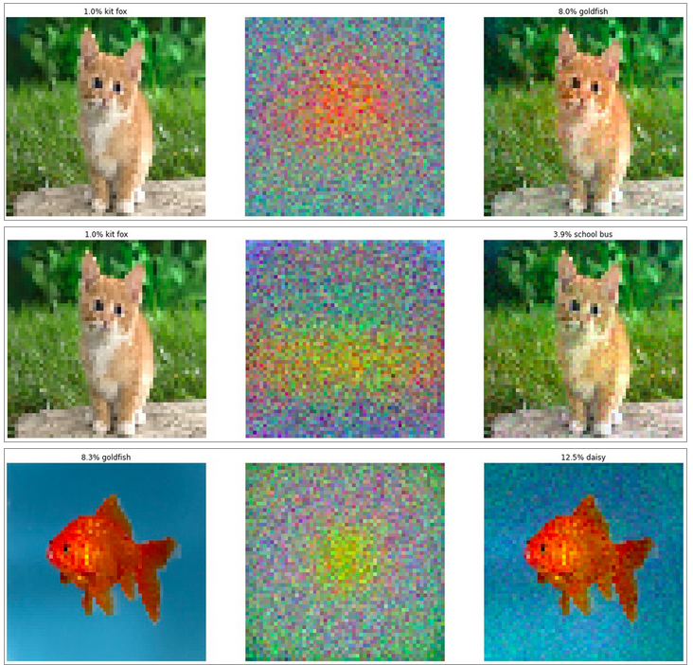
Fooling a linear classifier
http://karpathy.github.io/2015/03/30/breaking-convnets/

Slide 11
Analysis of the linear case
Response of classifier with weights $w$ to adversarial example $x+r$:
$$w^{T}\left(x+r\right)=w^{T}x+w^{T}r$$
Suppose the pixel values have precision $ε$, i.e., the classifier is normally expected to predict the same class for $x$ and $x+r$ as long as ${\left\|r\right\|}_{∞}≤ε$
How to choose $r$ to maximize the increase in activation $w^{T}r$ subject to ${\left\|r\right\|}_{∞}≤ε$?
$$r =ε sgn⁡(w)$$
I. Goodfellow, J. Schlens, C. Szegedy, Explaining and harnessing adversarial examples, ICLR 2015
Notes:
The infinity norm is the maximum of the absolute values of the components
If a given entry of w is positive (resp. negative), set corresponding entry of r to +epsilon (resp. –epsilon).

Slide 12
Analysis of the linear case
Response of classifier with weights $w$ to adversarial example $x+r$, $r =ε sgn⁡(w)$:
$$w^{T}\left(x+r\right)=w^{T}x+ε w^{T}sgn⁡(w)$$
If $w$ has dimensionality $d$ and average element magnitude $m$, how much will the activation increase?
By $εdm$, i.e., linearly as a function of $d$
The higher the dimensionality, the easier it is to make many small changes to the input that cause a large change in the output
I. Goodfellow, J. Schlens, C. Szegedy, Explaining and harnessing adversarial examples, ICLR 2015

Slide 13
Toy example
$$x$$
2 | -1 | 3 | -2 | 2 | 2 | 1 | -4 | 5 | 1
-1 | -1 | 1 | -1 | 1 | -1 | 1 | 1 | -1 | 1
$$w$$
$$w^{T}x=−2+1+3+2+2−2+1−4−5+1=−3$$
$${σ(w}^{T}x)=\frac{1}{1+e^{−\left(−3\right)}}=0.047$$
http://karpathy.github.io/2015/03/30/breaking-convnets/

Slide 14
Toy example
$$x$$
2 | -1 | 3 | -2 | 2 | 2 | 1 | -4 | 5 | 1
-1 | -1 | 1 | -1 | 1 | -1 | 1 | 1 | -1 | 1
1.5 | -1.5 | 3.5 | -2.5 | 2.5 | 1.5 | 1.5 | -3.5 | 4.5 | 1.5
$$w$$
$$x + r$$
$$w^{T}x=−2+1+3+2+2−2+1−4−5+1=−3$$
$${σ(w}^{T}x)=\frac{1}{1+e^{−\left(−3\right)}}=0.047$$
$$w^{T}\left(x+r\right)=$$
$$−3+10∗0.5=2$$
$${σ(w}^{T}(x+r))=\frac{1}{1+e^{−2}}=0.88$$
http://karpathy.github.io/2015/03/30/breaking-convnets/
Notes:
epsilon = 0.5, d = 10

Slide 15
Adversarial examples: Outline
Basic definition, analysis of fooling linear classifiers
Generating adversarial examples
Fast gradient sign, iterative variants
Universal adversarial perturbations

Slide 16
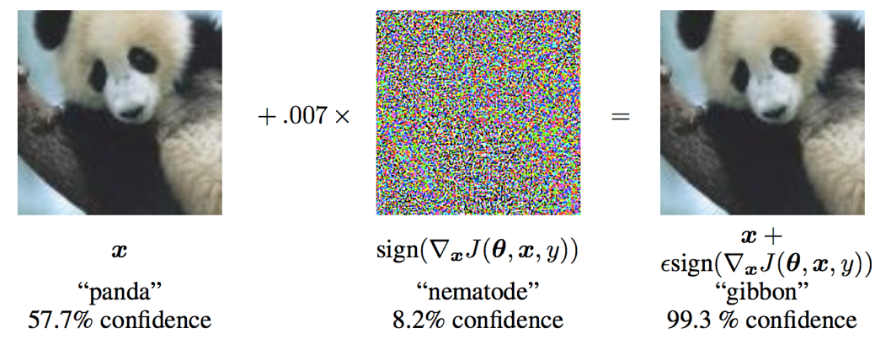
Generating adversarial examples
Fast gradient sign method: Find the gradient of the loss w.r.t. correct class $y^{∗}$, take element-wise sign, update in resulting direction:
$$x←x+ε sgn⁡\left(\frac{∂L(x,y^{∗}) }{∂x}\right)$$
I. Goodfellow, J. Schlens, C. Szegedy, Explaining and harnessing adversarial examples, ICLR 2015
Notes:
From the paper: We can linearize the cost function around the current value of θ, obtaining an optimal max-norm constrained pertubation

Slide 17
Generating adversarial examples
Fast gradient sign method:
$$x←x+ε sgn⁡\left(\frac{∂L(x,y^{∗}) }{∂x}\right)$$
Iterative gradient sign method: take multiple smaller steps until misclassified, each time clip result to be within $ε$-neighborhood of original image
Least likely class method: try to misclassify image as class $\hat{y}$with smallest initial score:
$$x←x−ε sgn⁡\left(\frac{∂L(x,\hat{y}) }{∂x}\right)$$
A. Kurakin, I. Goodfellow, S. Bengio, Adversarial examples in the real world, ICLR 2017 workshop
Notes:
From the paper: Both [fast gradient sign and iterative gradient sign methods] simply try to increase the cost of the correct class, without specifying which of the incorrect classes the model should select. Such methods are sufficient for application to datasets such as MNIST and CIFAR-10, where the number of classes is small and all classes are highly distinct from each other. On ImageNet, with a much larger number of classes and the varying degrees of significance in the difference between classes, these methods can result in uninteresting misclassifications, such as mistaking one breed of sled dog for another breed of sled dog. In order to create more interesting mistakes, we introduce the iterative least-likely class method. This iterative method tries to make an adversarial image which will be classified as a specific desired target class.

Slide 18
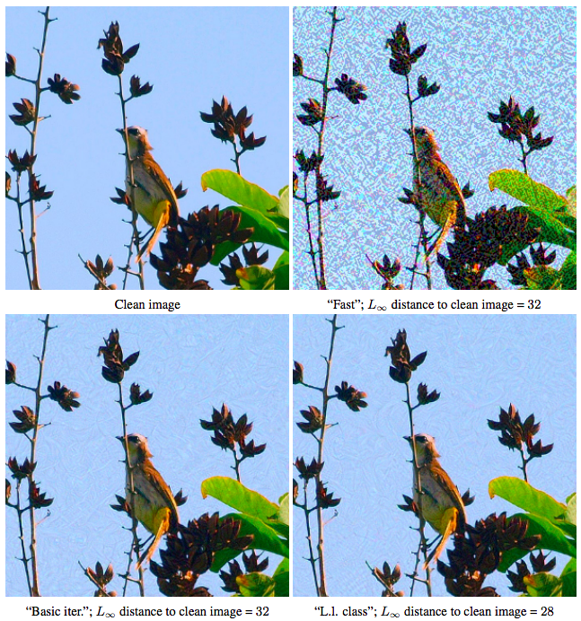
Generating adversarial examples
Comparison of methods for $ε=32$
A. Kurakin, I. Goodfellow, S. Bengio, Adversarial examples in the real world, ICLR 2017 workshop

Slide 19
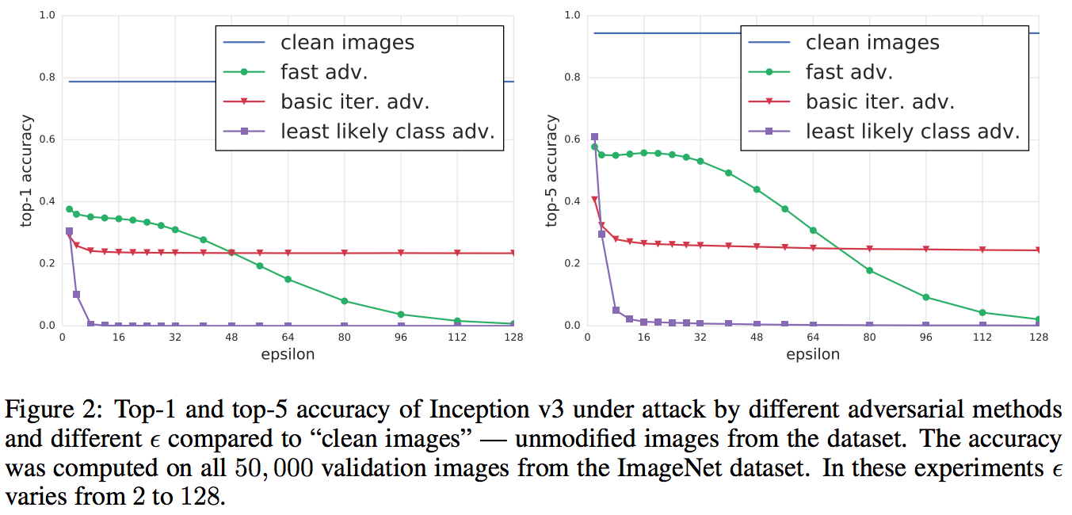
Generating adversarial examples
A. Kurakin, I. Goodfellow, S. Bengio, Adversarial examples in the real world, ICLR 2017 workshop

Slide 20
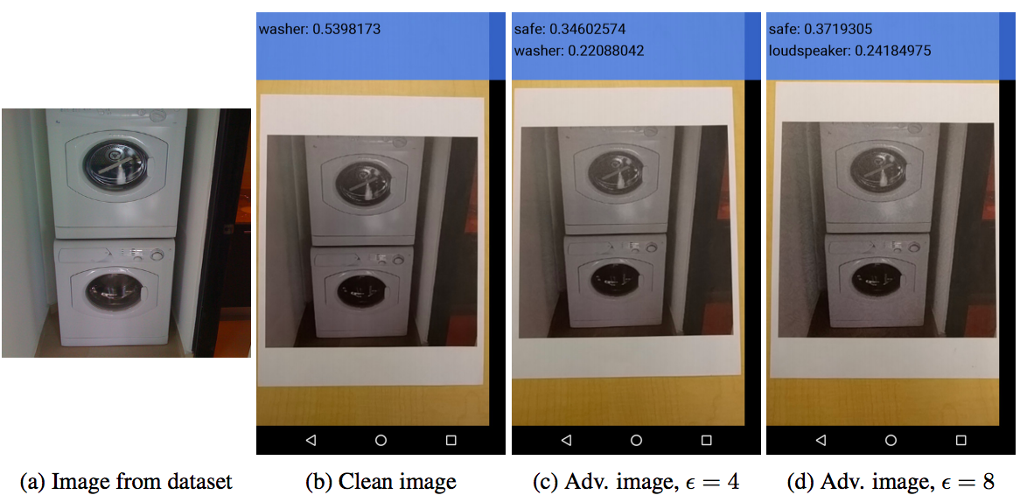
Printed adversarial examples
“Black box” attack on a cell phone app: take a clean image, add perturbation, print out, classify with TensorFlow Camera Demo app
A. Kurakin, I. Goodfellow, S. Bengio, Adversarial examples in the real world, ICLR 2017 workshop

Slide 21
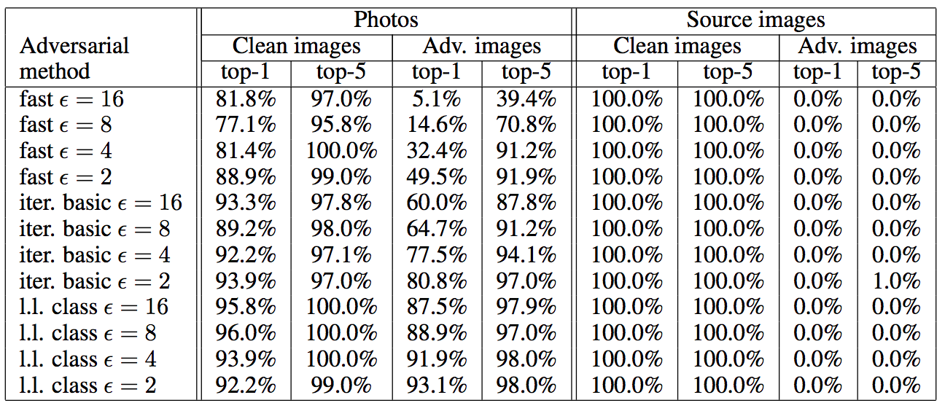
Printed adversarial examples
Accuracies for printed vs. digital images:
A. Kurakin, I. Goodfellow, S. Bengio, Adversarial examples in the real world, ICLR 2017 workshop

Slide 22
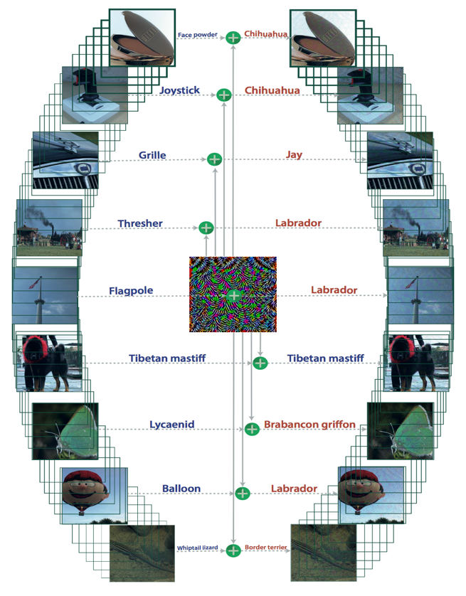
Universal adversarial perturbations
Goal: for a given network, find an image-independent perturbation vector that causes all images to be misclassified with high probability
S.-M. Moosavi-Dezfooli, A. Fawzi, O. Fawzi, P. Frossard, Universal adversarial perturbations, CVPR 2017

Slide 23
Universal adversarial perturbations
Approach:
Start with $r = 0$
Cycle through training examples $xi$ (in multiple passes)
If $xi+r$ is misclassified, skip to $x_{i+1}$
Find minimum perturbation $Δr$ that takes $xi+r+Δr$ to another class
Update $r←r+Δr$, enforce $\left\|r\right\|≤ε$
Terminate when fooling rate on training examples reaches target value
S.-M. Moosavi-Dezfooli, A. Fawzi, O. Fawzi, P. Frossard, Universal adversarial perturbations, CVPR 2017

Slide 24
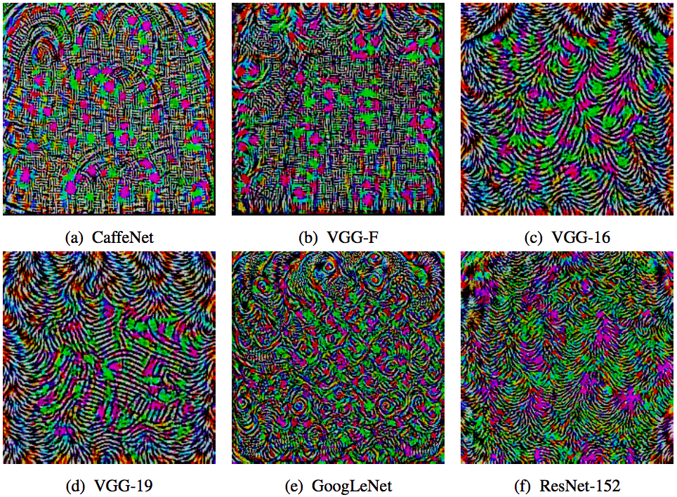
Universal adversarial perturbations
Perturbation vectors computed from different architectures:
S.-M. Moosavi-Dezfooli, A. Fawzi, O. Fawzi, P. Frossard, Universal adversarial perturbations, CVPR 2017

Slide 25
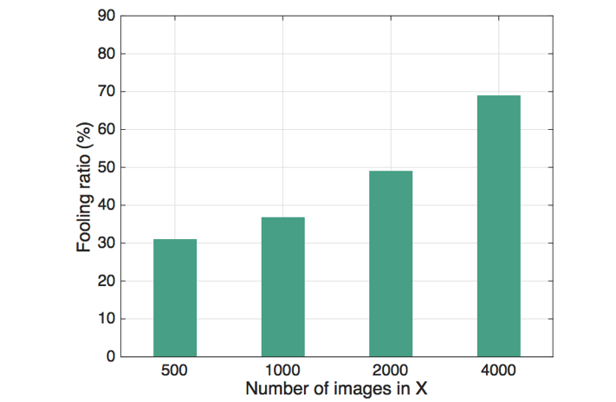
Universal adversarial perturbations
Fooling ratio on validation set vs. training set (X) size for GoogLeNet
Fooling rates on different models after training on 10,000 images
S.-M. Moosavi-Dezfooli, A. Fawzi, O. Fawzi, P. Frossard, Universal adversarial perturbations, CVPR 2017

Slide 26
Universal adversarial perturbations
Universal perturbations turn out to generalize well across models!
Fooling rate when computing a perturbation for one model (rows) and testing it on others (columns)
S.-M. Moosavi-Dezfooli, A. Fawzi, O. Fawzi, P. Frossard, Universal adversarial perturbations, CVPR 2017

Slide 27
Adversarial examples: Outline
Basic definition, analysis of fooling linear classifiers
Generating adversarial examples
Fast gradient sign, iterative variants
Universal adversarial perturbations
Why are neural networks easy to fool?

Slide 28
Properties of adversarial examples: Summary
For any input image, it is usually easy to generate a very similar image that gets misclassified by the same network
To obtain an adversarial example, one does not need to do precise gradient ascent
Adversarial images can (somewhat) survive transformations like being printed and photographed
It is possible to attack many images with the same perturbation
Adversarial examples that can fool one network have a high chance of fooling a network with different parameters and even architecture

Slide 29
Why are deep networks easy to fool?
Networks are “too linear”: it is easy to manipulate output in a predictable way given the input
The input dimensionality is high, so one can get a large change in the output by changing individual inputs by small amounts
Neural networks can fit anything, but nothing prevents them from behaving erratically between training samples
Counter-intuitively, a network can both generalize well on natural images and be susceptible to adversarial examples
Adversarial examples generalize well because different models learn similar functions when trained to perform the same task (or because adversarial examples are a function of the data rather than of the network)?

Slide 30
Adversarial examples are not bugs, but features?
Disentangle features into robust and non-robust
Construct a dataset which appears mislabeled to humans (via adversarial examples) but results in good accuracy on the original test set
A. Ilyas et al. Adversarial Examples are not Bugs, they are Features. NeurIPS 2019

Slide 31
Adversarial examples: Outline
Basic definition, analysis of fooling linear classifiers
Generating adversarial examples
Fast gradient sign, iterative variants
Universal adversarial perturbations
Why are neural networks easy to fool?
Defending against adversarial examples
Adversarial training
Learning to reject adversarial examples
Robust architectures
Image pre-processing

Slide 32
Defending against adversarial examples
Adversarial training: networks can be made somewhat resistant by augmenting or regularizing training with adversarial examples (Goodfellow et al. 2015, Tramer et al. 2018)

Slide 33
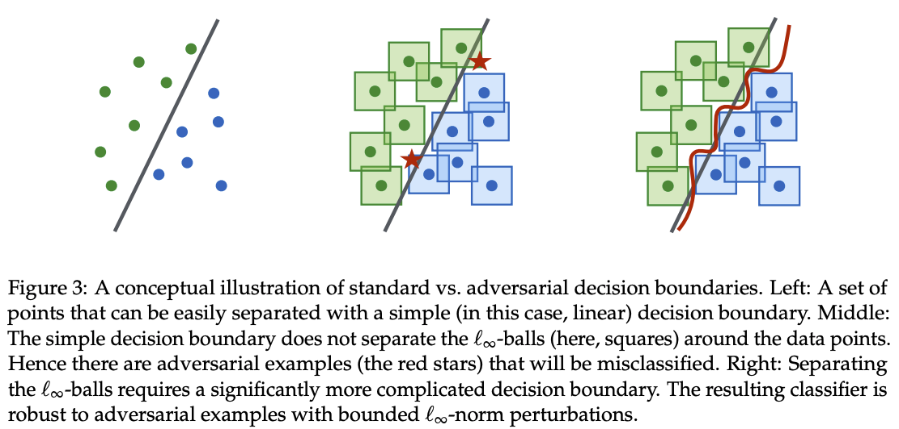
Defending against adversarial examples
Adversarial training: networks can be made somewhat resistant by augmenting or regularizing training with adversarial examples (Goodfellow et al. 2015, Tramer et al. 2018)
Adversarial objectives can also be formulated (Madry et al., 2018)

Slide 34
Defending against adversarial examples
Adversarial training: networks can be made somewhat resistant by augmenting or regularizing training with adversarial examples (Goodfellow et al. 2015, Tramer et al. 2018)
Adversarial objectives can also be formulated (Madry et al., 2018)
There is even evidence that such models may give better performance when transferred to different tasks (Salman et al., 2020)

Slide 35
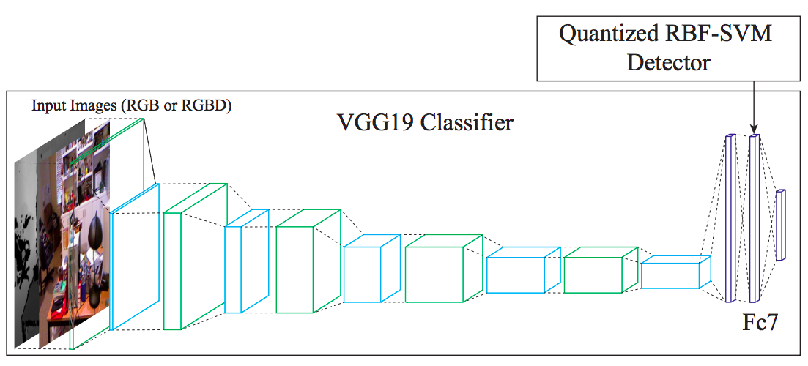
Defending against adversarial examples
Train a separate model to reject adversarial examples: SafetyNet
J. Lu, T. Issaranon, D. Forsyth, SafetyNet: Detecting and Rejecting Adversarial Examples Robustly, CVPR 2017

Slide 36
Defending against adversarial examples
Robust architectures
C. Xie et al., Feature Denoising for Improving Adversarial Robustness, CVPR 2018

Slide 37
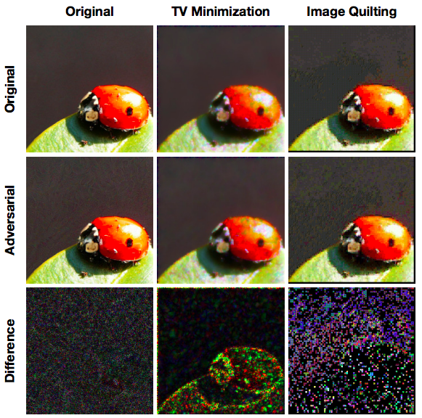
Defending against adversarial examples
Pre-process input images to disrupt adversarial perturbations
C. Guo, M. Rana, M. Cisse, L. van der Maaten, Countering Adversarial Images Using Input Transformations, ICLR 2018

Slide 38
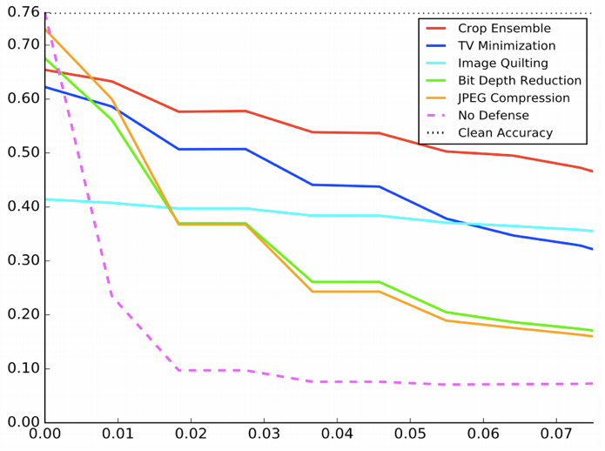
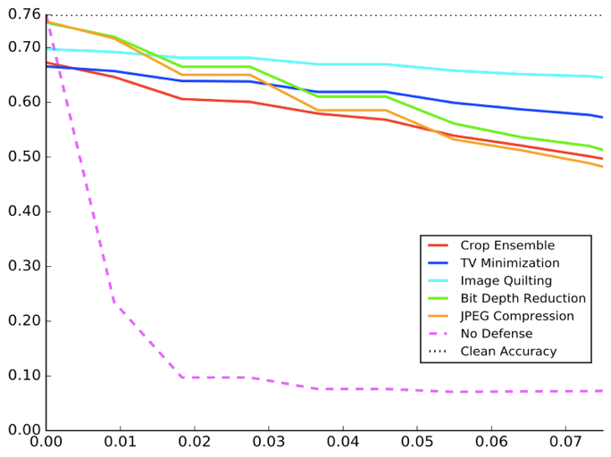
Defending against adversarial examples
Pre-process input images to disrupt adversarial perturbations
ResNet-50 tested on transformed images
ResNet-50 trained and tested on transformed images
Top-1 Accuracy
Strength of FGSM transformation
C. Guo, M. Rana, M. Cisse, L. van der Maaten, Countering Adversarial Images Using Input Transformations, ICLR 2018
Notes:
From the paper: In particular, ensembling 30 predictions over different, random image crops is very efficient: these predictions are correct for 40−60% of the images (note that 76% is the highest accuracy that one can expect to achieve). This result suggests that adversarial examples are susceptible to changes in the location and scale of the adversarial perturbations.

Slide 39
Adversarial examples: Outline
Basic definition, analysis of fooling linear classifiers
Generating adversarial examples
Fast gradient sign, iterative variants
Universal adversarial perturbations
Why are neural networks easy to fool?
Defending against adversarial examples
Adversarial training
Learning to reject adversarial examples
Robust architectures
Image pre-processing
Trends and open questions
Broadening the scope of adversarial examples
Adversarial examples and human perception

Slide 40
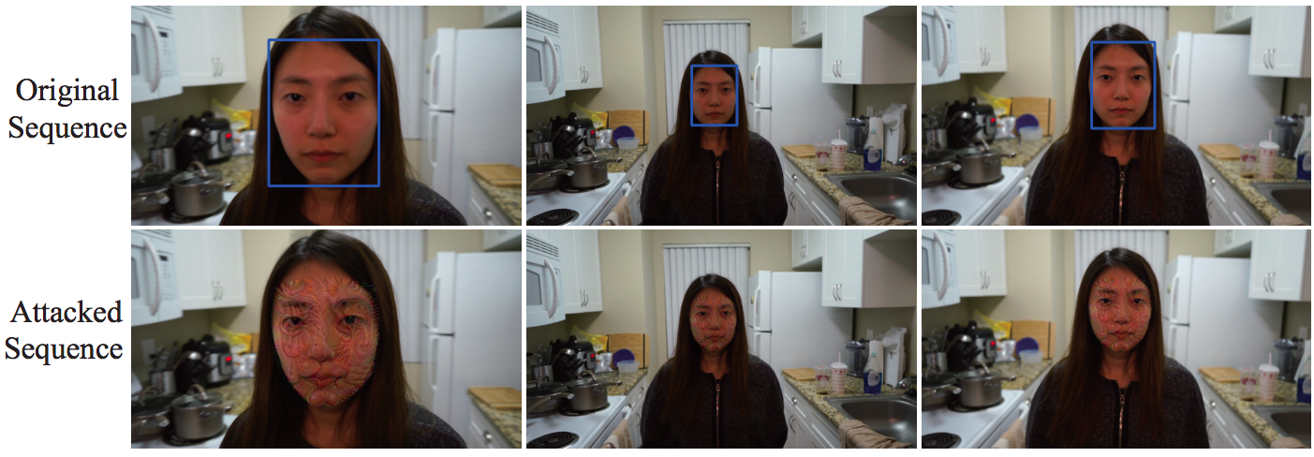
Adversarial examples for detection
TL;DR: It is much harder to fool a detector like Faster R-CNN or YOLO than a classifier; larger perturbations are required
J. Lu, H. Sibai, E. Fabry, Adversarial examples that fool detectors, arXiv 2018

Slide 41
Adversarial examples for detection
TL;DR: It is much harder to fool a detector like Faster R-CNN or YOLO than a classifier; larger perturbations are required
Original w/ Faster R-CNN detections
Attacked
J. Lu, H. Sibai, E. Fabry, Adversarial examples that fool detectors, arXiv 2018

Slide 42
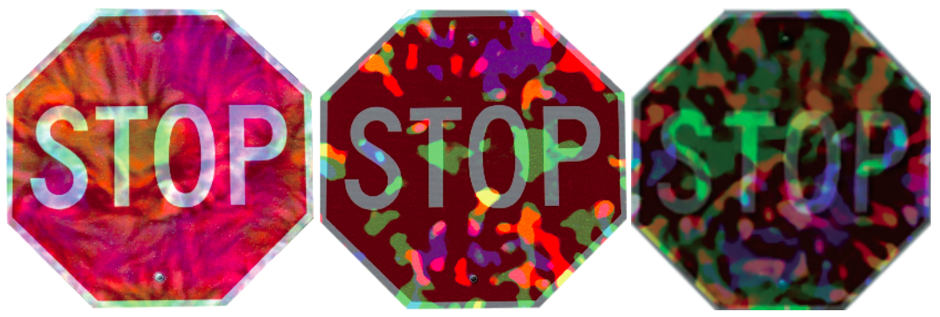
Adversarial examples for detection
TL;DR: It is much harder to fool a detector like Faster R-CNN or YOLO than a classifier; larger perturbations are required
It is even harder to fool a detector with physical objects
”All three patterns reliably fool detectors when mapped into videos. However, physical instances of these patterns are not equally successful. The first two stop signs, as physical objects, only occasionally fool Faster RCNN; the third one, which has a much more extreme pattern, is more effective.”
J. Lu, H. Sibai, E. Fabry, Adversarial examples that fool detectors, arXiv 2018

Slide 43
Adversarial examples for detection
TL;DR: It is much harder to fool a detector like Faster R-CNN or YOLO than a classifier; larger perturbations are required
It is even harder to fool a detector with physical objects
Original w/ Faster R-CNN detections
Digitally attacked
J. Lu, H. Sibai, E. Fabry, Adversarial examples that fool detectors, arXiv 2018

Slide 44
Adversarial examples for detection
TL;DR: It is much harder to fool a detector like Faster R-CNN or YOLO than a classifier; larger perturbations are required
It is even harder to fool a detector with physical objects
Physical adversarial stop sign
J. Lu, H. Sibai, E. Fabry, Adversarial examples that fool detectors, arXiv 2018

Slide 45
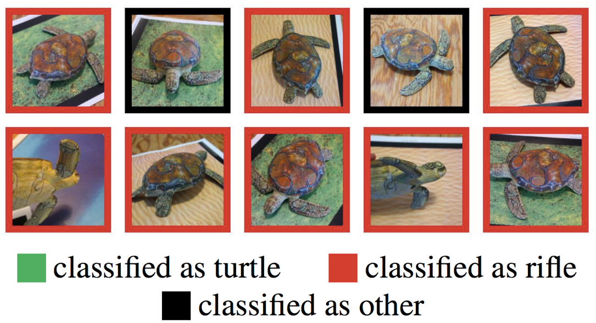
Adversarial examples for 3D transformations
3D printed adversarial object (YouTube video)
https://blog.openai.com/robust-adversarial-inputs/
A. Athalye, L. Engstrom, A. Ilyas, K. Kwok, Synthesizing Robust Adversarial Examples, ICML 2018

Slide 46
Adversarial examples beyond the infinity-norm constraint
A. Bhattad, M.-J. Chong, K. Liang, B. Li, D. Forsyth. Unrestricted adversarial examples via semantic manipulation. ICLR 2020

Slide 47
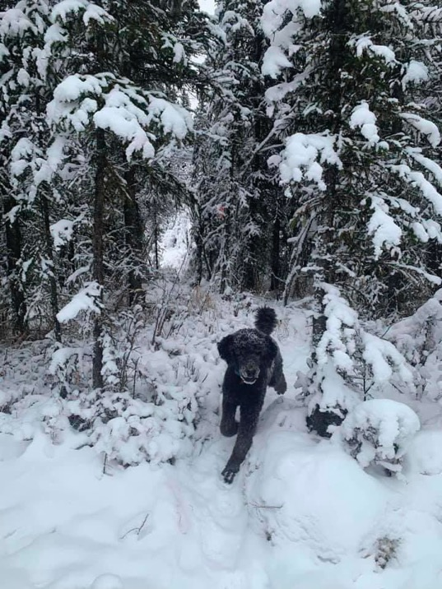
Adversarial examples and humans
Image source

Slide 48
Adversarial examples and humans
Adversarial examples that are designed to transfer across multiple architectures can also be shown to confuse the human visual system in rapid presentation settings
G. Elsayed et al., Adversarial Examples that Fool both Computer Vision and Time-Limited Humans, NeurIPS 2018

Slide 49
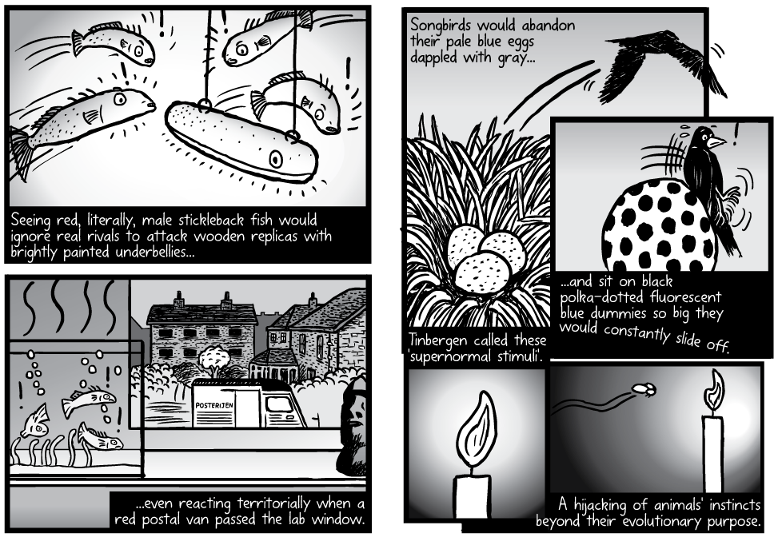
How robust is biological perception, really?
http://www.stuartmcmillen.com/comic/supernormal-stimuli/
https://en.wikipedia.org/wiki/Supernormal_stimulus

Slide 50
Recall: Generation of preferred inputs
A. Nguyen, J. Yosinski, J. Clune, Deep Neural Networks are Easily Fooled: High Confidence Predictions for Unrecognizable Images, CVPR 2015

Slide 51
Supernormal stimuli for humans?
https://en.wikipedia.org/wiki/Supernormal_stimulus

Slide 52
For further reading
https://nicholas.carlini.com/writing/2019/all-adversarial-example-papers.html
https://nicholas.carlini.com/writing/2018/adversarial-machine-learning-reading-list.html

