Slide 1
Everything you’ve ever wanted to know about linear classifiers (Part 1)

Slide 2
Outline
Examples of classification models: nearest neighbor, linear
Empirical loss minimization framework
Linear classification models
Linear regression
Logistic regression
Perceptron training algorithm
Support vector machines

Slide 3
Recall: The basic supervised learning framework
$$y = f(x)$$
Training (or learning): given a training set of labeled examples $\{(x1,y1), …, (xN,y_{N})\}$, instantiate a predictor $f$
Testing (or inference): apply $f$ to a new test example $x$ and output the predicted value $y = f(x)$
output
prediction function
input

Slide 4
Nearest neighbor classifier
Test example
Training examples from class 2
Training examples from class 1
$f(x) =$ label of the training example nearest to $x$
All we need is a distance function for our inputs
No training required!

Slide 5
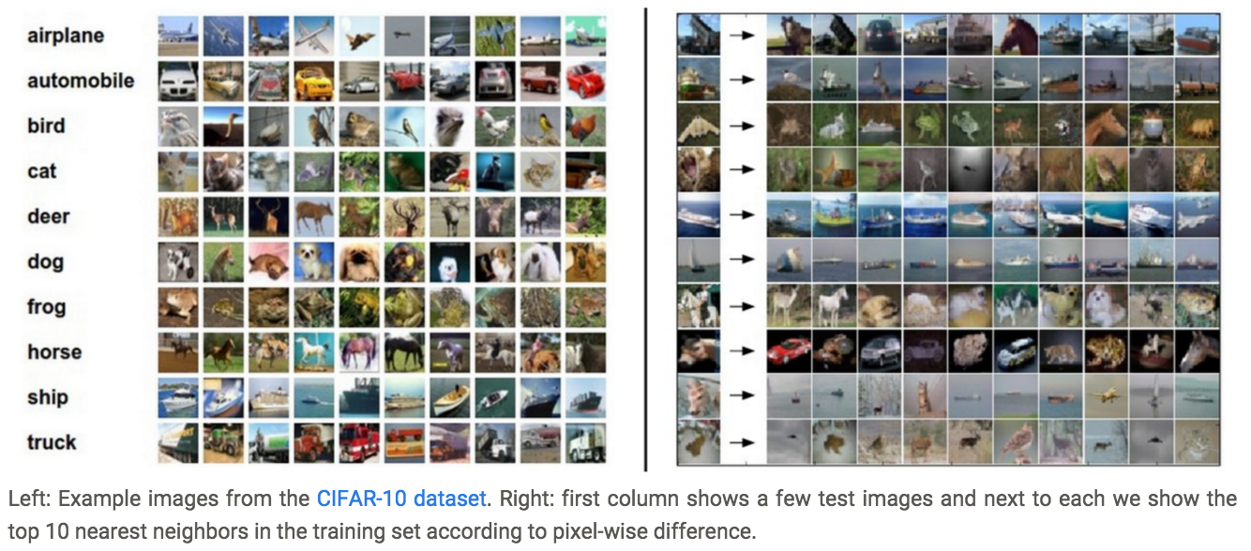
Nearest neighbors of images based on raw pixel values
Source: http://cs231n.github.io/classification/

Slide 6
K-nearest neighbor classifier
For a new point, find the $k$ closest points from training data
Vote for class label with labels of the $k$ points
k = 5

Slide 7
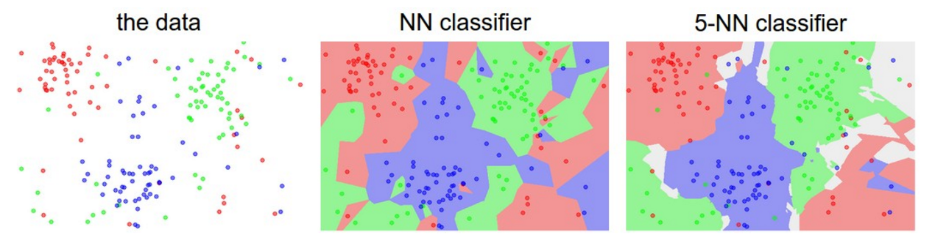
K-nearest neighbor classifier
For a new point, find the $k$ closest points from training data
Vote for class label with labels of the $k$ points
1-NN vs. $k$-NN
Source: http://cs231n.github.io/classification/

Slide 8
Linear classifier
Find a linear function to separate the classes:
$$f\left(x\right)=\operatorname{sgn}\left(w^{(1)}x^{(1)}+w^{(2)}x^{(2)}+…+w^{(D)}x^{(D)}+b\right)=sgn⁡\left(w ⋅ x + b\right)$$

Slide 9
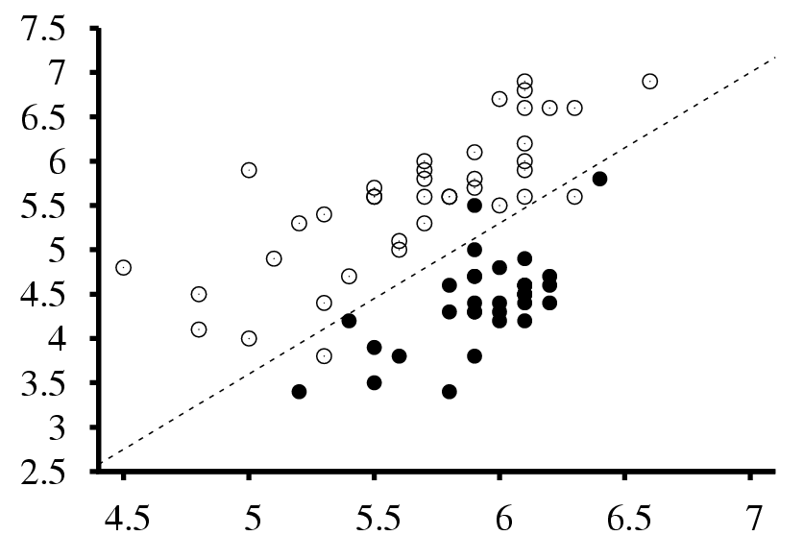
Visualizing linear classifiers
Seismic data classification
Earthquakes
Surface wave magnitude
Nuclear explosions
Body wave magnitude

Slide 10
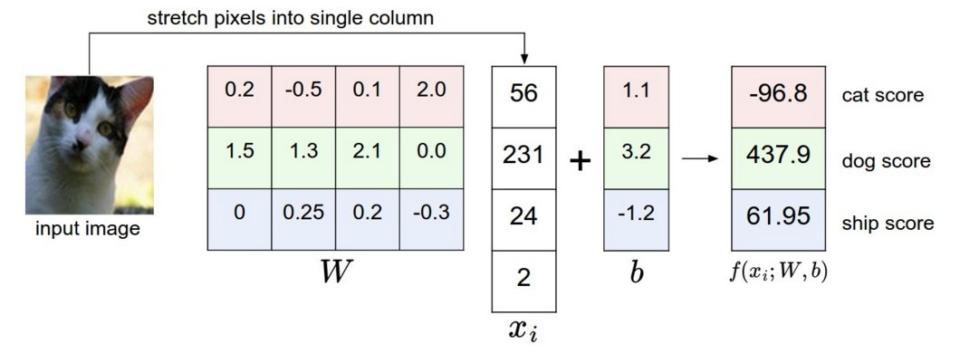
Visualizing linear classifiers
Source: http://cs231n.github.io/linear-classify/

Slide 11
Linear classifier: Perceptron view
Input
Weights
$$x^{(1)}$$
$$w^{(1)}$$
$$x^{(2)}$$
$$w^{(2)}$$
Output: $sgn⁡(wx + b)$
$$x^{(3)}$$
$$w^{(3)}$$
.
.
.
$$w^{(D)}$$
$$x^{(D)}$$

Slide 12
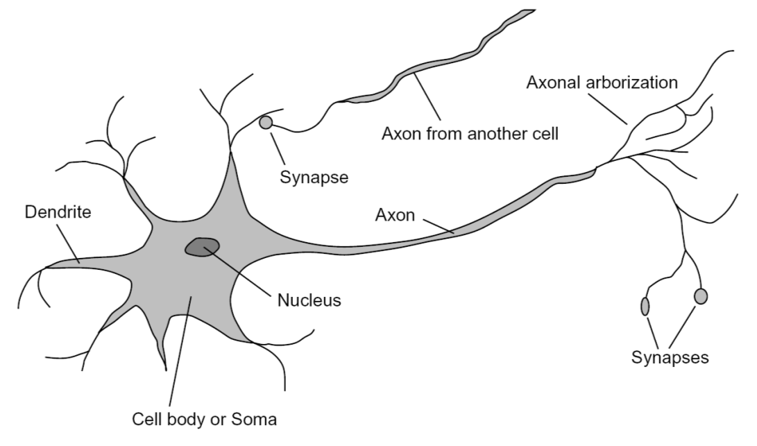
Loose inspiration: Biological neurons
Notes:
From Wikipedia: At the majority of synapses, signals are sent from the axon of one neuron to a dendrite of another... All neurons are electrically excitable, maintaining voltage gradients across their membranes… If the voltage changes by a large enough amount, an all-or-none electrochemical pulse called an action potential is generated, which travels rapidly along the cell's axon, and activates synaptic connections with other cells when it arrives.

Slide 13
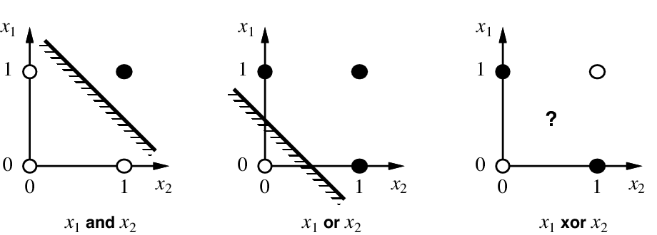
Perceptrons, linear separability, Boolean functions
$$x^{1}$$
$$x^{1}$$
$$x^{1}$$
$$x^{2}$$
$$x^{2}$$
$$x^{2}$$
$$x^{1} and{ x}^{2}$$
$$x^{1} or{ x}^{2}$$
$$x^{1} xor{ x}^{2}$$

Slide 14
NN vs. linear classifiers: Pros and cons
NN pros:
Simple to implement
Decision boundaries not necessarily linear
Works for any number of classes
Nonparametric method
NN cons:
Need good distance function
Slow at test time
Linear pros:
Low-dimensional parametric representation
Very fast at test time
Linear cons:
Works for two classes
How to train the linear function?
What if data is not linearly separable?

Slide 15
Outline
Examples of classification models: nearest neighbor, linear
Empirical loss minimization framework

Slide 16
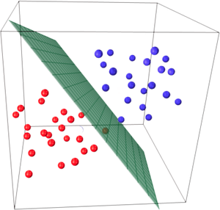
Empirical loss minimization
Let’s formalize the setting for learning of a parametric model in a supervised scenario
Image source

Slide 17
Empirical loss minimization
Given: training data $\left\{\left(x_{i},y_{i}\right), i=1,…,n\right\}$
Find: predictor $f$
Goal: make good predictions $\hat{y}=f(x)$ on test data
Source: Y. Liang

Slide 18
Empirical loss minimization
Given: training data $\left\{\left(x_{i},y_{i}\right), i=1,…,n\right\}$
Find: predictor $f$
Goal: make good predictions $\hat{y}=f(x)$ on test data
What kinds of functions?
Source: Y. Liang

Slide 19
Empirical loss minimization
Given: training data $\left\{\left(x_{i},y_{i}\right), i=1,…,n\right\}$
Find: predictor $f∈ℋ$
Goal: make good predictions $\hat{y}=f(x)$ on test data
Hypothesis class
Source: Y. Liang

Slide 20
Empirical loss minimization
Given: training data $\left\{\left(x_{i},y_{i}\right), i=1,…,n\right\}$
Find: predictor $f∈ℋ$
Goal: make good predictions $\hat{y}=f(x)$ on test data
Connection between training and test data?
Source: Y. Liang

Slide 21
Empirical loss minimization
Given: training data $\left\{\left(x_{i},y_{i}\right), i=1,…,n\right\}$ i.i.d. from distribution $D$
Find: predictor $f∈ℋ$
Goal: make good predictions $\hat{y}=f(x)$ on test data i.i.d. from distribution $D$
Source: Y. Liang

Slide 22
Empirical loss minimization
Given: training data $\left\{\left(x_{i},y_{i}\right), i=1,…,n\right\}$ i.i.d. from distribution $D$
Find: predictor $f∈ℋ$
Goal: make good predictions $\hat{y}=f(x)$ on test data i.i.d. from distribution $D$
What kind of performance measure?
Source: Y. Liang

Slide 23
Empirical loss minimization
Given: training data $\left\{\left(x_{i},y_{i}\right), i=1,…,n\right\}$ i.i.d. from distribution $D$
Find: predictor $f∈ℋ$
S.t. the expected loss is small: $L\left(f\right)=𝔼_{(x,y)∽D}[l\left(f,x,y\right)]$
Various loss functions
Source: Y. Liang

Slide 24
Empirical loss minimization
Given: training data $\left\{\left(x_{i},y_{i}\right), i=1,…,n\right\}$ i.i.d. from distribution $D$
Find: predictor $f∈ℋ$
S.t. the expected loss is small: $L\left(f\right)=𝔼_{(x,y)∽D}\left[l\left(f,x,y\right)\right]$
Example losses:
$0−1$ loss: $l\left(f,x,y\right)=𝕀[f(x)≠y]$ and $L\left(f\right)=Pr⁡[f(x)≠y$]
$l_{2}$ loss: $l\left(f,x,y\right)={[f\left(x\right)−y]}^{2}$ and $L\left(f\right)=$ $𝔼\left[{ [f\left(x\right)−y]}^{2}\right]$
Source: Y. Liang

Slide 25
Empirical loss minimization
Given: training data $\left\{\left(x_{i},y_{i}\right), i=1,…,n\right\}$ i.i.d. from distribution $D$
Find: predictor $f∈ℋ$
S.t. the expected loss is small: $L\left(f\right)=𝔼_{(x,y)∽D}\left[l\left(f,x,y\right)\right]$
Can’t optimize this directly
Source: Y. Liang

Slide 26
Empirical loss minimization
Given: training data $\left\{\left(x_{i},y_{i}\right), i=1,…,n\right\}$ i.i.d. from distribution $D$
Find: predictor $f∈ℋ$ that minimizes $\hat{L}\left(f\right)=\frac{1}{n}\sum_{i=1}^{n}{l(f,x_{i},y_{i})}$
Empirical loss
Source: Y. Liang

Slide 27
Supervised learning in a nutshell
Collect training data and labels
Specify model: select hypothesis class and loss function
Train model: find the function in the hypothesis class that minimizes the empirical loss on the training data

Slide 28
Outline
Example classification models: nearest neighbor, linear
Empirical loss minimization
Linear classification models
Linear regression
Logistic regression
Perceptron training algorithm
Support vector machines

Slide 29
Training linear classifiers
Given: i.i.d. training data $\left\{\left(x_{i},y_{i}\right), i=1,…,n\right\}$, $y_{i}∈\{−1,1\}$
Hypothesis class: $f_{w}(x)={sgn⁡(w}^{T}x)$
Classification with bias, i.e. $f_{w}\left(x\right)={sgn⁡(w}^{T}x+b)$, can be reduced to the case w/o bias by letting $\tilde{w}=\left[w;b\right]$ and $\tilde{x}=[x;1]$
Source: Y. Liang

Slide 30
Training linear classifiers
Given: i.i.d. training data $\left\{\left(x_{i},y_{i}\right), i=1,…,n\right\}$, $y_{i}∈\{−1,1\}$
Hypothesis class: $f_{w}(x)={sgn⁡(w}^{T}x)$
Loss: how about minimizing the number of mistakes on the training data? $\hat{L}\left(f_{w}\right)=\frac{1}{n}\sum_{i=1}^{n}{𝕀[sgn\left(w^{T}x_{i}\right)≠y_{i}]}$
Difficult to optimize directly (NP-hard), so people resort to surrogate loss functions
Source: Y. Liang

Slide 31
Linear regression (“straw man” model)
Find $f_{w}(x)=w^{T}x$ that minimizes $l_{2}$ loss or mean squared error $\hat{L}\left(f_{w}\right)=\frac{1}{n}\sum_{i=1}^{n}{{(w^{T}x_{i}−y_{i})}^{2}}$
Ignores the fact that $y∈\{−1,1\}$ but is easy to optimize
Source: Y. Liang

Slide 32
Linear regression: Optimization
Let $X$ be a matrix whose ith row is $x_{i}^{T}$, $Y$ be the vector ${(y_{1},…, y_{n})}^{T}$
$$\hat{L}\left(f_{w}\right)=\frac{1}{n}\sum_{i=1}^{n}{{(w^{T}x_{i}−y_{i})}^{2}}=\frac{1}{n}{\left\|Xw−Y\right\|}_{2}^{2}$$
Source: Y. Liang

Slide 33
Linear regression: Optimization
Let $X$ be a matrix whose ith row is $x_{i}^{T}$, $Y$ be the vector ${(y_{1},…, y_{n})}^{T}$
$$\hat{L}\left(f_{w}\right)=\frac{1}{n}\sum_{i=1}^{n}{{(w^{T}x_{i}−y_{i})}^{2}}=\frac{1}{n}{\left\|Xw−Y\right\|}_{2}^{2}$$
This is a convex function of the weights
Source: Y. Liang

Slide 34
Linear regression: Optimization
Let $X$ be a matrix whose ith row is $x_{i}^{T}$, $Y$ be the vector ${(y_{1},…, y_{n})}^{T}$
$$\hat{L}\left(f_{w}\right)=\frac{1}{n}\sum_{i=1}^{n}{{(w^{T}x_{i}−y_{i})}^{2}}=\frac{1}{n}{\left\|Xw−Y\right\|}_{2}^{2}$$
Find the gradient w.r.t. $w$: ${∇_{w}\left\|Xw−Y\right\|}_{2}^{2}$
Source: Y. Liang

Slide 35
Linear regression: Optimization
Let $X$ be a matrix whose ith row is $x_{i}^{T}$, $Y$ be the vector ${(y_{1},…, y_{n})}^{T}$
$$\hat{L}\left(f_{w}\right)=\frac{1}{n}\sum_{i=1}^{n}{{(w^{T}x_{i}−y_{i})}^{2}}=\frac{1}{n}{\left\|Xw−Y\right\|}_{2}^{2}$$
Find the gradient w.r.t. $w$: ${∇_{w}\left\|Xw−Y\right\|}_{2}^{2}=∇_{w}\left[{\left(Xw−Y\right)}^{T}\left(Xw−Y\right)\right]$
$=∇_{w}\left[w^{T}X^{T}Xw−2w^{T}X^{T}Y+Y^{T}Y\right]$
$=2X^{T}Xw−2X^{T}Y$
Set gradient to zero to get the minimizer:
$$X^{T}Xw=X^{T}Y$$
$$w={(X^{T}X)}^{−1}X^{T}Y$$
Source: Y. Liang

Slide 36
Linear regression: Optimization
Linear algebra view
If $X$ is invertible, simply solve $Xw=Y$ and get $w=X^{−1}Y$
But typically $X$ is a “tall” matrix so you need to find the least squares solution to an over-constrained system
Source: Y. Liang

Slide 37
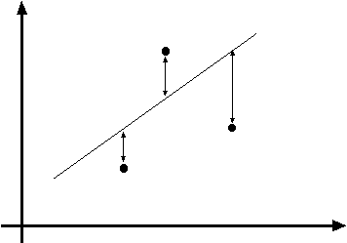
Linear regression as maximum likelihood estimation
Interpretation of $l_{2}$ loss: negative log likelihood assuming $y$ is normally distributed with mean $f_{w}\left(x\right)=w^{T}x+b$
y = w^{T}x + b
(x_{i}, y_{i})
$$P\left(y | x\right)=Normal(y;wTx + b,σ^{2})$$

Slide 38
Maximum likelihood estimation
Given: i.i.d. training data $\left\{\left(x_{i},y_{i}\right), i=1,…,n\right\}$
Let $\left\{P_{θ}\left(y | x\right), θ∈Θ\right\}$ be a family of distributions parameterized by $θ$
Maximum (conditional) likelihood estimate: $θ_{ML}={argmax}_{θ}\prod_{i}{P_{θ}(y_{i}|x_{i})}$
$={argmin}_{θ}−\sum_{i}{log}$ $P_{θ}(y_{i}|x_{i})$

Slide 39
Maximum likelihood estimation
$θ_{ML}={argmin}_{θ}−\sum_{i}{log}$ $P_{θ}(y_{i}|x_{i})$
Assume $P_{θ}\left(y | x\right)=Normal(y;f_{θ}\left(x\right),σ^{2})$
$$log P_{θ}\left(y | x\right)=\log\left[\frac{1}{\sqrt{2πσ^{2}}}exp\left[−\frac{{\left(y−f_{θ}\left(x\right)\right)}^{2}}{{2σ}^{2}}\right]\right]$$
$$=−\frac{1}{2σ^{2}}{\left(y−f_{θ}\left(x\right)\right)}^{2}−\log{σ}−\frac{1}{2}log⁡(2π)$$
$$θ_{ML}={argmin}_{θ}\sum_{i}{{\left(y_{i}−f_{θ}\left(x_{i}\right)\right)}^{2}}$$

Slide 40
Linear regression as maximum likelihood estimation
Interpretation of $l_{2}$ loss: negative log likelihood assuming $y$ is normally distributed with mean $f_{w}\left(x\right)=w^{T}x+b$
Does this make sense for binary classification?
y = w^{T}x + b
(x_{i}, y_{i})
$$P\left(y | x\right)=Normal(y;wTx + b,σ^{2})$$

Slide 41
Problem with linear regression
In practice, very sensitive to outliers
Figure from Pattern Recognition and Machine Learning, Bishop

Slide 42
Problem with linear regression
In practice, very sensitive to outliers
+1
-1

Slide 43
Next idea
Instead of a linear function, how about we fit a function representing the confidence of the classifier?
1
$$P(y=1|x)$$
0.5
0

Slide 44
Linear classifiers: Outline
Example classification models: nearest neighbor, linear
Empirical loss minimization
Linear classification models
Linear regression (least squares)
Logistic regression

Slide 45
Logistic regression
Let’s learn a probabilistic classifier estimating the probability of the input $x$ having a positive label, given by putting a sigmoid function around the linear response $w^{T}x$:
${ P}_{w}\left(y=1 | x\right)=σ\left(w^{T}x\right)=\frac{1}{1+exp⁡(−w^{T}x)}$

Slide 46
Sigmoid: Properties
$$P_{w}\left(y=1 | x\right)=σ\left(w^{T}x\right)=\frac{1}{1+exp⁡(−w^{T}x)}$$
What is the range?
What is $σ\left(0\right)$?
What is $P_{w}\left(y=−1 | x\right)$?

Slide 47
Sigmoid: Properties
$$P_{w}\left(y=1 | x\right)=σ\left(w^{T}x\right)=\frac{1}{1+exp⁡(−w^{T}x)}$$
What is the range?
What is $σ\left(0\right)$?
What is $P_{w}\left(y=−1 | x\right)$?
$$P_{w}\left(y=−1 | x\right)=1−P_{w}\left(y=1 | x\right)=1−σ\left(w^{T}x\right)$$
$=\frac{1+\exp\left(−w^{T}x\right)−1}{1+\exp\left(−w^{T}x\right)}=\frac{exp⁡(−w^{T}x)}{1+exp⁡(−w^{T}x)}=\frac{1}{\exp\left(w^{T}x\right)+1}$
$$=σ\left({−w}^{T}x\right)$$

Slide 48
Sigmoid: Properties
$$P_{w}\left(y=1 | x\right)=σ\left(w^{T}x\right)=\frac{1}{1+exp⁡(−w^{T}x)}$$
Sigmoid is symmetric: $1−σ\left(t\right)=σ\left(−t\right)$
Notes:
Reflecting the sigmoid along the horizontal line y = 0.5 is the same as reflecting it along the vertical line t = 0

Slide 49
Sigmoid: Properties
$$P_{w}\left(y=1 | x\right)=σ\left(w^{T}x\right)=\frac{1}{1+exp⁡(−w^{T}x)}$$
What happens if we scale $w$ by a constant?

Slide 50
Sigmoid: Properties
$$P_{w}\left(y=1 | x\right)=σ\left(w^{T}x\right)=\frac{1}{1+exp⁡(−w^{T}x)}$$
What happens if we scale $w$ by a constant?
Image source

Slide 51
Sigmoid: Interpretation
We can write out the connection between the posteriors $P(y|x)$ and the class-conditional densities $P\left(x | y\right)$:
$$P\left(y=1 | x\right)=\frac{P\left(x | y=1\right)P\left(y=1\right)}{P(x)}$$
$$=\frac{P\left(x | y=1\right)P\left(y=1\right)}{P\left(x | y=1\right)P\left(y=1\right)+P\left(x | y=−1\right)P(y=−1)}$$
$$=\frac{1}{1+exp⁡(−a)}=σ(a), a=log\frac{P(y=1|x)}{P(y=−1|x)}$$

Slide 52
Sigmoid: Interpretation
Adopting a linear + sigmoid model is equivalent to assuming linear log odds:
$$log\frac{P(y=1|x)}{P(y=−1|x)}=w^{T}x+b$$
This happens when $P\left(x | y=1\right)$ and $P\left(x | y=−1\right)$ are Gaussians with different means and the same covariance matrices ($w$ is related to the difference between the means)

Slide 53
Logistic loss
Given: $\left\{\left(x_{i},y_{i}\right), i=1,…,n\right\}$, $y_{i}∈\{−1,1\}$
Maximum (conditional) likelihood estimate: find $w$that minimizes
$$\hat{L}\left(w\right)=−\frac{1}{n}\sum_{i=1}^{n}{\log{P_{w}\left(y_{i} | x_{i}\right)}}$$
$$l\left(w,x_{i}, y_{i}\right)=−\log{P_{w}\left(y_{i} | x_{i}\right)}$$
If $y_{i}=1:$
$$P_{w}\left(y_{i} | x_{i}\right)={σ\left(w^{T}x_{i}\right)}$$
If $y_{i}=−1:$
$$P_{w}\left(y_{i} | x_{i}\right)={1−σ\left(w^{T}x_{i}\right)=σ\left(−w^{T}x_{i}\right)}$$
Thus,
$$l\left(w,x_{i}, y_{i}\right)=−\log{σ\left(y_{i}w^{T}x_{i}\right)}$$

Slide 54
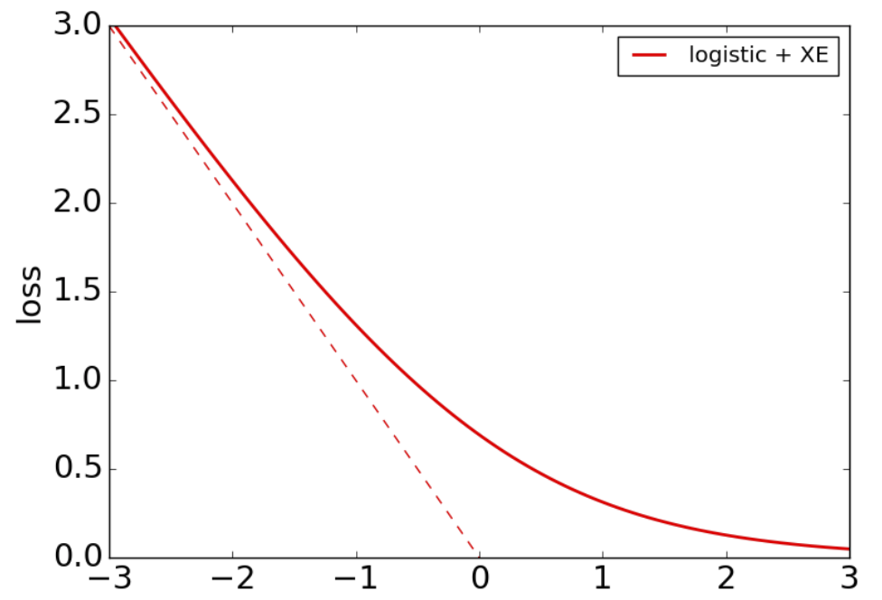
Logistic loss
$$l\left(w,x_{i}, y_{i}\right)=−\log{σ\left(y_{i}w^{T}x_{i}\right)}$$
$$y_{i}w^{T}x_{i}$$
Figure source

Slide 55
Logistic loss: Optimization
Given: $\left\{\left(x_{i},y_{i}\right), i=1,…,n\right\}$, $y_{i}∈\{−1,1\}$
Find $w$that minimizes
$$\hat{L}\left(w\right)=−\frac{1}{n}\sum_{i=1}^{n}{\log{P_{w}\left(y_{i} | x_{i}\right)}}$$
There is no closed-form expression for the minimum and we need to use gradient descent to find it

Slide 56
Gradient descent
Goal: find $w$ to minimize loss $\hat{L}(w)$
Start with some initial estimate of $w$
Repeat until convergence:
Find $∇\hat{L}(w)$, the gradient of the loss w.r.t. $w$
Take a small step in the opposite direction: $w←w−η ∇\hat{L}(w)$

Slide 57
The gradient vector
$$\hat{L}$$
$$\hat{L}(w)$$
Fastest rate of increase
$$w^{2}$$
$$∇\hat{L}(w)$$
$$w$$
$$w^{1}$$

Slide 58
The gradient vector
$$\hat{L}$$
$$\hat{L}(w)$$
Fastest rate of decrease
$$w^{2}$$
$$−∇\hat{L}(w)$$
$$w$$
$$w^{1}$$

Slide 59
Gradient descent
$$\hat{L}$$
$$\hat{L}(w−η∇\hat{L}(w))$$
$$w^{2}$$
$$w−η∇\hat{L}(w)$$
$$w^{1}$$

Slide 60
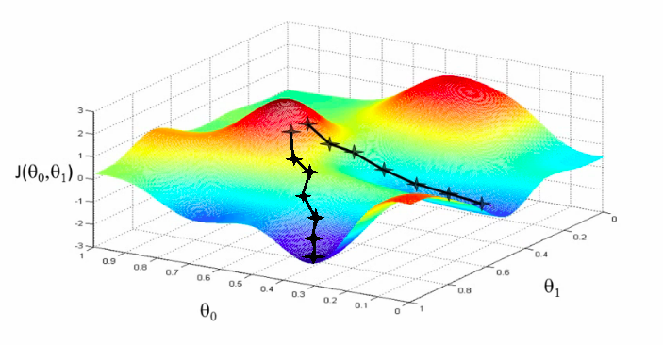
Gradient descent
Goal: find $w$ to minimize loss $\hat{L}(w)$
Start with some initial estimate of $w$
Repeat until convergence:
Find $∇\hat{L}(w)$, the gradient of the loss w.r.t. $w$
Take a small step in the opposite direction: $w←w−η ∇\hat{L}(w)$
$$\hat{L}$$
$$w^{2}$$
$$w^{1}$$

Slide 61
Gradient descent
Goal: find $w$ to minimize loss $\hat{L}(w)$
Start with some initial estimate of $w$
Repeat until convergence:
Find $∇\hat{L}(w)$, the gradient of the loss w.r.t. $w$
Take a small step in the opposite direction: $w←w−η ∇\hat{L}(w)$
$η$is the step size or learning rate
Figure source

Slide 62
Full batch gradient descent
Since $\hat{L}\left(w\right)=\frac{1}{n}\sum_{i=1}^{n}{l\left(w,x_{i}, y_{i}\right)}$, we have
$$∇\hat{L}\left(w\right)=\frac{1}{n}\sum_{i=1}^{n}{∇l\left(w,x_{i}, y_{i}\right)}$$
For a single parameter update, need to cycle through the entire training set!

Slide 63
Stochastic gradient descent (SGD)
At each iteration, take a single data point $\left(x_{i},y_{i}\right)$ and perform a parameter update using $∇l\left(w,x_{i},y_{i}\right)$, the gradient of the loss for that point:
$$w←w−η ∇l\left(w,x_{i},y_{i}\right)$$
This is called an online or stochastic update
In practice, mini-batch SGD is typically used:
Group data into mini-batches of size $b$
Compute gradient of the loss for the mini-batch $\left(x_{1},y_{1}\right),…, {(x}_{b},y_{b})$:
$$∇\hat{L}=\frac{1}{b}\sum_{i=1}^{b}{∇l(w,x_{i},y_{i})}$$
Update parameters: $w←w−η∇\hat{L}$

Slide 64
SGD for logistic regression
$$l\left(w,x_{i}, y_{i}\right)=−\log{σ\left(y_{i}w^{T}x_{i}\right)}$$
Let’s find the gradient:
$$∇l\left(w,x_{i}, y_{i}\right)=−∇_{w}\log{σ\left(y_{i}w^{T}x_{i}\right)}$$
$$=−\frac{∇_{w}σ\left(y_{i}w^{T}x_{i}\right)}{σ\left(y_{i}w^{T}x_{i}\right)}$$
Derivative of log:
$${\left[log\left(g\left(a\right)\right)\right]}^{′}=\frac{g′(a)}{g(a)}$$

Slide 65
SGD for logistic regression
$$l\left(w,x_{i}, y_{i}\right)=−\log{σ\left(y_{i}w^{T}x_{i}\right)}$$
Let’s find the gradient:
$$∇l\left(w,x_{i}, y_{i}\right)=−∇_{w}\log{σ\left(y_{i}w^{T}x_{i}\right)}$$
$$=−\frac{∇_{w}σ\left(y_{i}w^{T}x_{i}\right)}{σ\left(y_{i}w^{T}x_{i}\right)}$$
$$=−\frac{σ\left(y_{i}w^{T}x_{i}\right)σ\left({−y}_{i}w^{T}x_{i}\right)y_{i}x_{i}}{σ\left(y_{i}w^{T}x_{i}\right)}$$
Derivative of sigmoid:
$σ^{′}\left(a\right)=σ\left(a\right)\left(1−σ(a)\right)=$ $σ\left(a\right)σ\left(−a\right)$

Slide 66
SGD for logistic regression
$$l\left(w,x_{i}, y_{i}\right)=−\log{σ\left(y_{i}w^{T}x_{i}\right)}$$
Let’s find the gradient:
$$∇l\left(w,x_{i}, y_{i}\right)=−∇_{w}\log{σ\left(y_{i}w^{T}x_{i}\right)}$$
$$=−\frac{∇_{w}σ\left(y_{i}w^{T}x_{i}\right)}{σ\left(y_{i}w^{T}x_{i}\right)}$$
$$=−\frac{σ\left(y_{i}w^{T}x_{i}\right)σ\left({−y}_{i}w^{T}x_{i}\right)y_{i}x_{i}}{σ\left(y_{i}w^{T}x_{i}\right)}$$
We also used the chain rule: ${\left[g_{2}\left(g_{1}\left(a\right)\right)\right]}^{′}={g_{2}}^{′}\left(g_{1}\left(a\right)\right){g_{1}}^{′}(a)$

Slide 67
SGD for logistic regression
$$l\left(w,x_{i}, y_{i}\right)=−\log{σ\left(y_{i}w^{T}x_{i}\right)}$$
Let’s find the gradient:
$$∇l\left(w,x_{i}, y_{i}\right)=−∇_{w}\log{σ\left(y_{i}w^{T}x_{i}\right)}$$
$$=−\frac{∇_{w}σ\left(y_{i}w^{T}x_{i}\right)}{σ\left(y_{i}w^{T}x_{i}\right)}$$
$$=−\frac{σ\left(y_{i}w^{T}x_{i}\right)σ\left({−y}_{i}w^{T}x_{i}\right)y_{i}x_{i}}{σ\left(y_{i}w^{T}x_{i}\right)}$$
$$=−σ\left({−y}_{i}w^{T}x_{i}\right)y_{i}x_{i}$$
SGD update:
$$w←w+η σ\left({−y}_{i}w^{T}x_{i}\right)y_{i}x_{i}$$

Slide 68
SGD for logistic regression
Let’s take a closer look at the SGD update:
$$w←w+η σ\left({−y}_{i}w^{T}x_{i}\right)y_{i}x_{i}$$
What happens if $x_{i}$ is incorrectly, but confidently, classified?
The update rule approaches $w←w+η y_{i}x_{i}$
What happens if $x_{i}$ is correctly, and confidently, classified?
The update approaches zero (but never actually reaches zero)

Slide 69
SGD for logistic regression
Logistic regression does not converge for linearly separable data!
Scaling $w$ by ever larger constants makes the classifier more confident and keeps increasing the likelihood of the data
Image source

Slide 70
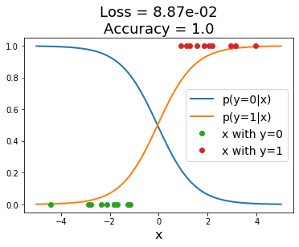
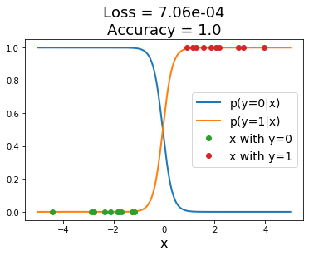
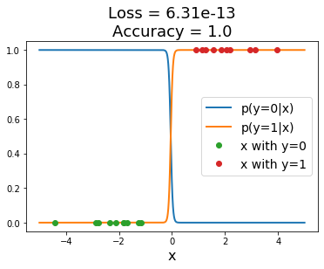
SGD for logistic regression
Logistic regression does not converge for linearly separable data!
Scaling $w$ by ever larger constants makes the classifier more confident and keeps increasing the likelihood of the data
Source: J. Johnson

