Slide 1
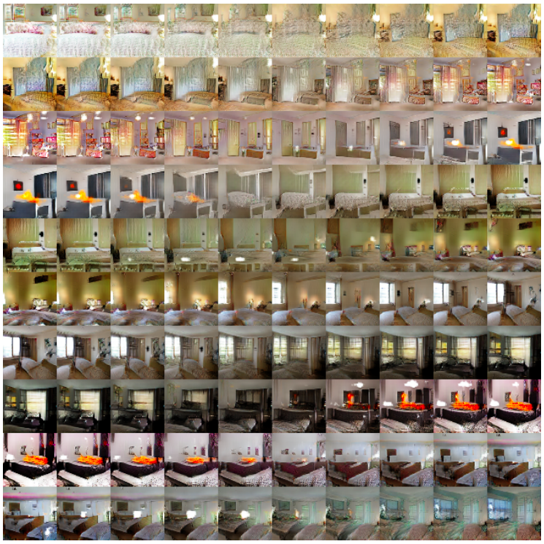
Generative adversarial networks: Introduction

Slide 2
Outline
Generative modeling tasks
Original GAN formulation
Alternative GAN objectives
Evaluating GANs

Slide 3
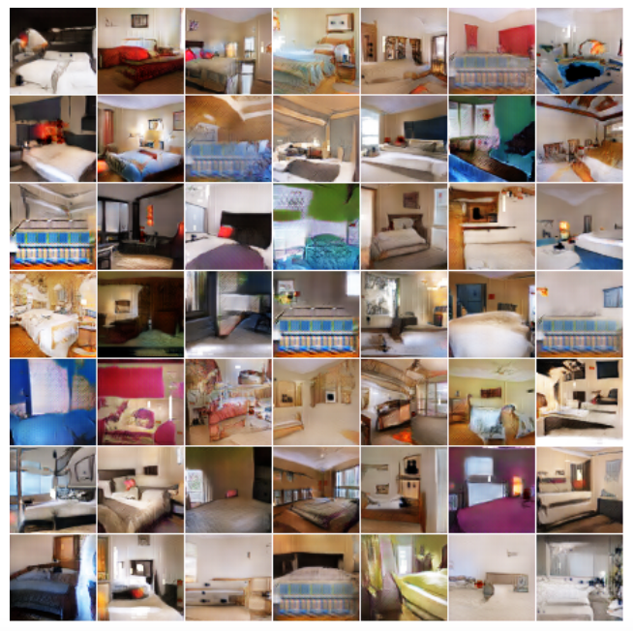
Generative modeling tasks
Generation: learn to sample from the distribution represented by the training set
Unsupervised learning task

Slide 4
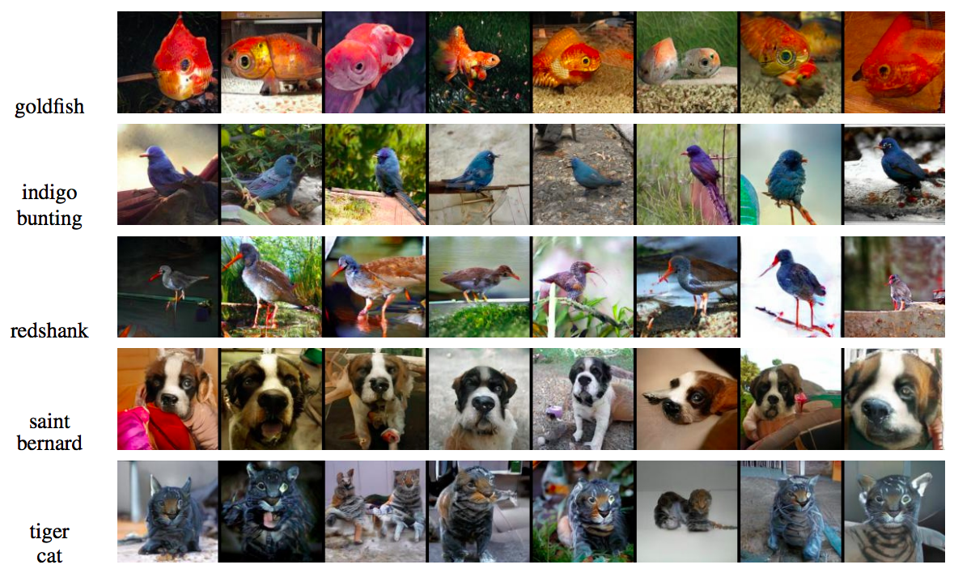
Generative modeling tasks
Generation conditioned on class label or text prompt
Figure source

Slide 5
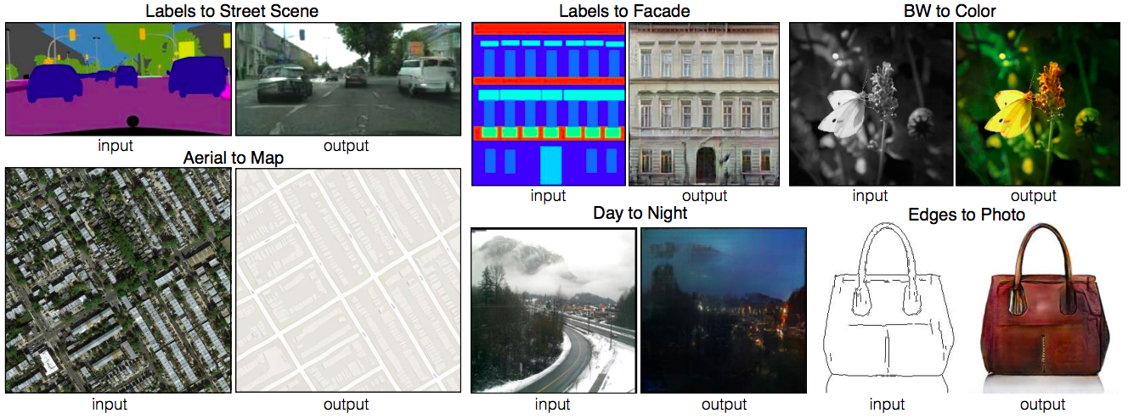
Generative modeling tasks
Generation conditioned on image (image-to-image translation)
P. Isola, J.-Y. Zhu, T. Zhou, A. Efros, Image-to-Image Translation with Conditional Adversarial Networks, CVPR 2017

Slide 6
Designing a network for generative tasks
We need an architecture that can generate an image
Recall upsampling architectures for dense prediction
Random seed or latent code
Unconditional generation

Slide 7
Designing a network for generative tasks
We need an architecture that can generate an image
Recall upsampling architectures for dense prediction
Image-to-image translation

Slide 8
Designing a network for generative tasks
We need an architecture that can generate an image
Recall upsampling architectures for dense prediction
We need to design the right loss function and training framework

Slide 9
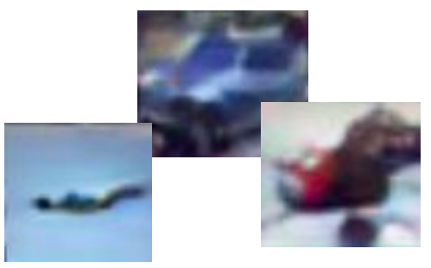
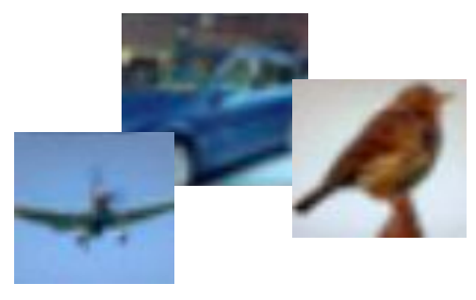
Learning to sample
Training data $x \sim p_{data}$
Generated samples $x \sim p_{model}$
We want to learn $p_{model}$ that matches $p_{data}$
Adapted from Stanford CS231n

Slide 10
Generative adversarial networks
Train two networks with opposing objectives:
Generator: learns to generate samples
Discriminator: learns to distinguish between generated and real samples
$$G$$
$$D$$
Random noise $z$
“Fake”
$$D$$
“Real”
Figure adapted from F. Fleuret
I. Goodfellow, J. Pouget-Abadie, M. Mirza, B. Xu, D. Warde-Farley, S. Ozair, A. Courville, Y. Bengio, Generative adversarial nets, NIPS 2014

Slide 11
GAN objective
The discriminator $D(x)$ should output the probability that the sample $x$ is real
That is, we want $D(x)$ to be close to 1 for real data and close to 0 for fake
Expected conditional log likelihood for real and generated data:
$𝔼_{x\sim p_{data}}\log{D(x)}$
$=𝔼_{x\sim p_{data}}\log{D(x)} + 𝔼_{z\sim p}log⁡(1−D\left(G(z)\right))$
$$+ 𝔼_{x\sim p_{gen}}\log\left(1−D\left(x\right)\right)$$
We seed the generator with noise $z$ drawn from a simple distribution $p$ (Gaussian or uniform)

Slide 12
GAN objective
$$V\left(G,D\right)=𝔼_{x\sim p_{data}}\log{D(x)}+𝔼_{z\sim p}log⁡(1−D\left(G(z)\right))$$
The discriminator wants to correctly distinguish real and fake samples:
$$D^{∗}={arg max}_{D} V(G,D)$$
The generator wants to fool the discriminator:
$$G^{∗}={arg min}_{G} V(G,D)$$
Train the generator and discriminator jointly in a minimax game

Slide 13
GAN objective: Theoretical properties
$$V\left(G,D\right)=𝔼_{x\sim p_{data}}\log{D(x)}+𝔼_{z\sim p}log⁡(1−D\left(G(z)\right))$$
Assuming unlimited capacity for generator and discriminator and unlimited training data:
The objective $\min_{G}\max_{D}V\left(G,D\right)$ is equivalent to Jensen-Shannon divergence between $p_{data}$ and $p_{gen}$ and global optimum (Nash equilibrium) is given by $p_{data}=p_{gen}$
If at each step, $D$ is allowed to reach its optimum given $G$, and $G$ is updated to decrease $V\left(G,D\right)$, then $p_{gen}$ with eventually converge to $p_{data}$

Slide 14
GAN training
$$V\left(G,D\right)=𝔼_{x\sim p_{data}}\log{D(x)}+𝔼_{z\sim p}log⁡(1−D\left(G(z)\right))$$
Alternate between
Gradient ascent on discriminator:
$$D^{∗}={arg max}_{D} V\left(G,D\right)$$
Gradient descent on generator (minimize log-probability of generator samples being labeled “fake”):
$$G^{∗}={arg min}_{G} V\left(G,D\right)$$
$$={arg min}_{G} 𝔼_{z\sim p}log⁡(1−D\left(G(z)\right))$$
In practice, do gradient ascent on generator (maximize log-probability of generator samples being labeled “real”):
$$G^{∗}={arg max}_{G} 𝔼_{z\sim p}log⁡(D\left(G(z)\right))$$

Slide 15
Non-saturating GAN loss (NSGAN)
$\min_{w_{G}}𝔼_{z\sim p} log⁡(1−D\left(G(z)\right))$ vs. $\max_{w_{G}}𝔼_{z\sim p} log⁡(D\left(G(z)\right))$
Minimize log-probability of generator samples labeled “fake”
Maximize log-probability of generator samples labeled “real”

Slide 16
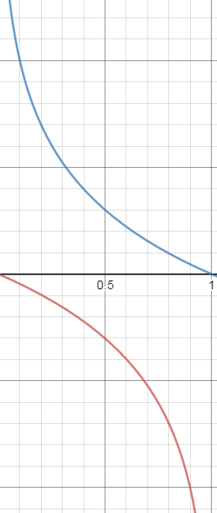
Non-saturating GAN loss (NSGAN)
$\min_{w_{G}}𝔼_{z\sim p} log⁡(1−D\left(G(z)\right))$ vs. $\max_{w_{G}}𝔼_{z\sim p} log⁡(D\left(G(z)\right))$
Minimize log-probability of generator samples labeled “fake”
Maximize log-probability of generator samples labeled “real”
$$−log⁡(D(G(z))$$
Large gradients for low-quality samples
Small gradients for high-quality samples
Low discriminator score (low-quality samples)
High discriminator score (high-quality samples)
$$D(G\left(z\right))$$
Want to learn from confidently rejected sample but gradients here are small
These samples already fool the discriminator so we don’t need large gradients here
$$log⁡(1−D(G(z))$$
Figure source

Slide 17
NSGAN training algorithm
Update discriminator:
Repeat for $k$ steps:
Sample mini-batch of noise samples $z_{1},…, z_{m}$ and mini-batch of real samples $x_{1},…, x_{m}$
Update parameters of $D$ by stochastic gradient ascent on
$$\frac{1}{m}\sum_{m}{\left[\log{D(x_{m})}+log⁡(1−D\left(G(z_{m})\right))\right]}$$
Update generator:
Sample mini-batch of noise samples $z_{1},…, z_{m}$
Update parameters of $G$ by stochastic gradient ascent on
$$\frac{1}{m}\sum_{m}{\log{D\left(G(z_{m})\right)}}$$
Repeat until happy with results
Notes:
From the paper: Optimizing D to completion in the inner loop of training is computationally prohibitive, and on finite datasets would result in overfitting. Instead, we alternate between k steps of optimizing D and one step of optimizing G. This results in D being maintained near its optimal solution, so long as G changes slowly enough

Slide 18
GAN: Schematic picture
Update discriminator: push $D(x_{data})$ close to 1 and $D\left(G(z)\right)$ close to 0
The generator is a “black box” to the discriminator
$$G(z)$$
$$z$$
$$G$$
$$D$$
$$D\left(G(z)\right)$$
$$D(x_{data})$$
$$x_{data}$$

Slide 19
GAN: Schematic picture
Update generator: increase $D\left(G(z)\right)$
Requires back-propagating through the composed generator-discriminator network (i.e., the discriminator cannot be a black box)
The generator is exposed to real data only via the output of the discriminator and its gradients
$$G(z)$$
$$z$$
$$G$$
$$D$$
$$D\left(G(z)\right)$$

Slide 20
GAN: Schematic picture
Test time – the discriminator is discarded
$$z$$
$$G$$
$$G(z)$$

Slide 21
Original GAN results
MNIST digits
Toronto Face Dataset
Nearest real image for sample to the left
I. Goodfellow, J. Pouget-Abadie, M. Mirza, B. Xu, D. Warde-Farley, S. Ozair, A. Courville, Y. Bengio, Generative adversarial nets, NIPS 2014

Slide 22
Original GAN results
CIFAR-10 (FC networks)
CIFAR-10 (conv networks)
I. Goodfellow, J. Pouget-Abadie, M. Mirza, B. Xu, D. Warde-Farley, S. Ozair, A. Courville, Y. Bengio, Generative adversarial nets, NIPS 2014

Slide 23
DCGAN
Early, influential convolutional architecture for generator
Uniformly distributed input
Linear transformation
Four transposed convolution layers with output stride of 2 for upsampling, followed by ReLU activations
Tanh activations in the last layer
A. Radford, L. Metz, S. Chintala, Unsupervised representation learning with deep convolutional generative adversarial networks, ICLR 2016

Slide 24
DCGAN
Early, influential convolutional architecture for generator
Discriminator architecture (empirically determined to give best training stability):
Don’t use pooling, only strided convolutions
Use Leaky ReLU activations (sparse gradients cause problems for training)
Use only one FC layer before the softmax output
Use batch normalization after most layers (in the generator also)
A. Radford, L. Metz, S. Chintala, Unsupervised representation learning with deep convolutional generative adversarial networks, ICLR 2016

Slide 25
DCGAN results
Generated bedrooms after one epoch

Slide 26
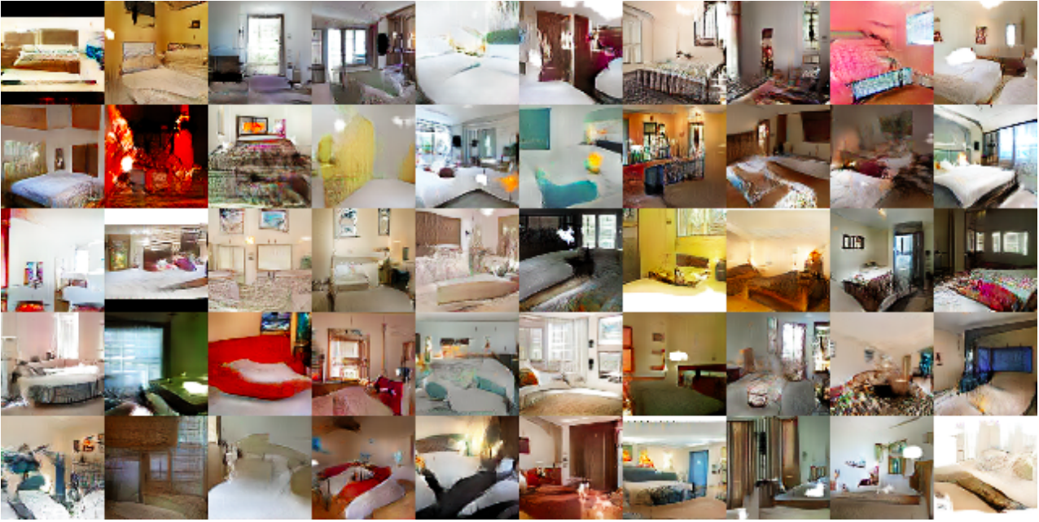
DCGAN results
Generated bedrooms after five epochs

Slide 27
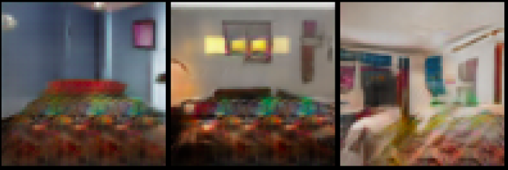
DCGAN results
More bedrooms
Notice repetition artifacts
(analysis)
Source: F. Fleuret

Slide 28
DCGAN results
Interpolation between different points in the z space

Slide 29
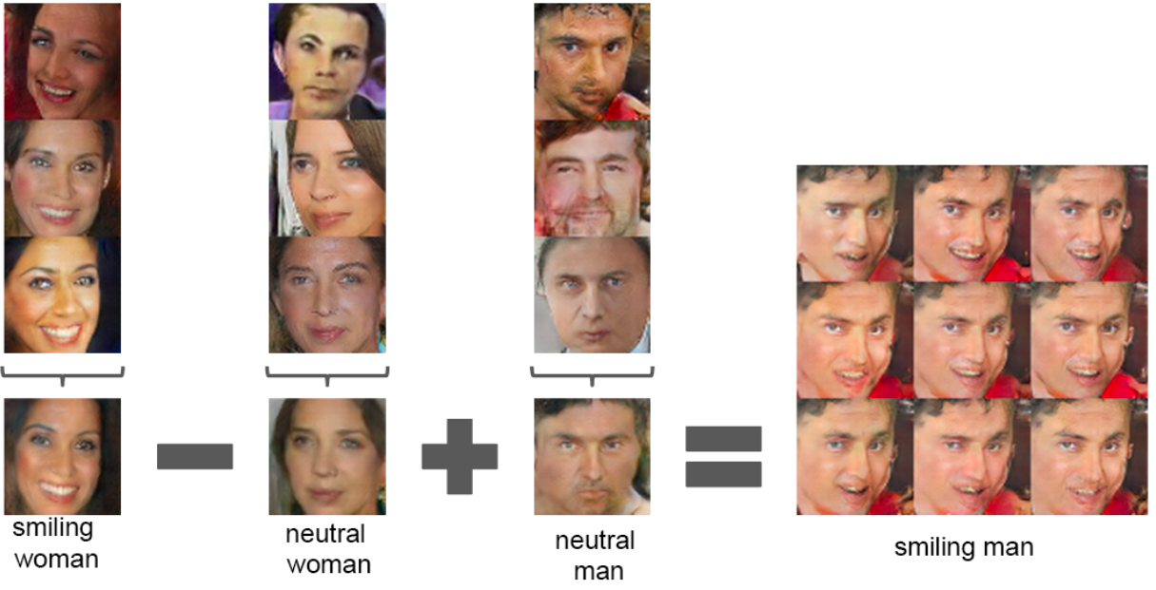
DCGAN results
Vector arithmetic in the z space
Notes:
For each column, the Z vectors of samples are averaged. Arithmetic was then performed on the mean vectors creating a new vector Y . The center sample on the right hand side is produced by feeding Y as input to the generator. To demonstrate the interpolation capabilities of the generator, uniform noise sampled with scale +-0.25 was added to Y to produce the 8 other samples

Slide 30
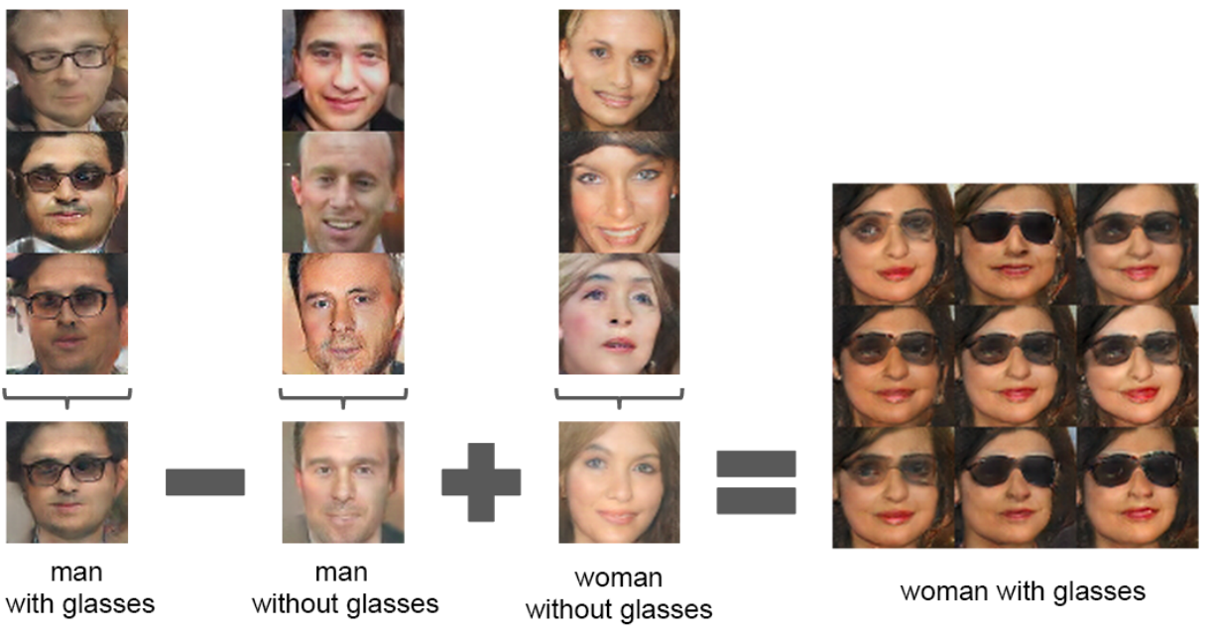
DCGAN results
Vector arithmetic in the z space
Notes:
For each column, the Z vectors of samples are averaged. Arithmetic was then performed on the mean vectors creating a new vector Y . The center sample on the right hand side is produced by feeding Y as input to the generator. To demonstrate the interpolation capabilities of the generator, uniform noise sampled with scale +-0.25 was added to Y to produce the 8 other samples

Slide 31
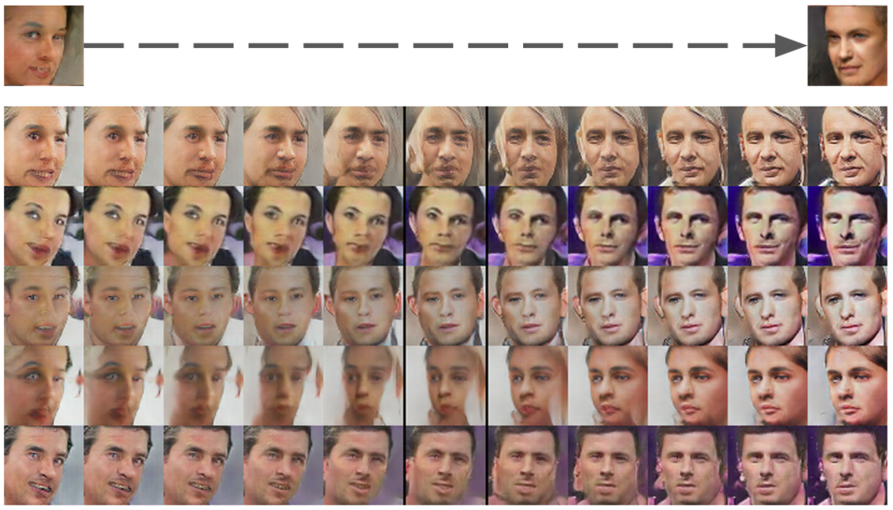
DCGAN results
Pose transformation by adding a “turn” vector
Notes:
A ”turn” vector was created from four averaged samples of faces looking left vs looking right. By adding interpolations along this axis to random samples we were able to reliably transform their pose.

Slide 32
Problems with GAN training
Stability
Parameters can oscillate or diverge, generator loss does not correlate with sample quality
Behavior very sensitive to hyperparameter selection
Notes:
Explanation of mode collapse from https://medium.com/@jonathan_hui/gan-why-it-is-so-hard-to-train-generative-advisory-networks-819a86b3750b
Let’s consider one extreme case where G is trained extensively without updates to D. The generated images will converge to find the optimal image x* that fool D the most, the most realistic image from the discriminator perspective. In this extreme, x* will be independent of z. This is bad news. The mode collapses to a single point. The gradient associated with z approaches zero.
When we restart the training in the discriminator, the most effective way to detect generated images is to detect this single mode. Since the generator desensitizes the impact of z already, the gradient from the discriminator will likely push the single point around for the next most vulnerable mode. This is not hard to find. The generator produces such an imbalance of modes in training that it deteriorates its capability to detect others. Now, both networks are overfitted to exploit the short-term opponent weakness. This turns into to a cat-and-mouse game and the model will not converge.

Slide 33
Problems with GAN training
Mode collapse
Generator ends up modeling only a small subset of the training data
Source
Source
Notes:
Explanation of mode collapse from https://medium.com/@jonathan_hui/gan-why-it-is-so-hard-to-train-generative-advisory-networks-819a86b3750b
Let’s consider one extreme case where G is trained extensively without updates to D. The generated images will converge to find the optimal image x* that fool D the most, the most realistic image from the discriminator perspective. In this extreme, x* will be independent of z. This is bad news. The mode collapses to a single point. The gradient associated with z approaches zero.
When we restart the training in the discriminator, the most effective way to detect generated images is to detect this single mode. Since the generator desensitizes the impact of z already, the gradient from the discriminator will likely push the single point around for the next most vulnerable mode. This is not hard to find. The generator produces such an imbalance of modes in training that it deteriorates its capability to detect others. Now, both networks are overfitted to exploit the short-term opponent weakness. This turns into to a cat-and-mouse game and the model will not converge.

Slide 34
Outline
Generative modeling tasks
Original GAN formulation
Alternative GAN objectives

Slide 35
Wasserstein GAN (WGAN)
Motivated by Wasserstein or Earth mover’s distance, which is an alternative to JS divergence for comparing distributions
In practice, use linear activation instead of sigmoid in the discriminator and drop the logs from the objective:
$$\min_{G} \max_{D}\left[𝔼_{x\sim p_{data}}D\left(x\right)−𝔼_{z\sim p}D\left(G(z)\right)\right]$$
Due to theoretical considerations, important to ensure smoothness of discriminator
This paper’s suggested method is clipping weights to fixed range $[−c,c]$
M. Arjovsky, S. Chintala, L. Bottou, Wasserstein generative adversarial networks, ICML 2017

Slide 36
Wasserstein GAN (WGAN)
Benefits (claimed)
Better gradients, more stable training
M. Arjovsky, S. Chintala, L. Bottou, Wasserstein generative adversarial networks, ICML 2017

Slide 37
Wasserstein GAN (WGAN)
Benefits (claimed)
Better gradients, more stable training
Objective function value is more meaningfully related to quality of generator output
Original GAN divergence
WGAN divergence
M. Arjovsky, S. Chintala, L. Bottou, Wasserstein generative adversarial networks, ICML 2017

Slide 38
Improved Wasserstein GAN (WGAN-GP)
Weight clipping leads to problems with discriminator training
Improved Wasserstein discriminator loss:
$$𝔼_{\tilde{x}\sim p_{gen}}D\left(\tilde{x}\right)−𝔼_{x\sim p_{real}}D\left(x\right)$$
$$+ λ{ 𝔼}_{\hat{x}\sim p_{\hat{x}}}\left[{\left({\left\|∇_{\hat{x}}D(\hat{x})\right\|}_{2}−1\right)}^{2}\right]$$
Unit norm gradient penalty on points $\hat{x}$obtained by interpolating real and generated samples
I. Gulrajani, F. Ahmed, M. Arjovsky, V. Dumoulin, A. Courville, Improved training of Wasserstein GANs, NIPS 2017

Slide 39
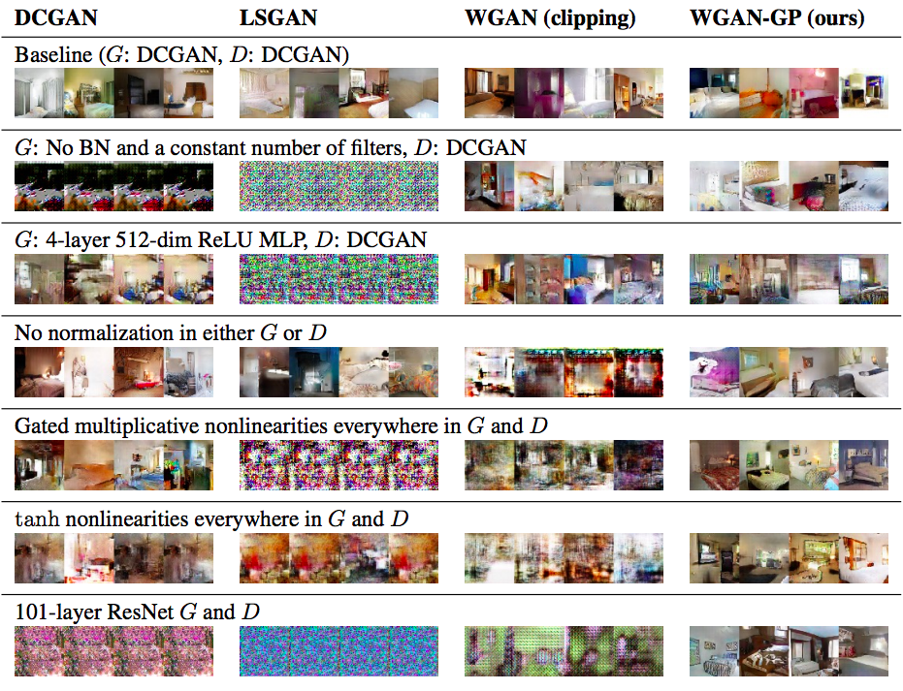
Improved Wasserstein GAN: Results
I. Gulrajani, F. Ahmed, M. Arjovsky, V. Dumoulin, A. Courville, Improved training of Wasserstein GANs, NIPS 2017

Slide 40
Least Squares GAN (LSGAN)
Use least squares cost for generator and discriminator
Equivalent to minimizing Pearson $χ^{2}$ divergence
$$L_{D}=𝔼_{x\sim p_{data}}{\left(D\left(x\right)−1\right)}^{2}+𝔼_{z\sim p}⁡{(D\left(G(z)\right))}^{2}$$
$$L_{G}= 𝔼_{z\sim p}{(D\left(G\left(z\right)\right)−1)}^{2}$$
Push discrim. response on real data close to 1
Push response on generated data close to 0
Push response on generated data close to 1
X. Mao, Q. Li, H. Xie, R. Y. Lau, Z. Wang, and S. P. Smolley, Least squares generative adversarial networks, ICCV 2017

Slide 41
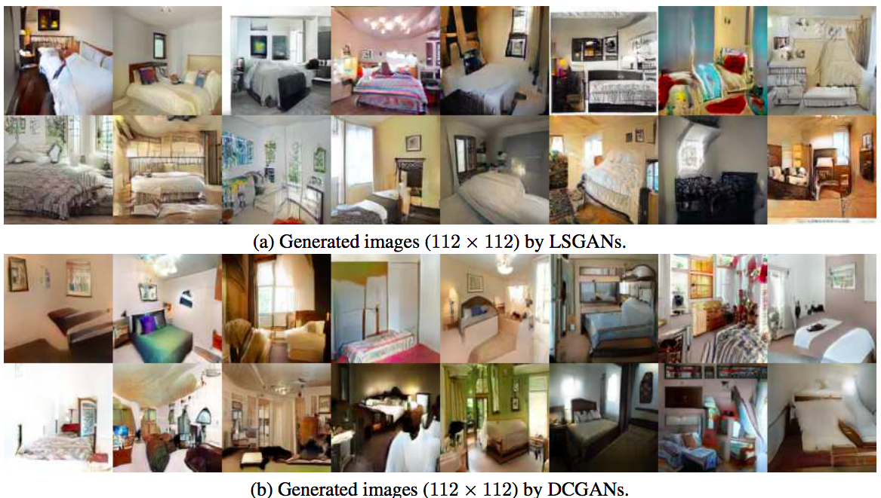
Least Squares GAN (LSGAN)
Benefits (claimed)
Higher-quality images
X. Mao, Q. Li, H. Xie, R. Y. Lau, Z. Wang, and S. P. Smolley, Least squares generative adversarial networks, ICCV 2017

Slide 42
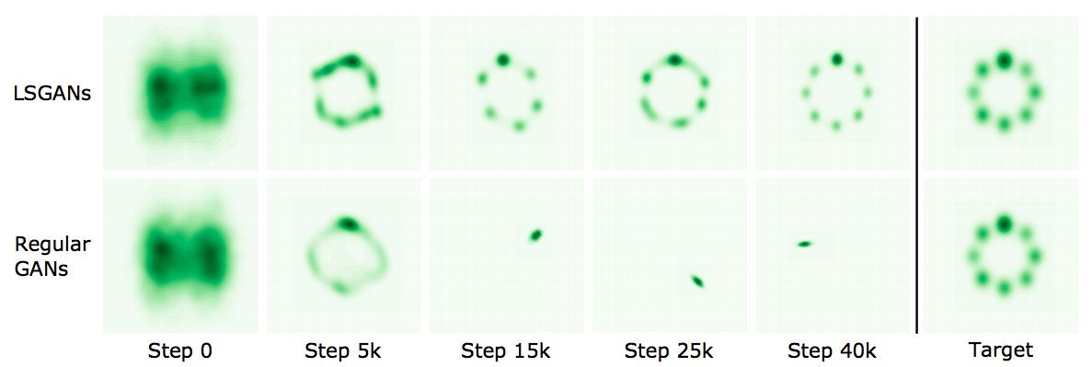
Least Squares GAN (LSGAN)
Benefits (claimed)
Higher-quality images
More stable and resistant to mode collapse
X. Mao, Q. Li, H. Xie, R. Y. Lau, Z. Wang, and S. P. Smolley, Least squares generative adversarial networks, ICCV 2017

Slide 43
GAN with hinge loss
Discriminator: Drive discriminator score on real data above $1$, on generated data below $−1$
$$L_{D}={−𝔼}_{x\sim p_{data}}\left[min(0,D\left(x\right)−1)\right]$$
$$−𝔼_{z\sim p}\left[min⁡(0,−D\left(G\left(z\right)\right)−1)\right]$$
Generator: maximize discriminator score on generated data
$$L_{G}={−𝔼}_{z\sim p}D(G\left(z\right))$$
T. Miyato et al., Spectral normalization for generative adversarial networks, ICLR 2018
Notes:
Discriminator: Drive discriminator score on real data above 1, on generated data below -1
Generator: maximize discriminator score on generated data

Slide 44
Outline
Generative modeling tasks
Original GAN formulations
Alternative GAN objectives
Evaluating GANs

Slide 45
How to evaluate GANs?
Showing pictures of samples is not enough, especially for simpler datasets like MNIST, CIFAR, faces, bedrooms, etc.
We cannot directly compute the likelihoods of high-dimensional samples (real or generated), or compare their distributions
Many GAN approaches claim mainly to improve stability, which is hard to evaluate

Slide 46
GAN evaluation: Human studies
Example: Turing test
T. Salimans, I. Goodfellow, W. Zaremba, V. Cheung, A. Radford, X. Chen, Improved techniques for training GANs, NIPS 2016

Slide 47
GAN evaluation: Inception score (IS)
Key idea: generators should produce images with a variety of recognizable object classes
Pass generated samples $x$through an image classifier (InceptionNet), compute posterior class distributions $P\left(y | x\right)$ and marginal distribution $P(y)$
Compute Inception score as
$IS\left(G\right)=exp\left[𝔼_{x\sim G} KL(P\left(y | x\right)∥P\left(y\right))\right]$.
IS should be high when:
Samples $x$ contain recognizable objects, so entropy of $P(y|x)$ is low
The predicted labels of samples are diverse, so the entropy of $P(y)$ is high
What if a generator overfits (memorizes the training set)?
What if it outputs a single image per class?
T. Salimans, I. Goodfellow, W. Zaremba, V. Cheung, A. Radford, X. Chen, Improved techniques for training GANs, NIPS 2016

Slide 48
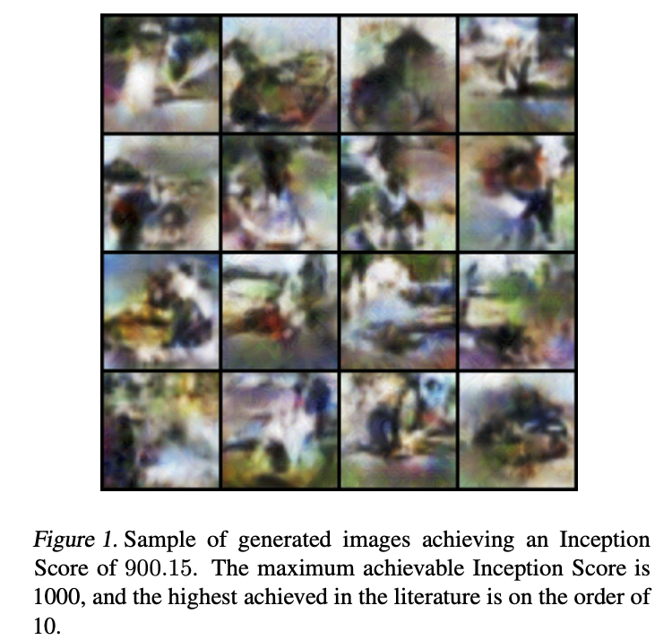
GAN evaluation: Inception score (IS)
Disadvantages
A GAN that simply memorizes the training data (overfitting) or outputs a single image per class (mode dropping) could still score well
Is sensitive to network weights, not necessarily valid for generative models not trained on ImageNet, can be gamed (Barratt & Sharma 2018)

Slide 49
GAN evaluation: Fréchet Inception Distance (FID)
Key idea: fit simple distributions (Gaussians) to statistics of feature activations for real and generated data; estimate divergence parametrically
Pass generated samples through a network (InceptionNet), compute activations for a chosen layer
Estimate multivariate mean and covariance of activations, compute Fréchet distance to those of real data
Advantages: correlated with visual quality of samples and human judgment, can detect mode dropping (unlike IS)
Disadvantages: cannot detect overfitting (like IS), can be sensitive to resampling and compression (Parmar et al. 2021)
M. Heusel, H. Ramsauer, T. Unterthiner, B. Nessler, S. Hochreiter, GANs trained by a two time-scale update rule converge to a local Nash equilibrium, NIPS 2017

Slide 50
Are GANs created equal?
From the abstract: “We find that most models can reach similar scores with enough hyperparameter optimization and random restarts. This suggests that improvements can arise from a higher computational budget and tuning more than fundamental algorithmic changes … We did not find evidence that any of the tested algorithms consistently outperforms the non-saturating GAN introduced in Goodfellow et al. (2014)”
M. Lucic, K. Kurach, M. Michalski, O. Bousquet, S. Gelly, Are GANs created equal? A large-scale study, NIPS 2018

