Slide 1
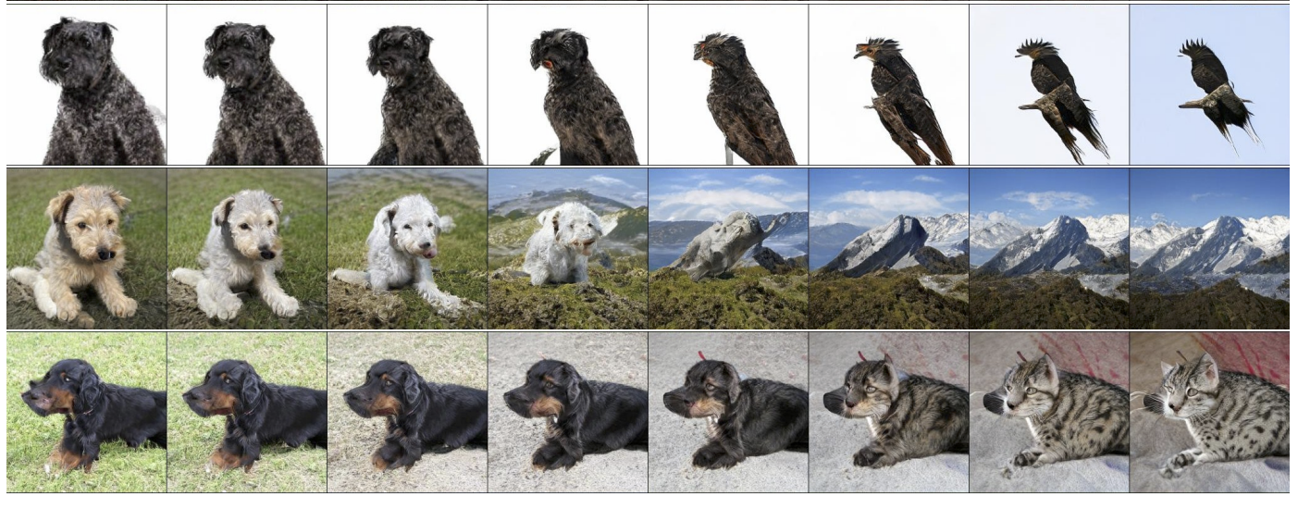
Advanced GAN models and applications
BigGAN (2018)

Slide 2
“The early years”

Slide 3
“The early years”
EBGAN (2017)
BigGAN (2018)

Slide 4
Advanced GAN models and applications
Progressive GAN
StyleGAN
GAN-based image editing applications
Self-attention GAN, BigGAN
StyleGAN-XL, GigaGAN, StyleGAN-T

Slide 5
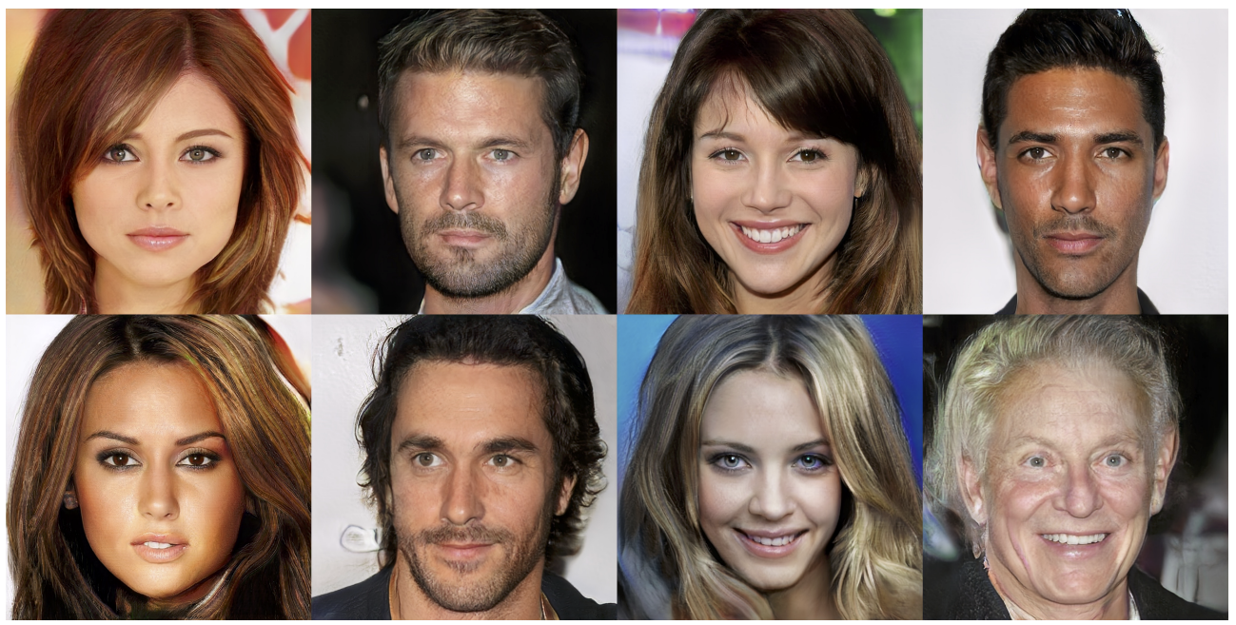
Progressive GANs
Realistic face images up to 1024 x 1024 resolution
T. Karras, T. Aila, S. Laine, J. Lehtinen. Progressive Growing of GANs for Improved Quality, Stability, and Variation. ICLR 2018

Slide 6
Progressive GANs
Key idea: train lower-resolution models, gradually add layers corresponding to higher-resolution outputs
Source
T. Karras, T. Aila, S. Laine, J. Lehtinen. Progressive Growing of GANs for Improved Quality, Stability, and Variation. ICLR 2018

Slide 7
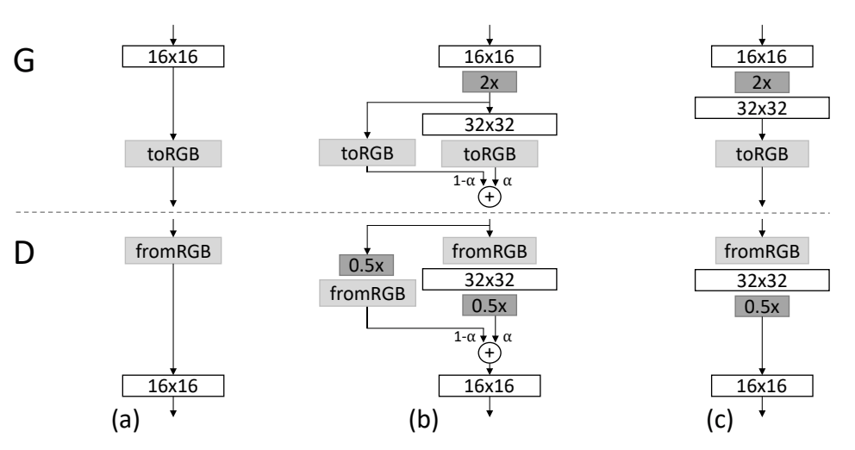
Progressive GANs
Key idea: train lower-resolution models, gradually add layers corresponding to higher-resolution outputs
Transition from 16x16 to 32x32 images
T. Karras, T. Aila, S. Laine, J. Lehtinen. Progressive Growing of GANs for Improved Quality, Stability, and Variation. ICLR 2018
Notes:
Caption: When doubling the resolution of the generator (G) and discriminator (D) we fade in the new layers smoothly. This example illustrates the transition from 16 × 16 images (a) to 32 × 32 images (c). During the transition (b) we treat the layers that operate on the higher resolution like a residual block, whose weight α increases linearly from 0 to 1. Here 2× and 0.5× refer to doubling and halving the image resolution using nearest neighbor filtering and average pooling, respectively. The toRGB represents a layer that projects feature vectors to RGB colors and fromRGB does the reverse; both use 1 × 1 convolutions. When training the discriminator, we feed in real images that are downscaled to match the current resolution of the network. During a resolution transition, we interpolate between two resolutions of the real images, similarly to how the generator output combines two resolutions.

Slide 8
Progressive GANs: Implementation details
Loss: WGAN-GP loss (preferred) or LSGAN
Architectures:
Nearest neighbor upsampling (2x2 replication) followed by regular convolutions instead of transposed conv layers
Average pooling instead of striding for downsampling in discriminator
Leaky ReLUs used in discriminator and generator
Per-pixel response normalization in generator: rescale feature vector in each pixel to unit length after each conv layer
Use of minibatch standard deviation in discriminator (append to feature map)
Exponential moving average of generator weights for display
T. Karras, T. Aila, S. Laine, J. Lehtinen. Progressive Growing of GANs for Improved Quality, Stability, and Variation. ICLR 2018

Slide 9
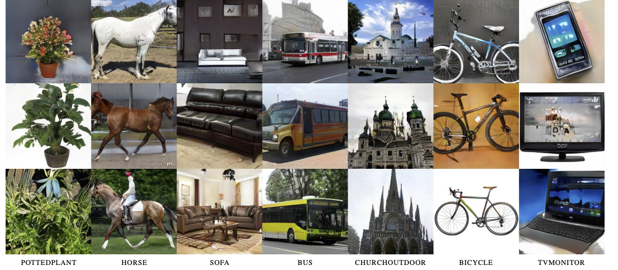
Progressive GANs: Results
256 x 256 results for LSUN categories

Slide 10
StyleGAN
Built on top of Progressive GAN
Start generation with constant (instead of noise vector)
Noise vector is transformed to latent vector $w$ that is later specialized to style codes
Style codes control adaptive instance normalization (AdaIN) or scaling and biasing of each feature map
Add noise after each convolution and before nonlinearity (enables stochastic detail)
T. Karras, S. Laine, T. Aila. A Style-Based Generator Architecture for Generative Adversarial Networks. CVPR 2019

Slide 11
StyleGAN: Results
T. Karras, S. Laine, T. Aila. A Style-Based Generator Architecture for Generative Adversarial Networks. CVPR 2019

Slide 12
Mixing styles
“Two sets of images were generated from their respective latent codes (sources A and B); the rest of the images were generated by copying a specified subset of styles from source B and taking the rest from source A.”
Notes:
Two sets of images were generated from their respective latent codes (sources A and B); the rest of the images were generated by copying a specified subset of styles from source B and taking the rest from source A. Copying the styles corresponding to coarse spatial resolutions (4 2 – 8 2 ) brings high-level aspects such as pose, general hair style, face shape, and eyeglasses from source B, while all colors (eyes, hair, lighting) and finer facial features resemble A. If we instead copy the styles of middle resolutions (162 – 322 ) from B, we inherit smaller scale facial features, hair style, eyes open/closed from B, while the pose, general face shape, and eyeglasses from A are preserved. Finally, copying the fine styles (642 – 10242 ) from B brings mainly the color scheme and microstructure.

Slide 13
Mixing styles
Notes:
Two sets of images were generated from their respective latent codes (sources A and B); the rest of the images were generated by copying a specified subset of styles from source B and taking the rest from source A. Copying the styles corresponding to coarse spatial resolutions (4 2 – 8 2 ) brings high-level aspects such as pose, general hair style, face shape, and eyeglasses from source B, while all colors (eyes, hair, lighting) and finer facial features resemble A. If we instead copy the styles of middle resolutions (162 – 322 ) from B, we inherit smaller scale facial features, hair style, eyes open/closed from B, while the pose, general face shape, and eyeglasses from A are preserved. Finally, copying the fine styles (642 – 10242 ) from B brings mainly the color scheme and microstructure.

Slide 14
Mixing styles
Notes:
Two sets of images were generated from their respective latent codes (sources A and B); the rest of the images were generated by copying a specified subset of styles from source B and taking the rest from source A. Copying the styles corresponding to coarse spatial resolutions (4 2 – 8 2 ) brings high-level aspects such as pose, general hair style, face shape, and eyeglasses from source B, while all colors (eyes, hair, lighting) and finer facial features resemble A. If we instead copy the styles of middle resolutions (162 – 322 ) from B, we inherit smaller scale facial features, hair style, eyes open/closed from B, while the pose, general face shape, and eyeglasses from A are preserved. Finally, copying the fine styles (642 – 10242 ) from B brings mainly the color scheme and microstructure.

Slide 15
DeepFakes
https://www.npr.org/2022/03/27/1088140809/fake-linkedin-profiles

Slide 16
StyleGAN: Bedrooms
T. Karras, S. Laine, T. Aila. A Style-Based Generator Architecture for Generative Adversarial Networks. CVPR 2019

Slide 17
StyleGAN: Cars
T. Karras, S. Laine, T. Aila. A Style-Based Generator Architecture for Generative Adversarial Networks. CVPR 2019

Slide 18
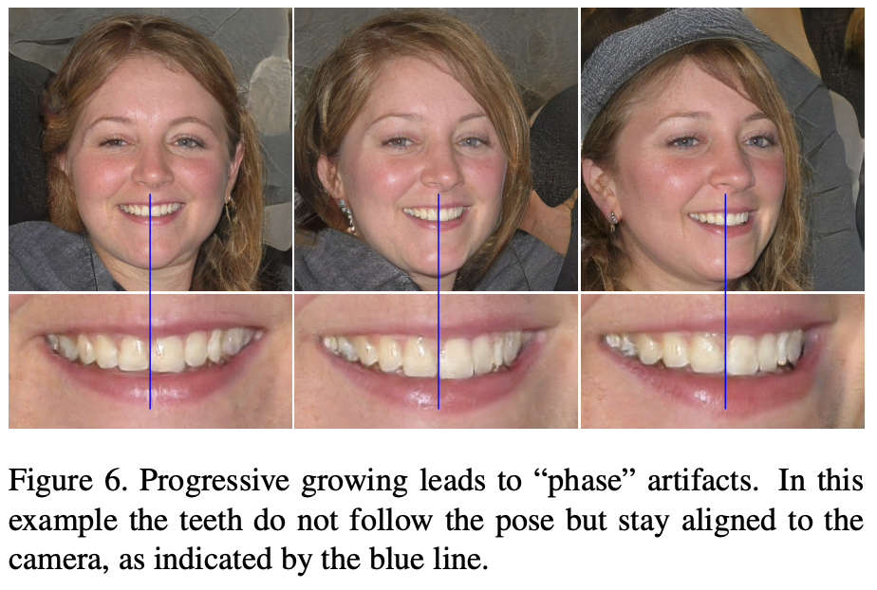
StyleGAN2
Change normalization, remove progressive growing to address StyleGAN artifacts
T. Karras et al. Analyzing and Improving the Image Quality of StyleGAN. CVPR 2020

Slide 19
StyleGAN3
T. Karras et al. Alias-Free Generative Adversarial Networks. NeurIPS 2021

Slide 20
StyleGAN3
Videos
T. Karras et al. Alias-Free Generative Adversarial Networks. NeurIPS 2021

Slide 21
Outline
Progressive GAN
StyleGAN
GAN-based image editing applications

Slide 22
GAN Dissection
D. Bau et al. GAN Dissection: Visualizing and understanding generative adversarial networks. ICLR 2019

Slide 23
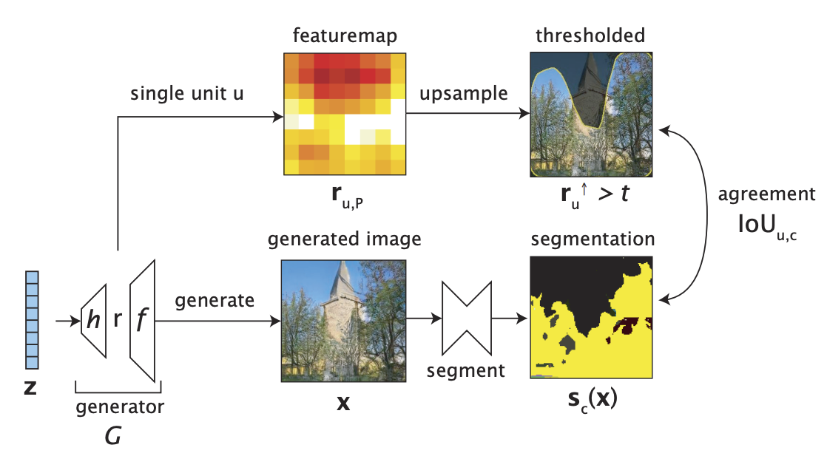
GAN Dissection
Dissection:
D. Bau et al. GAN Dissection: Visualizing and understanding generative adversarial networks. ICLR 2019

Slide 24
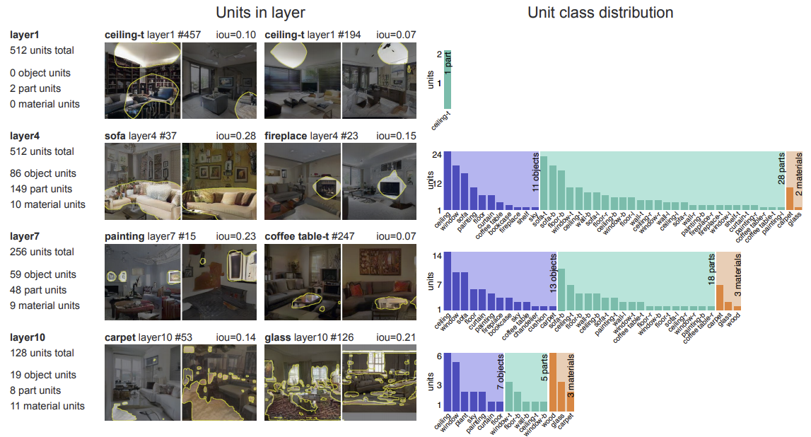
GAN Dissection
Interpreting units at different levels of a progressive GAN (trained on “bedroom”):
D. Bau et al. GAN Dissection: Visualizing and understanding generative adversarial networks. ICLR 2019

Slide 25
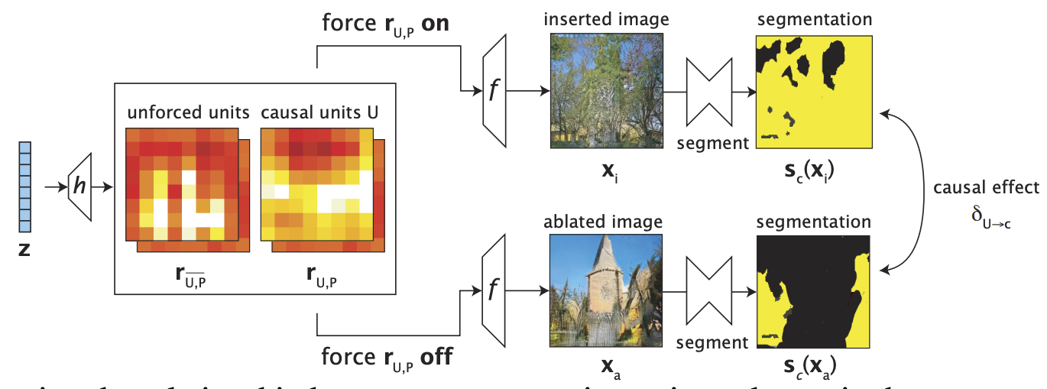
GAN Dissection
Intervention:
D. Bau et al. GAN Dissection: Visualizing and understanding generative adversarial networks. ICLR 2019

Slide 26
GANPaint demo
https://ganpaint.io/demo/?project=church
D. Bau et al. Semantic Photo Manipulation with a Generative Image Prior. SIGGRAPH 2019

Slide 27
Discovery of latent space directions
Try to find simple “walks” in the latent space of GANs to achieve various meaningful transformations to explore structure of that space and test GANs’ ability to interpolate between training samples
A. Jahanian, L. Chai, and P. Isola. On the "steerability" of generative adversarial networks. ICLR 2020

Slide 28
Discovery of latent space directions
Goal: learn a set of directions inducing “disentangled” image transformations that are easy to distinguish from each other
A.Voynov and A. Babenko. Unsupervised Discovery of Interpretable Directions in the GAN Latent Space. ICML 2020

Slide 29
GAN inversion and image editing
W. Xia et al. GAN Inversion: A Survey. arXiv 2022

Slide 30
GAN-based image editing
Use pre-trained attribute classifiers to find latent space directions corresponding to pose, smile, age, gender, eyeglasses
Y. Shen, J. Gu, X. Tang, B. Zhou. Interpreting the Latent Space of GANs for Semantic Face Editing. CVPR 2020

Slide 31
GAN-based image editing
Z. Wu et al. StyleSpace Analysis: Disentangled Controls for StyleGAN Image Generation. CVPR 2021

Slide 32
GAN-based image editing
Z. Wu et al. StyleSpace Analysis: Disentangled Controls for StyleGAN Image Generation. CVPR 2021

Slide 33
Editing using text prompts
Combine powerful recent image-text embedding technique (CLIP) with pre-trained StyleGAN for text-based image editing
O. Patashnik et al.. StyleCLIP: Text-Driven Manipulation of StyleGAN Imagery. ICCV 2021

Slide 34
Stylization by GAN fine-tuning
M. J. Chong and D. Forsyth. JoJoGAN: One Shot Face Stylization. ECCV 2022

Slide 35
Stylization by GAN fine-tuning
M. J. Chong and D. Forsyth. JoJoGAN: One Shot Face Stylization. ECCV 2022

Slide 36
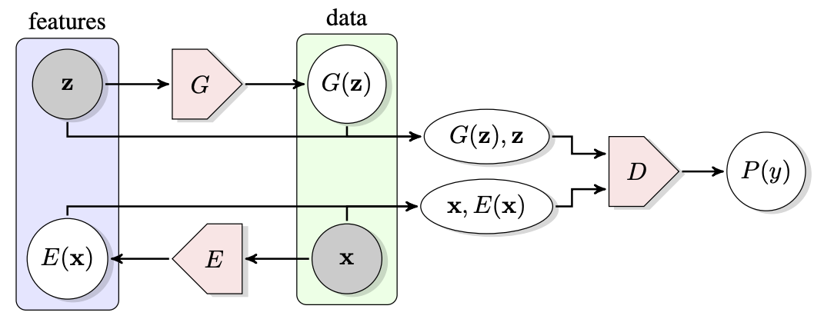
GANs for representation learning
Bidirectional GAN (BiGAN): simultaneously train generator and encoder (mapping from images to $z$ vectors or approximate inverse of the generator), show that the encoder creates a latent representation useful for other tasks
J. Donahue, P. Krähenbühl, T. Darrell, Adversarial Feature Learning, ICLR 2017

Slide 37
GANs for representation learning: BigBiGAN
Train BiGAN with BigGAN architecture on ImageNet
Show that bidirectional framework improves image generation
Encoder representation gives results comparable to (then) state-of-the-art self-supervised models on ImageNet classification
J. Donahue, K. Simonyan, Large Scale Adversarial Representation Learning, NeurIPS 2019

Slide 38
GANs for representation learning: BigBiGAN
Real images $x$
Reconstructions $G(E(x))$
J. Donahue, K. Simonyan, Large Scale Adversarial Representation Learning, NeurIPS 2019

Slide 39
Outline
Progressive GAN
StyleGAN
GAN-based image editing applications
Self-attention GAN, BigGAN

Slide 40
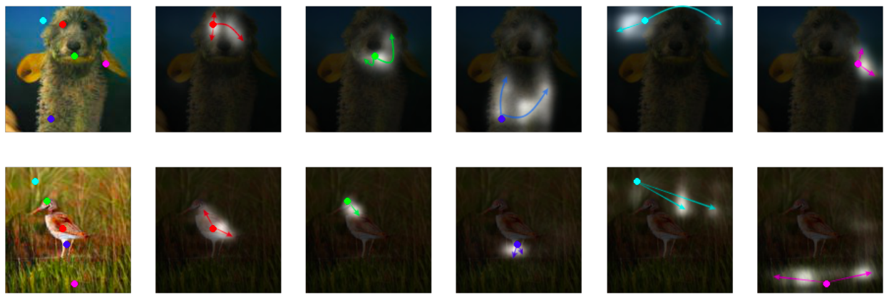
Self-attention GAN
Adaptive receptive fields to capture non-local structure
H. Zhang, I. Goodfellow, D. Metaxas, A. Odena. Self-Attention Generative Adversarial Networks. ICML 2019
Notes:
In each row, the first image shows five representative query locations with color coded dots. The other five images are attention maps for those query locations, with corresponding color coded arrows summarizing the most-attended regions. The self-attention module calculates response at a position as a weighted sum of the features at all positions, where the weights – or attention vectors – are calculated with only a small computational cost.
From the abstract: Traditional convolutional GANs generate high-resolution details as a function of only spatially local points in lower-resolution feature maps. In SAGAN, details can be generated using cues from all feature locations. Moreover, the discriminator can check that highly detailed features in distant portions of the image are consistent with each other.

Slide 41
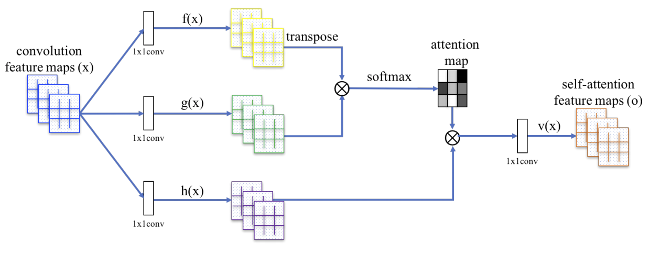
Self-attention GAN
Adaptive receptive fields to capture non-local structure (based on Wang et al., 2018)
$$s_{ij}={f\left(x_{i}\right)}^{T}g(x_{j})$$
$$β_{j,i}=\frac{exp(s_{ij})}{\sum_{i}{exp(s_{ij})}}$$
How much to attend to location $i$ while synthesizing feature at location $j$
$$o_{j}=v\left(\sum_{i}{β_{j,i}}h\left(x_{i}\right)\right)$$

Slide 42
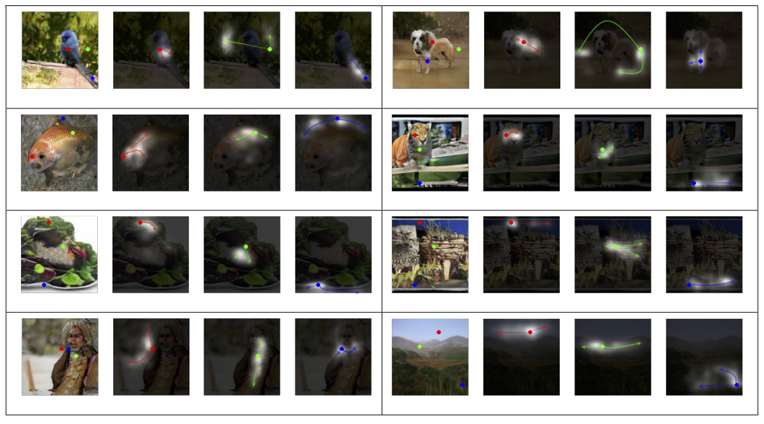
Attention map visualization

Slide 43
Self-attention GAN: Implementation details
Both generator and discriminator are conditioned on class label $y$
$$y$$
$$y$$
$$G$$
$$G(z,y)$$
$$D$$
$$z$$
$$D(G\left(z,y\right),y)$$

Slide 44
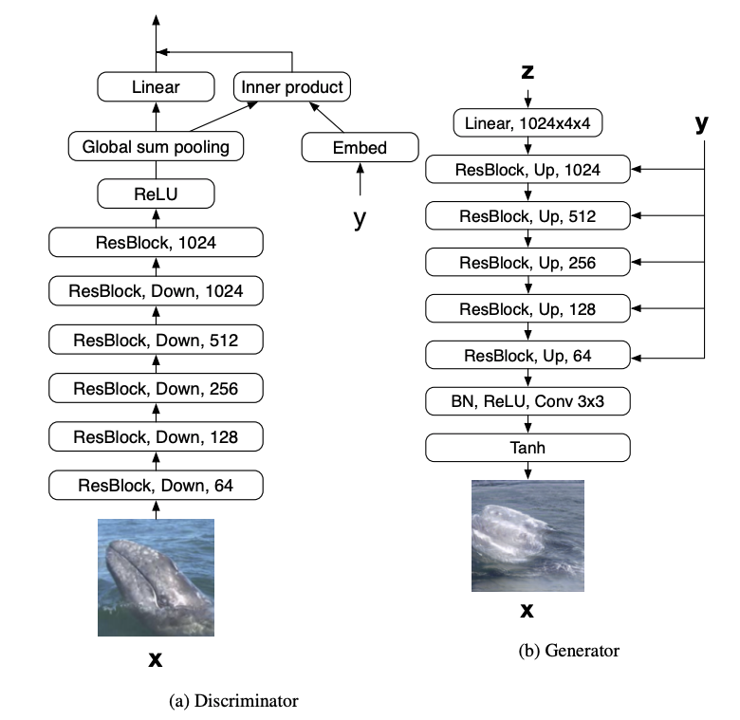
Self-attention GAN: Implementation details
Both generator and discriminator are conditioned on class label $y$
Conditioning the discriminator: projection (Miyato & Koyama, 2018)
Conditioning the generator: conditional batch norm
Figure source

Slide 45
Self-attention GAN: Implementation details
Both generator and discriminator are conditioned on class label $y$
Hinge loss formulation
Discriminator: Drive discriminator score on real data above $1$, on generated data below $−1$
$$L_{D}={−𝔼}_{(x,y)\sim p_{data}}\left[min(0,D\left(x,y\right)−1)\right]$$
$$−𝔼_{z\sim p_{z},y\sim p_{data}}\left[min⁡(0,−D\left(G\left(z,y\right),y\right)−1)\right]$$
Generator: maximize discriminator score on generated data
$$L_{G}={−𝔼}_{z\sim p_{z},y\sim p_{data}}D(G\left(z,y\right),y)$$
Notes:
Discriminator: Drive discriminator score on real data above 1, on generated data below -1
Generator: maximize discriminator score on generated data

Slide 46
Self-attention GAN: Implementation details
Both generator and discriminator are conditioned on class label $y$
Hinge loss formulation
Spectral normalization for generator and discriminator (Miyato et al., 2018) – divide weight matrices by largest singular value (estimated)
Different learning rates for generator and discriminator (TTUR or two-timescale update rule – Heusel et al., 2017)

Slide 47
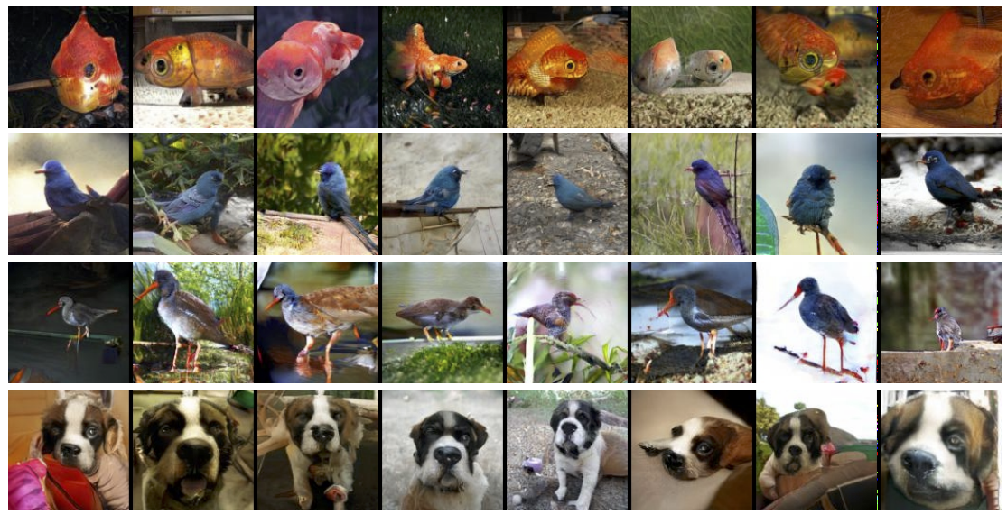
Self-attention GAN: Results
128 x 128 ImageNet
goldfish
indigo bunting
redshank
Saint Bernard

Slide 48
BigGAN
Scale up SA-GAN to generate ImageNet images up to 512 x 512 resolution
A. Brock, J. Donahue, K. Simonyan, Large scale GAN training for high fidelity natural image synthesis, ICLR 2019

Slide 49
BigGAN: Implementation details
8x larger batch size, 50% more channels (2x more parameters) than baseline SA-GAN
Hierarchical latent space: feed (transformations of) $z$ vector into multiple layers of the generator

Slide 50
BigGAN: Implementation details
8x larger batch size, 50% more channels (2x more parameters) than baseline SA-GAN
Hierarchical latent space: feed (transformations of) $z$ vector into multiple layers of the generator
Truncation trick: at test time, resample the components of the $z$ vector whose magnitude falls above a certain threshold
Trade off diversity for image quality
“The effects of increasing truncation. From left to right, the threshold is set to 2, 1, 0.5, 0.04.”

Slide 51
BigGAN: Implementation details
8x larger batch size, 50% more channels (2x more parameters) than baseline SA-GAN
Hierarchical latent space: feed (transformations of) $z$ vector into multiple layers of the generator
Truncation trick: at test time, resample the components of the $z$ vector whose magnitude falls above a certain threshold
Lots of other tricks (initialization, training, etc.)
Training observed to be unstable, but good results are achieved “just before collapse”
Evidence that discriminator memorizes the training data, but the generator doesn’t

Slide 52
BigGAN: Implementation details
https://xkcd.com/1838/

Slide 53
Announcements and reminders
Assignment 3 was due yesterday
Assignment 4 is out, due Wednesday, April 19
Quiz 3 will be out 9AM tomorrow through 9AM Monday, April 10
Project progress reports are due next Friday, April 14

Slide 54
Last time: Advanced GAN models and applications
Progressive GAN
StyleGAN
GAN-based image editing applications
Self-attention GAN, BigGAN
StyleGAN-XL, GigaGAN, StyleGAN-T

Slide 55
BigGAN
Scale up SA-GAN to generate ImageNet images up to 512 x 512 resolution
A. Brock, J. Donahue, K. Simonyan, Large scale GAN training for high fidelity natural image synthesis, ICLR 2019

Slide 56
Review: Class-conditional generation
Both generator and discriminator are conditioned on class label $y$
$$y$$
$$y$$
$$G$$
$$G(z,y)$$
$$D$$
$$z$$
$$D(G\left(z,y\right),y)$$

Slide 57
Review: Self-attention GAN
Adaptive receptive fields to capture non-local structure
H. Zhang, I. Goodfellow, D. Metaxas, A. Odena. Self-Attention Generative Adversarial Networks. ICML 2019
Notes:
In each row, the first image shows five representative query locations with color coded dots. The other five images are attention maps for those query locations, with corresponding color coded arrows summarizing the most-attended regions. The self-attention module calculates response at a position as a weighted sum of the features at all positions, where the weights – or attention vectors – are calculated with only a small computational cost.
From the abstract: Traditional convolutional GANs generate high-resolution details as a function of only spatially local points in lower-resolution feature maps. In SAGAN, details can be generated using cues from all feature locations. Moreover, the discriminator can check that highly detailed features in distant portions of the image are consistent with each other.

Slide 58
Review: Self-attention GAN
Adaptive receptive fields to capture non-local structure (based on Wang et al., 2018)
$$s_{ij}={f\left(x_{i}\right)}^{T}g(x_{j})$$
$$β_{j,i}=\frac{exp(s_{ij})}{\sum_{i}{exp(s_{ij})}}$$
How much to attend to location $i$ while synthesizing feature at location $j$
$$o_{j}=v\left(\sum_{i}{β_{j,i}}h\left(x_{i}\right)\right)$$

Slide 59
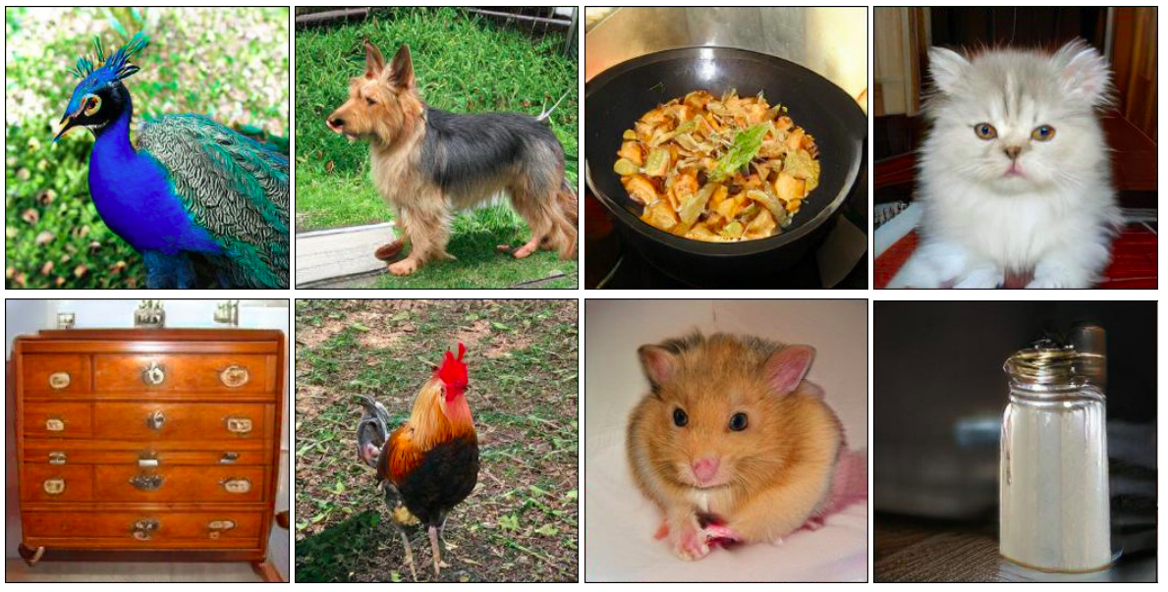
BigGAN: Results
Samples at 256 x 256 resolution:

Slide 60
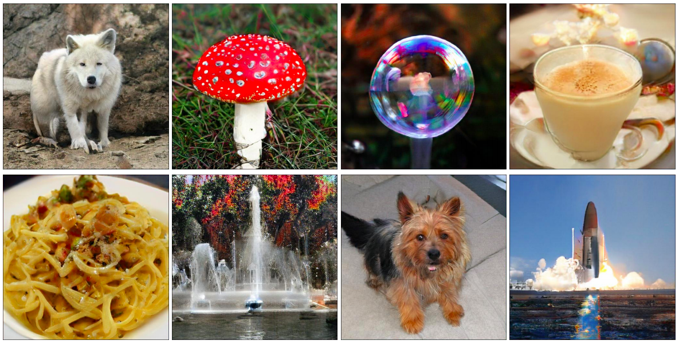
BigGAN: Results
Samples at 512 x 512 resolution:

Slide 61
BigGAN: Results
Truncation trick: at test time, resample the components of the $z$ vector whose magnitude falls above a certain threshold
Trade off diversity for image quality
“The effects of increasing truncation. From left to right, the threshold is set to 2, 1, 0.5, 0.04.”

Slide 62
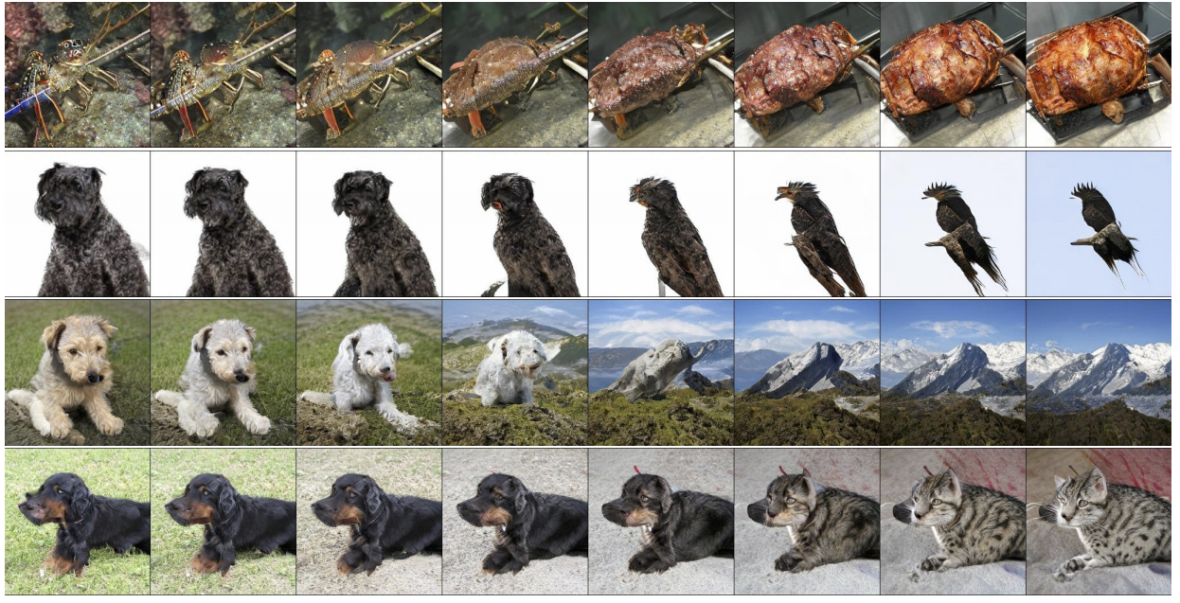
BigGAN: Results
Interpolation between $c$ with $z$ held constant:

Slide 63
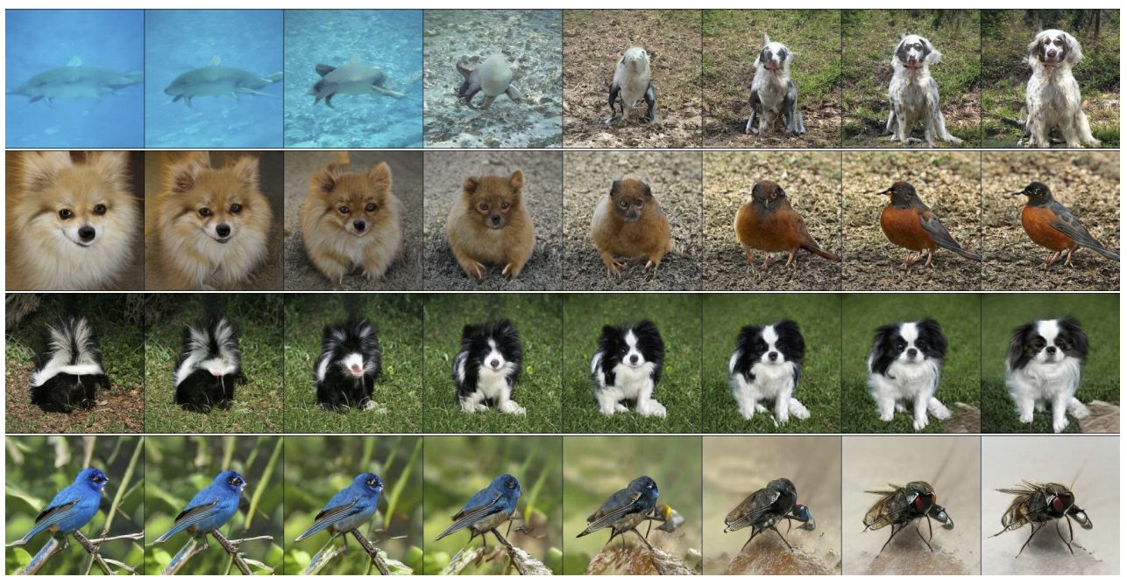
BigGAN: Results
Interpolation between $c, z$ pairs:

Slide 64
BigGAN: Results
Difficult classes:

Slide 65
Outline
Progressive GAN
StyleGAN
GAN-based image editing applications
Self-attention GAN, BigGAN
StyleGAN-XL, GigaGAN, StyleGAN-T

Slide 66
StyleGAN-XL
A. Sauer et al. StyleGAN-XL: Scaling StyleGAN to Large Diverse Datasets. SIGGRAPH 2022

Slide 67
Disclaimer
https://xkcd.com/1838/

Slide 68
StyleGAN-XL: Details
Generator based on StyleGAN3 with progressive growing and 3x more parameters

Slide 69
StyleGAN-XL: Details
Generator based on StyleGAN3 with progressive growing and 3x more parameters
Discriminator based on projected GANs
Recall the standard GAN objective:
$$V\left(G,D\right)=𝔼_{x\sim p_{data}}\log{D(x)}+𝔼_{z\sim p}log⁡(1−D\left(G(z)\right))$$
Projected GAN objective introduces multiple discriminators operating on projections $P_{l}$from a fixed pre-trained feature space:
$V\left(G,D\right)=\sum_{l}{\left(𝔼_{x\sim p_{data}}\log{D_{l}(P_{l}\left(x\right))}+𝔼_{z\sim p}log⁡(1−D_{l}(P_{l}\left(G(z)\right))\right)}$
Each $P_{l}$returns a feature map of a different resolution by applying random cross-channel mixing and cross-scale mixing to a pre-trained network
A. Sauer et al. Projected GANs Converge Faster. NeurIPS 2021

Slide 70
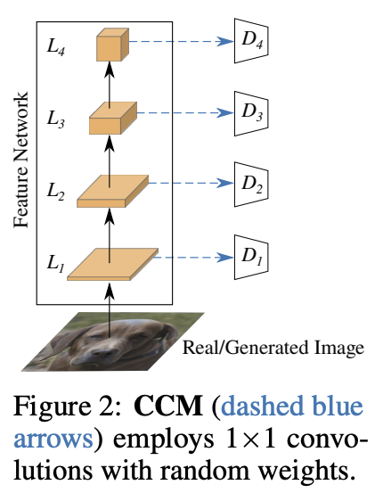
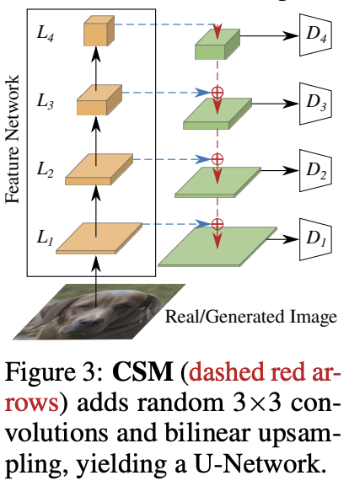
StyleGAN-XL: Details
Cross-channel mixing (CCM)
Cross-scale mixing (CSM)
A. Sauer et al. Projected GANs Converge Faster. NeurIPS 2021

Slide 71
StyleGAN-XL: Details
Generator based on StyleGAN3 with progressive growing and 3x more parameters
Discriminator based on projected GANs
Both generator and discriminator are conditioned on pre-trained class embedding vectors
Classifier guidance: add cross-entropy loss of pre-trained classifier to the generator objective to encourage output of classifier to have high probability for correct class

Slide 72
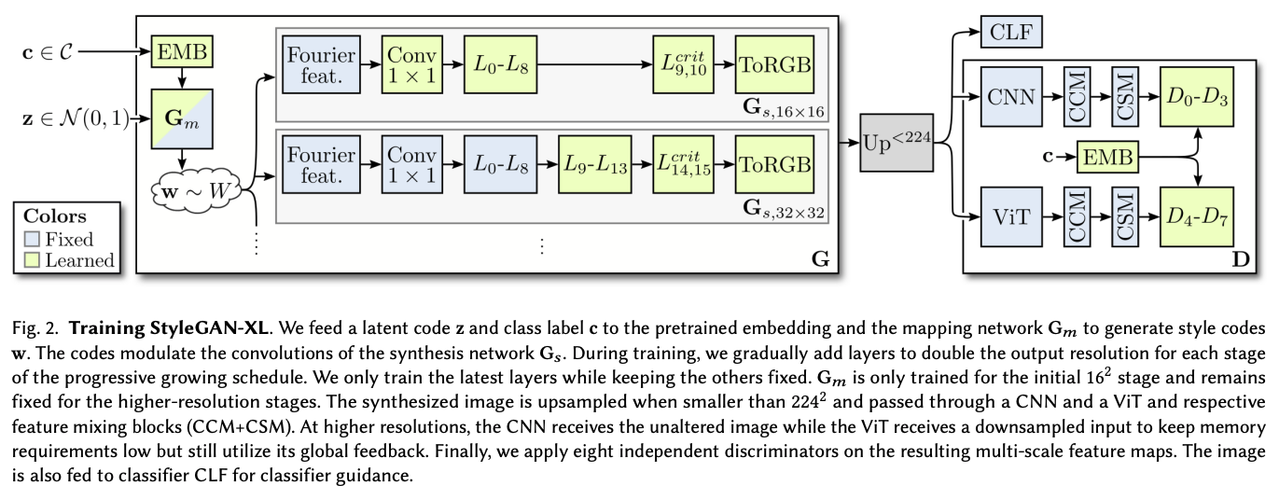
StyleGAN-XL: Details

Slide 73
StyleGAN-XL: Results

Slide 74
Text-to-image synthesis: GigaGAN
M. Kang et al. Scaling up GANs for Text-to-Image Synthesis. CVPR 2023

Slide 75
GigaGAN: Generator
Goal: catch up to diffusion models by training a GAN for text-to-image generation on 2B images from the LAION dataset
1B parameters, 6x larger than StyleGAN-XL, but smaller than diffusion models (Imagen: 3B, DALL-E 2: 5.5B, Parti: 20B)
First generate at 64x64 resolution, then upsample to 512x512 using a separate network
Architecture based on StyleGAN2, but with self-attention layers and sample-adaptive convolution kernel selection

Slide 76
GigaGAN: Generator

Slide 77
CLIP: Contrastive Language-Image Pretraining
Contrastive objective: in a batch of N image-text pairs, classify each text string to the correct image and vice versa
Radford et al., Learning Transferable Visual Models From Natural Language Supervision, ICML 2021
https://openai.com/blog/clip/

Slide 78
CLIP: Contrastive Language-Image Pretraining
Radford et al., Learning Transferable Visual Models From Natural Language Supervision, ICML 2021
https://openai.com/blog/clip/

Slide 79
CLIP: Details
Image encoders
ResNet-50 with self-attention layer on top of global average pooling
Vision transformer (ViT)
Language encoder: GPT-style transformer with 63M parameters
Dataset: 400M image-text pairs from the Web

Slide 80
CLIP: Results

Slide 81
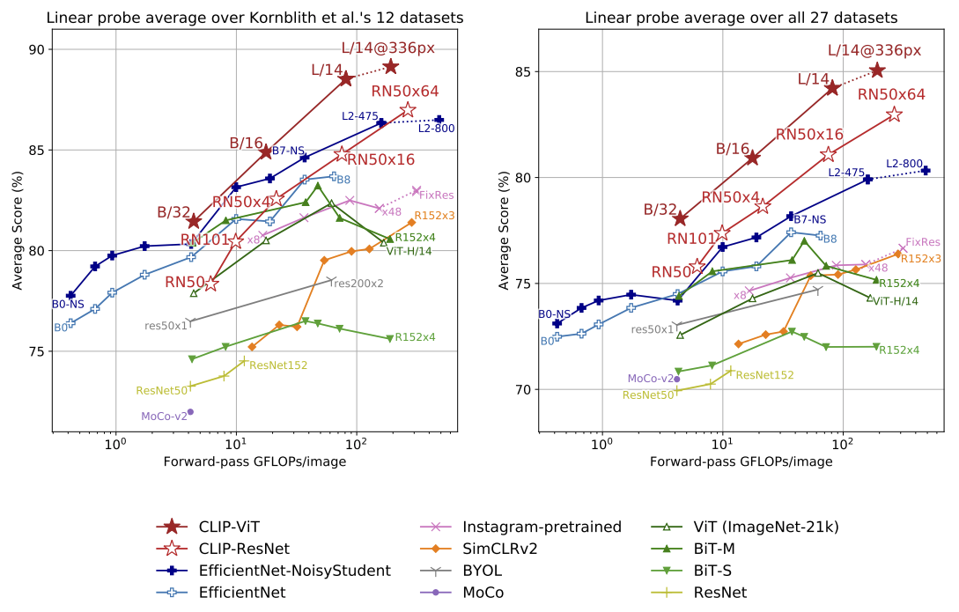
CLIP: Results

Slide 82
GigaGAN: Generator

Slide 83
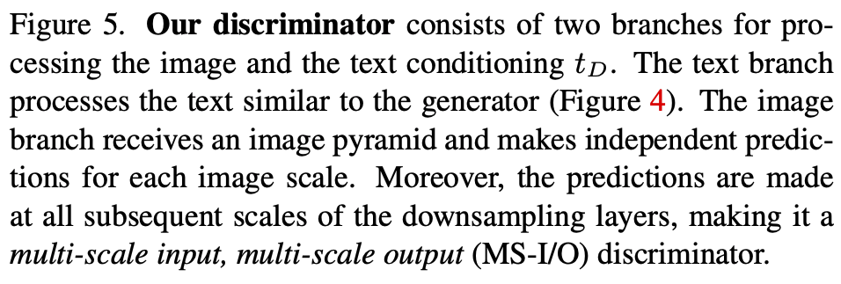
GigaGAN: Discriminator

Slide 84
GigaGAN: Discriminator
Multiple loss terms:
Standard adversarial loss (NSGAN)
Matching-aware loss where image is paired with random conditioning vector and discriminator is encouraged to label the pair as “fake”
CLIP contrastive loss: enforce high image-text similarity using pre-trained image and text encoders
“Vision-aided loss” similar to projected GAN

Slide 85
GigaGAN: Style mixing

Slide 86
GigaGAN: Prompt interpolation

Slide 87
GigaGAN: Prompt mixing

Slide 88
GigaGAN: Comparison with diffusion models

Slide 89
GigaGAN: Comparison with diffusion models

Slide 90
GigaGAN: Comparison with diffusion models

Slide 91
GigaGAN: Comparison with diffusion models

Slide 92
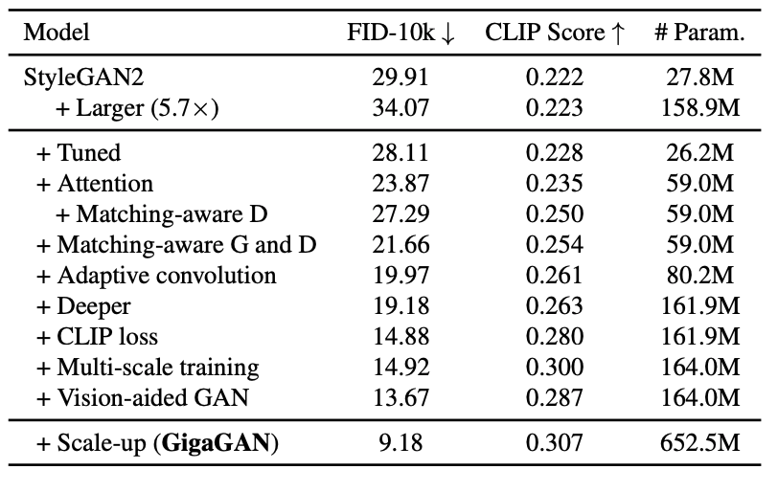
GigaGAN: Quantitative evaluation
Image quality measure
Image-text coherence measure

Slide 93
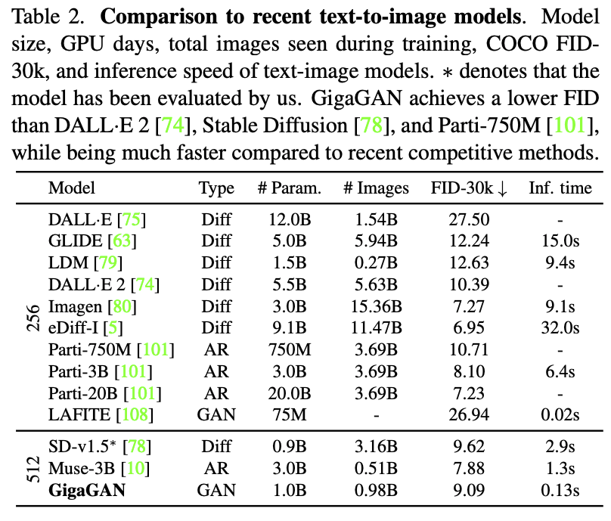
GigaGAN: Quantitative evaluation
“While our model can be optimized to better match the feature distribution of real images than existing models, the quality of the generated images is not necessarily better… We acknowledge that this may represent a corner case of zero-shot FID on COCO2014 dataset and suggest that further research on a better evaluation metric is necessary to improve text-to-image models.”

Slide 94
StyleGAN-T
A. Sauer et al. StyleGAN-T: Unlocking the Power of GANs for Fast Large-Scale Text-to-Image Synthesis. arXiv 2023

Slide 95
StyleGAN-T
Attempt to extend StyleGAN-XL to text-to-image generation
Backbone dropped down to StyleGAN2, numerous modifications to incorporate image-text conditioning
1B parameter model
Achieves FID-30K of 13.9 – compared to 9.09 for GigaGAN

Slide 96
StyleGAN-T

