Slide 1
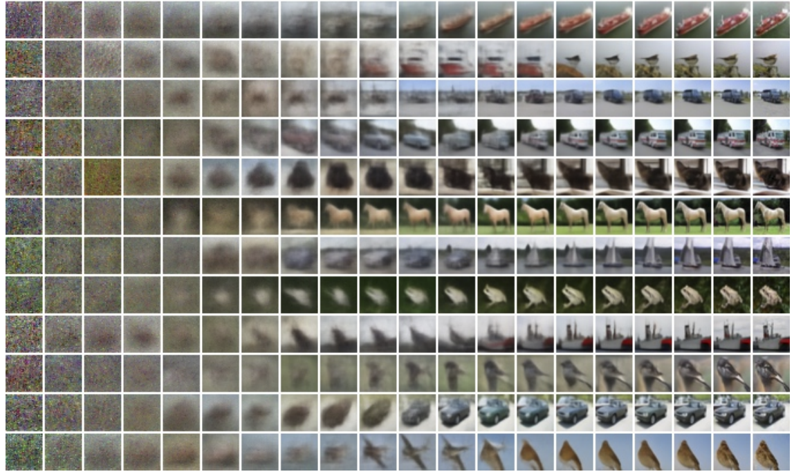
Diffusion models

Slide 2
Diffusion models
https://www.nytimes.com/2023/04/08/technology/ai-photos-pope-francis.html

Slide 3
Outline
Denoising diffusion probabilistic models (DDPMs)
Conditional diffusion models
Large-scale models
Controlling and fine-tuning image generation
Societal, ethical, and legal issues

Slide 4
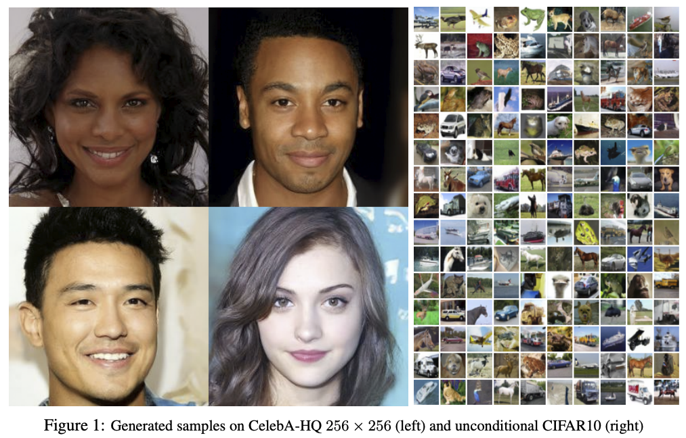
Denoising diffusion probabilistic models (DDPMs)
J. Ho et al. Denoising diffusion probabilistic models. NeurIPS 2020
Notes:
We present high quality image synthesis results using diffusion probabilistic models, a class of latent variable models inspired by considerations from nonequilibrium thermodynamics. Our best results are obtained by training on a weighted variational bound designed according to a novel connection between diffusion probabilistic models and denoising score matching with Langevin dynamics, and our models naturally admit a progressive lossy decompression scheme that can be interpreted as a generalization of autoregressive decoding. On the unconditional CIFAR10 dataset, we obtain an Inception score of 9.46 and a state-of-the-art FID score of 3.17. On 256x256 LSUN, we obtain sample quality similar to ProgressiveGAN

Slide 5
DDPMs: Basic idea
Unconditional CIFAR10 sample generation
J. Ho et al. Denoising diffusion probabilistic models. NeurIPS 2020
Blog introduction: https://lilianweng.github.io/posts/2021-07-11-diffusion-models/
CVPR 2022 tutorial

Slide 6
DDPMs: Basic idea
Forward process $q$ turns images into Gaussian noise
Reverse process $p$ turns noise into images
Provided the increments of $t$ are small enough, $p_{θ}(x_{t−1}|x_{t})$ is Gaussian and we can train a neural network to estimate the mean of $x_{t−1}$ given $x_{t}$
J. Ho et al. Denoising diffusion probabilistic models. NeurIPS 2020

Slide 7
DDPMs: Basic idea
$ε_{θ}(x_{t},t)$ is the predicted noise component of image $x_{t}$ given noise level $t$
Network parameters $θ$ are updated to reduce L2 error between actual noise $ε$ and predicted noise $ε_{θ}(x_{t},t)$
$$x_{t}$$
J. Ho et al. Denoising diffusion probabilistic models. NeurIPS 2020

Slide 8
DDPMs: Basic idea
J. Ho et al. Denoising diffusion probabilistic models. NeurIPS 2020

Slide 9
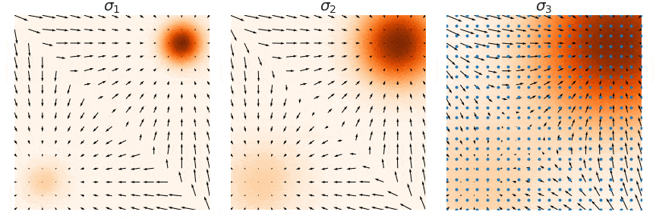
Alternate viewpoint: Score-based generative modeling
It can be shown that $ε_{θ}\left(x_{t},t\right)≈−∇_{x_{t}}\log{q(x_{t})}$, where $∇_{x_{t}}\log{q(x_{t})}$ is the score function of the (noisy) data distribution
To sample from the original data density $q(x_{0})$, we can use annealed Langevin dynamics, i.e., start by sampling from noise-perturbed versions of the data distribution and gradually reduce the amount of noise
Original density
Medium noise
Maximum noise
Y. Song and S. Ermon. Generative Modeling by Estimating Gradients of the Data Distribution. NeurIPS 2019
https://yang-song.net/blog/2021/score/

Slide 10
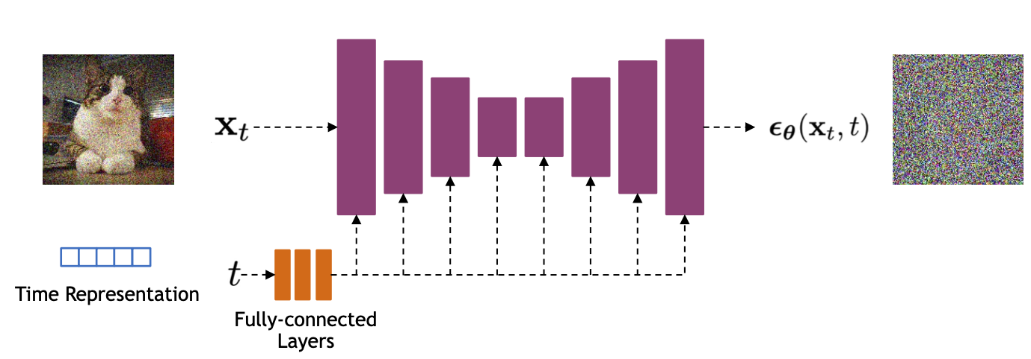
DDPMs: Implementation
U-Net architectures are typically used to represent $ε_{θ}(x_{t},t)$
Bells and whistles: residual blocks, self-attention
Time is encoded using sinusoidal positional embeddings or random Fourier features, fed into the U-Net using addition or adaptive normalization
Source: CVPR 2002 DM tutorial

Slide 11
Efficient sampling at high resolutions: Cascaded generation
In practice, data augmentation for inputs to upsampling models is crucial (esp. adding Gaussian noise or early stopping for base model)
J. Ho et al. Cascaded Diffusion Models for High Fidelity Image Generation. JMLR 2022

Slide 12
Outline
Denoising diffusion probabilistic models (DDPMs)
Conditional diffusion models

Slide 13
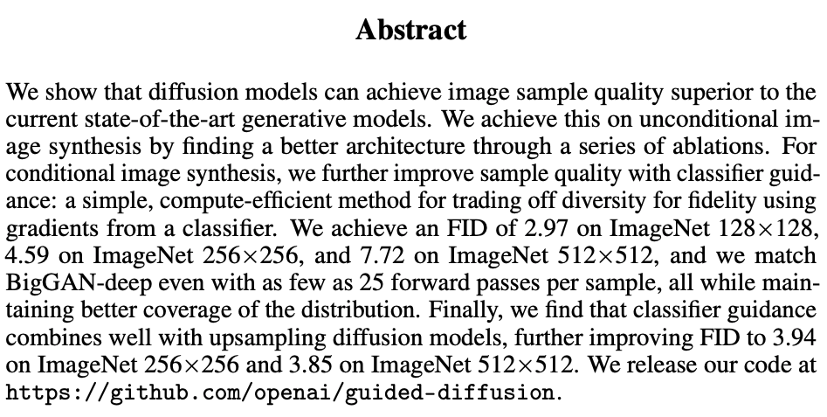
Class-conditioned DDPMs
“We can sample with as few as 25 forward passes while maintaining FIDs comparable to BigGAN”
P. Dhariwal and A. Nichol. Diffusion Models Beat GANs on Image Synthesis. NeurIPS 2021
Notes:
“When using classifier guidance, we find that we can sample with as few as 25 forward passes while maintaining FIDs comparable to BigGAN”

Slide 14
Classifier guidance
We can sample from the class-conditional density $q(x_{t}|c)$ with the help of a pre-trained classifier $P(c|x_{t})$
Bayes rule:
$$q\left(x_{t} | c\right)∝P\left(c | x_{t}\right)q\left(x_{t}\right)$$
$$\log{q\left(x_{t} | c\right)}=\log{P\left(c | x_{t}\right)}+\log{q\left(x_{t}\right)}+const.$$
$$∇_{x_{t}}\log{q\left(x_{t} | c\right)} = ∇_{x_{t}}\log{P\left(c | x_{t}\right)} + ∇_{x_{t}}\log{q\left(x_{t}\right)}$$
To sample from class $c$, steer sample in the modified direction $∇_{x_{t}}[\log{q\left(x_{t}\right)+w log{P\left(c | x_{t}\right)}}]$
conditional score function
obtained from classifier output
unconditional score function (pre-trained)

Slide 15
Classifier-free guidance
Instead of training an additional classifier, get an “implicit classifier” by jointly training a conditional and unconditional diffusion model: $P\left(c | x_{t}\right)∝q\left(x_{t} | c\right)/q\left(x_{t}\right)$
Both $q\left(x_{t} | c\right)$ and $q\left(x_{t}\right)$ are represented using the same network, trained by dropping out $c$ with some probability (corresponding to the unconditional case)
The modified score function corresponding to this implicit classifier is
$$∇_{x_{t}}\left[\log{q\left(x_{t}\right)+w\log{P\left(c | x_{t}\right)}}\right]=∇_{x_{t}}\left[\log{q\left(x_{t}\right)+w(\log{q\left(x_{t} | c\right)−}\log{q(x_{t}))}}\right]$$
Sample is steered away from the unconditional distribution in the direction of the conditional one
J. Ho and T. Salimans. Classifier-Free Diffusion Guidance. arXIv 2021

Slide 16
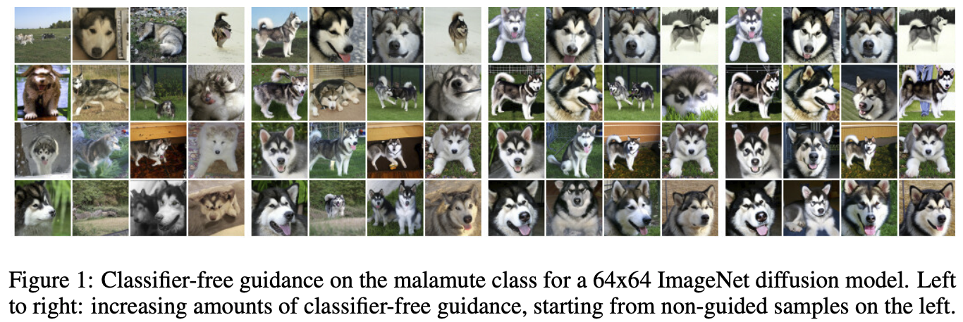
Classifier-free guidance
J. Ho and T. Salimans. Classifier-Free Diffusion Guidance. arXIv 2021

Slide 17
Text-guided diffusion
Instead of a class label, $c$ can be an encoded text prompt, injected into the U-Net using cross-attention
$$ε_{θ}(x_{t},c,t)$$
Conditioning information: text c, time t
Image source

Slide 18
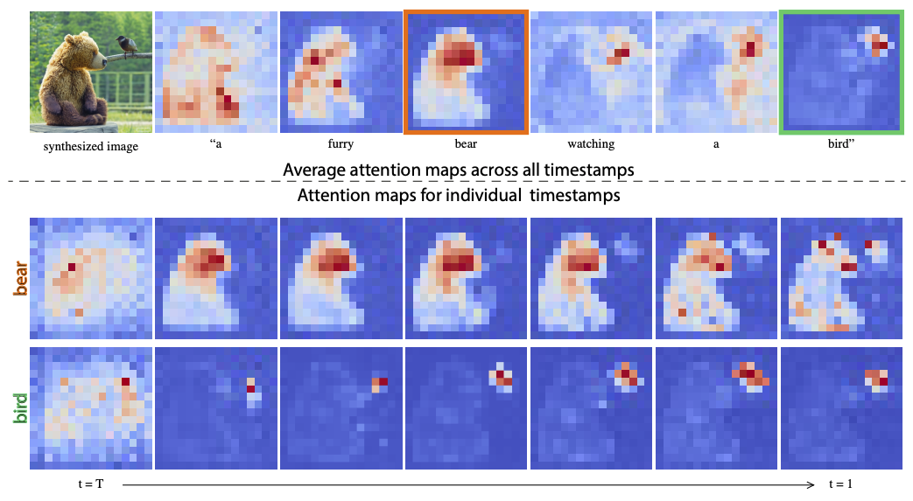
Text-guided diffusion
Instead of a class label, $c$ can be an encoded text prompt, injected into the U-Net using cross-attention
Image source

Slide 19
Text-guided diffusion
Instead of a class label, $c$ can be an encoded text prompt, injected into the U-Net using cross-attention
Classifier-free guidance works the same way as before, by training both conditional and unconditional models using text dropout
CLIP guidance: steer samples in the direction of $∇_{x_{t}}CLIP(x_{t},c)$
Note: both classifier and CLIP must be noise-aware (trained on noised images)

Slide 20
Recall: CLIP
Contrastive objective: in a batch of N image-text pairs, classify each text string to the correct image and vice versa
Radford et al., Learning Transferable Visual Models From Natural Language Supervision, ICML 2021
https://openai.com/blog/clip/

Slide 21
Outline
Denoising diffusion probabilistic models (DDPMs)
Conditional diffusion models
Large-scale models

Slide 22
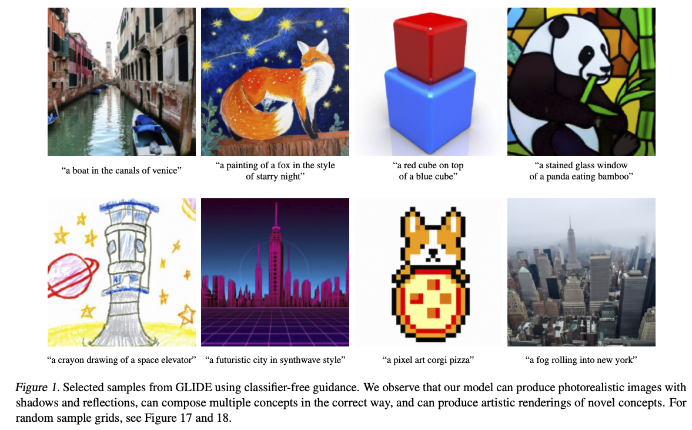
OpenAI GLIDE
Text-to-image generation using classifier-free or CLIP guidance, generate at 64x64, upsample to 256x256
A. Nichol et al. GLIDE: Towards Photorealistic Image Generation and Editing with Text-Guided Diffusion Models. ICML 2022
Notes:
Guided Language to Image Diffusion for Generation and Editing

Slide 23
OpenAI GLIDE
Text-to-image generation using classifier-free or CLIP guidance, generate at 64x64, upsample to 256x256
64x64 generator: 2.3B parameters
Upsampler: 1.5B parameters
Text encoder: 1.2B parameters
Dataset: same as for DALL-E, 250M image-text pairs from the Internet
A. Nichol et al. GLIDE: Towards Photorealistic Image Generation and Editing with Text-Guided Diffusion Models. ICML 2022
Notes:
Guided Language to Image Diffusion for Generation and Editing

Slide 24
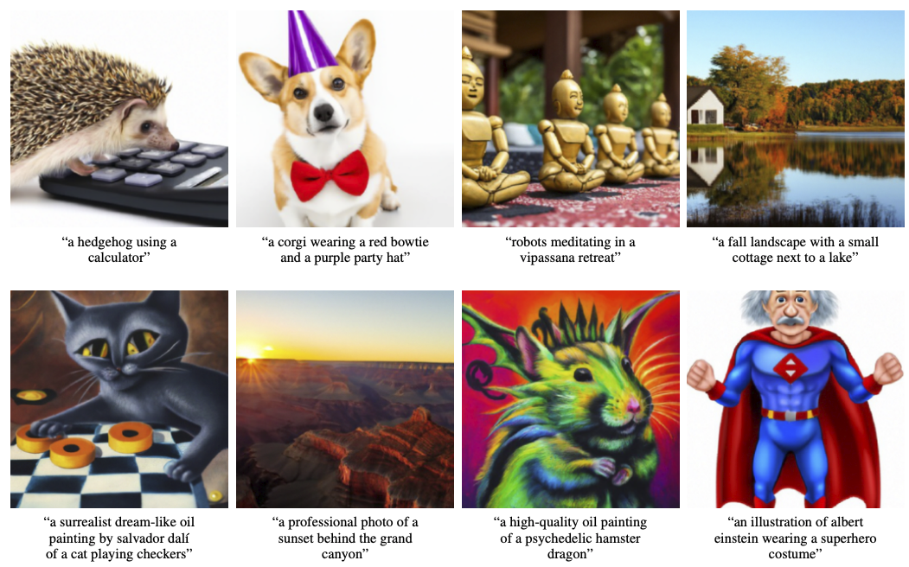
OpenAI GLIDE
A. Nichol et al. GLIDE: Towards Photorealistic Image Generation and Editing with Text-Guided Diffusion Models. ICML 2022
Notes:
Guided Language to Image Diffusion for Generation and Editing

Slide 25
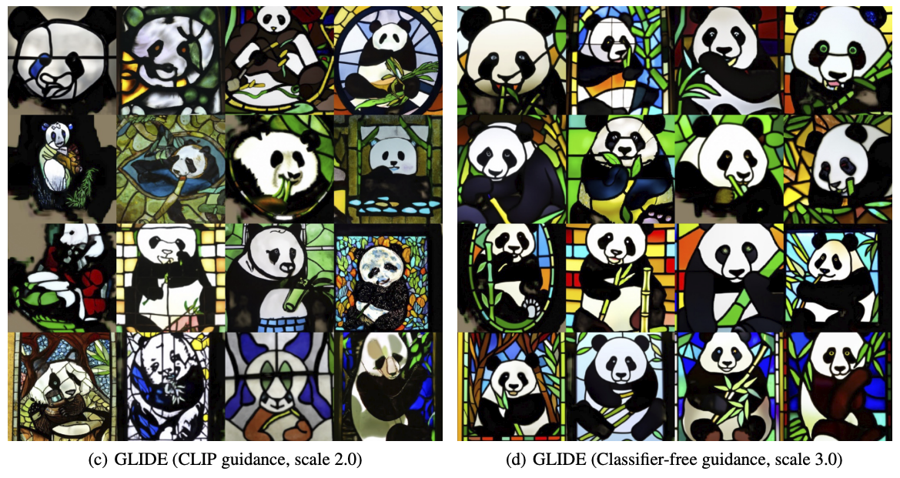
OpenAI GLIDE
A. Nichol et al. GLIDE: Towards Photorealistic Image Generation and Editing with Text-Guided Diffusion Models. ICML 2022

Slide 26
OpenAI GLIDE

Slide 27
DALL-E 2
A. Ramesh et al. Hierarchical text-conditional image generation with CLIP latents. Preprint 2022

Slide 28
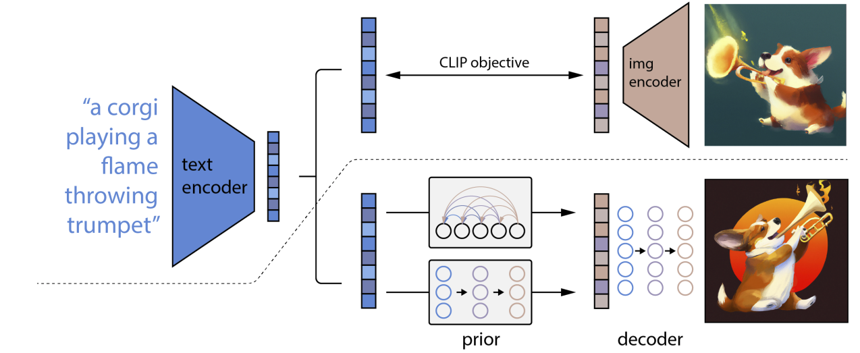
DALL-E 2

Slide 29
DALL-E 2
CLIP text encoding
CLIP image encoding
Generative model to produce CLIP image encoding given CLIP text encoding
Diffusion model (GLIDE) conditioned on CLIP image embedding and text prompt
Generate at 64x64, upsample to 256x256, then upsample to 1024x1024

Slide 30
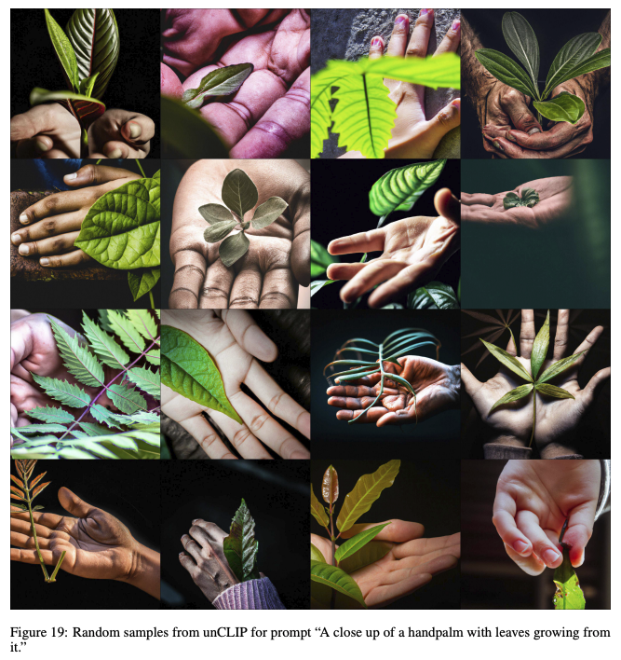
DALL-E 2: Results

Slide 31
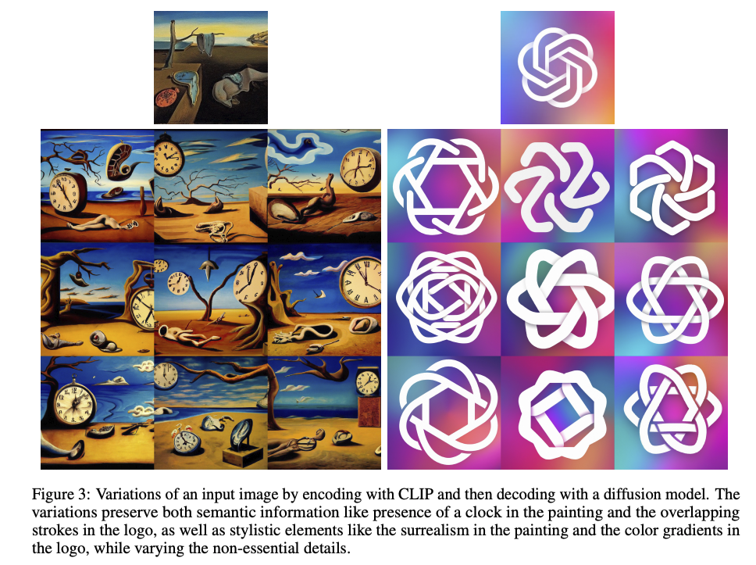
DALL-E 2: Results

Slide 32
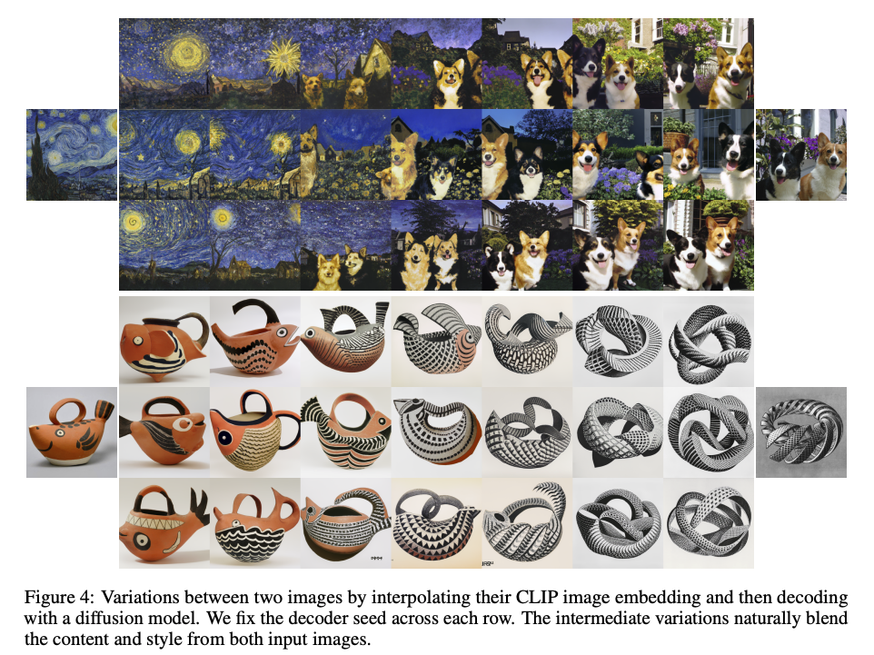
DALL-E 2: Results

Slide 33
DALL-E 2: Limitations

Slide 34
Latent diffusion model (basis of Stable Diffusion)
R. Rombach et al. High-Resolution Image Synthesis with Latent Diffusion Models. CVPR 2022

Slide 35
Latent diffusion model (basis of Stable Diffusion)
Key idea: train a separate encoder and decoder to convert images to and from a lower-dimensional latent space, run conditional diffusion model in latent space
https://medium.com/@steinsfu/stable-diffusion-clearly-explained-ed008044e07e

Slide 36
Latent diffusion model (basis of Stable Diffusion)
Key idea: train a separate encoder and decoder to convert images to and from a lower-dimensional latent space, run conditional diffusion model in latent space
https://medium.com/@steinsfu/stable-diffusion-clearly-explained-ed008044e07e

Slide 37
Latent diffusion model (basis of Stable Diffusion)
Key idea: train a separate encoder and decoder to convert images to and from a lower-dimensional latent space, run conditional diffusion model in latent space
Close-up of U-Net: Conditioning information incorporated using cross-attention
https://medium.com/@steinsfu/stable-diffusion-clearly-explained-ed008044e07e

Slide 38
Latent diffusion model (basis of Stable Diffusion)

Slide 39
Google Imagen (not public)
C. Saharia et al. Photorealistic Text-to-Image Diffusion Models with Deep Language Understanding. NeurIPS 2022

Slide 40
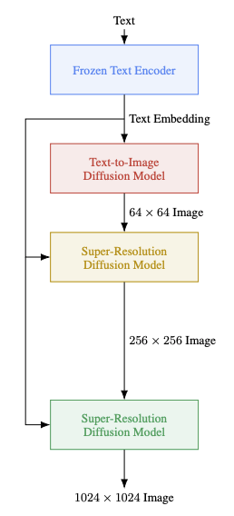
Google Imagen: Details
Text encoder is a large language model (4.6B parameters) trained on text only
Diffusion model to generate at 64x64, upsample to 256x256, then 1024x1024
Architecture: efficient U-Net (2B parameters): more parameters at lower resolutions, convolutions after downsampling and before upsampling
Classifier-free guidance with a dynamic thresholding technique, enabling good generation quality with high guidance weights
Training dataset: 460M image-text pairs (internally collected), 400M pairs from the LAION dataset
C. Saharia et al. Photorealistic Text-to-Image Diffusion Models with Deep Language Understanding. NeurIPS 2022

Slide 41
Google Imagen: Evaluation
Impact of model size, implementation choices
Curves are obtained by varying guidance weight
FID evaluated on COCO dataset by sampling prompts and generating images using the same prompts

Slide 42
Google Imagen: Evaluation
Human evaluation on DrawBench (set of 200 prompts)

Slide 43
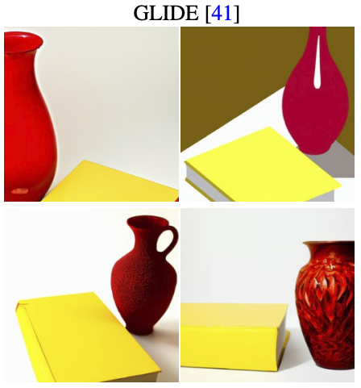
Imagen vs. DALL-E 2 vs. GLIDE
“A yellow book and a red vase”

Slide 44
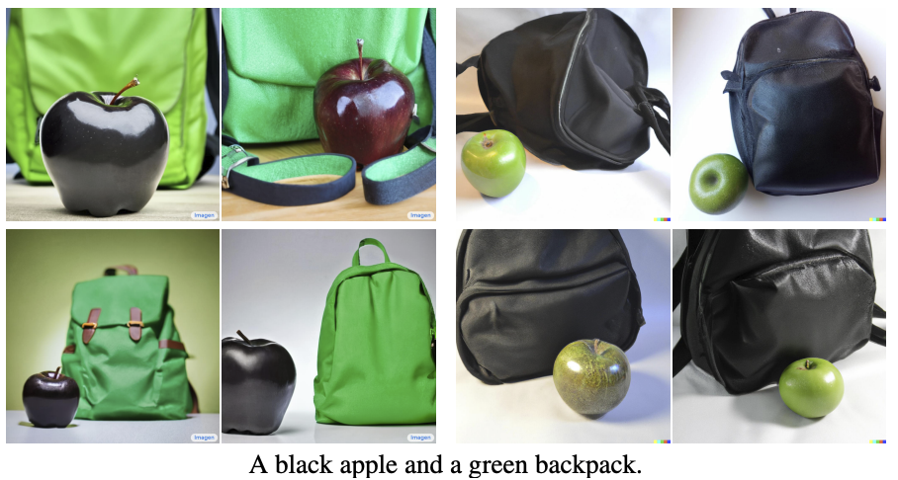
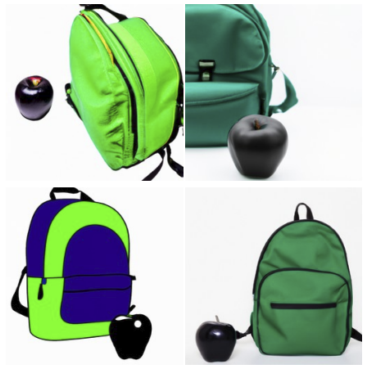
Imagen vs. DALL-E 2 vs. GLIDE
“A black apple and a green backpack”
“We observe that GLIDE is better than DALL-E 2 in assigning the colors to the objects.”

Slide 45
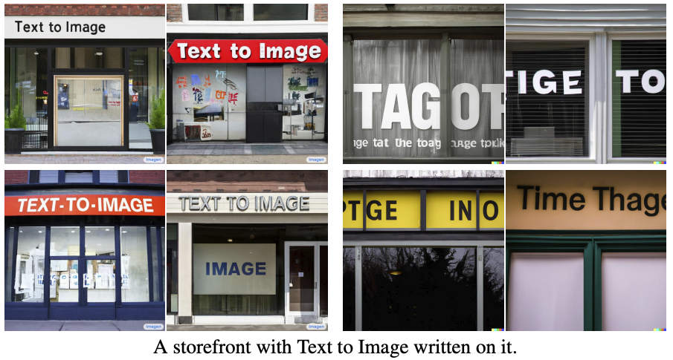
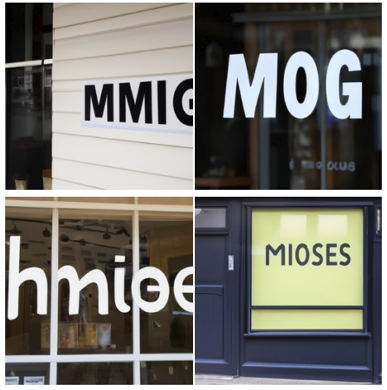
Imagen vs. DALL-E 2 vs. GLIDE
“A storefront with Text to Image written on it”

Slide 46
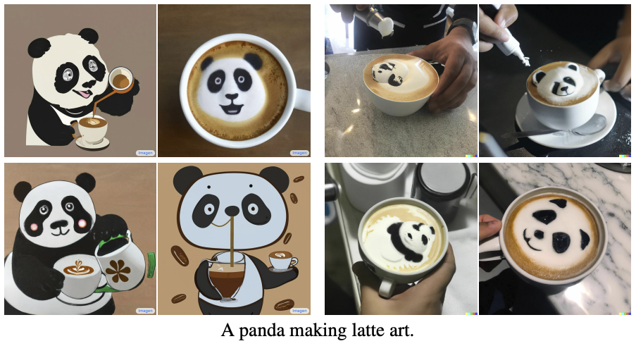
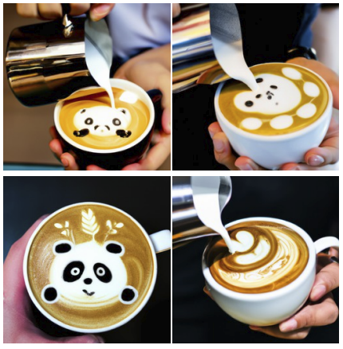
Imagen vs. DALL-E 2 vs. GLIDE
“A panda making latte art”

Slide 47
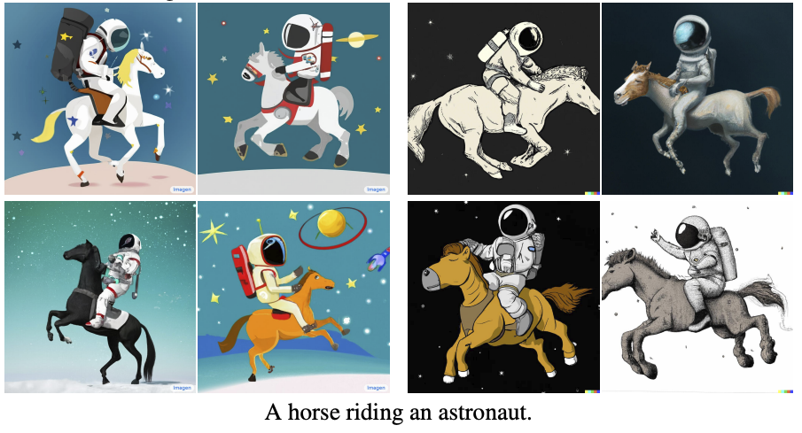
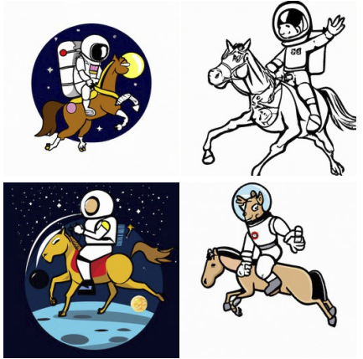
Imagen vs. DALL-E 2 vs. GLIDE
“A horse riding an astronaut”

Slide 48
Outline
Denoising diffusion probabilistic models (DDPMs)
Conditional diffusion models
Large-scale models
Controlling and fine-tuning image generation

Slide 49
Customizing DMs: Textual inversion
R. Gal et al. An Image is Worth One Word: Personalizing Text-to-Image Generation using Textual Inversion. ICLR 2023

Slide 50
Customizing DMs: Textual inversion
R. Gal et al. An Image is Worth One Word: Personalizing Text-to-Image Generation using Textual Inversion. ICLR 2023

Slide 51
Textual inversion: Results

Slide 52
Textual inversion: Results

Slide 53
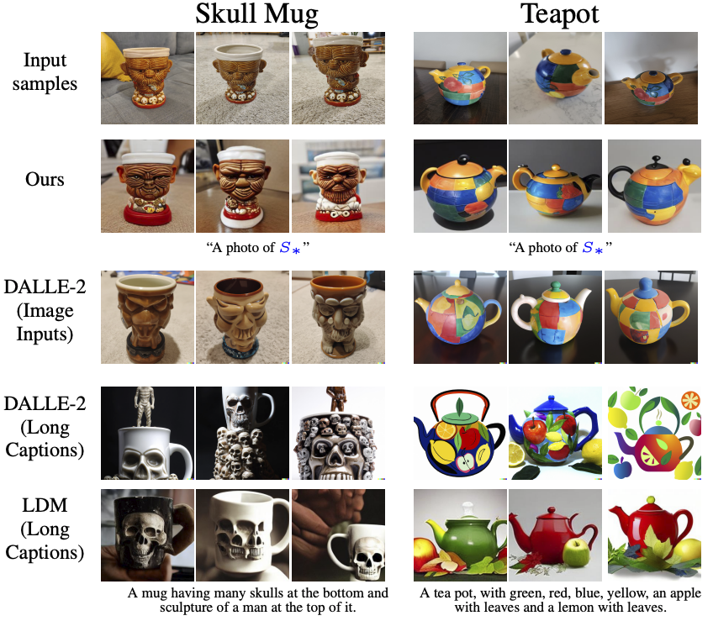
Textual inversion: Comparisons

Slide 54
Customizing DMs: DreamBooth
N. Ruiz et al. DreamBooth: Fine Tuning Text-to-Image Diffusion Models for Subject-Driven Generation. arXiv 2022

Slide 55
Customizing DMs: DreamBooth
Prompt: "retro style yellow alarm clock with a white clock face and a yellow number three on the right part of the clock face in the jungle"
N. Ruiz et al. DreamBooth: Fine Tuning Text-to-Image Diffusion Models for Subject-Driven Generation. arXiv 2022

Slide 56
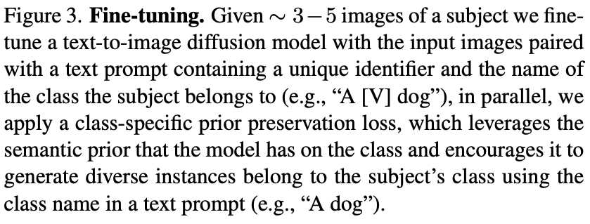
Customizing DMs: DreamBooth
N. Ruiz et al. DreamBooth: Fine Tuning Text-to-Image Diffusion Models for Subject-Driven Generation. arXiv 2022

Slide 57
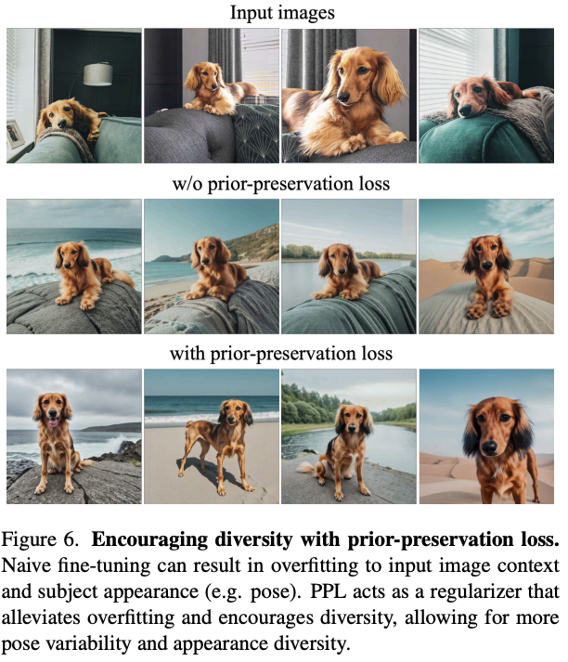
Customizing DMs: DreamBooth
N. Ruiz et al. DreamBooth: Fine Tuning Text-to-Image Diffusion Models for Subject-Driven Generation. arXiv 2022

Slide 58
DreamBooth: Results

Slide 59
DreamBooth: Results
“a [painting/sculpture] of a [V] [class noun] in the style of [famous artist]”
“a cross of a [V] dog and a [target species]”

Slide 60
DreamBooth: Comparison with textual inversion
“a [V] vase in the snow”
“a [V] vase on the beach”
“a [V] vase in the jungle”
“a [V] vase with Eiffel Tower in the background

Slide 61
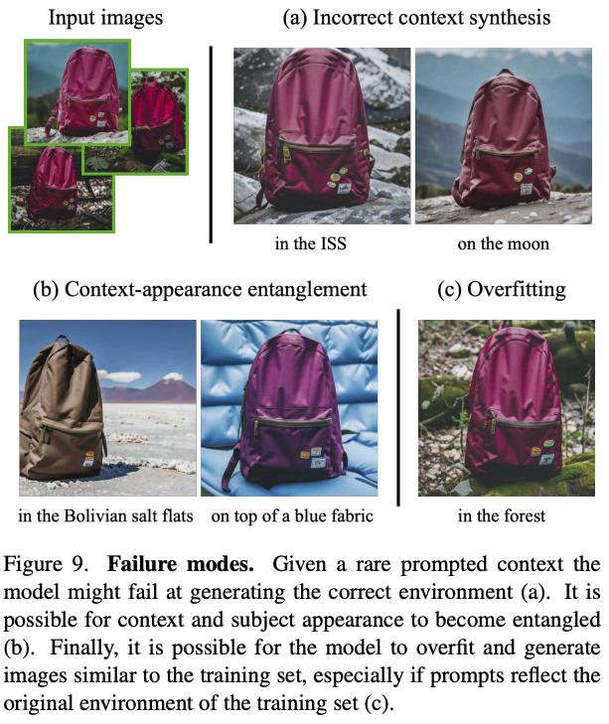
DreamBooth: Limitations

Slide 62
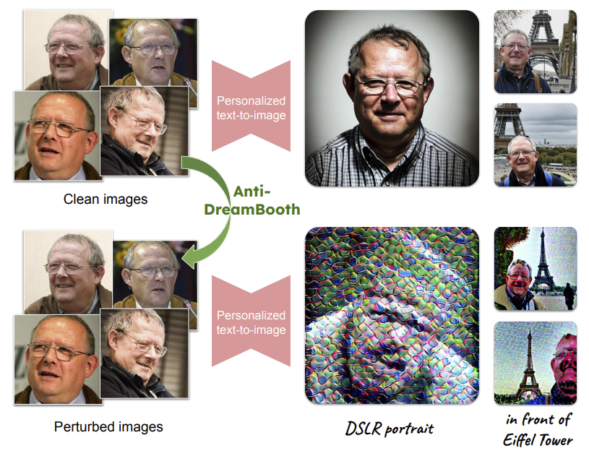
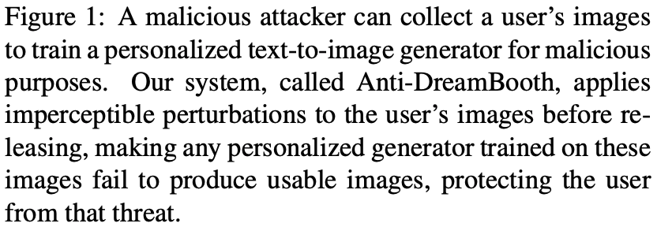
Anti-DreamBooth
T. V. Le et al. Anti-DreamBooth: Protecting users from personalized text-to-image synthesis. arXiv 2023

Slide 63
Prompt-to-Prompt Image Editing
A. Hertz et al. Prompt-to-Prompt Image Editing with Cross Attention Control. arXiv 2022

Slide 64
Prompt-to-Prompt Image Editing

Slide 65
Prompt-to-Prompt Image Editing

Slide 66
InstructPix2Pix
T. Brooks, A. Holynski, and A. Efros. InstructPix2Pix: Learning to Follow Image Editing Instructions. CVPR 2023

Slide 67
InstructPix2Pix
T. Brooks, A. Holynski, and A. Efros. InstructPix2Pix: Learning to Follow Image Editing Instructions. CVPR 2023

Slide 68
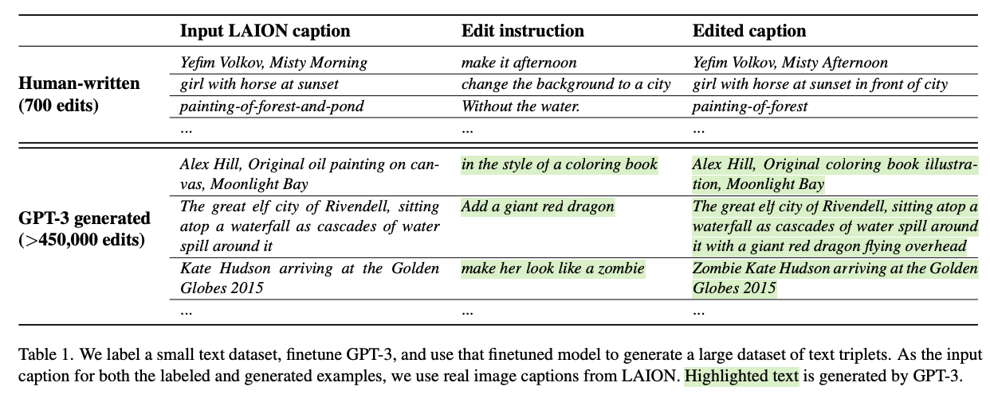
InstructPix2Pix
Fine-tuning GPT-3:

Slide 69
InstructPix2Pix
Generating input-output image pairs:

Slide 70
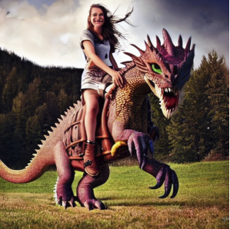
InstructPix2Pix
Fine-tuning a DM for image-to-image translation:
Input image (conditioning)
Noisy output image
Noise estimate
“Have her ride a dragon”
Time t

Slide 71
InstructPix2Pix: Results

Slide 72
InstructPix2Pix: Results

Slide 73
InstructPix2Pix: Results

Slide 74
InstructPix2Pix: Failure cases

Slide 75
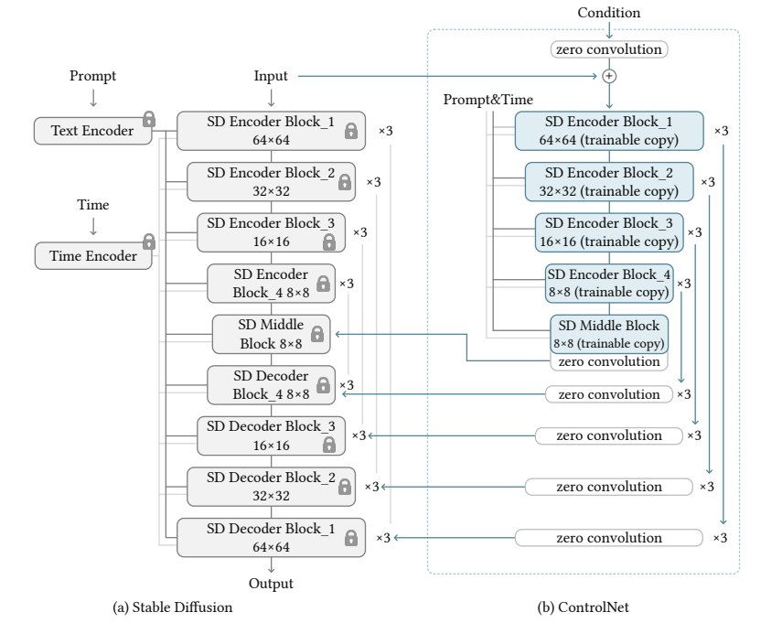
ControlNet
Add a trainable “wrapper” around a pre-trained DM to fine-tune it for pix2pix tasks
L. Zhang and M. Agrawala. Adding Conditional Control to Text-to-Image Diffusion Models. arXiv 2023

Slide 76
ControlNet
L. Zhang and M. Agrawala. Adding Conditional Control to Text-to-Image Diffusion Models. arXiv 2023

Slide 77
ControlNet
L. Zhang and M. Agrawala. Adding Conditional Control to Text-to-Image Diffusion Models. arXiv 2023

Slide 78
ControlNet
L. Zhang and M. Agrawala. Adding Conditional Control to Text-to-Image Diffusion Models. arXiv 2023

Slide 79
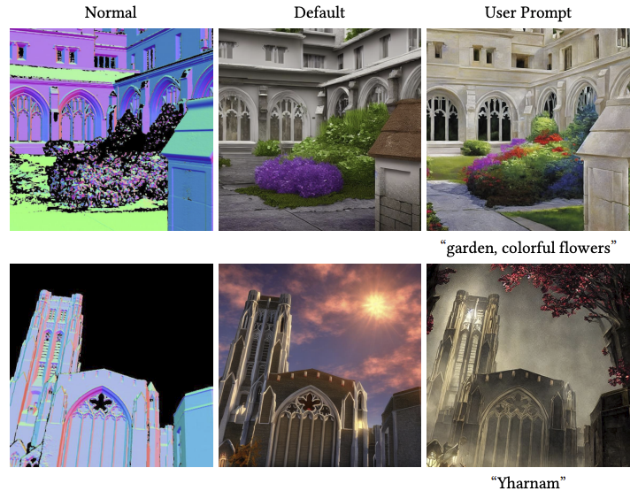
ControlNet
L. Zhang and M. Agrawala. Adding Conditional Control to Text-to-Image Diffusion Models. arXiv 2023

Slide 80
Connecting 2D to 3D: DreamFusion
B. Poole, A. Jain, J. Barron, B. Mildenhall. DreamFusion: Text-to-3D using 2D Diffusion. arXiv 2022

Slide 81
Connecting 2D to 3D: DreamFusion
B. Poole, A. Jain, J. Barron, B. Mildenhall. DreamFusion: Text-to-3D using 2D Diffusion. arXiv 2022
Notes:
DreamFusion generates 3D objects from a natural language caption such as “a DSLR photo of a peacock on a surfboard.” The scene is represented by a Neural Radiance Field that is randomly initialized and trained from scratch for each caption. Our NeRF parameterizes volumetric density and albedo (color) with an MLP. We render the NeRF from a random camera, using normals computed from gradients of the density to shade the scene with a random lighting direction. Shading reveals geometric details that are ambiguous from a single viewpoint. To compute parameter updates, DreamFusion diffuses the rendering and reconstructs it with a (frozen) conditional Imagen model to predict the injected noise εˆφ(zt|y; t). This contains structure that should improve fidelity, but is high variance. Subtracting the injected noise produces a low variance update direction stopgrad[εˆφ − ε] that is backpropagated through the rendering process to update the NeRF MLP parameters.

Slide 82
Outline
Denoising diffusion probabilistic models (DDPMs)
Conditional diffusion models
Large-scale models
Controlling and fine-tuning image generation
Societal, ethical, and legal issues

Slide 83
Societal, ethical, and legal issues
Closed or open?
Safe or unsafe?
Potential for generating DeepFakes and misinformation
Dataset image rights
Artists’ rights
The nature of creativity

Slide 84
In the news
https://www.theverge.com/2023/1/17/23558516/ai-art-copyright-stable-diffusion-getty-images-lawsuit

Slide 85
In the news
https://www.newyorker.com/culture/infinite-scroll/is-ai-art-stealing-from-artists

Slide 86
In the news
https://www.bbc.com/news/world-us-canada-65069316

Slide 87
In the news
https://petapixel.com/2023/04/03/midjourney-bans-ai-images-of-chinese-president-xi-jinping/

