Slide 1
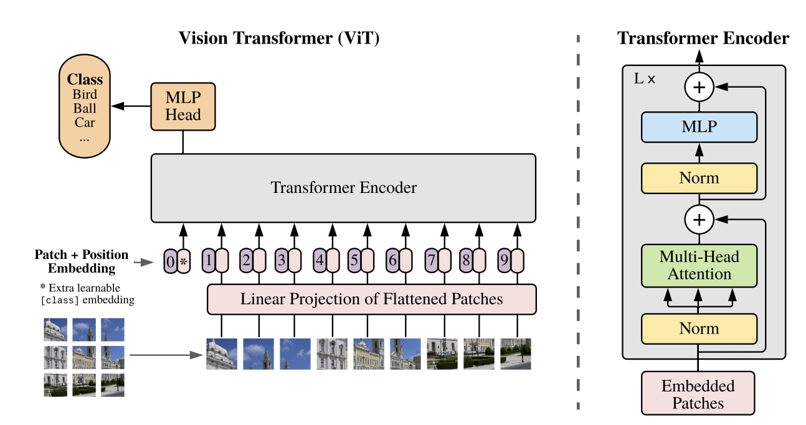
Transformers for image modeling

Slide 2
Transformers for image modeling: Outline
Architectures
Self-supervised learning
Autoregressive text-to-image generation
Trends

Slide 3
Vision-and-language BERT
image regions and features from detector output
vision-language co-attention
predict object class of masked out region
predict whether image and sentence go together
J. Lu, D. Batra, D. Parikh, S. Lee, ViLBERT: Pretraining Task-Agnostic Visiolinguistic Representations for Vision-and-Language Tasks, NeurIPS 2019

Slide 4
Detection Transformer (DETR) – Facebook AI
Hybrid of CNN and transformer, aimed at standard recognition task
N. Carion et al., End-to-end object detection with transformers, ECCV 2020
Notes:
DETR uses a conventional CNN backbone to learn a 2D representation of an input image. The model flattens it and supplements it with a positional encoding before passing it into a transformer encoder. A transformer decoder then takes as input a small fixed number of learned positional embeddings, which we call object queries, and additionally attends to the encoder output. We pass each output embedding of the decoder to a shared feed forward network (FFN) that predicts either a detection (class and bounding box) or a “no object” class.

Slide 5
Image transformer – Google
Image generation and super-resolution with 32x32 output, attention restricted to local neighborhoods
N. Parmar et al., Image transformer, ICML 2018
Notes:
Abstract: In this work, we generalize a recently proposed model architecture based on self-attention, the Transformer, to a sequence modeling formulation of image generation with a tractable likelihood. By restricting the selfattention mechanism to attend to local neighborhoods we significantly increase the size of images the model can process in practice, despite maintaining significantly larger receptive fields per layer than typical convolutional neural networks. While conceptually simple, our generative models significantly outperform the current state of the art in image generation on ImageNet, improving the best published negative log-likelihood on ImageNet from 3.83 to 3.77.

Slide 6
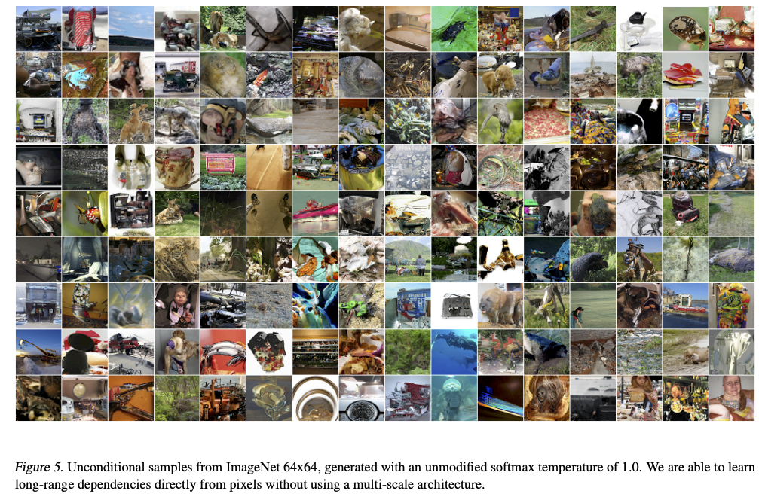
Sparse transformers – OpenAI
R. Child et al., Generating Long Sequences with Sparse Transformers, arXiv 2019

Slide 7
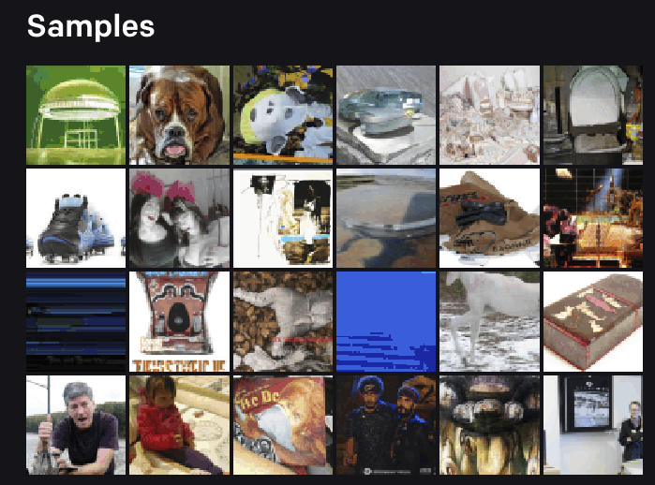
Image GPT – OpenAI
https://openai.com/blog/image-gpt/
M. Chen et al., Generative pretraining from pixels, ICML 2020
Notes:
Abstract: We train a sequence Transformer to auto-regressively predict pixels, without incorporating knowledge of the 2D input structure. Despite training on low-resolution ImageNet without labels, we find that a GPT-2 scale model learns strong image representations as measured by linear probing, fine-tuning, and low-data classification. On CIFAR-10, we achieve 96.3% accuracy with a linear probe, outperforming a supervised Wide ResNet, and 99.0% accuracy with full finetuning, matching the top supervised pre-trained models. An even larger model trained on a mixture of ImageNet and web images is competitive with self-supervised benchmarks on ImageNet, achieving 72.0% top-1 accuracy on a linear probe of our features.

Slide 8
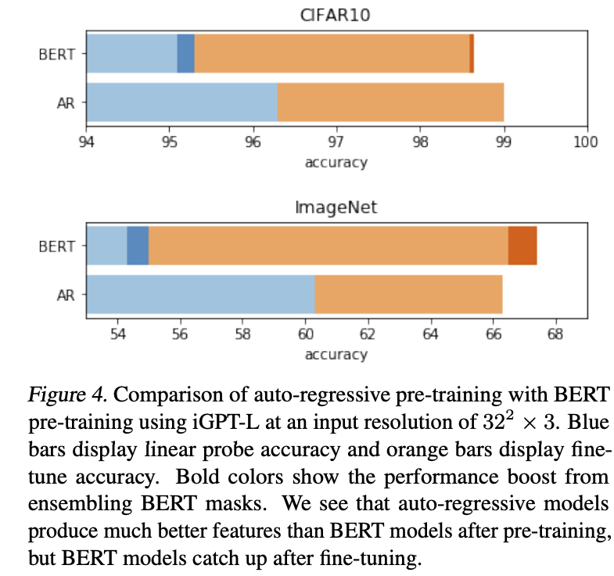
Image GPT
Image resolution up to 64x64, color values quantized to 512 levels (9 bits), dense attention
For transfer learning, average-pool encoded features across all positions
M. Chen et al., Generative pretraining from pixels, ICML 2020

Slide 9
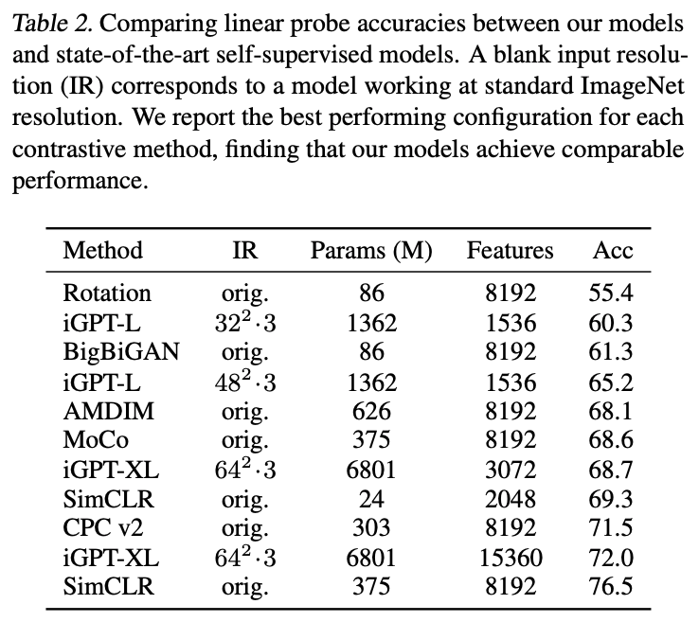
Image GPT
M. Chen et al., Generative pretraining from pixels, ICML 2020

Slide 10
Vision transformer (ViT) – Google
Split an image into patches, feed linearly projected patches into standard transformer encoder
With patches of 14x14 pixels, you need 16x16=256 patches to represent 224x224 images
A. Dosovitskiy et al. An image is worth 16x16 words: Transformers for image recognition at scale. ICLR 2021
Notes:
Abstract: While the Transformer architecture has become the de-facto standard for natural language processing tasks, its applications to computer vision remain limited. In vision, attention is either applied in conjunction with convolutional networks, or used to replace certain components of convolutional networks while keeping their overall structure in place. We show that this reliance on CNNs is not necessary and a pure transformer applied directly to sequences of image patches can perform very well on image classification tasks. When pre-trained on large amounts of data and transferred to multiple mid-sized or small image recognition benchmarks (ImageNet, CIFAR-100, VTAB, etc.), Vision Transformer (ViT) attains excellent results compared to state-of-the-art convolutional networks while requiring substantially fewer computational resources to train

Slide 11
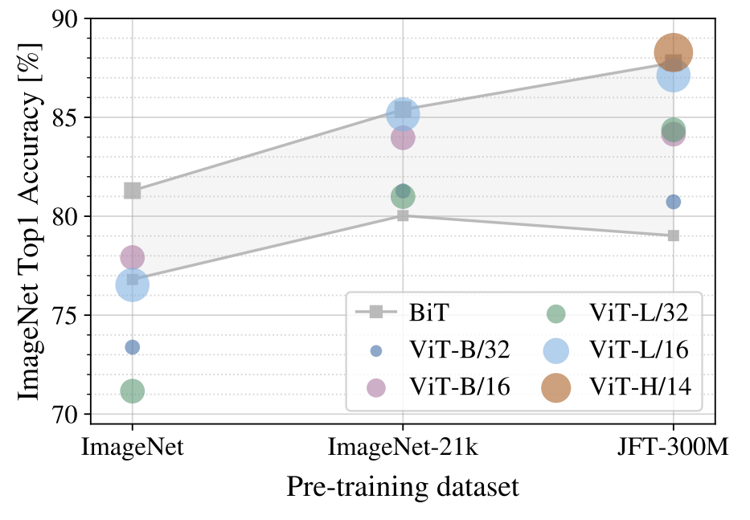
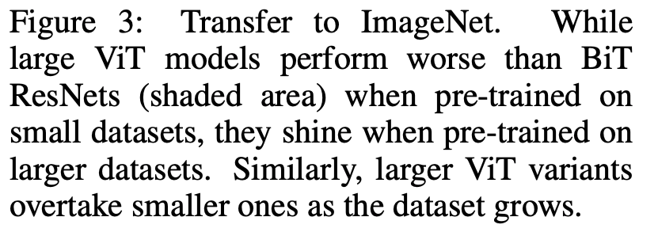
Vision transformer (ViT)
Trained in a supervised fashion, fine-tuned on ImageNet
BiT: Big Transfer (ResNet)
ViT: Vision Transformer (Base/Large/Huge, patch size of 14x14, 16x16, or 32x32)
Internal Google dataset (not public)
A. Dosovitskiy et al. An image is worth 16x16 words: Transformers for image recognition at scale. ICLR 2021
Notes:
Patches of size 14x14 = 16x16 patches to represent 224x224 images (sequence length = 256)

Slide 12
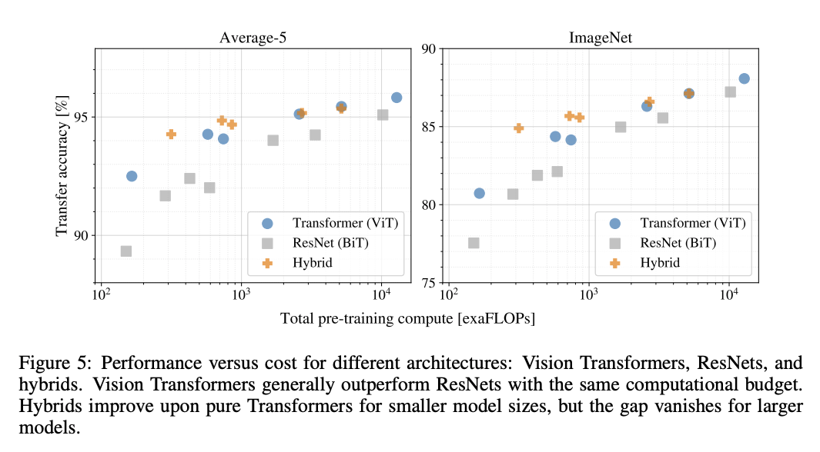
Vision transformer (ViT)
Transformers are claimed to be more computationally efficient than CNNs or hybrid architectures
A. Dosovitskiy et al. An image is worth 16x16 words: Transformers for image recognition at scale. ICLR 2021
Notes:
Abstract: While the Transformer architecture has become the de-facto standard for natural language processing tasks, its applications to computer vision remain limited. In vision, attention is either applied in conjunction with convolutional networks, or used to replace certain components of convolutional networks while keeping their overall structure in place. We show that this reliance on CNNs is not necessary and a pure transformer applied directly to sequences of image patches can perform very well on image classification tasks. When pre-trained on large amounts of data and transferred to multiple mid-sized or small image recognition benchmarks (ImageNet, CIFAR-100, VTAB, etc.), Vision Transformer (ViT) attains excellent results compared to state-of-the-art convolutional networks while requiring substantially fewer computational resources to train

Slide 13
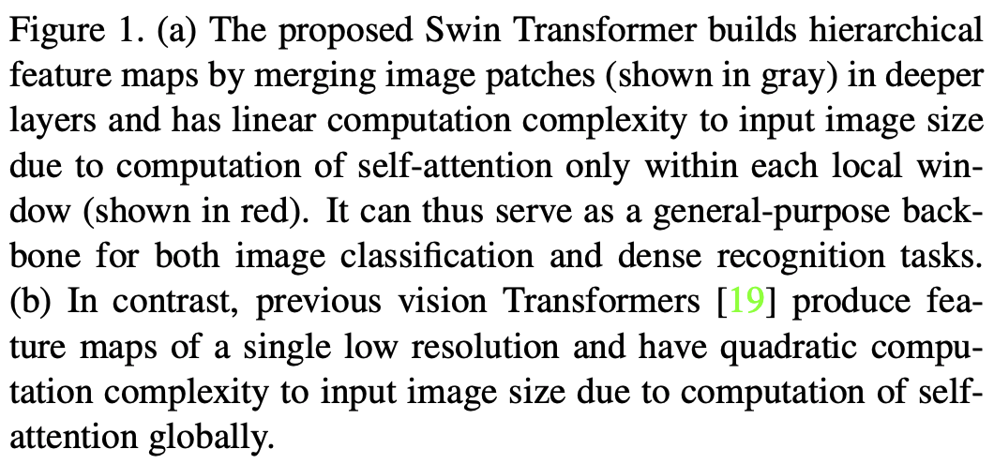
Hierarchical transformer: Swin
Z. Liu et al. Swin Transformer: Hierarchical Vision Transformer using Shifted Windows. ICCV 2021

Slide 14
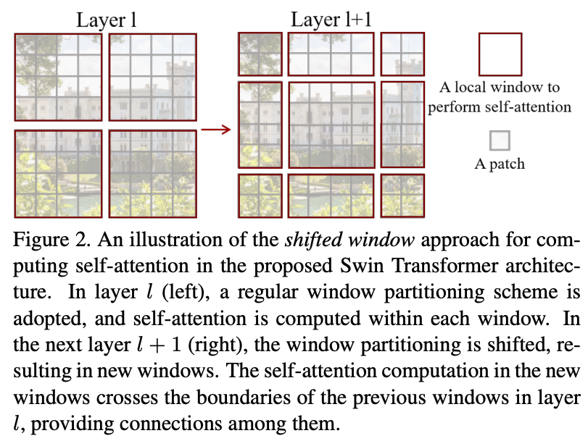
Hierarchical transformer: Swin
Z. Liu et al. Swin Transformer: Hierarchical Vision Transformer using Shifted Windows. ICCV 2021

Slide 15
Hierarchical transformer: Swin
Z. Liu et al. Swin Transformer: Hierarchical Vision Transformer using Shifted Windows. ICCV 2021

Slide 16
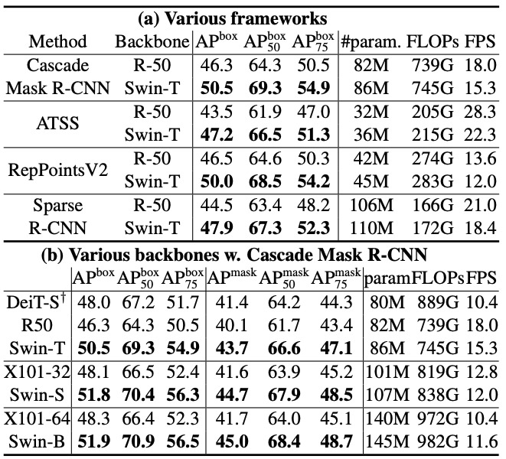
Swin results
COCO detection and segmentation

Slide 17
Beyond transformers?
I. Tolstikhin et al. MLP-Mixer: An all-MLP Architecture for Vision. NeurIPS 2021

Slide 18
Hybrid of CNNs and transformers?
T. Xiao et al. Early convolutions help transformers see better. NeurIPS 2021
Notes:
Abstract: Vision transformer (ViT) models exhibit substandard optimizability. In particular, they are sensitive to the choice of optimizer (AdamW vs. SGD), optimizer hyperparameters, and training schedule length. In comparison, modern convolutional neural networks are easier to optimize. Why is this the case? In this work, we conjecture that the issue lies with the patchify stem of ViT models, which is implemented by a stride-p p×p convolution (p = 16 by default) applied to the input image. This large-kernel plus large-stride convolution runs counter to typical design choices of convolutional layers in neural networks. To test whether this atypical design choice causes an issue, we analyze the optimization behavior of ViT models with their original patchify stem versus a simple counterpart where we replace the ViT stem by a small number of stacked stride-two 3×3 convolutions. While the vast majority of computation in the two ViT designs is identical, we find that this small change in early visual processing results in markedly different training behavior in terms of the sensitivity to optimization settings as well as the final model accuracy. Using a convolutional stem in ViT dramatically increases optimization stability and also improves peak performance (by ∼1-2% top-1 accuracy on ImageNet-1k), while maintaining flops and runtime. The improvement can be observed across the wide spectrum of model complexities (from 1G to 36G flops) and dataset scales (from ImageNet-1k to ImageNet-21k). These findings lead us to recommend using a standard, lightweight convolutional stem for ViT models in this regime as a more robust architectural choice compared to the original ViT model design.

Slide 19
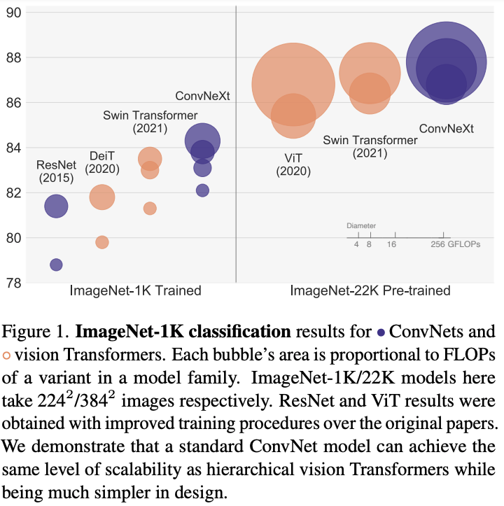
Or completely back to CNNs?
Z. Liu et al. A ConvNet for the 2020s. CVPR 2022

Slide 20
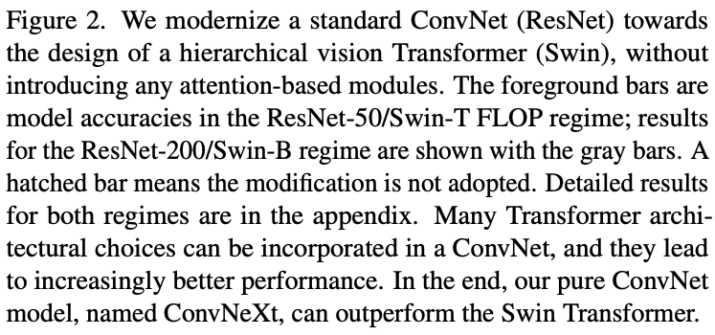
Back to CNNs?
Z. Liu et al. A ConvNet for the 2020s. CVPR 2022

Slide 21
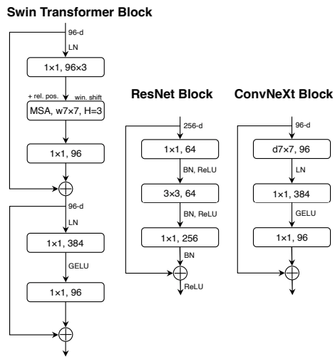
Back to CNNs?
Z. Liu et al. A ConvNet for the 2020s. CVPR 2022

Slide 22
Outline
Architectures
Self-supervised learning

Slide 23
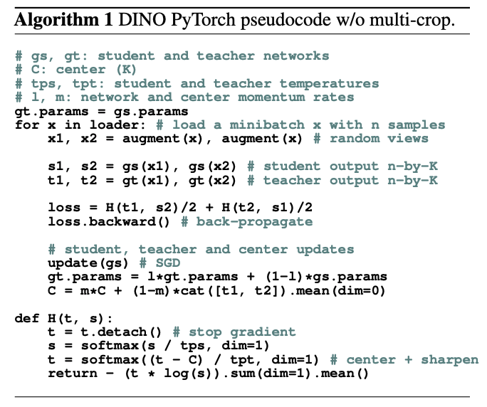
DINO: Self-distillation with no labels
M. Caron et al. Emerging Properties in Self-Supervised Vision Transformers. ICCV 2021

Slide 24
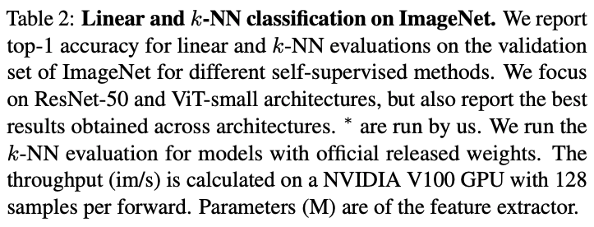
DINO
M. Caron et al. Emerging Properties in Self-Supervised Vision Transformers. ICCV 2021

Slide 25
DINO
M. Caron et al. Emerging Properties in Self-Supervised Vision Transformers. ICCV 2021

Slide 26
Masked autoencoders
K. He et al. Masked autoencoders are scalable vision learners. CVPR 2022

Slide 27
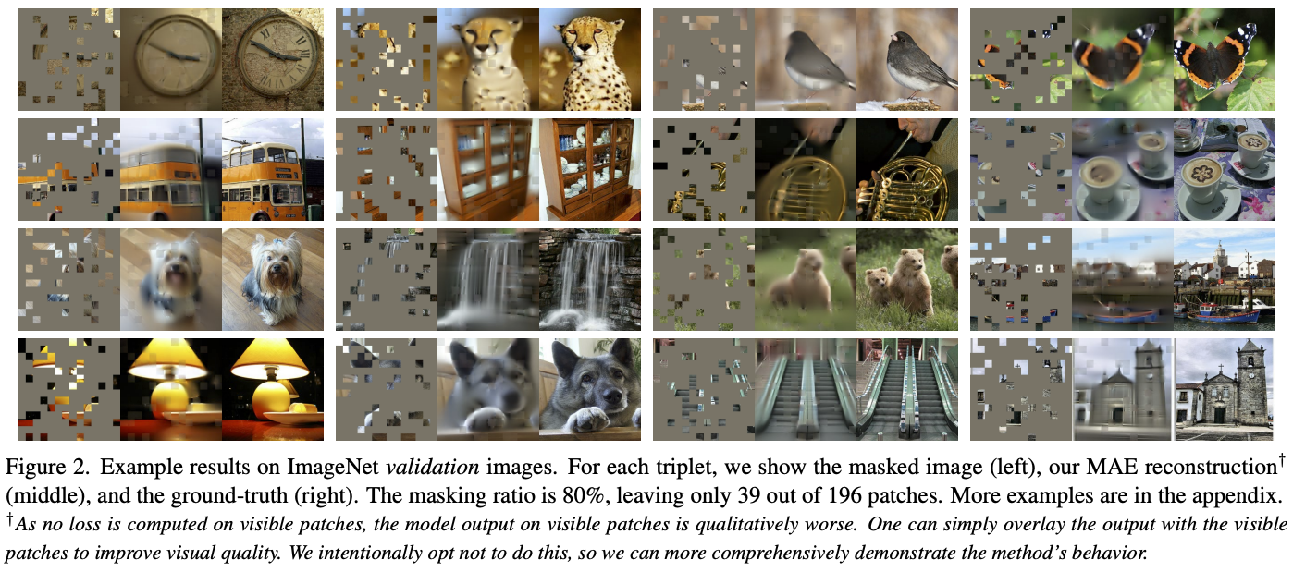
Masked autoencoders
K. He et al. Masked autoencoders are scalable vision learners. CVPR 2022

Slide 28
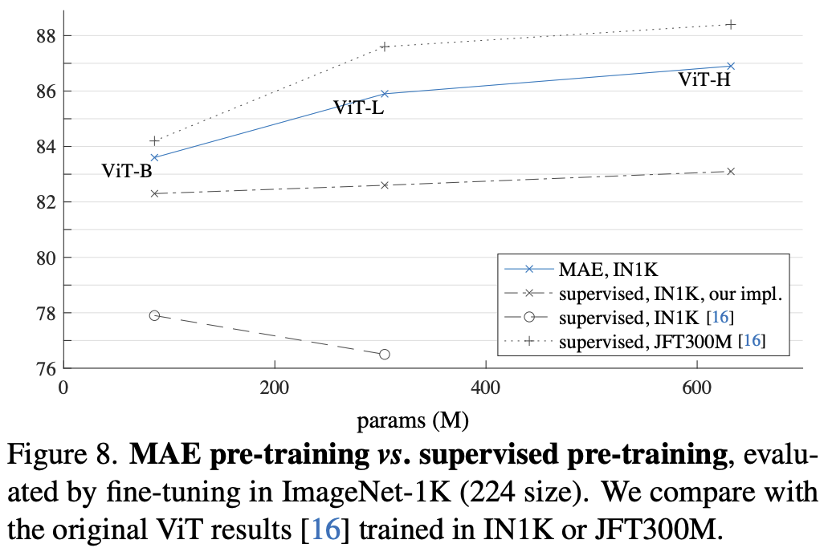
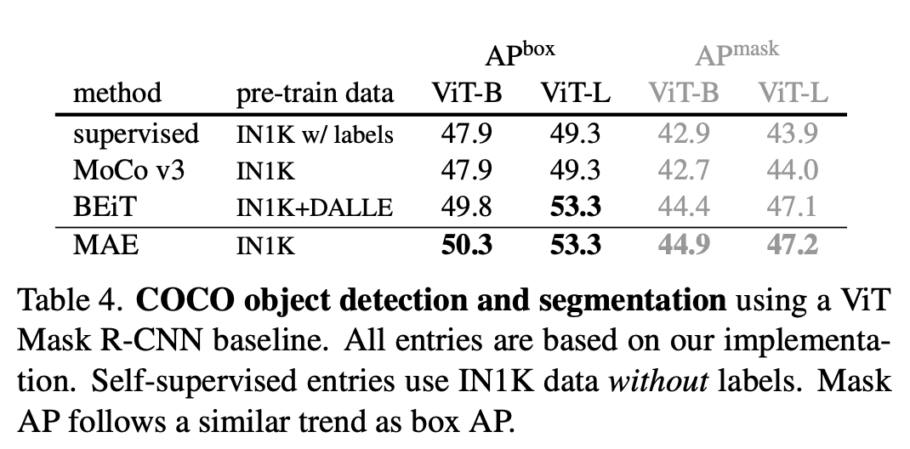
Masked autoencoders: Results
K. He et al. Masked autoencoders are scalable vision learners. CVPR 2022

Slide 29
Application: Visual prompting
A. Bar et al. Visual prompting via image inpainting. NeurIPS 2022

Slide 30
Application: Visual prompting

Slide 31
Application: Visual prompting

Slide 32
Application: Visual prompting

Slide 33
Outline
Architectures
Self-supervised learning
Autoregressive text-to-image generation

Slide 34
DALL-E
Learn a joint sequential transformer model that can be used to generate image based on text prompt
A. Ramesh et al., Zero-Shot Text-to-Image Generation, arXiv 2021
https://openai.com/blog/dall-e/

Slide 35
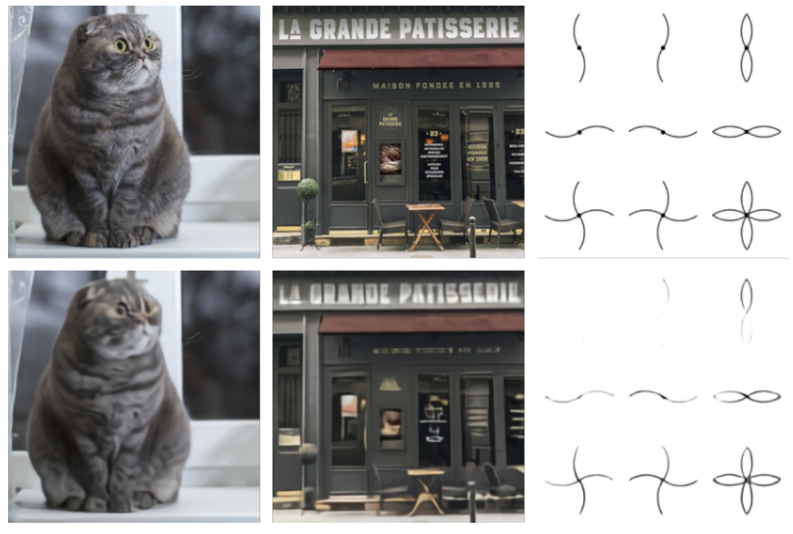
DALL-E: Image encoding
Train convolutional encoder and decoder to compress images to 32x32 grids of discrete tokens (each assuming 8192 values)

Slide 36
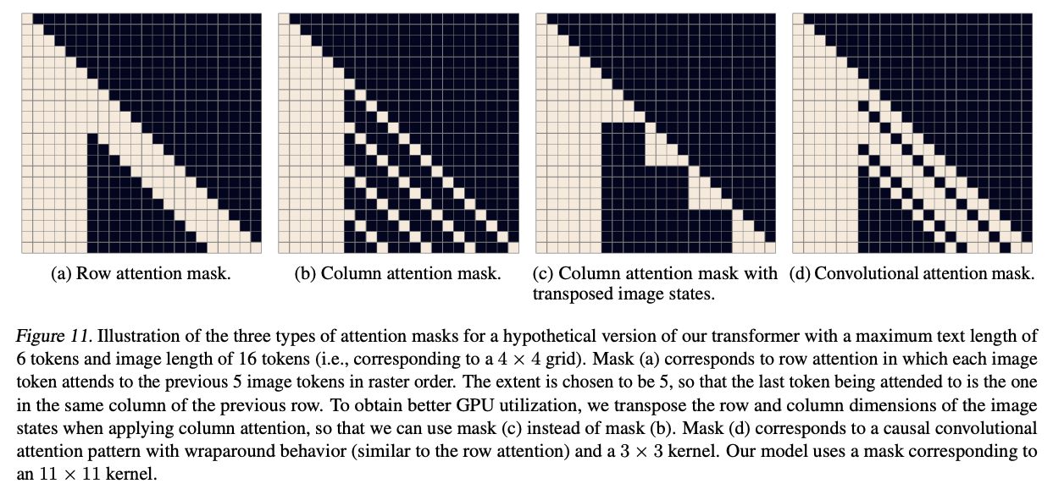
DALL-E: Transformer architecture and training
Concatenate up to 256 text tokens with 32x32=1024 image tokens, learn a transformer model with 64 layers and 12B parameters
Dataset: 250M image-text pairs from the Internet
Transformer model details
Decoder-only architecture
64 self-attention layers,
62 attention heads, sparse attention patterns
Mixed-precision training, distributed optimization

Slide 37
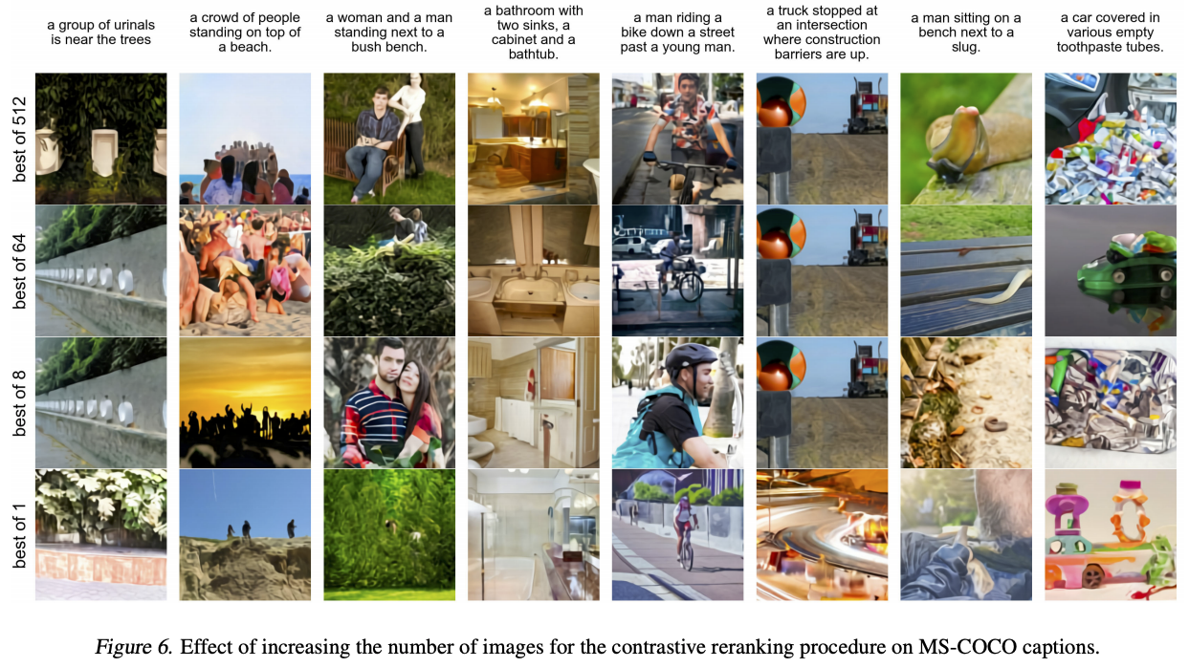
DALL-E: Generating images given text
Output samples reranked using CLIP

Slide 38
PARTI: Pathways auto-regressive text-to-image
J. Yu et al. Scaling Autoregressive Models for Content-Rich Text-to-Image Generation. arXiv 2022

Slide 39
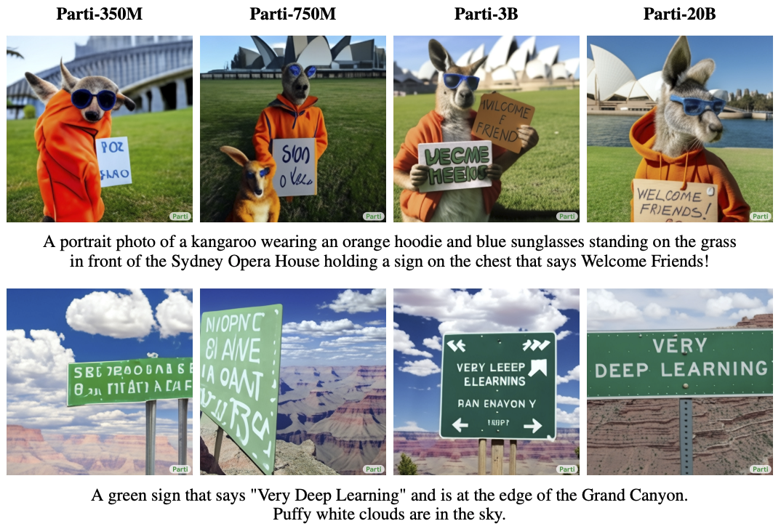
PARTI

Slide 40
PARTI

Slide 41
PARTI

Slide 42
PARTI

Slide 43
PARTI

Slide 44
Outline
Architectures
Self-supervised learning
Autoregressive text-to-image generation
Trends

Slide 45
Trends
Unification of tasks, datasets, modalities: “foundation models”
Availability of increasingly powerful and reliable high-level primitives

Slide 46
DINOv2
M. Oquab et al. DINOv2: Learning Robust Visual Features without Supervision. arXiv 2023

Slide 47
DINOv2
M. Oquab et al. DINOv2: Learning Robust Visual Features without Supervision. arXiv 2023

Slide 48
Segment Anything Model
Kirillov et al. Segment Anything. arXiv 2023
https://segment-anything.com/

Slide 49
Visual Programming
T. Gupta and A. Kembhavi. Visual Programming: Compositional visual reasoning without training. CVPR 2023

Slide 50
Visual Programming
Modules supported in VisProg

Slide 51
Visual Programming
Image editing with natural language

Slide 52
Visual Programming
Reasoning about image pairs

Slide 53
Visual Programming
Example results

Slide 54
ViperGPT
S. Menon et al. ViperGPT: Visual Inference via Python Execution for Reasoning. arXiv 2023

Slide 55
ViperGPT

Slide 56
So, where does this leave us?

Slide 57
Computer vision before deep learning
Computer vision now
Computer vision academics?

