Slide 1
Linear classifiers: Outline
Examples of classification models: nearest neighbor, linear
Empirical loss minimization framework
Linear classification models
Linear regression
Logistic regression
Perceptron loss
SVM loss
General recipe: Data loss, regularization
Multi-class classification
Multi-class perceptron
Multi-class SVM
Softmax

Slide 2
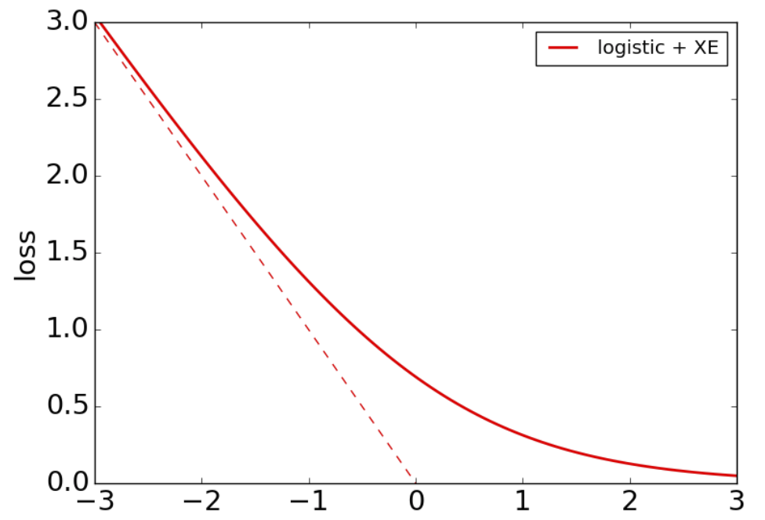
Recall: The shape of logistic loss
$$l\left(w,x_{i}, y_{i}\right)=−\log{σ\left(y_{i}w^{T}x_{i}\right)}$$
Approaches $−y_{i}w^{T}x_{i}$
Approaches 0
$$y_{i}w^{T}x_{i}$$
Figure source

Slide 3
Perceptron
Let’s define the perceptron hinge loss:
$$l\left(w,x_{i}, y_{i}\right)=max\left(0,{−y}_{i}w^{T}x_{i}\right)$$
Perceptron hinge loss
Incorrectly classified
Correctly classified
$$y_{i}w^{T}x_{i}$$

Slide 4
Perceptron
Let’s define the perceptron hinge loss:
$$l\left(w,x_{i}, y_{i}\right)=max\left(0,{−y}_{i}w^{T}x_{i}\right)$$
Training: find $w$ that minimizes
$$\hat{L}\left(w\right)=\frac{1}{n}\sum_{i=1}^{n}{l\left(w,x_{i}, y_{i}\right)}=\frac{1}{n}\sum_{i=1}^{n}{max\left(0,{−y}_{i}w^{T}x_{i}\right)}$$
Once again, there is no closed-form solution, so let’s go straight to SGD

Slide 5
Deriving the perceptron update
Let’s differentiate the perceptron hinge loss:
$$l\left(w,x_{i}, y_{i}\right)=max\left(0,{−y}_{i}w^{T}x_{i}\right)$$
(Strictly speaking, this loss is not differentiable, so we need to find a sub-gradient)
Incorrectly classified
Correctly classified
$$y_{i}w^{T}x_{i}$$

Slide 6
Deriving the perceptron update
Let’s differentiate the perceptron hinge loss:
$$l\left(w,x_{i}, y_{i}\right)=max\left(0,{−y}_{i}w^{T}x_{i}\right)$$
$$∇l\left(w,x_{i}, y_{i}\right)=−𝕀[y_{i}w^{T}x_{i}<0]y_{i}x_{i}$$
$\frac{d}{da}\max\left(0,a\right)=𝕀[a>0]$
Incorrectly classified
Correctly classified
$$y_{i}w^{T}x_{i}$$

Slide 7
Deriving the perceptron update
Let’s differentiate the perceptron hinge loss:
$$l\left(w,x_{i}, y_{i}\right)=max\left(0,{−y}_{i}w^{T}x_{i}\right)$$
$$∇l\left(w,x_{i}, y_{i}\right)=−𝕀[y_{i}w^{T}x_{i}<0]y_{i}x_{i}$$
We also used the chain rule: ${\left[g_{2}\left(g_{1}\left(a\right)\right)\right]}^{′}={g_{2}}^{′}\left(g_{1}\left(a\right)\right){g_{1}}^{′}(a)$

Slide 8
Deriving the perceptron update
Let’s differentiate the perceptron hinge loss:
$$l\left(w,x_{i}, y_{i}\right)=max\left(0,{−y}_{i}w^{T}x_{i}\right)$$
$$∇l\left(w,x_{i}, y_{i}\right)=−𝕀[y_{i}w^{T}x_{i}<0]y_{i}x_{i}$$
Corresponding SGD update ($w←w−η ∇l\left(w,x_{i},y_{i}\right)$):
$$w←w+η 𝕀[y_{i}w^{T}x_{i}<0]y_{i}x_{i}$$
If $x_{i}$is correctly classified: do nothing
If $x_{i}$ is incorrectly classified: $w←w+η y_{i}x_{i}$

Slide 9
Perceptron training algorithm
Initialize weights randomly
Cycle through training examples in multiple passes (epochs)
For each training example $(x_{i},y_{i})$:
If current prediction $sgn⁡(w^{T}x_{i})$ does not match $y_{i}$then update weights:
$$w←w+η y_{i}x_{i}$$
where $η$ is a learning rate that should decay slowly* over time

Slide 10
Understanding the perceptron update rule
Perceptron update rule: If $y_{i}≠sgn⁡(w^{T}x_{i})$ then update weights:
$$w←w+η y_{i}x_{i}$$
The raw response of the classifier changes to
$$w^{T}x_{i}+η y_{i}{\left\|x_{i}\right\|}^{2}$$
How does the response change if $y_{i}=1$?
The response $w^{T}x_{i}$is initially negative and will be increased
How does the response change if $y_{i}=−1$?
The response $w^{T}x_{i}$is initially positive and will be decreased

Slide 11
Linear classifiers: Outline
Example classification models: nearest neighbor, linear
Empirical loss minimization
Linear classification models
Linear regression (least squares)
Logistic regression
Perceptron loss
Support vector machine (SVM) loss

Slide 12
Support vector machines
When the data is linearly separable, which of the many possible solutions should we prefer?
Perceptron training algorithm: no special criterion, solution depends on initialization

Slide 13
Support vector machines
When the data is linearly separable, which of the many possible solutions should we prefer?
Perceptron training algorithm: no special criterion, solution depends on initialization
SVM criterion: maximize the margin, or distance between the hyperplane and the closest training example
Margin
Support vectors
Separating hyperplane

Slide 14
Finding the maximum margin hyperplane
We want to maximize the margin, or distance between the hyperplane $w^{T}x=0$ and the closest training example $x_{0}$
This distance is given by $\frac{{|w}^{T}x_{0}|}{\left\|w\right\|}$ (for derivation see, e.g., here)
Assuming the data is linearly separable, we can fix the scale of $w$ so that $y_{i}w^{T}x_{i}=1$ for support vectors and $y_{i}w^{T}x_{i}$ $≥1$ for all other points
Then the margin is given by $\frac{1}{\left\|w\right\|}$

Slide 15
Finding the maximum margin hyperplane
We want to maximize margin $\frac{1}{\left\|w\right\|}$ while correctly classifying all training data: ${y_{i}w}^{T}x_{i}≥1$
Equivalent problem:
$$\min_{w}\frac{1}{2}{\left\|w\right\|}^{2} s.t. {y_{i}w}^{T}x_{i}≥1 ∀i$$
This is a quadratic objective with linear constraints: convex optimization problem, global optimum can be found using well-studied methods

Slide 16
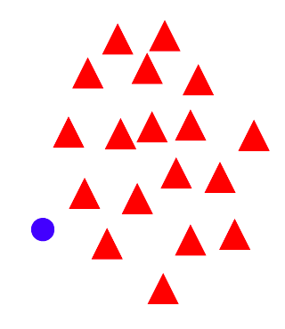
“Soft margin” formulation
What about non-separable data?
And even for separable data, we may prefer a larger margin with a few constraints violated
Source

Slide 17
“Soft margin” formulation
What about non-separable data?
And even for separable data, we may prefer a larger margin with a few constraints violated
Source

Slide 18
“Soft margin” formulation
Penalize margin violations using SVM hinge loss:
$$\min_{w}\frac{λ}{2}{\left\|w\right\|}^{2} + \sum_{i=1}^{n}{max⁡[0,1−}{y_{i}w}^{T}x_{i}]$$
Hinge loss
$$(0,1)$$
Incorrectly classified
$$(1,0)$$
Correctly classified
$$y_{i}w^{T}x_{i}$$
+1
0
-1

Slide 19
“Soft margin” formulation
Penalize margin violations using SVM hinge loss:
$$\min_{w}\frac{λ}{2}{\left\|w\right\|}^{2} + \sum_{i=1}^{n}{max⁡[0,1−}{y_{i}w}^{T}x_{i}]$$
Hinge loss
$$(0,1)$$
Incorrectly classified
$$(1,0)$$
Correctly classified
$$y_{i}w^{T}x_{i}$$
+1
0
Recall hinge loss used by the perceptron update algorithm!
-1

Slide 20
“Soft margin” formulation
Penalize margin violations using SVM hinge loss:
$$\min_{w}\frac{λ}{2}{\left\|w\right\|}^{2} + \sum_{i=1}^{n}{max⁡[0,1−}{y_{i}w}^{T}x_{i}]$$
Maximize margin –
a.k.a. regularization
Minimize misclassification loss

Slide 21
SGD update for SVM
$l\left(w,x_{i},y_{i}\right)=$ $\frac{λ}{2n}{\left\|w\right\|}^{2}+max⁡[0, 1−{y_{i}w}^{T}x_{i}]$
$∇l\left(w,x_{i},y_{i}\right)=$ $\frac{λ}{n}w−𝕀[{y_{i}w}^{T}x_{i}<1]y_{i}x_{i}$
Recall: $\frac{d}{da}\max\left(0,a\right)=𝕀[a>0]$

Slide 22
SGD update for SVM
$l\left(w,x_{i},y_{i}\right)=$ $\frac{λ}{2n}{\left\|w\right\|}^{2}+max⁡[0, 1−{y_{i}w}^{T}x_{i}]$
$∇l\left(w,x_{i},y_{i}\right)=$ $\frac{λ}{n}w−𝕀[{y_{i}w}^{T}x_{i}<1]y_{i}x_{i}$
SGD update:
If ${y_{i}w}^{T}x_{i}≥1$: $w←w$ $−η\frac{λ}{n}w$
If ${y_{i}w}^{T}x_{i}<1$: $w←w+η\left(y_{i}x_{i}−\frac{λ}{n}w\right)$
S. Shalev-Schwartz et al., Pegasos: Primal Estimated sub-GrAdient SOlver for SVM, Mathematical Programming, 2011

Slide 23
SVM vs. perceptron
SVM loss: $l\left(w,x_{i},y_{i}\right)=$ $\frac{λ}{2n}{\left\|w\right\|}^{2}+max⁡[0, 1−{y_{i}w}^{T}x_{i}]$
SVM update:
If ${y_{i}w}^{T}x_{i}≥1$: $w←\left(1−η\frac{λ}{n}\right)w$
If ${y_{i}w}^{T}x_{i}<1$: $w←\left(1−η\frac{λ}{n}\right)w+η{ y}_{i}x_{i}$
Perceptron loss: $l\left(w,x_{i},y_{i}\right)=$ $max⁡[0, −{y_{i}w}^{T}x_{i}]$
Perceptron update:
If ${y_{i}w}^{T}x_{i}<0$: $w←w+η{ y}_{i}x_{i}$
Otherwise: do nothing
What are the differences?

Slide 24
Linear classifiers: Outline
Examples of classification models: nearest neighbor, linear
Empirical loss minimization framework
Linear classification models
Linear regression
Logistic regression
Perceptron training algorithm
Support vector machines
General recipe: data loss, regularization

Slide 25
General recipe
Find parameters $w$that minimize the sum of a regularization loss and a data loss:
$$\hat{L}\left(w\right) = λR\left(w\right) + \frac{1}{n}\sum_{i=1}^{n}{l({w,x}_{i},y_{i})}$$
empirical loss
regularization
data loss
L2 regularization: $$R(w)=\frac{1}{2}{\left\|w\right\|}_{2}^{2}$$

Slide 26
Closer look at L2 regularization
Regularized objective: $\hat{L}(w)=\frac{λ}{2}{\left\|w\right\|}_{2}^{2}+\sum_{i=1}^{n}{l(w,x_{i},y_{i})}$
Gradient of objective:
$$∇\hat{L}(w)=λw+\sum_{i=1}^{n}{∇l(w,x_{i},y_{i})}$$
SGD update:
$$w←w−η\left(\frac{λ}{n}w+∇l\left(w,x_{i},y_{i}\right)\right)$$
$$w←\left(1−\frac{ηλ}{n}\right)w−η∇l\left(w,x_{i},y_{i}\right)$$
Interpretation: weight decay

Slide 27
General recipe
Find parameters $w$that minimize the sum of a regularization loss and a data loss:
$$\hat{L}\left(w\right) = λR\left(w\right) + \frac{1}{n}\sum_{i=1}^{n}{l({w,x}_{i},y_{i})}$$
empirical loss
regularization
data loss
L2 regularization: $$R(w)=\frac{1}{2}{\left\|w\right\|}_{2}^{2}$$
L1 regularization: $$R(w)={\left\|w\right\|}_{1}^{}$$

Slide 28
Closer look at L1 regularization
Regularized objective:
$$\hat{L}\left(w\right)=λ{\left\|w\right\|}_{1}+\sum_{i=1}^{n}{l\left(w,x_{i},y_{i}\right)}$$
$$=λ\sum_{d}{\left|w^{(d)}\right|}+\sum_{i=1}^{n}{l\left(w,x_{i},y_{i}\right)}$$
Gradient: $∇\hat{L}\left(w\right)=λ sgn⁡(w)+\sum_{i=1}^{n}{∇l(w,x_{i},y_{i})}$
(here sgn is an elementwise function)
SGD update:
$$w←w−\frac{ηλ}{n}\operatorname{sgn}\left(w\right)−η∇l\left(w,x_{i},y_{i}\right)$$
Interpretation: encouraging sparsity
Notes:
The update always drives the weights to zero by a constant amount (not a multiple of the weight)

Slide 29
General recipe
Find parameters $w$that minimize the sum of a regularization loss and a data loss:
$$\hat{L}\left(w\right) = λR\left(w\right) + \frac{1}{n}\sum_{i=1}^{n}{l({w,x}_{i},y_{i})}$$
Optimize by stochastic gradient descent (SGD): At each iteration, sample a single data point $\left(x_{i},y_{i}\right)$ and take a step in the direction opposite the gradient of the loss for that point:
$$w←w−η ∇_{w}\left[\frac{λ}{n}R\left(w\right)+l\left(w,x_{i},y_{i}\right)\right]$$
empirical loss
regularization
data loss

Slide 30
Summary of SGD updates
Linear regression:
$$w←w+η ({y_{i}−w}^{T}x_{i}){ x}_{i}$$
Logistic regression:
$$w←w+η σ\left({−y}_{i}w^{T}x_{i}\right){ y}_{i}x_{i}$$
Perceptron:
$$w←w+η 𝕀[y_{i}w^{T}x_{i}<0]{ y}_{i}x_{i}$$
SVM:
$$w←\left(1−\frac{ηλ}{n}\right)w+η 𝕀[y_{i}w^{T}x_{i}<1]{ y}_{i}x_{i}$$

Slide 31
Linear classifiers: Outline
Examples of classification models: nearest neighbor, linear
Empirical loss minimization framework
Linear classification models
Linear regression
Logistic regression
Perceptron training algorithm
Support vector machines
General recipe: data loss, regularization
Multi-class classification
Multi-class perceptron
Multi-class SVM
Softmax

Slide 32
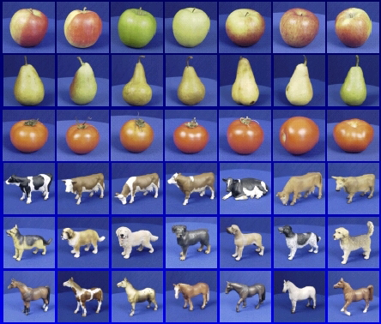
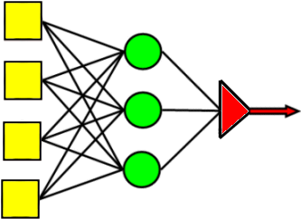
One-vs-all classification
Let $y∈\{1,…,C\}$
Learn $C$ scoring functions $f_{1}, f_{2},…,f_{C}$
Classify $x$to class $\hat{y}={argmax}_{c} f_{c}(x)$
Let’s start with multi-class perceptrons:
$$f_{c}\left(x\right)=w_{c}^{T}x$$
Argmax
Perceptrons w/ weights $w_{c}$
Inputs

Slide 33
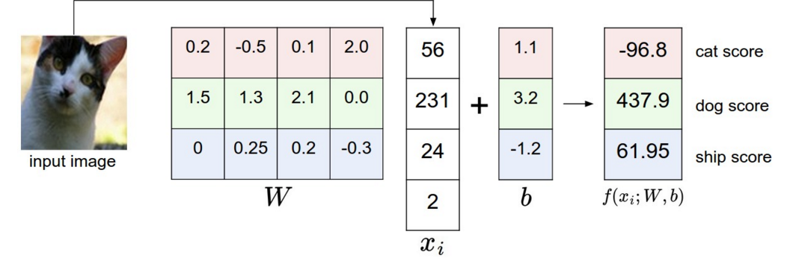
Multi-class perceptrons
Multi-class perceptrons: $f_{c}\left(x\right)=w_{c}^{T}x$
Let $W$ be the matrix with rows $w_{c}$
What loss should we use for multi-class classification?
Figure source: Stanford 231n

Slide 34
Multi-class perceptrons
Multi-class perceptrons: $f_{c}\left(x\right)=w_{c}^{T}x$
Let $W$ be the matrix with rows $w_{c}$
What loss should we use for multi-class classification?
For ${(x}_{i},y_{i})$, let the loss be the sum of hinge losses associated with predictions for all incorrect classes:
$$l\left(W,x_{i},y_{i}\right)=\sum_{c≠y_{i}}{max[0,{w_{c}^{T}x_{i}−w}_{y_{i}}^{T}x_{i}]}$$
Score for correct class ($y_{i}$) has to be greater than the score for the incorrect class ($c$)

Slide 35
Multi-class perceptrons
$$l\left(W,x_{i},y_{i}\right)=\sum_{c≠y_{i}}{max[0,{w_{c}^{T}x_{i}−w}_{y_{i}}^{T}x_{i}]}$$
Gradient w.r.t. $w_{y_{i}}$:
$$−\sum_{c≠y_{i}}{𝕀}[{w_{c}^{T}x_{i}>w}_{y_{i}}^{T}x_{i}]x_{i}$$
Recall: $\frac{d}{da}\max\left(0,a\right)=𝕀[a>0]$

Slide 36
Multi-class perceptrons
$$l\left(W,x_{i},y_{i}\right)=\sum_{c≠y_{i}}{max[0,{w_{c}^{T}x_{i}−w}_{y_{i}}^{T}x_{i}]}$$
Gradient w.r.t. $w_{y_{i}}$:
$$−\sum_{c≠y_{i}}{𝕀}[{w_{c}^{T}x_{i}>w}_{y_{i}}^{T}x_{i}]x_{i}$$
Gradient w.r.t. $w_{c}$, $c≠y_{i}$:
$$𝕀[{w_{c}^{T}x_{i}>w}_{y_{i}}^{T}x_{i}]x_{i}$$
Update rule: for each $c$ s.t. ${w_{c}^{T}x_{i}>w}_{y_{i}}^{T}x_{i}$:
$$w_{y_{i}}←w_{y_{i}}+ηx_{i}$$
$$w_{c}←w_{c}−ηx_{i}$$

Slide 37
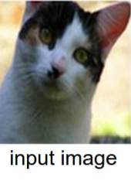
Multi-class perceptrons
Update rule: for each $c$ s.t. ${w_{c}^{T}x_{i}>w}_{y_{i}}^{T}x_{i}$:
$$w_{y_{i}}←w_{y_{i}}+ηx_{i}$$
$$w_{c}←w_{c}−ηx_{i}$$
Is this equivalent to training $C$ independent one-vs-all classifiers?
Independent
Do nothing
Decrease
Decrease
Multi-class
Increase
Decrease
Do nothing
Cat score: 65.1
Dog score: 101.4
Ship score: 24.9

Slide 38
Multi-class SVM
Recall single-class SVM loss:
$l\left(w,x_{i},y_{i}\right)=$ $\frac{λ}{2n}{\left\|w\right\|}^{2}+max⁡[0, 1−{y_{i}w}^{T}x_{i}]$
Generalization to multi-class:
$l\left(W,x_{i},y_{i}\right)=$ $\frac{λ}{2n}{\left\|W\right\|}^{2}+\sum_{c≠y_{i}}{max[0,{1−w}_{y_{i}}^{T}x_{i}+w_{c}^{T}x_{i}]}$
Score for correct class has to be greater than the score for the incorrect class by at least a margin of 1
$$(0,1)$$
$$(1,0)$$
Score for correct class – score for incorrect class
Source: Stanford 231n

Slide 39
Multi-class SVM
$l\left(W,x_{i},y_{i}\right)=$ $\frac{λ}{2n}{\left\|W\right\|}^{2}+\sum_{c≠y_{i}}{max[0,{1−w}_{y_{i}}^{T}x_{i}+w_{c}^{T}x_{i}]}$
Gradient w.r.t. $w_{y_{i}}$:
$$\frac{λ}{n}w_{y_{i}}−\sum_{c≠y_{i}}{𝕀\left[w_{y_{i}}^{T}x_{i}−w_{c}^{T}x_{i}<1\right]x_{i}}$$
Gradient w.r.t. $w_{c}$, $c≠y_{i}$:
$$\frac{λ}{n}w_{c}+𝕀[w_{y_{i}}^{T}x_{i}−w_{c}^{T}x_{i}<1]x_{i}$$
Update rule (almost* equivalent to above):
For each $c≠y_{i}$s.t. $w_{y_{i}}^{T}x_{i}−w_{c}^{T}x_{i}<1$: $w_{y_{i}}←w_{y_{i}}+ηx_{i}$, $w_{c}←w_{c}−ηx_{i}$
For ${c=1, …, C: w}_{c}←\left(1−η\frac{λ}{n}\right)w_{c}$

Slide 40
Announcements
Assignment 1 is out, due Tuesday, February 14
Quiz 1 will be available 9AM this Thursday, February 9, through 9AM Monday, February 13

Slide 41
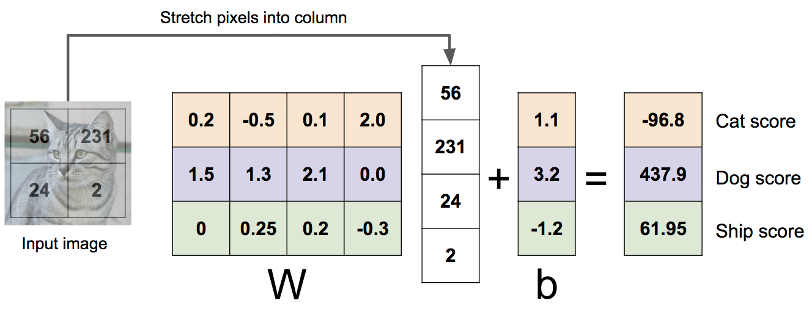
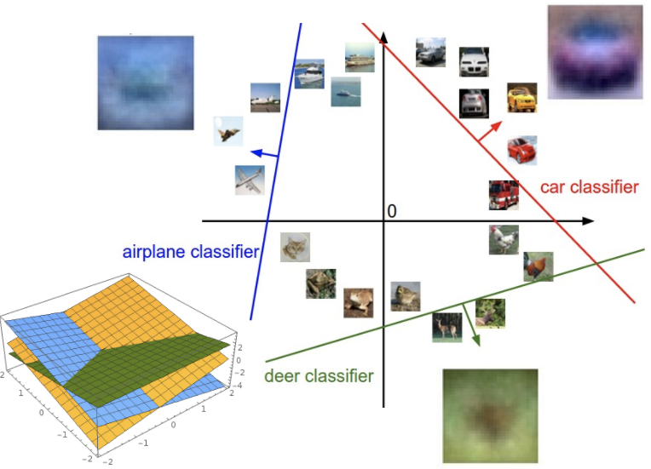
Review: Three ways to think about linear classifiers
Algebraic Viewpoint
Visual Viewpoint
Geometric Viewpoint
One template per class
Hyperplanes cutting up space
$$f_{W}\left(x\right)= Wx+b$$
Source: J. Johnson

Slide 42
Review: General recipe for training classifiers
Find parameters $w$that minimize the sum of a regularization loss and a data loss:
$$\hat{L}\left(w\right) = λR\left(w\right) + \frac{1}{n}\sum_{i=1}^{n}{l({w,x}_{i},y_{i})}$$
empirical loss
regularization
data loss
L2 regularization: $$R(w)=\frac{1}{2}{\left\|w\right\|}_{2}^{2}$$
L1 regularization: $$R(w)={\left\|w\right\|}_{1}^{}$$

Slide 43
Last week: Linear classifiers
Examples of classification models: nearest neighbor, linear
Empirical loss minimization framework
Linear classification models
Linear regression
Logistic regression
Perceptron training algorithm
Support vector machines
General recipe: data loss, regularization
Multi-class classification
Multi-class perceptrons
Multi-class SVM
Softmax

Slide 44
Softmax
We want to squash the vector of responses $\left(f_{1},…,f_{c}\right)$ into a vector of “probabilities”:
$$softmax\left(f_{1},…,f_{c}\right)=\left(\frac{exp⁡(f_{1})}{\sum_{j}{exp⁡(f_{j})}},…,\frac{exp⁡(f_{C})}{\sum_{j}{exp⁡(f_{j})}}\right)$$
The outputs are between 0 and 1 and sum to 1
If one of the inputs (logits) is much larger than the others, then the corresponding softmax value will be close to 1 and others will be close to 0

Slide 45
Softmax and sigmoid
For two classes:
$$softmax\left(f, −f\right)=\left(\frac{exp⁡(f)}{\exp{(f)}+exp⁡(−f)},\frac{exp⁡(−f)}{\exp\left(f\right)+exp⁡(−f)}\right)$$
$=\left(\frac{1}{1+exp⁡(−2f)},\frac{1}{\exp\left(2f\right)+1}\right)$
$=\left(σ\left(2f\right),σ(−2f)\right)$
Thus, softmax is the generalization of sigmoid for more than two classes

Slide 46
Cross-entropy loss
It is natural to use negative log likelihood loss with softmax:
$$l\left(W,x_{i},y_{i}\right)=−\log{P_{W}\left(y_{i} | x_{i}\right)}=−log\left(\frac{\exp\left(w_{y_{i}}^{T}x_{i}\right)}{\sum_{j}{\exp\left(w_{j}^{T}x_{i}\right)}}\right)$$
This is also the cross-entropy between the “empirical” distribution $\hat{P}\left(c | x_{i}\right)=𝕀[{c=y}_{i}]$ and “estimated” distribution $P_{W}(c|x_{i})$:
$$−\sum_{c}{\hat{P}\left(c | x_{i}\right)\log{P_{W}(c|x_{i})}}$$
$P$(correct class | $x_{i}$) $= 1$
$P$(incorrect class | $x_{i}$) $= 0$
Empirical distribution $\hat{P}\left(c | x_{i}\right)$
Estimated distribution $P_{W}(c|x_{i})$

Slide 47
SVM loss vs. cross-entropy loss
Correct class is the third one (blue)
Source: Stanford 231n

Slide 48
SGD with cross-entropy loss
$$l\left(W,x_{i},y_{i}\right)=−\log{P_{W}\left(y_{i} | x_{i}\right)}=−log\left(\frac{\exp\left(w_{y_{i}}^{T}x_{i}\right)}{\sum_{j}{\exp\left(w_{j}^{T}x_{i}\right)}}\right)$$
$$={−w}_{y_{i}}^{T}x_{i}+log\left(\sum_{j}{\exp\left(w_{j}^{T}x_{i}\right)}\right)$$
Gradient w.r.t. $w_{y_{i}}$:
$$−x_{i}+\frac{\exp\left(w_{y_{i}}^{T}x_{i}\right)x_{i}}{\sum_{j}{\exp\left(w_{j}^{T}x_{i}\right)}}=(P_{W}\left(y_{i} | x_{i}\right)−1)x_{i}$$
Gradient w.r.t. $w_{c}$, $c≠y_{i}$:
$$\frac{\exp\left(w_{c}^{T}x_{i}\right)x_{i}}{\sum_{j}{\exp\left(w_{j}^{T}x_{i}\right)}}=P_{W}\left(c | x_{i}\right)x_{i}$$

Slide 49
SGD with cross-entropy loss
Gradient w.r.t. $w_{y_{i}}$: $(P_{W}\left(y_{i} | x_{i}\right)−1)x_{i}$
Gradient w.r.t. $w_{c}$, $c≠y_{i}$: $P_{W}\left(c | x_{i}\right)x_{i}$
Update rule:
For $y_{i}:$
$$w_{y_{i}}←w_{y_{i}}+η\left({1−P}_{W}\left(y_{i} | x_{i}\right)\right)x_{i}$$
For $c≠y_{i}:$
$$w_{c}←w_{c}−ηP_{W}\left(c | x_{i}\right)x_{i}$$

Slide 50
Softmax trick: Avoiding overflow
Exponentiated values $\exp\left(f_{c}\right)$can become very large and cause overflow
Note that adding the same constant to all softmax inputs (logits) does not change the output of the softmax:
$$\frac{\exp\left(f_{c}\right)}{\sum_{j}{\exp\left(f_{j}\right)}}=\frac{K exp\left(f_{c}\right)}{\sum_{j}{K exp\left(f_{j}\right)}}=\frac{\exp\left(f_{c}+\log{K}\right)}{\sum_{j}{\exp\left(f_{j}+\log{K}\right)}}$$
Then we can let $\log{K}={−max}_{j}{ f}_{j}$ (i.e., make largest input to softmax be 0)

Slide 51
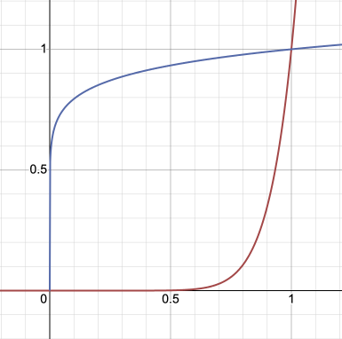
Softmax trick: Temperature scaling
Suppose we divide every input to the softmax by the same constant $T$:
$$softmax\left(f_{1},…,f_{c};T\right)=\left(\frac{exp⁡(f_{1}/T)}{\sum_{j}{exp⁡(f_{j}/T)}},…,\frac{exp⁡(f_{C}/T)}{\sum_{j}{exp⁡(f_{j}/T)}}\right)$$
Prior to normalization, each entry $exp⁡(f_{1})$ is raised to the power $1/T$
If $T$ is close to 0, the largest entry will dominate and output distribution will approach one-hot
If $T$ is high, output distribution will approach uniform
$$T=0.1$$
$$T=10$$
Source

Slide 52
Softmax trick: Temperature scaling
Low temperature:
More concentrated distribution
Higher temperature:
More uniform distribution
Figure source

Slide 53
Softmax trick: Label smoothing
Recall: cross-entropy loss measures the difference between the “observed” label distribution $\hat{P}\left(c | x_{i}\right)$ and “estimated” distribution $P_{W}(c|x_{i})$:
$$−\sum_{c}{\hat{P}\left(c | x_{i}\right)\log{P_{W}(c|x_{i})}}$$
“Hard” prediction targets
$P$(correct class | $x_{i}$) $= 1$
$P$(incorrect class | $x_{i}$) $= 0$
Empirical distribution $\hat{P}\left(c | x_{i}\right)$
Estimated distribution $P_{W}(c|x_{i})$

Slide 54
Softmax trick: Label smoothing
Recall: cross-entropy loss measures the difference between the “observed” label distribution $\hat{P}\left(c | x_{i}\right)$ and “estimated” distribution $P_{W}(c|x_{i})$:
$$−\sum_{c}{\hat{P}\left(c | x_{i}\right)\log{P_{W}(c|x_{i})}}$$
“Soft” prediction targets
$P$(correct class | $x_{i}$) $= 1−ε$
$P$(incorrect class | $x_{i}$) $=$ $\frac{ε}{C−1}$
Empirical distribution $\hat{P}\left(c | x_{i}\right)$
Estimated distribution $P_{W}(c|x_{i})$

Slide 55
Softmax trick: Label smoothing
When using softmax loss, replace hard 1 and 0 prediction targets with “soft” targets of $1−ε$ and $\frac{ε}{C−1}$
Why is this a good idea?
A form of regularization to avoid overly confident predictions, account for label noise

