Slide 1
Multi-layer networks, hyperparameter search, validation

Slide 2
From linear to nonlinear classifiers
To achieve good accuracy on challenging problems, we need to be able to train nonlinear models
Two strategies for making nonlinear predictors out of linear ones:
  “Shallow” approach: hand-crafted feature transformation (typically nonlinear, non-trainable) followed by trainable classifier (typically linear)
  “Deep” approach: stack multiple layers of linear predictors (interspersed with nonlinearities)
Hand-crafted feature transformation
Trainable
classifier
Input
Output
Layer 1
Layer 2
…
Layer L
Input
Output

Slide 3


From linear classifiers to multi-layer networks
$$x$$
$$y=w^{T}x$$

Slide 4



From linear classifiers to multi-layer networks
Linear layer
$$y^{(1)}=w^{(1)}∙x$$
$$y^{(2)}=w^{(2)}∙x$$
$$x$$
$$⋮$$

Slide 5
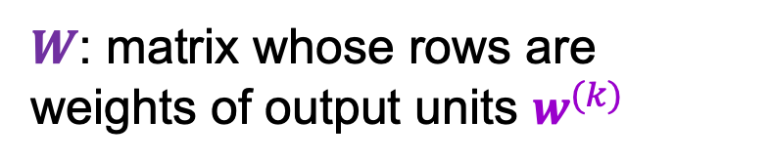

From linear classifiers to multi-layer networks
Linear layer
$$x$$
$$y=Wx$$
$W$: matrix whose rows are weights of output units $w^{(k)}$

Slide 6



From linear classifiers to multi-layer networks
Linear layer
Nonlinearity
$$y$$
$$x$$
$$z=g(y)$$
$$y=Wx$$

Slide 7
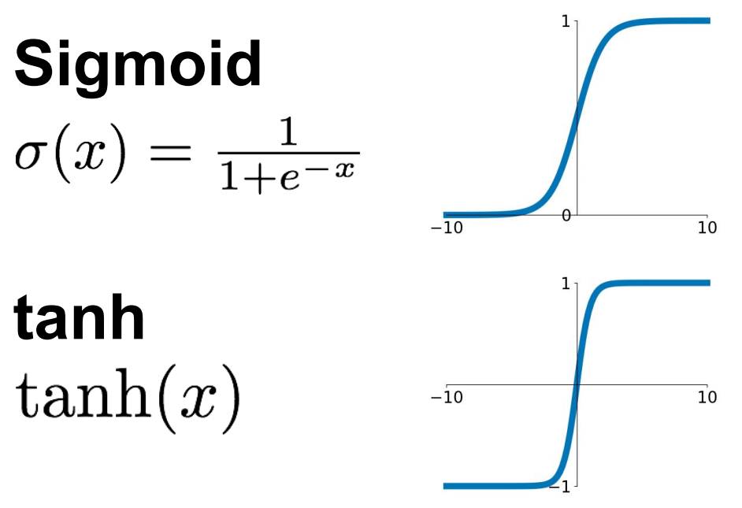
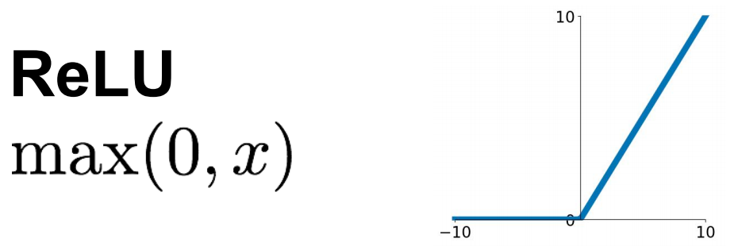
Common nonlinearities (or activation functions)
Source: Stanford 231n

Slide 8
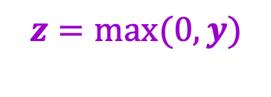
From linear classifiers to multi-layer networks
Linear layer
Nonlinearity
$$y$$
$$x$$
$$z=g(y)$$
…
Why do we need the nonlinearity?
$$y=Wx$$
$$z=max(0,y)$$

Slide 9


The power of nonlinearities
Points not linearly separable in original space
$$x^{(2)}$$
$$x^{(1)}$$
Source: J. Johnson

Slide 10

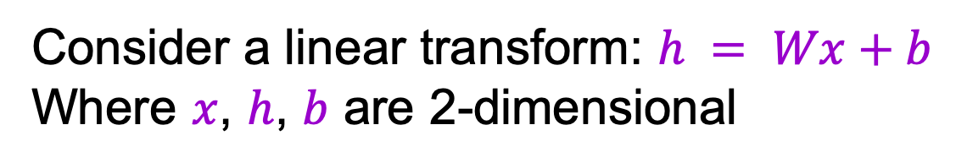

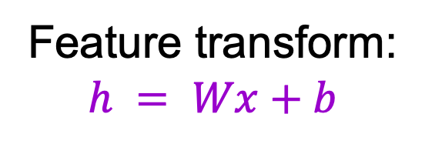
The power of nonlinearities
Points not linearly separable in original space
Consider a linear transform: $h = Wx+b$
Where $x$, $h$, $b$ are 2-dimensional
$$x^{(2)}$$
$$h^{(2)}$$
Feature transform:
$$h = Wx+b$$
$$x^{(1)}$$
$$h^{(1)}$$
Still not linearly separable!
Source: J. Johnson

Slide 11
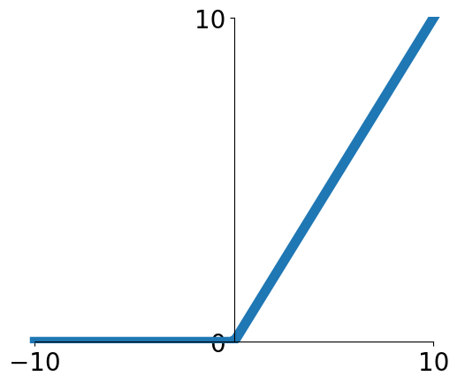
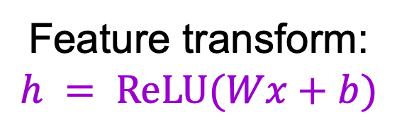
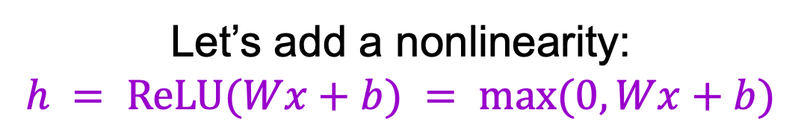
The power of nonlinearities
Points not linearly separable in original space
Let’s add a nonlinearity:
$$h = ReLU(Wx+b) = max⁡(0, Wx+b)$$
$$x^{(2)}$$
$$h^{(2)}$$
Feature transform:
$$h = ReLU(Wx+b)$$
$$x^{(1)}$$
$$h^{(1)}$$
Source: J. Johnson

Slide 12
The power of nonlinearities
Points not linearly separable in original space
Let’s add a nonlinearity:
$$h = ReLU(Wx+b) = max⁡(0, Wx+b)$$
$$x^{(2)}$$
$$h^{(2)}$$
Feature transform:
$$h = ReLU(Wx+b)$$
$$x^{(1)}$$
$$h^{(1)}$$
Source: J. Johnson

Slide 13
The power of nonlinearities
Points not linearly separable in original space
Let’s add a nonlinearity:
$$h = ReLU(Wx+b) = max⁡(0, Wx+b)$$
$$x^{(2)}$$
$$h^{(2)}$$
Feature transform:
$$h = ReLU(Wx+b)$$
$$x^{(1)}$$
$$h^{(1)}$$
Points are linearly separable in feature space!
Source: J. Johnson

Slide 14
The power of nonlinearities
Let’s add a nonlinearity:
$$h = ReLU(Wx+b) = max⁡(0, Wx+b)$$
$$x^{(2)}$$
$$h^{(2)}$$
Feature transform:
$$h = ReLU(Wx+b)$$
$$x^{(1)}$$
$$h^{(1)}$$
Source: J. Johnson

Slide 15
The power of nonlinearities
Let’s add a nonlinearity:
$$h = ReLU(Wx+b) = max⁡(0, Wx+b)$$
$$x^{(2)}$$
$$h^{(2)}$$
A
Feature transform:
$$h = ReLU(Wx+b)$$
A
$$x^{(1)}$$
$$h^{(1)}$$
Source: J. Johnson

Slide 16
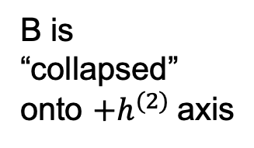
The power of nonlinearities
Let’s add a nonlinearity:
$$h = ReLU(Wx+b) = max⁡(0, Wx+b)$$
$$x^{(2)}$$
$$h^{(2)}$$
A
Feature transform:
$$h = ReLU(Wx+b)$$
B
B
A
B is “collapsed” onto ${+h}^{(2)}$axis
$$x^{(1)}$$
$$h^{(1)}$$
Source: J. Johnson

Slide 17
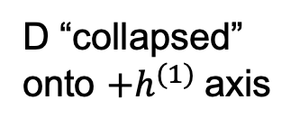
The power of nonlinearities
Let’s add a nonlinearity:
$$h = ReLU(Wx+b) = max⁡(0, Wx+b)$$
$$x^{(2)}$$
$$h^{(2)}$$
A
Feature transform:
$$h = ReLU(Wx+b)$$
B
B
A
B is “collapsed” onto ${+h}^{(2)}$axis
D
$$x^{(1)}$$
$$h^{(1)}$$
D
D “collapsed” onto ${+h}^{(1)}$axis
Source: J. Johnson

Slide 18
The power of nonlinearities
Let’s add a nonlinearity:
$$h = ReLU(Wx+b) = max⁡(0, Wx+b)$$
$$x^{(2)}$$
$$h^{(2)}$$
A
Feature transform:
$$h = ReLU(Wx+b)$$
B
B
A
B is “collapsed” onto ${+h}^{(2)}$axis
D
$$x^{(1)}$$
$$h^{(1)}$$
C
C
D
C “collapsed” onto origin
D “collapsed” onto ${+h}^{(1)}$axis
Source: J. Johnson

Slide 19
The power of nonlinearities
Points not linearly separable in original space
Let’s add a nonlinearity:
$$h = ReLU(Wx+b) = max⁡(0, Wx+b)$$
$$x^{(2)}$$
$$h^{(2)}$$
Feature transform:
$$h = ReLU(Wx+b)$$
$$x^{(1)}$$
$$h^{(1)}$$
Source: J. Johnson

Slide 20
The power of nonlinearities
Points not linearly separable in original space
Let’s add a nonlinearity:
$$h = ReLU(Wx+b) = max⁡(0, Wx+b)$$
$$x^{(2)}$$
$$h^{(2)}$$
Feature transform:
$$h = ReLU(Wx+b)$$
$$x^{(1)}$$
$$h^{(1)}$$
Source: J. Johnson

Slide 21
The power of nonlinearities
Points not linearly separable in original space
Let’s add a nonlinearity:
$$h = ReLU(Wx+b) = max⁡(0, Wx+b)$$
$$x^{(2)}$$
$$h^{(2)}$$
Feature transform:
$$h = ReLU(Wx+b)$$
$$x^{(1)}$$
$$h^{(1)}$$
Points are linearly separable in feature space!
Source: J. Johnson

Slide 22
The power of nonlinearities
Points not linearly separable in original space
Let’s add a nonlinearity:
$$h = ReLU(Wx+b) = max⁡(0, Wx+b)$$
$$x^{(2)}$$
$$h^{(2)}$$
Feature transform:
$$h = ReLU(Wx+b)$$
$$x^{(1)}$$
$$h^{(1)}$$
Points are linearly separable in feature space!
Linear classifier in feature space gives nonlinear classifier in original space
Source: J. Johnson

Slide 23



Two-layer neural network
Individual dimensions of $x$
Output of hidden layer: $g(W_{1}x)$
Final output: $g\left(W_{2}g(W_{1}x)\right)$
Image source

Slide 24










Two-layer neural network
Introduce a hidden layer of perceptrons computing linear combinations of inputs followed by nonlinearities
$${g(w}_{11}^{T}x)$$
$$g\left(w_{21}^{T}g(W_{1}x)\right)$$
$${g(w}_{12}^{T}x)$$
$$g\left(w_{22}^{T}g(W_{1}x)\right)$$
Individual dimensions of $x$
$${g(w}_{1K}^{T}x)$$
$$g\left(w_{2M}^{T}g(W_{1}x)\right)$$
Output of hidden layer: $g(W_{1}x)$
Output of second layer: $g\left(W_{2}g(W_{1}x)\right)$
Image source
$W_{1}$: matrix with rows $w_{1j}^{T}$
Why do we need the nonlinearities?

Slide 25

Two-layer networks as combinations of templates
Linear classifier: One template per class

Slide 26
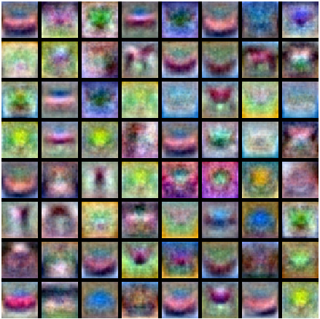
Two-layer networks as combinations of templates
First layer: bank of templates
Second layer: recombines templates
Source: J. Johnson

Slide 27
Two-layer networks as combinations of templates
First layer: bank of templates
Second layer: recombines templates
Can use different templates to cover multiple modes of a class
Source: J. Johnson

Slide 28
Two-layer networks as combinations of templates
First layer: bank of templates
Second layer: recombines templates
It’s a “distributed” representation:
Most templates are
not interpretable
Source: J. Johnson

Slide 29
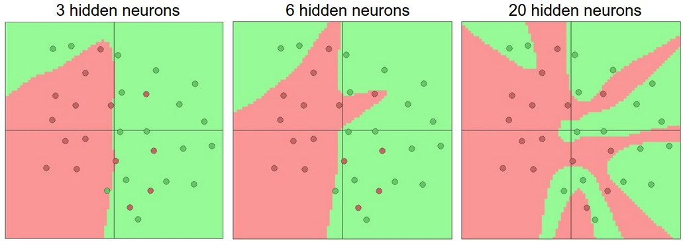
Expressiveness of two-layer networks
How complex can we make the decision boundary in a two-layer network?
The bigger the hidden layer, the more complex the model
A two-layer network is a universal function approximator
  But the hidden layer may need to be huge
Figure source

Slide 30
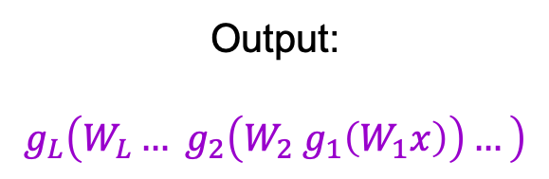

Neural networks beyond two layers
Output:
$$g_{L}\left(W_{L}… g_{2}\left(W_{2}{ g}_{1}\left(W_{1}x\right)\right)…\right)$$
Individual dimensions of $x$
Image source

Slide 31
“Deep” pipeline
Layer 1
Layer 2
…
Layer L
Input
Output
  Learn a feature hierarchy
  Each layer extracts features from the output of previous layer
  All layers are trained jointly

Slide 32
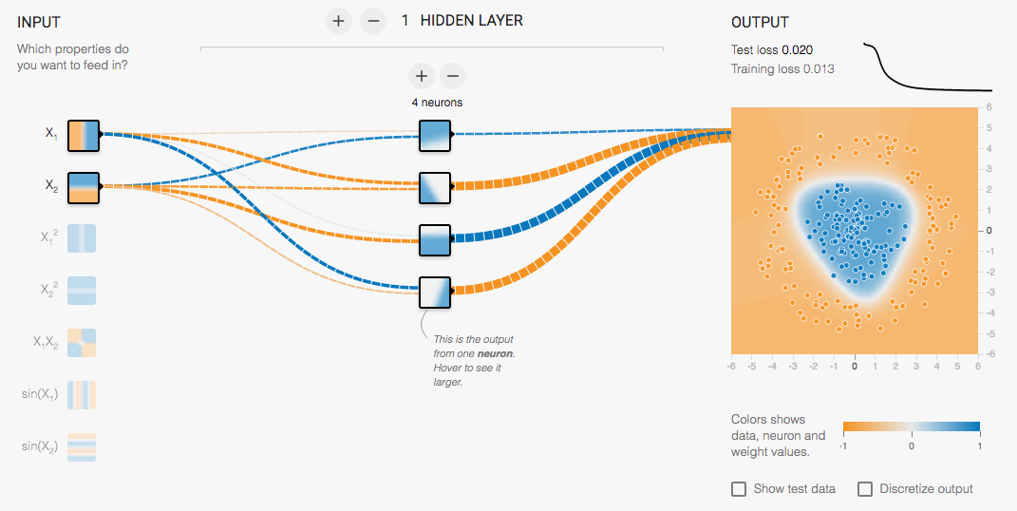
Multi-Layer network demo
http://playground.tensorflow.org/

Slide 33
Overview
Multi-layer networks
Hyperparameter search, validation

Slide 34
Supervised learning outline revisited
Collect data and labels
Specify model: select model class and loss function
Train model: find the parameters of the model that minimize the empirical loss on the training data
This involves hyperparameters that affect the generalization ability of the trained model

Slide 35
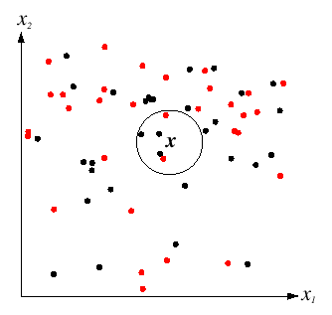

Hyperparameters
$K$ in $K$-nearest-neighbor
  What if $K$ is too large?
  What if $K$ is too small?

Slide 36
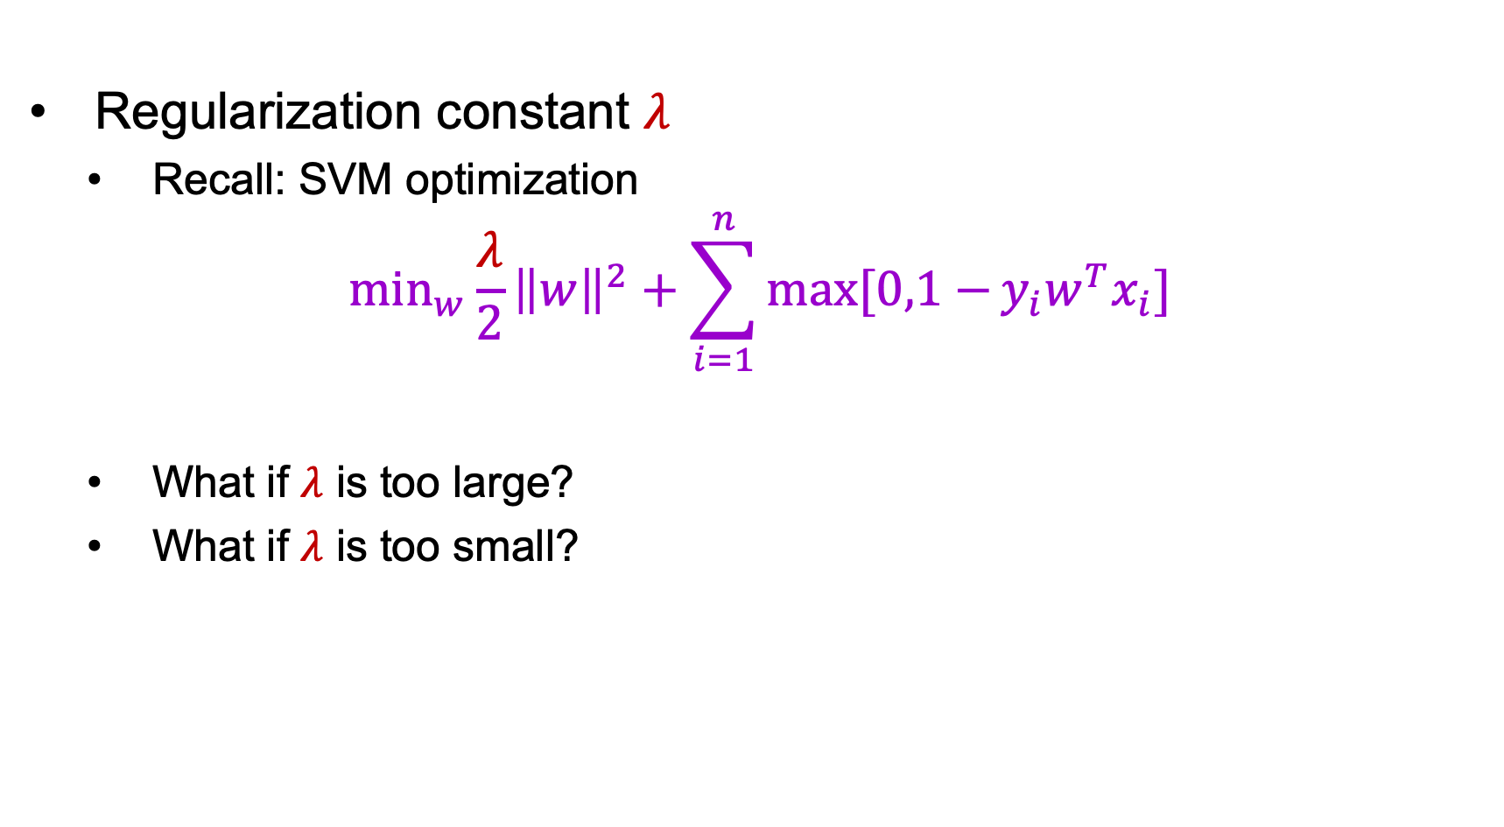
Hyperparameters
Regularization constant $λ$
  Recall: SVM optimization
$$\min_{w}\frac{λ}{2}{\left\|w\right\|}^{2}+\sum_{i=1}^{n}{max⁡[0,1−}{y_{i}w}^{T}x_{i}]$$
  What if $λ$ is too large?
  What if $λ$ is too small?

Slide 37
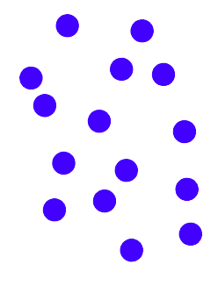
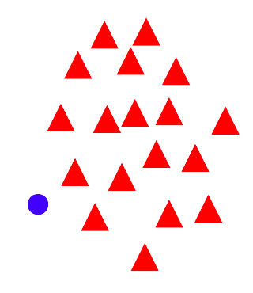

Hyperparameters
Regularization constant $λ$
  Tradeoff between margin and classification errors
Source

Slide 38
Hyperparameters
Regularization constant $λ$
  Tradeoff between margin and classification errors
Source

Slide 39
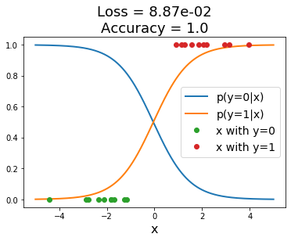
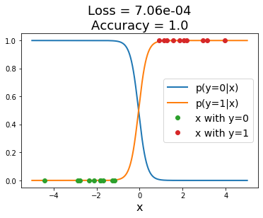
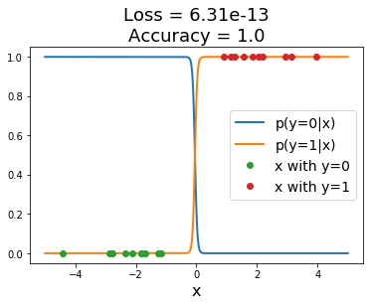

Hyperparameters
Regularization constant $λ$
  Related: preventing the classifier from getting over-confident
Sigmoid classifier, logistic loss
Source: J. Johnson

Slide 40

Hyperparameters in multi-layer networks
Number of layers, number of units per layer
Source: Stanford 231n

Slide 41
Hyperparameters in multi-layer networks
Number of layers, number of units per layer
Number of hidden units in a two-layer network
Source: Stanford 231n

Slide 42
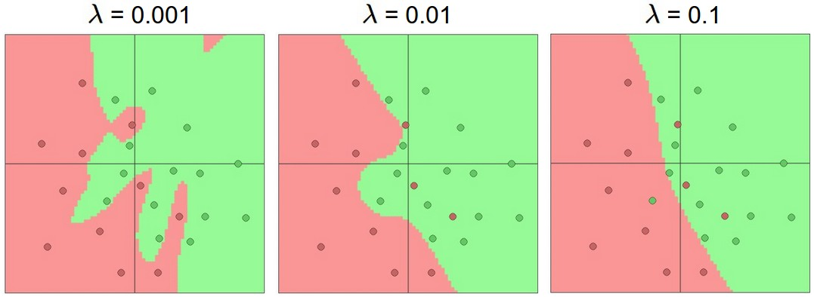
Hyperparameters in multi-layer networks
Number of layers, number of units per layer
Type of nonlinearity
Type of loss function
Regularization constant
Source: Stanford 231n

Slide 43
Hyperparameters in multi-layer networks
Number of layers, number of units per layer
Type of nonlinearity
Type of loss function
Regularization constant
SGD settings: learning rate schedule, number of epochs, minibatch size, etc.
Our hyperparameter choices affect the “capacity” of the model and its ability to generalize to new data
  But first: how do we measure the generalization ability of our model?
  Need to measure both training and test error

Slide 44
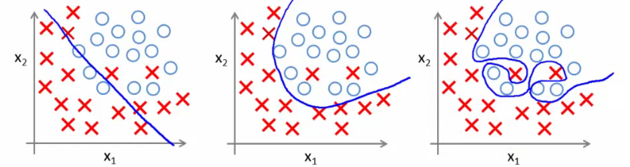
Model complexity and generalization
Generalization (test) error of learning algorithms has two main components:
  Bias: error due to simplifying model assumptions
  Variance: error due to randomness of training set
“Simple” model
“Intermediate” model
“Complex” model
High bias, low variance
Low bias, high variance
Figure source

Slide 45
Bias-variance tradeoff
What if your model bias is too high?
  Your model is underfitting – it is incapable of capturing the important characteristics of the training data
What if your model variance is too high?
  Your model is overfitting – it is fitting noise and unimportant characteristics of the data
How to recognize underfitting or overfitting?
Underfitting
Overfitting
Figure source

Slide 46
Bias-variance tradeoff
What if your model bias is too high?
  Your model is underfitting – it is incapable of capturing the important characteristics of the training data
What if your model variance is too high?
  Your model is overfitting – it is fitting noise and unimportant characteristics of the data
How to recognize underfitting or overfitting?
  Need to look at both training and test error
  Underfitting: training and test error are both high
  Overfitting: training error is low, test error is high

Slide 47
Behavior of training and test error
Test error
Error
Training error
Model capacity
Underfitting: training and test error are both high
Overfitting: training error is low but test error is high
Source: D. Hoiem

Slide 48
Underfitting and overfitting: The classical view
Underfitting
Good generalization
Overfitting
Figure source

Slide 49
Behavior of training and test error
In practice, overparameterized neural networks tend to be resistant to overfitting, even after the training error goes to zero
Test error
Error
Training error
Underfitting
Model capacity
Overfitting
In neural networks, we also observe this kind of behavior for a fixed model as a function of training time!
Source: D. Hoiem

Slide 50
Generalization and training set size
Few training examples
Test Error
Many training examples
Underfitting
Model capacity
Overfitting
Bottom line: more training data is always good!
Source: D. Hoiem
Notes:
Note: these figures don’t work in pdf

Slide 51
Generalization and training set size
Error
Testing
Generalization gap
Training
Number of training examples
(fixed model)
Source: D. Hoiem

Slide 52
Hyperparameter search in practice
Given a fixed dataset, you have to find the hyperparameter settings that give the best generalization performance
Test error
Error
Training error
Underfitting
Model capacity
Overfitting
Source: D. Hoiem

Slide 53
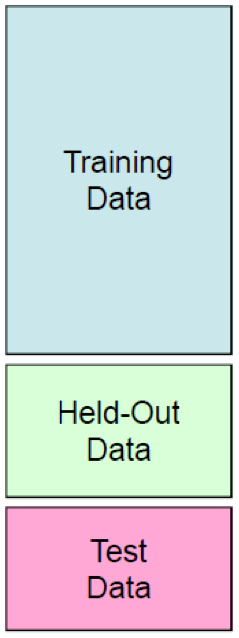
Hyperparameter search in practice
For a range of hyperparameter choices, iterate:
  Learn parameters on the training data
  Measure accuracy on the held-out or
  validation data
Finally, measure accuracy on the test data
You should avoid peeking at the test set during hyperparameter search since it is supposed to represent never before seen data

Slide 54
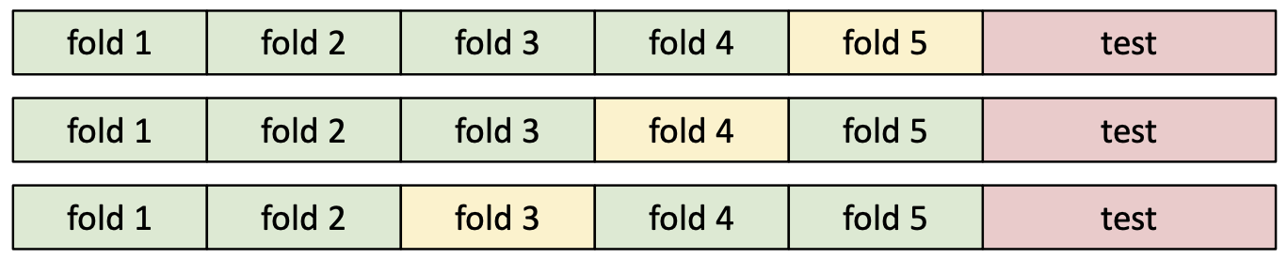
Hyperparameter search in practice
Variant: K-fold cross-validation
  Partition the entire training set into K groups
  In each run (or fold), select one of the groups as the validation set and train on the other K-1 groups. At the end, average the accuracies across the K folds
  Typically not used for deep learning due to computational expense
Training
Validation
Source: J. Johnson

Slide 55
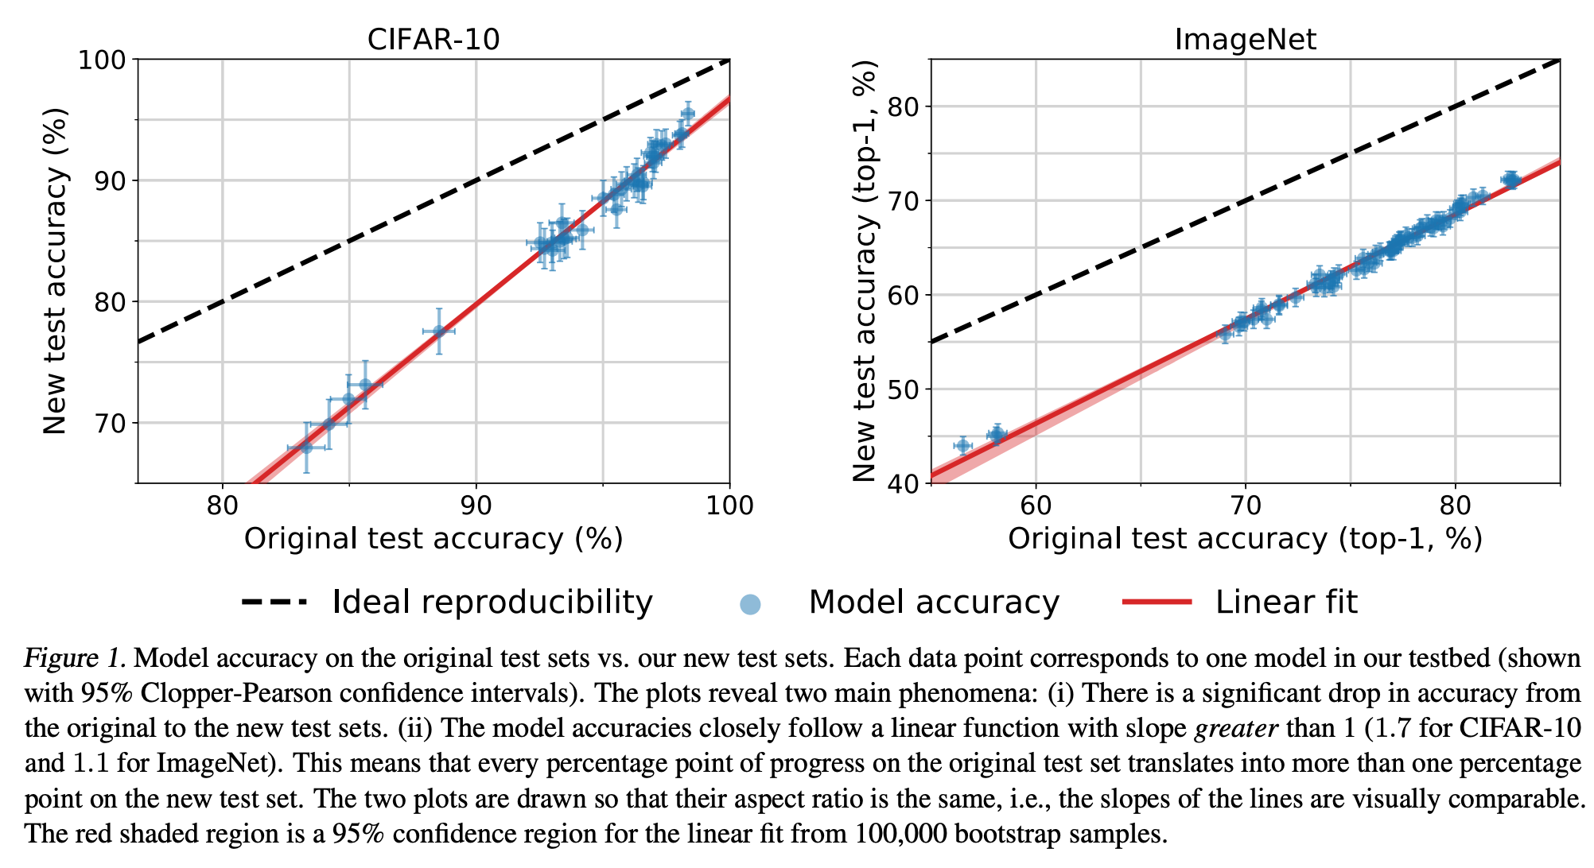
The mysteries of generalization
B. Recht et al. Do ImageNet classifiers generalize to ImageNet? ICML 2019
See also: C. Zhang et al. Understanding deep learning (still) requires rethinking generalization. Comm. ACM, 2021
https://www.argmin.net/p/i-dont-know-what-ive-been-trying

Slide 56
What’s the big deal?
If you don’t maintain proper training-validation-test hygiene, you will be fooling yourself or others (professors, reviewers, employers, customers)
It may even cause a public scandal!

Slide 57

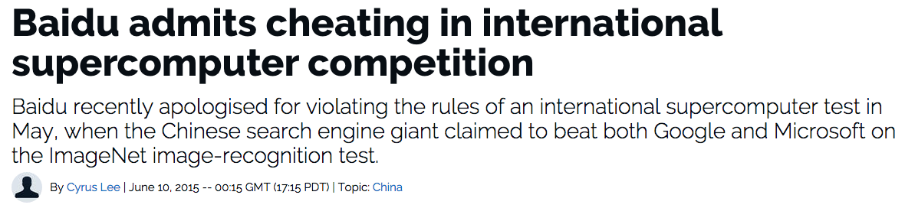
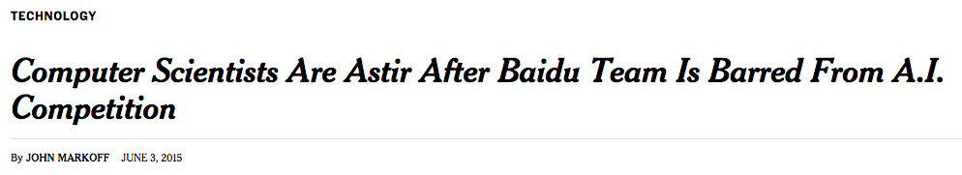



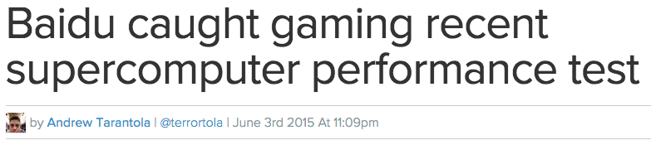
What’s the big deal?

Slide 58
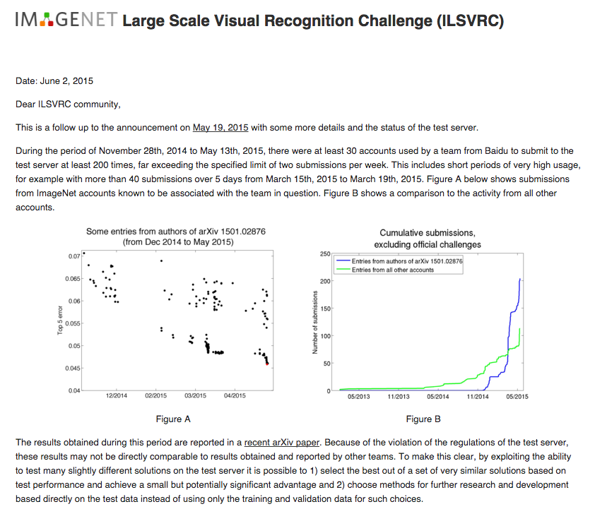
http://www.image-net.org/challenges/LSVRC/announcement-June-2-2015

