Slide 1
Convolutional architectures
Image source

Slide 2
Outline
AlexNet (2012-2013)
VGGNet (2014)
GoogLeNet (2014)
ResNet (2015)
Beyond ResNet (2016 and onward): Wide ResNet, ResNeXT, DenseNet

Slide 3
ImageNet Challenge
ILSVRC
Figure source

Slide 4
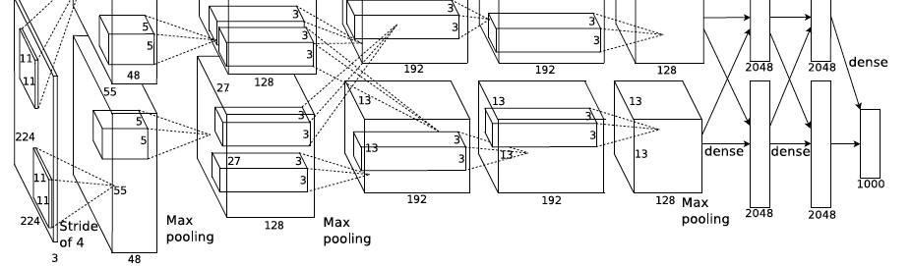
AlexNet: ILSVRC 2012 winner
Successor of LeNet-5, but with a few crucial changes
Y. LeCun, L. Bottou, Y. Bengio, and P. Haffner, Gradient-based learning applied to document recognition, Proc. IEEE 86(11): 2278–2324, 1998
A. Krizhevsky, I. Sutskever, and G. Hinton, ImageNet Classification with Deep Convolutional Neural Networks, NIPS 2012
Notes:
Two-GPU architecture

Slide 5
AlexNet: ILSVRC 2012 winner
Successor of LeNet-5, but with a few crucial changes
Max pooling, ReLU nonlinearity
Dropout regularization
More data and bigger model (7 hidden layers, 650K units, 60M params)
GPU implementation (50x speedup over CPU)
Trained on two GPUs for a week
A. Krizhevsky, I. Sutskever, and G. Hinton, ImageNet Classification with Deep Convolutional Neural Networks, NIPS 2012
Notes:
Two-GPU architecture

Slide 6
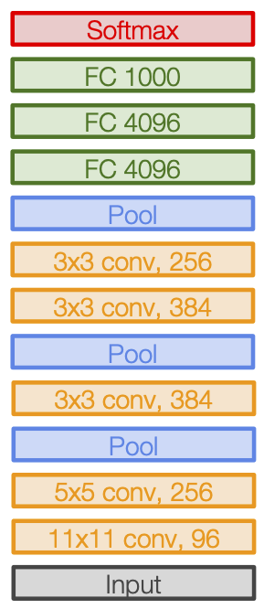
AlexNet: ILSVRC 2012 winner
Notes:
Two-GPU architecture

Slide 7
AlexNet (modified): Table view
 | Input size |  | Layer |  |  |  | Output size
Layer | C | H / W | filters | kernel | stride | pad | C | H / W | memory (KB) | params (k) | flop (M)
conv1 | 3 | 227 | 64 | 11 | 4 | 2 | 64 | 56 | 784 | 23 | 73
pool1 | 64 | 56 |  | 3 | 2 | 0 | 64 | 27 | 182 | 0 | 0
conv2 | 64 | 27 | 192 | 5 | 1 | 2 | 192 | 27 | 547 | 307 | 224
pool2 | 192 | 27 |  | 3 | 2 | 0 | 192 | 13 | 127 | 0 | 0
conv3 | 192 | 13 | 384 | 3 | 1 | 1 | 384 | 13 | 254 | 664 | 112
conv4 | 384 | 13 | 256 | 3 | 1 | 1 | 256 | 13 | 169 | 885 | 145
conv5 | 256 | 13 | 256 | 3 | 1 | 1 | 256 | 13 | 169 | 590 | 100
pool5 | 256 | 13 |  | 3 | 2 | 0 | 256 | 6 | 36 | 0 | 0
flatten | 256 | 6 |  |  |  |  | 9216 |  | 36 | 0 | 0
fc6 | 9216 |  | 4096 |  |  |  | 4096 |  | 16 | 37,749 | 38
fc7 | 4096 |  | 4096 |  |  |  | 4096 |  | 16 | 16,777 | 17
fc8 | 4096 |  | 1000 |  |  |  | 1000 |  | 4 | 4,096 | 4
Source: J. Johnson

Slide 8
AlexNet (modified): Analysis
FC6 input size:
6 x 6 x 256 = 9216
Output size: 4096
Params: 9216 x 4096 = 37,749K
Most of the memory usage is in the early convolution layers
Nearly all parameters are in the fully-connected layers
Most floating-point ops occur in the convolution layers
Source: J. Johnson

Slide 9
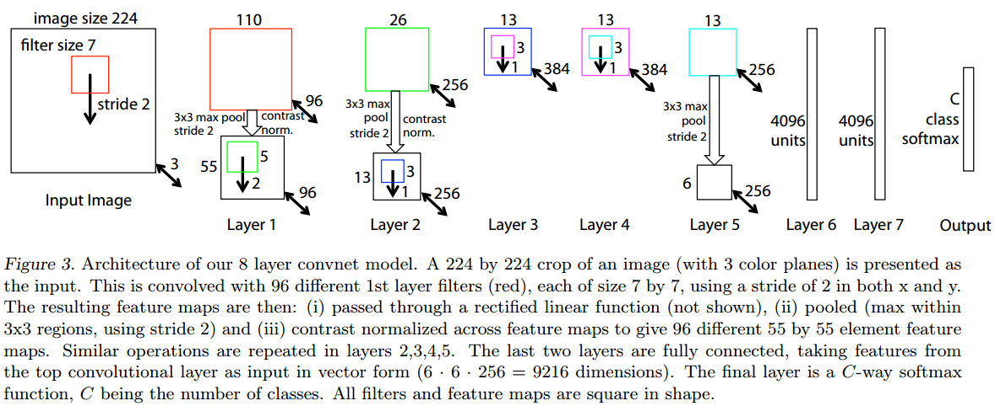
Clarifai or ZFNet: ILSVRC 2013 winner
Refinement of AlexNet
M. Zeiler and R. Fergus, Visualizing and Understanding Convolutional Networks, ECCV 2014 (Best Paper Award winner)

Slide 10
Outline
AlexNet (2012-2013)
VGGNet (2014)
GoogLeNet (2014)

Slide 11
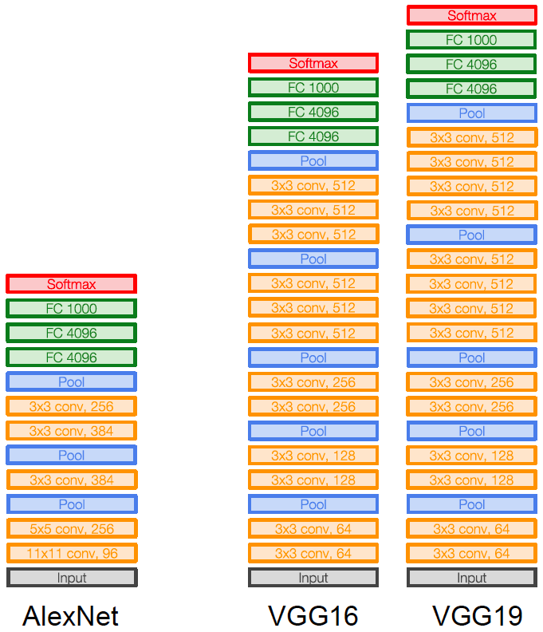
VGGNet: ILSVRC 2014 2nd place
Image source
K. Simonyan and A. Zisserman, Very Deep Convolutional Networks for Large-Scale Image Recognition, ICLR 2015
Notes:
LRN – local response normalization (doesn’t improve performance)

Slide 12
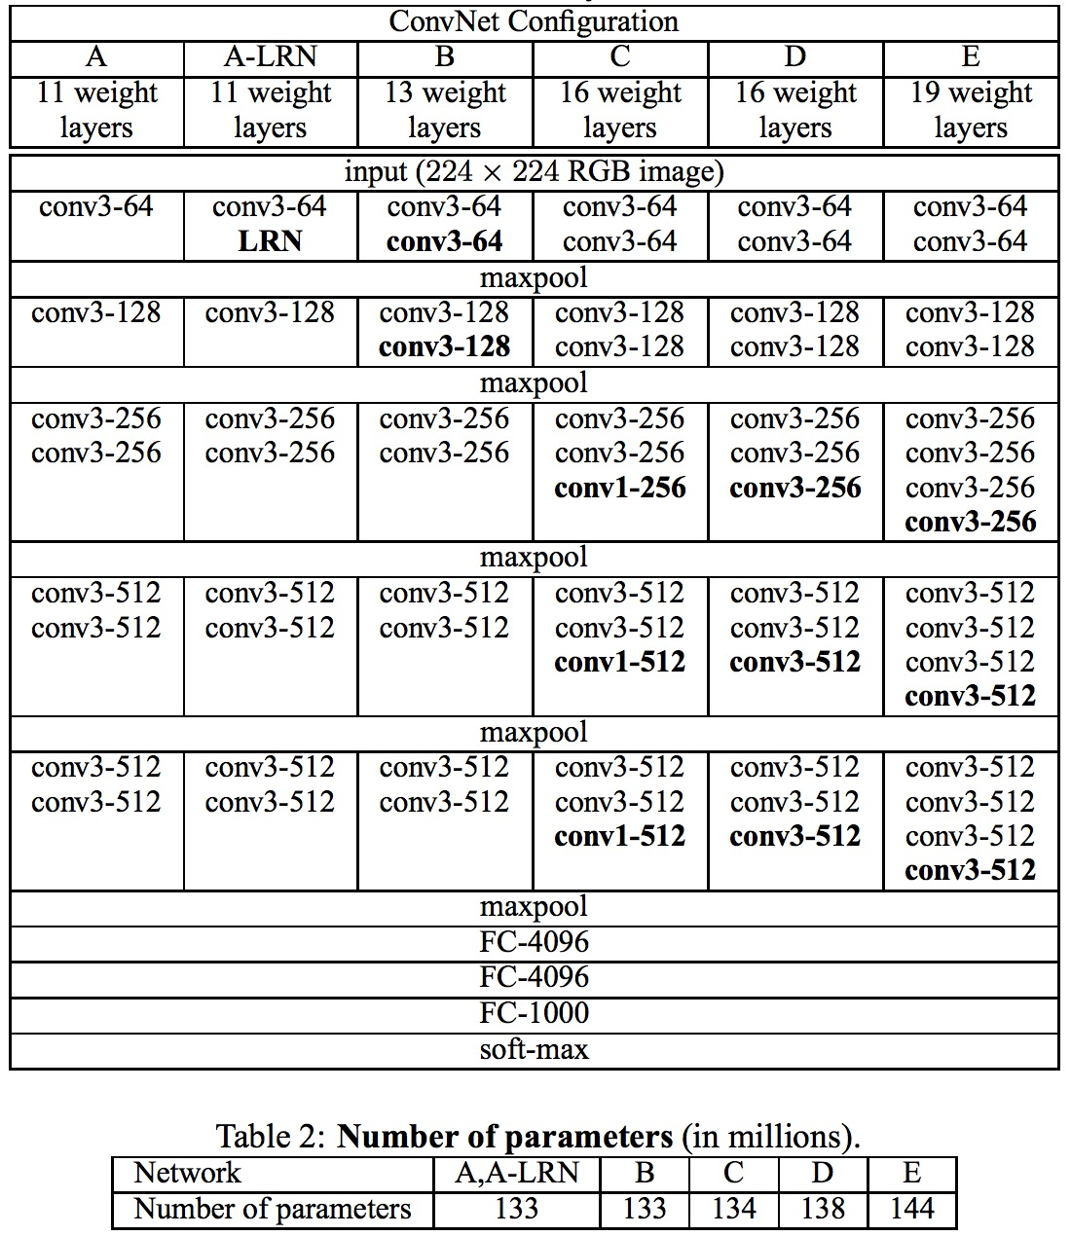
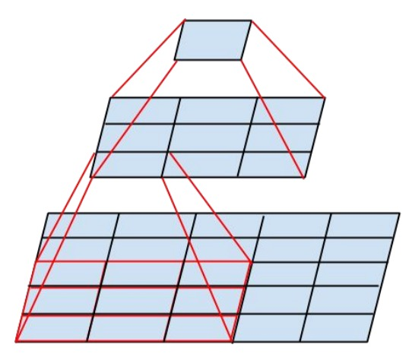
VGGNet: ILSVRC 2014 2nd place
Sequence of deeper networks trained progressively
Large receptive fields replaced by successive layers of $3×3$ convolutions (with ReLU in between)
How many weights does one $7×7$ conv layer with $K$ input and output channels have?
$49K2$
What about three $3×3$ conv layers with $K$ input and output channels?
$27K2$
All maxpool layers are $2×2$ stride $2$, followed by doubling of the number of channels (keeping cost of convolutions the same)
Notes:
LRN – local response normalization (doesn’t improve performance)

Slide 13
Another view of VGG-19 architecture (modified)
Image source

Slide 14
VGGNet vs. AlexNet
AlexNet total: 1.9 MB
VGG-16 total: 48.6 MB (25x)
AlexNet total: 61M
VGG-16 total: 138M (2.3x)
AlexNet total: 0.7 GFLOP
VGG-16 total: 13.6 GFLOP (19.4x)
Source: J. Johnson

Slide 15
GoogLeNet: ILSVRC 2014 winner
http://knowyourmeme.com/memes/we-need-to-go-deeper
C. Szegedy et al., Going deeper with convolutions, CVPR 2015

Slide 16
GoogLeNet: Aggressive stem
Stem network at the start aggressively downsamples input
Source: J. Johnson

Slide 17
GoogLeNet: Aggressive stem
Stem network at the start aggressively downsamples input
 | Input size |  | Layer |  |  |  | Output size
Layer | C | H / W | filters | kernel | stride | pad | C | H/W | memory (KB) | params (K) | flop (M)
conv | 3 | 224 | 64 | 7 | 2 | 3 | 64 | 112 | 3136 | 9 | 118
max-pool | 64 | 112 |  | 3 | 2 | 1 | 64 | 56 | 784 | 0 | 2
conv | 64 | 56 | 64 | 1 | 1 | 0 | 64 | 56 | 784 | 4 | 13
conv | 64 | 56 | 192 | 3 | 1 | 1 | 192 | 56 | 2352 | 111 | 347
max-pool | 192 | 56 |  | 3 | 2 | 1 | 192 | 28 | 588 | 0 | 1
Total from 224 to 28 resolution:
Memory: 7.5 MB
Params: 124K
MFLOP: 418
Source: J. Johnson

Slide 18
GoogLeNet: Aggressive stem
Compare VGG-16:
Memory: 42.9 MB (5.7x)
Params: 1.1M (8.9x)
MFLOP: 7485 (17.8x)
Total from 224 to 28 resolution:
Memory: 7.5 MB
Params: 124K
MFLOP: 418
Source: J. Johnson

Slide 19
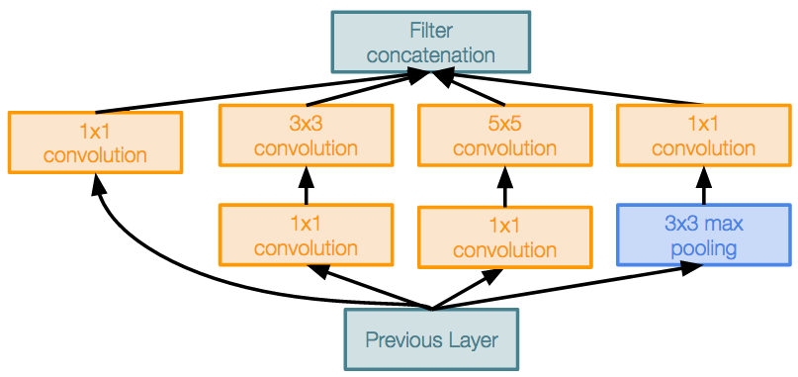
GoogLeNet: Inception module
Parallel paths with different receptive field sizes and operations are meant to capture sparse patterns of correlations in the stack of feature maps
Use $1×1$ convolutions for dimensionality reduction before expensive convolutions
Source: J. Johnson

Slide 20
Recall: Regular conv layer
$K$ feature maps
$L$ feature maps
$F×F×K$ filter
$L$ filters
conv layer

Slide 21
Recall: 1x1 convolution
$K$ feature maps
$L$ feature maps
$1×1×K$ filter
$L$ filters
$1×1$ conv layer

Slide 22
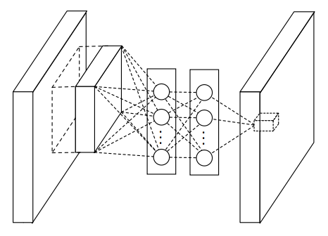
1x1 convolution
“network in network”
M. Lin, Q. Chen, and S. Yan, Network in network, ICLR 2014

Slide 23
Why 1x1 convolutions?
Option 1: $3×3$ conv layer with $256$ channels at input and output
$256×256×3×3 ≈ 600,000$ operations (per location)
Option 2: “bottleneck module”
$1×1$ conv layer, $256 → 64$ channels
$3×3$ conv layer, $64 → 64$ channels
$1×1$ conv layer, $64 →256$ channels
$256×64×1×1 ≈ 16,000$
$64×64×3×3 ≈ 36,000$
$64×256×1×1 ≈ 16,000$
Total $≈ 70,000$ operations

Slide 24
GoogLeNet: Global average pooling
Instead of large FC layers at the end, use global average pooling to collapse spatial dimensions, followed by linear layer to produce class scores
Recall VGG-16: Most parameters were in the FC layers!
Source: J. Johnson

Slide 25
GoogLeNet: Global average pooling
GoogLeNet head:
 | Input size |  | Layer |  |  |  | Output size
Layer | C | H/W | filters | kernel | stride | pad | C | H/W | memory (KB) | params (k) | flop (M)
avg-pool | 1024 | 7 |  | 7 | 1 | 0 | 1024 | 1 | 4 | 0 | 0
fc | 1024 |  | 1000 |  |  |  | 1000 |  | 0 | 1025 | 1
Source: J. Johnson

Slide 26
GoogLeNet: Global average pooling
GoogLeNet head:
 | Input size |  | Layer |  |  |  | Output size
Layer | C | H/W | filters | kernel | stride | pad | C | H/W | memory (KB) | params (k) | flop (M)
avg-pool | 1024 | 7 |  | 7 | 1 | 0 | 1024 | 1 | 4 | 0 | 0
fc | 1024 |  | 1000 |  |  |  | 1000 |  | 0 | 1025 | 1
Layer | C | H/W | filters | kernel | stride | pad | C | H/W | memory (KB) | params (k) | flop (M)
flatten | 512 | 7 |  |  |  |  | 25088 |  | 98
fc6 | 25088 |  |  | 4096 |  |  | 4096 |  | 16 | 102760 | 103
fc7 | 4096 |  |  | 4096 |  |  | 4096 |  | 16 | 16777 | 17
fc8 | 4096 |  |  | 1000 |  |  | 1000 |  | 4 | 4096 | 4
Compare with VGG-16:
Source: J. Johnson

Slide 27
GoogLeNet: Auxiliary classifiers
Training using loss at the end of the network didn’t work well: network is too deep, gradients don’t propagate cleanly
As a hack, attach “auxiliary classifiers” at several intermediate points in the network that also try to classify the image and receive loss
GoogLeNet was before batch normalization! With BatchNorm no longer need to use this trick
Source: J. Johnson

Slide 28
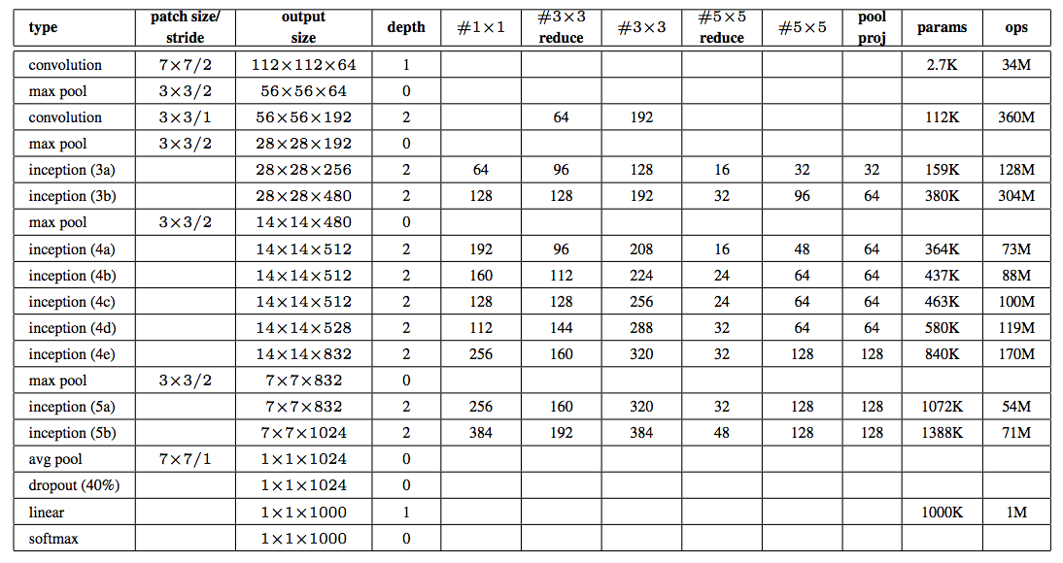
GoogLeNet
An alternative view:
C. Szegedy et al., Going deeper with convolutions, CVPR 2015

Slide 29
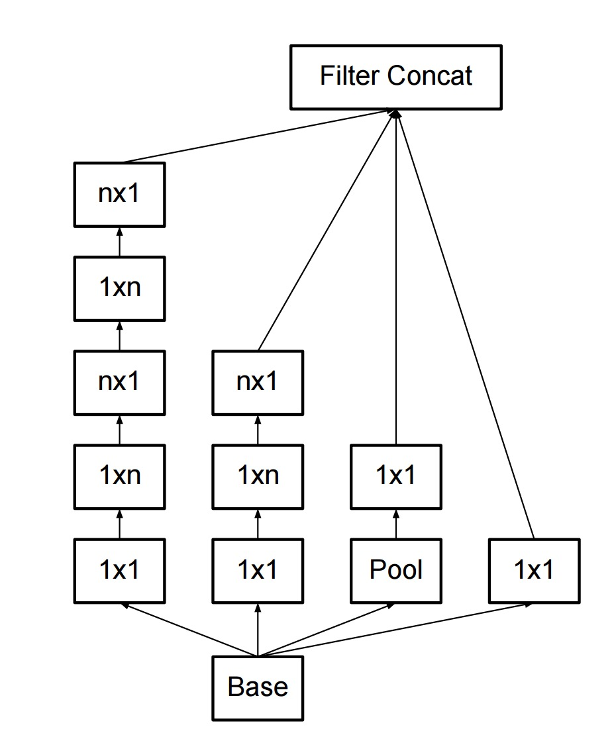
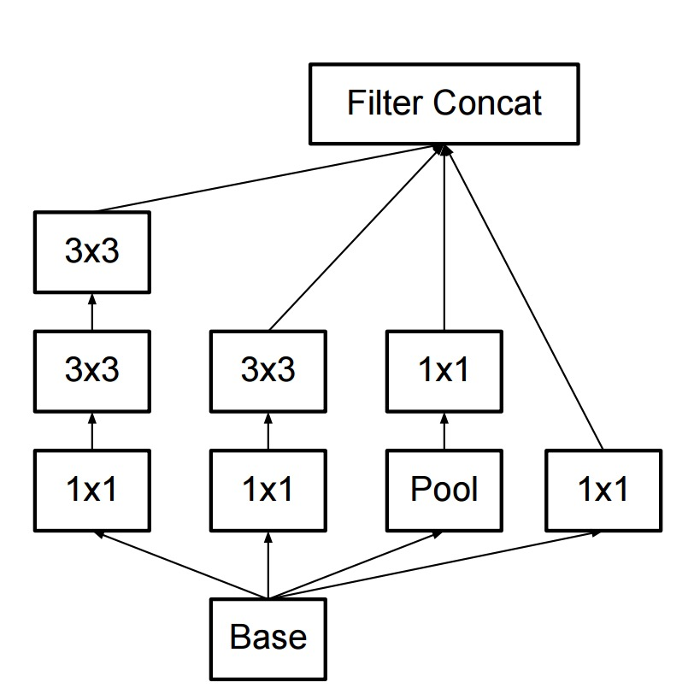
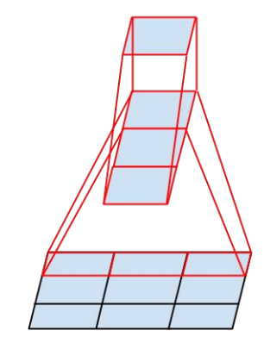
Inception v2, v3
Improve training with batch normalization, eliminating need for auxiliary classifiers
More variants of inception modules with aggressive factorization of filters
C. Szegedy et al., Rethinking the inception architecture for computer vision, CVPR 2016

Slide 30
ImageNet Challenge 2012-2014
Team | Year | Place | Error (top-5) | External data
SuperVision – Toronto (7 layers) | 2012 | - | 16.4% | no
SuperVision | 2012 | 1st | 15.3% | ImageNet 22k
Clarifai – NYU (7 layers) | 2013 | - | 11.7% | no
Clarifai | 2013 | 1st | 11.2% | ImageNet 22k
VGG – Oxford (16 layers) | 2014 | 2nd | 7.32% | no
GoogLeNet (19 layers) | 2014 | 1st | 6.67% | no
Human expert* |  |  | 5.1%
http://karpathy.github.io/2014/09/02/what-i-learned-from-competing-against-a-convnet-on-imagenet/
Notes:
Best non-convnet in 2012: 26.2%

Slide 31
Outline
AlexNet (2012-2013)
VGGNet (2014)
GoogLeNet (2014)
ResNet (2015)

Slide 32
ResNet: ILSVRC 2015 winner
K. He, X. Zhang, S. Ren, and J. Sun, Deep Residual Learning for Image Recognition, CVPR 2016 (Best Paper)

Slide 33
ResNet: ILSVRC 2015 winner
K. He, X. Zhang, S. Ren, and J. Sun, Deep Residual Learning for Image Recognition, CVPR 2016 (Best Paper)

Slide 34
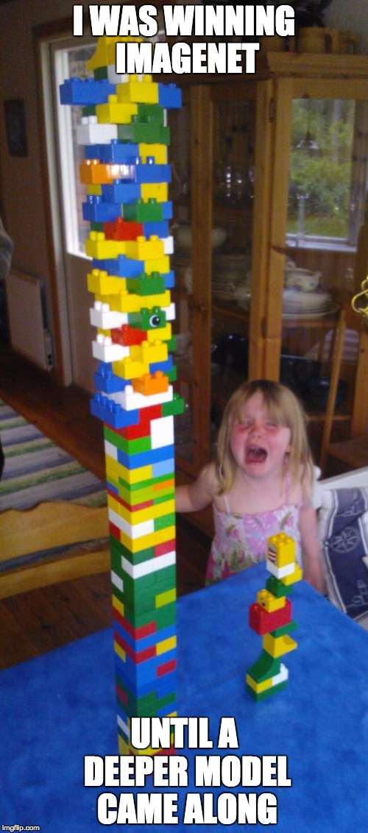
Source (?)

Slide 35
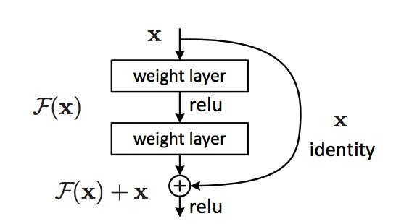
ResNet
The residual module
Introduce skip or shortcut connections (existing before in various forms in literature)
Make it easy for network layers to represent the identity mapping
K. He, X. Zhang, S. Ren, and J. Sun, Deep Residual Learning for Image Recognition, CVPR 2016 (Best Paper)

Slide 36
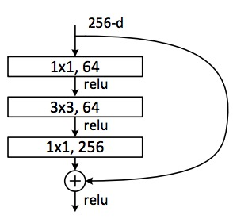
ResNet
Deeper residual module (bottleneck)
Directly performing $3×3$ convolutions with 256 feature maps at input and output: $256×256×3×3 ≈ 600K$operations
Using $1×1$ convolutions to reduce 256 to 64 feature maps, followed by $3×3$ convolutions, followed by 1$×$1 convolutions to expand back to 256 maps: $256×64×1×1 ≈ 16K$ $64×64×3×3 ≈ 36K$ $64×256×1×1 ≈ 16K$ Total $≈70K$
K. He, X. Zhang, S. Ren, and J. Sun, Deep Residual Learning for Image Recognition, CVPR 2016 (Best Paper)

Slide 37
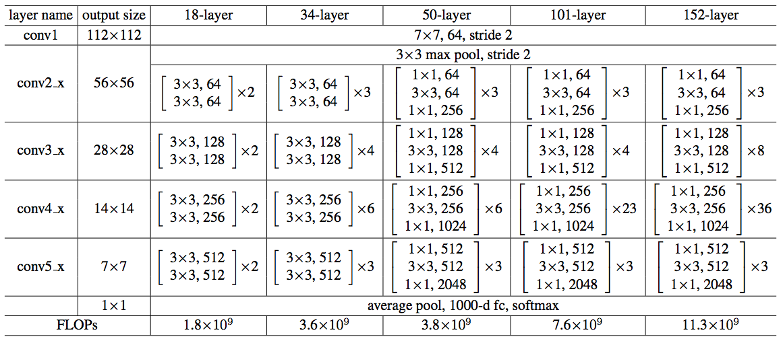
ResNet
Architectures for ImageNet:
K. He, X. Zhang, S. Ren, and J. Sun, Deep Residual Learning for Image Recognition, CVPR 2016 (Best Paper)

Slide 38
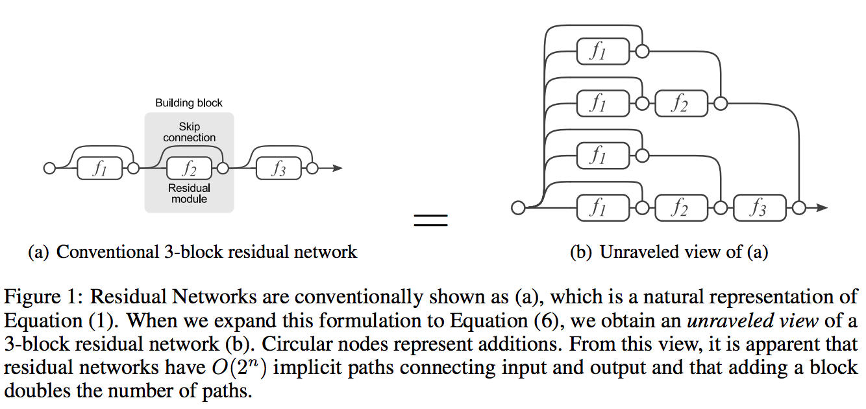
Why do ResNets work?
ResNets are collections of many paths of different length, and shorter paths predominantly contribute to training
A. Veit, M. Wilber, S. Belongie, Residual Networks Behave Like Ensembles of Relatively Shallow Networks, NIPS 2016
Notes:
In this work we propose a novel interpretation of residual networks showing that they can be seen as a collection of many paths of differing length. Moreover, residual networks seem to enable very deep networks by leveraging only the short paths during training. To support this observation, we rewrite residual networks as an explicit collection of paths. Unlike traditional models, paths through residual networks vary in length. Further, a lesion study reveals that these paths show ensemble-like behavior in the sense that they do not strongly depend on each other. Finally, and most surprising, most paths are shorter than one might expect, and only the short paths are needed during training, as longer paths do not contribute any gradient. For example, most of the gradient in a residual network with 110 layers comes from paths that are only 10-34 layers deep. Our results reveal one of the key characteristics that seem to enable the training of very deep networks: Residual networks avoid the vanishing gradient problem by introducing short paths which can carry gradient throughout the extent of very deep networks.

Slide 39
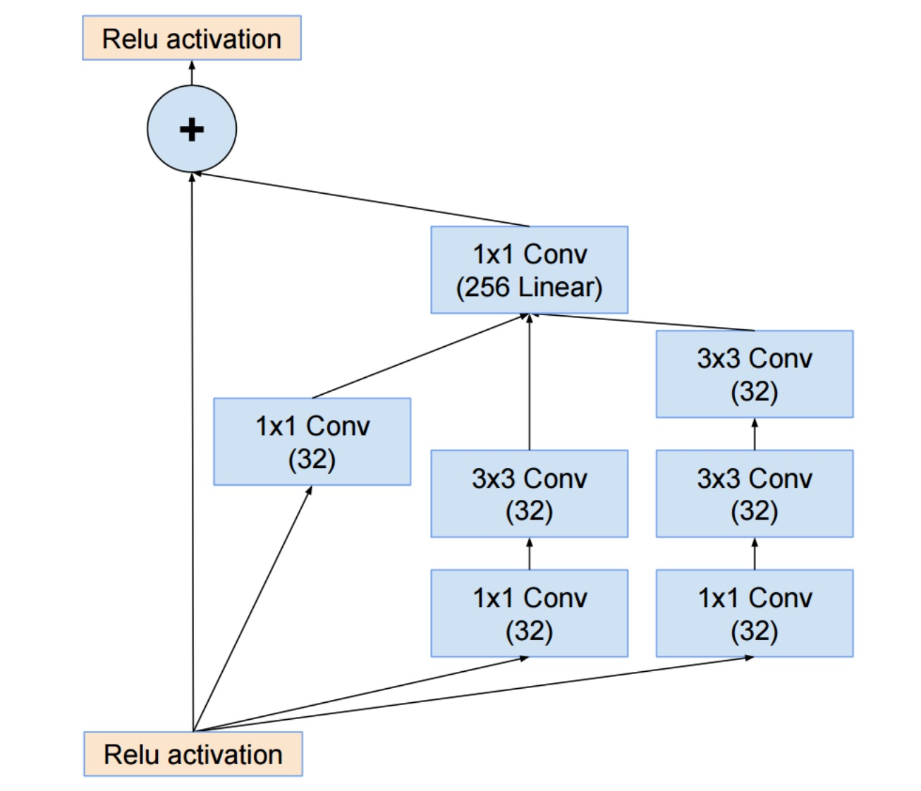
Inception v4
C. Szegedy et al., Inception-v4, Inception-ResNet and the Impact of Residual Connections on Learning, arXiv 2016

Slide 40
Summary: ILSVRC 2012-2015
Team | Year | Place | Error (top-5) | External data
SuperVision – Toronto (AlexNet, 7 layers) | 2012 | - | 16.4% | no
SuperVision | 2012 | 1st | 15.3% | ImageNet 22k
Clarifai – NYU (7 layers) | 2013 | - | 11.7% | no
Clarifai | 2013 | 1st | 11.2% | ImageNet 22k
VGG – Oxford (16 layers) | 2014 | 2nd | 7.32% | no
GoogLeNet (19 layers) | 2014 | 1st | 6.67% | no
ResNet (152 layers) | 2015 | 1st* | 3.57%
*Officially, there was no longer a classification competition and ResNet-based systems won in localization and detection

Slide 41
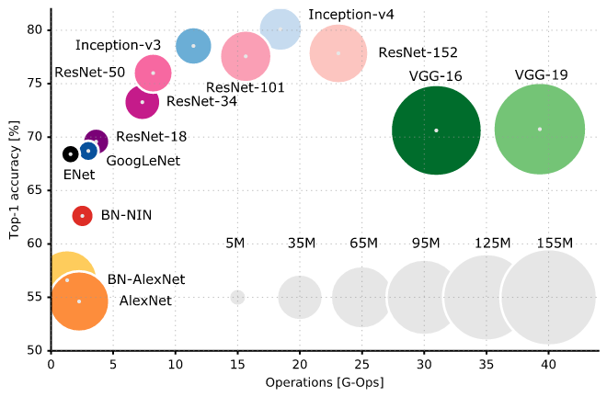
Comparing architectures
https://culurciello.github.io/tech/2016/06/04/nets.html

Slide 42
Outline
AlexNet (2012-2013)
VGGNet (2014)
GoogLeNet (2014)
ResNet (2015)
Beyond ResNet (2016 and onward): Wide ResNet, ResNeXT, DenseNet

Slide 43
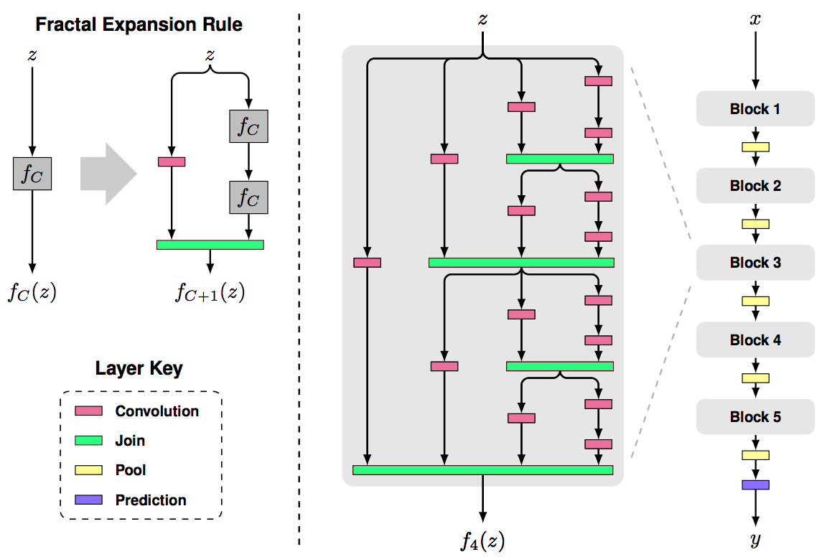
Beyond ResNet: FractalNet
Claim: key to good performance is not having skip connections (residuals), but having both shallow and deep paths
S. Larsson, M. Maire and G. Shakhnarovich, FractalNet: Ultra-Deep Neural Networks without Residuals, ICLR 2017
Notes:
Abstract: We introduce a design strategy for neural network macro-architecture based on selfsimilarity. Repeated application of a simple expansion rule generates deep networks whose structural layouts are precisely truncated fractals. These networks contain interacting subpaths of different lengths, but do not include any pass-through or residual connections; every internal signal is transformed by a filter and nonlinearity before being seen by subsequent layers. In experiments, fractal networks match the excellent performance of standard residual networks on both CIFAR and ImageNet classification tasks, thereby demonstrating that residual representations may not be fundamental to the success of extremely deep convolutional neural networks. Rather, the key may be the ability to transition, during training, from effectively shallow to deep. We note similarities with student-teacher behavior and develop drop-path, a natural extension of dropout, to regularize co-adaptation of subpaths in fractal architectures. Such regularization allows extraction of highperformance fixed-depth subnetworks. Additionally, fractal networks exhibit an anytime property: shallow subnetworks provide a quick answer, while deeper subnetworks, with higher latency, provide a more accurate answer

Slide 44
Beyond ResNet: Stochastic depth
At training time, in each mini-batch, randomly drop a subset of layers (bypass with identity function). At test time, use full network
Forces the network to learn better, speeds up convergence, improves accuracy
G. Huang, Y. Sun, Z. Liu, D. Sedra, and K. Weinberger, Deep Networks with Stochastic Depth, ECCV 2016
Notes:
From WRN paper: As gradient flows through the network there is nothing to force it to go through residual block weights and it can avoid learning anything during training, so it is possible that there is either only a few blocks that learn useful representations, or many blocks share very little information with small contribution to the final goal. This problem was formulated as diminishing feature reuse in [28]. The authors of [14] tried to address this problem with the idea of randomly disabling residual blocks during training.

Slide 45
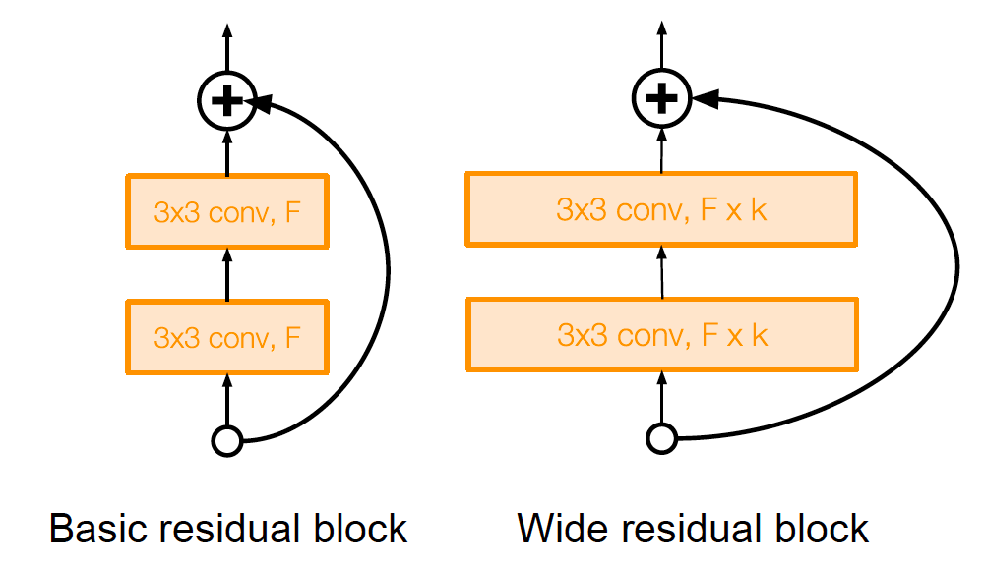
Beyond ResNet: Wide ResNet
Reduce number of residual blocks, but increase number of feature maps in each block
More parallelizable, better feature reuse
16-layer WRN outperforms 1000-layer ResNets, though with much larger # of parameters
Image source
S. Zagoryuko and N. Komodakis, Wide Residual Networks, BMVC 2016

Slide 46
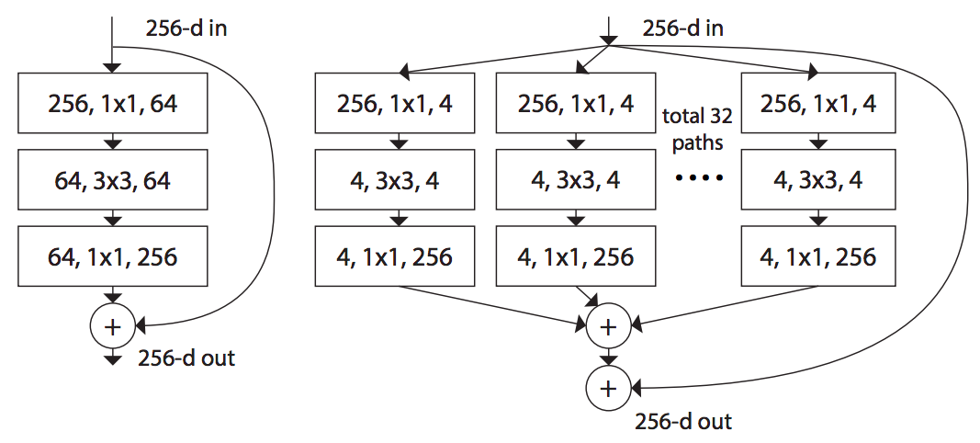
Beyond ResNet: ResNeXt
Propose “cardinality” as a new factor in network design, apart from depth and width
Claim that increasing cardinality is a better way to increase capacity than increasing depth or width
ResNet
ResNeXt, roughly same complexity
S. Xie, R. Girshick, P. Dollar, Z. Tu, and K. He, Aggregated Residual Transformations for Deep Neural Networks, CVPR 2017
Notes:
Abstract: We present a simple, highly modularized network architecture for image classification. Our network is constructed by repeating a building block that aggregates a set of transformations with the same topology. Our simple design results in a homogeneous, multi-branch architecture that has only a few hyper-parameters to set. This strategy exposes a new dimension, which we call “cardinality” (the size of the set of transformations), as an essential factor in addition to the dimensions of depth and width. On the ImageNet-1K dataset, we empirically show that even under the restricted condition of maintaining complexity, increasing cardinality is able to improve classification accuracy. Moreover, increasing cardinality is more effective than going deeper or wider when we increase the capacity.

Slide 47
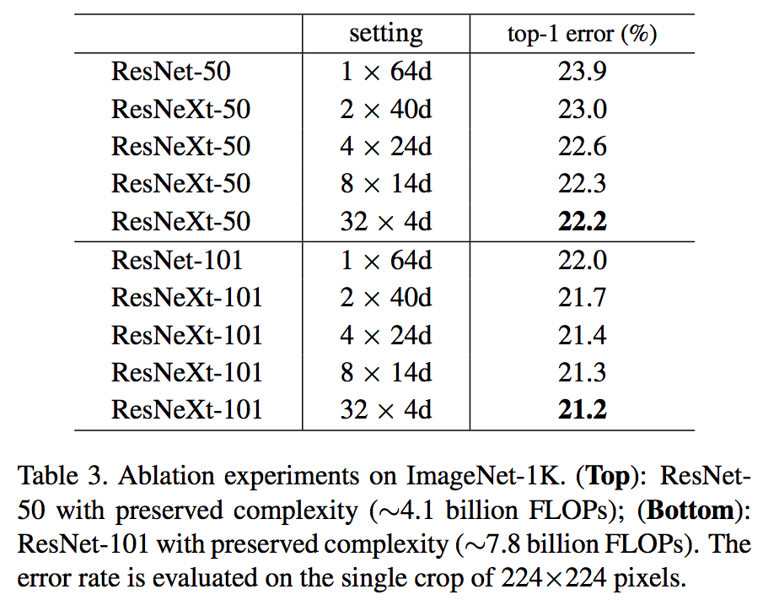
Beyond ResNet: ResNeXt
S. Xie, R. Girshick, P. Dollar, Z. Tu, and K. He, Aggregated Residual Transformations for Deep Neural Networks, CVPR 2017

Slide 48
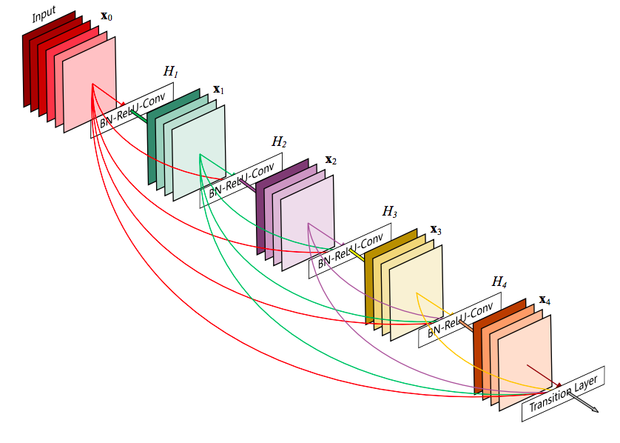
Beyond ResNet: DenseNets
G. Huang, Z. Liu, and L. van der Maaten, Densely Connected Convolutional Networks, CVPR 2017 (Best Paper Award)

Slide 49
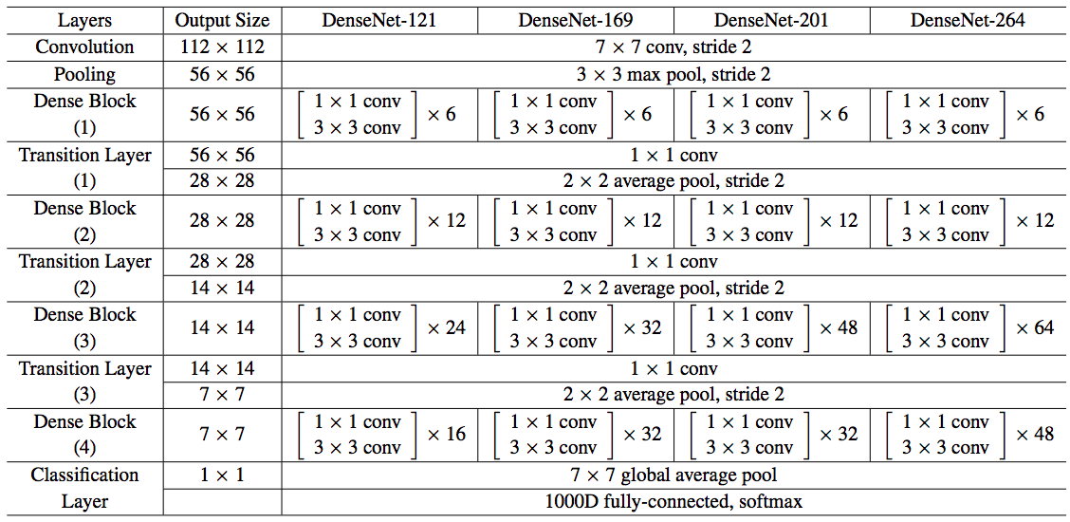
DenseNets
G. Huang, Z. Liu, and L. van der Maaten, Densely Connected Convolutional Networks, CVPR 2017 (Best Paper Award)

Slide 50
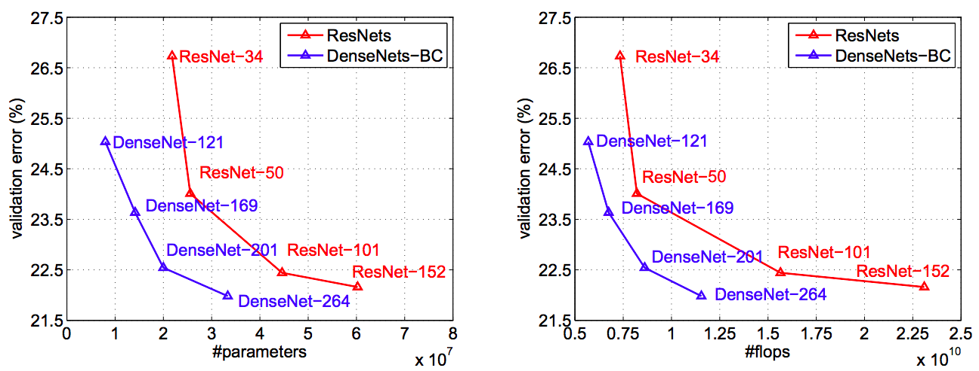
DenseNets
ImageNet validation error vs. number of parameters and test-time operations
G. Huang, Z. Liu, and L. van der Maaten, Densely Connected Convolutional Networks, CVPR 2017 (Best Paper Award)

Slide 51
How to use a pre-trained network for a new task?
Strategy 1: Use as feature extractor
Remove these layers
Use as off-the-shelf feature

Slide 52
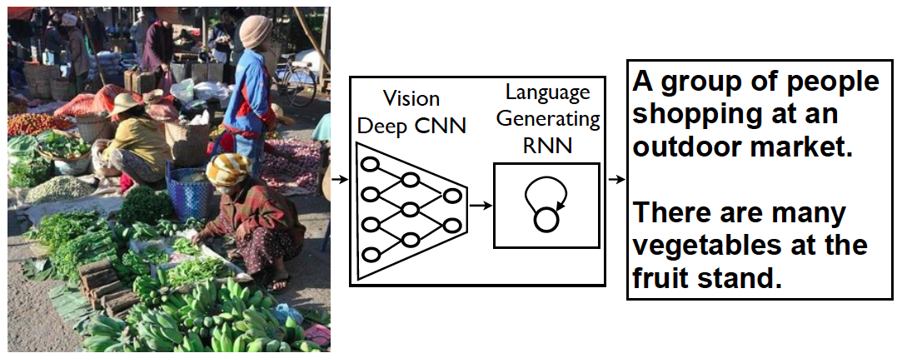
Example: CNNs for image captioning
FC vectors from pre-trained network
O. Vinyals, A. Toshev, S. Bengio, and D. Erhan. Show and tell: A neural image caption generator. CVPR 2015

Slide 53
How to use a pre-trained network for a new task?
Strategy 2: Transfer learning
Train new prediction layer(s)
Keep frozen or fine-tune

