Slide 1
Object detection
Image source

Slide 2
Outline
Task definition and evaluation
Two-stage detectors:
  R-CNN
  Fast R-CNN
  Faster R-CNN
Single-stage and multi-resolution detectors
Other detectors: CornerNet, DETR

Slide 3
Object detection evaluation
At test time, predict bounding boxes, class labels, and confidence scores
For each detection, determine whether it is a true or false positive
  But how?
dog: 0.6
dog
dog: 0.55
cat: 0.8
cat
Ground truth (GT)

Slide 4
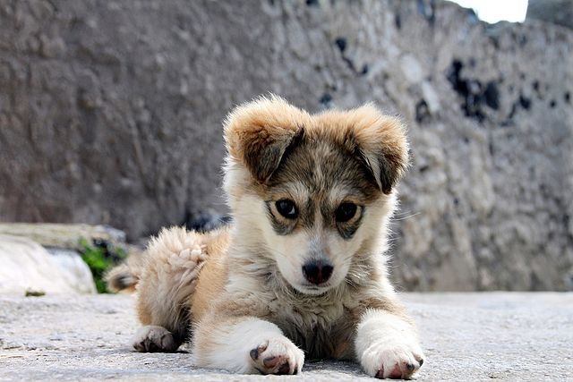
Comparing Boxes: Intersection over Union (IoU)
How can we compare our prediction to the ground-truth box?
Our Prediction
Ground Truth
Source: J. Johnson

Slide 5
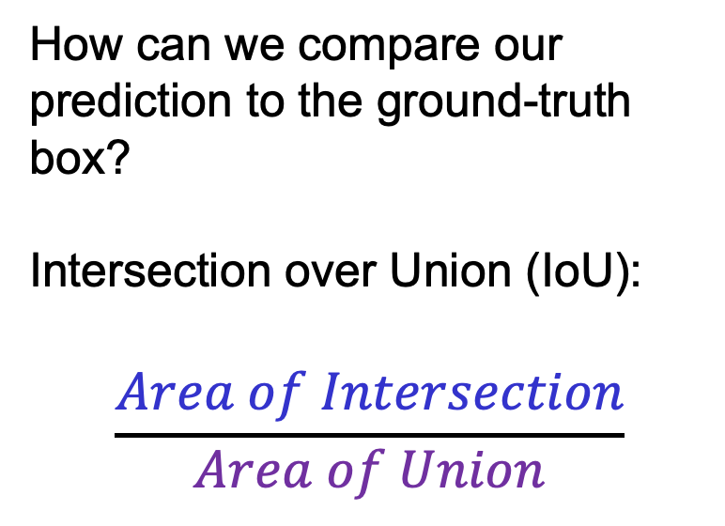
Comparing Boxes: Intersection over Union (IoU)
How can we compare our prediction to the ground-truth box?
Intersection over Union (IoU):
$$\frac{Area of Intersection}{Area of Union}$$
Our Prediction
Ground Truth
Source: J. Johnson

Slide 6
Comparing Boxes: Intersection over Union (IoU)
How can we compare our prediction to the ground-truth box?
Intersection over Union (IoU):
$$\frac{Area of Intersection}{Area of Union}$$
Our Prediction
Ground Truth
Source: J. Johnson

Slide 7
Comparing Boxes: Intersection over Union (IoU)
How can we compare our prediction to the ground-truth box?
Intersection over Union (IoU):
$$\frac{Area of Intersection}{Area of Union}$$
Our Prediction
Ground Truth
IoU = 0.51
IoU > 0.5 is “decent”
Source: J. Johnson

Slide 8
Comparing Boxes: Intersection over Union (IoU)
How can we compare our prediction to the ground-truth box?
Intersection over Union (IoU):
$$\frac{Area of Intersection}{Area of Union}$$
Our Prediction
Ground Truth
IoU = 0.72
IoU > 0.5 is “decent”
IoU > 0.7 is “pretty good”
Source: J. Johnson

Slide 9
Comparing Boxes: Intersection over Union (IoU)
How can we compare our prediction to the ground-truth box?
Intersection over Union (IoU):
$$\frac{Area of Intersection}{Area of Union}$$
Our Prediction
Ground Truth
IoU = 0.91
IoU > 0.5 is “decent”
IoU > 0.7 is “pretty good”
IoU > 0.9 is “almost perfect”
Source: J. Johnson

Slide 10
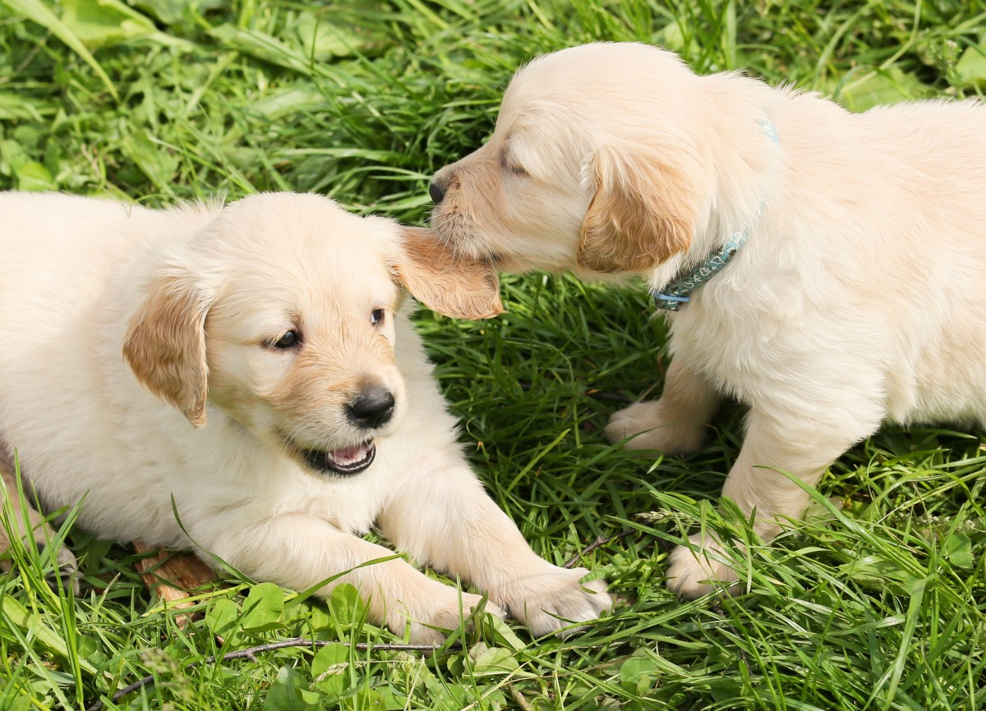
Non-maximum suppression
Problem: Detectors often output many overlapping detections
Solution: Post-process raw detections using Non-Max Suppression (NMS)
P(dog) = 0.75
P(dog) = 0.9
P(dog) = 0.7
P(dog) = 0.8
Source: J. Johnson

Slide 11
Non-maximum suppression
Problem: Detectors often output many overlapping detections
Solution: Post-process raw detections using Non-Max Suppression (NMS)
Select next highest-scoring box
Eliminate lower-scoring boxes with IoU > threshold (e.g. 0.7)
If any boxes remain, GOTO 1
P(dog) = 0.75
P(dog) = 0.9
P(dog) = 0.7
P(dog) = 0.8
Source: J. Johnson

Slide 12
Non-maximum suppression
Problem: Detectors often output many overlapping detections
Solution: Post-process raw detections using Non-Max Suppression (NMS)
Select next highest-scoring box
Eliminate lower-scoring boxes with IoU > threshold (e.g. 0.7)
If any boxes remain, GOTO 1
P(dog) = 0.75
P(dog) = 0.9
P(dog) = 0.7
P(dog) = 0.8
Source: J. Johnson

Slide 13
Non-maximum suppression
Problem: Detectors often output many overlapping detections
Solution: Post-process raw detections using Non-Max Suppression (NMS)
Select next highest-scoring box
Eliminate lower-scoring boxes with IoU > threshold (e.g. 0.7)
If any boxes remain, GOTO 1
P(dog) = 0.75
P(dog) = 0.9
P(dog) = 0.7
Source: J. Johnson

Slide 14
Non-maximum suppression
Problem: Detectors often output many overlapping detections
Solution: Post-process raw detections using Non-Max Suppression (NMS)
Select next highest-scoring box
Eliminate lower-scoring boxes with IoU > threshold (e.g. 0.7)
If any boxes remain, GOTO 1
P(dog) = 0.75
P(dog) = 0.9
P(dog) = 0.7
Source: J. Johnson

Slide 15
Non-maximum suppression
Problem: Detectors often output many overlapping detections
Solution: Post-process raw detections using Non-Max Suppression (NMS)
Select next highest-scoring box
Eliminate lower-scoring boxes with IoU > threshold (e.g. 0.7)
If any boxes remain, GOTO 1
P(dog) = 0.75
P(dog) = 0.9
Source: J. Johnson

Slide 16
Non-maximum suppression
Problem: Detectors often output many overlapping detections
Solution: Post-process raw detections using Non-Max Suppression (NMS)
Select next highest-scoring box
Eliminate lower-scoring boxes with IoU > threshold (e.g. 0.7)
If any boxes remain, GOTO 1
P(dog) = 0.75
P(dog) = 0.9
Source: J. Johnson

Slide 17

Non-maximum suppression
How would NMS do on an image like this?
It will eliminate “good” boxes when objects are highly overlapping
Source: J. Johnson

Slide 18
Evaluating object detectors
All detections sorted by score
Run object detector on all test images (with NMS)
For each category, compute Average Precision (AP) or area under Precision vs. Recall Curve
0.99
0.95
0.90
0.5
0.10
All ground-truth boxes
Source: J. Johnson

Slide 19
Evaluating object detectors
All detections sorted by score
Run object detector on all test images (with NMS)
For each category, compute Average Precision (AP) or area under Precision vs. Recall Curve
  For each detection (highest to lowest score)
    If it matches some GT box with IoU > 0.5, mark it as positive and eliminate the GT
    Otherwise mark it as negative
0.99
0.95
0.90
0.5
0.10
Match: IoU > 0.5
All ground-truth boxes
Source: J. Johnson

Slide 20
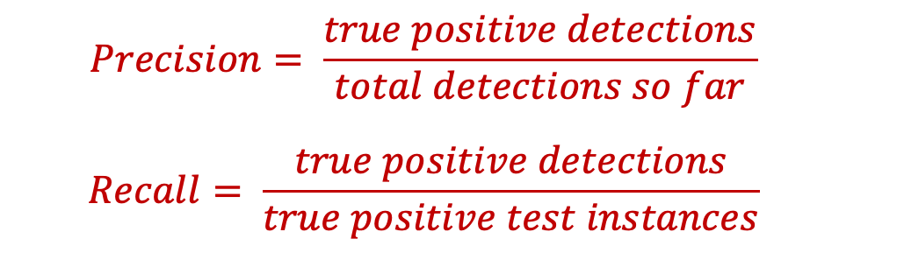
Evaluating object detectors
All detections sorted by score
Run object detector on all test images (with NMS)
For each category, compute Average Precision (AP) or area under Precision vs. Recall Curve
  For each detection (highest to lowest score)
    If it matches some GT box with IoU > 0.5, mark it as positive and eliminate the GT
    Otherwise mark it as negative
    Plot a point on PR Curve
0.99
0.95
0.90
0.5
0.10
All ground-truth boxes
  $$Precision= \frac{true positive detections}{total detections so far}$$
  $$Recall= \frac{true positive detections}{true positive test instances}$$
Precision
1.0
Source: J. Johnson
Recall

Slide 21
Evaluating object detectors
All detections sorted by score
Run object detector on all test images (with NMS)
For each category, compute Average Precision (AP) or area under Precision vs. Recall Curve
  For each detection (highest to lowest score)
    If it matches some GT box with IoU > 0.5, mark it as positive and eliminate the GT
    Otherwise mark it as negative
    Plot a point on PR Curve
0.99
0.95
0.90
0.5
0.10
Match: IoU > 0.5
All ground-truth boxes
Precision = 1/1 = 1.0
Recall = 1/3 = 0.33
Precision
1.0
Source: J. Johnson
Recall

Slide 22
Evaluating object detectors
All detections sorted by score
Run object detector on all test images (with NMS)
For each category, compute Average Precision (AP) or area under Precision vs. Recall Curve
  For each detection (highest to lowest score)
    If it matches some GT box with IoU > 0.5, mark it as positive and eliminate the GT
    Otherwise mark it as negative
    Plot a point on PR Curve
0.99
0.95
0.90
0.5
0.10
Match: IoU > 0.5
All ground-truth boxes
Precision = 2/2 = 1.0
Recall = 2/3 = 0.67
Precision
1.0
Source: J. Johnson
Recall

Slide 23
Evaluating object detectors
All detections sorted by score
Run object detector on all test images (with NMS)
For each category, compute Average Precision (AP) or area under Precision vs. Recall Curve
  For each detection (highest to lowest score)
    If it matches some GT box with IoU > 0.5, mark it as positive and eliminate the GT
    Otherwise mark it as negative
    Plot a point on PR Curve
0.99
0.95
0.90
0.5
0.10
No match > 0.5 IoU with GT
All ground-truth boxes
Precision
Precision = 2/3 = 0.67
Recall = 2/3 = 0.67
1.0
Source: J. Johnson
Recall

Slide 24
Evaluating object detectors
All detections sorted by score
Run object detector on all test images (with NMS)
For each category, compute Average Precision (AP) or area under Precision vs. Recall Curve
  For each detection (highest to lowest score)
    If it matches some GT box with IoU > 0.5, mark it as positive and eliminate the GT
    Otherwise mark it as negative
    Plot a point on PR Curve
0.99
0.95
0.90
0.5
0.10
No match > 0.5 IoU with GT
All ground-truth boxes
Precision
Precision = 2/4 = 0.5
Recall = 2/3 = 0.67
1.0
Source: J. Johnson
Recall

Slide 25
Evaluating object detectors
All detections sorted by score
Run object detector on all test images (with NMS)
For each category, compute Average Precision (AP) or area under Precision vs. Recall Curve
  For each detection (highest to lowest score)
    If it matches some GT box with IoU > 0.5, mark it as positive and eliminate the GT
    Otherwise mark it as negative
    Plot a point on PR Curve
0.99
0.95
0.90
0.5
0.10
Match: > 0.5 IoU
All ground-truth boxes
Precision
Precision = 3/5 = 0.6
Recall = 3/3 = 1.0
1.0
Source: J. Johnson
Recall

Slide 26
Object detection: Outline
Task definition and evaluation
Two-stage detectors:
  R-CNN
  Fast R-CNN
  Faster R-CNN
Single-stage and multi-resolution detectors
Other detectors: CornerNet, DETR

Slide 27
Evaluating object detectors
All detections sorted by score
Run object detector on all test images (with NMS)
For each category, compute Average Precision (AP) or area under Precision vs. Recall Curve
  For each detection (highest to lowest score)
    If it matches some GT box with IoU > 0.5, mark it as positive and eliminate the GT
    Otherwise mark it as negative
    Plot a point on PR Curve
  Average Precision (AP) = area under PR curve
0.99
0.95
0.90
0.5
0.10
All ground-truth boxes
Precision
AP = 0.86
1.0
Source: J. Johnson
Recall

Slide 28
Evaluating object detectors
All detections sorted by score
Run object detector on all test images (with NMS)
For each category, compute Average Precision (AP) or area under Precision vs. Recall Curve
0.99
0.95
0.90
0.5
0.10
How to get AP = 1.0?
Hit all GT boxes with IoU > 0.5, and have no “false positive” detections ranked above any “true positives”
All ground-truth boxes
Precision
AP = 0.86
1.0
Source: J. Johnson
Recall

Slide 29
Object detection evaluation
At test time, predict bounding boxes, class labels, and confidence scores
For each detection, determine whether it is a true or false positive
For each class, sort detections from highest to lowest confidence, plot Recall-Precision curve and compute Average Precision
(area under the curve)
Take mean of AP over classes to get mAP
  Precision:
  true positive detections /
  total detections
  Recall:
  true positive detections /
  total positive test instances

Slide 30
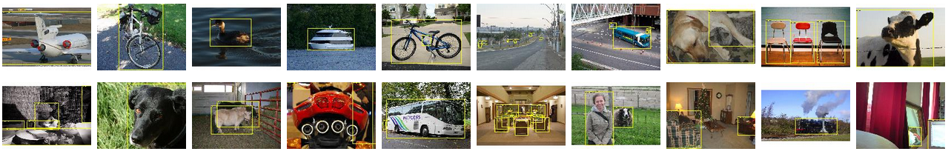
PASCAL VOC Challenge (2005-2012)
20 challenge classes:
  Person
  Animals: bird, cat, cow, dog, horse, sheep
  Vehicles: airplane, bicycle, boat, bus, car, motorbike, train
  Indoor: bottle, chair, dining table, potted plant, sofa, tv/monitor
Dataset size (by 2012): 11.5K training/validation images, 27K bounding boxes, 7K segmentations
http://host.robots.ox.ac.uk/pascal/VOC/

Slide 31
Progress on PASCAL detection
PASCAL VOC
Before CNNs
After CNNs

Slide 32
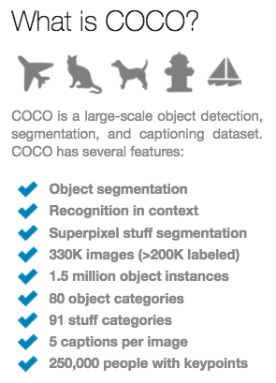
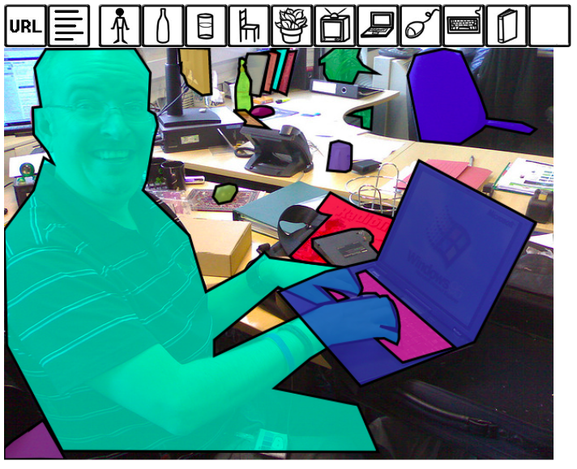
More recent benchmark: COCO
http://cocodataset.org/#home

Slide 33
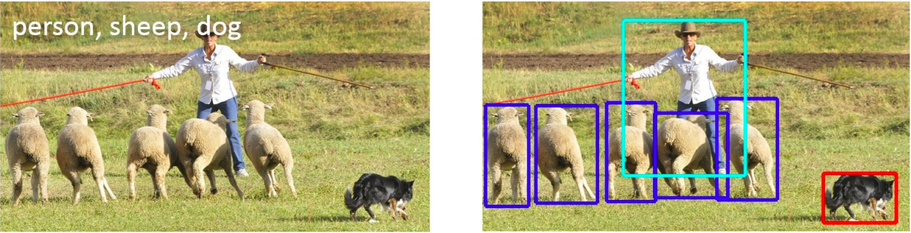
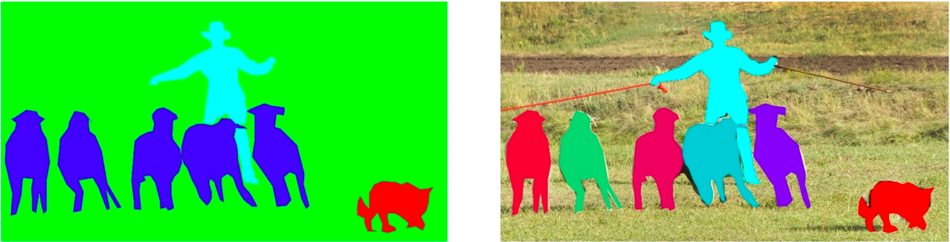
COCO dataset: Tasks
image classification
object detection
semantic segmentation
instance segmentation
Also: keypoint prediction, captioning, question answering…

Slide 34
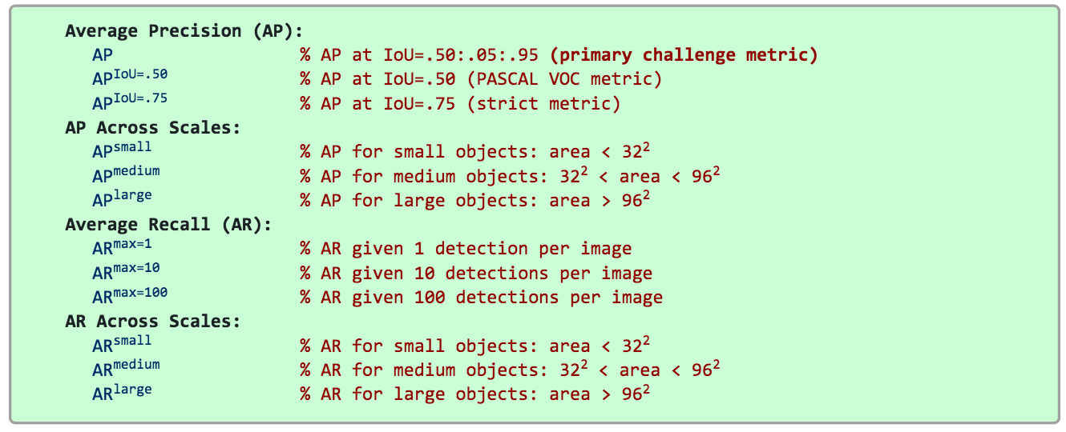
COCO detection metrics
Leaderboard: http://cocodataset.org/#detection-leaderboard
  Not updated since 2020

Slide 35
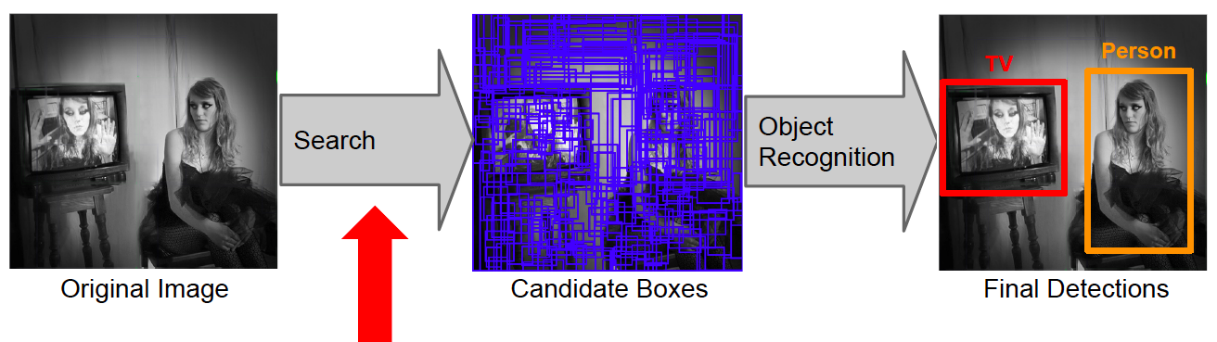
Object detection: Outline
Task definition and evaluation
Two-stage detectors
Proposal Generation
Region Proposals
Image source

Slide 36
R-CNN: Region proposals + CNN features
Source: R. Girshick
SVMs
Classify regions with SVMs
SVMs
ConvNet
SVMs
ConvNet
Forward each region through ConvNet
ConvNet
Warped image regions
Region proposals
Input image
R. Girshick, J. Donahue, T. Darrell, and J. Malik, Rich Feature Hierarchies for Accurate Object Detection and Semantic Segmentation, CVPR 2014
Notes:
The features are also sent to a linear regressor that improves object localization.
The components outlined in purple are “post hoc” in the sense that they are learned after the convnet weights are trained and forever frozen.

Slide 37
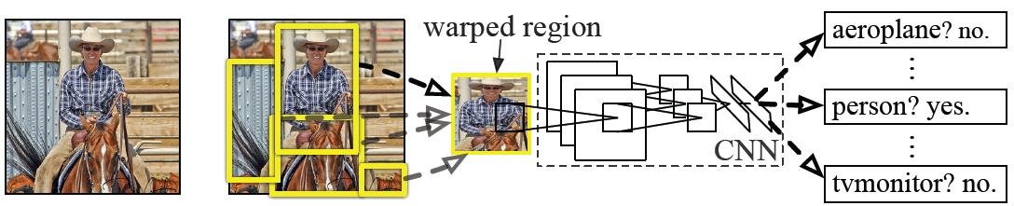
R-CNN details
Regions: ~2000 Selective Search proposals
Network: AlexNet pre-trained on ImageNet (1000 classes), fine-tuned on PASCAL (21 classes)
Final detector: warp proposal regions, extract fc7 network activations (4096 dimensions), classify with linear SVM
Bounding box regression to refine box locations
Performance: mAP of 53.7% on PASCAL 2010
(vs. 35.1% for Selective Search and 33.4% for Deformable Part Models)
Notes:
Object detection system overview. Our system (1) takes an input image, (2) extracts around 2000 bottom-up region proposals, (3) computes features for each proposal using a large convolutional neural network (CNN), and then (4) classifies each region using class-specific linear SVMs. R-CNN achieves a mean average precision (mAP) of 53.7% on PASCAL VOC 2010. For comparison, Uijlings et al. (2013) report 35.1% mAP using the same region proposals, but with a spatial pyramid and bag-of-visual-words approach. The popular deformable part models perform at 33.4%.

Slide 38
R-CNN pros and cons
Pros
  Much more accurate than previous approaches!
  Any deep architecture can immediately be “plugged in”
Cons
  Not a single end-to-end system
    Fine-tune network with softmax classifier (log loss)
    Train post-hoc linear SVMs (hinge loss)
    Train post-hoc bounding-box regressions (least squares)
  Training was slow (84h), took up a lot of storage
    2000 CNN passes per image
  Inference (detection) was slow (47s / image with VGG16)

Slide 39
Fast R-CNN
Softmax classifier
Linear +
softmax
Linear
Bounding-box regressors
FCs
Fully-connected layers
RoI Pooling layer
Region proposals
Conv5 feature map of image
ConvNet
Forward whole image through ConvNet
Source: R. Girshick
R. Girshick, Fast R-CNN, ICCV 2015
Notes:
Rather than using post-hoc bounding-box regressors, bounding-box regression is implemented as an additional linear layer in the network

Slide 40
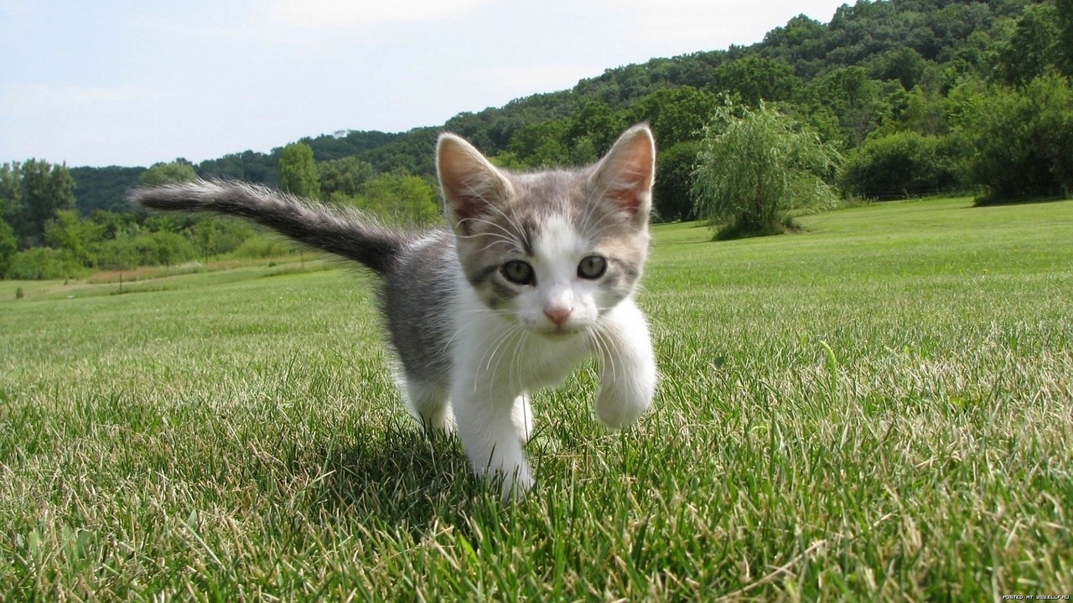
RoI pooling
Input Image
(e.g., 3 x 640 x 480)
Source: J. Johnson

Slide 41
RoI pooling
CNN
Input Image
(e.g., 3 x 640 x 480)
Feature map
(e.g., 512 x 20 x 15)
Source: J. Johnson

Slide 42
RoI pooling
Project proposal onto features
CNN
Input Image
(e.g., 3 x 640 x 480)
Feature map
(e.g., 512 x 20 x 15)
Source: J. Johnson

Slide 43
RoI pooling
“Snap” proposal to feature grid
Project proposal onto features
Want fixed-size RoI representation regardless of its size
CNN
Input Image
(e.g., 3 x 640 x 480)
Feature map
(e.g., 512 x 20 x 15)
Source: J. Johnson

Slide 44
RoI pooling
Divide into (roughly) equal sub-regions
Project proposal onto features
CNN
Input Image
(e.g., 3 x 640 x 480)
Feature map
(e.g., 512 x 20 x 15)
Source: J. Johnson

Slide 45
RoI pooling
Divide into (roughly) equal sub-regions
Project proposal onto features
Max-pool within each subregion
CNN
Region features
(here 512 x 2 x 2;
In practice 512 x 7 x 7)
Input Image
(e.g., 3 x 640 x 480)
Feature map
(e.g., 512 x 20 x 15)
Source: J. Johnson

Slide 46
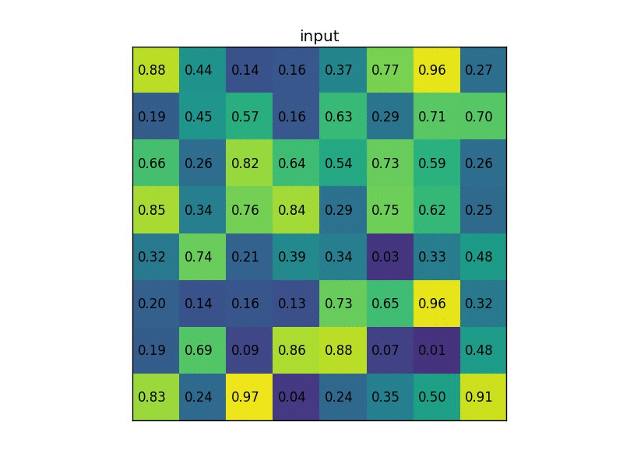
RoI pooling illustration
Image source

Slide 47
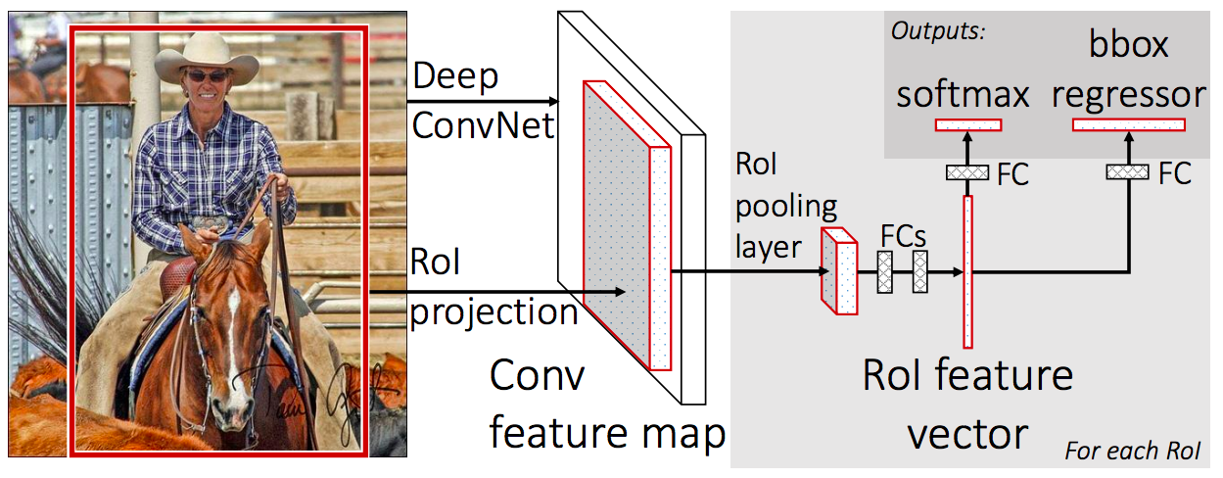

Prediction
For each RoI, network predicts probabilities for $C+1$ classes (class 0 is background) and four bounding box offsets for $C$ classes
R. Girshick, Fast R-CNN, ICCV 2015

Slide 48
Fast R-CNN training
Log loss + smooth L1 loss
Multi-task loss
Linear +
softmax
Linear
FCs
Trainable
ConvNet
Source: R. Girshick
R. Girshick, Fast R-CNN, ICCV 2015
Notes:
Rather than using post-hoc bounding-box regressors, bounding-box regression is implemented as an additional linear layer in the network

Slide 49
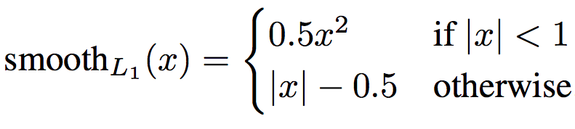
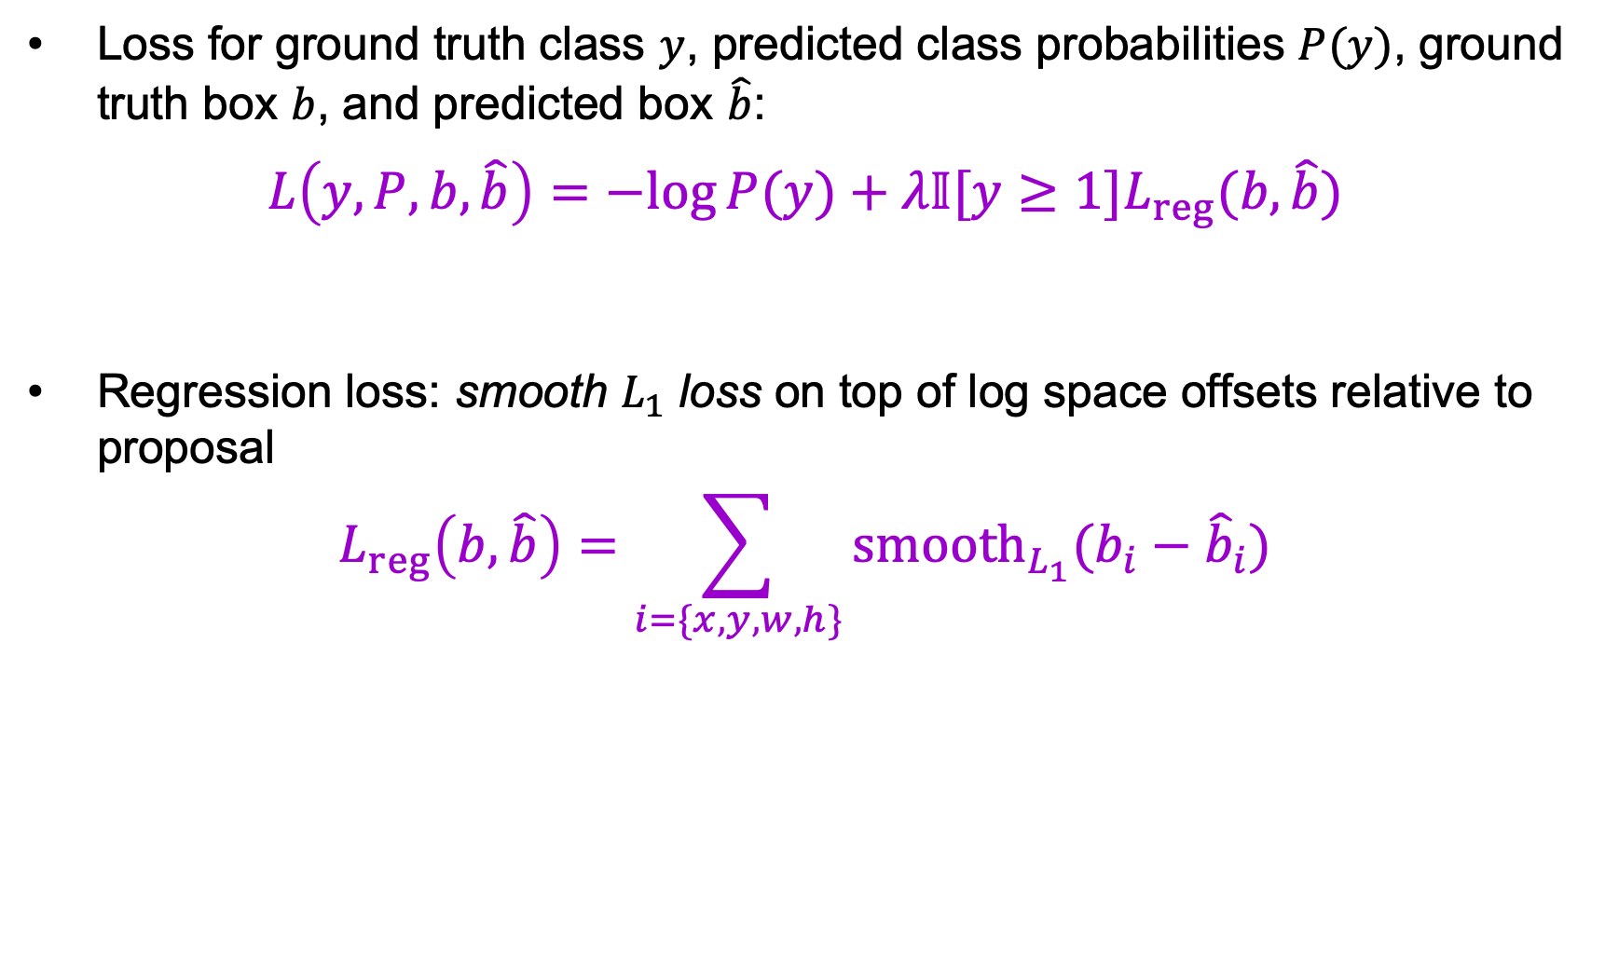
Multi-task loss
Loss for ground truth class $y$, predicted class probabilities $P(y)$, ground truth box $b$, and predicted box $\hat{b}$:
$$L\left(y, P, b,\hat{b}\right)=−log⁡P(y)+λ𝕀[y≥1]L_{reg}(b,\hat{b})$$
Regression loss: smooth $L_{1}$ loss on top of log space offsets relative to proposal
$$L_{reg}\left(b,\hat{b}\right)=\sum_{i=\{x,y,w,h\}}{{smooth}_{L_{1}}(b_{i}−{\hat{b}}_{i}})$$
softmax loss
regression loss

Slide 50
Bounding box regression
Ground truth box
Target offset to predict*
Region proposal
(a.k.a default box, prior, reference, anchor)
Loss
Predicted offset
Predicted box
*Typically in transformed, normalized coordinates

Slide 51







ROI pooling: Backpropagation
Similar to max pooling, but has to take into account overlap of pooling regions
$$r_{1}$$
RoI pooling
$$z_{1,4}$$
$$r_{1}$$
$$z_{2,1}$$
$$x_{33}$$
$$r_{2}$$
$$r_{2}$$
RoI pooling
Feature Map
Source: Ross Girshick

Slide 52






ROI pooling: Backpropagation
Similar to max pooling, but has to take into account overlap of pooling regions
$$r_{1}$$
$$i^{∗}\left(1,4\right)=33$$
$$z_{1,4}$$
$$i^{∗}\left(2,1\right)=33$$
$$r_{1}$$
$$z_{2,1}$$
Backward Pass:
Have $\frac{∂e}{∂z}$,
want $\frac{∂e}{∂x}$
max pooling “switch” (argmax back-pointer)
$$x_{33}$$
$$r_{2}$$
$$r_{2}$$
$$\frac{∂e}{∂x_{i}}=\sum_{r}{\sum_{j}{\frac{∂e}{∂z_{rj}}}}\frac{∂z_{rj}}{∂x_{i}}=\sum_{r}{\sum_{j}{𝕀\left[i=i^{∗}\left(r,j\right)\right]\frac{∂e}{∂z_{rj}}}}$$
Over regions $r$,
RoI indices $j$
1 if $r, j$ “pooled”
input $i$; 0 o/w
Source: Ross Girshick

Slide 53
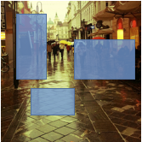
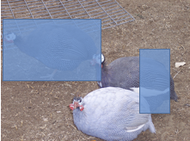
Mini-batch sampling
Sample a few images (e.g., 2)
Sample many regions from each image (64)
...
...
...
...
Sample images
SGD mini-batch
Source: R. Girshick, K. He

Slide 54
Fast R-CNN results
 | Fast R-CNN | R-CNN
Train time (h) | 9.5 | 84
- Speedup | 8.8x
Test time / image | 0.32s | 47.0s
- Test speedup | 146x
mAP | 66.9% | 66.0%
(vs. 53.7% for AlexNet)
Timings exclude object proposal time, which is equal for all methods.
All methods use VGG16.
Source: R. Girshick, K. He
Notes:
These speed improvements do not sacrifice object detection accuracy. In fact, mean average precision is better than the baseline methods due to our improved training.

Slide 55
Announcements and reminders
Quiz 2 will be out 9AM this Friday, March 22, through 9AM next Tuesday, March 26
MP3 is out, due Wednesday, April 3
Project progress updates will be due Friday, April 12

Slide 56
Object detection: Outline
Task definition and evaluation
Two-stage detectors:
  R-CNN
  Fast R-CNN
  Faster R-CNN
Single-stage and multi-resolution detectors
Other detectors: CornerNet, DETR

Slide 57
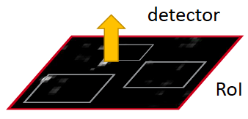
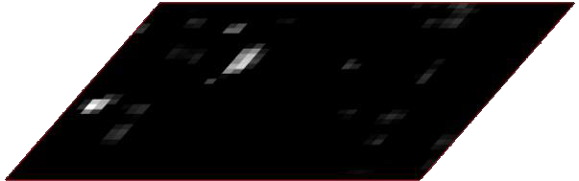
Faster R-CNN
Region proposals
Region Proposal Network
feature map
CNN
S. Ren, K. He, R. Girshick, and J. Sun, Faster R-CNN: Towards Real-Time Object Detection with Region Proposal Networks, NIPS 2015

Slide 58
Region proposal network (RPN)
Idea: tile the image with “anchor boxes” of a set size and try to predict how likely each anchor is to contain an object
Anchor is an object?
Figure source: J. Johnson

Slide 59
Region proposal network (RPN)
Idea: tile the image with “anchor boxes” of a set size and try to predict how likely each anchor is to contain an object
Anchor is an object?
Figure source: J. Johnson

Slide 60
Region proposal network (RPN)
Idea: tile the image with “anchor boxes” of a set size and try to predict how likely each anchor is to contain an object
Anchor is an object?
Figure source: J. Johnson

Slide 61
Region proposal network (RPN)
Idea: tile the image with “anchor boxes” of a set size and try to predict how likely each anchor is to contain an object
Anchor is an object?
Figure source: J. Johnson

Slide 62
Region proposal network (RPN)
Idea: tile the image with “anchor boxes” of a set size and try to predict how likely each anchor is to contain an object
Introduce anchor boxes at multiple scales and aspect ratios to handle a wider range of object sizes and shapes
Anchor is an object?
Anchor is an object?
Anchor is an object?
Anchor is an object?
Figure source: J. Johnson

Slide 63
Region proposal network (RPN)
Idea: put an “anchor box” of fixed size over each position in the feature map and try to predict whether this box is likely to contain an object
Anchor is an object?
Figure source: J. Johnson

Slide 64
Region proposal network (RPN)
Idea: put an “anchor box” of fixed size over each position in the feature map and try to predict whether this box is likely to contain an object
Anchor is an object?
Figure source: J. Johnson

Slide 65
Region proposal network (RPN)
Idea: put an “anchor box” of fixed size over each position in the feature map and try to predict whether this box is likely to contain an object
Anchor is an object?
Conv
Figure source: J. Johnson

Slide 66
Region proposal network (RPN)
Implementation: put conv layers over low-resolution feature grid, for each grid location predict “object/no object” scores and bounding box regression coordinates
(obj score, coords)
(obj score, coords)
(obj score, coords)
(obj score, coords)
Conv

Slide 67
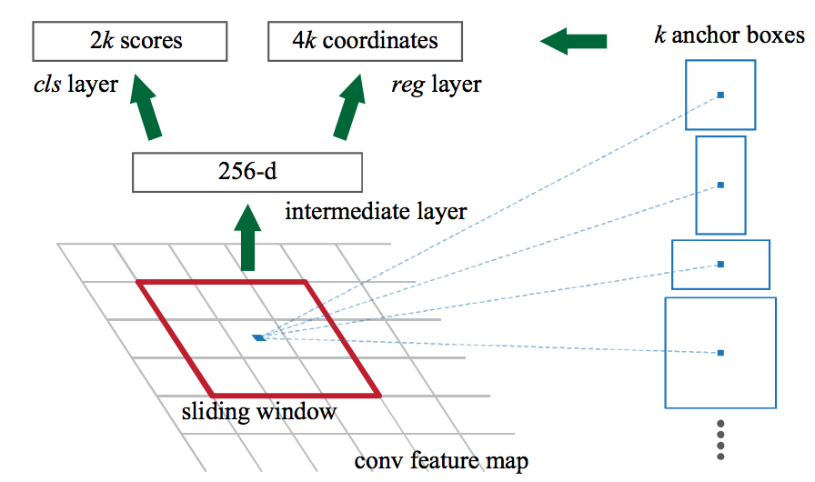
Faster R-CNN RPN design
Slide a small window (3x3) over the conv5 layer
  Predict object/no object
  Regress bounding box coordinates with reference to anchors
  (3 scales x 3 aspect ratios)
Notes:
At each sliding-window location, we simultaneously predict multiple region proposals, where the number of maximum possible proposals for each location is denoted as k. So the reg layer has 4k outputs encoding the coordinates of k boxes, and the cls layer outputs 2k scores that estimate probability of object or not object for each proposal

Slide 68

One network, four losses
Classification loss
Bounding-box regression loss
…
Classification loss
Bounding-box regression loss
RoI pooling
proposals
Region Proposal Network
feature map
CNN
Source: R. Girshick, K. He
image

Slide 69
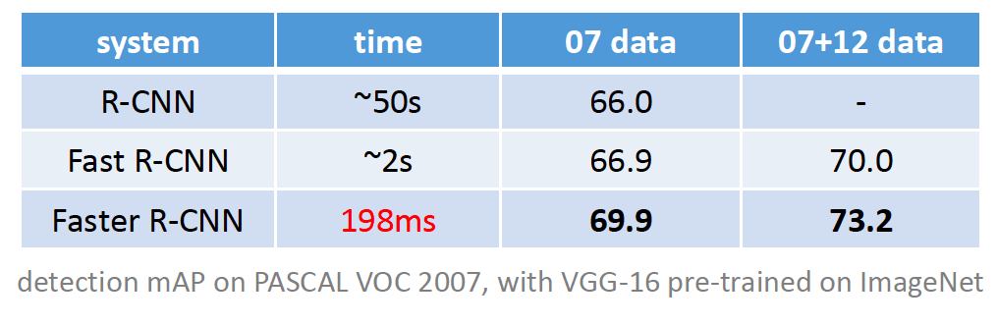
Faster R-CNN results

Slide 70
Object detection progress
Faster R-CNN
Fast R-CNN
Before CNNs
R-CNNv1
After CNNs

Slide 71
Outline
Task definition and evaluation
Two-stage detectors
  R-CNN
  Fast R-CNN
  Faster R-CNN
Single-stage and multi-resolution detectors

Slide 72
Streamlined detection architectures
The Faster R-CNN pipeline separates proposal generation and region classification
Is it possible to do detection in one shot?
Region Proposals
RPN
Classification + Regression
Conv feature map of the entire image
RoI features
Detections
RoI pooling
Classification + Regression
Conv feature map of the entire image
Detections

Slide 73
YOLO
Divide the image into a coarse grid and directly predict class label and a few candidate boxes for each grid cell
J. Redmon, S. Divvala, R. Girshick, and A. Farhadi, You Only Look Once: Unified, Real-Time Object Detection, CVPR 2016

Slide 74
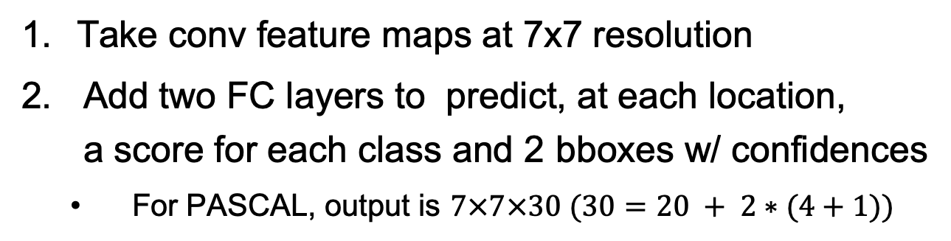
YOLO
Take conv feature maps at 7x7 resolution
Add two FC layers to predict, at each location,
a score for each class and 2 bboxes w/ confidences
  For PASCAL, output is $7×7×30 (30=20 + 2∗(4+1))$
J. Redmon, S. Divvala, R. Girshick, and A. Farhadi, You Only Look Once: Unified, Real-Time Object Detection, CVPR 2016

Slide 75
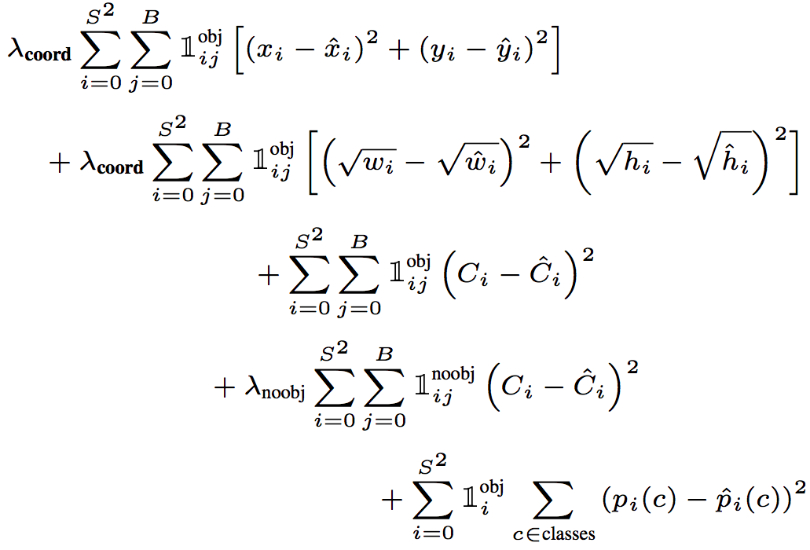
YOLO
Objective function:
Regression
Object/no object confidence
Class prediction
Notes:
At training time we only want one bounding box predictor to be responsible for each object. We assign one predictor to be “responsible” for predicting an object based on which prediction has the highest current IOU with the ground truth.

Slide 76

YOLO
Objective function:
Cell i contains object, predictor j is responsible for it
Small deviations matter less for larger boxes than for smaller boxes
Confidence for object
Confidence for no object
Down-weight loss from boxes that don’t contain objects ($λ_{noobj}=0.5)$
Class probability
Notes:
At training time we only want one bounding box predictor to be responsible for each object. We assign one predictor to be “responsible” for predicting an object based on which prediction has the highest current IOU with the ground truth.

Slide 77
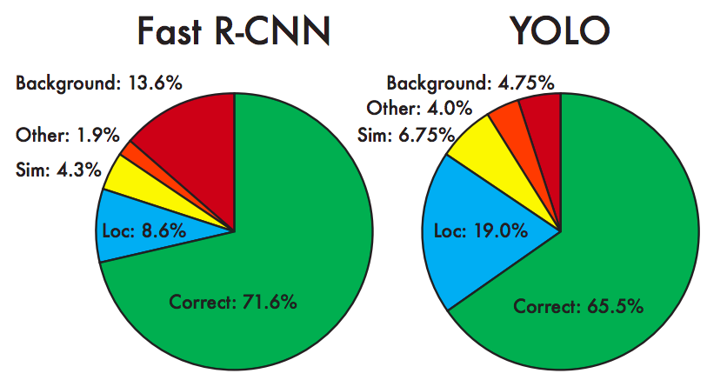
YOLO: Results
Each grid cell predicts only two boxes and can only have one class – this limits the number of nearby objects that can be predicted
Localization accuracy suffers compared to Fast(er) R-CNN due to coarser features, errors on small boxes
7x speedup over Faster R-CNN (45-155 FPS vs. 7-18 FPS)
Performance on PASCAL 2007

Slide 78
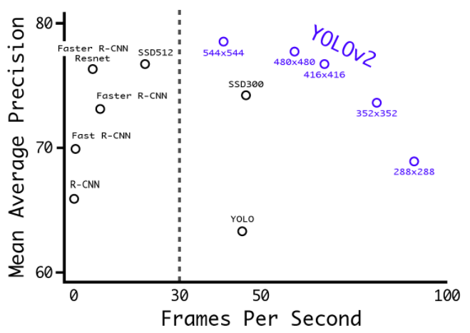
YOLO v2
Remove FC layer, do convolutional prediction with anchor boxes instead
Increase resolution of input images and conv feature maps
Improve accuracy using batch normalization and other tricks
VOC 2007 results
YouTube demo
J. Redmon and A. Farhadi, YOLO9000: Better, Faster, Stronger, CVPR 2017

Slide 79
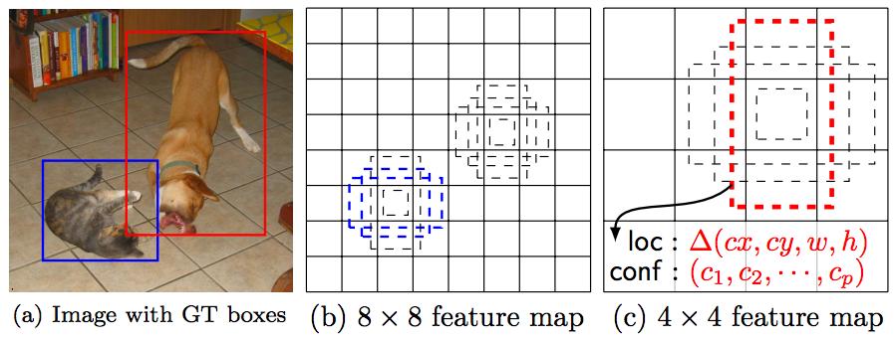
Multi-resolution prediction: SSD
Predict boxes of different size from different conv maps
Each level of resolution has its own predictor
W. Liu, D. Anguelov, D. Erhan, C. Szegedy, S. Reed, C.-Y. Fu, and A. Berg, SSD: Single Shot MultiBox Detector, ECCV 2016

Slide 80
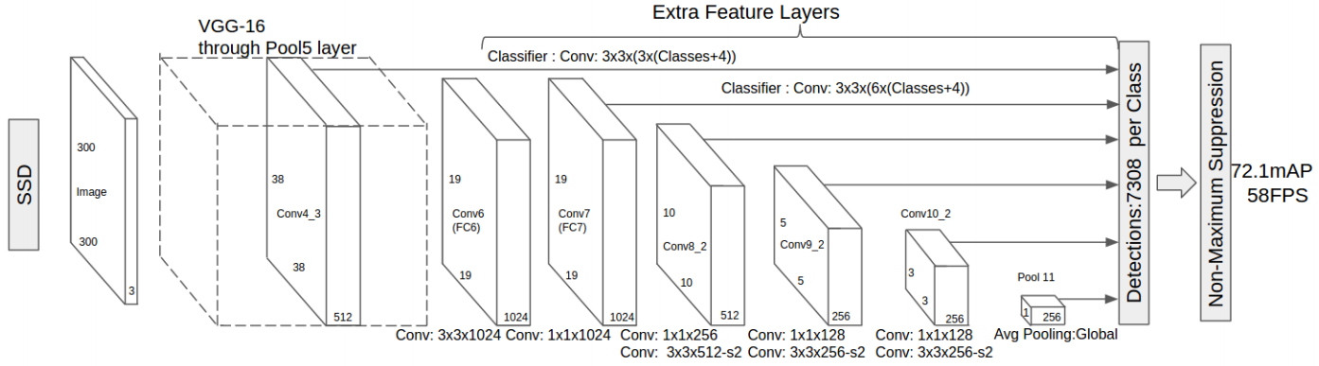
Multi-resolution prediction: SSD
Predict boxes of different size from different conv maps
Each level of resolution has its own predictor
W. Liu, D. Anguelov, D. Erhan, C. Szegedy, S. Reed, C.-Y. Fu, and A. Berg, SSD: Single Shot MultiBox Detector, ECCV 2016

Slide 81
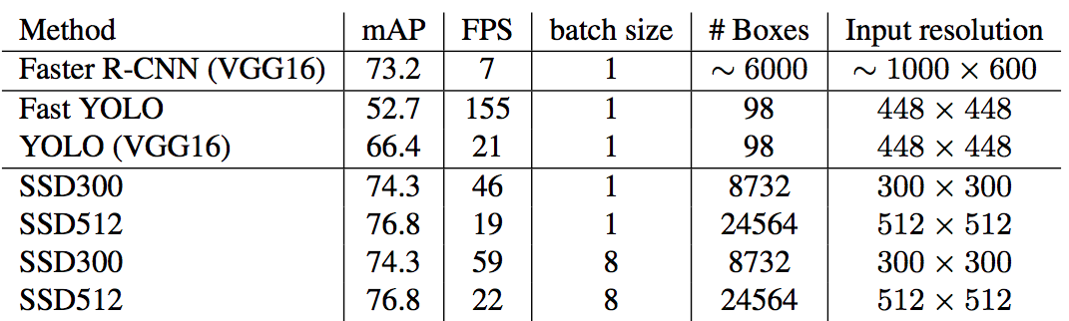
SSD: Results (PASCAL 2007)
More accurate and faster than YOLO and Faster R-CNN

Slide 82
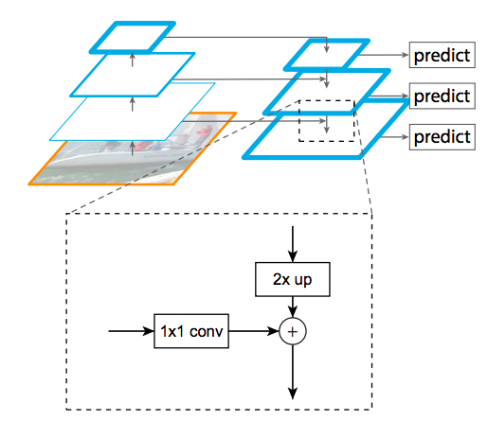
Feature pyramid networks
Improve predictive power of lower-level feature maps by adding contextual information from higher-level feature maps
Predict different sizes of bounding boxes from different levels of the pyramid (but share parameters of predictors)
T.-Y. Lin, P. Dollar, R. Girshick, K. He, B. Hariharan, and S. Belongie, Feature pyramid networks for object detection, CVPR 2017

Slide 83
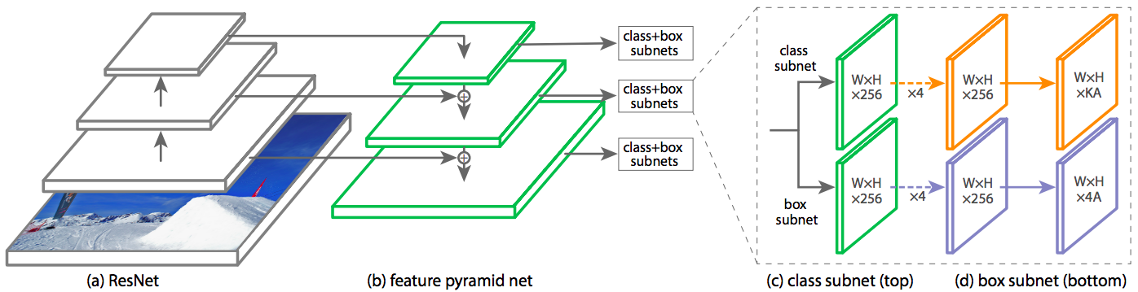
RetinaNet
Classification subnet: predict the probability of object at each position for each of A anchors and K object classes
Box subnet: for each position and each anchor, predict offset to ground truth box (if any)
T.-Y. Lin, P. Goyal, R. Girshick, K. He, P. Dollar, Focal loss for dense object detection, ICCV 2017

Slide 84
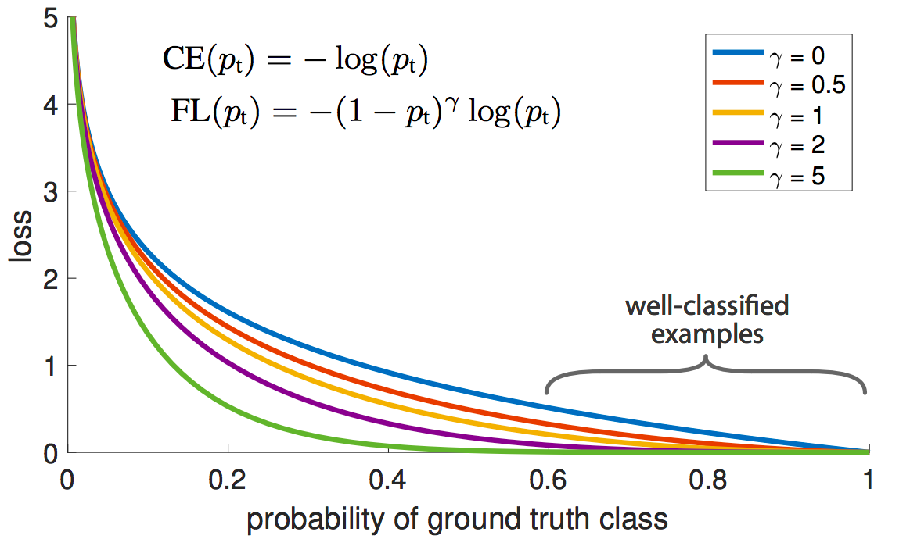
RetinaNet
Focal loss: down-weight the standard cross-entropy loss for well-classified examples
T.-Y. Lin, P. Goyal, R. Girshick, K. He, P. Dollar, Focal loss for dense object detection, ICCV 2017
Notes:
From the paper: (1) When an example is misclassified and pt is small, the modulating factor is near 1 and the loss is unaffected. As pt → 1, the factor goes to 0 and the loss for well-classified examples is down-weighted. (2) The focusing parameter γ smoothly adjusts the rate at which easy examples are downweighted. When γ = 0, FL is equivalent to CE, and as γ is increased the effect of the modulating factor is likewise increased (we found γ = 2 to work best in our experiments)

Slide 85
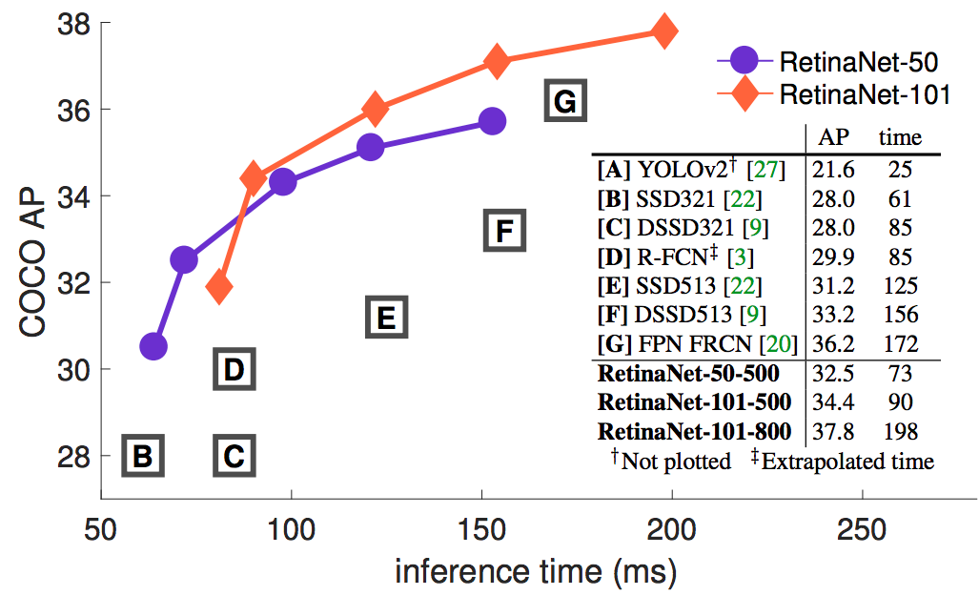
RetinaNet: Results
T.-Y. Lin, P. Goyal, R. Girshick, K. He, P. Dollar, Focal loss for dense object detection, ICCV 2017
Notes:
From the paper: (1) When an example is misclassified and pt is small, the modulating factor is near 1 and the loss is unaffected. As pt → 1, the factor goes to 0 and the loss for well-classified examples is down-weighted. (2) The focusing parameter γ smoothly adjusts the rate at which easy examples are downweighted. When γ = 0, FL is equivalent to CE, and as γ is increased the effect of the modulating factor is likewise increased (we found γ = 2 to work best in our experiments)

Slide 86
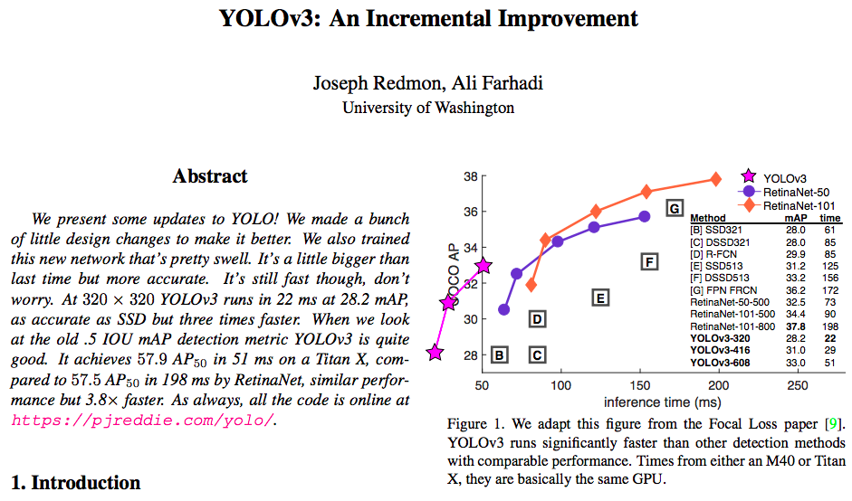
YOLO v3
https://pjreddie.com/media/files/papers/YOLOv3.pdf

Slide 87
Summary so far
R-CNN: region proposals + CNN on cropped, resampled regions
Fast R-CNN: region proposals + RoI pooling on top of a conv feature map
Faster R-CNN: RPN + RoI pooling
Next generation of detectors: YOLO, SSD, RetinaNet
  Direct prediction of BB offsets, class scores on top of conv feature maps
  Get better context by combining feature maps at multiple resolutions
Most recent trends: architectures borrowed from dense prediction, transformers

Slide 88
Fully convolutional one-stage detector (FCOS)
“Anchor-free” approach
Run backbone CNN to get features aligned to input image
Figure source: J. Johnson
Tian et al., FCOS: Fully Convolutional One-Stage Object Detection, ICCV 2019

Slide 89
Fully convolutional one-stage detector (FCOS)
“Anchor-free” approach
For each class, predict whether location falls inside a GT bounding box
Figure source: J. Johnson
Tian et al., FCOS: Fully Convolutional One-Stage Object Detection, ICCV 2019

Slide 90
Fully convolutional one-stage detector (FCOS)
“Anchor-free” approach
For positive points, also regress distance to left, right, top, and bottom of GT box (with L2 loss)
T
L
R
B
Figure source: J. Johnson
Tian et al., FCOS: Fully Convolutional One-Stage Object Detection, ICCV 2019

Slide 91
Fully convolutional one-stage detector (FCOS)
“Anchor-free” approach
T
For positive points, also regress distance to left, right, top, and bottom of GT box (with L2 loss)
L
R
B
Weight detections by “centerness” and confidence, perform NMS
Figure source: J. Johnson
Tian et al., FCOS: Fully Convolutional One-Stage Object Detection, ICCV 2019

Slide 92
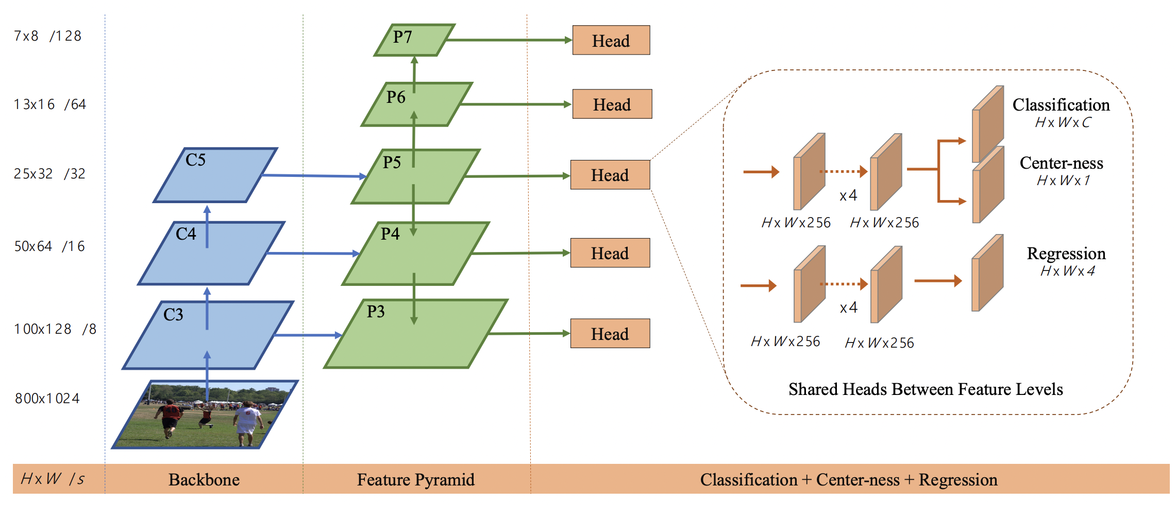
Fully convolutional one-stage detector (FCOS)
Tian et al., FCOS: Fully Convolutional One-Stage Object Detection, ICCV 2019

Slide 93
Outline
Task definition and evaluation
Two-stage detectors
  R-CNN
  Fast R-CNN
  Faster R-CNN
Single-stage and multi-resolution detectors
Other detectors: CornerNet, DETR

Slide 94
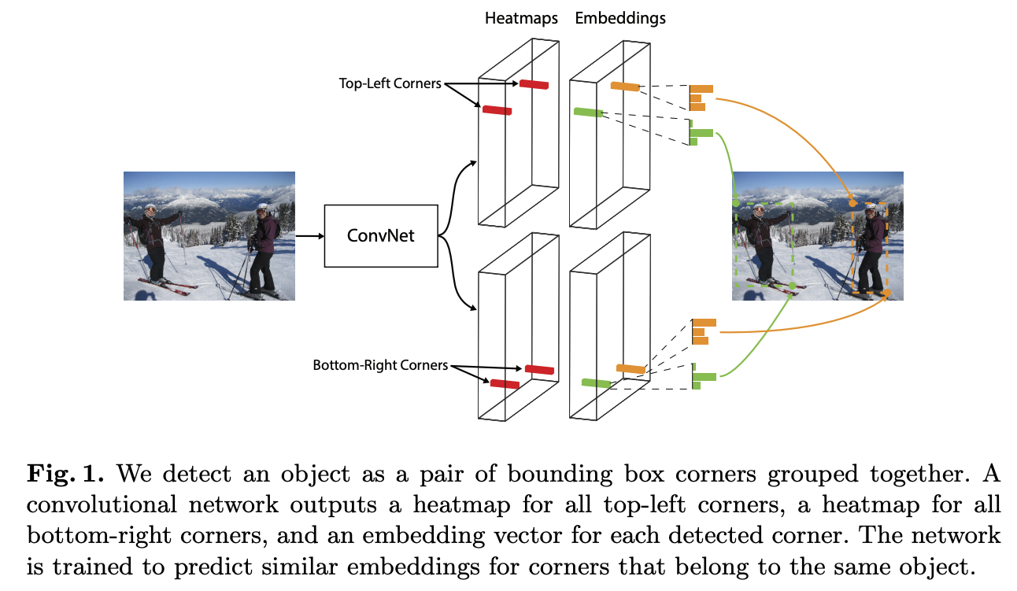
CornerNet
H. Law and J. Deng, CornerNet: Detecting Objects as Paired Keypoints, ECCV 2018
Notes:
We detect an object as a pair of bounding box corners grouped together. A convolutional network outputs a heatmap for all top-left corners, a heatmap for all bottom-right corners, and an embedding vector for each detected corner. The network is trained to predict similar embeddings for corners that belong to the same object.

Slide 95
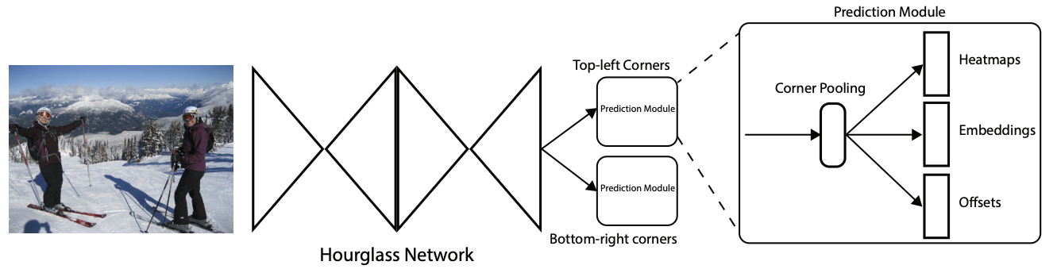
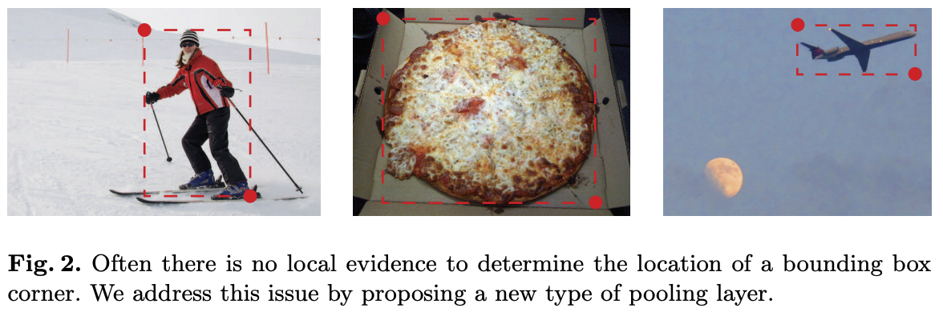
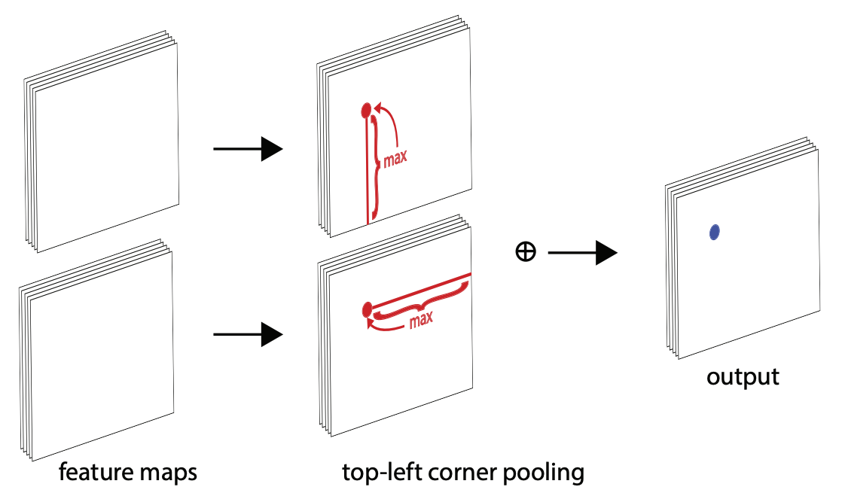
CornerNet
H. Law and J. Deng, CornerNet: Detecting Objects as Paired Keypoints, ECCV 2018
Notes:
We detect an object as a pair of bounding box corners grouped together. A convolutional network outputs a heatmap for all top-left corners, a heatmap for all bottom-right corners, and an embedding vector for each detected corner. The network is trained to predict similar embeddings for corners that belong to the same object.

Slide 96
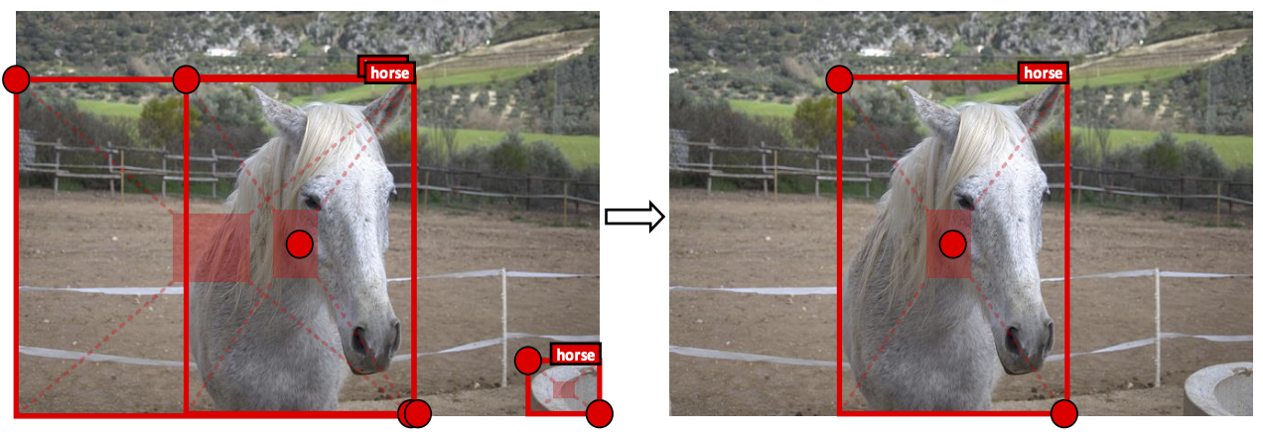
CenterNet
Use an additional center point to verify predictions:
K. Duan et al. CenterNet: Keypoint Triplets for Object Detection, ICCV 2019

Slide 97
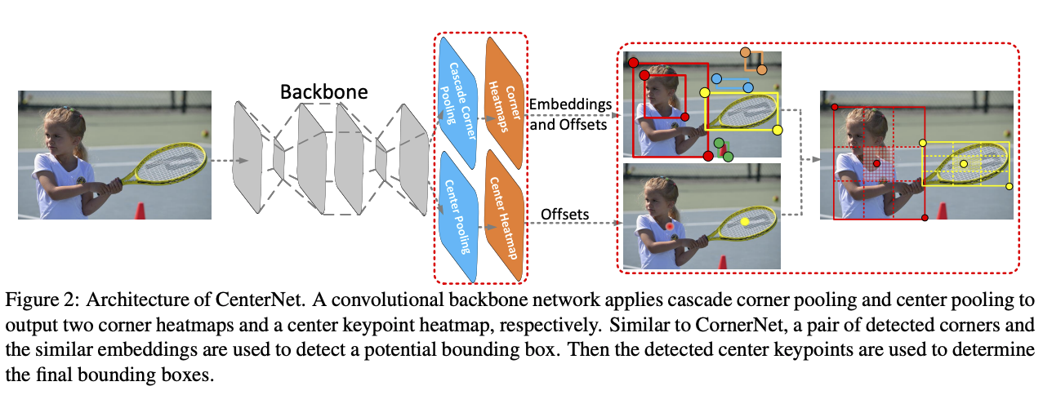
CenterNet
K. Duan et al. CenterNet: Keypoint Triplets for Object Detection, ICCV 2019

Slide 98
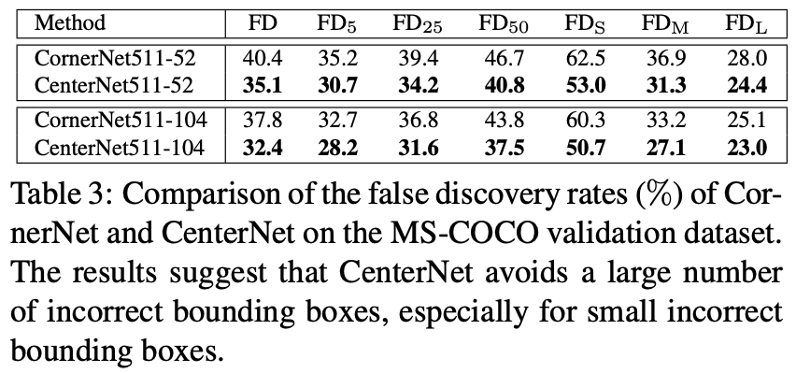
CenterNet
K. Duan et al. CenterNet: Keypoint Triplets for Object Detection, ICCV 2019

Slide 99
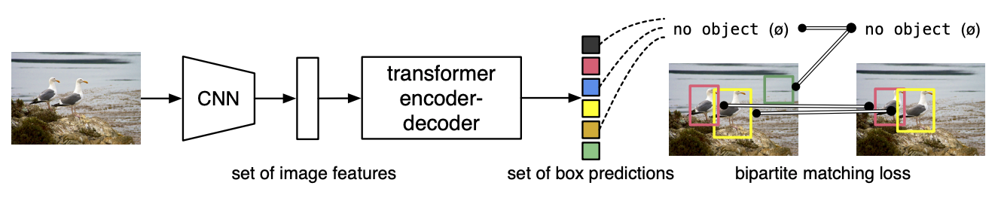
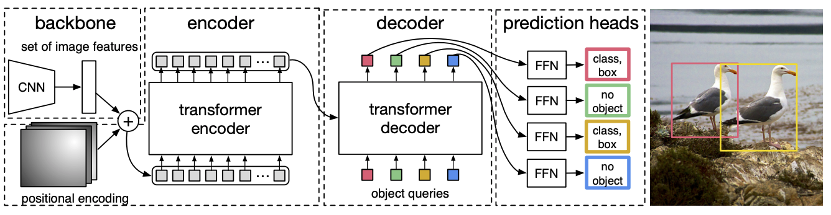
Detection Transformer (DETR)
N. Carion et al., End-to-end object detection with transformers, ECCV 2020
Notes:
DETR uses a conventional CNN backbone to learn a 2D representation of an input image. The model flattens it and supplements it with a positional encoding before passing it into a transformer encoder. A transformer decoder then takes as input a small fixed number of learned positional embeddings, which we call object queries, and additionally attends to the encoder output. We pass each output embedding of the decoder to a shared feed forward network (FFN) that predicts either a detection (class and bounding box) or a “no object” class.

