Slide 1
CNNs for dense image labeling
image classification
object detection
semantic segmentation
instance segmentation

Slide 2
Outline
Operations and architectures for dense prediction: U-Net
Instance segmentation: Mask R-CNN
Other dense prediction problems

Slide 3
Dense prediction architectures
To make predictions for all pixels at once, we can design a network with only stride-1 convolutions and element-wise operations
What are the pros and cons of this approach?
Source: Stanford CS231n

Slide 4
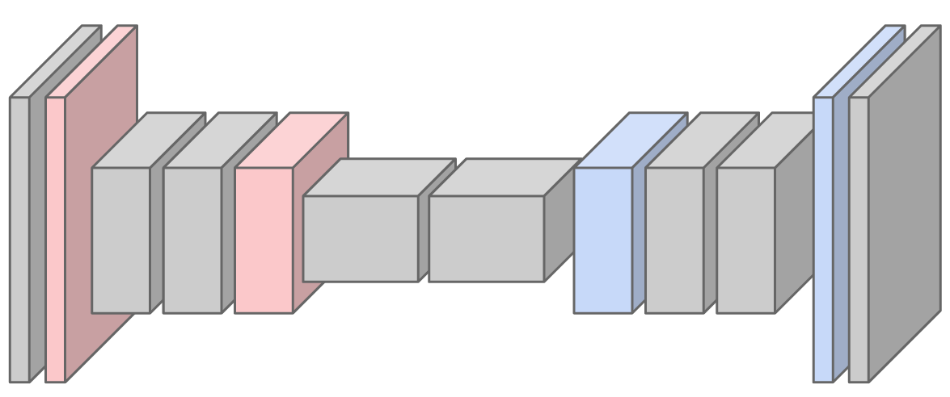
Dense prediction architectures
Practical solution: first downsample, then upsample
Source: Stanford CS231n

Slide 5
Dense prediction architectures
Problem: no way to recover information lost to downsampling
Fuse encoder and decoder feature maps at the same resolution
Figure source

Slide 6
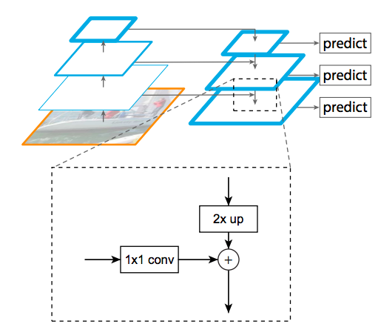
Recall: Feature pyramid networks
Improve predictive power of lower-level feature maps by adding contextual information from higher-level feature maps
Predict different sizes of bounding boxes from different levels of the pyramid (but share parameters of predictors)
T.-Y. Lin, P. Dollar, R. Girshick, K. He, B. Hariharan, and S. Belongie, Feature pyramid networks for object detection, CVPR 2017

Slide 7
U-Net
O. Ronneberger, P. Fischer, T. Brox, U-Net: Convolutional Networks for Biomedical Image Segmentation, MICCAI 2015

Slide 8
Feature map upsampling
Step 1: increase the resolution of the feature grid

Slide 9
Feature map upsampling
Step 2: interpolate to get the missing values

Slide 10
Bilinear interpolation
A
B
$$\frac{1}{2}(A+B)$$
C
D

Slide 11
Bilinear interpolation
A
B
$$\frac{1}{2}(A+C)$$
C
D

Slide 12
Bilinear interpolation
A
B
$$\frac{1}{4}(A+B+C+D)$$
C
D

Slide 13
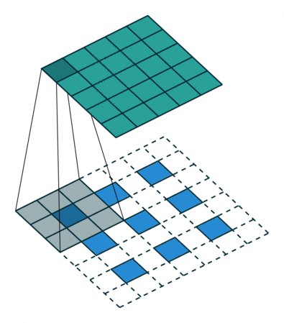
Feature map upsampling
For 2x upsampling, dilate the input by inserting rows and columns of zeros between adjacent entries, convolve with upsampling filter
Upsampling filter:
$$\frac{1}{4}$$ | $$\frac{1}{2}$$ | $$\frac{1}{4}$$
$$\frac{1}{2}$$ | $$1$$ | $$\frac{1}{2}$$
$$\frac{1}{4}$$ | $$\frac{1}{2}$$ | $$\frac{1}{4}$$
output
input
V. Dumoulin and F. Visin, A guide to convolution arithmetic for deep learning, arXiv 2018

Slide 14
Feature map upsampling: Max unpooling
Can be used when max pooling is used to downsample
Max pooling
Max unpooling
$$1$$ | $$2$$ | $$6$$ | $$3$$
$$3$$ | $$5$$ | $$2$$ | $$1$$
$$1$$ | $$2$$ | $$2$$ | $$1$$
$$7$$ | $$3$$ | $$4$$ | $$8$$
$$0$$ | $$0$$ | $$6$$ | $$0$$
$$0$$ | $$5$$ | $$0$$ | $$0$$
$$0$$ | $$0$$ | $$0$$ | $$0$$
$$7$$ | $$0$$ | $$0$$ | $$8$$
$$5$$ | $$6$$
$$7$$ | $$8$$
Remember pooling indices (which element was max)
Output is sparse, so unpooling is typically followed by a transposed convolution layer

Slide 15
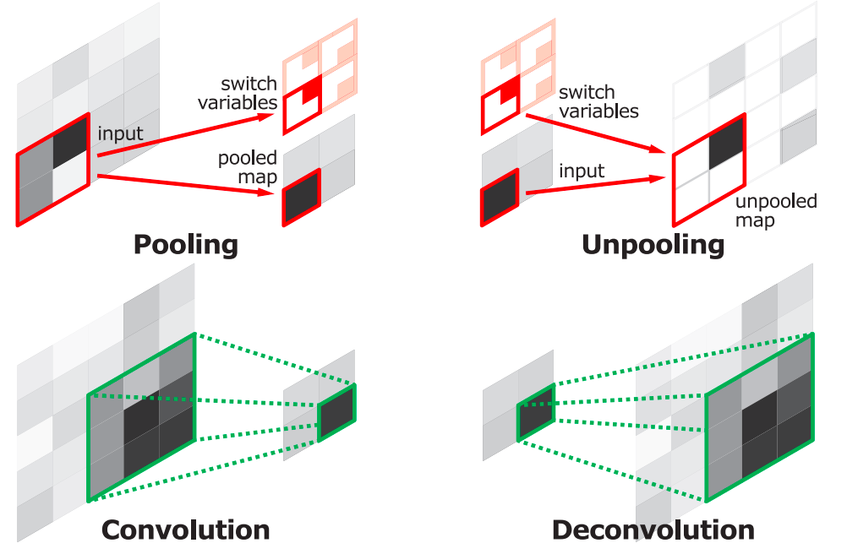
DeconvNet
H. Noh, S. Hong, and B. Han, Learning Deconvolution Network for Semantic Segmentation, ICCV 2015

Slide 16
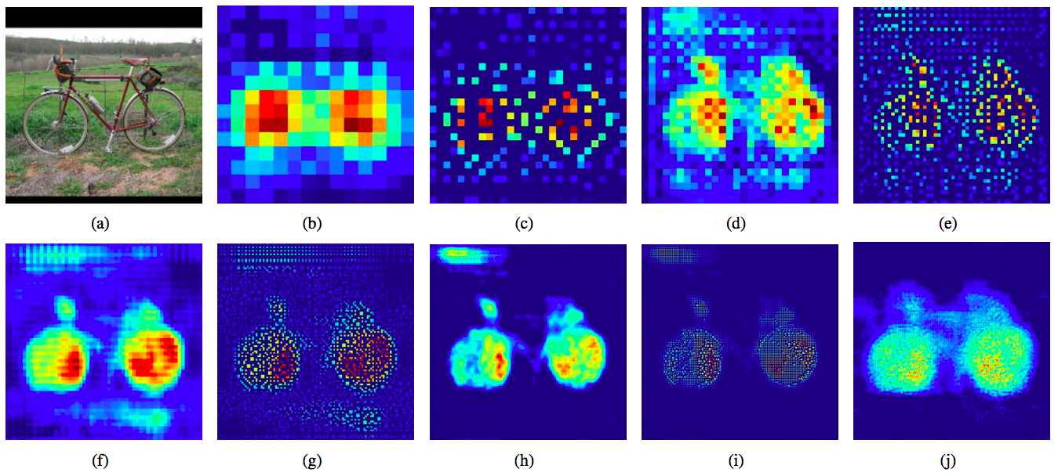
DeconvNet
Original image
14x14 deconv
28x28 unpooling
28x28 deconv
54x54 unpooling
54x54 deconv
112x112 unpooling
112x112 deconv
224x224 unpooling
224x224 deconv
H. Noh, S. Hong, and B. Han, Learning Deconvolution Network for Semantic Segmentation, ICCV 2015

Slide 17
DeconvNet results
PASCAL VOC 2012 | mIoU
FCN-8 | 62.2
DeconvNet | 69.6
Ensemble of DeconvNet and FCN | 71.7

Slide 18
SegNet
Drop the FC layers, get better results
V. Badrinarayanan, A. Kendall and R. Cipolla, SegNet: A Deep Convolutional Encoder-Decoder Architecture for Image Segmentation, PAMI 2017

Slide 19
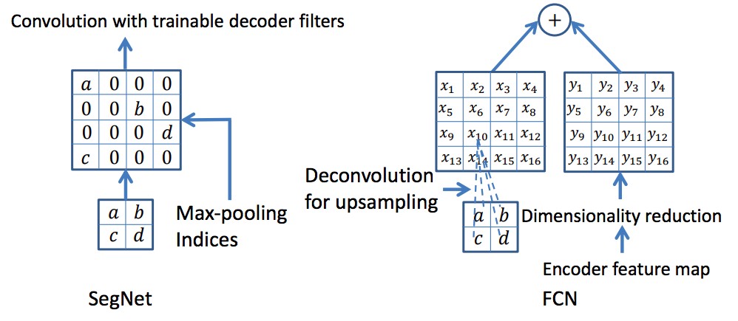
SegNet
V. Badrinarayanan, A. Kendall and R. Cipolla, SegNet: A Deep Convolutional Encoder-Decoder Architecture for Image Segmentation, PAMI 2017

Slide 20
Dense prediction: Outline
Operations and architectures for dense prediction: U-Net
Instance segmentation: Mask R-CNN

Slide 21
Instance segmentation
Source: Kaiming He

Slide 22
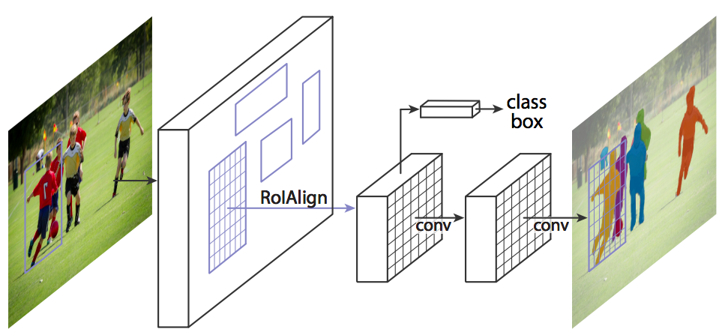
Mask R-CNN
Mask R-CNN = Faster R-CNN + FCN on RoIs
Classification+regression branch
Mask branch: separately predict segmentation for each possible class
K. He, G. Gkioxari, P. Dollar, and R. Girshick, Mask R-CNN, ICCV 2017 (Best Paper Award)

Slide 23
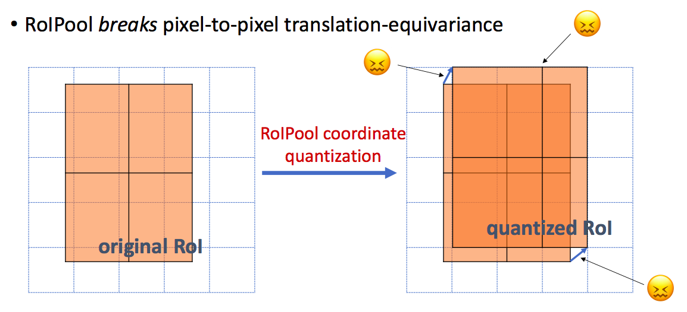
RoIAlign vs. RoIPool
RoIPool: nearest neighbor quantization
Source: K. He, R. Girshick

Slide 24
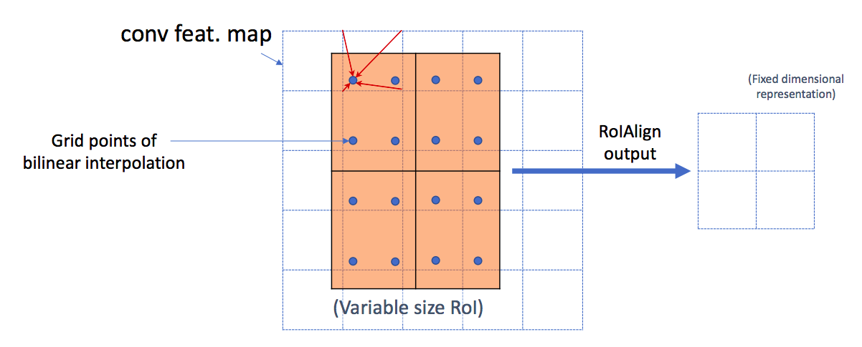
RoIAlign vs. RoIPool
RoIPool: nearest neighbor quantization
RoIAlign: bilinear interpolation
Source: K. He, R. Girshick
Notes:
Use bilinear interpolation to compute the exact values of the input features at four regularly sampled locations in each RoI bin, and aggregate the result (using max or average).

Slide 25
Bilinear interpolation
$$\left(x_{1},y_{1}\right)$$
$$\left(x_{2},y_{1}\right)$$
A
B
$$f\left(x,y\right)=w_{11}A+w_{21}B{+w}_{12}C+w_{22}D$$
C
D
$$\left(x_{1},y_{2}\right)$$
$$\left(x_{2},y_{2}\right)$$
$$w_{11}=\frac{\left(x_{2}−x\right)\left(y_{2}−y\right)}{\left(x_{2}−x_{1}\right)\left(y_{2}−y_{1}\right)}$$
$$w_{12}=\frac{\left(x_{2}−x\right)\left(y−y_{1}\right)}{\left(x_{2}−x_{1}\right)\left(y_{2}−y_{1}\right)}$$
$$w_{21}=\frac{\left(x−x_{1}\right)\left(y_{2}−y\right)}{\left(x_{2}−x_{1}\right)\left(y_{2}−y_{1}\right)}$$
$$w_{22}=\frac{(x−x_{1})\left(y−y_{1}\right)}{\left(x_{2}−x_{1}\right)\left(y_{2}−y_{1}\right)}$$
http://en.wikipedia.org/wiki/Bilinear_interpolation

Slide 26
Mask R-CNN
Classification+regression branch
Mask branch: separately predict segmentation for each possible class

Slide 27
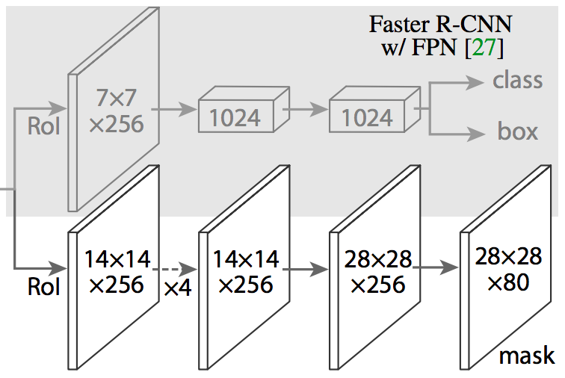
Mask R-CNN
From RoIAlign features, predict class label, bounding box, and segmentation mask
Classification/regression head from an established object detector (e.g., FPN)
Separately predict binary mask for each class with per-pixel sigmoids, use average binary cross-entropy loss
Notes:
The mask branch has a Km2 - dimensional output for each RoI, which encodes K binary masks of resolution m × m, one for each of the K classes. To this we apply a per-pixel sigmoid, and define Lmask as the average binary cross-entropy loss. For an RoI associated with ground-truth class k, Lmask is only defined on the k-th mask (other mask outputs do not contribute to the loss).
Arrows denote either conv, deconv, or fc layers as can be inferred from context (conv preserves spatial dimension while deconv increases it). All convs are 3×3, except the output conv which is 1×1, deconvs are 2×2 with stride 2

Slide 28
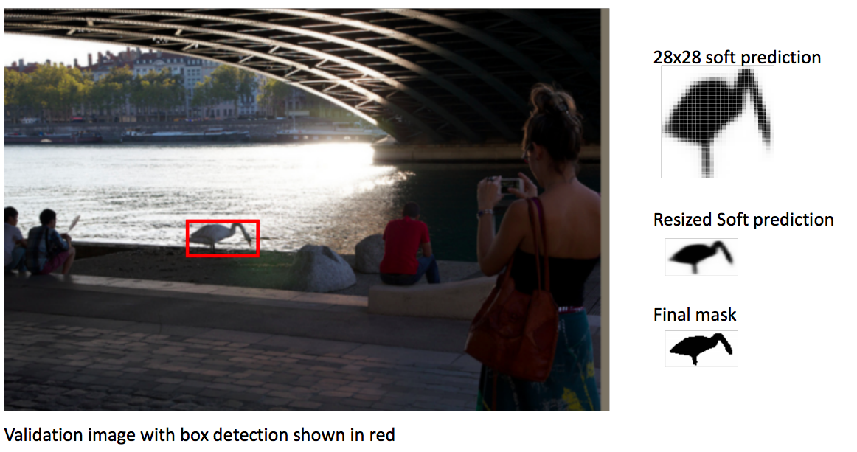
Mask R-CNN

Slide 29
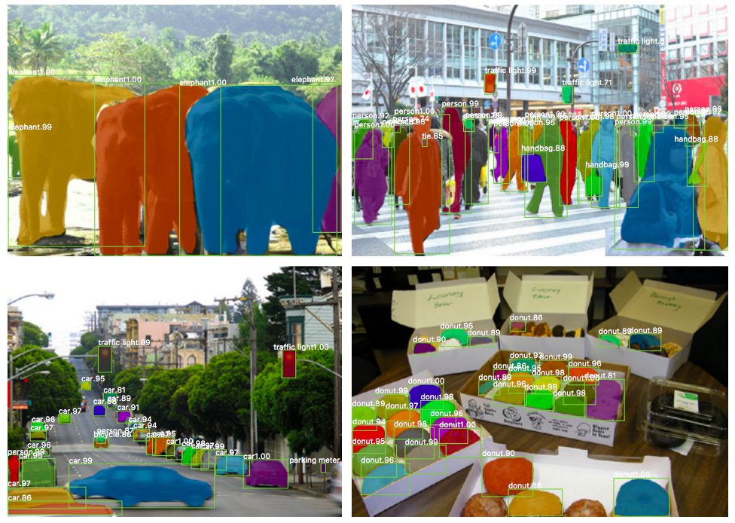
Example results

Slide 30
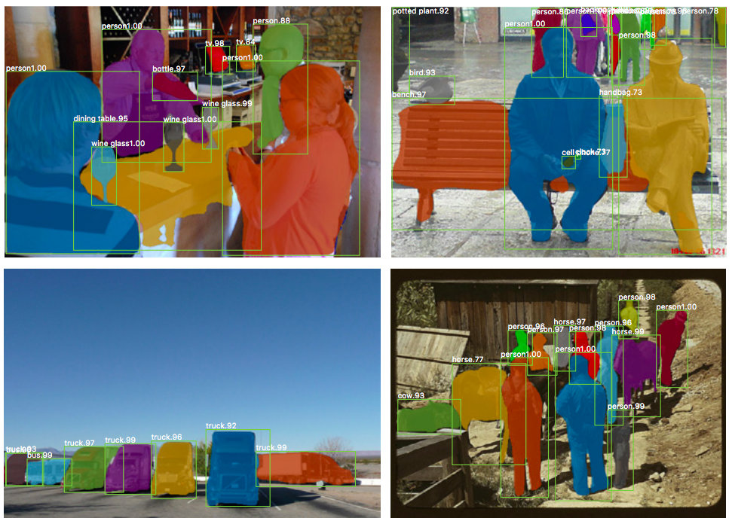
Example results

Slide 31
Instance segmentation results on COCO
AP at different IoU thresholds
AP for different size instances

Slide 32
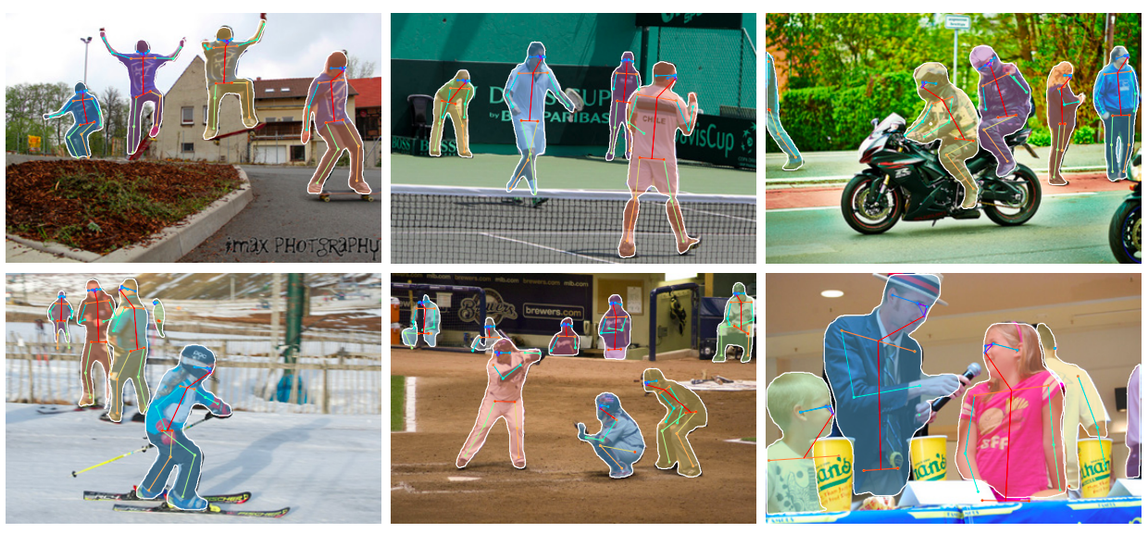
Keypoint prediction
Given $K$ keypoints, train model to predict $K$ $m × m$one-hot maps with cross-entropy losses over $m^{2}$ outputs

Slide 33
Outline
Operations and architectures for dense prediction: U-Net
Instance segmentation: Mask R-CNN
Other dense prediction problems

Slide 34
Panoptic segmentation
A. Kirillov et al. Panoptic segmentation. CVPR 2019
Notes:
Each pixel of an image must be assigned a semantic label and an instance id. Pixels with the same label and id belong to the same object; for stuff labels the instance id is ignored.

Slide 35
Panoptic feature pyramid networks
A. Kirillov et al. Panoptic feature pyramid networks. CVPR 2019
Notes:
We start with an FPN backbone [36], widely used in object detection, for extracting rich multi-scale features. (b) As in Mask R-CNN [24], we use a region-based branch on top of FPN for instance segmentation. (c) In parallel, we add a lightweight denseprediction branch on top of the same FPN features for semantic segmentation. This simple extension of Mask RCNN with FPN is a fast and accurate baseline for both tasks

Slide 36
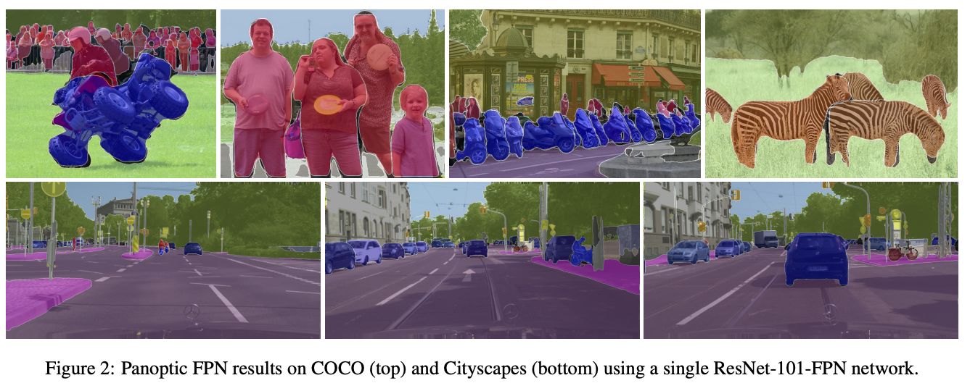
Panoptic feature pyramid networks
A. Kirillov et al. Panoptic feature pyramid networks. CVPR 2019
Notes:
We start with an FPN backbone [36], widely used in object detection, for extracting rich multi-scale features. (b) As in Mask R-CNN [24], we use a region-based branch on top of FPN for instance segmentation. (c) In parallel, we add a lightweight denseprediction branch on top of the same FPN features for semantic segmentation. This simple extension of Mask RCNN with FPN is a fast and accurate baseline for both tasks

Slide 37
Amodal instance segmentation
K. Li and J. Malik. Amodal instance segmentation. ECCV 2016

Slide 38
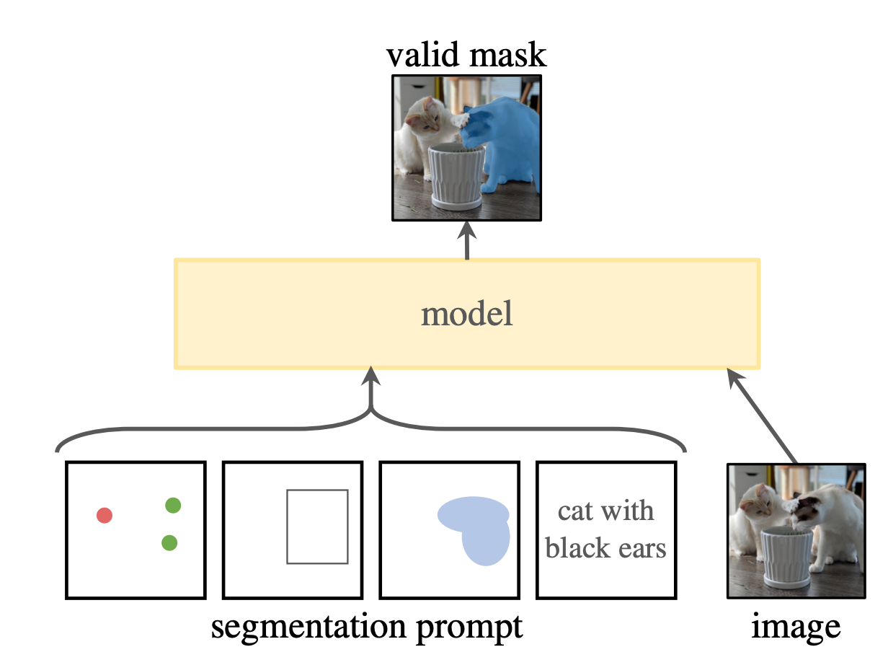
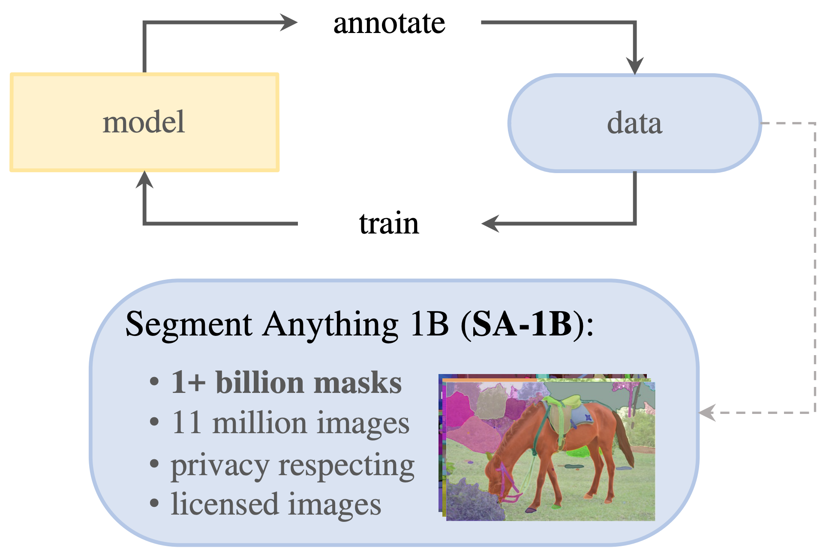
Promptable segmentation
A. Kirilllov et al. Segment anything. ICCV 2023

Slide 39
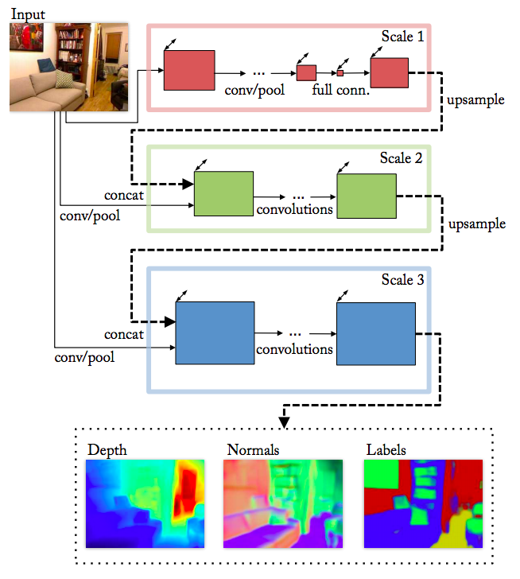
Depth and normal estimation
Predicted depth
Ground truth
D. Eigen and R. Fergus, Predicting Depth, Surface Normals and Semantic Labels with a Common Multi-Scale Convolutional Architecture, ICCV 2015

Slide 40
Depth and normal estimation
Predicted normals
Ground truth
D. Eigen and R. Fergus, Predicting Depth, Surface Normals and Semantic Labels with a Common Multi-Scale Convolutional Architecture, ICCV 2015

Slide 41
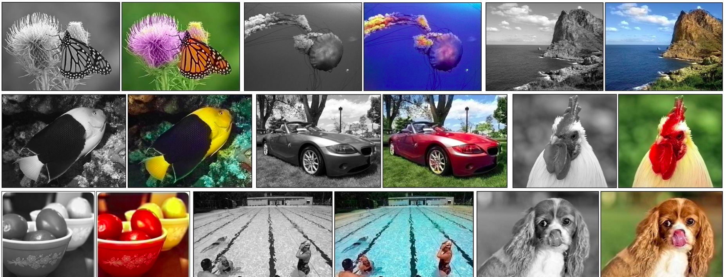
Colorization
R. Zhang, P. Isola, and A. Efros, Colorful Image Colorization, ECCV 2016

Slide 42
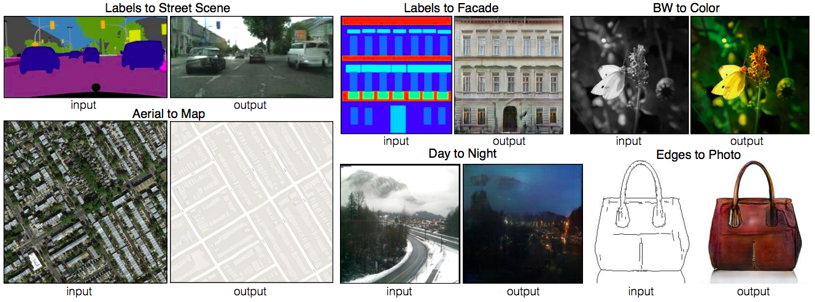
Image-to-image translation (paired)
P. Isola, J.-Y. Zhu, T. Zhou, A. Efros, Image-to-Image Translation with Conditional Adversarial Networks, CVPR 2017

Slide 43
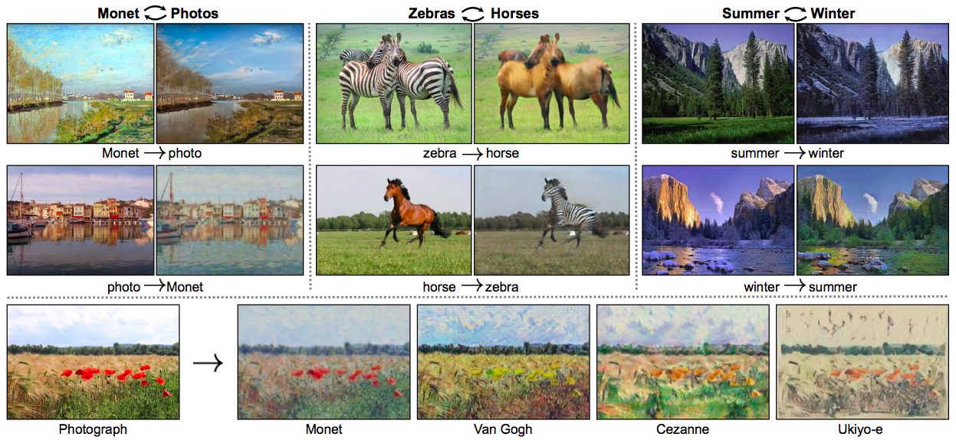
Image-to-image translation (unpaired)
J.-Y. Zhu, T. Park, P. Isola, A. Efros, Unpaired Image-to-Image Translation Using Cycle-Consistent Adversarial Networks, ICCV 2017

Slide 44
Image generation
z
random seed or latent vector

