Slide 1
The rise (and fall?) of GANs
M. Kang et al. Scaling up GANs for Text-to-Image Synthesis. CVPR 2023

Slide 2
The rise of GANs

Slide 3
The rise of GANs
EBGAN (2017)
BigGAN (2018)

Slide 4
The golden age of GANs: The StyleGAN family
2018: Progressive GAN
2019: StyleGAN
2020: StyleGAN2
2021: StyleGAN3
2022: StyleGAN-XL
2023: GigaGAN

Slide 5
Recall: DCGAN architecture
Uniformly distributed input
Linear transformation
Four transposed convolution layers with output stride of 2 for upsampling, followed by ReLU activations
Tanh activations in the last layer
A. Radford, L. Metz, S. Chintala, Unsupervised representation learning with deep convolutional generative adversarial networks, ICLR 2016

Slide 6
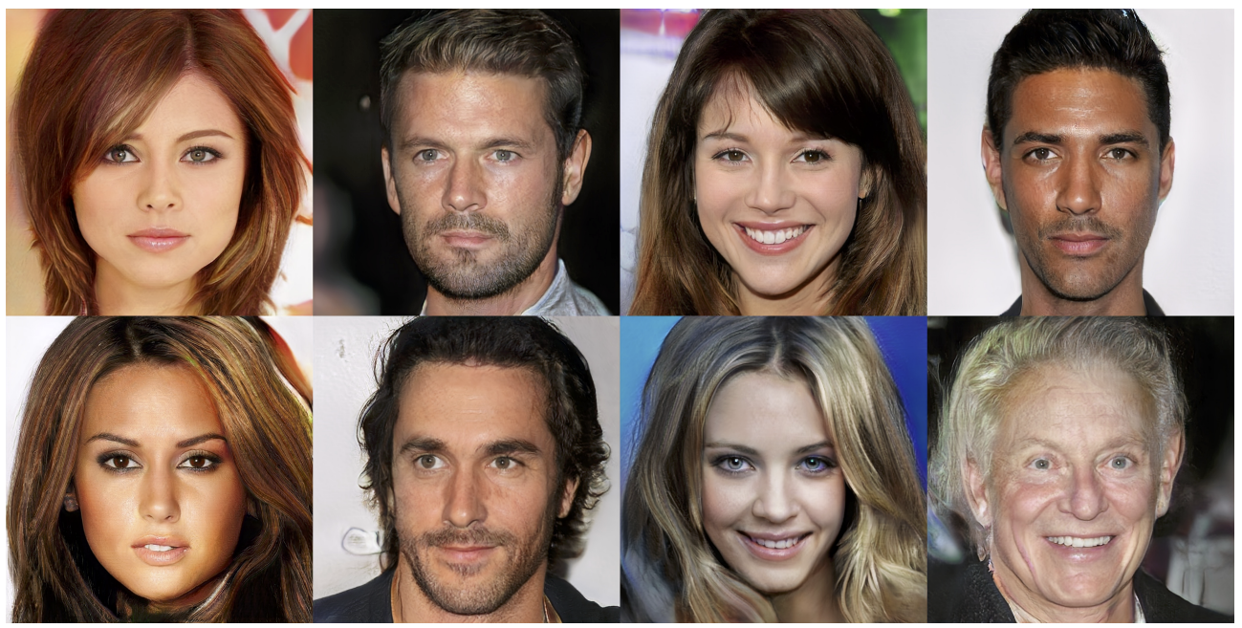
Progressive GANs
Realistic face images up to 1024 x 1024 resolution
T. Karras, T. Aila, S. Laine, J. Lehtinen. Progressive Growing of GANs for Improved Quality, Stability, and Variation. ICLR 2018

Slide 7
Progressive GANs
Key idea: train lower-resolution models, gradually add layers corresponding to higher-resolution outputs
Source
T. Karras, T. Aila, S. Laine, J. Lehtinen. Progressive Growing of GANs for Improved Quality, Stability, and Variation. ICLR 2018

Slide 8
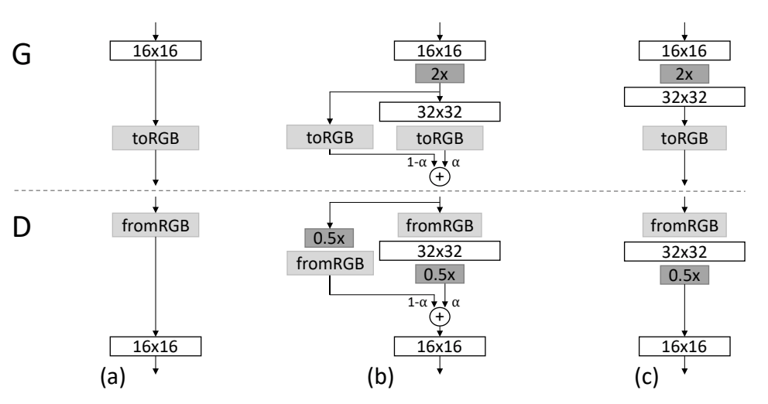
Progressive GANs
Key idea: train lower-resolution models, gradually add layers corresponding to higher-resolution outputs
Transition from 16x16 to 32x32 images
T. Karras, T. Aila, S. Laine, J. Lehtinen. Progressive Growing of GANs for Improved Quality, Stability, and Variation. ICLR 2018
Notes:
Caption: When doubling the resolution of the generator (G) and discriminator (D) we fade in the new layers smoothly. This example illustrates the transition from 16 × 16 images (a) to 32 × 32 images (c). During the transition (b) we treat the layers that operate on the higher resolution like a residual block, whose weight α increases linearly from 0 to 1. Here 2× and 0.5× refer to doubling and halving the image resolution using nearest neighbor filtering and average pooling, respectively. The toRGB represents a layer that projects feature vectors to RGB colors and fromRGB does the reverse; both use 1 × 1 convolutions. When training the discriminator, we feed in real images that are downscaled to match the current resolution of the network. During a resolution transition, we interpolate between two resolutions of the real images, similarly to how the generator output combines two resolutions.

Slide 9
Progressive GANs: Implementation details
Loss: WGAN-GP loss (preferred) or LSGAN
Architectures:
Nearest neighbor upsampling (2x2 replication) followed by regular convolutions instead of transposed conv layers
Average pooling instead of striding for downsampling in discriminator
Leaky ReLUs used in discriminator and generator
Per-pixel response normalization in generator: rescale feature vector in each pixel to unit length after each conv layer
Use of minibatch standard deviation in discriminator (append to feature map)
Exponential moving average of generator weights for display
T. Karras, T. Aila, S. Laine, J. Lehtinen. Progressive Growing of GANs for Improved Quality, Stability, and Variation. ICLR 2018

Slide 10
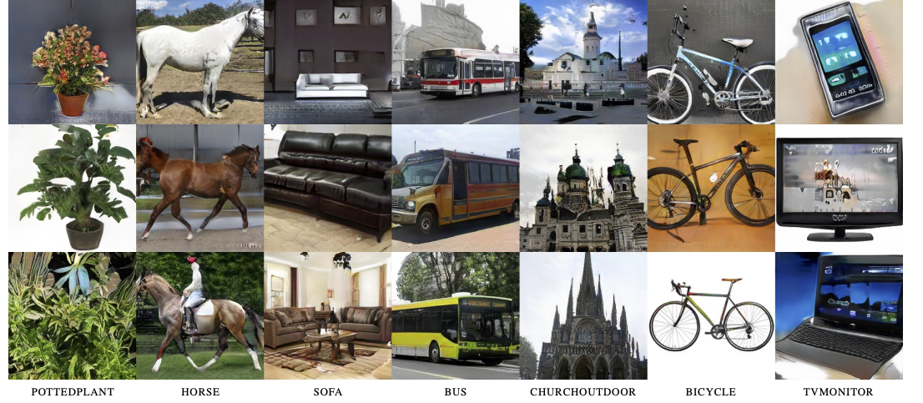
Progressive GANs: Results
256 x 256 results for LSUN categories

Slide 11
StyleGAN
Built on top of Progressive GAN
T. Karras, S. Laine, T. Aila. A Style-Based Generator Architecture for Generative Adversarial Networks. CVPR 2019

Slide 12
StyleGAN
Built on top of Progressive GAN
Start generation with constant (instead of noise vector)
Noise vector is transformed to latent vector $w$ that is later specialized to style codes
Style codes control adaptive instance normalization (AdaIN) or scaling and biasing of each feature map
Add noise after each convolution and before nonlinearity (enables stochastic detail)
T. Karras, S. Laine, T. Aila. A Style-Based Generator Architecture for Generative Adversarial Networks. CVPR 2019

Slide 13
StyleGAN: Results
T. Karras, S. Laine, T. Aila. A Style-Based Generator Architecture for Generative Adversarial Networks. CVPR 2019

Slide 14
Mixing styles
“Two sets of images were generated from their respective latent codes (sources A and B); the rest of the images were generated by copying a specified subset of styles from source B and taking the rest from source A.”
Notes:
Two sets of images were generated from their respective latent codes (sources A and B); the rest of the images were generated by copying a specified subset of styles from source B and taking the rest from source A. Copying the styles corresponding to coarse spatial resolutions (4 2 – 8 2 ) brings high-level aspects such as pose, general hair style, face shape, and eyeglasses from source B, while all colors (eyes, hair, lighting) and finer facial features resemble A. If we instead copy the styles of middle resolutions (162 – 322 ) from B, we inherit smaller scale facial features, hair style, eyes open/closed from B, while the pose, general face shape, and eyeglasses from A are preserved. Finally, copying the fine styles (642 – 10242 ) from B brings mainly the color scheme and microstructure.

Slide 15
Mixing styles
Notes:
Two sets of images were generated from their respective latent codes (sources A and B); the rest of the images were generated by copying a specified subset of styles from source B and taking the rest from source A. Copying the styles corresponding to coarse spatial resolutions (4 2 – 8 2 ) brings high-level aspects such as pose, general hair style, face shape, and eyeglasses from source B, while all colors (eyes, hair, lighting) and finer facial features resemble A. If we instead copy the styles of middle resolutions (162 – 322 ) from B, we inherit smaller scale facial features, hair style, eyes open/closed from B, while the pose, general face shape, and eyeglasses from A are preserved. Finally, copying the fine styles (642 – 10242 ) from B brings mainly the color scheme and microstructure.

Slide 16
Mixing styles
Notes:
Two sets of images were generated from their respective latent codes (sources A and B); the rest of the images were generated by copying a specified subset of styles from source B and taking the rest from source A. Copying the styles corresponding to coarse spatial resolutions (4 2 – 8 2 ) brings high-level aspects such as pose, general hair style, face shape, and eyeglasses from source B, while all colors (eyes, hair, lighting) and finer facial features resemble A. If we instead copy the styles of middle resolutions (162 – 322 ) from B, we inherit smaller scale facial features, hair style, eyes open/closed from B, while the pose, general face shape, and eyeglasses from A are preserved. Finally, copying the fine styles (642 – 10242 ) from B brings mainly the color scheme and microstructure.

Slide 17
StyleGAN: Bedrooms
T. Karras, S. Laine, T. Aila. A Style-Based Generator Architecture for Generative Adversarial Networks. CVPR 2019

Slide 18
StyleGAN: Cars
T. Karras, S. Laine, T. Aila. A Style-Based Generator Architecture for Generative Adversarial Networks. CVPR 2019

Slide 19
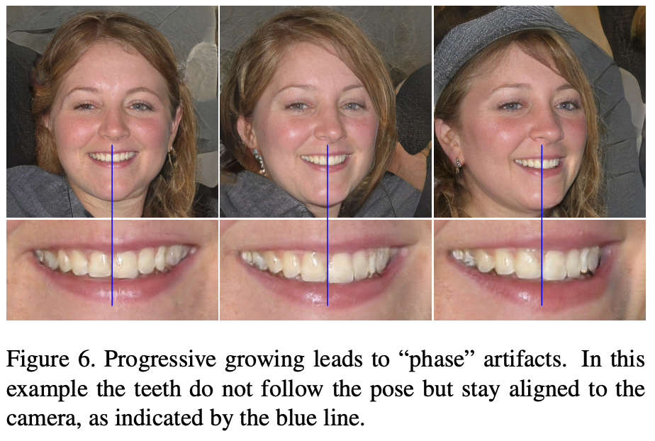
StyleGAN2
Change normalization, remove progressive growing to address StyleGAN artifacts
T. Karras et al. Analyzing and Improving the Image Quality of StyleGAN. CVPR 2020

Slide 20
StyleGAN3
T. Karras et al. Alias-Free Generative Adversarial Networks. NeurIPS 2021

Slide 21
StyleGAN3
Videos
T. Karras et al. Alias-Free Generative Adversarial Networks. NeurIPS 2021

Slide 22
Application of GANs: Inversion and image editing
W. Xia et al. GAN Inversion: A Survey. TPAMI 2023

Slide 23
GAN-based image editing
Use pre-trained attribute classifiers to find latent space directions corresponding to pose, smile, age, gender, eyeglasses
Y. Shen, J. Gu, X. Tang, B. Zhou. Interpreting the Latent Space of GANs for Semantic Face Editing. CVPR 2020

Slide 24
GAN-based image editing
Z. Wu et al. StyleSpace Analysis: Disentangled Controls for StyleGAN Image Generation. CVPR 2021

Slide 25
GAN-based image editing
Z. Wu et al. StyleSpace Analysis: Disentangled Controls for StyleGAN Image Generation. CVPR 2021

Slide 26
Editing using text prompts
Combine powerful recent image-text embedding technique (CLIP) with pre-trained StyleGAN for text-based image editing
O. Patashnik et al.. StyleCLIP: Text-Driven Manipulation of StyleGAN Imagery. ICCV 2021

Slide 27
The golden age of GANs: The StyleGAN family
2018: Progressive GAN
2019: StyleGAN
2020: StyleGAN2
2021: StyleGAN3
In the meanwhile…

Slide 28
BigGAN
Scale up self-attention GAN to generate ImageNet images up to 512 x 512 resolution
A. Brock, J. Donahue, K. Simonyan, Large scale GAN training for high fidelity natural image synthesis, ICLR 2019

Slide 29
BigGAN
The good
The bad

Slide 30
Diffusion models
A. Ramesh et al. Hierarchical text-conditional image generation with CLIP latents. arXiv 2022

Slide 31
The golden age of GANs: The StyleGAN family
2018: Progressive GAN
2019: StyleGAN
2020: StyleGAN2
2021: StyleGAN3
2022: StyleGAN-XL
2023: GigaGAN

Slide 32
StyleGAN-XL
A. Sauer et al. StyleGAN-XL: Scaling StyleGAN to Large Diverse Datasets. SIGGRAPH 2022

Slide 33
StyleGAN-XL: Details
Generator based on StyleGAN3 with progressive growing and 3x more parameters
Discriminator based on projected GANs
Recall the standard GAN objective:
$$V\left(G,D\right)=𝔼_{x\sim p_{data}}\log{D(x)}+𝔼_{z\sim p}log⁡(1−D\left(G(z)\right))$$
Projected GAN objective introduces multiple discriminators operating on projections $P_{l}$from a fixed pre-trained feature space:
$V\left(G,D\right)=\sum_{l}{\left(𝔼_{x\sim p_{data}}\log{D_{l}(P_{l}\left(x\right))}+𝔼_{z\sim p}log⁡(1−D_{l}(P_{l}\left(G(z)\right))\right)}$
Each $P_{l}$returns a feature map of a different resolution by applying random cross-channel mixing and cross-scale mixing to a pre-trained network
A. Sauer et al. Projected GANs Converge Faster. NeurIPS 2021

Slide 34
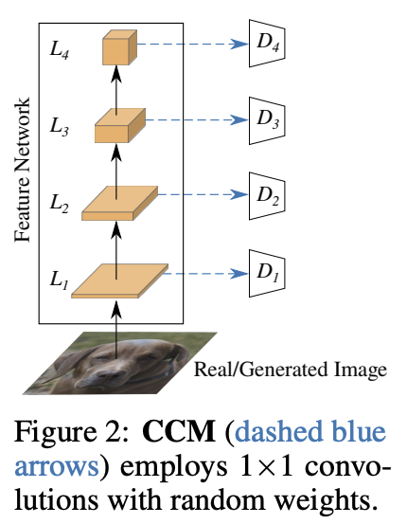
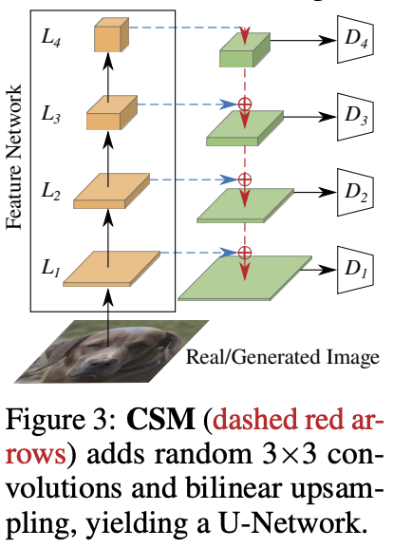
StyleGAN-XL: Details
Cross-channel mixing (CCM)
Cross-scale mixing (CSM)
A. Sauer et al. Projected GANs Converge Faster. NeurIPS 2021
Notes:
The purpose of CCM and CSM is to prohibit the discriminators from focusing on only a subset of its input feature space which would result in mode collapse.

Slide 35
StyleGAN-XL: Details
Generator based on StyleGAN3 with progressive growing and 3x more parameters
Discriminator based on projected GANs
Both generator and discriminator are conditioned on pre-trained class embedding vectors
Classifier guidance: add cross-entropy loss of pre-trained classifier to the generator objective to encourage output of classifier to have high probability for correct class

Slide 36
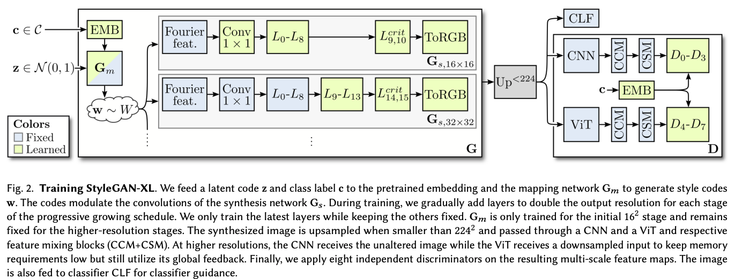
StyleGAN-XL: Details

Slide 37
StyleGAN-XL: Results on ImageNet

Slide 38
Text-to-image synthesis: GigaGAN
M. Kang et al. Scaling up GANs for Text-to-Image Synthesis. CVPR 2023

Slide 39
GigaGAN: Generator
Goal: catch up to diffusion models by training a GAN for text-to-image generation on 2B images from the LAION dataset
1B parameters, 6x larger than StyleGAN-XL, but smaller than diffusion models (Imagen: 3B, DALL-E 2: 5.5B, Parti: 20B)
First generate at 64x64 resolution, then upsample to 512x512 using a separate network
Architecture based on StyleGAN2, but with self-attention layers and sample-adaptive convolution kernel selection

Slide 40
GigaGAN: Generator

Slide 41
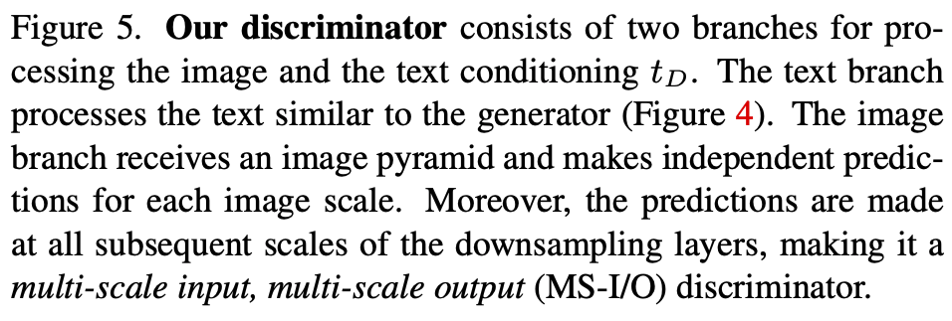
GigaGAN: Discriminator

Slide 42
GigaGAN: Discriminator
Multiple loss terms:
Standard adversarial loss (NSGAN)
Matching-aware loss where image is paired with random conditioning vector and discriminator is encouraged to label the pair as “fake”
CLIP contrastive loss: enforce high image-text similarity using pre-trained image and text encoders
“Vision-aided loss” similar to projected GAN

Slide 43
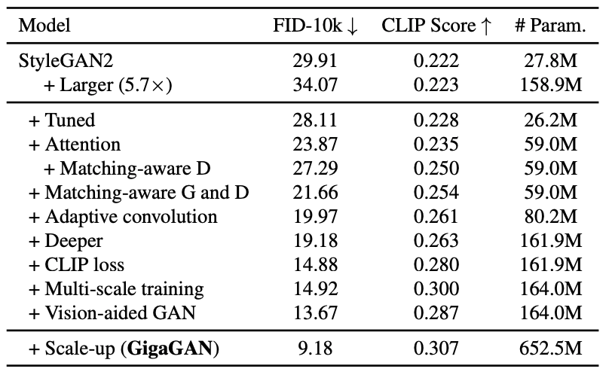
GigaGAN: Ablation study
Image quality measure
Image-text coherence measure

Slide 44
GigaGAN: Style mixing

Slide 45
GigaGAN: Prompt interpolation

Slide 46
GigaGAN: Prompt mixing

Slide 47
GigaGAN: Comparison with diffusion models

Slide 48
GigaGAN: Comparison with diffusion models

Slide 49
GigaGAN: Comparison with diffusion models

Slide 50
GigaGAN: Comparison with diffusion models

Slide 51
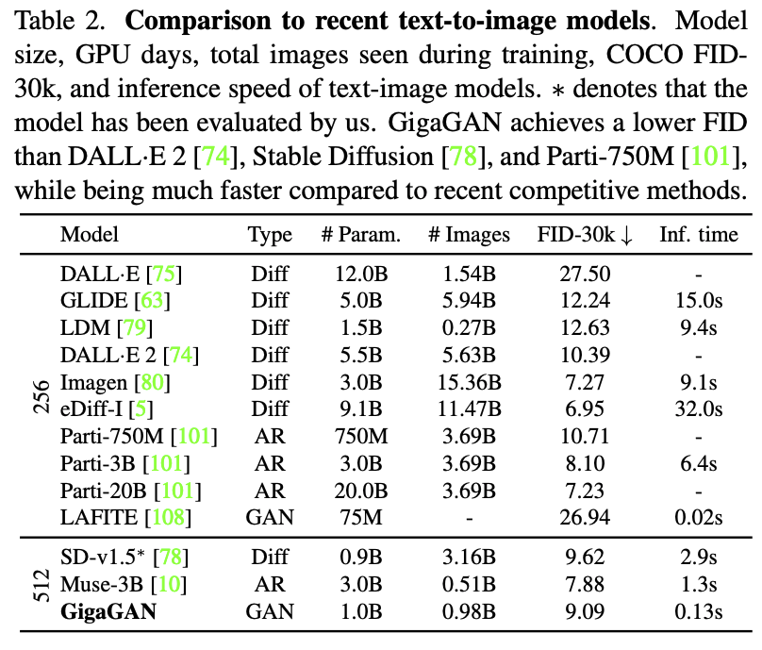
GigaGAN: Quantitative evaluation
“While our model can be optimized to better match the feature distribution of real images than existing models, the quality of the generated images is not necessarily better… We acknowledge that this may represent a corner case of zero-shot FID on COCO2014 dataset and suggest that further research on a better evaluation metric is necessary to improve text-to-image models.”

Slide 52
Do GANs have a future?
We have to stay tuned to find out…

