Slide 1
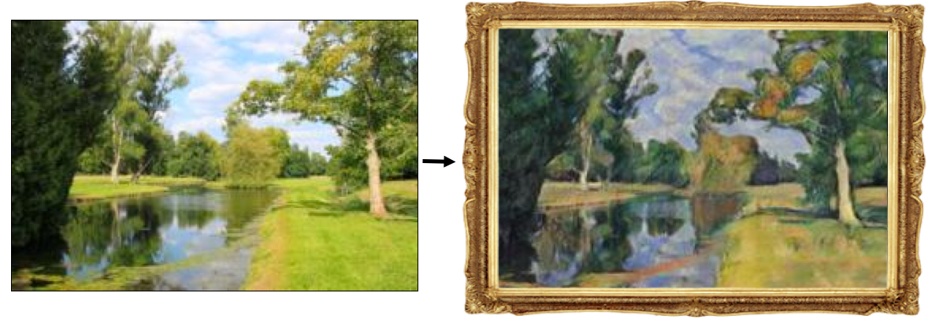
Image-to-image translation

Slide 2
Outline
Paired image-to-image translation: pix2pix
Unpaired image-to-image translation: CycleGAN
Extensions, applications

Slide 3
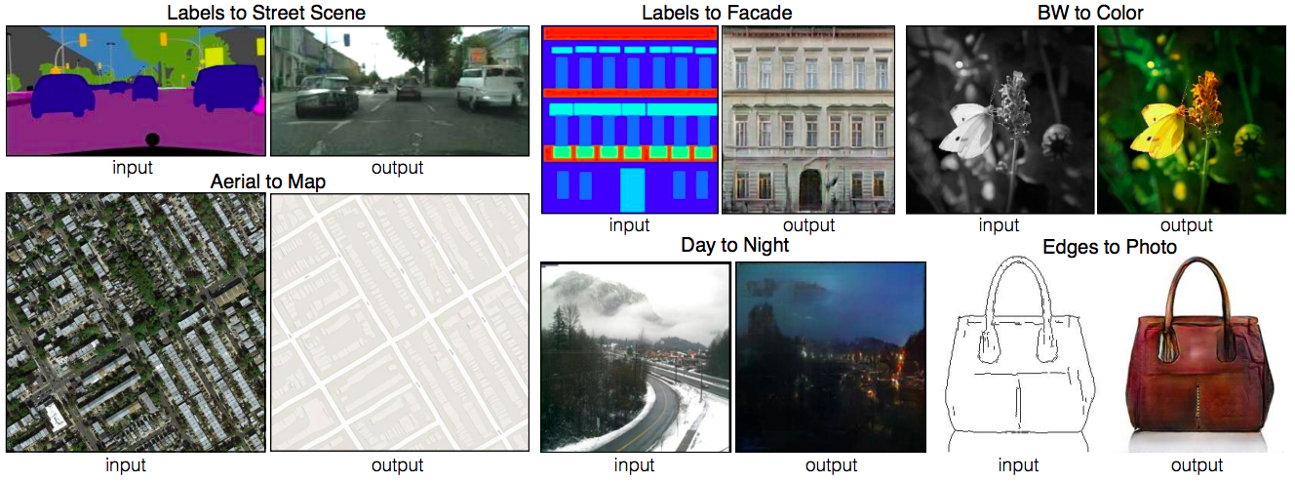
Paired image-to-image translation
P. Isola, J.-Y. Zhu, T. Zhou, A. Efros, Image-to-Image Translation with Conditional Adversarial Networks, CVPR 2017

Slide 4
Pix2pix
Produce modified image $y$ conditioned on input image $x$ (note change of notation)
Generator receives $x$ as input
Discriminator receives an $x, y$pair and has to decide whether it is real or fake

Slide 5
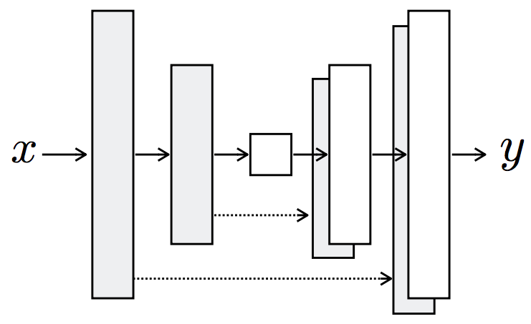
Pix2pix: Generator
Generator architecture: U-Net (no $z$ used as input)

Slide 6
Pix2pix: Generator
Generator architecture: U-Net (no $z$ used as input)
Encode: convolution $→$ BatchNorm $→$ ReLU
Decode: transposed convolution $→$ BatchNorm $→$ ReLU
Figure source

Slide 7
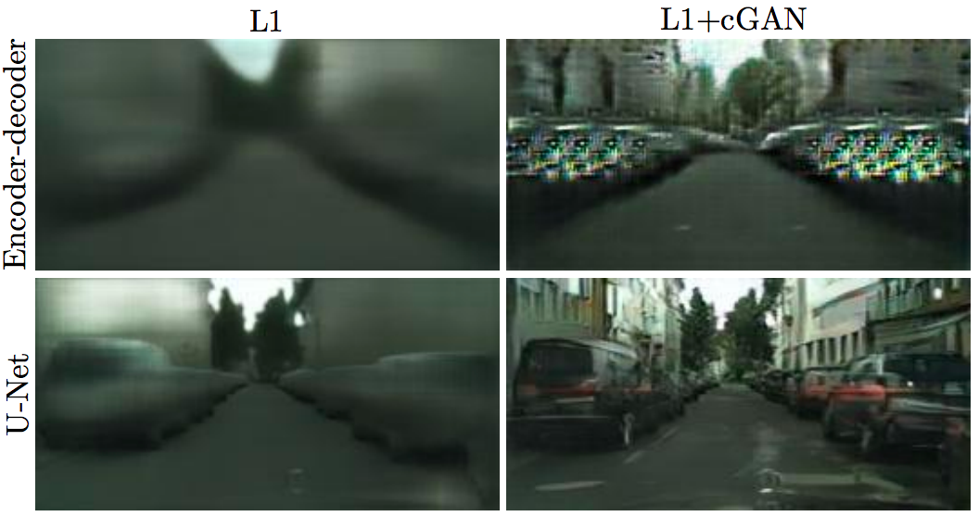
Pix2pix: Generator
Effect of adding skip connections to the generator

Slide 8
Pix2pix: Generator loss
GAN loss plus L1 reconstruction penalty
$$G^{∗}=\arg{\min_{G}}\max_{D}ℒ_{GAN}\left(G,D\right)+λ \sum_{i}{{\left\|y_{i}−G(x_{i})\right\|}_{1}}$$
Generated output $G(x_{i})$should be close to ground truth target $y_{i}$

Slide 9
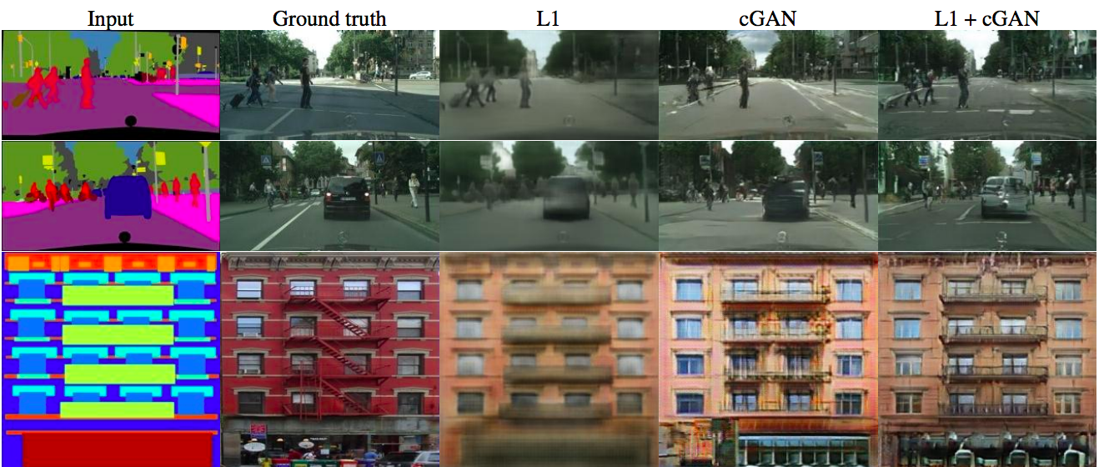
Pix2pix: Generator loss
GAN loss plus L1 reconstruction penalty
$$G^{∗}=\arg{\min_{G}}\max_{D}ℒ_{GAN}\left(G,D\right)+λ \sum_{i}{{\left\|y_{i}−G(x_{i})\right\|}_{1}}$$

Slide 10
Pix2pix: Discriminator
Given input image $x$ and second image $y$, decide whether $y$ is a ground truth target or produced by the generator

Slide 11
Pix2pix: Discriminator
“PatchGAN” architecture: output a 30x30 map where each value (0 to 1) represents the quality of the corresponding section of the output image, average to obtain final discriminator loss
Implemented as FCN, effective patch size can be increased by increasing the depth
Figure source

Slide 12
Pix2pix: Discriminator
“PatchGAN” architecture: output a 30x30 map where each value (0 to 1) represents the quality of the corresponding section of the output image, average to obtain final discriminator loss
Implemented as FCN, effective patch size can be increased by increasing the depth
Effect of discriminator patch size on generator output

Slide 13
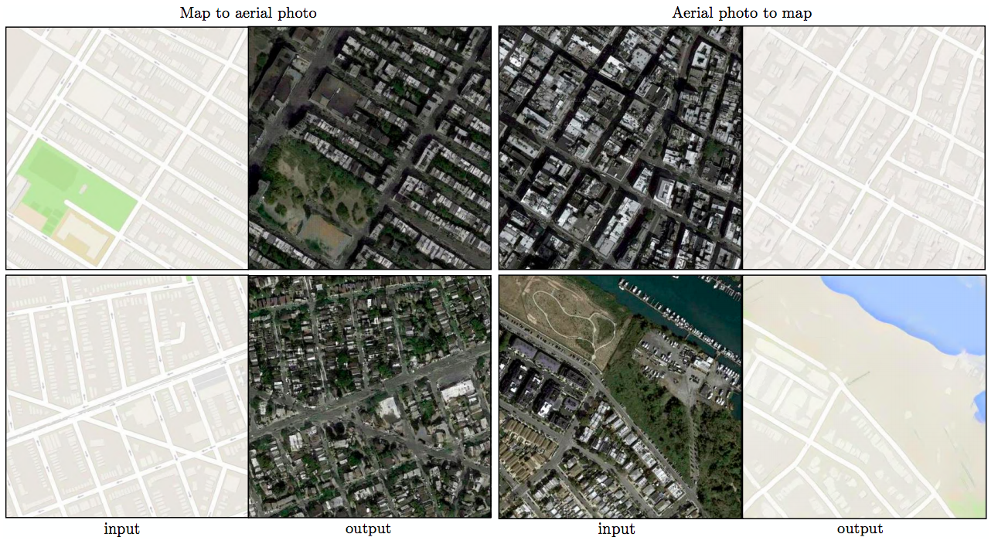
Pix2pix: Results
Translating between maps and aerial photos

Slide 14
Pix2pix: Results
Translating between maps and aerial photos
Human study:
Notes:
Turkers were presented with a series of trials that pitted a “real” image against a “fake” image generated by our algorithm. On each trial, each image appeared for 1 second, after which the images disappeared and Turkers were given unlimited time to respond as to which was fake. The first 10 images of each session were practice and Turkers were given feedback. No feedback was provided on the 40 trials of the main experiment. Each session tested just one algorithm at a time, and Turkers were not allowed to complete more than one session. ∼ 50 Turkers evaluated each algorithm.

Slide 15
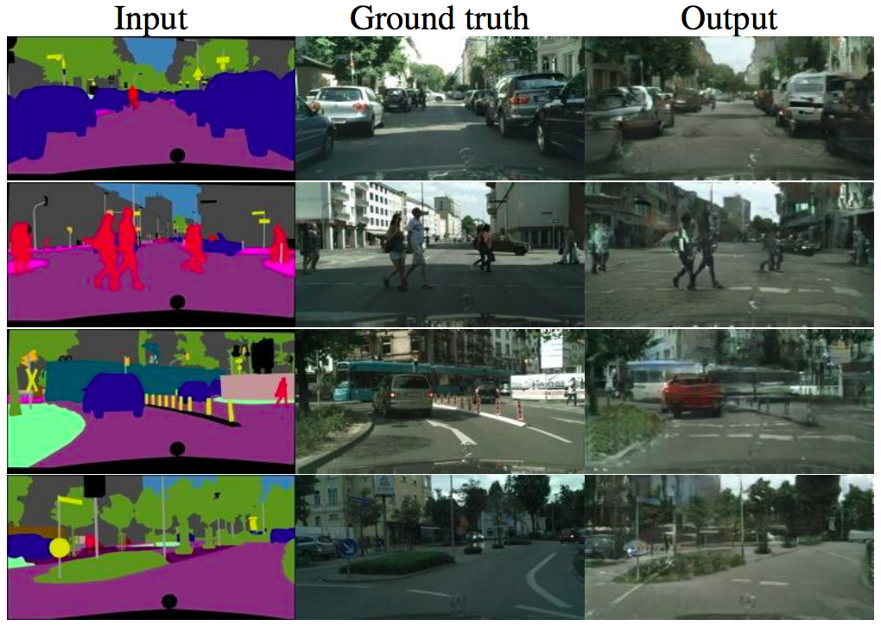
Pix2pix: Results
Semantic labels to scenes

Slide 16
Pix2pix: Results
Semantic labels to scenes
Evaluation: FCN score – the higher the quality of the output, the better the FCN should do at recovering the original semantic labels

Slide 17
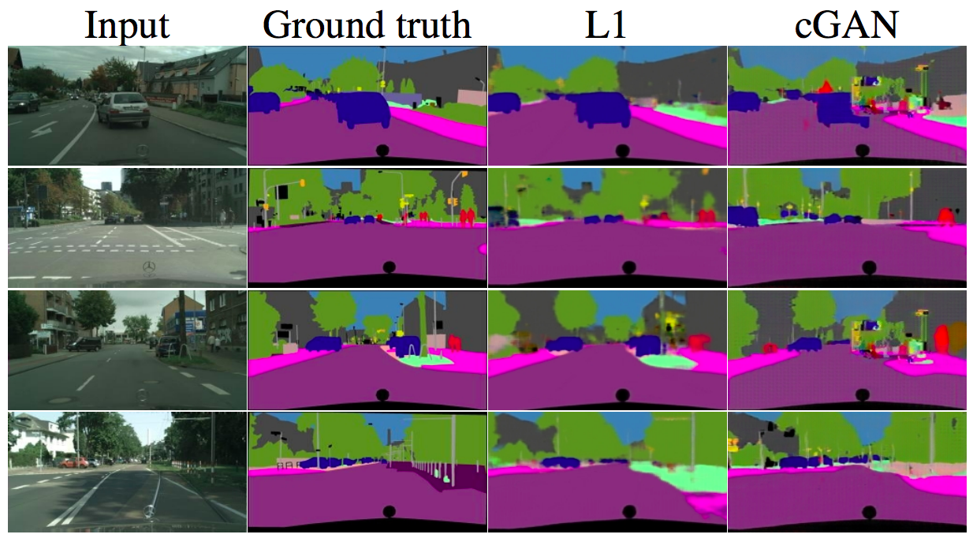
Pix2pix: Results
Scenes to semantic labels

Slide 18
Pix2pix: Results
Scenes to semantic labels
Accuracy is worse than that of regular FCNs or generator with L1 loss

Slide 19
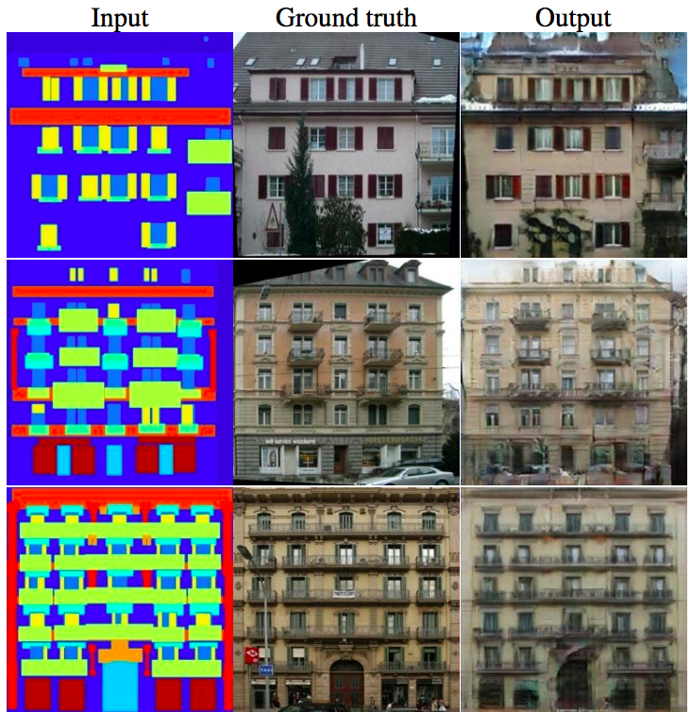
Pix2pix: Results
Semantic labels to facades

Slide 20
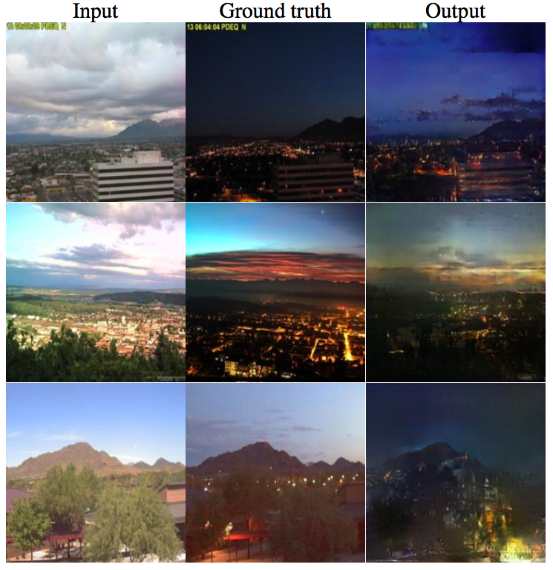
Pix2pix: Results
Day to night

Slide 21
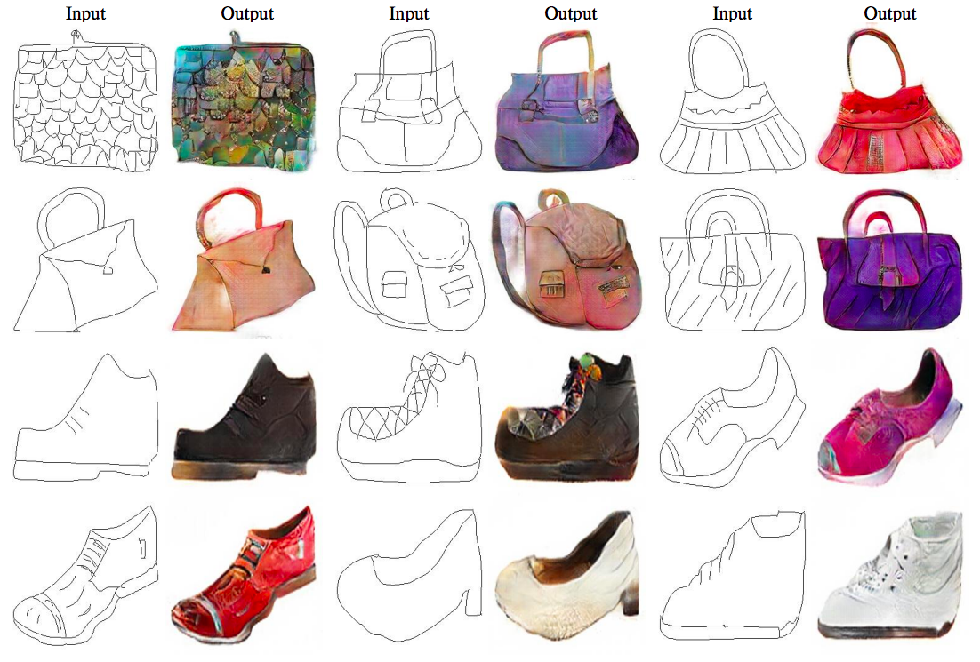
Pix2pix: Results
Edges to photos

Slide 22
Pix2pix: Results
pix2pix demo

Slide 23
Pix2pix: Limitations
Visual quality could be improved
Requires $x, y$pairs for training
Does not model conditional distribution $P(y|x)$, returns a single mode instead

Slide 24
Outline
Paired image-to-image translation: pix2pix
Unpaired image-to-image translation: CycleGAN

Slide 25
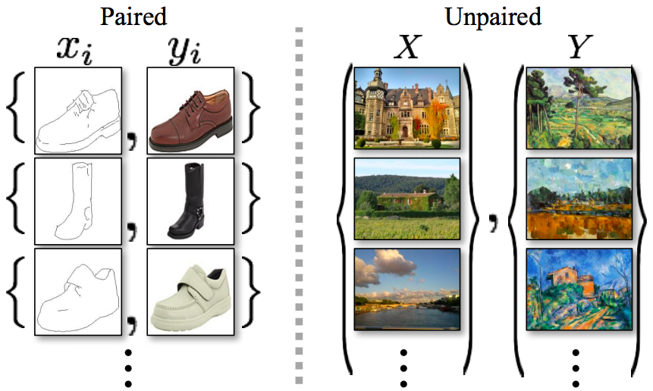
Unpaired image-to-image translation
Given two unordered image collections $X$ and $Y$, learn to “translate” an image from one into the other and vice versa
J.-Y. Zhu, T. Park, P. Isola, A. Efros, Unpaired Image-to-Image Translation Using Cycle-Consistent Adversarial Networks, ICCV 2017

Slide 26
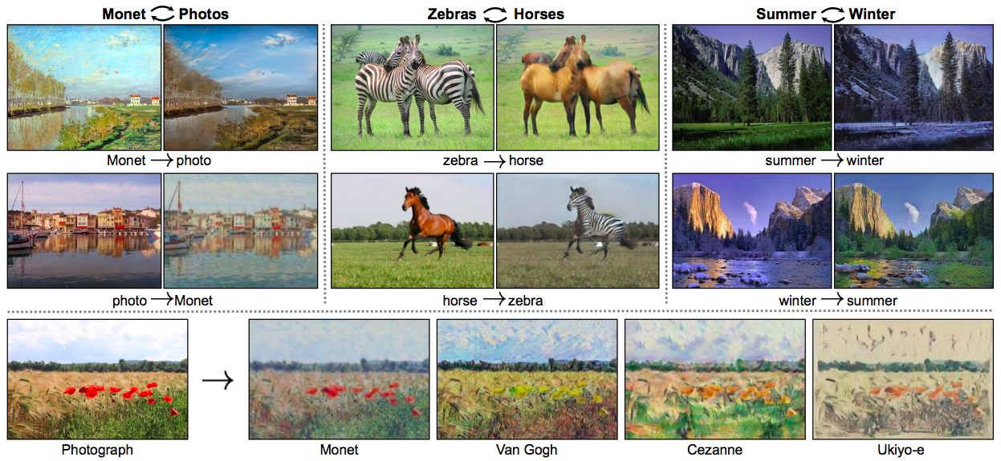
Unpaired image-to-image translation
Given two unordered image collections $X$ and $Y$, learn to “translate” an image from one into the other and vice versa
J.-Y. Zhu, T. Park, P. Isola, A. Efros, Unpaired Image-to-Image Translation Using Cycle-Consistent Adversarial Networks, ICCV 2017

Slide 27
CycleGAN
Given: domains $X$ and $Y$
Train two generators $F$ and $G$ and two discriminators $D_{X}$ and $D_{Y}$
$G$ translates from $X$ to $Y$, $F$ translates from $Y$ to $X$
$D_{X}$recognizes images from $X$, $D_{Y}$ from $Y$
Cycle consistency: we want $F(G(x))≈x$ and $G(F(y))≈y$
Notes:
(a) Our model contains two mapping functions G : X → Y and F : Y → X, and associated adversarial discriminators DY and DX. DY encourages G to translate X into outputs indistinguishable from domain Y , and vice versa for DX and F. To further regularize the mappings, we introduce two cycle consistency losses that capture the intuition that if we translate from one domain to the other and back again we should arrive at where we started: (b) forward cycle-consistency loss: x → G(x) → F(G(x)) ≈ x, and (c) backward cycle-consistency loss: y → F(y) → G(F(y)) ≈ y

Slide 28
CycleGAN: Architecture
Generators (based on Johnson et al., 2016):
Discriminators: PatchGAN on 70 x 70 patches
Figure source

Slide 29
CycleGAN: Loss
Requirements:
$G$ translates from $X$ to $Y$, $F$ translates from $Y$ to $X$
$D_{X}$recognizes images from $X$, $D_{Y}$ from $Y$
We want $F(G(x))≈x$ and $G(F(y))≈y$
CycleGAN discriminator loss: LSGAN
$$ℒ_{GAN}\left(D_{Y}\right)=𝔼_{y\sim p_{data}(y)}\left[{(D_{Y}\left(y\right)−1)}^{2}\right]+𝔼_{x\sim p_{data}(x)}\left[{D_{Y}\left(G\left(x\right)\right)}^{2}\right]$$
$$ℒ_{GAN}\left(D_{X}\right)=𝔼_{x\sim p_{data}(x)}\left[{(D_{X}\left(x\right)−1)}^{2}\right]+𝔼_{y\sim p_{data}(y)}\left[{D_{X}\left(F\left(y\right)\right)}^{2}\right]$$
CycleGAN generator loss:
$ℒ_{cyc}\left(G,F\right)=𝔼_{x\sim p_{data}(x)}\left[{D_{Y}\left(G\left(x\right)−1\right)}^{2}\right]+𝔼_{y\sim p_{data}(y)}\left[{D_{X}\left(F\left(y\right)−1\right)}^{2}\right]$
$$+ 𝔼_{x\sim p_{data}(x)}\left[{\left\|F\left(G\left(x\right)\right)−x\right\|}_{1}\right]+𝔼_{y\sim p_{data}(y)}\left[{\left\|G\left(F\left(y\right)\right)−y\right\|}_{1}\right]$$

Slide 30
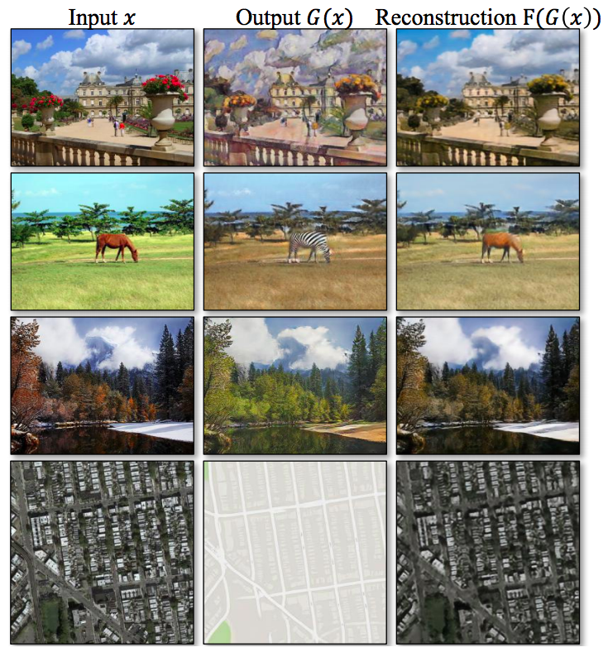
CycleGAN
Illustration of cycle consistency:

Slide 31
CycleGAN: Results
Translation between maps and aerial photos

Slide 32
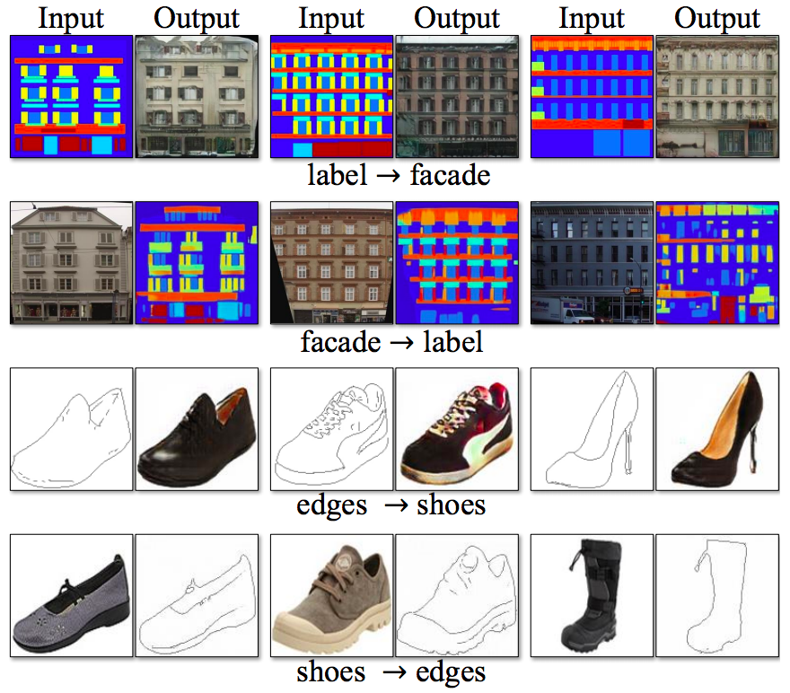
CycleGAN: Results
Other pix2pix tasks

Slide 33
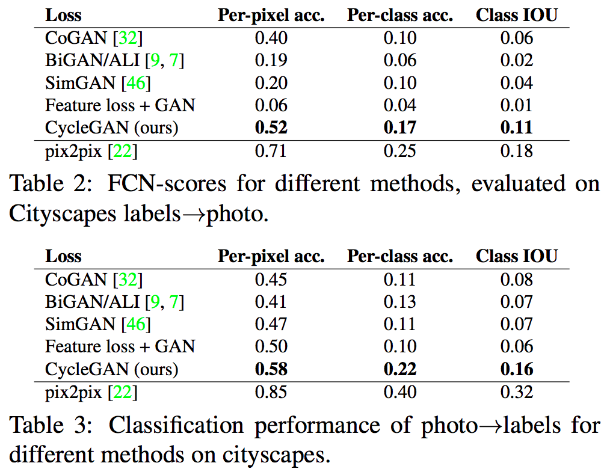
CycleGAN: Results
Scene to labels and labels to scene
Worse performance than pix2pix due to lack of paired training data

Slide 34
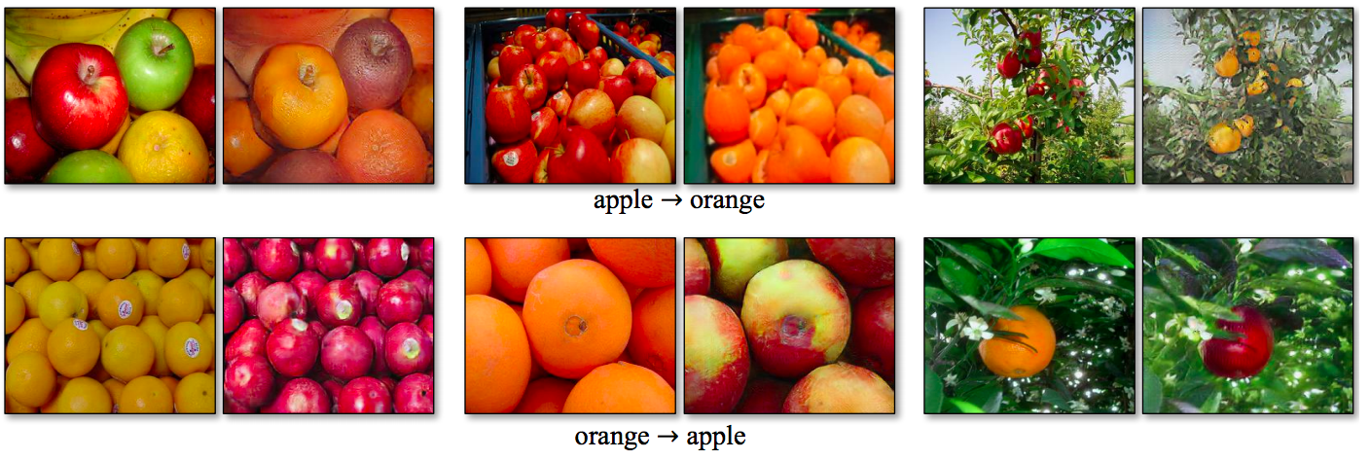
CycleGAN: Results
Tasks for which paired data is unavailable

Slide 35
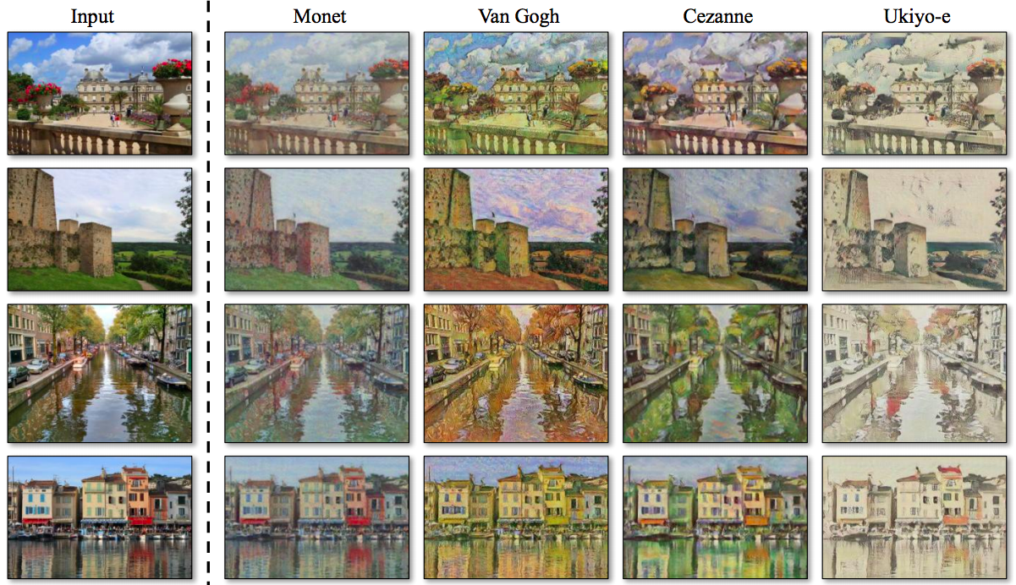
CycleGAN: Results
Style transfer

Slide 36
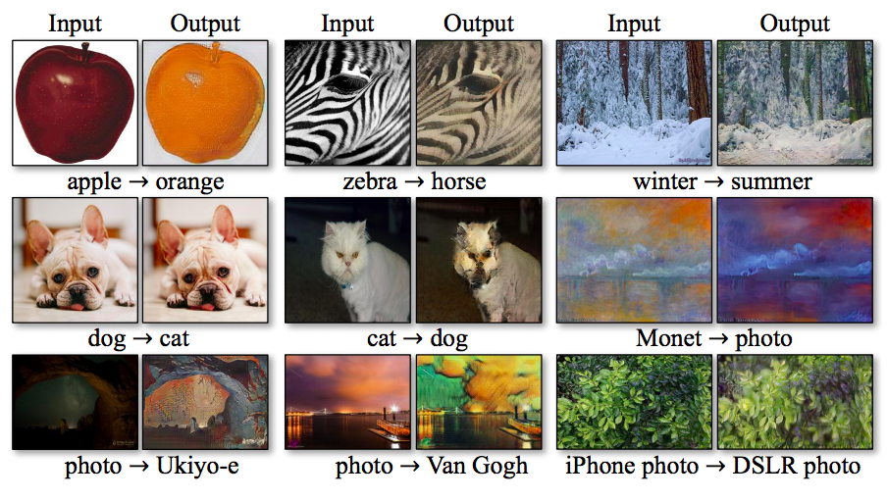
CycleGAN: Failure cases

Slide 37
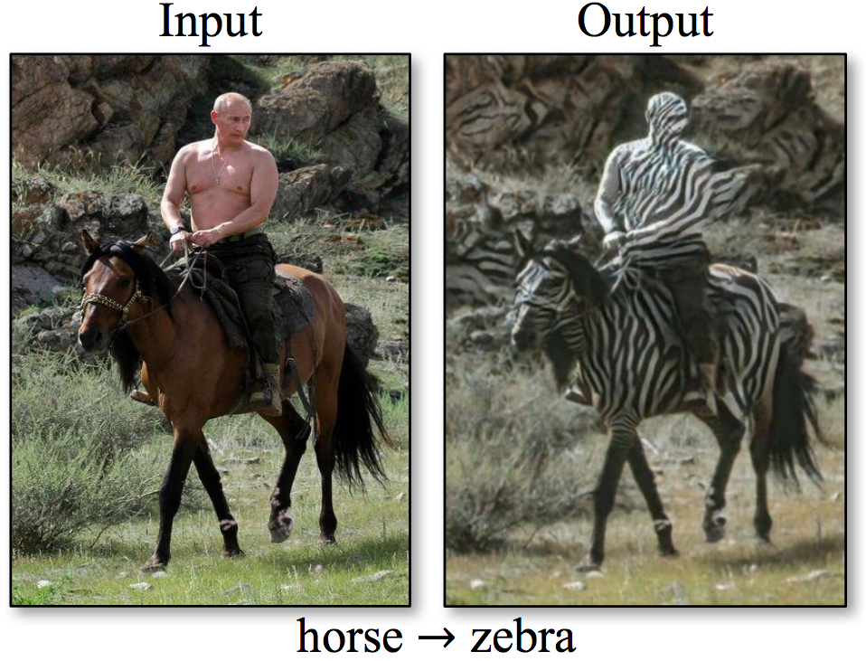
CycleGAN: Failure cases

Slide 38
CycleGAN: Limitations
Cannot handle shape changes (e.g., dog to cat)
Can get confused on images outside of the training domains (e.g., horse with rider)
Cannot close the gap with paired translation methods
Does not account for the fact that one transformation direction may be more challenging than the other

Slide 39
Outline
Paired image-to-image translation: pix2pix
Unpaired image-to-image translation: CycleGAN
Extensions, applications

Slide 40
Multimodal image-to-image translation
J.Y. Zhu, R. Zhang, D. Pathak, T. Darrell, A. A. Efros, O. Wang, E. Shechtman, Toward Multimodal Image-to-Image Translation, NIPS 2017

Slide 41
High-resolution, high-quality pix2pix
T.-C. Wang et al., High-Resolution Image Synthesis and Semantic Manipulation with Conditional GANs, CVPR 2018

Slide 42
High-resolution, high-quality pix2pix
Two-scale generator architecture (up to 2048 x 1024 resolution)
First train global generator network (G1) on lower-res images
Then append higher-res enhancer network (G2) blocks and train G1 and G2 jointly
T.-C. Wang et al., High-Resolution Image Synthesis and Semantic Manipulation with Conditional GANs, CVPR 2018

Slide 43
High-resolution, high-quality pix2pix
Two-scale generator architecture (up to 2048 x 1024 resolution)
Three-scale discriminator architecture (full res, 2x and 4x downsampled)
Incorporate feature matching loss into discriminator

Slide 44
Human generation conditioned on pose
https://carolineec.github.io/everybody_dance_now/
C. Chan, S. Ginosar, T. Zhou, A. Efros. Everybody Dance Now. ICCV 2019

Slide 45
Human generation conditioned on pose
C. Chan, S. Ginosar, T. Zhou, A. Efros. Everybody Dance Now. ICCV 2019

Slide 46
Human generation conditioned on pose
https://carolineec.github.io/everybody_dance_now/
C. Chan, S. Ginosar, T. Zhou, A. Efros. Everybody Dance Now. ICCV 2019

Slide 47
cGAN evaluation: Perceptual metrics
SSIM: structural similarity (Wang et al., 2004)
MS-SIM: multi-scale structural similarity (Wang et al., 2003)
LPIPS: Learned perceptual image patch similarity (Zhang et al. 2018)

