Slide 1
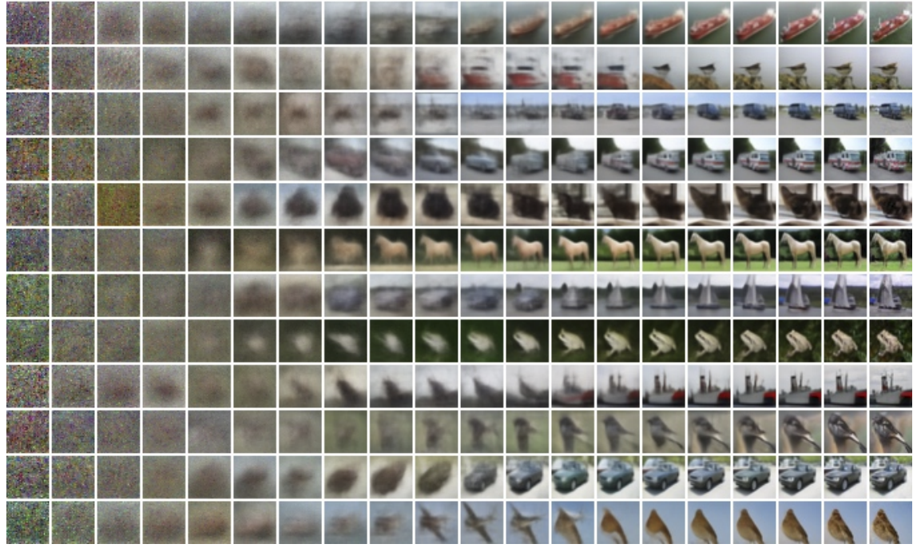
Diffusion models
Notes:
!!!!!TURN ON THE RECORDING!!!!!

Slide 2
Diffusion models
https://www.nytimes.com/2023/04/08/technology/ai-photos-pope-francis.html
Notes:
!!!!!TURN ON THE RECORDING!!!!!

Slide 3
Outline
Part 1: Basics
Denoising diffusion probabilistic models (DDPMs)
Conditional diffusion models
Large-scale models: DALL-E 2, Stable Diffusion, Imagen
Part 2: Recent Advances
Denoising diffusion implicit models (DDIMs)
Stable Diffusion XL, Stable Diffusion 3
Progressive Distillation
Latent Consistency Models (LCM)
(next class) Part 3: Implementation, Applications, and Ethical issues
Notes:
!!!!!TURN ON THE RECORDING!!!!!

Slide 4
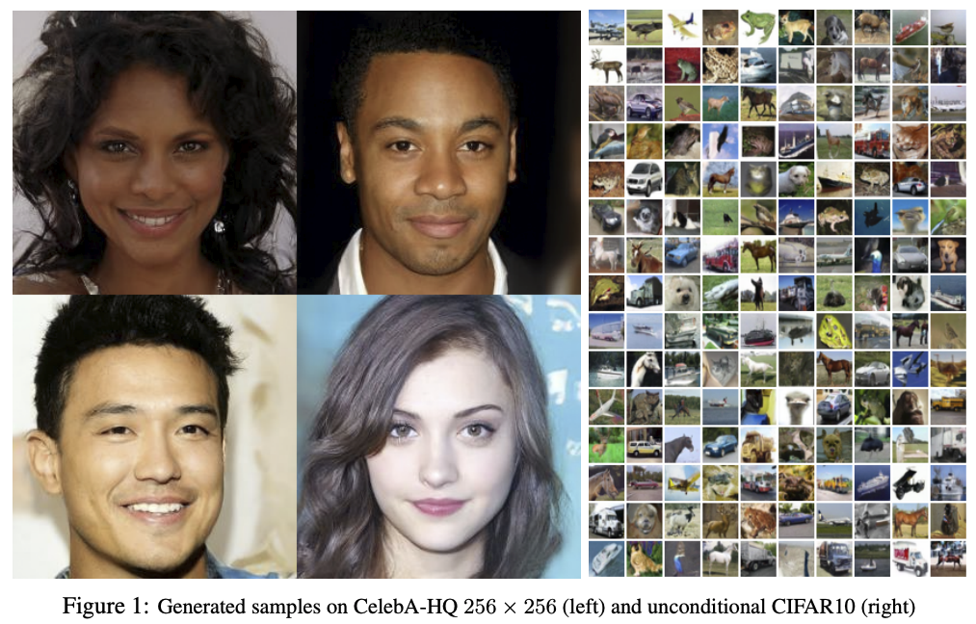
Denoising diffusion probabilistic models (DDPMs)
J. Ho et al. Denoising diffusion probabilistic models. NeurIPS 2020
Notes:
We present high quality image synthesis results using diffusion probabilistic models, a class of latent variable models inspired by considerations from nonequilibrium thermodynamics. Our best results are obtained by training on a weighted variational bound designed according to a novel connection between diffusion probabilistic models and denoising score matching with Langevin dynamics, and our models naturally admit a progressive lossy decompression scheme that can be interpreted as a generalization of autoregressive decoding. On the unconditional CIFAR10 dataset, we obtain an Inception score of 9.46 and a state-of-the-art FID score of 3.17. On 256x256 LSUN, we obtain sample quality similar to ProgressiveGAN

Slide 5
DDPMs: Basic idea
Unconditional CIFAR10 sample generation
J. Ho et al. Denoising diffusion probabilistic models. NeurIPS 2020
Blog introduction: https://lilianweng.github.io/posts/2021-07-11-diffusion-models/
CVPR 2022 tutorial

Slide 6
DDPMs: Basic idea
Forward process $q$ turns images into Gaussian noise
Reverse process $p$ turns noise into images
Provided the increments of $t$ are small enough, $p_{θ}(x_{t−1}|x_{t})$ is Gaussian and we can train a neural network to estimate the mean of $x_{t−1}$ given $x_{t}$
J. Ho et al. Denoising diffusion probabilistic models. NeurIPS 2020

Slide 7
DDPMs: Basic idea
$ε_{θ}(x_{t},t)$ is the predicted noise component of image $x_{t}$ given noise level $t$
Network parameters $θ$ are updated to reduce L2 error between actual noise $ε$ and predicted noise $ε_{θ}(x_{t},t)$
$$x_{t}$$
J. Ho et al. Denoising diffusion probabilistic models. NeurIPS 2020

Slide 8
DDPMs: Basic idea
J. Ho et al. Denoising diffusion probabilistic models. NeurIPS 2020

Slide 9
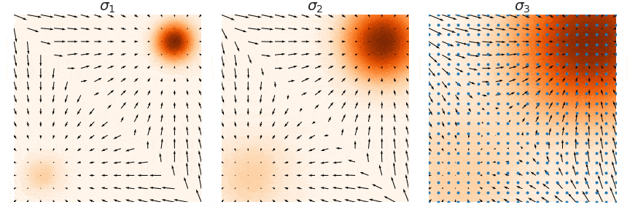
Alternate viewpoint: Score-based generative modeling
It can be shown that $ε_{θ}\left(x_{t},t\right)≈−∇_{x_{t}}\log{q(x_{t})}$, where $∇_{x_{t}}\log{q(x_{t})}$ is the score function of the (noisy) data distribution
To sample from the original data density $q(x_{0})$, we can use annealed Langevin dynamics, i.e., start by sampling from noise-perturbed versions of the data distribution and gradually reduce the amount of noise
Original density
Medium noise
Maximum noise
Y. Song and S. Ermon. Generative Modeling by Estimating Gradients of the Data Distribution. NeurIPS 2019
https://yang-song.net/blog/2021/score/

Slide 10
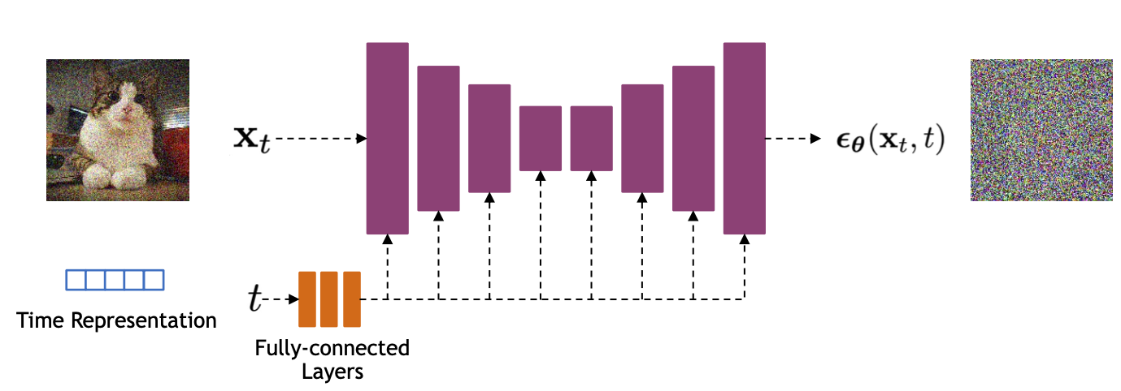
DDPMs: Implementation
U-Net architectures are typically used to represent $ε_{θ}(x_{t},t)$
Bells and whistles: residual blocks, self-attention
Time is encoded using sinusoidal positional embeddings or random Fourier features, fed into the U-Net using addition or adaptive normalization
Source: CVPR 2002 DM tutorial

Slide 11
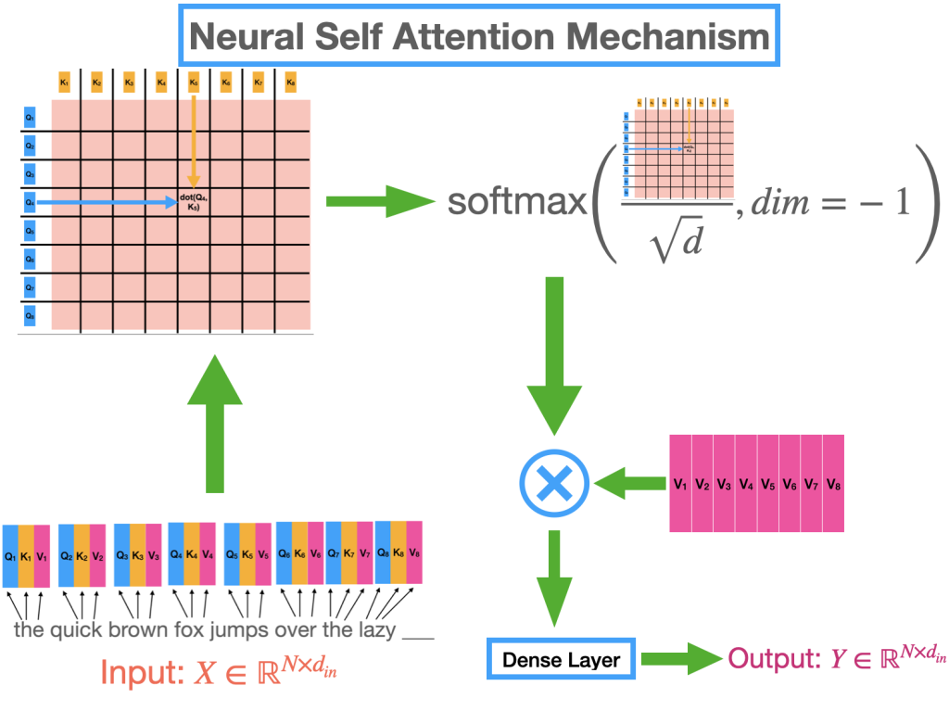
Attention Module

Slide 12
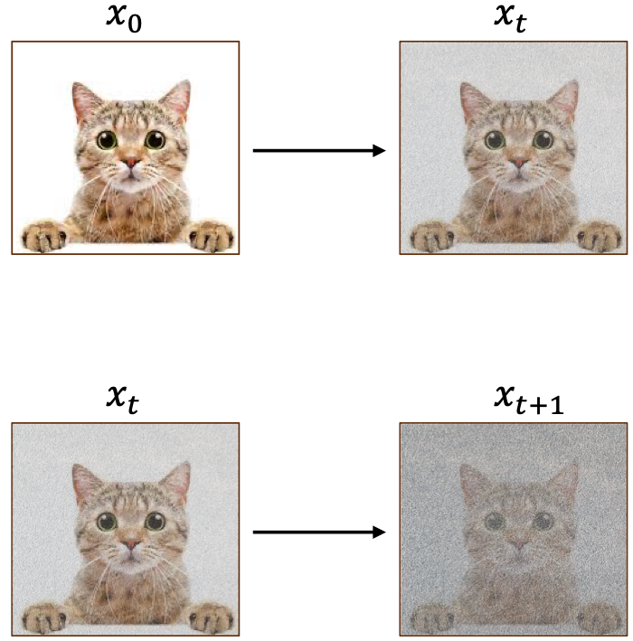
How do we do this in practice?
Step 1: Sample image from the dataset, generate noisy image using forward process
Step 2: Given noisy image, generate slightly noisier image
https://www.eecs.umich.edu/courses/eecs442-ahowens/fa23/slides/lec11-diffusion.pdf

Slide 13
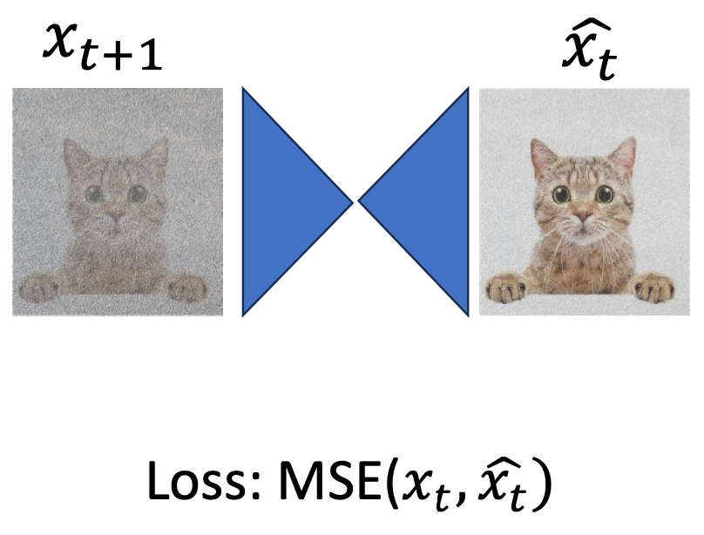
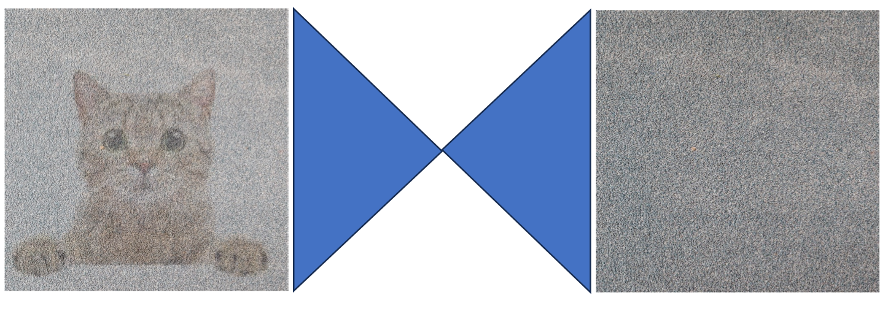
How do we do this in practice?
During Training
During Inference
Input
Output
U-net
U-net
U-net predicts the noise
https://www.eecs.umich.edu/courses/eecs442-ahowens/fa23/slides/lec11-diffusion.pdf

Slide 14
Efficient sampling at high resolutions: Cascaded generation
In practice, data augmentation for inputs to upsampling models is crucial (esp. adding Gaussian noise or early stopping for base model)
J. Ho et al. Cascaded Diffusion Models for High Fidelity Image Generation. JMLR 2022

Slide 15
GANs vs. VAEs vs. Diffusion Models

Slide 16
Outline
Part 1: Basics
Denoising diffusion probabilistic models (DDPMs)
Conditional diffusion models

Slide 17
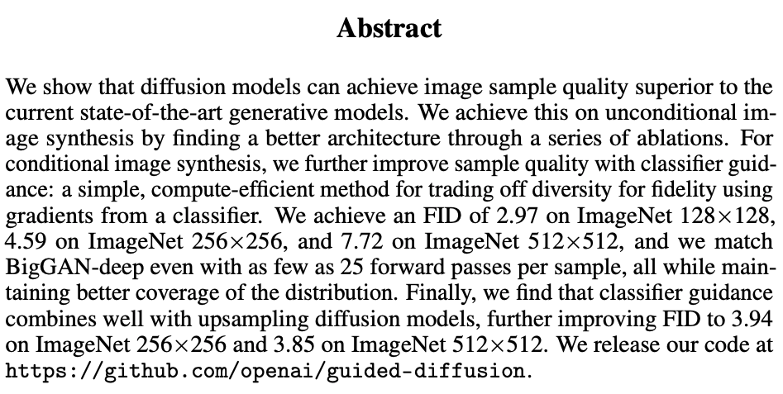
Class-conditioned DDPMs
“We can sample with as few as 25 forward passes while maintaining FIDs comparable to BigGAN”
P. Dhariwal and A. Nichol. Diffusion Models Beat GANs on Image Synthesis. NeurIPS 2021
Notes:
“When using classifier guidance, we find that we can sample with as few as 25 forward passes while maintaining FIDs comparable to BigGAN”

Slide 18
Classifier guidance
We can sample from the class-conditional density $q(x_{t}|c)$ with the help of a pre-trained classifier $P(c|x_{t})$
Bayes rule:
$$q\left(x_{t} | c\right)∝P\left(c | x_{t}\right)q\left(x_{t}\right)$$
$$\log{q\left(x_{t} | c\right)}=\log{P\left(c | x_{t}\right)}+\log{q\left(x_{t}\right)}+const.$$
$$∇_{x_{t}}\log{q\left(x_{t} | c\right)} = ∇_{x_{t}}\log{P\left(c | x_{t}\right)} + ∇_{x_{t}}\log{q\left(x_{t}\right)}$$
To sample from class $c$, steer sample in the modified direction $∇_{x_{t}}[\log{q\left(x_{t}\right)+w log{P\left(c | x_{t}\right)}}]$
conditional score function
obtained from classifier output
unconditional score function (pre-trained)

Slide 19
Classifier-free guidance
Instead of training an additional classifier, get an “implicit classifier” by jointly training a conditional and unconditional diffusion model: $P\left(c | x_{t}\right)∝q\left(x_{t} | c\right)/q\left(x_{t}\right)$
Both $q\left(x_{t} | c\right)$ and $q\left(x_{t}\right)$ are represented using the same network, trained by dropping out $c$ with some probability (corresponding to the unconditional case)
The modified score function corresponding to this implicit classifier is
$$∇_{x_{t}}\left[\log{q\left(x_{t}\right)+w\log{P\left(c | x_{t}\right)}}\right]=∇_{x_{t}}\left[\log{q\left(x_{t}\right)+w(\log{q\left(x_{t} | c\right)−}\log{q(x_{t}))}}\right]$$
Sample is steered away from the unconditional distribution in the direction of the conditional one
J. Ho and T. Salimans. Classifier-Free Diffusion Guidance. arXIv 2021

Slide 20
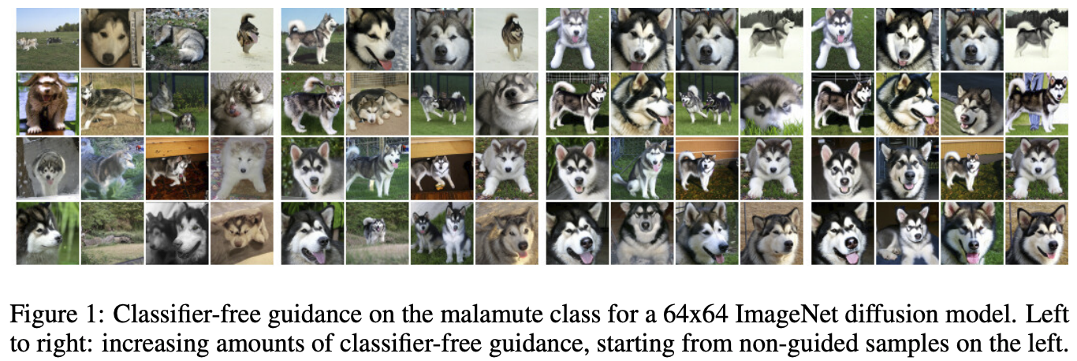
Classifier-free guidance
J. Ho and T. Salimans. Classifier-Free Diffusion Guidance. arXIv 2021

Slide 21
Text-guided diffusion
Instead of a class label, $c$ can be an encoded text prompt, injected into the U-Net using cross-attention
$$ε_{θ}(x_{t},c,t)$$
Conditioning information: text c, time t
Image source

Slide 22
Cross Attention Module
Image
Text
Q comes from Text; K, V comes from Image

Slide 23
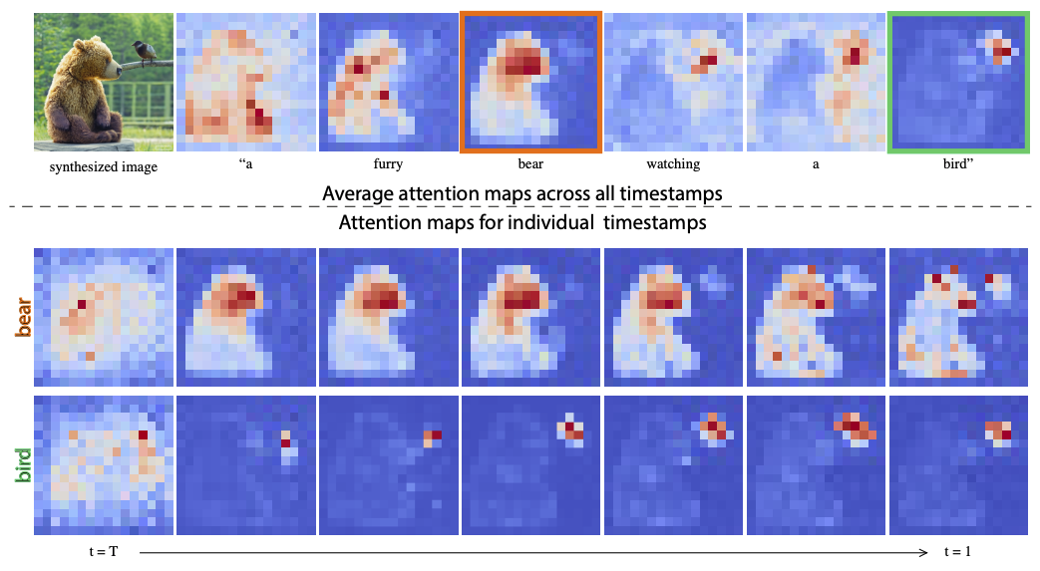
Text-guided diffusion
Instead of a class label, $c$ can be an encoded text prompt, injected into the U-Net using cross-attention
Image source

Slide 24
Text-guided diffusion
Instead of a class label, $c$ can be an encoded text prompt, injected into the U-Net using cross-attention
Classifier-free guidance works the same way as before, by training both conditional and unconditional models using text dropout
CLIP guidance: steer samples in the direction of $∇_{x_{t}}CLIP(x_{t},c)$
Note: both classifier and CLIP must be noise-aware (trained on noised images)

Slide 25
CLIP
Contrastive objective: in a batch of N image-text pairs, classify each text string to the correct image and vice versa
Radford et al., Learning Transferable Visual Models From Natural Language Supervision, ICML 2021
https://openai.com/blog/clip/
Notes:
Explain contrastive as well in high-level intuition

Slide 26
Outline
Part 1: Basics
Denoising diffusion probabilistic models (DDPMs)
Conditional diffusion models
Large-scale models: DALL-E 2, Stable Diffusion, Imagen

Slide 27
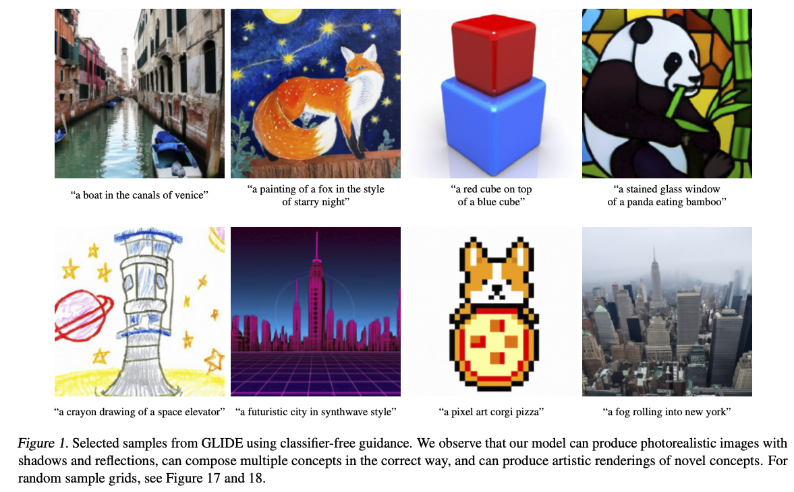
OpenAI GLIDE
Text-to-image generation using classifier-free or CLIP guidance, generate at 64x64, upsample to 256x256
A. Nichol et al. GLIDE: Towards Photorealistic Image Generation and Editing with Text-Guided Diffusion Models. ICML 2022
Notes:
Guided Language to Image Diffusion for Generation and Editing

Slide 28
OpenAI GLIDE
Text-to-image generation using classifier-free or CLIP guidance, generate at 64x64, upsample to 256x256
64x64 generator: 2.3B parameters
Upsampler: 1.5B parameters
Text encoder: 1.2B parameters
Dataset: same as for DALL-E, 250M image-text pairs from the Internet
A. Nichol et al. GLIDE: Towards Photorealistic Image Generation and Editing with Text-Guided Diffusion Models. ICML 2022
Notes:
Guided Language to Image Diffusion for Generation and Editing

Slide 29
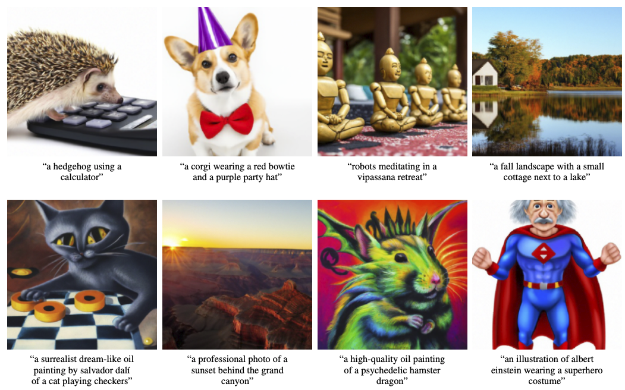
OpenAI GLIDE
A. Nichol et al. GLIDE: Towards Photorealistic Image Generation and Editing with Text-Guided Diffusion Models. ICML 2022
Notes:
Guided Language to Image Diffusion for Generation and Editing

Slide 30
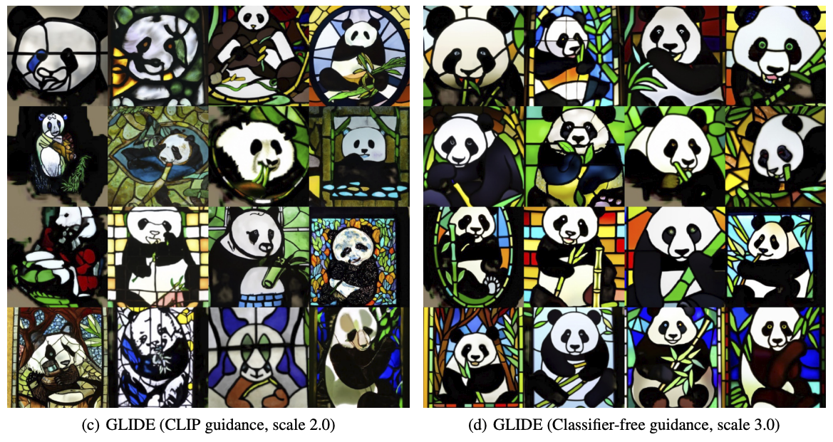
OpenAI GLIDE
A. Nichol et al. GLIDE: Towards Photorealistic Image Generation and Editing with Text-Guided Diffusion Models. ICML 2022

Slide 31
OpenAI GLIDE

Slide 32
DALL-E 2
A. Ramesh et al. Hierarchical text-conditional image generation with CLIP latents. Preprint 2022

Slide 33
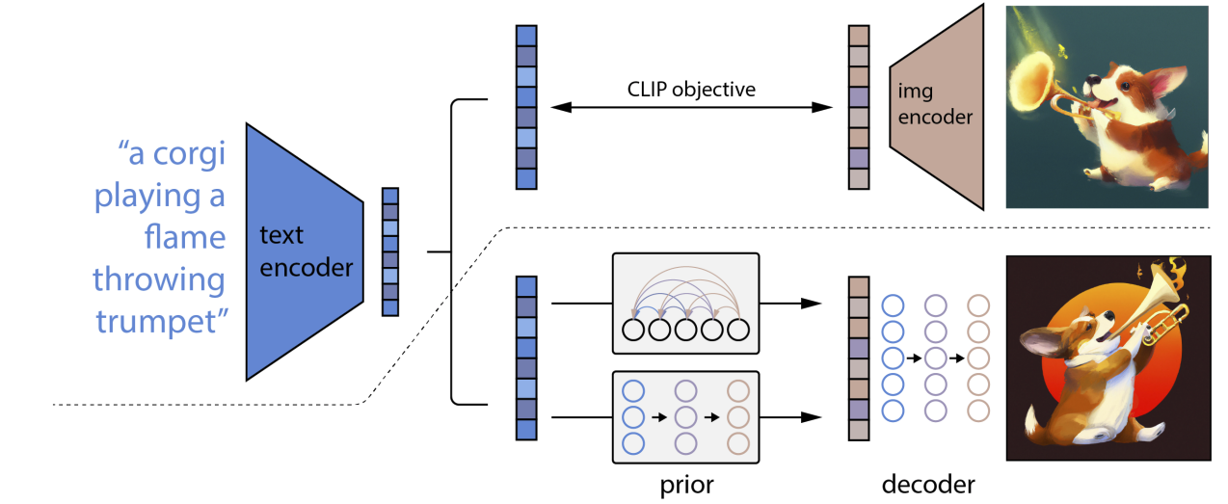
DALL-E 2

Slide 34
DALL-E 2
CLIP text encoding
CLIP image encoding
Generative model to produce CLIP image encoding given CLIP text encoding
Diffusion model (GLIDE) conditioned on CLIP image embedding and text prompt
Generate at 64x64, upsample to 256x256, then upsample to 1024x1024
Notes:
Delete the reference to GLIDE; suppl. With the CLIP understanding

Slide 35
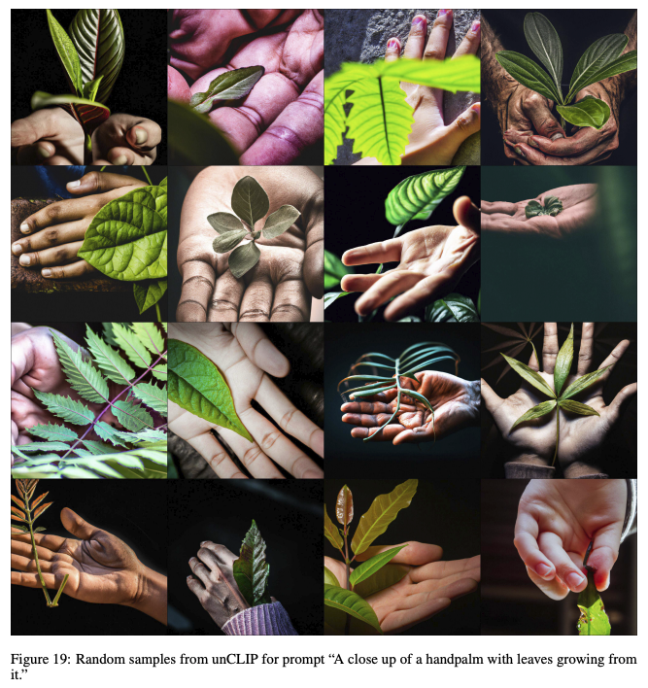
DALL-E 2: Results

Slide 36
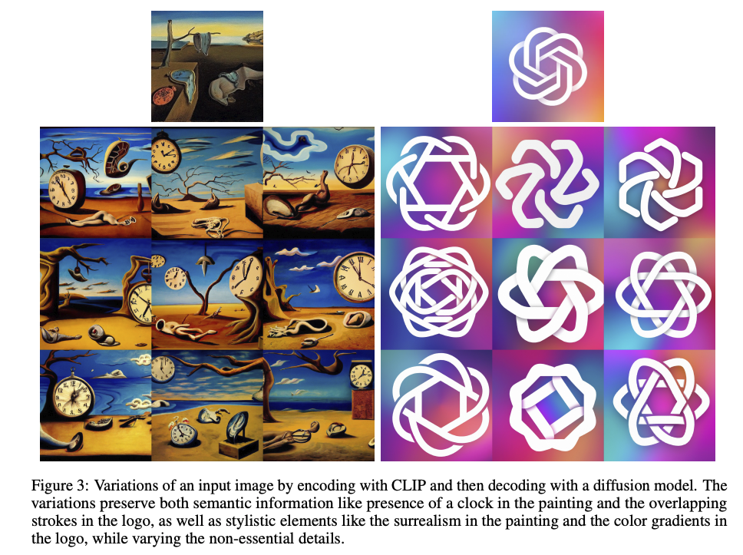
DALL-E 2: Results

Slide 37
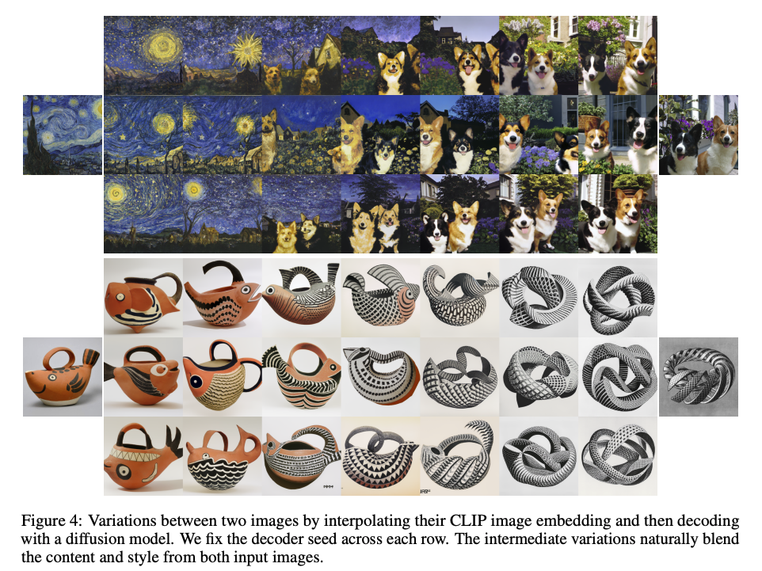
DALL-E 2: Results

Slide 38
DALL-E 2: Limitations
Notes:
Check if any of these limitations are fixed with the latest models
Getting the right attributes, getting the text rendered correctly, generating hands

Slide 39
Latent diffusion model (basis of Stable Diffusion)
Notes:
Q, K , V is not explained, don’t use the above image, so might be easy to find a simpler image, keep the paper reference,

Slide 40
Latent diffusion model (basis of Stable Diffusion)
Key idea: train a separate encoder and decoder to convert images to and from a lower-dimensional latent space, run conditional diffusion model in latent space
R. Rombach et al. High-Resolution Image Synthesis with Latent Diffusion Models. CVPR 2022
https://medium.com/@steinsfu/stable-diffusion-clearly-explained-ed008044e07e

Slide 41
Latent diffusion model (basis of Stable Diffusion)
Key idea: train a separate encoder and decoder to convert images to and from a lower-dimensional latent space, run conditional diffusion model in latent space
https://medium.com/@steinsfu/stable-diffusion-clearly-explained-ed008044e07e

Slide 42
Latent diffusion model (basis of Stable Diffusion)
Key idea: train a separate encoder and decoder to convert images to and from a lower-dimensional latent space, run conditional diffusion model in latent space
Close-up of U-Net: Conditioning information incorporated using cross-attention
https://medium.com/@steinsfu/stable-diffusion-clearly-explained-ed008044e07e
Notes:
Same – remove the figure

Slide 43
Latent diffusion model (basis of Stable Diffusion)
Notes:
Add a slide about SDv1.5, SDv.2.1, SDXL, SD3 and put some results

Slide 44
Google Imagen (not public)
C. Saharia et al. Photorealistic Text-to-Image Diffusion Models with Deep Language Understanding. NeurIPS 2022

Slide 45
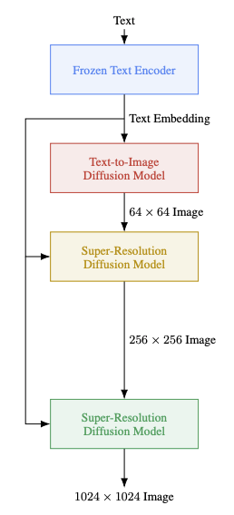
Google Imagen: Details
Text encoder is a large language model (4.6B parameters) trained on text only
Diffusion model to generate at 64x64, upsample to 256x256, then 1024x1024
Architecture: efficient U-Net (2B parameters): more parameters at lower resolutions, convolutions after downsampling and before upsampling
Classifier-free guidance with a dynamic thresholding technique, enabling good generation quality with high guidance weights
Training dataset: 460M image-text pairs (internally collected), 400M pairs from the LAION dataset
C. Saharia et al. Photorealistic Text-to-Image Diffusion Models with Deep Language Understanding. NeurIPS 2022

Slide 46
Google Imagen: Evaluation
Impact of model size, implementation choices
Curves are obtained by varying guidance weight
FID evaluated on COCO dataset by sampling prompts and generating images using the same prompts

Slide 47
Google Imagen: Evaluation
Human evaluation on DrawBench (set of 200 prompts)

Slide 48
Imagen vs. DALL-E 2
“A yellow book and a red vase”

Slide 49
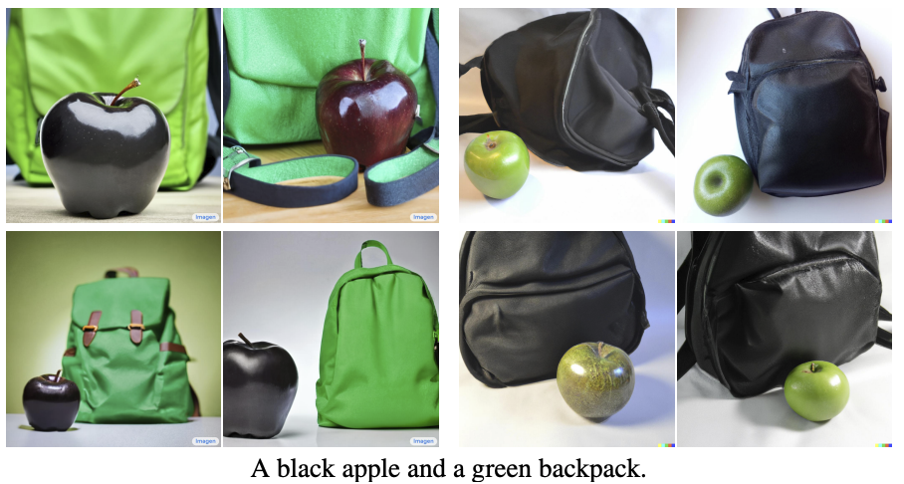
Imagen vs. DALL-E 2
“A black apple and a green backpack”
Imagen is better than DALL-E 2 in assigning the colors to the objects

Slide 50
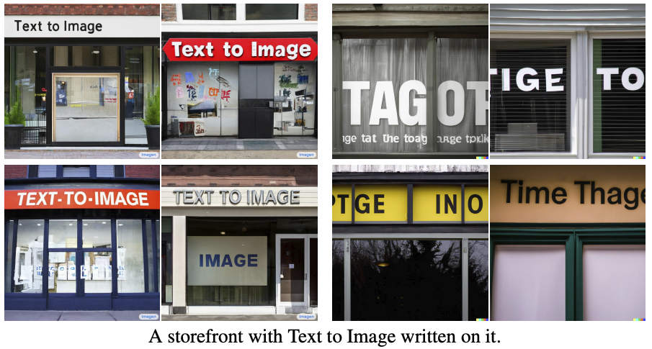
Imagen vs. DALL-E 2
“A storefront with Text to Image written on it”

Slide 51
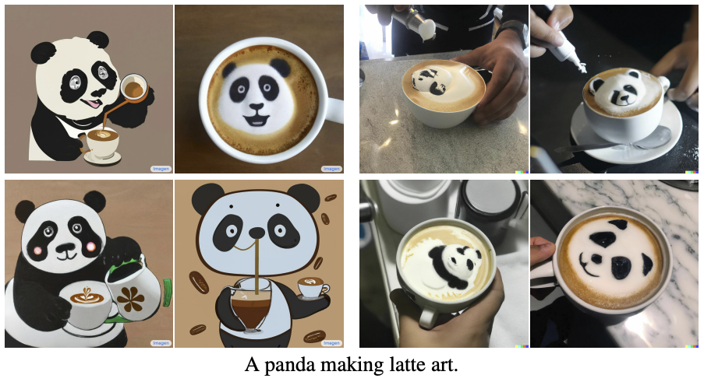
Imagen vs. DALL-E 2
“A panda making latte art”

Slide 52
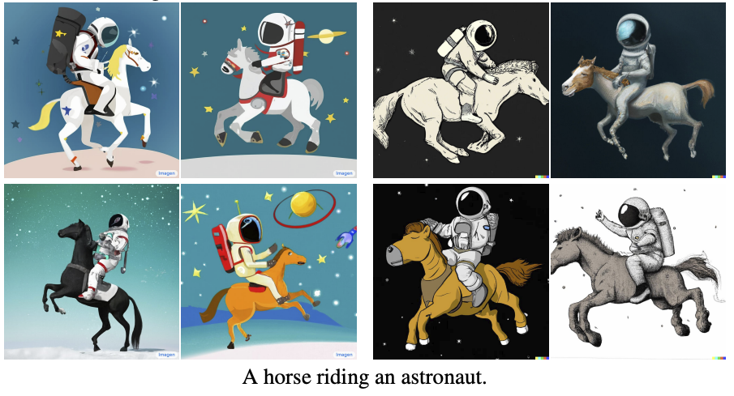
Imagen vs. DALL-E 2
“A horse riding an astronaut”
Notes:
Add a slide here about Deep Floyd - IF model – open-source version of Imagen

Slide 53
Outline
Part 1: Basics
Denoising diffusion probabilistic models (DDPMs)
Conditional diffusion models
Large-scale models: DALL-E 2, Stable Diffusion, Imagen
Part 2: Recent Advances
Denoising diffusion implicit models (DDIMs)

Slide 54
Denoising Diffusion Implicit Models (DDIMs)
Sangwoo Mo, Introduction to Diffusion Models

Slide 55
DDIM follows a deterministic process
DDPM follows stochastic process
DDIM follows deterministic process
The same original noise $x_{T}$ to same image $x_{0}$
Tidiane Ndir, presentation on Faster diffusion, Uni of Freiburg

Slide 56
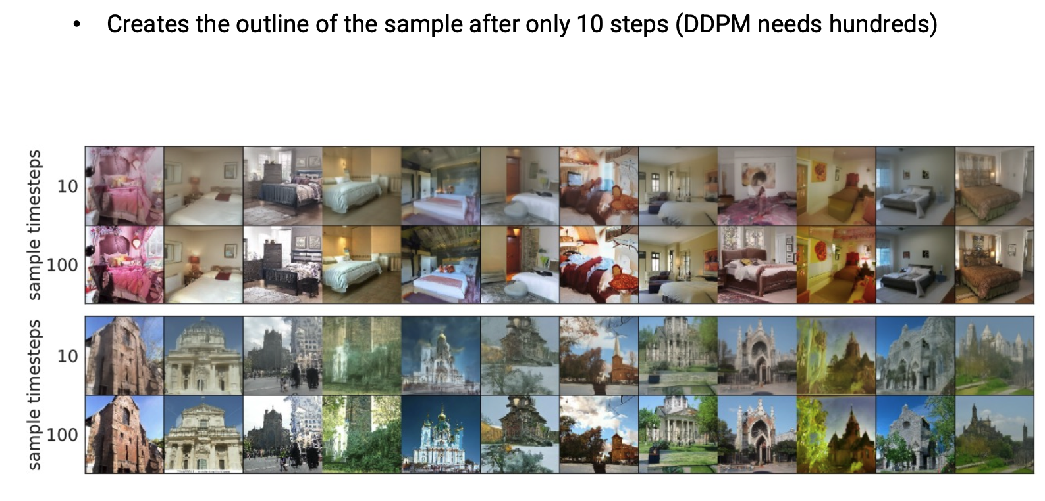
DDIM reduces the sampling steps significantly

Slide 57
Outline
Part 1: Basics
Denoising diffusion probabilistic models (DDPMs)
Conditional diffusion models
Large-scale models: DALL-E 2, Stable Diffusion, Imagen
Part 2: Recent Advances
Denoising diffusion implicit models (DDIMs)
Stable Diffusion XL, Stable Diffusion 3

Slide 58
Recall Stable Diffusion (SD v1.4, SD v1.5, SD v2.1)

Slide 59
Improved SDXL pipeline
Separate refiner model
Two text-encoders
Bigger U-net with more attention blocks and higher number of parameters
https://towardsdatascience.com/the-arrival-of-sdxl-1-0-4e739d5cc6c7

Slide 60
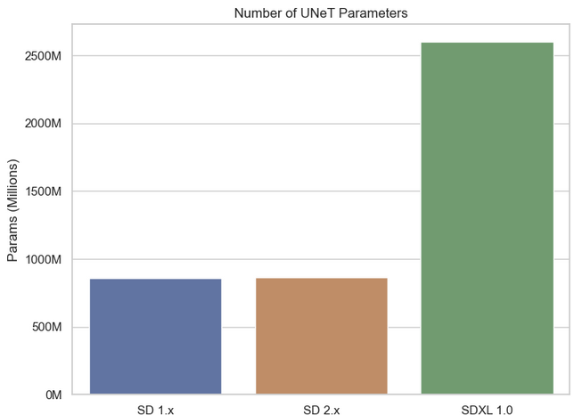
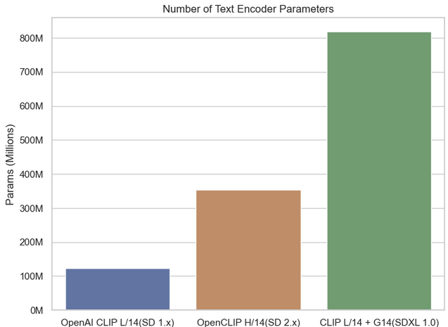
SDXL
https://towardsdatascience.com/the-arrival-of-sdxl-1-0-4e739d5cc6c7

Slide 61
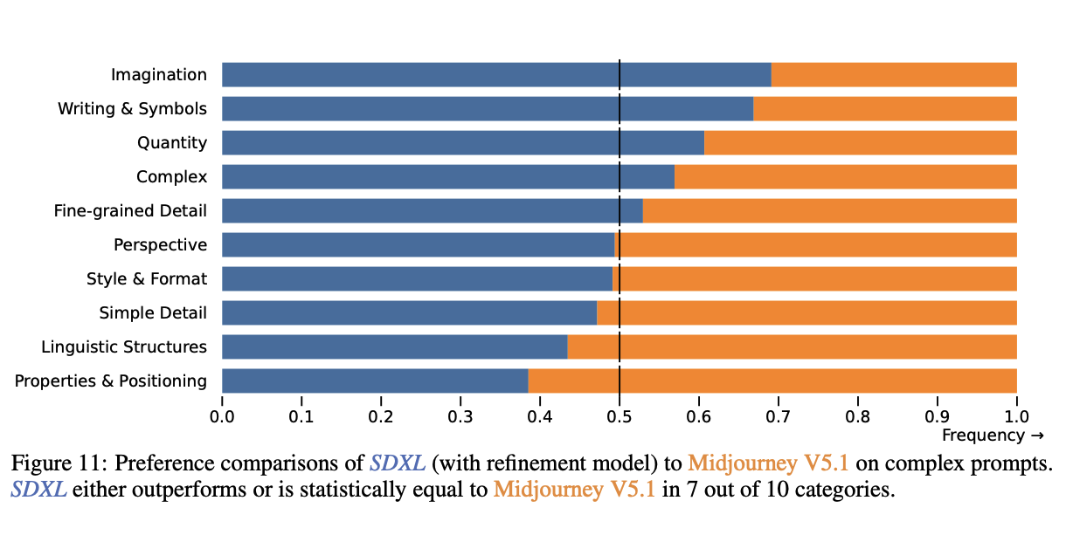
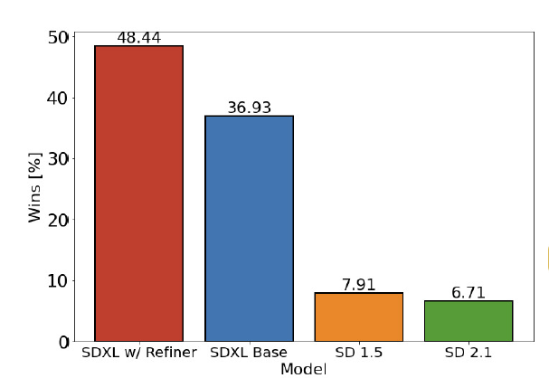
SDXL: Improvements in generation quality
Comparing user preferences between SDXL and
previous models.
Improving Latent Diffusion Models for High-Resolution Image Synthesis

Slide 62
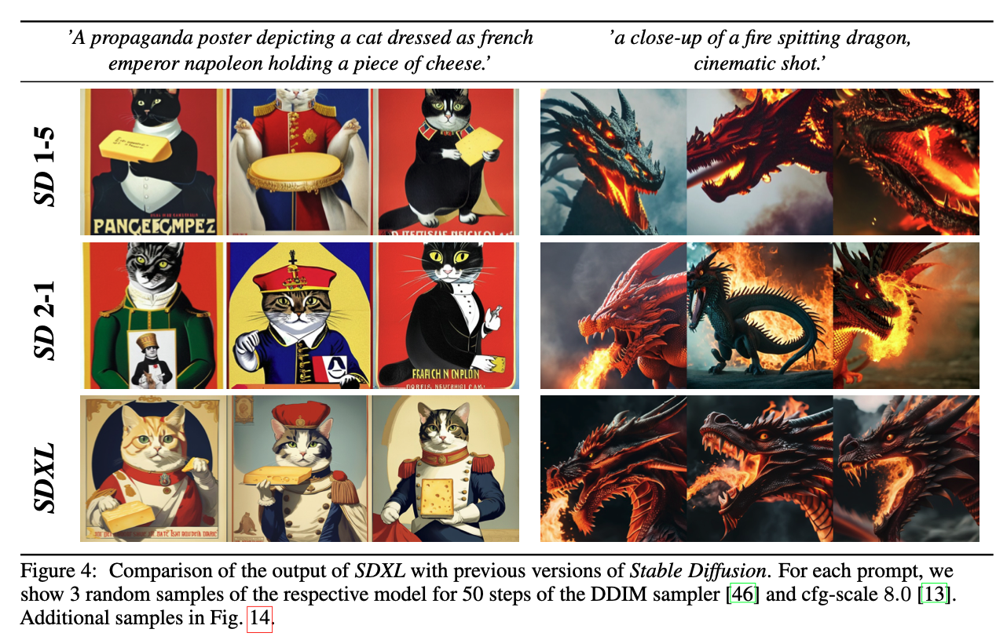
SDXL: Results

Slide 63
SDXL: Results

Slide 64
SD3
https://stability.ai/news/stable-diffusion-3-research-paper

Slide 65
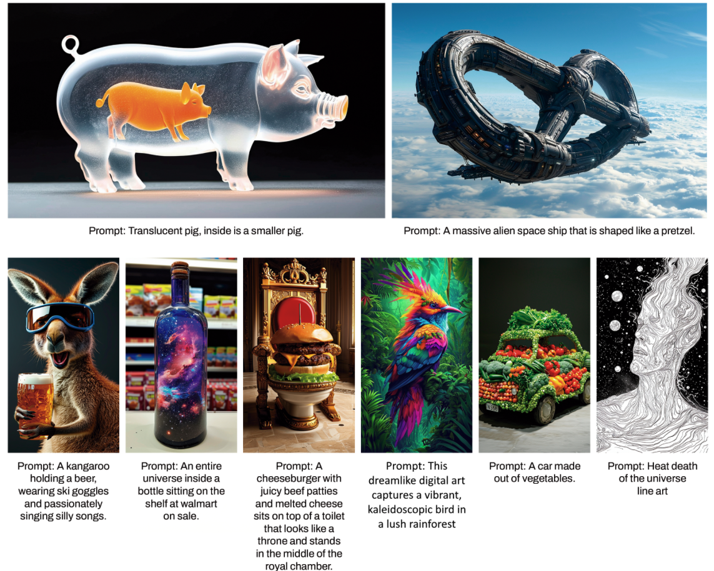
SD3: Results

Slide 66
Outline
Part 1: Basics
Denoising diffusion probabilistic models (DDPMs)
Conditional diffusion models
Large-scale models: DALL-E 2, Stable Diffusion, Imagen
Part 2: Recent Advances
Denoising diffusion implicit models (DDIMs)
Stable Diffusion XL, Stable Diffusion 3
Progressive Distillation

Slide 67
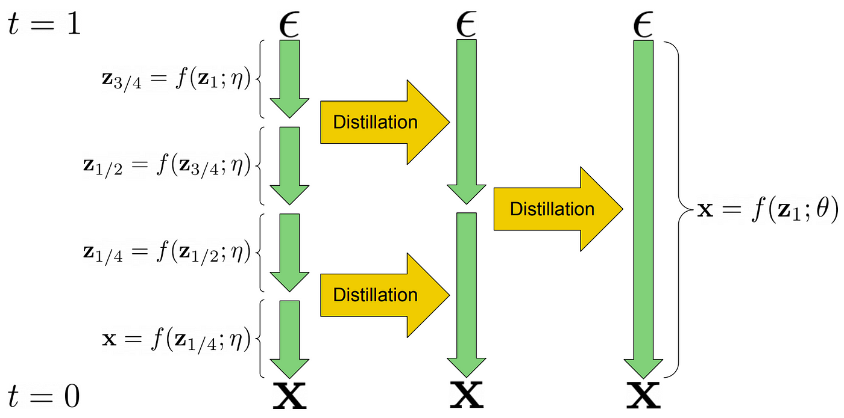
Progressive Distillation
Salimans et al, Progressive distillation for fast sampling of diffusion models

Slide 68
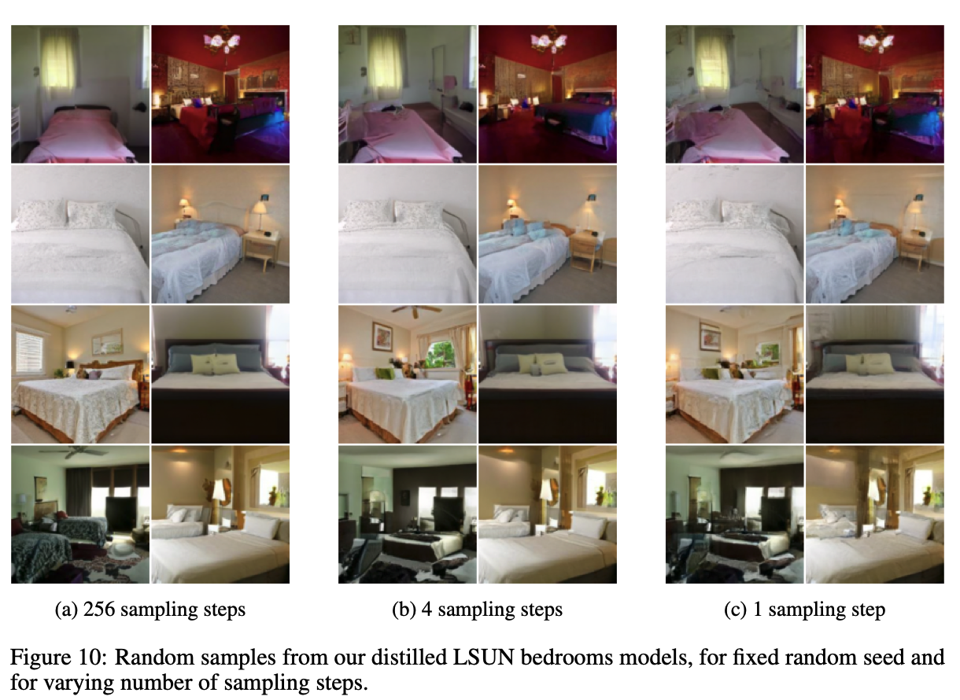
Progressive Distillation: Results

Slide 69
Outline
Part 1: Basics
Denoising diffusion probabilistic models (DDPMs)
Conditional diffusion models
Large-scale models: DALL-E 2, Stable Diffusion, Imagen
Part 2: Recent Advances
Denoising diffusion implicit models (DDIMs)
Stable Diffusion XL, Stable Diffusion 3
Model Distillation
Latent Consistency Models (LCM)

Slide 70
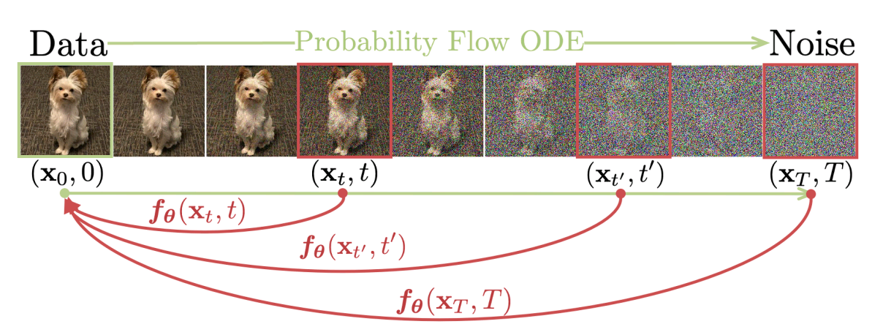
Latent Consistency Models
Consistency Models
Latent Consistency Models: combine the above idea with Latent Diffusion Models
Song et al., Consistency Models
Luo et al, Latent Consistency Models: Synthesizing High-Resolution Images with Few-step Inference

Slide 71
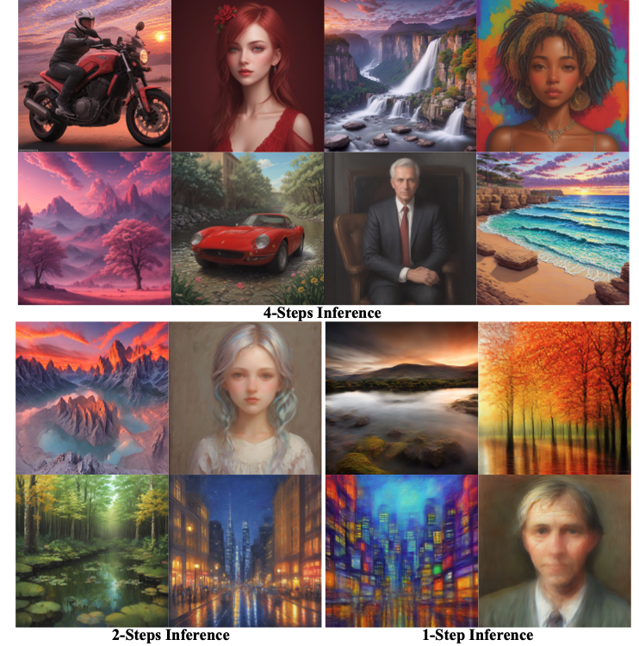
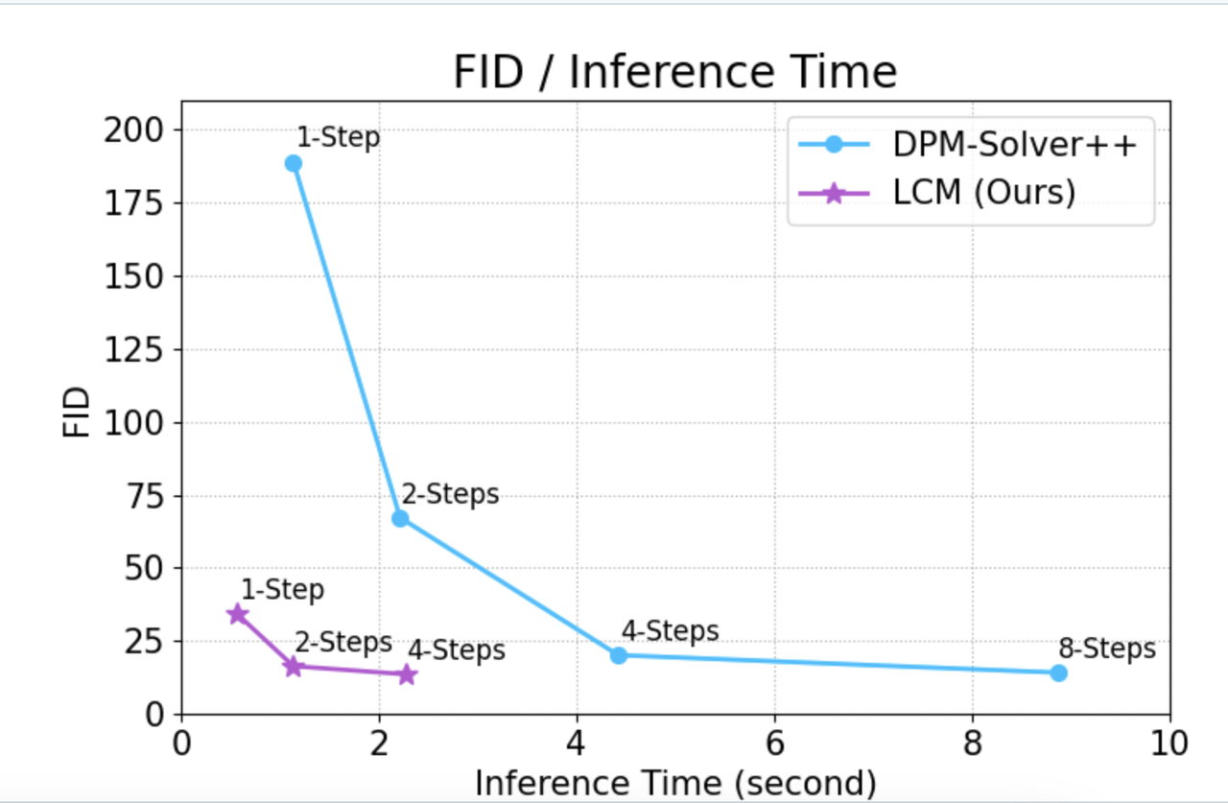
Latent Consistency Models: Results

Slide 72
Outline
Part 1: Basics
Denoising diffusion probabilistic models (DDPMs)
Conditional diffusion models
Large-scale models: DALL-E 2, Stable Diffusion, Imagen
Part 2: Recent Advances
Denoising diffusion implicit models (DDIMs)
Stable Diffusion XL, Stable Diffusion 3
Progressive Distillation
Latent Consistency Models (LCM)
(next class) Part 3: Implementation, Applications, and Ethical issues

