Slide 1
Outline (Cont. from part 1 covered in Lec#17)
Part 1: Basics
Denoising diffusion probabilistic models (DDPMs)
Conditional diffusion models
Large-scale models: DALL-E 2, Stable Diffusion, Imagen
Part 2: Recent Advances
Denoising diffusion implicit models (DDIMs)
Stable Diffusion XL, Stable Diffusion 3
Progressive Distillation

Slide 2
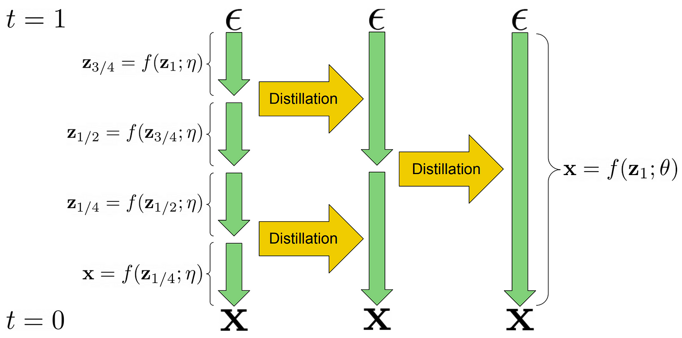
Progressive Distillation
Salimans et al, Progressive distillation for fast sampling of diffusion models

Slide 3
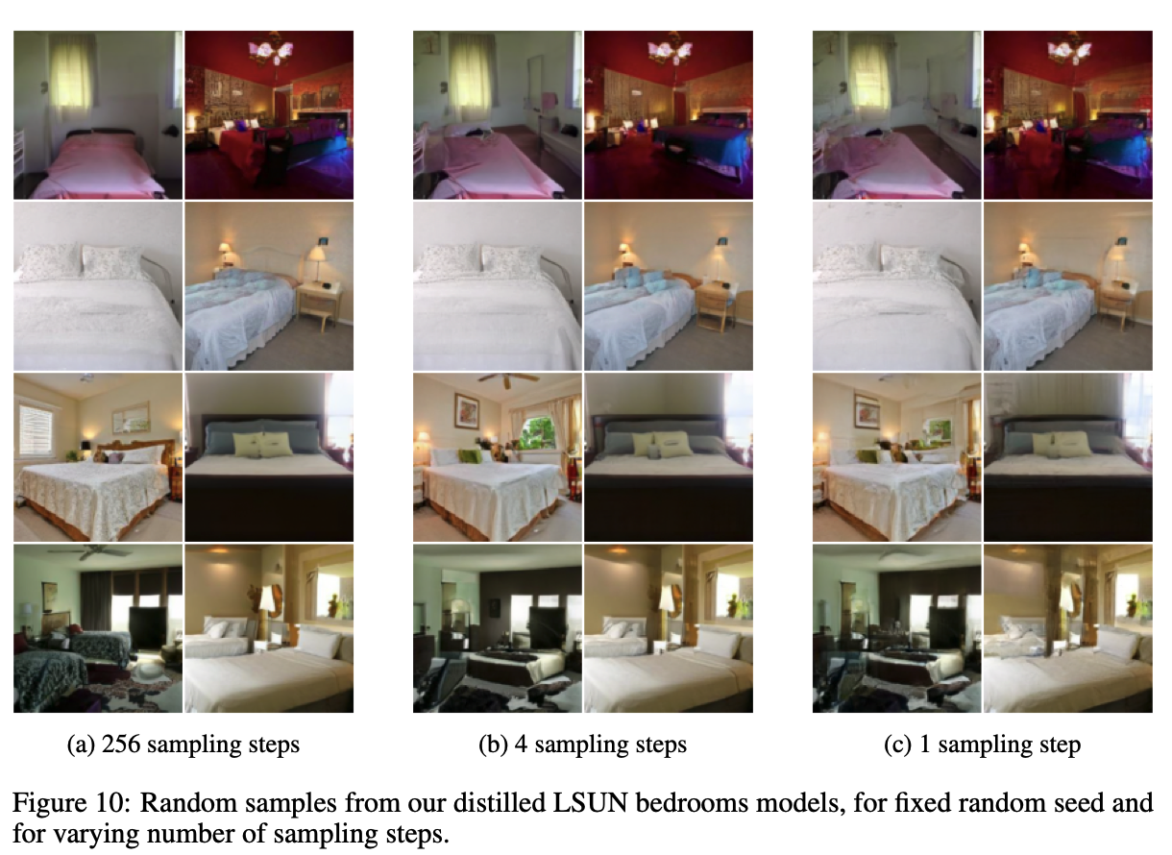
Progressive Distillation: Results

Slide 4
Outline
Part 1: Basics
Denoising diffusion probabilistic models (DDPMs)
Conditional diffusion models
Large-scale models: DALL-E 2, Stable Diffusion, Imagen
Part 2: Recent Advances
Denoising diffusion implicit models (DDIMs)
Stable Diffusion XL, Stable Diffusion 3
Model Distillation
Latent Consistency Models (LCM)

Slide 5
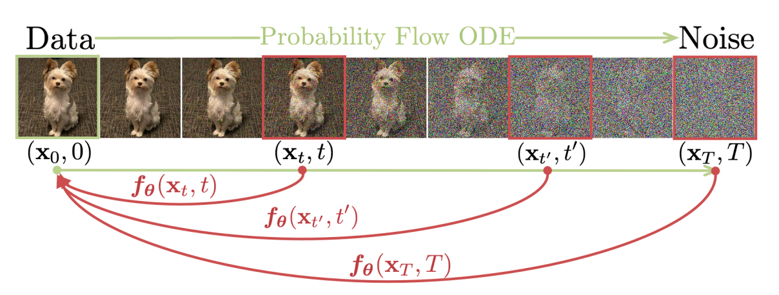
Latent Consistency Models
Consistency Models
Latent Consistency Models: combine the above idea with Latent Diffusion Models
Song et al., Consistency Models
Luo et al, Latent Consistency Models: Synthesizing High-Resolution Images with Few-step Inference

Slide 6
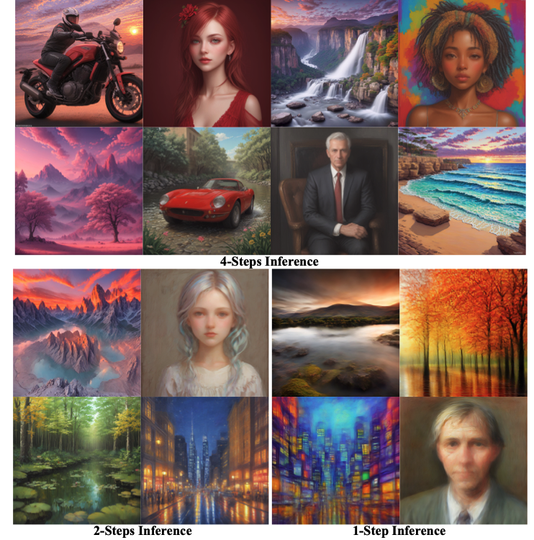
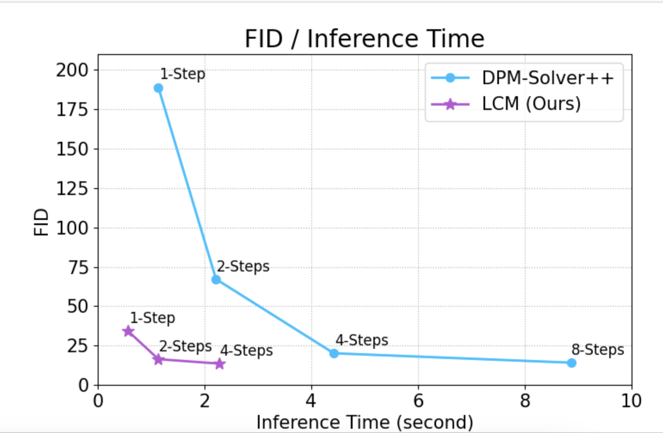
Latent Consistency Models: Results

Slide 7
Outline
Part 1: Basics
Denoising diffusion probabilistic models (DDPMs)
Conditional diffusion models
Large-scale models: DALL-E 2, Stable Diffusion, Imagen
Part 2: Recent Advances
Denoising diffusion implicit models (DDIMs)
Stable Diffusion XL, Stable Diffusion 3
Progressive Distillation
Latent Consistency Models (LCM)
(next class) Part 3: Applications and Implementation, Ethical issues

Slide 8
Outline
Part 3: Applications and Implementation; Ethical Issues
Customizing Diffusion Models
  Textual Inversion
  DreamBooth
  Low Rank Approximation (LoRA)
  ZipLoRA
ControlNet
Prompt-to-Prompt
InstructPix2Pix
DreamFusion
Working with Diffusion Models: Implementation aspects
Societal, ethical, and legal issues

Slide 9
Outline
Part 3: Applications and Implementation; Ethical Issues
Customizing Diffusion Models
  Textual Inversion
  DreamBooth
  Low Rank Approximation (LoRA)
  ZipLoRA

Slide 10
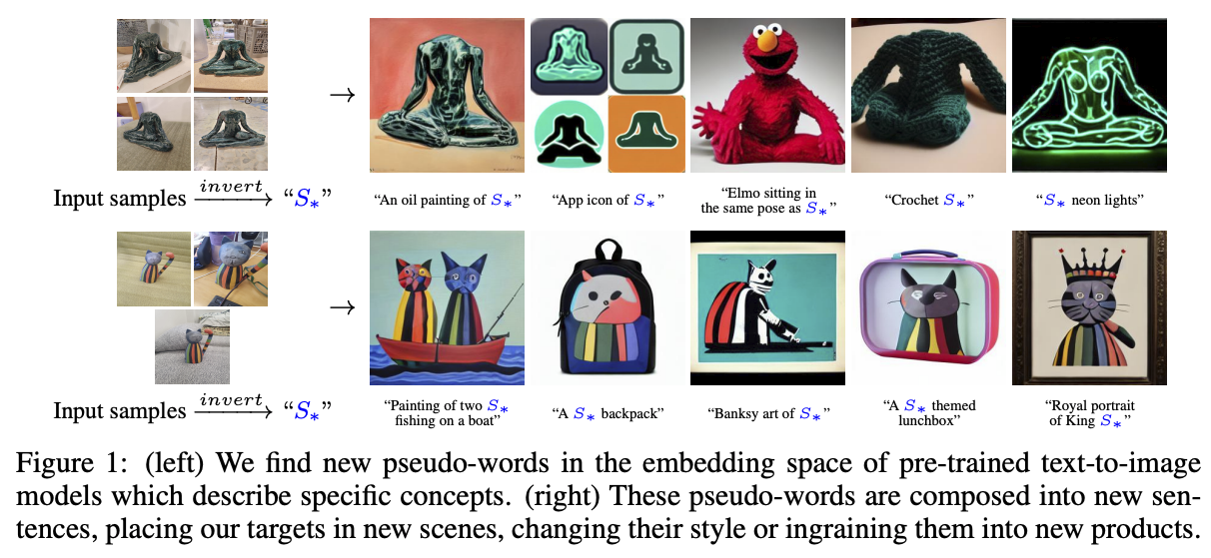
Customizing DMs: Textual inversion
R. Gal et al. An Image is Worth One Word: Personalizing Text-to-Image Generation using Textual Inversion. ICLR 2023

Slide 11
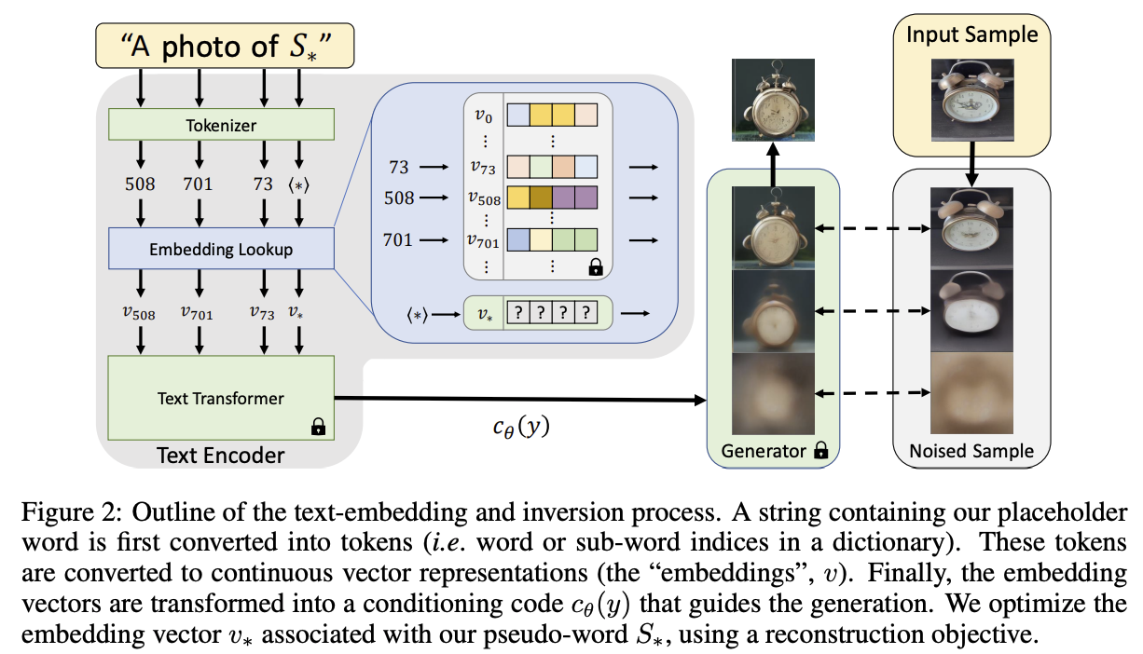
Customizing DMs: Textual inversion
R. Gal et al. An Image is Worth One Word: Personalizing Text-to-Image Generation using Textual Inversion. ICLR 2023

Slide 12
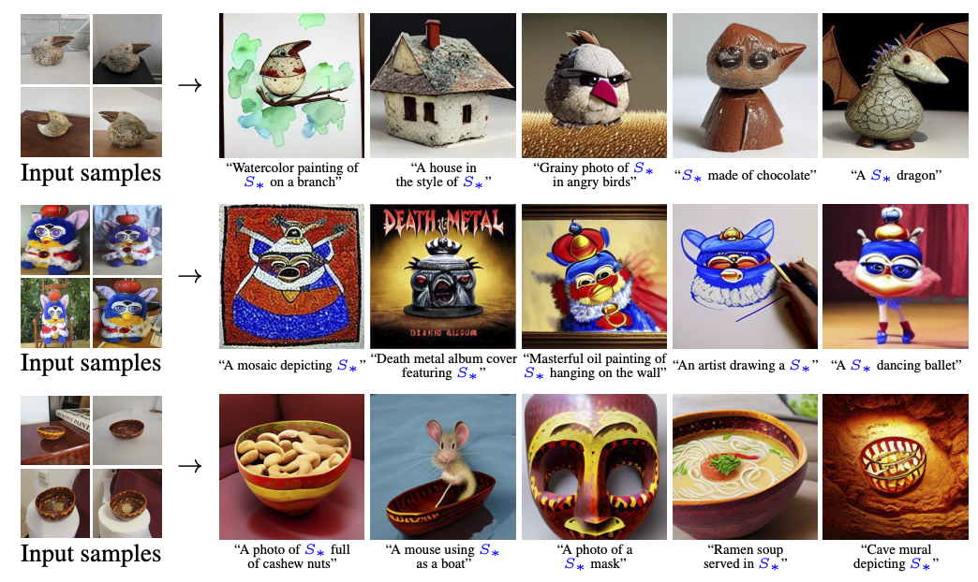
Textual inversion: Results

Slide 13
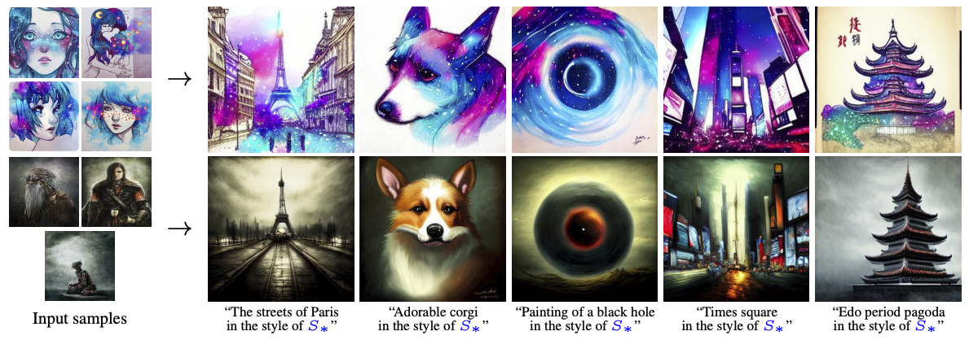
Textual inversion: Results

Slide 14
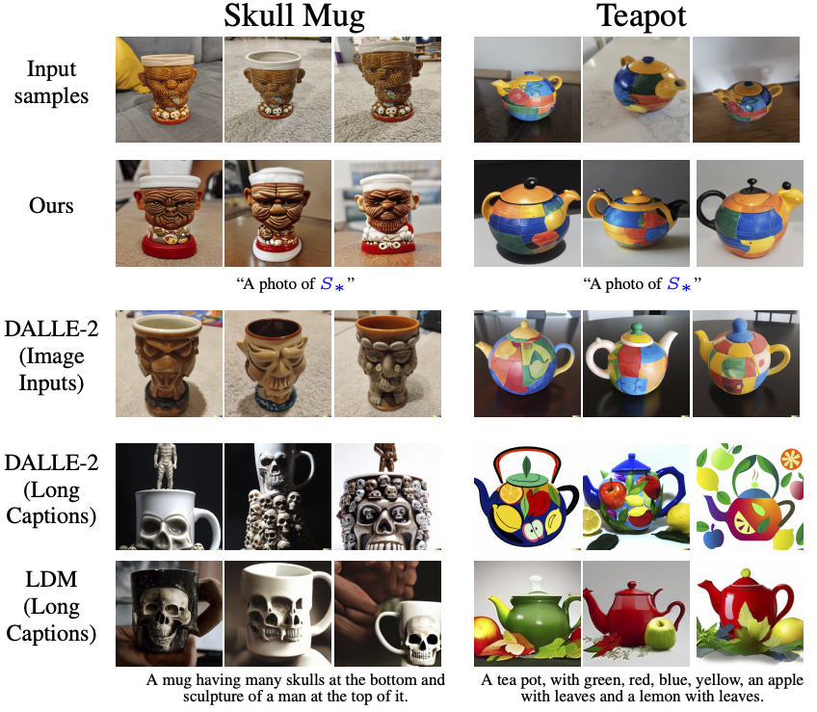
Textual inversion: Comparisons

Slide 15
Customizing DMs: DreamBooth
N. Ruiz et al. DreamBooth: Fine Tuning Text-to-Image Diffusion Models for Subject-Driven Generation. arXiv 2022

Slide 16
Customizing DMs: DreamBooth
Prompt: "retro style yellow alarm clock with a white clock face and a yellow number three on the right part of the clock face in the jungle"
N. Ruiz et al. DreamBooth: Fine Tuning Text-to-Image Diffusion Models for Subject-Driven Generation. arXiv 2022

Slide 17
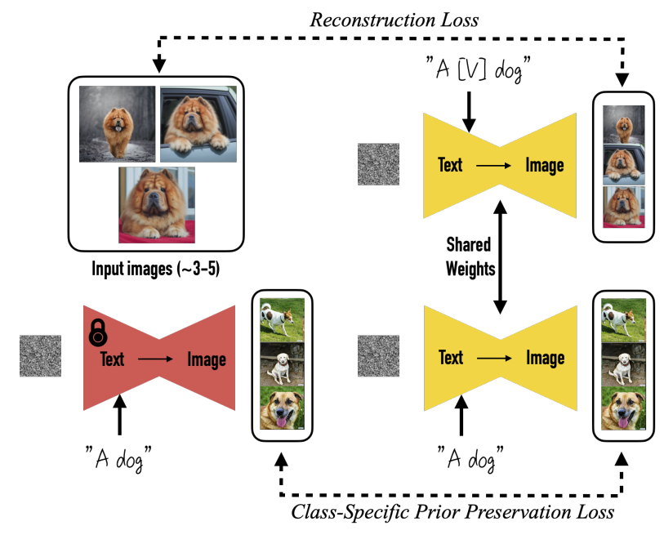
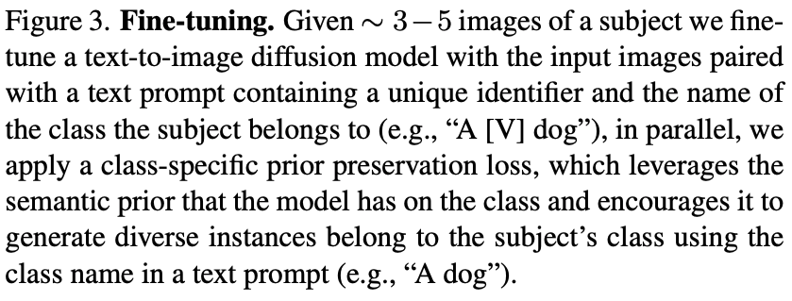
Customizing DMs: DreamBooth
N. Ruiz et al. DreamBooth: Fine Tuning Text-to-Image Diffusion Models for Subject-Driven Generation. arXiv 2022

Slide 18
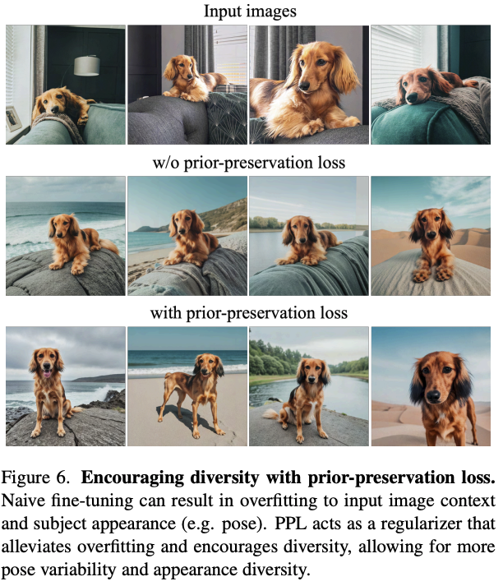
Customizing DMs: DreamBooth
N. Ruiz et al. DreamBooth: Fine Tuning Text-to-Image Diffusion Models for Subject-Driven Generation. arXiv 2022

Slide 19
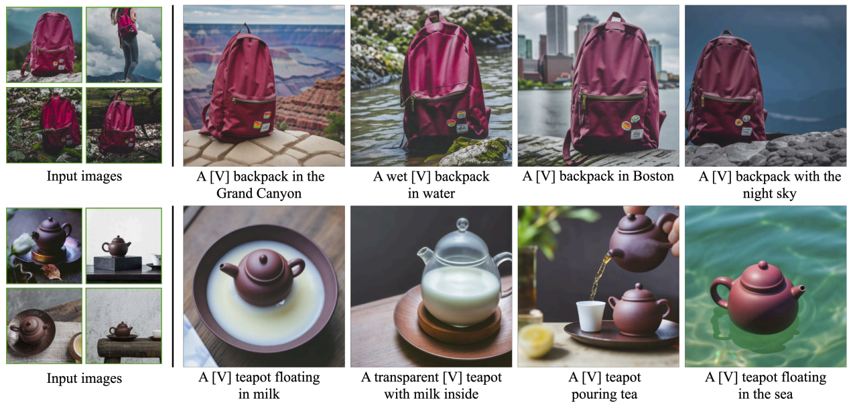
DreamBooth: Results

Slide 20
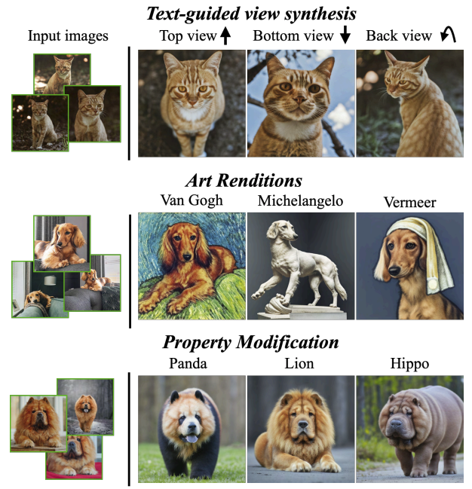
DreamBooth: Results
“a [painting/sculpture] of a [V] [class noun] in the style of [famous artist]”
“a cross of a [V] dog and a [target species]”

Slide 21
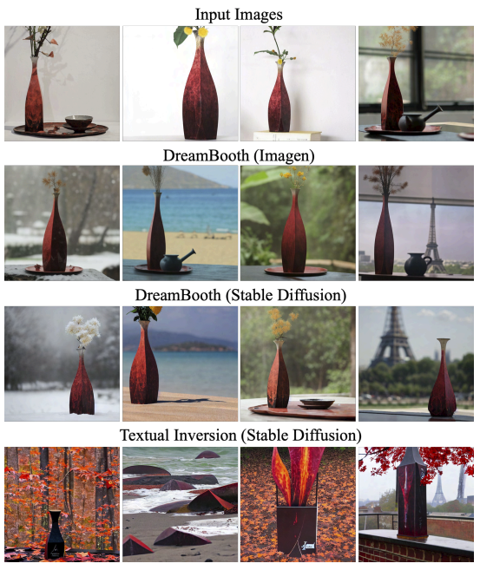
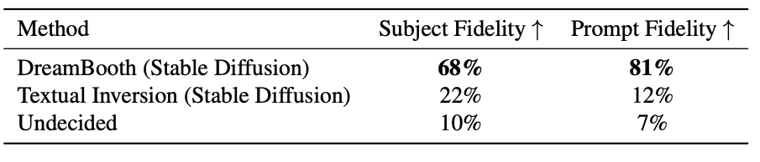
DreamBooth: Comparison with textual inversion
“a [V] vase in the snow”
“a [V] vase on the beach”
“a [V] vase in the jungle”
“a [V] vase with Eiffel Tower in the background

Slide 22
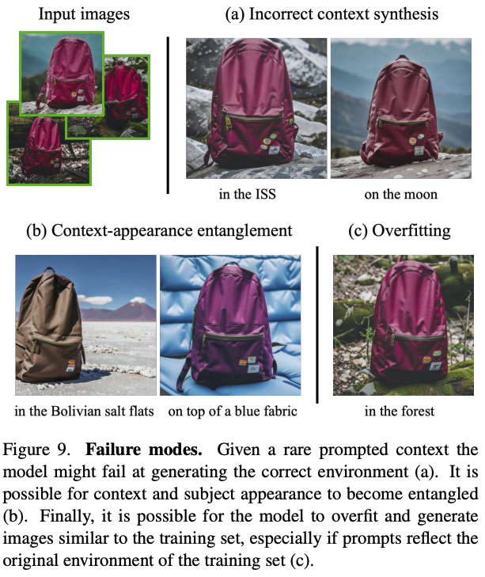
DreamBooth: Limitations

Slide 23
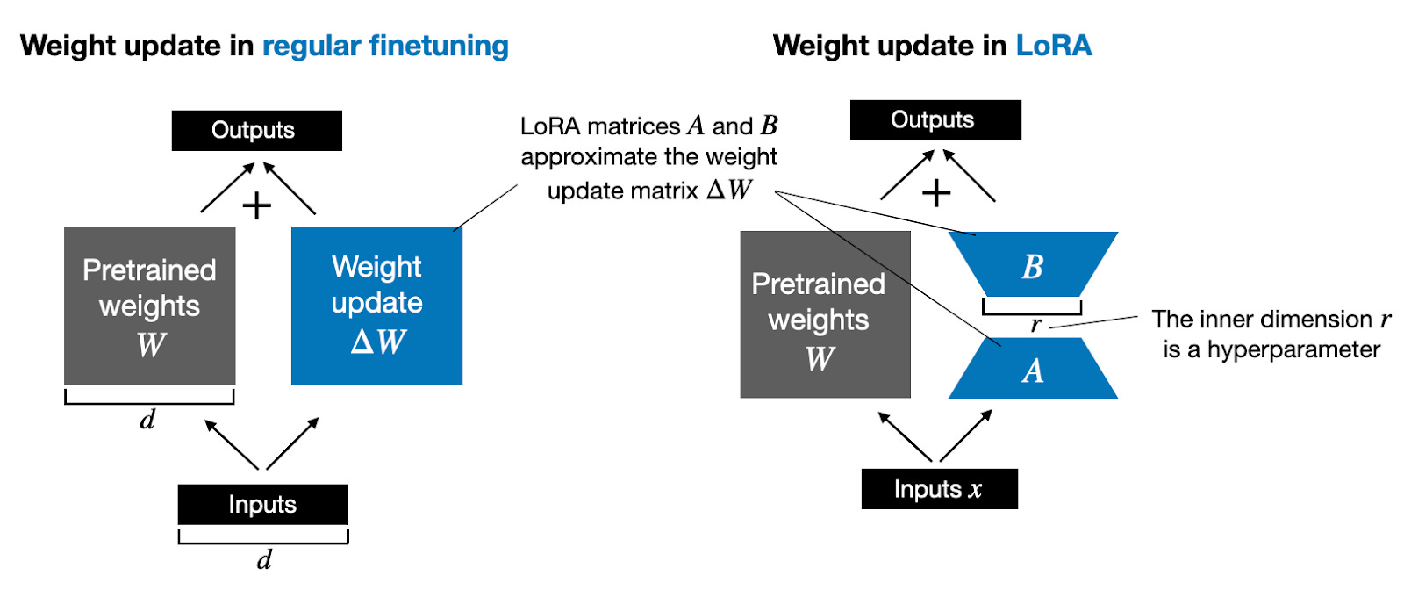
Efficient Customization: DreamBooth with LoRA
$A$ is initialized with standard normal; $B$ is initialized with zeros
Hu et al., LoRA: Low-Rank Adaptation of Large Language Models, ICLR’22; https://magazine.sebastianraschka.com/p/practical-tips-for-finetuning-llms

Slide 24
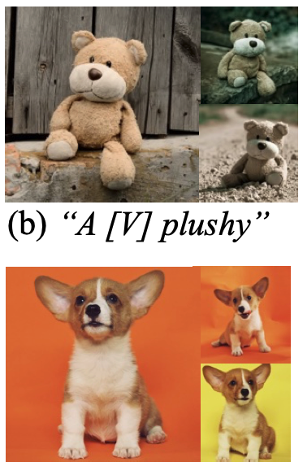
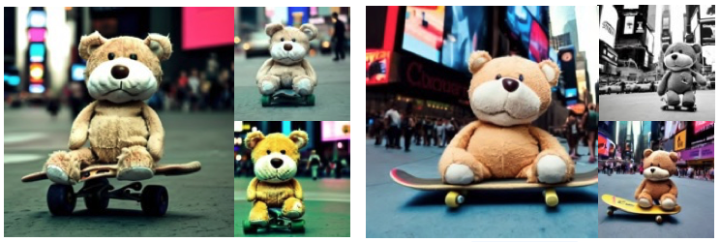
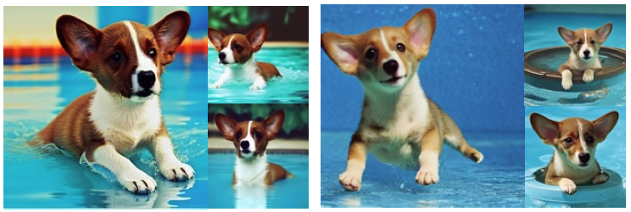
LoRA DreamBooth: Results
Input Images
LoRA DreamBooth (r=4)
DreamBooth

Slide 25
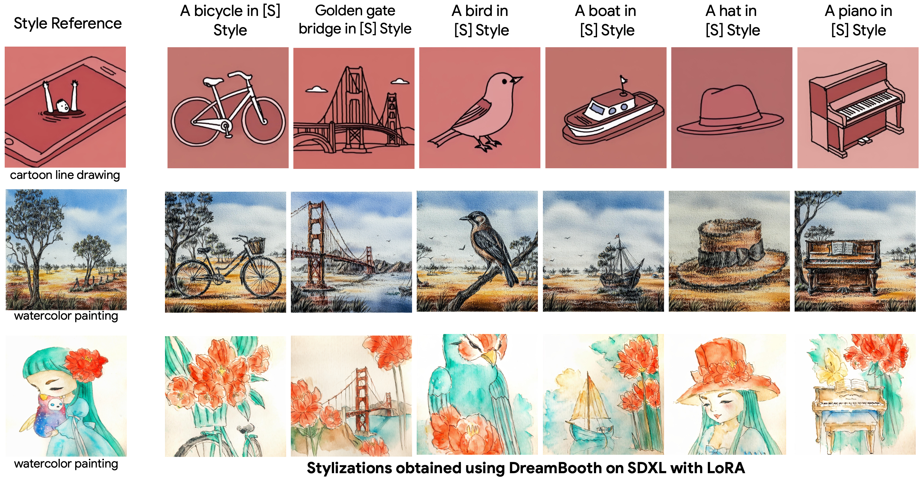
LoRA DreamBooth for Stylizations (on SDXL)
Shah et al., ZipLoRA: Any Subject in Any Style by Effectively Merging LoRAs, arxiv’23
Notes:
Add ref. / make it bigger

Slide 26

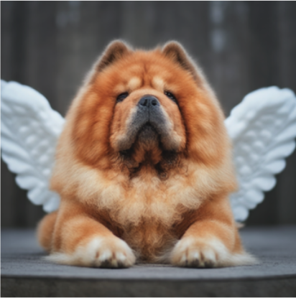
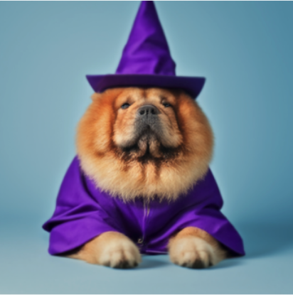

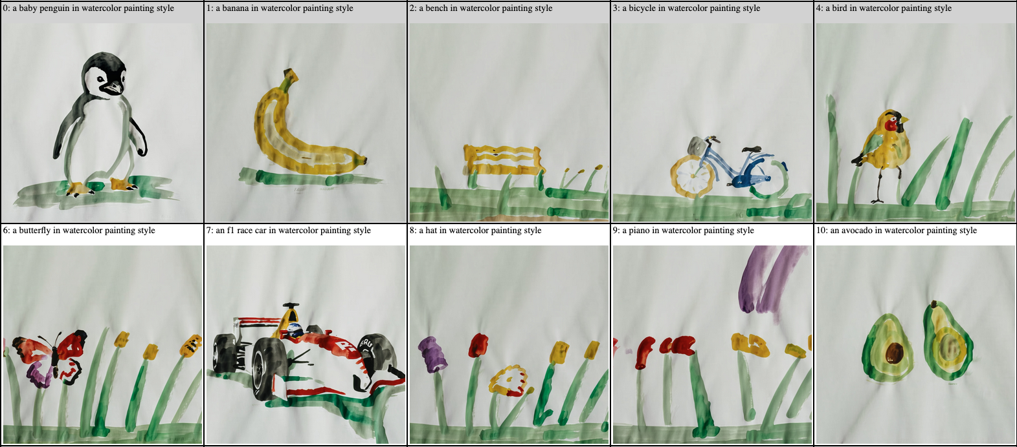
Can we Merge Content and Style LoRAs?
[V] with angel wings
[V] in wizard outfit
[V] as nurse
penguin in [S] style
bike in [S] style

Slide 27
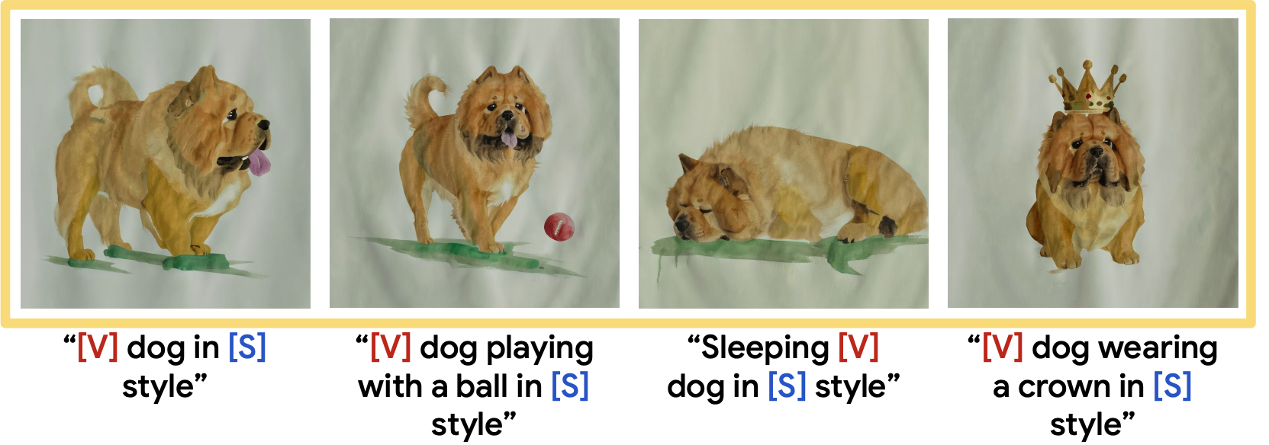
Can we Merge Content and Style LoRAs?

Slide 28
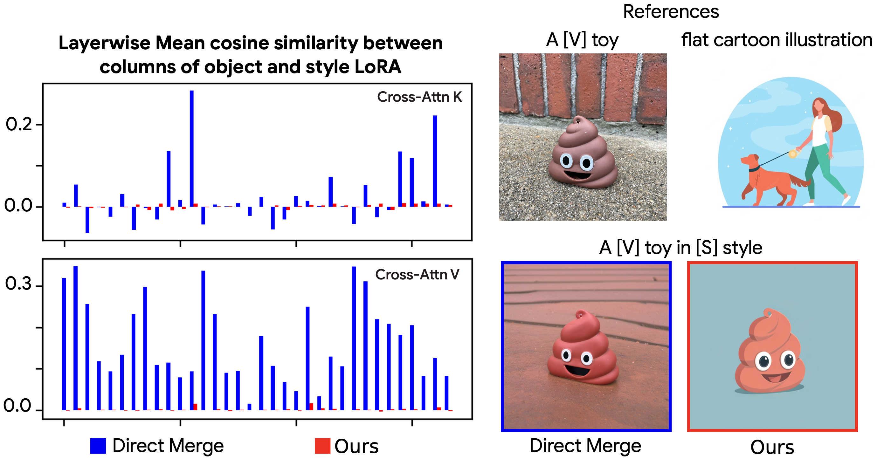
Properties of LoRA weights: Insight
Orthogonality matters!

Slide 29


ZipLoRA: Method
||
-
||₂
||
-
||₂
Shah et al., ZipLoRA: Any Subject in Any Style by Effectively Merging LoRAs, arxiv’23

Slide 30
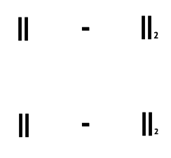

ZipLoRA: Alignment Loss
Shah et al., ZipLoRA: Any Subject in Any Style by Effectively Merging LoRAs, arxiv’23

Slide 31
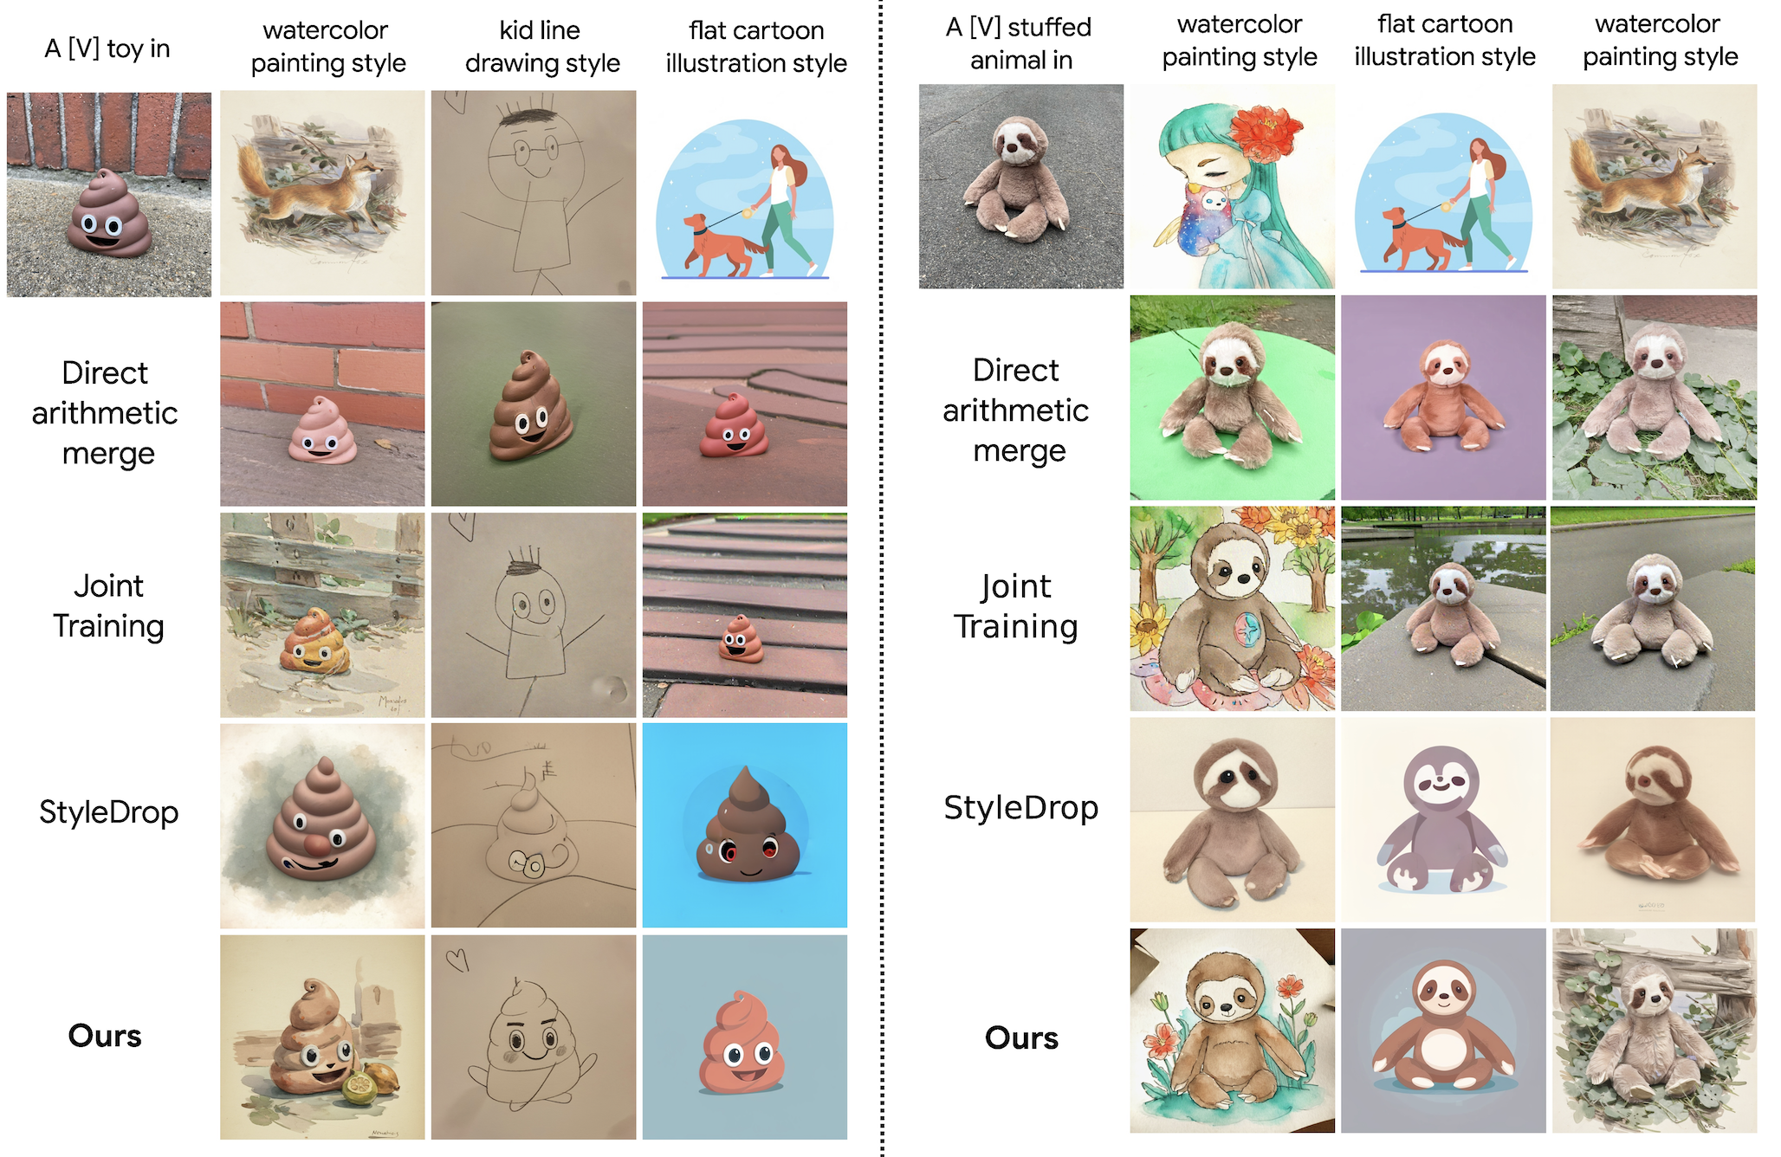

Slide 32
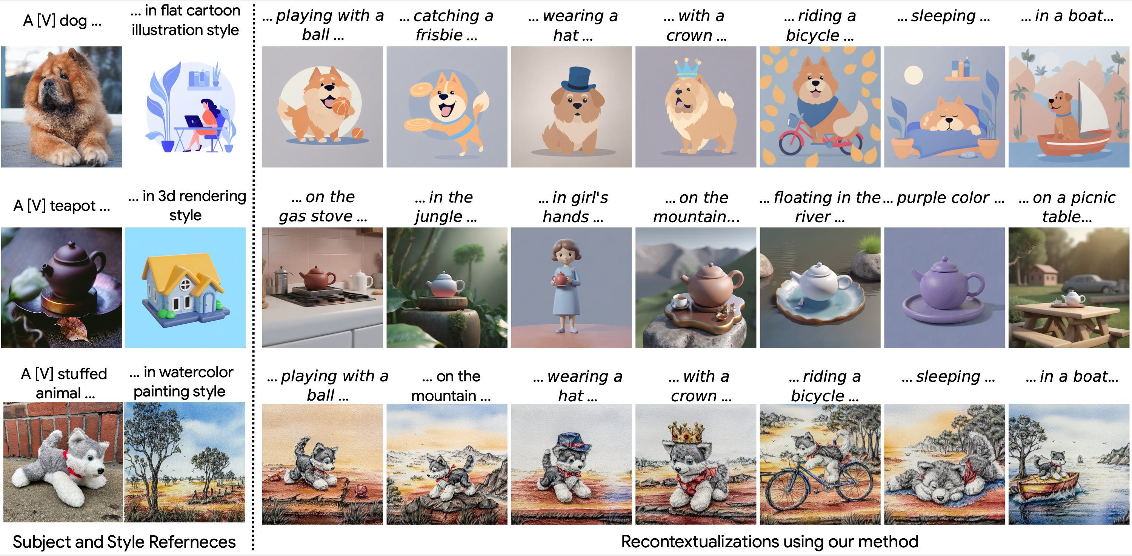
ZipLoRA produces successful recontextualizations

Slide 33
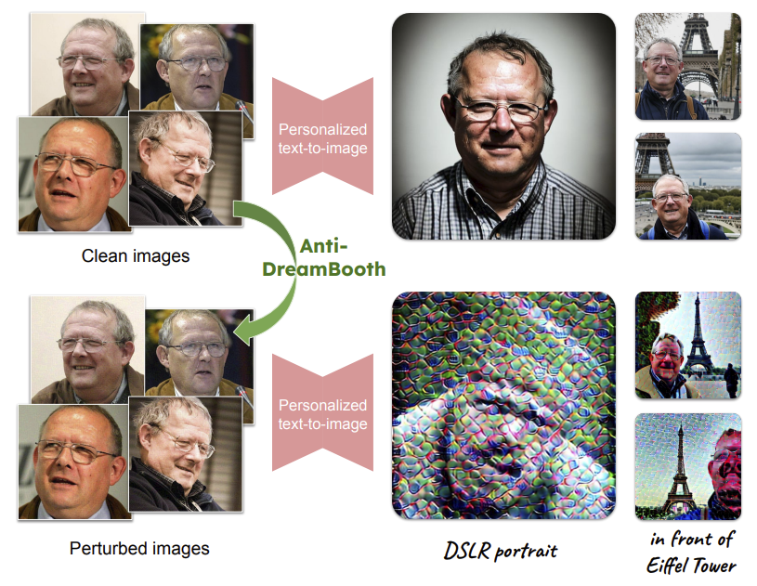
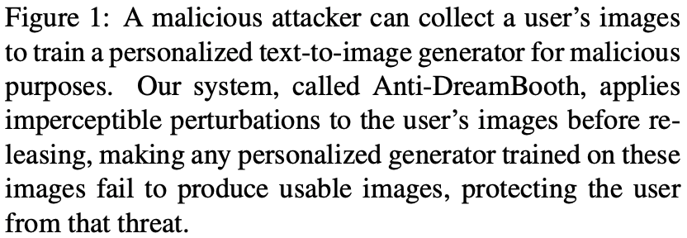
Anti-DreamBooth
T. V. Le et al. Anti-DreamBooth: Protecting users from personalized text-to-image synthesis. arXiv 2023

Slide 34
Outline
Part 3: Applications and Implementation; Ethical Issues
Customizing Diffusion Models
  Textual Inversion
  DreamBooth
  Low Rank Approximation (LoRA)
  ZipLoRA
ControlNet

Slide 35
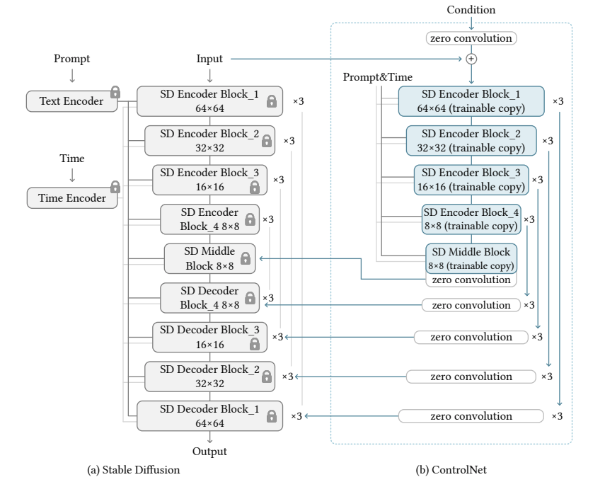
ControlNet
Add a trainable “wrapper” around a pre-trained DM to fine-tune it for pix2pix tasks
L. Zhang and M. Agrawala. Adding Conditional Control to Text-to-Image Diffusion Models. arXiv 2023
Notes:
Controlnet should come before instruct p2p , should I move before dreambooth?

Slide 36
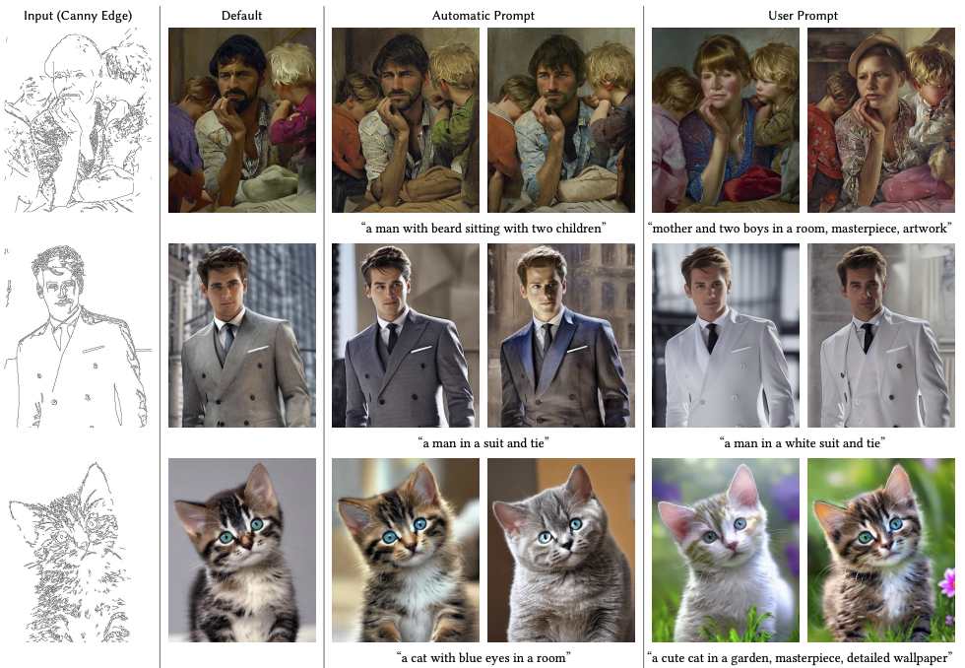
ControlNet
L. Zhang and M. Agrawala. Adding Conditional Control to Text-to-Image Diffusion Models. arXiv 2023

Slide 37
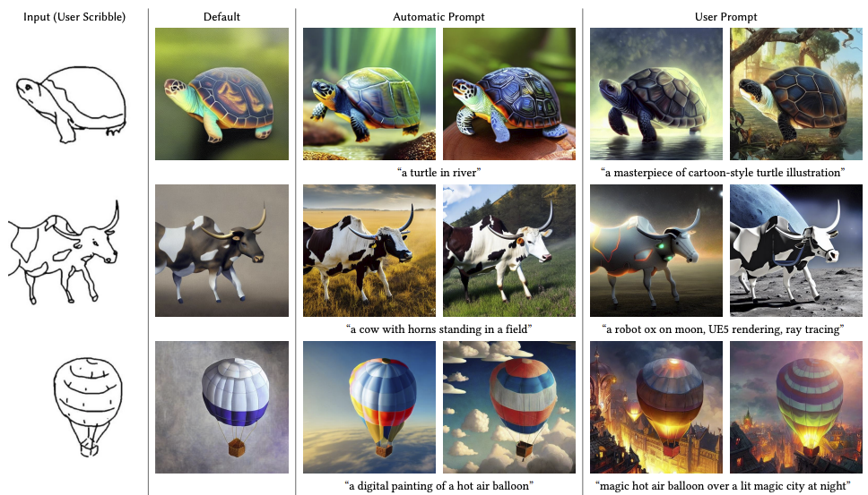
ControlNet
L. Zhang and M. Agrawala. Adding Conditional Control to Text-to-Image Diffusion Models. arXiv 2023

Slide 38
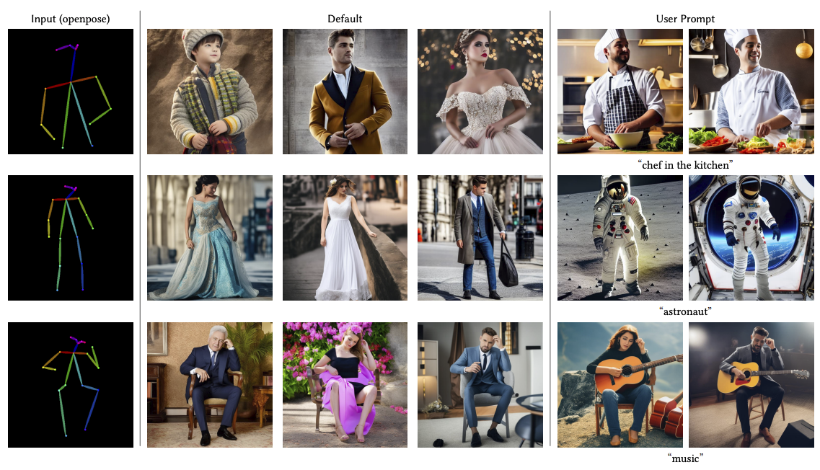
ControlNet
L. Zhang and M. Agrawala. Adding Conditional Control to Text-to-Image Diffusion Models. arXiv 2023

Slide 39
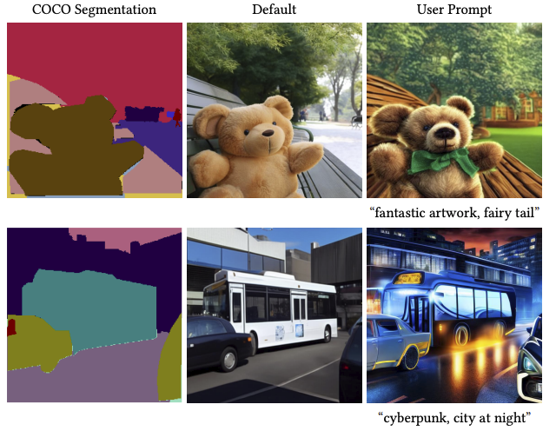
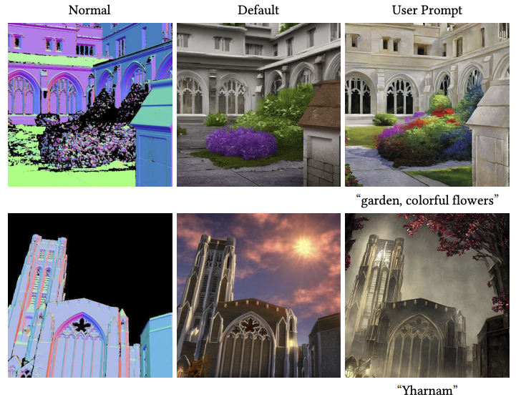
ControlNet
L. Zhang and M. Agrawala. Adding Conditional Control to Text-to-Image Diffusion Models. arXiv 2023

Slide 40
Outline
Part 3: Applications and Implementation; Ethical Issues
Customizing Diffusion Models
  Textual Inversion
  DreamBooth
  Low Rank Approximation (LoRA)
  ZipLoRA
ControlNet
Prompt-to-Prompt and InstructPix2Pix

Slide 41
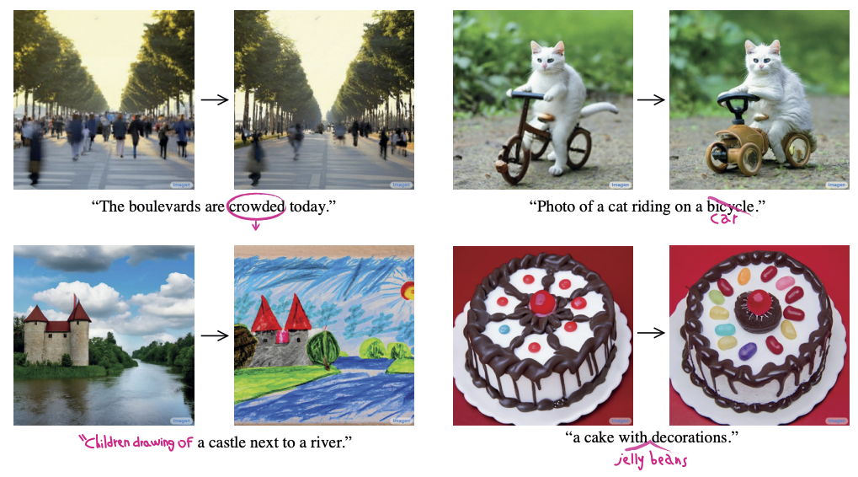
Prompt-to-Prompt Image Editing
A. Hertz et al. Prompt-to-Prompt Image Editing with Cross Attention Control. arXiv 2022

Slide 42
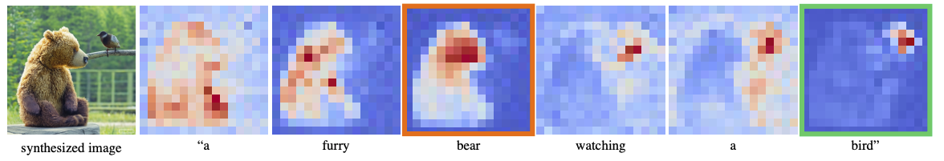
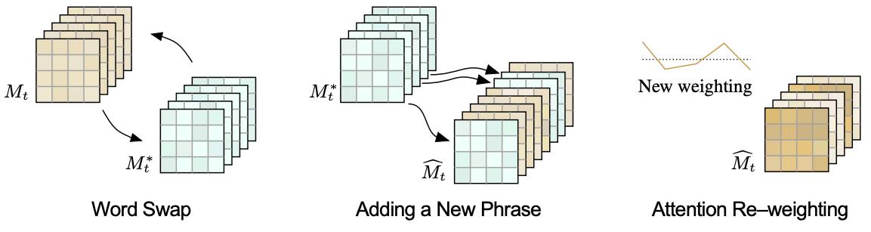
Prompt-to-Prompt Image Editing

Slide 43
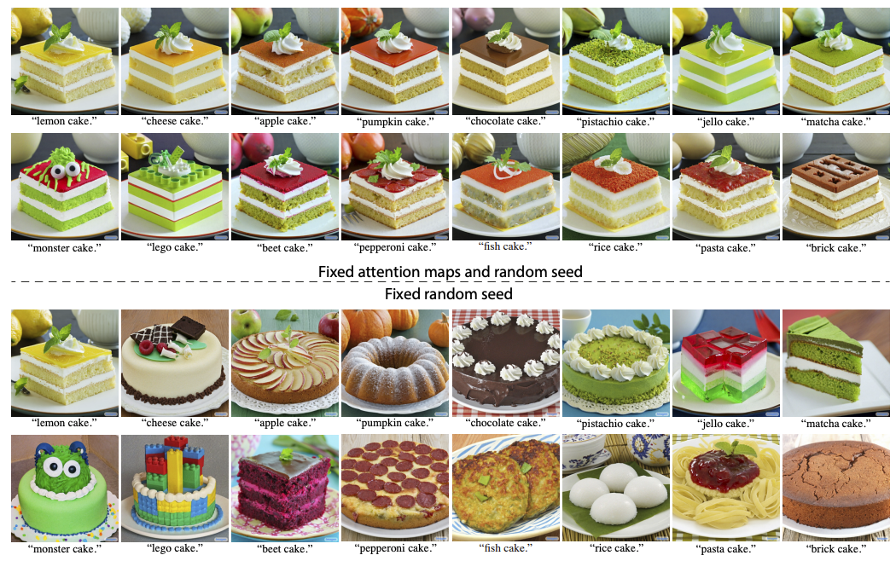
Prompt-to-Prompt Image Editing

Slide 44
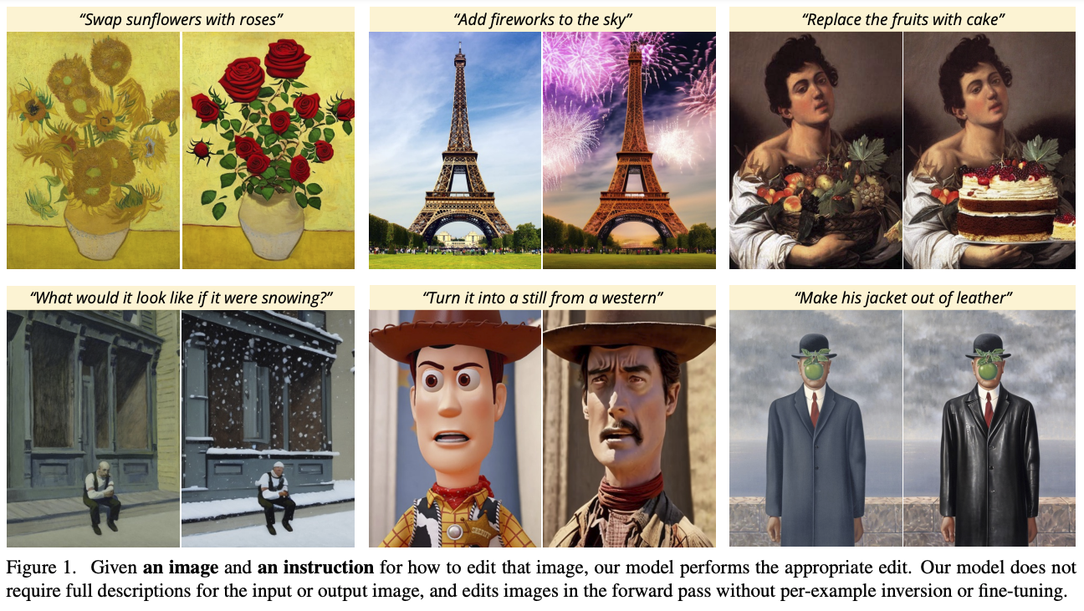
InstructPix2Pix
T. Brooks, A. Holynski, and A. Efros. InstructPix2Pix: Learning to Follow Image Editing Instructions. CVPR 2023

Slide 45
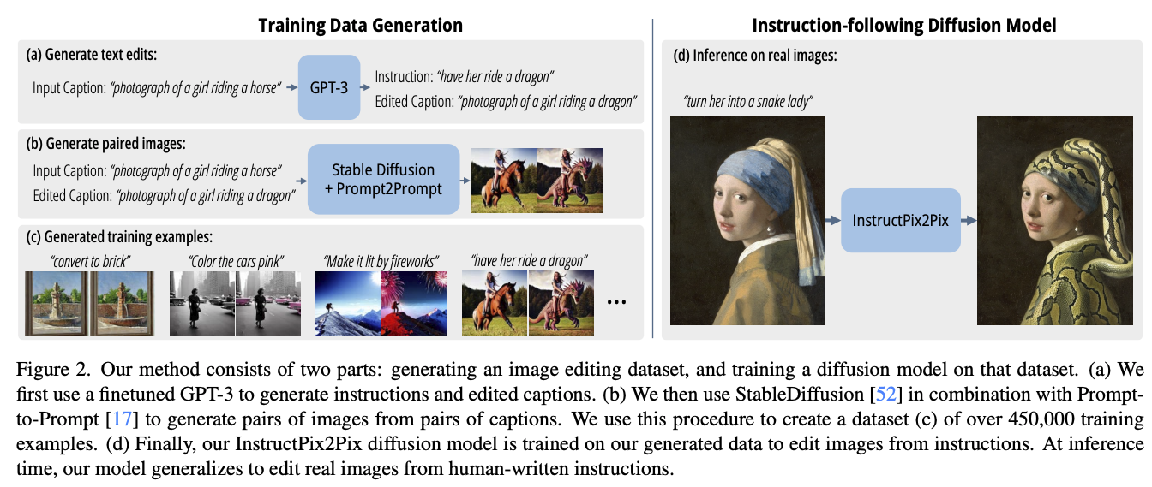
InstructPix2Pix
T. Brooks, A. Holynski, and A. Efros. InstructPix2Pix: Learning to Follow Image Editing Instructions. CVPR 2023

Slide 46
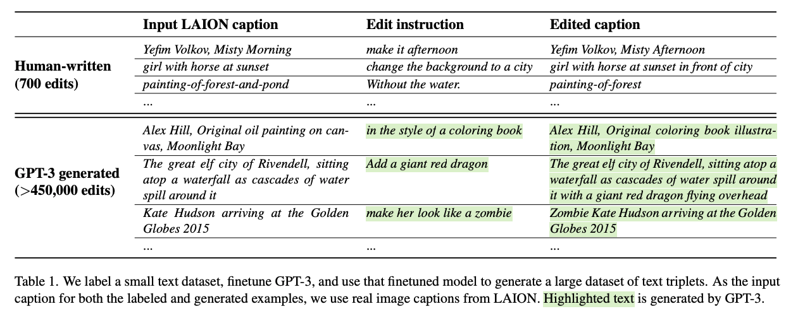
InstructPix2Pix
Fine-tuning GPT-3:

Slide 47
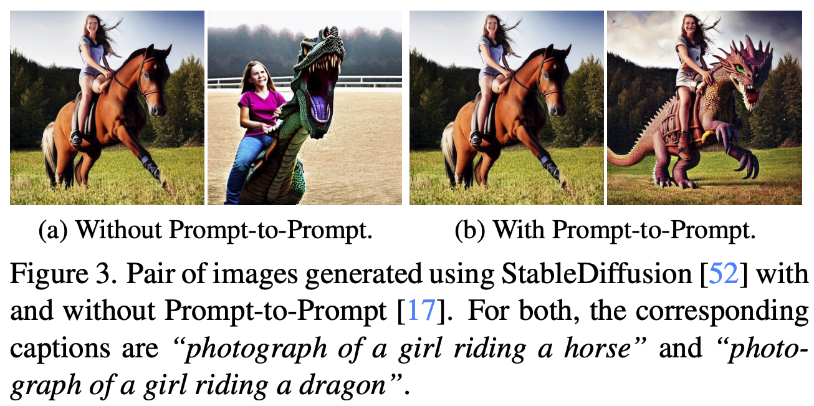
InstructPix2Pix
Generating input-output image pairs:

Slide 48
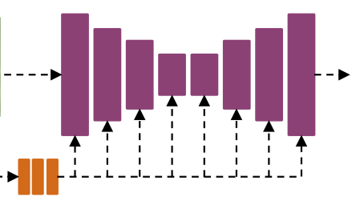
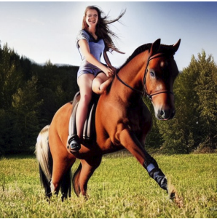
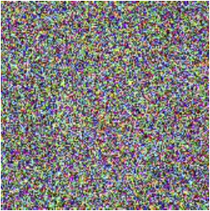

InstructPix2Pix
Fine-tuning a DM for image-to-image translation:
Input image (conditioning)
Noisy output image
Noise estimate
“Have her ride a dragon”
Time t

Slide 49

InstructPix2Pix: Results

Slide 50

InstructPix2Pix: Results

Slide 51

InstructPix2Pix: Results

Slide 52

InstructPix2Pix: Failure cases

Slide 53
Outline
Part 3: Applications and Implementation; Ethical Issues
Customizing Diffusion Models
  Textual Inversion
  DreamBooth
  Low Rank Approximation (LoRA)
  ZipLoRA
ControlNet
Prompt-to-Prompt
InstructPix2Pix
DreamFusion

Slide 54

Connecting 2D to 3D: DreamFusion
B. Poole, A. Jain, J. Barron, B. Mildenhall. DreamFusion: Text-to-3D using 2D Diffusion. arXiv 2022

Slide 55

Connecting 2D to 3D: DreamFusion
B. Poole, A. Jain, J. Barron, B. Mildenhall. DreamFusion: Text-to-3D using 2D Diffusion. arXiv 2022
Notes:
DreamFusion generates 3D objects from a natural language caption such as “a DSLR photo of a peacock on a surfboard.” The scene is represented by a Neural Radiance Field that is randomly initialized and trained from scratch for each caption. Our NeRF parameterizes volumetric density and albedo (color) with an MLP. We render the NeRF from a random camera, using normals computed from gradients of the density to shade the scene with a random lighting direction. Shading reveals geometric details that are ambiguous from a single viewpoint. To compute parameter updates, DreamFusion diffuses the rendering and reconstructs it with a (frozen) conditional Imagen model to predict the injected noise εˆφ(zt|y; t). This contains structure that should improve fidelity, but is high variance. Subtracting the injected noise produces a low variance update direction stopgrad[εˆφ − ε] that is backpropagated through the rendering process to update the NeRF MLP parameters.

Slide 56
Outline
Part 3: Applications and Implementation; Ethical Issues
Customizing Diffusion Models
  Textual Inversion
  DreamBooth
  Low Rank Approximation (LoRA)
  ZipLoRA
ControlNet
Prompt-to-Prompt
InstructPix2Pix
DreamFusion
Working with Diffusion Models: Implementation aspects

Slide 57
Working with Diffusion Models
Fast moving area with new research coming in everyday
Variety of pre-trained, open-source models available
Working directly with the implementations and codebases helps!
Starting point: diffusers library by huggingface
Popular open-source models:
  Stable Diffusion
  SDXL
  SD3 (recently announced)
  Deep-Floyd IF (open-source alternative of Imagen)
Some useful websites
  Huggingface, Reddit threads on Stable Diffusion; Civit.ai; publicprompts.art

Slide 58
Outline
Part 3: Applications and Implementation; Ethical Issues
Customizing Diffusion Models
  Textual Inversion
  DreamBooth
  Low Rank Approximation (LoRA)
  ZipLoRA
ControlNet
Prompt-to-Prompt
InstructPix2Pix
DreamFusion
Working with Diffusion Models: Implementation aspects
Societal, ethical, and legal issues

Slide 59
Societal, ethical, and legal issues
Closed or open?
Safe or unsafe?
Potential for generating DeepFakes and misinformation
Dataset image rights
Artists’ rights
The nature of creativity

Slide 60

In the news
https://www.theverge.com/2023/1/17/23558516/ai-art-copyright-stable-diffusion-getty-images-lawsuit

Slide 61

In the news
https://www.newyorker.com/culture/infinite-scroll/is-ai-art-stealing-from-artists

Slide 62


In the news
https://www.bbc.com/news/world-us-canada-65069316

Slide 63

In the news
https://petapixel.com/2023/04/03/midjourney-bans-ai-images-of-chinese-president-xi-jinping/

