Slide 1
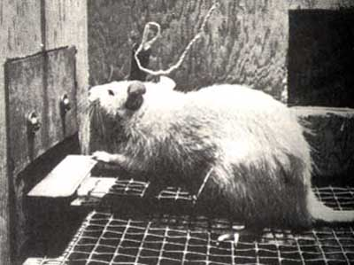
Introduction to deep reinforcement learning

Slide 2
Outline
Introduction to reinforcement learning
Markov Decision Process (MDP) formalism
The Bellman equation
Q-learning
Deep Q networks (DQN)
Extensions
Double DQN
Dueling DQN

Slide 3
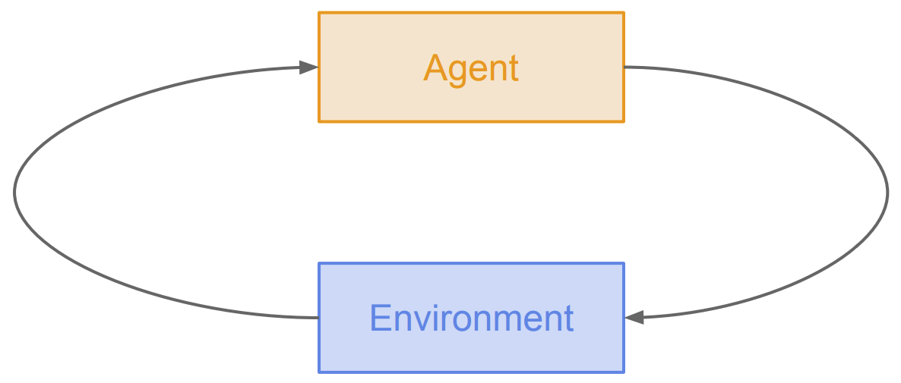
Reinforcement learning (RL)
Setting: agent that can take actions affecting the state of the environment and observe occasional rewards that depend on the state
Goal: learn a policy (mapping from states to actions) to maximize expected reward over time
Successor states, rewards
Actions

Slide 4
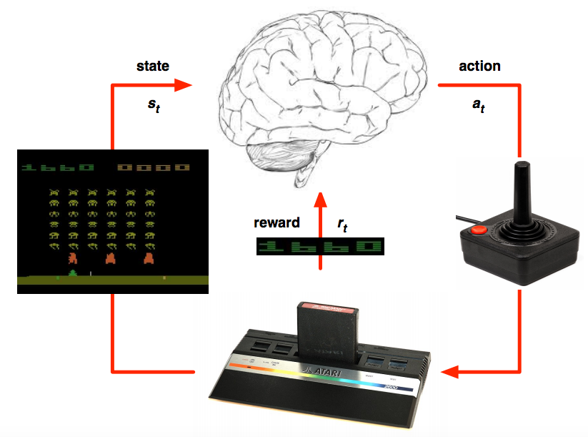
Example applications of deep RL
Playing games
V. Mnih, K. Kavukcuoglu, D. Silver, A. Graves, I. Antonoglou, D. Wierstra, M. Riedmiller, Human-level control through deep reinforcement learning, Nature 2015

Slide 5
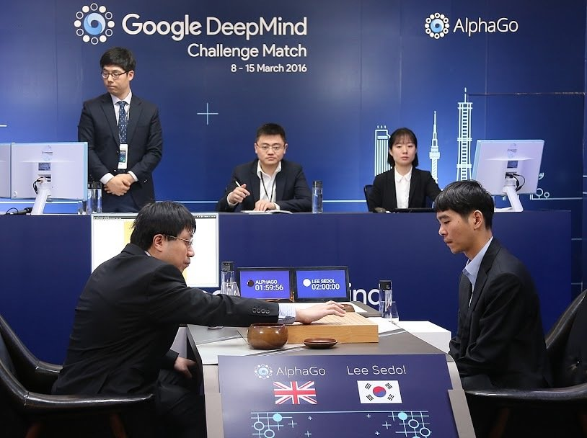
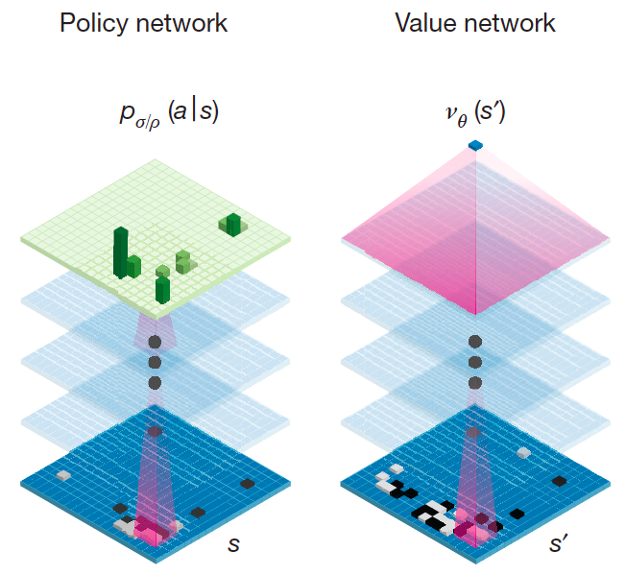
Example applications of deep RL
Playing games
https://deepmind.com/research/alphago/
Notes:
What is the state representation? What is the transition model? What is the reward function?

Slide 6
Sensorimotor learning
A. Agarwal, A. Kumar, J. Malik, and D. Pathak. Legged Locomotion in Challenging Terrains using Egocentric Vision. CoRL 2022

Slide 7
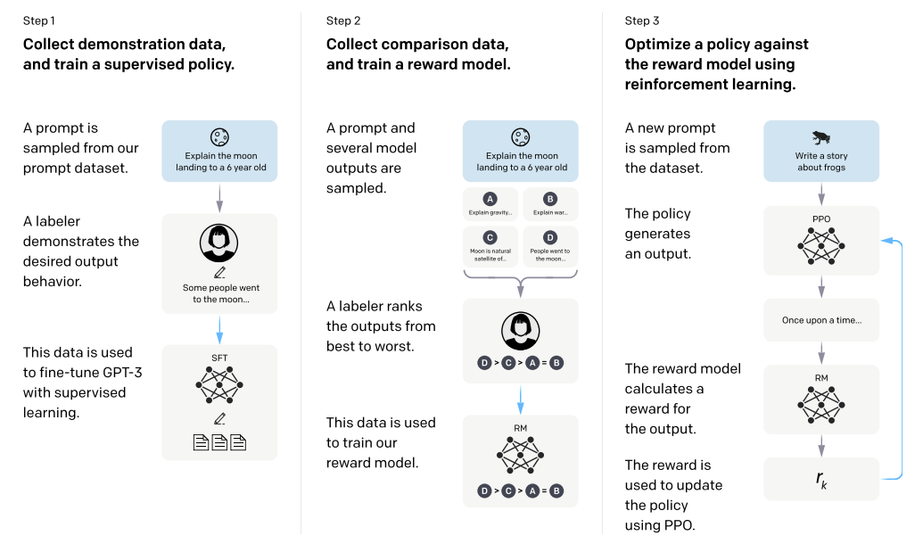
Example applications of deep RL
Improving large language models
L. Ouyang et al. Training language models to follow instructions with human feedback. NeurIPS 2022

Slide 8
Formalism: Markov Decision Processes
Components:
States $s$, beginning with initial state $s0$
Actions $a$
Transition model $P(s′ | s, a)$
Markov assumption: the probability of going to $s′$ from $s$ depends only on $s$ and $a$ and not on any other past actions or states
Reward function $r(s)$
Policy $(s)$: the action that an agent takes in any given state
The “solution” to an MDP

Slide 9
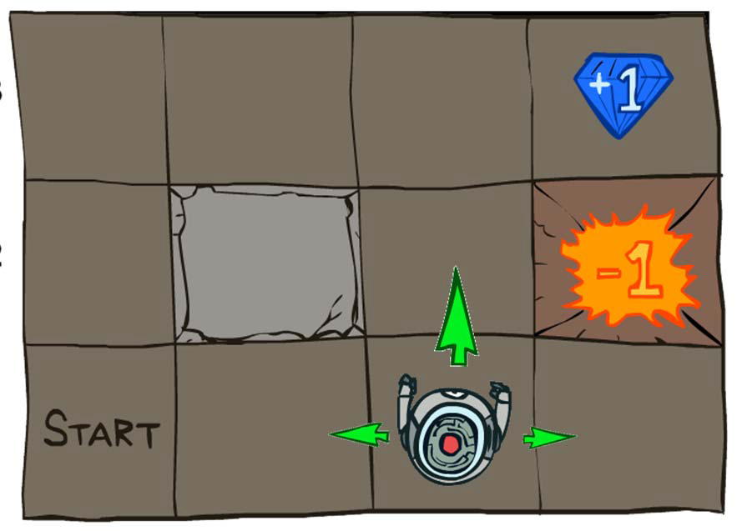
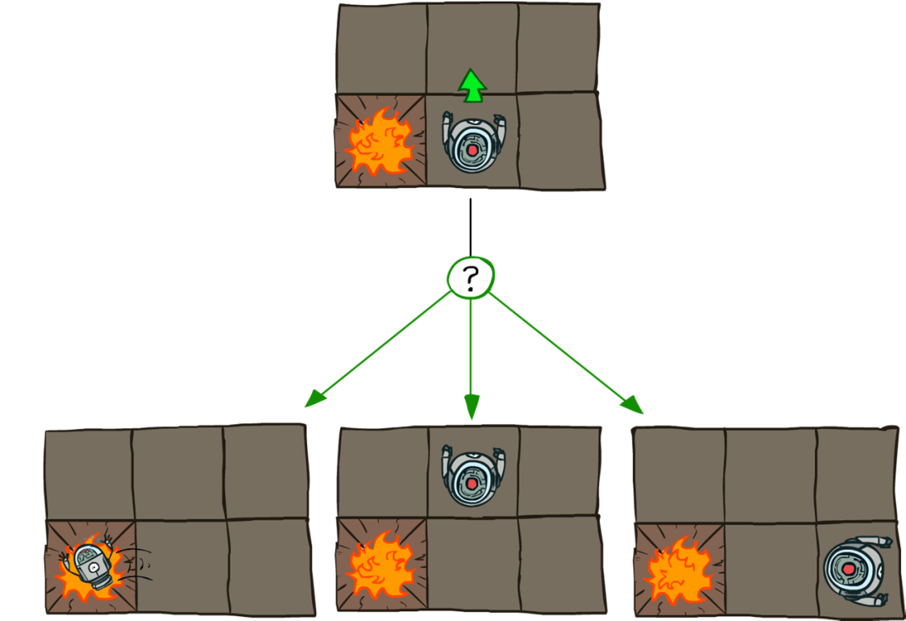
Example MDP: Grid world
Transition model:
0.1
0.8
0.1
$r(s) = −0.04$ for every non-terminal state
Source: P. Abbeel and D. Klein

Slide 10
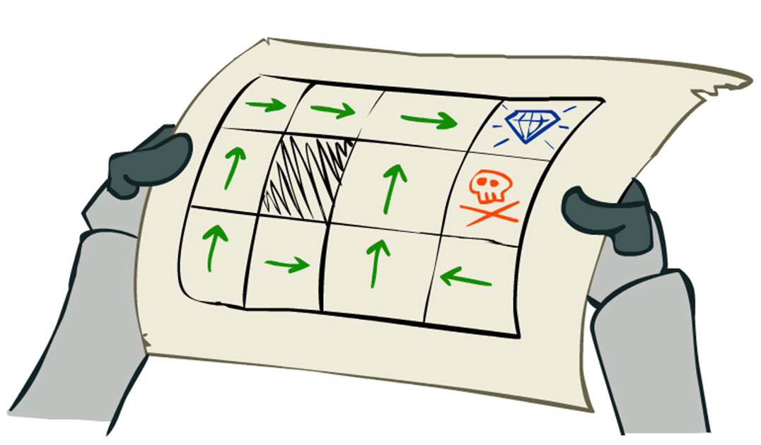
Example MDP: Grid world
Goal: find the best policy
Source: P. Abbeel and D. Klein

Slide 11
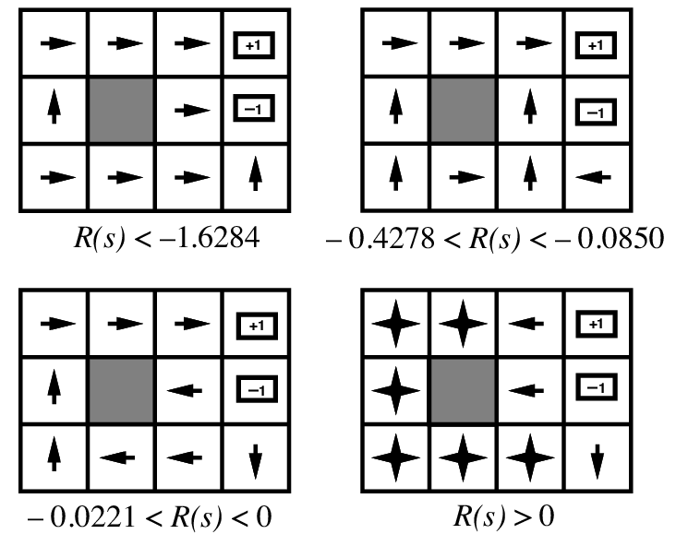
Example MDP: Grid world
Optimal policies for various values of $r(s)$:

Slide 12
Reinforcement learning loop
From state $s$, take action $a$ determined by policy $π(s)$
Environment selects next state $s′$ based on transition model $P(s′|s,a)$
Observe $s′$ and reward $r(s′)$, update policy
Compare: SGD loop
Get input $x_{i}$ sampled i.i.d. from data distribution
Use model with parameters $w$ to predict output $y$
Observe target output $y_{i}$ and loss $l(w,x_{i},y_{i})$
Update $w$ to reduce loss: $w←w−η ∇l\left(w,x_{i},y_{i}\right)$

Slide 13
RL vs. supervised learning
Reinforcement learning
Agent’s actions affect the environment and help to determine next observation
Rewards may be sparse
Rewards are not differentiable w.r.t. model parameters
Supervised learning
Next input does not depend on previous inputs or agent’s predictions
There is a supervision signal at every step
Loss is differentiable w.r.t. model parameters

Slide 14
Solving MDPs
Components:
States $s$, beginning with initial state $s0$
Actions $a$
Transition model $P(s′ | s, a)$
Markov assumption: the probability of going to $s′$ from $s$ depends only on $s$ and $a$ and not on any other past actions or states
Reward function $r(s)$
Policy $(s)$: the action that an agent takes in any given state
The “solution” to an MDP
But how to find this solution?

Slide 15
Cumulative rewards of state sequences
Suppose that following policy $π$ starting in state $s_{0}$ leads to a sequence or trajectory $τ=(s_{0},s_{1},s_{2}, …)$
How do we define the cumulative reward of this trajectory?
Problem: the sum of rewards of individual states grows is not normalized w.r.t. sequence length and can even be infinite
Solution: define cumulative reward as sum of rewards discounted by a factor $γ$, $0< γ≤1$
Image source: P. Abbeel and D. Klein

Slide 16
Discounting
Discounted cumulative reward of trajectory $τ=(s_{0},s_{1},s_{2},s_{3},…)$:
$$r\left(s_{0},s_{1},s_{2},s_{3},…\right)=r\left(s_{0}\right)+γ r\left(s_{1}\right)+γ^{2}r\left(s_{2}\right)+γ^{3}r\left(s_{3}\right)+…$$
$$=\sum_{t≥0}{γ^{t} r(s_{t})}$$
Sum is bounded by $\frac{r_{max}}{1−γ}$ (assuming $0< γ≤1$)
Helps algorithms converge
Notice:
$r\left(s_{0},s_{1},s_{2},s_{3},…\right)=$ $r\left(s_{0}\right)+γ r\left(s_{1},s_{2},s_{3},…\right)$
Cumulative reward of trajectory starting at $s_{0}$
Reward at $s_{0}$
Discounted reward of trajectory starting at $s_{1}$

Slide 17
Value function
The value function $V^{π}(s)$ of a state $s$ w.r.t. policy $π$ is the expected cumulative reward of following that policy starting in $s$: $V^{π}\left(s\right)= 𝔼_{τ}\left[r(τ)|{ s}_{0}=s, π\right]$ where $τ$ is a trajectory with starting state $s$, actions given by $π$, and successor states drawn according to transition model: $s_{t+1}\sim P\left(∙ | s_{t,}a_{t}\right)$
The optimal value of a state is the value achievable by following the best possible policy:
$$V^{∗}(s)=\max_{π}{ V}^{π}\left(s\right)$$

Slide 18
The optimal policy
How do we express the optimal policy in terms of optimal state values?
What action $a$ to choose?

Slide 19
The optimal policy
How do we express the optimal policy in terms of optimal state values?
Agent chooses action $a$

Slide 20
The optimal policy
How do we express the optimal policy in terms of optimal state values?
Take the action that maximizes the expected future cumulative value:
$$π^{∗}\left(s\right)={arg max}_{a}𝔼_{s^{′}\sim P(∙|s,a)}V^{∗}\left(s^{′}\right)$$
Agent chooses action $a$
Expected value for action $a$:
$$𝔼_{s^{′}\sim P(∙|s,a)}V^{∗}\left(s^{′}\right)=\sum_{s^{′}}{P\left(s^{′} | s,a\right)V^{∗}(s^{′})}$$
Environment chooses $s^{′}\sim P(∙|s, a)$
Expected reward: $V^{∗}(s^{′})$

Slide 21
The Bellman equation
$$V^{∗}\left(s\right) = r\left(s\right) + γ\max_{a} 𝔼_{s^{′}\sim P(∙|s,a)}V^{∗}(s^{′})$$
Reward in current state
Expected future cumulative value assuming agent follows the optimal policy
Agent receives reward $r(s)$
Agent chooses action $a$
Optimal policy:
$$π^{∗}\left(s\right)={arg max}_{a}𝔼_{s^{′}\sim P(∙|s,a)}V^{∗}\left(s^{′}\right)$$
Environment chooses $s^{′}\sim P(∙|s, a)$
Expected reward: $V^{∗}(s^{′})$

Slide 22
The Bellman equation
$$V^{∗}\left(s\right) = r\left(s\right) + γ\max_{a} 𝔼_{s^{′}\sim P(∙|s,a)}V^{∗}(s^{′})$$
Reward in current state
Expected future cumulative value assuming agent follows the optimal policy
It’s a recursive relationship between optimal values of successive states!

Slide 23
Q-learning
To choose actions using value functions, we need to know the transition model:
$$π^{∗}\left(s\right)={arg max}_{a}𝔼_{s^{′}\sim P\left(∙ | s,a\right)}V^{∗}\left(s^{′}\right) \\ ={arg max}_{a}\sum_{s^{′}}{P(s^{′}|s,a)V^{∗}\left(s^{′}\right)}$$
It is more convenient to define the value of a state-action pair:
$$Q^{π}\left(s,a\right)=𝔼_{τ}\left[r(τ)|s_{0}=s,{ a}_{0}=a, π\right]$$
Then the optimal policy is given by
$$π^{∗}\left(s\right)={arg max}_{a}Q^{∗}\left(s,a\right)$$

Slide 24
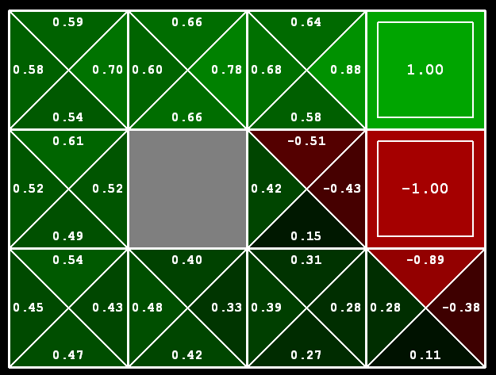
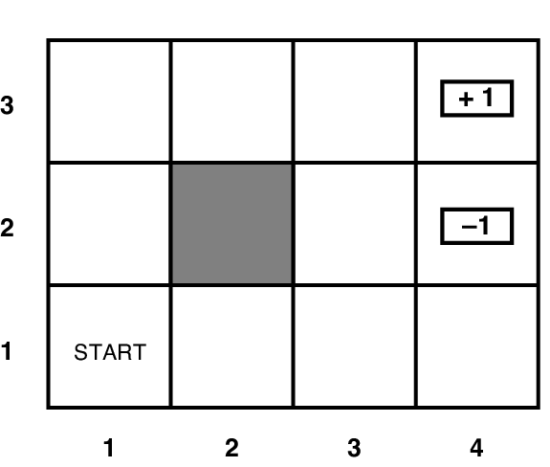
Q-value function: Example

Slide 25
Bellman equation for Q-values
Relationship between regular values and Q-values:
$$V^{∗}\left(s\right)=\max_{a}Q^{∗}\left(s,a\right)$$
Regular Bellman equation:
$$V^{∗}\left(s\right)=r\left(s\right)+γ\max_{a} 𝔼_{s^{′}\sim P(∙|s,a)}V^{∗}(s^{′})$$
Bellman equation for Q-values:
$$Q^{∗}\left(s,a\right)=r\left(s\right)+γ 𝔼_{s^{′}\sim P(∙|s,a)}\max_{a^{′}}Q^{∗}\left(s′,a′\right)$$
$${=𝔼}_{s^{′}\sim P(∙|s,a)}\left[r\left(s\right)+γ\max_{a^{′}}Q^{∗}\left(s′,a′\right)\right]$$

Slide 26
RL: Outline
Introduction to reinforcement learning
Markov Decision Process (MDP) formalism and classical Bellman equation
Q-learning
Deep Q networks

Slide 27
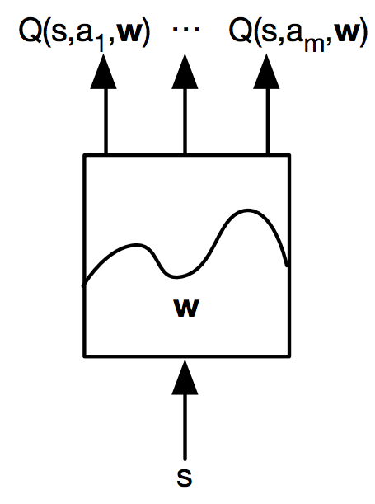
Deep Q-learning
$Q^{∗}(s,a){=𝔼}_{s^{′}\sim P(∙|s,a)}\left[r\left(s\right)+γ\max_{a^{′}}Q^{∗}\left(s′,a′\right)|s,a\right]$
Idea 1: estimate Q-values using a neural network:
$$Q^{∗}\left(s,a\right)≈Q_{w}(s,a)$$
V. Mnih, K. Kavukcuoglu, D. Silver, A. Graves, I. Antonoglou, D. Wierstra, M. Riedmiller, Human-level control through deep reinforcement learning, Nature 2015

Slide 28
Deep Q-learning
$Q^{∗}(s,a){=𝔼}_{s^{′}\sim P(∙|s,a)}\left[r\left(s\right)+γ\max_{a^{′}}Q^{∗}\left(s′,a′\right)|s,a\right]$
Idea 1: estimate Q-values using a neural network:
$$Q^{∗}\left(s,a\right)≈Q_{w}(s,a)$$
Idea 2: instead of taking the expectation over successor states, use a single transition $\left(s,a,s^{′}\right)$ to update estimate of $Q_{w}\left(s,a\right)$ to better agree with the target
$$r\left(s\right)+γ\max_{a^{′}}Q_{w}\left(s^{′},a′\right)$$
Idea 3: to avoid training instability, compute target values using a different snapshot of the network, $Q_{target}$

Slide 29
Deep Q-learning
Given transition $(s,a,s′)$, compute target:
$$y_{target}\left(s,a,s′\right)=r\left(s\right)+γ\max_{a^{′}}Q_{target}\left(s^{′},a^{′}\right)$$
Loss function:
$$L\left(w\right){=𝔼}_{s,a,s′}\left[{(y_{target}(s,a,s′)−Q_{w}\left(s,a\right))}^{2}\right]$$
Gradient update:
$$∇_{w}L(w){=𝔼}_{s,a,s′ }\left[(y_{target}(s,a,s′)−Q_{w}\left(s,a\right)){ ∇}_{w}Q_{w}\left(s,a\right)\right]$$
$${=𝔼}_{s,a,s^{′}}\left[(r\left(s\right)+γ\max_{a^{′}}Q_{target}\left(s′,a′\right)−Q_{w}\left(s,a\right)){ ∇}_{w}Q_{w}\left(s,a\right)\right]$$
Sample transitions $(s,a,s′)$ by choosing actions from a behavior distribution and using an experience replay buffer

Slide 30
Deep Q-learning in practice
Training is prone to instability
Unlike in supervised learning, the targets themselves are moving!
Successive experiences are correlated and dependent on the policy
Policy may change rapidly with slight changes to parameters, leading to drastic change in data distribution
Solutions
Freeze target Q network (or use exponential moving average)
Use experience replay

Slide 31
Deep Q-learning: Summary
At each time step:
Take action $at$ according to epsilon-greedy policy
Store experience $(st, a_{t}, r_{t+1}, s_{t+1})$ in replay memory buffer
Randomly sample mini-batch of experiences from the buffer
Perform gradient descent step on loss:
$$L\left(w\right){=𝔼}_{s,a,s^{′}}\left[{(r\left(s\right)+γ\max_{a^{′}}Q_{target}\left(s′,a′\right)−Q_{w}\left(s,a\right))}^{2}\right]$$
Update target network every $C$ steps
Notes:
Prioritized experience replay (Schaul et al., 2016):
Increase the probability of sampling transitions whose Q-values are farther from the target

Slide 32
Deep Q-learning in Atari
V. Mnih, K. Kavukcuoglu, D. Silver, A. Graves, I. Antonoglou, D. Wierstra, M. Riedmiller, Human-level control through deep reinforcement learning, Nature 2015

Slide 33
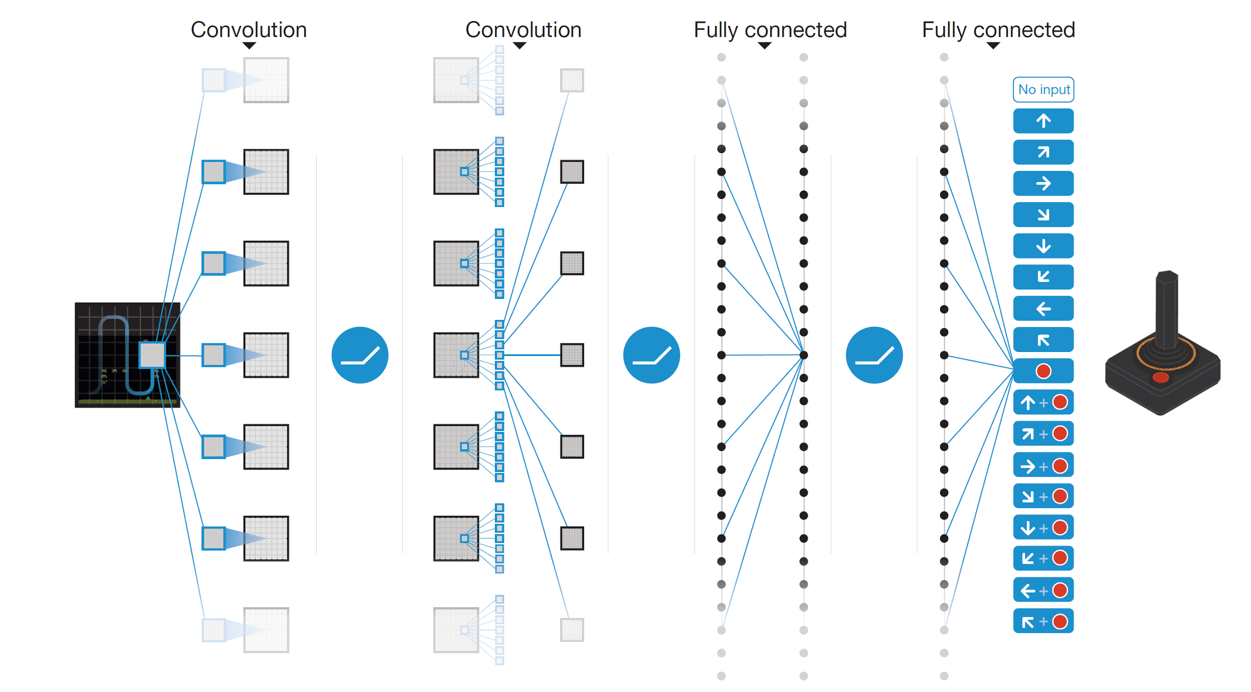
Deep Q-learning in Atari
End-to-end learning of $Q(s,a)$ from pixels $s$
Output is $Q(s,a)$ for 18 joystick/button configurations
Reward is change in score for that step
Deep Q-Network (DQN)
Q(s,a₁)
Q(s,a₂)
Q(s,a₃)
.
.
.
.
.
.
.
.
.
.
.
Q(s,a₁₈)

Slide 34
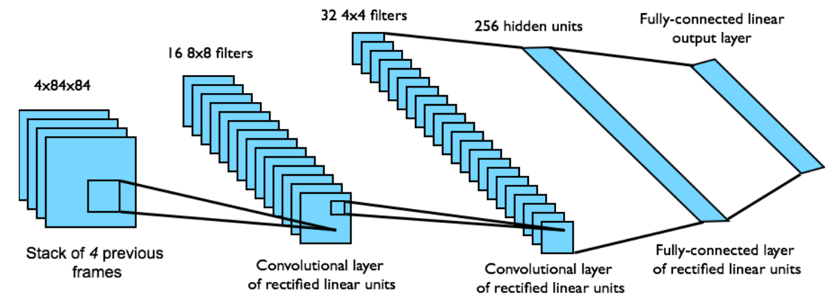
Deep Q-learning in Atari
Input state is stack of raw pixels (grayscale) from last 4 frames
Network architecture and hyperparameters fixed for all games
Deep Q-Network (DQN)

Slide 35
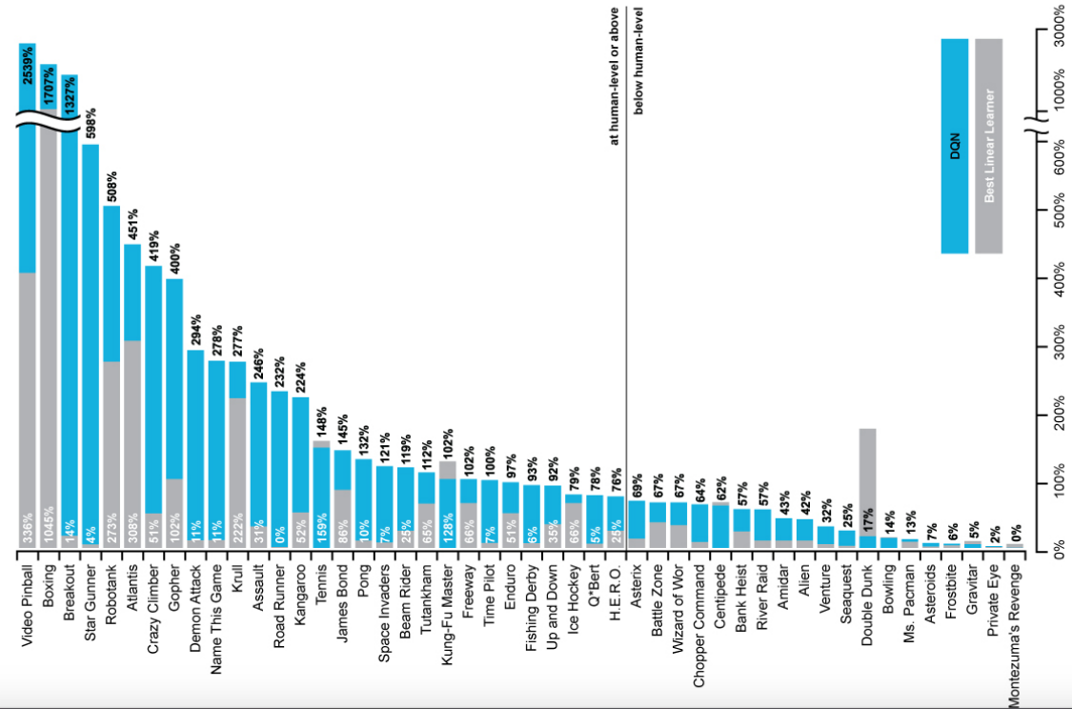
Deep Q-learning in Atari
Notes:
The performance of DQN is normalized with respect to a professional human games tester (that is, 100% level) and random play (that is, 0% level). Note that the normalized performance of DQN, expressed as a percentage, is calculated as: 100 × (DQN score − random play score)/(human score − random play score).

Slide 36
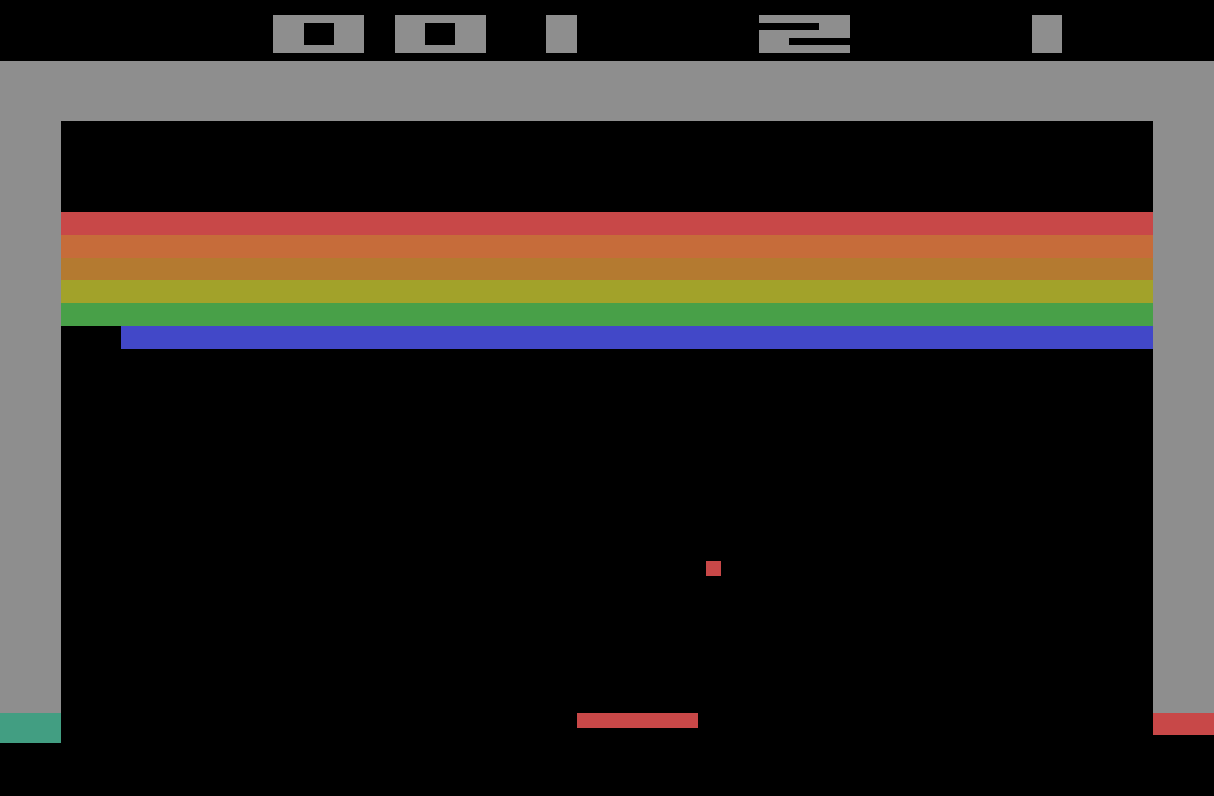
Breakout demo
https://www.youtube.com/watch?v=TmPfTpjtdgg

Slide 37
Outline
Introduction to reinforcement learning
Markov Decision Process (MDP) formalism and classical Bellman equation
Q-learning
Deep Q networks
Extensions
Double DQN
Dueling DQN

Slide 38
Extension: Double Q-learning
Max operator in standard Q-learning is used both to select and evaluate an action, leading to systematic over-estimation of Q-values
Modification: select action using the online (current) network, but evaluate Q-value using the target network
Regular DQN target:
$$y_{target}\left(s,a\right)=r\left(s\right)+γ\max_{a^{′}}Q_{target}\left(s′,a′\right)$$
Double DQN target:
$$y_{target}\left(s,a\right)=r\left(s\right)+γ Q_{target}\left(s′, {argmax}_{a′}Q_{w}\left(s′,a′\right)\right)$$
H. van Hasselt, A. Guez, D. Silver, Deep Reinforcement Learning with Double Q-learning, AAAI 2016

Slide 39
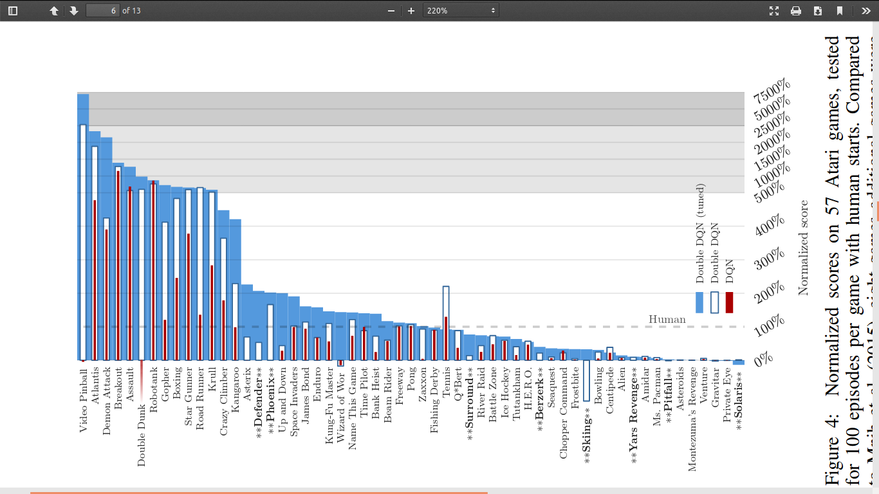
Double DQN results

Slide 40
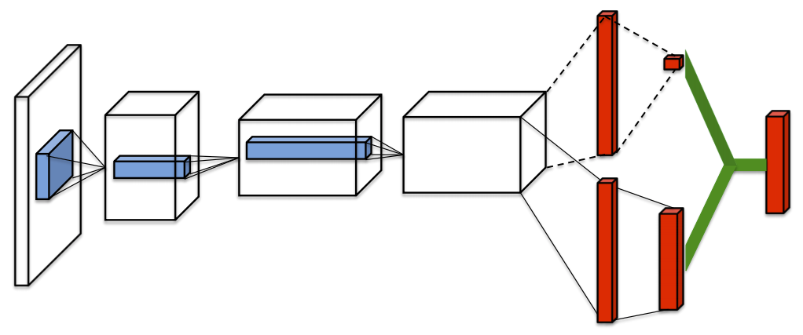
Another extension: Dueling DQN
Decompose estimation of Q-function into value and advantage functions
Value function
Q-function
Advantage function
Z. Wang et al., Dueling Network Architectures for Deep Reinforcement Learning, ICML 2016

Slide 41
Dueling DQN
Decompose estimation of Q-function into value and advantage functions
Motivation: in many states, actions don’t meaningfully affect the environment, so it is not necessary to know the exact value of each action at each time step
Z. Wang et al., Dueling Network Architectures for Deep Reinforcement Learning, ICML 2016

Slide 42
Dueling DQN
Decompose estimation of Q-function into value and advantage functions:
$Q\left(s,a\right)=V\left(s\right)+\left(A\left(s,a\right)−\max_{a^{′}} A(s,a^{′})\right)$ or
$$Q\left(s,a\right)=V\left(s\right)+\left(A\left(s,a\right)−\frac{1}{|𝒜|}\sum_{a^{′}}{A(s,a^{′})}\right)$$
Z. Wang et al., Dueling Network Architectures for Deep Reinforcement Learning, ICML 2016

Slide 43
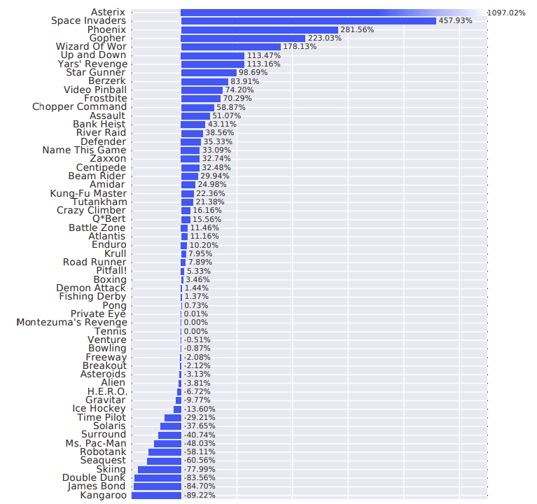
Dueling DQN: Results
Improvements over prioritized DDQN baseline:

