Slide 1
Policy Gradient Methods
Sources: Stanford CS 231n, Berkeley Deep RL course, David Silver’s RL course
Image source

Slide 2
Outline
Stochastic policy representation
Finding the policy gradient
REINFORCE algorithm
Actor-critic algorithms
Applications

Slide 3
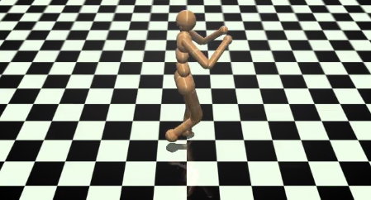
Policy gradient methods: Motivation
Instead of indirectly representing the policy using Q-values, it can be more efficient to parameterize and learn it directly
Especially in large or continuous action spaces
Image source: OpenAI Gym

Slide 4
Stochastic policy representation
Learn a function giving the probability distribution over actions from the current state:
$$π_{θ}\left(a|s\right)≈P(a|s)$$

Slide 5
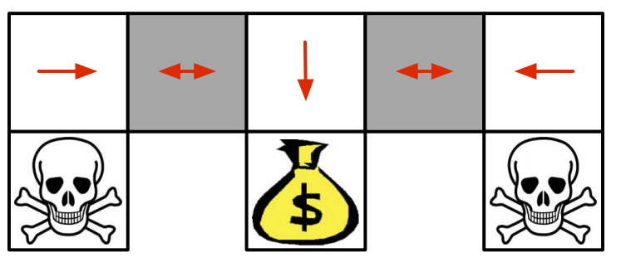
Stochastic policy representation
Learn a function giving the probability distribution over actions from the current state:
$$π_{θ}\left(a|s\right)≈P(a|s)$$
Why stochastic policies?
There are examples even of grid world scenarios where only a stochastic policy can reach optimality
?
?
Source: D. Silver
The agent can’t tell the difference between the gray cells

Slide 6
Stochastic policy representation
Learn a function giving the probability distribution over actions from the current state:
$$π_{θ}\left(a|s\right)≈P(a|s)$$
Why stochastic policies?
It’s mathematically convenient!
Softmax policy:
$$π_{θ}\left(a|s\right)=\frac{exp⁡(f_{θ}\left(s,a\right))}{\sum_{a^{′}}{exp⁡(f_{θ}\left(s,a^{′}\right))}}$$
Gaussian policy (for continuous action spaces):
$$π_{θ}\left(a|s\right)=\frac{1}{\sqrt{2πσ^{2}}}exp⁡\left(−\frac{{(a−f_{θ}\left(s\right))}^{2}}{{2σ}^{2}}\right)$$

Slide 7
Expected value of a policy
$$J\left(θ\right)=𝔼\left[\sum_{t≥0}{γ^{t} r_{t}}| π_{θ}\right]$$
$$=𝔼_{τ}\left[r(τ)\right]$$
$$=\int_{τ}{r\left(τ\right)p\left(τ;θ\right)dτ}$$
Expectation of return over trajectories $τ=(s_{0},a_{0},r_{0},s_{1},a_{1},r_{1},…)$
Probability of trajectory $τ$ under policy with parameters $θ$

Slide 8
Finding the policy gradient
$$J\left(θ\right)=\int_{τ}{r\left(τ\right)p\left(τ;θ\right)dτ}$$
$$∇_{θ}J(θ)=\int_{τ}{r\left(τ\right)∇_{θ}p\left(τ;θ\right)dτ}$$
$$=\int_{τ}{r\left(τ\right)p\left(τ;θ\right)\frac{∇_{θ}p\left(τ;θ\right)}{p\left(τ;θ\right)}dτ}$$
$$=\int_{τ}{r\left(τ\right)p\left(τ;θ\right)∇_{θ}\log{p\left(τ;θ\right)}dτ}$$
$$=𝔼_{τ}\left[r(τ)∇_{θ}\log{p\left(τ;θ\right)}\right]$$

Slide 9
Finding the policy gradient
$$∇_{θ}J(θ)=𝔼_{τ}\left[r(τ)∇_{θ}\log{p\left(τ;θ\right)}\right]$$
$$p\left(τ;θ\right)=P(s_{0})\prod_{t≥0}{π_{θ}(a_{t}|s_{t})P\left(s_{t+1} | s_{t},a_{t}\right)}$$
$$\log{p\left(τ;θ\right)}=log P\left(s_{0}\right)+\sum_{t≥0}{\left[\log{π_{θ}({a_{t}|s}_{t})}+\log{P\left(s_{t+1} | s_{t},a_{t}\right)}\right]}$$
$$∇_{θ}\log{p\left(τ;θ\right)}=\sum_{t≥0}{∇_{θ} log{π_{θ}({a_{t}|s}_{t})}}$$
Probability of trajectory $τ=(s_{0},a_{0}, s_{1},a_{1},…)$
The score function

Slide 10
Score function $∇_{θ} log{π_{θ}(a|s)}$
For softmax policy:
$$π_{θ}\left(a|s\right)=\frac{exp⁡(f_{θ}\left(s,a\right))}{\sum_{a^{′}}{exp⁡(f_{θ}\left(s,a^{′}\right))}}$$
$$∇_{θ} log{π_{θ}({a_{t}|s}_{t})}=∇_{θ}f_{θ}\left(s,a\right)−\sum_{a^{′}}{π_{θ}\left(a^{′}|s \right)}∇_{θ}f_{θ}\left(s,a^{′}\right)$$
For Gaussian policy:
$$π_{θ}\left(a|s\right)=\frac{1}{\sqrt{2πσ^{2}}}exp⁡\left(−\frac{{(a−f_{θ}\left(s\right))}^{2}}{{2σ}^{2}}\right)$$
$$∇_{θ} log{π_{θ}({a_{t}|s}_{t})}=\frac{\left(a−f_{θ}\left(s\right)\right)}{σ^{2}}∇_{θ}f_{θ}\left(s\right)−const.$$

Slide 11
Finding the policy gradient
$$∇_{θ}J(θ)=𝔼_{τ}\left[r(τ)∇_{θ}\log{p\left(τ;θ\right)}\right]$$
$$∇_{θ}\log{p\left(τ;θ\right)}=\sum_{t≥0}{∇_{θ} log{π_{θ}({a_{t}|s}_{t})}}$$
$$∇_{θ}J(θ)=𝔼_{τ}\left[\left(\sum_{t≥0}{γ^{t}r_{t}}\right)\left(\sum_{t≥0}{∇_{θ} log{π_{θ}({a_{t}|s}_{t})}}\right)\right]$$
How do we estimate the gradient in practice?
Return of trajectory $τ$
Gradient of log-likelihood of actions under current policy

Slide 12
Finding the policy gradient
$$∇_{θ}J(θ)=𝔼_{τ}\left[r(τ)∇_{θ}\log{p\left(τ;θ\right)}\right]$$
$$∇_{θ}\log{p\left(τ;θ\right)}=\sum_{t≥0}{∇_{θ} log{π_{θ}({a_{t}|s}_{t})}}$$
$$∇_{θ}J(θ)=𝔼_{τ}\left[\left(\sum_{t≥0}{γ^{t}r_{t}}\right)\left(\sum_{t≥0}{∇_{θ} log{π_{θ}({a_{t}|s}_{t})}}\right)\right]$$
Stochastic approximation: sample $N$ trajectories $τ_{1}, …,τ_{N}$
$$∇_{θ}J(θ)≈\frac{1}{N}\sum_{i=1}^{N}{\left(\sum_{t=0}^{T_{i}}{γ^{t}r_{i,t}}\right)\left(\sum_{t=0}^{T_{i}}{∇_{θ} log{π_{θ}({a_{i,t}|s}_{i,t})}}\right)}$$

Slide 13
REINFORCE algorithm
Sample $N$ trajectories $τ_{i}$ using current policy $π_{θ}$
Estimate the policy gradient:
$$∇_{θ}J(θ)≈\frac{1}{N}\sum_{i=1}^{N}{r(τ_{i})\left(\sum_{t=0}^{T_{i}}{∇_{θ} log{π_{θ}({a_{i,t}|s}_{i,t})}}\right)}$$
3. Update parameters by gradient ascent:
$$θ←θ+η∇_{θ}J(θ)$$
Williams et al. Simple statistical gradient-following algorithms for connectionist reinforcement learning. Machine Learning, 8(3):229-256, 1992

Slide 14
REINFORCE: Single-step version
In state $s$, sample action $a$ using current policy $π_{θ}$, observe reward $r$
Estimate the policy gradient:
$$∇_{θ}J(θ)≈r∇_{θ} log{π_{θ}(a|s)}$$
3. Update parameters by gradient ascent:
$$θ←θ+η∇_{θ}J(θ)$$
What effect does this update have?
Push up the probability of good actions, push down probability of bad actions

Slide 15
Outline
Stochastic policy representation
Finding the policy gradient
REINFORCE algorithm
Actor-critic algorithms

Slide 16
Reducing variance
Gradient estimate (for a single trajectory):
$$∇_{θ}J(θ)≈\sum_{t≥0}{r(τ)∇_{θ} log{π_{θ}({a_{t}|s}_{t})}}$$
General problem: rewards of sampled trajectories are too noisy and lead to unreliable policy gradients

Slide 17
Reducing variance
Gradient estimate (for a single trajectory):
$$∇_{θ}J(θ)≈\sum_{t≥0}{r(τ)∇_{θ} log{π_{θ}({a_{t}|s}_{t})}}$$
First observation: it seems bad to weight each action in a trajectory by the return of the entire trajectory. In particular, rewards obtained before an action was taken should not be used to weight that action
Instead, for each action, consider only the cumulative future reward:
$$∇_{θ}J(θ)≈\sum_{t≥0}{\left(\sum_{t^{′}≥t}{γ^{t^{′}−t}r_{t^{′}}}\right)∇_{θ} log{π_{θ}({a_{t}|s}_{t})}}$$

Slide 18
Reducing variance
$$∇_{θ}J(θ)≈\sum_{t≥0}{\left(\sum_{t^{′}≥t}{γ^{t^{′}−t}r_{t^{′}}}\right)∇_{θ} log{π_{θ}({a_{t}|s}_{t})}}$$
But then, why not use expected cumulative reward?
$$∇_{θ}J(θ)≈\sum_{t≥0}{Q^{π_{θ}}\left(s_{t },a_{t }\right)∇_{θ} log{π_{θ}({a_{t}|s}_{t})}}$$
Observed cumulative reward after taking action $a_{t}$ in state $s_{t}$

Slide 19
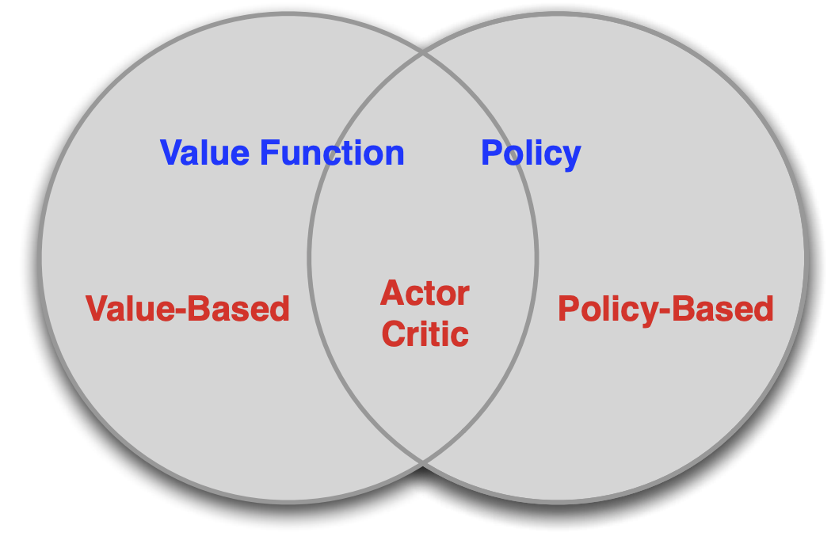
Actor-Critic algorithms
Combine policy gradients and Q-learning by simultaneously training an actor (the policy) and a critic (the Q-function)
Source: D. Silver

Slide 20
Reducing variance
$$∇_{θ}J(θ)≈\sum_{t≥0}{Q^{π_{θ}}\left(s_{t },a_{t }\right)∇_{θ} log{π_{θ}({a_{t}|s}_{t})}}$$
Next observation: the raw Q-values are not the most useful. If all Q-values are good, we will try to push up the probabilities of all the actions
Instead, compare Q-values of actions to some baseline function of the state:
$$∇_{θ}J(θ)≈\sum_{t≥0}{\left(Q^{π_{θ}}\left(s_{t },a_{t }\right)−V^{π_{θ}}\left(s_{t}\right)\right)∇_{θ} log{π_{θ}({a_{t}|s}_{t})}}$$
Advantage function $A^{π_{θ}}\left(s_{t },a_{t }\right)$

Slide 21
Estimating the advantage function
Advantage function:
$$A^{π_{θ}}\left(s,a\right)=Q^{π_{θ}}\left(s,a\right)−V^{π_{θ}}\left(s\right)$$
$$=𝔼_{s^{′}}\left[r+γ V^{π_{θ}}\left(s^{′}\right)|s,a\right]−V^{π_{θ}}\left(s\right)$$
$≈r+γ V^{π_{θ}}\left(s^{′}\right)−V^{π_{θ}}\left(s\right)$
(from a single transition)
Therefore, it is sufficient to learn the value function:
$$V^{π_{θ}}\left(s\right)≈V_{w}(s)$$

Slide 22
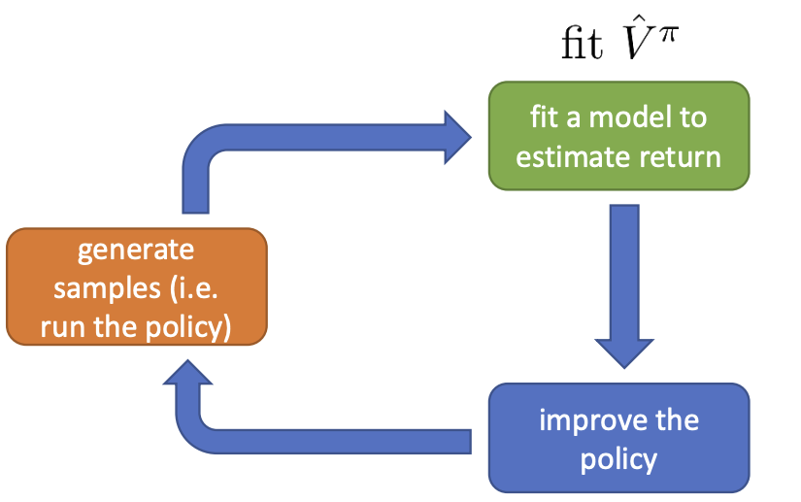
Online actor-critic algorithm
Sample action $a$ using current policy, observe reward $r$, successor state $s′$
Update $V_{w}(s)$ towards target $r+γV_{w}(s′)$
Estimate $A^{π_{θ}}\left(s,a\right)=r+γV_{w}\left(s^{′}\right)−V_{w}(s)$
Estimate $∇_{θ}J\left(θ\right)=A^{π_{θ}}\left(s,a\right)∇_{θ}\log{π_{θ}(a|s)}$
Update policy parameters: $θ←θ+η∇_{θ}J(θ)$
Source: Berkeley RL course

Slide 23
Asynchronous advantage actor-critic (A3C)
Agent 1
Experience 1
Local updates
Agent 2
Experience 2
Local updates
V, π
.
.
.
Agent n
Experience n
Local updates
Asynchronously update global parameters
Mnih et al. Asynchronous Methods for Deep Reinforcement Learning. ICML 2016

Slide 24
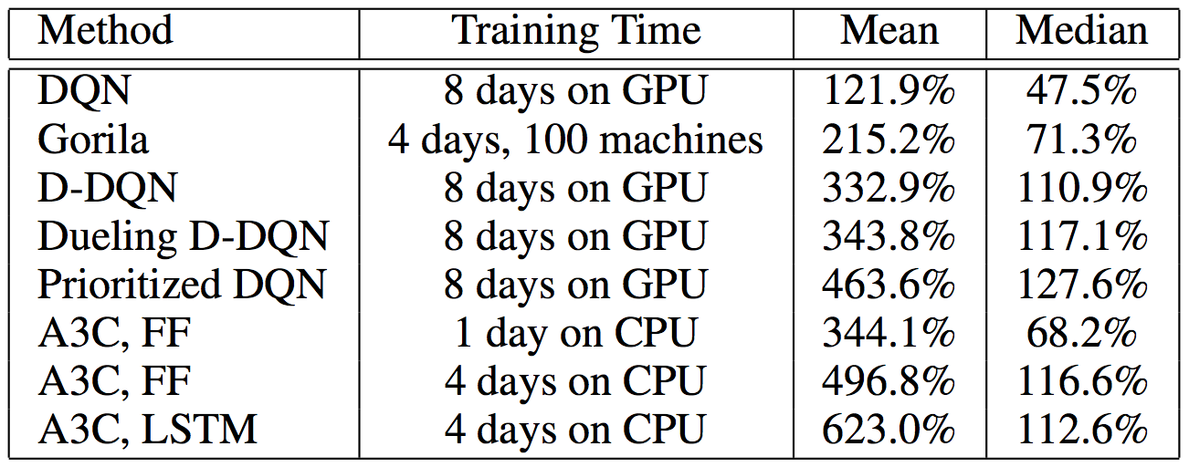
Asynchronous advantage actor-critic (A3C)
Mean and median human-normalized scores over 57 Atari games
Mnih et al. Asynchronous Methods for Deep Reinforcement Learning. ICML 2016

Slide 25
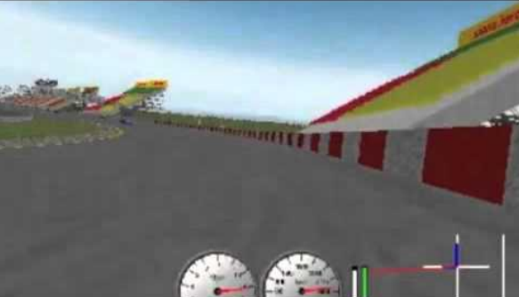
Asynchronous advantage actor-critic (A3C)
TORCS car racing simulation video
Mnih et al. Asynchronous Methods for Deep Reinforcement Learning. ICML 2016

Slide 26
Asynchronous advantage actor-critic (A3C)
Motor control tasks video
Mnih et al. Asynchronous Methods for Deep Reinforcement Learning. ICML 2016

Slide 27
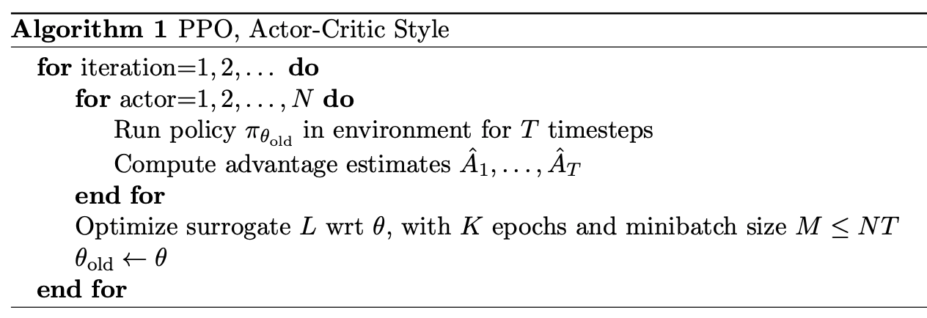
Proximal policy optimization (PPO)
Standard actor-critic algorithms are on-policy, cannot perform multiple update steps using the same set of samples
PPO enables multiple updates using the same minibatch of samples by using a complicated “surrogate objective” that carefully restricts how much the policy can change each time
J. Schulman et al. Proximal Policy Optimization Algorithms. arXiv 2017

Slide 28
Outline
Stochastic policy representation
Finding the policy gradient
REINFORCE algorithm
Actor-critic algorithms
Applications

Slide 29
Application: Adaptive policies for robot locomotion
Kumar et al. RMA: Rapid Motor Adaptation for Legged Robots. RSS 2021
Method video

Slide 30
Application: Adaptive policies for robot locomotion
Kumar et al. RMA: Rapid Motor Adaptation for Legged Robots. RSS 2021
Method video
Notes:
RMA consists of two subsystems - the base policy π and the adaptation module φ. Top: RMA is trained in two phases. In the first phase, the base policy π takes as input the current state xt, previous action at−1 and the privileged environmental factors et which is encoded into the latent extrinsics vector zt using the environmental factor encoder µ. The base policy is trained in simulation using model-free RL. In the second phase, the adaptation module φ is trained to predict the extrinsics zˆt from the history of state and actions via supervised learning with on-policy data. Bottom: At deployment, the adaptation module φ generates the extrinsics zˆt at 10Hz, and the base policy generates the desired joint positions at 100Hz which are converted to torques using A1’s PD controller. Since the adaptation module runs at a lower frequency, the base policy consumes the most recent extrinsics vector zˆt predicted by the adaptation module to predict at. This asynchronous design was critical for seamless deployment on low-cost robots like A1 with limited on-board compute.

Slide 31
Locomotion with vision in the loop
A. Agarwal et al. Legged Locomotion in Challenging Terrains using Egocentric Vision. CoRL 2022
Notes:
We train our locomotion policy in two phases to avoid rendering depth for too many samples. In phase 1, we use RL to train a policy π 1 that has access to scandots that are cheap to compute. In phase 2, we use π 1 to provide ground truth actions which another policy π 2 is trained to imitate. This student has access to depth map from the front camera. We consider two architectures (1) a monolithic one which is a GRU trained to output joint angles with raw observations as input (2) a decoupled architecture trained using RMA [3] that is trained to estimate vision and proprioception latents that condition a base feedforward walking policy.

Slide 32
Application: Learning skills from video
Video
X. B. Peng et al. SFV: Reinforcement Learning of Physical Skills from Videos. SIGGRAPH Asia 2018

Slide 33
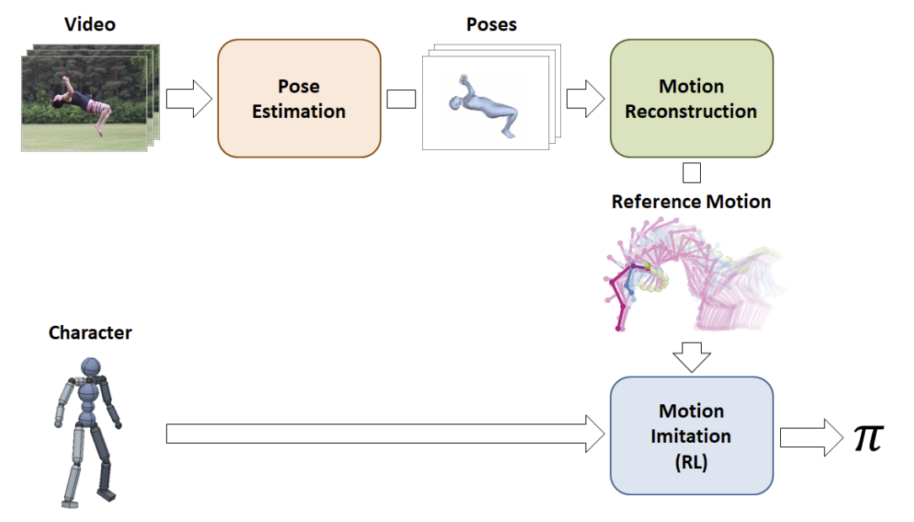
Application: Learning skills from video
X. B. Peng et al. SFV: Reinforcement Learning of Physical Skills from Videos. SIGGRAPH Asia 2018

Slide 34
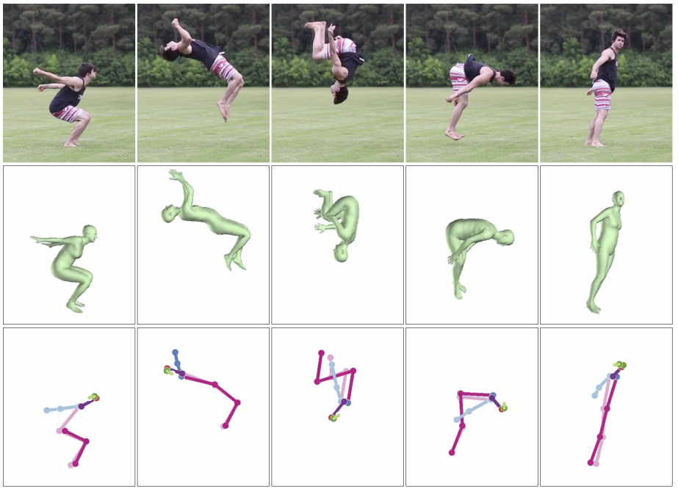
Skills from video: Motion estimation details
In each video frame, use both OpenPose 2D pose estimator and Human Mesh Recovery (HMR) 3D pose estimator
Video frames
3D pose predictions
2D pose predictions

Slide 35
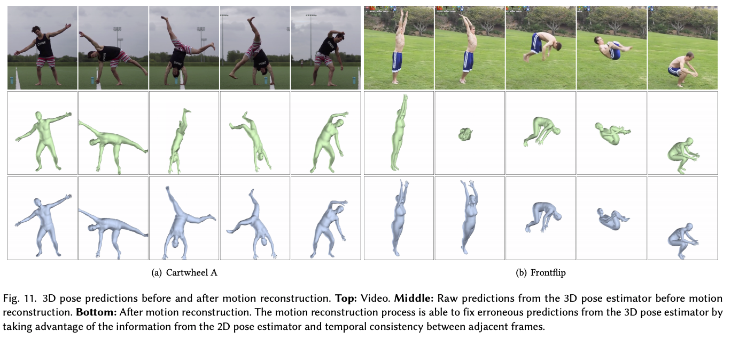
Skills from video: Motion estimation details
In each video frame, use both OpenPose 2D pose estimator and Human Mesh Recovery (HMR) 3D pose estimator
Motion reconstruction: optimize trajectory consistent with per-frame 2D and 3D predictions while maintaining smoothness

Slide 36
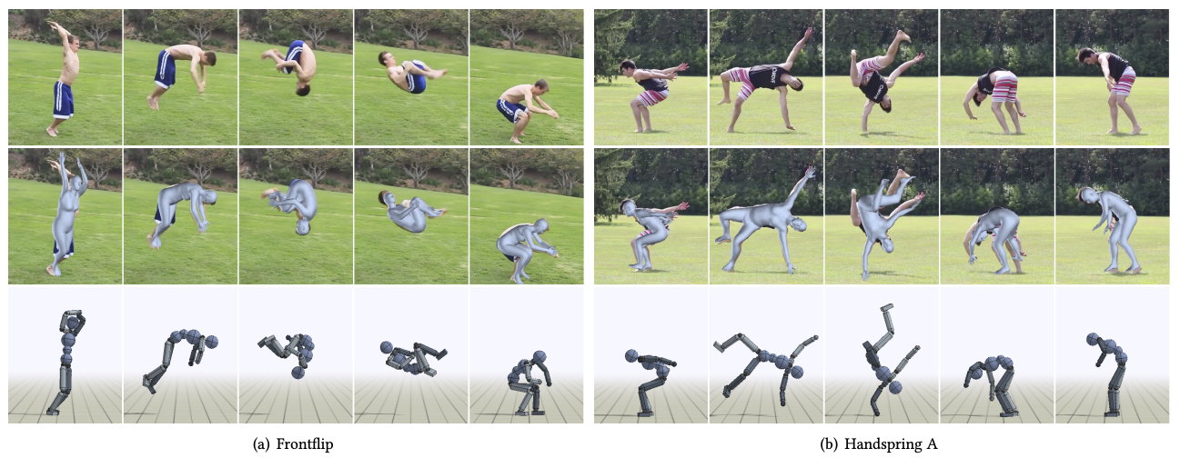
Skills from video: Motion imitation details
Find policy to encourage simulated motion to reproduce reference motion

Slide 37
Skills from video: Motion imitation details
States (body configurations): position of each body segment relative to the root, rotations, linear and angular velocities, phase during motion (0 at start, 1 at end)
Actions: target rotations for each joint (36 dimensions)
Transition model or dynamics: derived from physics-based simulation
Imitation reward function: sum of pose, velocity, end-effector, and center-of-mass error terms
Finding the policy: proximal policy optimization
Requires policy network (two FC layers, outputs represent parameters of Gaussian distributions over actions), value network
Adaptive state initialization: learn initial state distribution as another policy

Slide 38
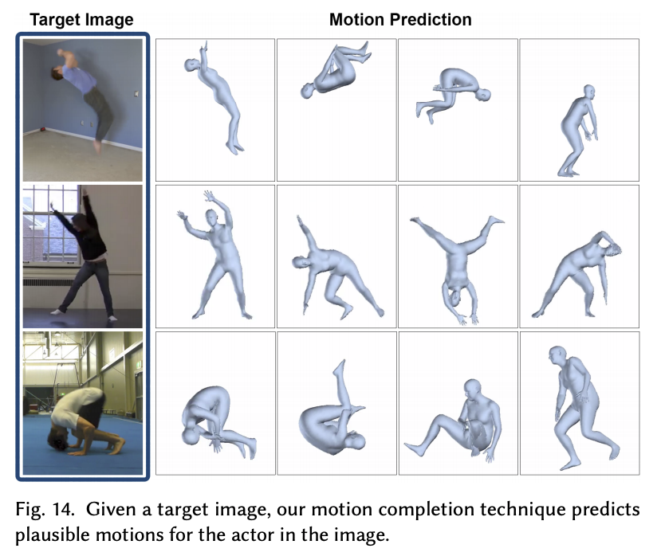
Skills from video: Results
Video

