Slide 1
Recurrent networks
Many slides adapted from Arun Mallya and Justin Johnson (and Stanford CS231n)
Image source

Slide 2
Outline
Sequential prediction tasks
Common recurrent units
Vanilla RNN unit (and how to train it)
Long Short-Term Memory (LSTM)
Gated Recurrent Unit (GRU)
Recurrent network architectures
Applications in (a bit) more detail
Language modeling
Image captioning

Slide 3
Sequential prediction example 1: Sentiment classification
Goal: classify a text sequence (e.g., restaurant, movie or product review, Tweet) as having positive or negative sentiment
“The food was really good”
“The vacuum cleaner broke within two weeks”
“The movie had slow parts, but overall was worth watching”
Notes:
What makes this problem challenging?
What feature representation or predictor structure can we use for this problem?

Slide 4
Sequential prediction example 1: Sentiment classification
Recurrent model:
Classifier
Hidden state
“Memory”
“Context”
h₅
h₁
h₂
h₃
h₄
“The”
“food”
“was”
“really”
“good”

Slide 5
Sequential prediction example 2: Text generation
Sample from the distribution of a given text corpus – also known as language modeling

Slide 6
Sequential prediction example 2: Text generation
Sample from the distribution of a given text corpus – also known as language modeling
Can be done one character or one word at a time:
“Thus”
“saith”
“the”
“Lord”
“of”
Classifier
Classifier
Classifier
Classifier
Classifier
h₁
h₂
h₃
h₄
h₅
h₁
h₂
h₃
h₄
h₅
“START”
“Thus”
“saith”
“the”
“Lord”
Image source

Slide 7
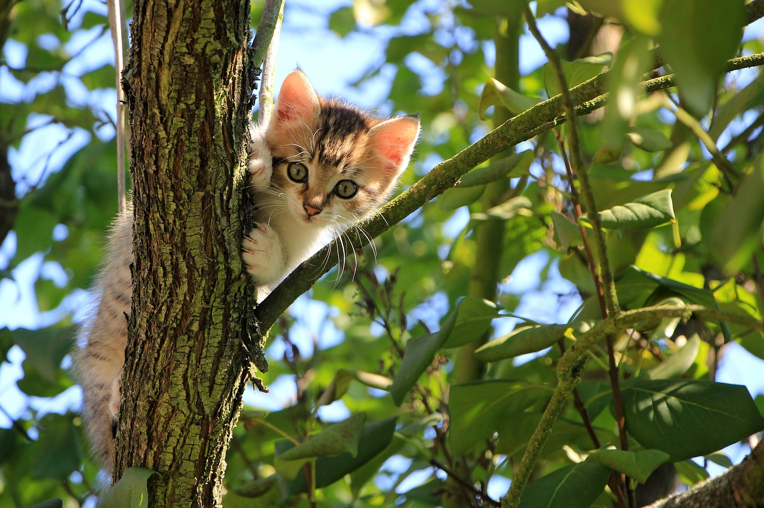
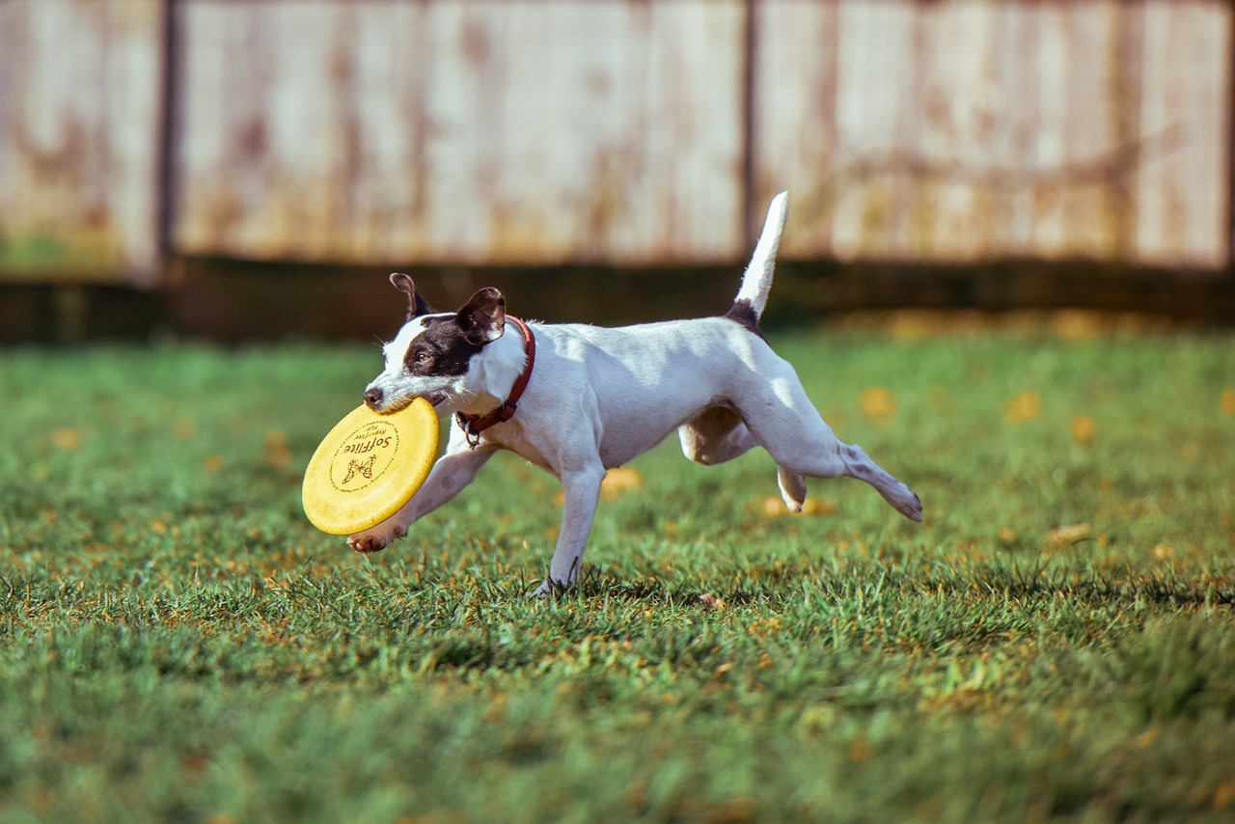
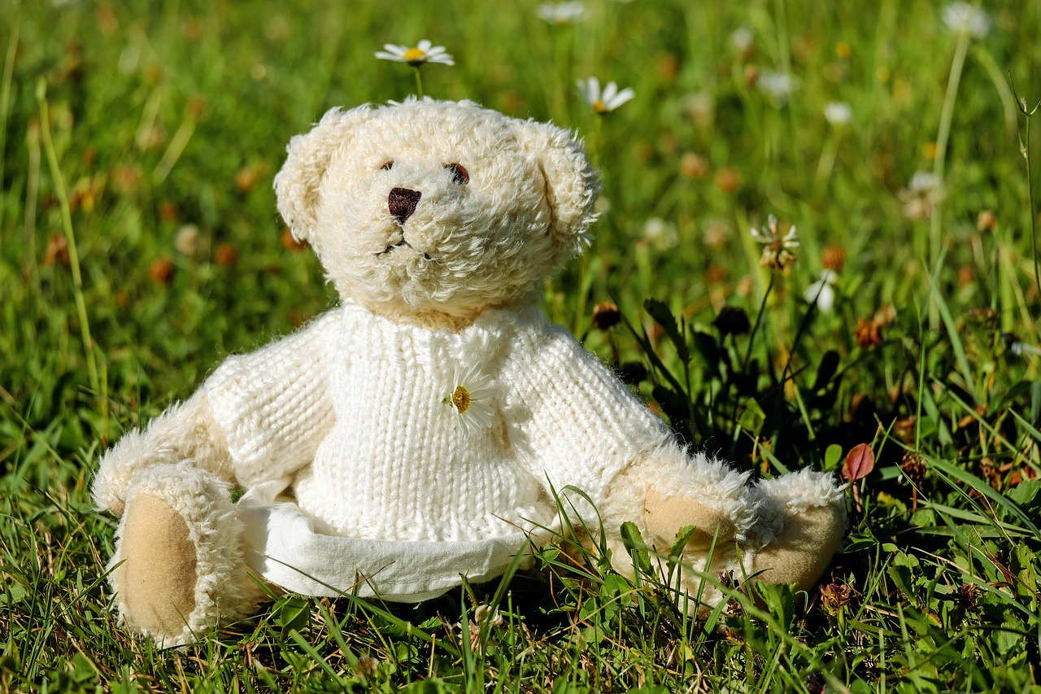
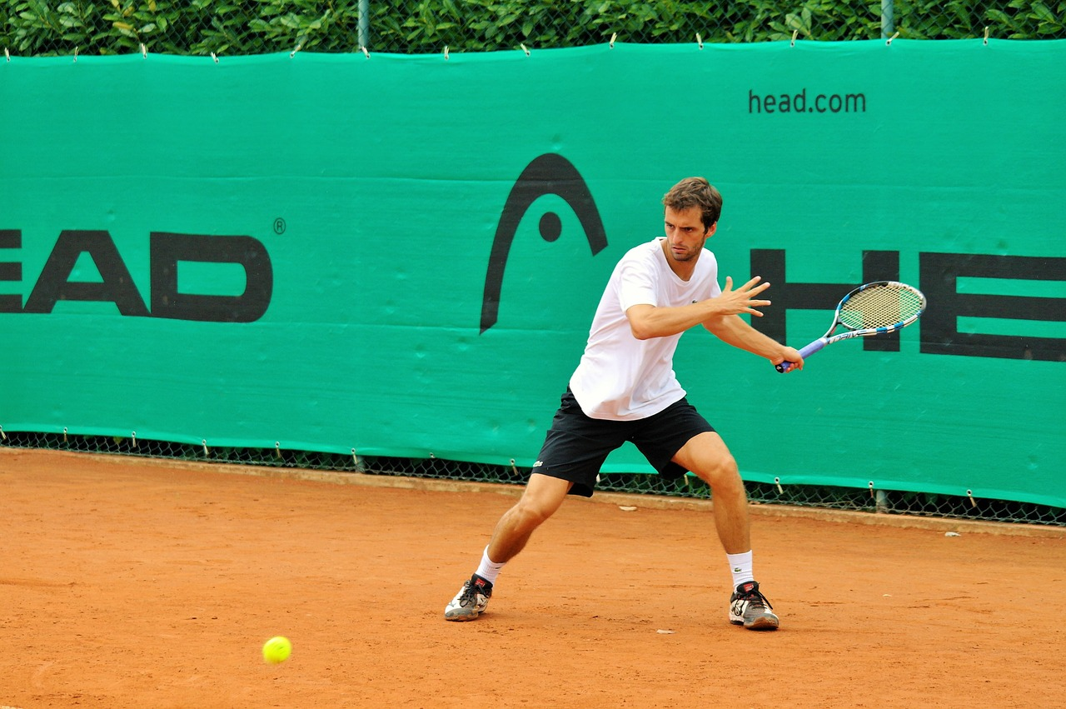
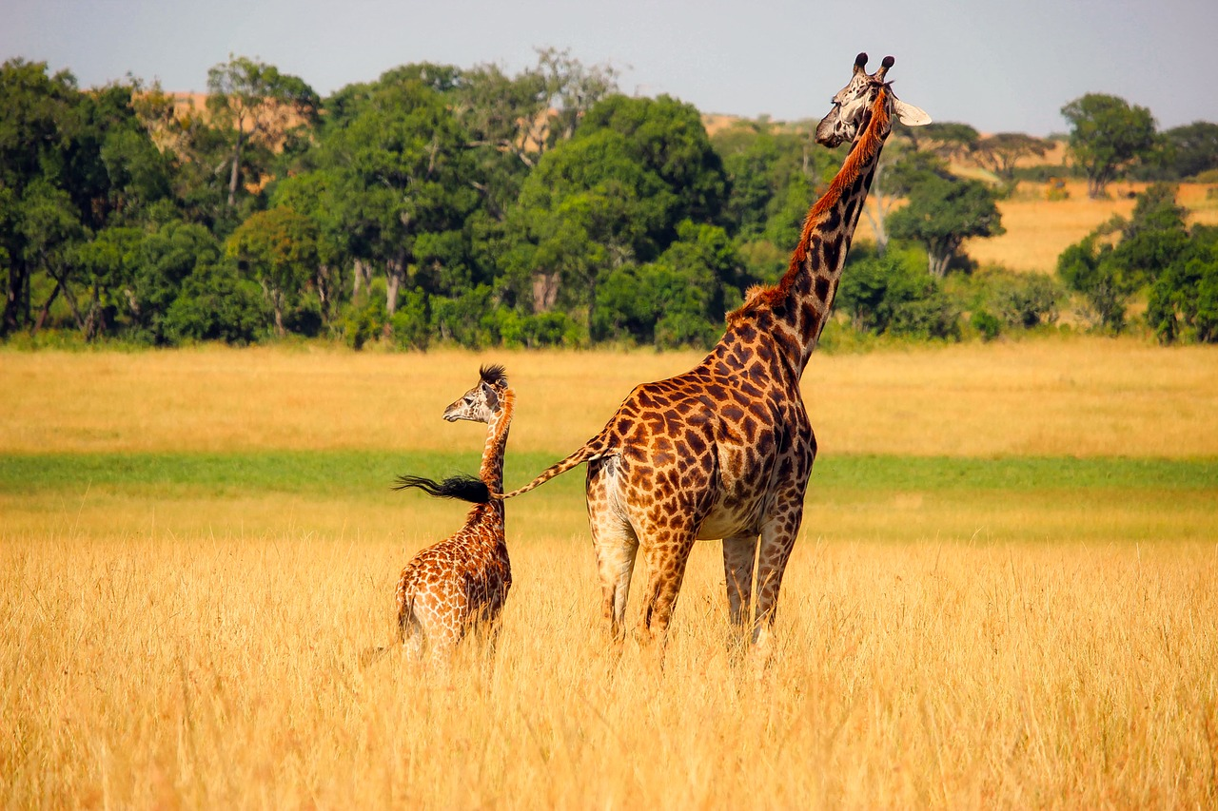
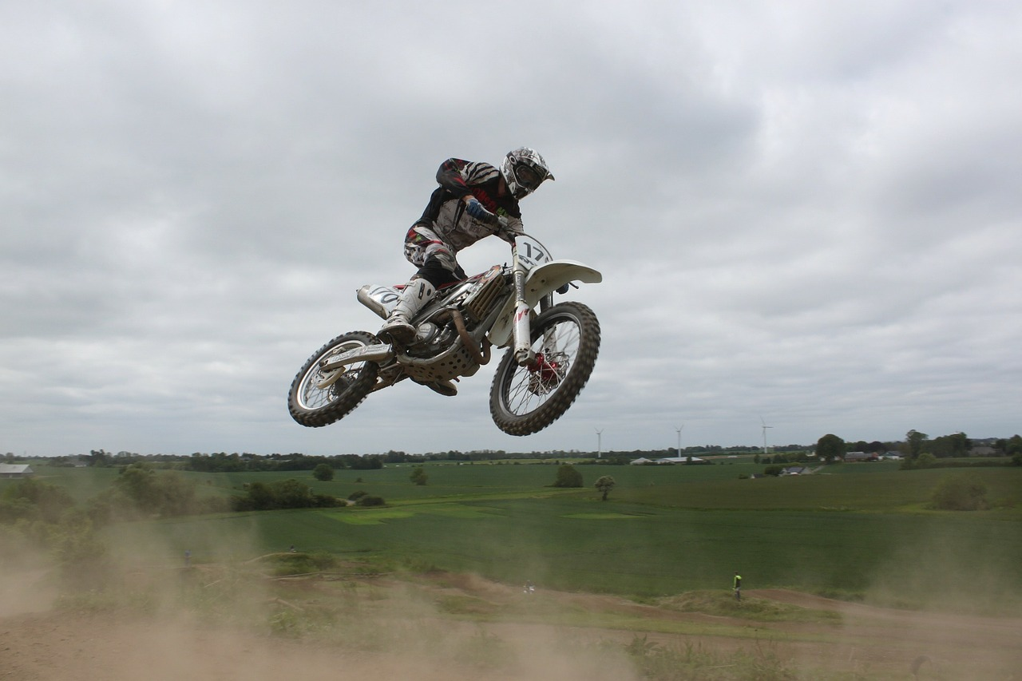
Sequential prediction example 3: Image captioning
A cat sitting on a suitcase on the floor
A cat is sitting on a tree branch
A dog is running in the grass with a frisbee
A white teddy bear sitting in the grass
Two people walking on the beach with surfboards
A tennis player in action on the court
Two giraffes standing in a grassy field
A man riding a dirt bike on a dirt track
Source: J. Johnson
Captions generated using neuraltalk2

Slide 8
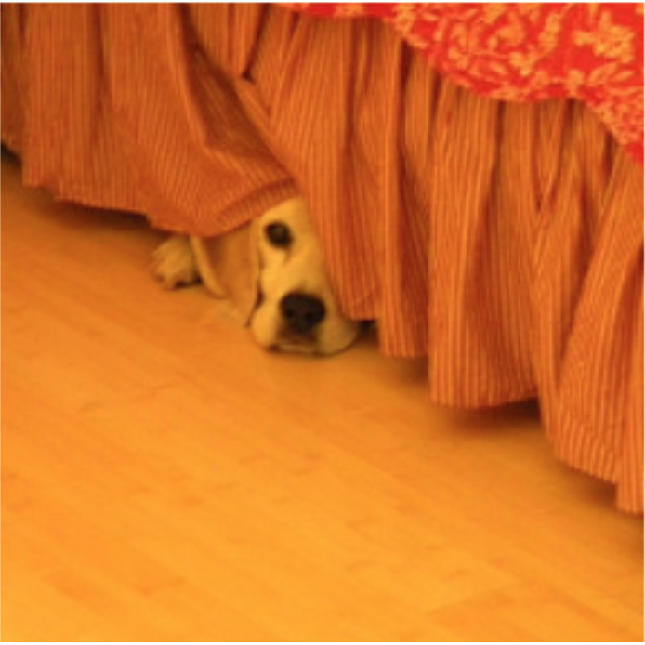
Sequential prediction example 3: Image captioning
“The”
“dog”
“is”
“hiding”
“STOP”
Classifier
Classifier
Classifier
Classifier
Classifier
h₁
h₂
h₃
h₄
h₅
CNN
h₀
h₁
h₂
h₃
h₄
“START”
“The”
“dog”
“is”
“hiding”

Slide 9
Example 4: Machine translation
https://translate.google.com/

Slide 10
Example 4: Machine translation
Multiple input – multiple output (or sequence to sequence) scenario:
“Matches”
“Nature”
“is”
“Correspondances”
“La”
“nature”

Slide 11
Summary: Input-output scenarios
Single - Single
Feedforward Network
Multiple - Single
Sequence Classification
Single - Multiple
Sequence generation, captioning
Multiple - Multiple
Sequence generation, captioning
Multiple - Multiple
Translation

Slide 12
Outline
Sequential prediction tasks
Common recurrent units
Vanilla RNN unit
Long Short-Term Memory (LSTM)
Gated Recurrent Unit (GRU)

Slide 13
Recurrent unit
$$y3$$
$$y2$$
Classifier
…
$$y1$$
$$h3$$
Classifier
$$h3$$
$$h2$$
$$h2$$
Hidden layer
Classifier
$$h1$$
$$h1$$
Hidden layer
$$x3$$
Hidden layer
$$t = 3$$
$$x2$$
$$h0$$
$$x1$$
$$t = 2$$
$$t = 1$$

Slide 14
Recurrent unit
Output at time $t$
$$yt$$
Classifier
Recurrence:
$$h_{t}=f_{W}(x_{t},h_{t−1})$$
Hidden representation at time $t$
$$ht$$
new state
function of $W$
input at time$t$
old state
Hidden layer
Input at time $t$
$$xt$$

Slide 15
Vanilla RNN cell
$$ht$$
$$h_{t}=f_{W}(x_{t},h_{t−1})$$
$=\tanh{W}\left(\begin{matrix}x_{t} \\ h_{t−1}\end{matrix}\right)$
$$W$$
$$h_{t−1}$$
$$xt$$
J. Elman, Finding structure in time, Cognitive science 14(2), pp. 179–211, 1990

Slide 16
Vanilla RNN cell
$$ht$$
$$h_{t}=f_{W}(x_{t},h_{t−1})$$
$=\tanh{W}\left(\begin{matrix}x_{t} \\ h_{t−1}\end{matrix}\right)$
$$W$$
$$h_{t−1}$$
$$xt$$
$$\tanh\left(a\right)=\frac{e^{a}−e^{−a}}{e^{a}+e^{−a}}$$ $=2σ\left(2a\right)−1$
$$σ\left(a\right)$$
$$\tanh\left(a\right)$$
Image source

Slide 17
Vanilla RNN cell
$$ht$$
$$h_{t}=f_{W}(x_{t},h_{t−1})$$
$=\tanh{W}\left(\begin{matrix}x_{t} \\ h_{t−1}\end{matrix}\right)$
$$W$$
$$h_{t−1}$$
$$xt$$
$$\frac{d}{da}tanh\left(a\right)=1−\tanh^{2}(a)$$
Image source

Slide 18
Vanilla RNN cell
$$ht$$
$$h_{t}=f_{W}(x_{t},h_{t−1})$$
$=\tanh{W}\left(\begin{matrix}x_{t} \\ h_{t−1}\end{matrix}\right)$
$=\tanh\left({W_{x}x_{t}+W}_{h}h_{t−1}\right)$
$$W$$
$$h_{t−1}$$
$$xt$$
n
m
$$W_{x}$$
$$W_{h}$$
$$x_{t}$$
m
n-dim.
$$h_{t−1}$$
m-dim.

Slide 19
RNN forward pass
e₁
e₂
e₃
$$e_{t}=−log(y_{t}({GT}_{t}))$$
y₁
y₂
y₃
$$y_{t}=softmax(W_{y}h_{t})$$
$$h_{t}=\tanh{W}\left(\begin{matrix}x_{t} \\ h_{t−1}\end{matrix}\right)$$
h₁
h₂
h₃
shared weights
h₀ x₁
h₁ x₂
h₂ x₃
Notes:
Note that the weights are shared over time
Essentially, copies of the RNN cell are made over time (unrolling/unfolding), with different inputs at different time steps

Slide 20
RNN forward pass: Computation graph
L
e₁
e₂
e₃
$$e_{t}=−log(y_{t}({GT}_{t}))$$
y₁
y₂
y₃
$$y_{t}=softmax(W_{y}h_{t})$$
W_{y}
$$h_{t}=\tanh{W}\left(\begin{matrix}x_{t} \\ h_{t−1}\end{matrix}\right)$$
h₁
h₂
h₃
W
h₀ x₁
h₁ x₂
h₂ x₃
Notes:
Note that the weights are shared over time
Essentially, copies of the RNN cell are made over time (unrolling/unfolding), with different inputs at different time steps

Slide 21
Training: Backpropagation through time (BPTT)
The unfolded network (used during forward pass) is treated as one big feed-forward network that accepts the whole time series as input
The weight updates are computed for each copy in the unfolded network, then summed (or averaged) and applied to the RNN weights

Slide 22
Backpropagation through time
Loss
Forward through entire sequence to compute loss, then backward to compute gradient
Source: J. Johnson

Slide 23
Backpropagation through time
Loss
Problem: Takes a lot of memory for long sequences!
Source: J. Johnson

Slide 24
Training: Backpropagation through time (BPTT)
The unfolded network (used during forward pass) is treated as one big feed-forward network that accepts the whole time series as input
The weight updates are computed for each copy in the unfolded network, then summed (or averaged) and applied to the RNN weights
In practice, truncated BPTT is used: run the RNN forward $k_{1}$ time steps, propagate backward for $k_{2}$ time steps
https://machinelearningmastery.com/gentle-introduction-backpropagation-time/
http://www.cs.utoronto.ca/~ilya/pubs/ilya_sutskever_phd_thesis.pdf

Slide 25
Truncated backpropagation through time
Loss
Run forward and backward through chunks of the sequence instead of whole sequence
Source: J. Johnson

Slide 26
Truncated backpropagation through time
Loss
Carry hidden states forward in time farther, but only backpropagate for some smaller number of steps
Source: J. Johnson

Slide 27
Truncated backpropagation through time
Loss
Source: J. Johnson

Slide 28
RNN backward pass
$$\frac{∂e}{∂h_{t}}$$
Error from predictions at future steps
$$ht$$
$$h_{t}=\tanh\left({W_{x}x_{t}+W}_{h}h_{t−1}\right)$$
$$\frac{∂e}{∂W_{h}}=\frac{∂e}{∂h_{t}}⨀\left(1−\tanh^{2}\left({W_{x}x_{t}+W}_{h}h_{t−1}\right)\right) h_{t−1}^{T}$$
$$\frac{∂e}{∂W_{x}}=\frac{∂e}{∂h_{t}}⨀\left(1−\tanh^{2}\left(W_{x}x_{t}+W_{h}h_{t−1}\right)\right){ x}_{t}^{T}$$
$$\frac{∂e}{∂h_{t−1}}=W_{h}^{T}\left(1−\tanh^{2}\left({W_{x}x_{t}+W}_{h}h_{t−1}\right)\right)⨀\frac{∂e}{∂h_{t}}$$
Parameter update
$$\frac{∂e}{∂W}$$
$$W$$
$$h_{t−1}$$
$$xt$$
$$\frac{∂e}{∂h_{t−1}}$$
Propagate to earlier time steps

Slide 29
Vanishing and exploding gradients
e_{n}
$$\frac{∂e}{∂h_{t−1}}=W_{h}^{T}\left(1−\tanh^{2}\left({W_{x}x_{t}+W}_{h}h_{t−1}\right)\right)⨀\frac{∂e}{∂h_{t}}$$
h₁
h₂
h_{n}
Computing gradient for $h0$
involves many multiplications by $W_{h}^{T}$ and rescalings between 0 and 1
h₀ x₁
h₁ x₂
h_{n-1} x_{n}
Gradients will vanish if largest singular value of $W_{h}$ is less than 1
and explode if it’s greater than 1

Slide 30
Outline
Examples of sequential prediction tasks
Common recurrent units
Vanilla RNN unit (and how to train it)
Long Short-Term Memory (LSTM)
Gated Recurrent Unit (GRU)

Slide 31
Long short-term memory (LSTM)
Add a memory cell that is not subject to matrix multiplication or squishing, thereby avoiding gradient decay
$xt$
$$h_{t−1}$$
$$ht$$
$$c_{t−1}$$
$$ct$$
S. Hochreiter and J. Schmidhuber, Long short-term memory, Neural Computation 9 (8), pp. 1735–1780, 1997

Slide 32
The LSTM cell
$$x_{t}$$
$$Wg$$
$$ht$$
$$g_{t}=tanh⁡W_{g}\left(\begin{matrix}x_{t} \\ h_{t−1}\end{matrix}\right)$$
$$h_{t−1}$$
Notes:
* Dashed line indicates time-lag

Slide 33
The LSTM cell
$$x_{t}$$
$$Wg$$
Cell
$$ct$$
$$ht$$
$$h_{t}=tanh⁡c_{t}$$
$$g_{t}=tanh⁡W_{g}\left(\begin{matrix}x_{t} \\ h_{t−1}\end{matrix}\right)$$
$$h_{t−1}$$
$$c_{t}=c_{t−1}+g_{t}$$
Notes:
* Dashed line indicates time-lag

Slide 34
The LSTM cell
$$x_{t}$$
$$Wg$$
Cell
$$ct$$
$$ht$$
$$g_{t}=tanh⁡W_{g}\left(\begin{matrix}x_{t} \\ h_{t−1}\end{matrix}\right)$$
$$h_{t−1}$$

Slide 35
The LSTM cell
$xt$ $h_{t−1}$
$$it$$
$$Wi$$
Input Gate
$$i_{t}=σ\left(W_{i}\left(\begin{matrix}x_{t} \\ h_{t−1}\end{matrix}\right)+b_{i}\right)$$
$$x_{t}$$
$$Wg$$
Cell
.
$$ct$$
$$ht$$
$$g_{t}=tanh⁡W_{g}\left(\begin{matrix}x_{t} \\ h_{t−1}\end{matrix}\right)$$
$$h_{t−1}$$
$$c_{t}=c_{t−1}+i_{t}⨀ g_{t}$$

Slide 36
The LSTM cell
$xt$ $h_{t−1}$
$xt$ $h_{t−1}$
$$it$$
$$Wi$$
o_{t}
$$Wo$$
Input Gate
Output Gate
$$i_{t}=σ\left(W_{i}\left(\begin{matrix}x_{t} \\ h_{t−1}\end{matrix}\right)+b_{i}\right)$$
$$o_{t}=σ\left(W_{o}\left(\begin{matrix}x_{t} \\ h_{t−1}\end{matrix}\right)+b_{o}\right)$$
$$x_{t}$$
$$Wg$$
Cell
.
.
$$ct$$
$$ht$$
$$h_{t}=o_{t}⨀ tanh⁡c_{t}$$
$$g_{t}=tanh⁡W_{g}\left(\begin{matrix}x_{t} \\ h_{t−1}\end{matrix}\right)$$
$$h_{t−1}$$
$$c_{t}=c_{t−1}+i_{t}⨀ g_{t}$$

Slide 37
The LSTM cell
$xt$ $h_{t−1}$
$xt$ $h_{t−1}$
$$it$$
$$Wi$$
o_{t}
$$Wo$$
Input Gate
Output Gate
$$i_{t}=σ\left(W_{i}\left(\begin{matrix}x_{t} \\ h_{t−1}\end{matrix}\right)+b_{i}\right)$$
$$o_{t}=σ\left(W_{o}\left(\begin{matrix}x_{t} \\ h_{t−1}\end{matrix}\right)+b_{o}\right)$$
$$x_{t}$$
$$Wg$$
Cell
.
.
$$ct$$
$$ht$$
$$h_{t}=o_{t}⨀ tanh⁡c_{t}$$
$$g_{t}=tanh⁡W_{g}\left(\begin{matrix}x_{t} \\ h_{t−1}\end{matrix}\right)$$
$$h_{t−1}$$
$$c_{t}={f_{t}⨀c}_{t−1}+i_{t}⨀ g_{t}$$
Forget Gate
f_{t}
$$f_{t}=σ\left(W_{f}\left(\begin{matrix}x_{t} \\ h_{t−1}\end{matrix}\right)+b_{f}\right)$$
$$Wf$$
$xt$ $h_{t−1}$

Slide 38
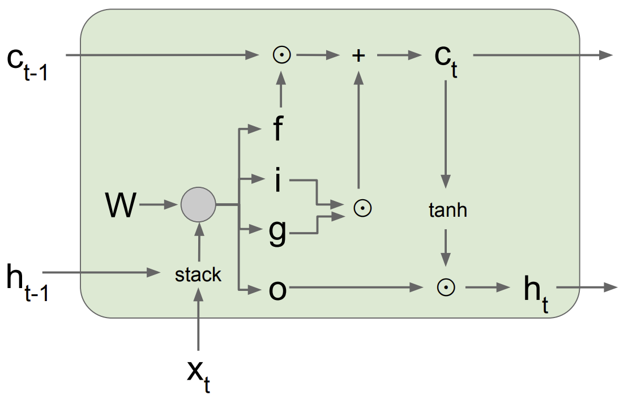
LSTM forward pass summary
$$\left(\begin{matrix}g_{t} \\ i_{t} \\ \begin{aligned}f_{t} \\ o_{t}\end{aligned}\end{matrix}\right)=\left(\begin{matrix}tanh \\ σ \\ \begin{aligned}σ \\ σ\end{aligned}\end{matrix}\right)\left(\begin{matrix}W_{g} \\ W_{i} \\ \begin{aligned}W_{f} \\ W_{o}\end{aligned}\end{matrix}\right)\left(\begin{aligned}x_{t} \\ h_{t−1}\end{aligned}\right)$$
$c_{t}={f_{t}⨀c}_{t−1}+i_{t}⨀ g_{t}$
$h_{t}=o_{t}⨀ tanh⁡c_{t}$
Figure source

Slide 39
LSTM backward pass
Gradient flow from $c_{t}$ to $c_{t−1}$ only involves back-propagating through addition and elementwise multiplication, not matrix multiplication or tanh
For complete details: Illustrated LSTM Forward and Backward Pass
Figure source

Slide 40
LSTM variant: Gated recurrent unit (GRU)
$xt$ $h_{t−1}$
Update Gate
$$zt$$
$$Wz$$
Get rid of separate cell state
Merge “forget” and “output” gates into “update” gate
$$x_{t}$$
$$W$$
$$h_{t}^{′}$$
.
$$ht$$
$$h_{t−1}$$
r_{t}
Reset Gate
$$Wf$$
$xt$ $h_{t−1}$
K. Cho et al., Learning phrase representations using RNN encoder-decoder for statistical machine translation, ACL 2014

Slide 41
Gated recurrent unit (GRU)
$$x_{t}$$
$$W$$
$$h_{t}=\tanh{W}\left(\begin{aligned}x_{t} \\ h_{t−1}\end{aligned}\right)$$
$$h_{t}^{}$$
$$h_{t−1}$$

Slide 42
Gated recurrent unit (GRU)
$$r_{t}=σ\left(W_{r}\left(\begin{aligned}x_{t} \\ h_{t−1}\end{aligned}\right)+b_{t}\right)$$
$$x_{t}$$
$$W$$
$$h_{t}^{′}=\tanh{W}\left(\begin{aligned}x_{t} \\ r_{t} ⨀{ h}_{t−1}\end{aligned}\right)$$
$$h_{t}^{′}$$
.
$$h_{t−1}$$
r_{t}
Reset Gate
$$Wr$$
$xt$ $h_{t−1}$

Slide 43
Gated recurrent unit (GRU)
$xt$ $h_{t−1}$
Update Gate
$$zt$$
$$Wz$$
$$r_{t}=σ\left(W_{r}\left(\begin{aligned}x_{t} \\ h_{t−1}\end{aligned}\right)+b_{t}\right)$$
$$x_{t}$$
$$W$$
$$h_{t}^{′}=\tanh{W}\left(\begin{aligned}x_{t} \\ r_{t} ⨀{ h}_{t−1}\end{aligned}\right)$$
$$h_{t}^{′}$$
.
$$h_{t−1}$$
$$z_{t}=σ\left(W_{z}\left(\begin{aligned}x_{t} \\ h_{t−1}\end{aligned}\right)+b_{z}\right)$$
r_{t}
Reset Gate
$$Wr$$
$xt$ $h_{t−1}$

Slide 44
LSTM variant: Gated recurrent unit (GRU)
$xt$ $h_{t−1}$
Get rid of separate cell state
Merge “forget” and “output” gates into “update” gate
Update Gate
$$zt$$
$$Wz$$
$$r_{t}=σ\left(W_{r}\left(\begin{aligned}x_{t} \\ h_{t−1}\end{aligned}\right)+b_{t}\right)$$
$$x_{t}$$
$$W$$
$$h_{t}^{′}$$
.
$$ht$$
$$h_{t}^{′}=\tanh{W}\left(\begin{aligned}x_{t} \\ r_{t} ⨀{ h}_{t−1}\end{aligned}\right)$$
$$h_{t−1}$$
$$z_{t}=σ\left(W_{z}\left(\begin{aligned}x_{t} \\ h_{t−1}\end{aligned}\right)+b_{z}\right)$$
r_{t}
Reset Gate
$$Wr$$
$h_{t}=\left(1−z_{t}\right) ⨀{ h}_{t−1}+z_{t}⨀$ $h_{t}^{′}$
$xt$ $h_{t−1}$
K. Cho et al., Learning phrase representations using RNN encoder-decoder for statistical machine translation, ACL 2014

Slide 45
Outline
Examples of sequential prediction tasks
Common recurrent units
Vanilla RNN unit (and how to train it)
Long Short-Term Memory (LSTM)
Gated Recurrent Unit (GRU)
Recurrent network architectures

Slide 46
Recall: Input-output scenarios
Multiple - Single
Sequence Classification
Single - Multiple
Sequence generation, captioning
Multiple - Multiple
Sequence generation, captioning
Multiple - Multiple
Translation

Slide 47
RNN architectures
Most general configuration:
y₁
y₂
y₃
y₄
y₅
y₆
x₁
x₂
x₃
x₄
x₅
x₆

Slide 48
Multi-layer RNNs
We can of course design RNNs with multiple hidden layers
y₁
y₂
y₃
y₄
y₅
y₆
x₁
x₂
x₃
x₄
x₅
x₆
Anything goes: skip connections across layers, across time, …

Slide 49
Multi-layer RNNs
We can of course design RNNs with multiple hidden layers
y₁
y₂
y₃
y₄
y₅
y₆
x₁
x₂
x₃
x₄
x₅
x₆
Anything goes: skip connections across layers, across time, …

Slide 50
Multi-layer RNNs
We can of course design RNNs with multiple hidden layers
y₁
y₂
y₃
y₄
y₅
y₆
x₁
x₂
x₃
x₄
x₅
x₆
Anything goes: skip connections across layers, across time, …

Slide 51
Bi-directional RNNs
RNNs can process the input sequence in forward and in the reverse direction (common in speech recognition)
y₁
y₂
y₃
y₄
y₅
y₆
x₁
x₂
x₃
x₄
x₅
x₆

Slide 52
Google Neural Machine Translation (GNMT)
Y. Wu et al., Google's Neural Machine Translation System: Bridging the Gap between Human and Machine Translation, arXiv 2016
Notes:
The model architecture of GNMT, Google’s Neural Machine Translation system. On the left is the encoder network, on the right is the decoder network, in the middle is the attention module. The bottom encoder layer is bi-directional: the pink nodes gather information from left to right while the green nodes gather information from right to left. The other layers of the encoder are uni-directional. Residual connections start from the layer third from the bottom in the encoder and decoder. The model is partitioned into multiple GPUs to speed up training. In our setup, we have 8 encoder LSTM layers (1 bi-directional layer and 7 uni-directional layers), and 8 decoder layers. With this setting, one model replica is partitioned 8-ways and is placed on 8 different GPUs typically belonging to one host machine. During training, the bottom bi-directional encoder layers compute in parallel first. Once both finish, the uni-directional encoder layers can start computing, each on a separate GPU. To retain as much parallelism as possible during running the decoder layers, we use the bottom decoder layer output only for obtaining recurrent attention context, which is sent directly to all the remaining decoder layers. The softmax layer is also partitioned and placed on multiple GPUs. Depending on the output vocabulary size we either have them run on the same GPUs as the encoder and decoder networks, or have them run on a separate set of dedicated GPUs.

Slide 53
Outline
Examples of sequential prediction tasks
Common recurrent units
Vanilla RNN unit
Long Short-Term Memory (LSTM)
Gated Recurrent Unit (GRU)
Recurrent network architectures
Applications in (a bit) more detail
Language modeling
Image captioning
Machine translation

Slide 54
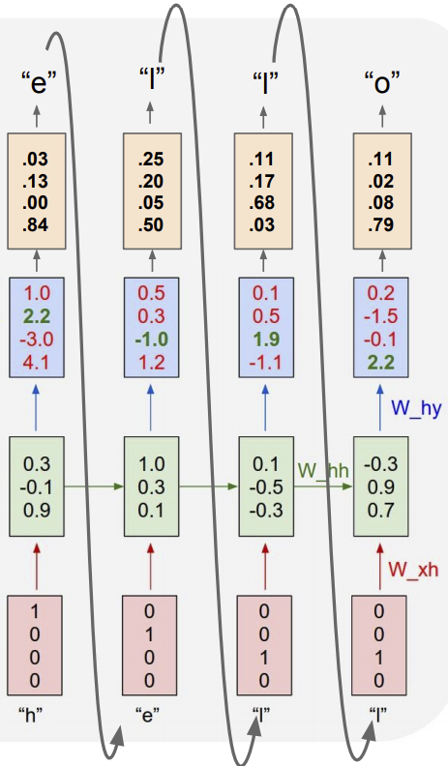
Language modeling: Character RNN
Output symbol $yi$
Output layer (linear + softmax)
$$p\left(y_{1},y_{2},…,y_{n}\right)=\prod_{i=1}^{n}{p(y_{i}|y_{1},…,y_{i−1})}≈\prod_{i=1}^{n}{P_{W}(y_{i}|h_{i})}$$
Hidden state $hi$
One-hot encoding $xi$
Input symbol
http://karpathy.github.io/2015/05/21/rnn-effectiveness/

Slide 55
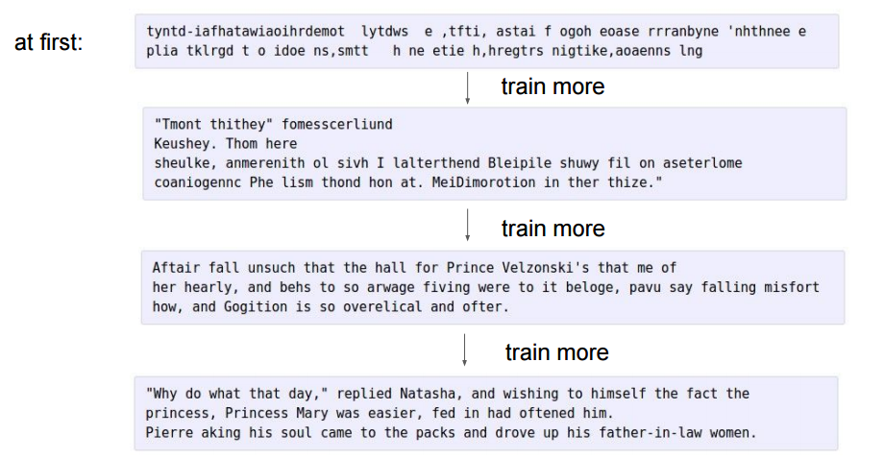
Language modeling: Character RNN
100th
iteration
300th
iteration
700th
iteration
2000th
iteration
http://karpathy.github.io/2015/05/21/rnn-effectiveness/

Slide 56
Searching for interpretable hidden units
quote detection cell
A. Karpathy, J. Johnson, and L. Fei-Fei, Visualizing and Understanding Recurrent Networks, ICLR Workshop 2016

Slide 57
Searching for interpretable hidden units
line position tracking cell
A. Karpathy, J. Johnson, and L. Fei-Fei, Visualizing and Understanding Recurrent Networks, ICLR Workshop 2016

Slide 58
Searching for interpretable hidden units
if statement cell
A. Karpathy, J. Johnson, and L. Fei-Fei, Visualizing and Understanding Recurrent Networks, ICLR Workshop 2016

Slide 59
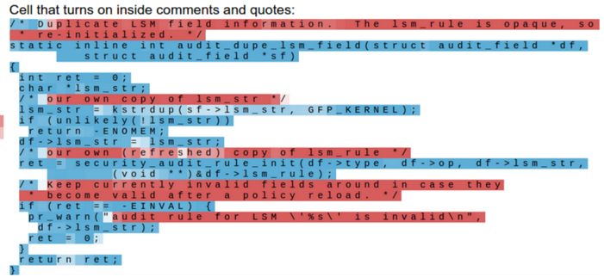
Searching for interpretable hidden units
quote/comment cell
A. Karpathy, J. Johnson, and L. Fei-Fei, Visualizing and Understanding Recurrent Networks, ICLR Workshop 2016

Slide 60
Searching for interpretable hidden units
code depth cell
A. Karpathy, J. Johnson, and L. Fei-Fei, Visualizing and Understanding Recurrent Networks, ICLR Workshop 2016

Slide 61
Searching for interpretable hidden units
¯\_(ツ)_/¯
A. Karpathy, J. Johnson, and L. Fei-Fei, Visualizing and Understanding Recurrent Networks, ICLR Workshop 2016

Slide 62
Sequence classification
“The food is usually not so good”
Word embedding
W_{e} x₁
Embed
One-hot encoding
x₁
“The”

Slide 63
Sequence classification
RNN
RNN
RNN
h₁
h₂
h_{n-1}
W_{e} x₁
W_{e} x₂
W_{e} x_{n}
Embed
Embed
Embed
x₁
x₂
x_{n}
“The”
“food”
“good”

Slide 64
Sequence classification
Ignore
Ignore
Linear Classifier
h₁
h₂
h_{n}
RNN
RNN
RNN
h₁
h₂
h_{n-1}
W_{e} x₁
W_{e} x₂
W_{e} x_{n}
Embed
Embed
Embed
x₁
x₂
x_{n}
“The”
“food”
“good”

Slide 65
Sequence classification
Linear Classifier
h = Sum(…)
h₁
h_{n}
h₂
RNN
RNN
RNN
h₁
h₂
h_{n-1}
W_{e} x₁
W_{e} x₂
W_{e} x_{n}
Embed
Embed
Embed
x₁
x₂
x_{n}
“The”
“food”
“good”
http://deeplearning.net/tutorial/lstm.html

Slide 66
Sequence classification
Linear Classifier
h = Sum(…)
h₁
h_{n}
h₂
Bi-RNN
Bi-RNN
Bi-RNN
h₁
h₂
h_{n-1}
W_{e} x₁
W_{e} x₂
W_{e} x_{n}
Embed
Embed
Embed
x₁
x₂
x_{n}
“The”
“food”
“good”

Slide 67
Recurrent models: Outline
Examples of sequential prediction tasks
Common recurrent units
Vanilla RNN unit
Long Short-Term Memory (LSTM)
Gated Recurrent Unit (GRU)
Recurrent network architectures
Applications in (a bit) more detail
Language modeling
Image captioning

Slide 68
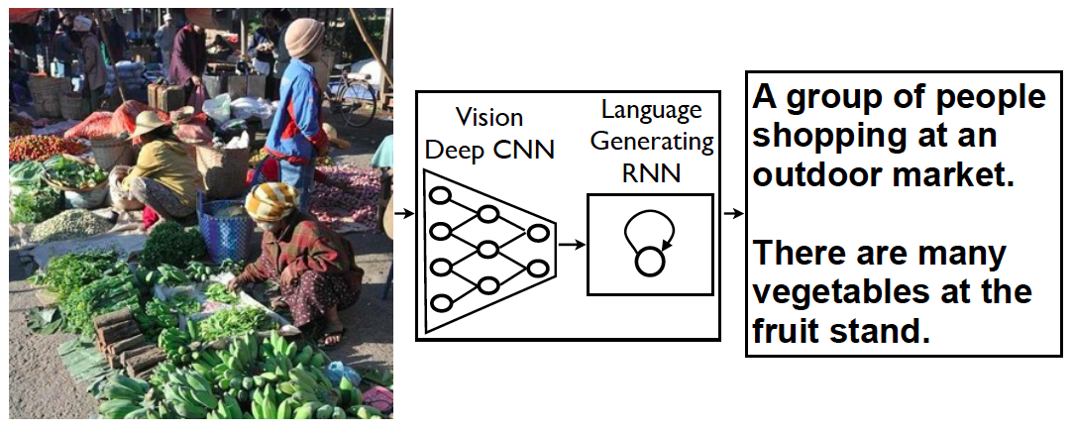
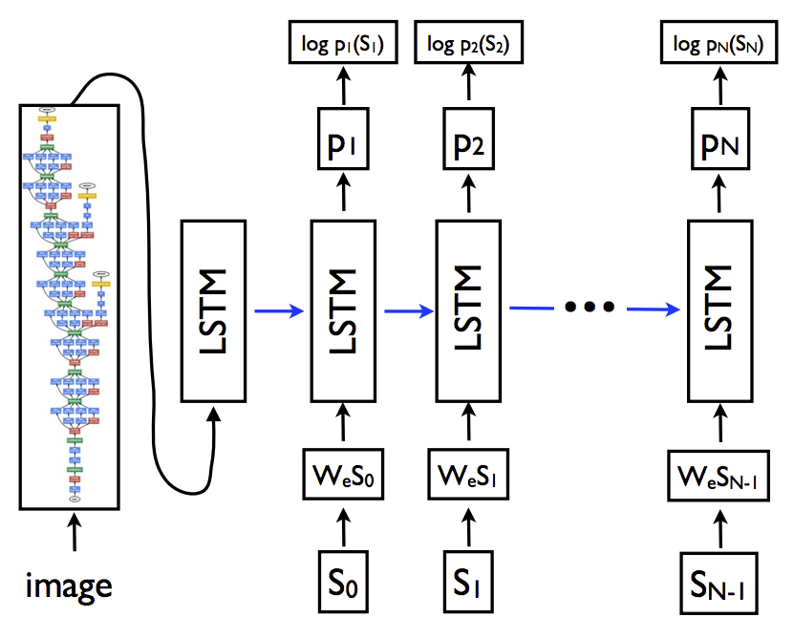
Image caption generation
Log-likelihood of next reference word
Softmax probability over next word
Training time
Maximize likelihood of reference captions
Word embedding
Words of reference caption (one-hot encoding)
O. Vinyals, A. Toshev, S. Bengio, D. Erhan, Show and Tell: A Neural Image Caption Generator, CVPR 2015

Slide 69
Image caption generation: Training time
Minimize negative log-likelihood of the ground truth caption $Y^{∗}=(Y_{1}^{∗},…,Y_{N}^{∗})$ given image $I$:
$$L\left(I,Y^{∗}\right)=−\sum_{t=1}^{N}{log{ P}_{W}(Y_{i}^{∗}|Y_{1}^{∗},…,Y_{i−1}^{∗},I)}$$
“The”
“dog”
“is”
“hiding”
“STOP”
Classifier
Classifier
Classifier
Classifier
Classifier
h₁
h₂
h₃
h₄
h₅
h₀
h₁
h₂
h₃
h₄
CNN
“START”
“The”
“dog”
“is”
“hiding”

Slide 70
Image caption generation: Test time
How do we produce a caption given a test image?
How about always choosing the highest-likelihood word?
“The”
“dog”
“is”
“hiding”
“STOP”
Classifier
Classifier
Classifier
Classifier
Classifier
h₁
h₂
h₃
h₄
h₅
h₀
h₁
h₂
h₃
h₄
CNN
“START”
“The”
“dog”
“is”
“hiding”

Slide 71
Image caption generation: Beam search
Maintain $k$ (beam width) top-scoring candidate sentences according to sum of per-word log-likelihoods (or some other score)
At each step, generate all their successors and keep the best $k$
Classifier
Classifier
Classifier
Classifier
Classifier
h₁
h₂
h₃
h₄
h₅
h₀
h₁
h₂
h₃
h₄
CNN
“START”

Slide 72
Image caption generation: Beam search
The
dog
is
hiding
STOP
A
yellow
dog
is
sitting
One
cat
sitting
on
the
Classifier
Classifier
Classifier
Classifier
Classifier
h₁
h₂
h₃
h₄
h₅
h₀
h₁
h₂
h₃
h₄
CNN
“START”

Slide 73
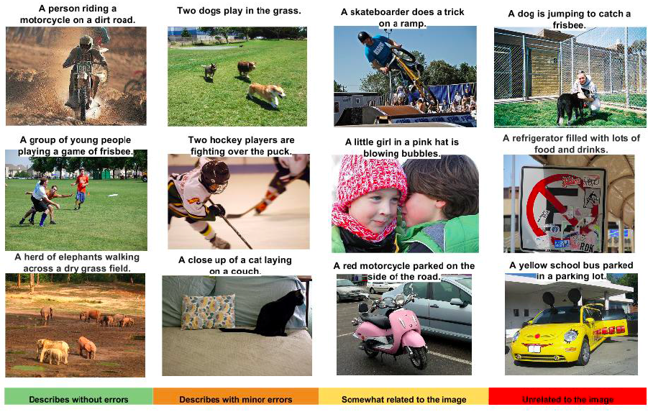
Image caption generation: Example outputs

Slide 74
How to evaluate image captioning?
Reference sentences (written by human annotators):
“A dog hides underneath a bed with its face peeking out of the bed skirt”
“The small white dog is peeking out from under the bed”
“A dog is peeking its head out from underneath a bed skirt”
“A dog peeking out from under a bed”
“A dog that is under a bed on the floor”
Generated sentence:
“A dog is hiding”

Slide 75
BLEU: Bilingual Evaluation Understudy
N-gram precision: count the number of n-gram matches between candidate and reference translation, divide by total number of n-grams in candidate translation
Clip counts by the maximum number of times an n-gram occurs in any reference translation
Multiply by brevity penalty to penalize short translations
Most commonly used measure for image captioning and machine translation despite multiple shortcomings
K. Papineni, S. Roukos, T. Ward, W.-J. Zhu, BLEU: a Method for Automatic Evaluation of Machine Translation, ACL 2002
Notes:
Purpose of clipping: “MT systems can overgenerate “reasonable” words, resulting in improbable, but high-precision, translations. Intuitively the problem is clear: a reference word should be considered exhausted after a matching candidate word is identified.”

Slide 76
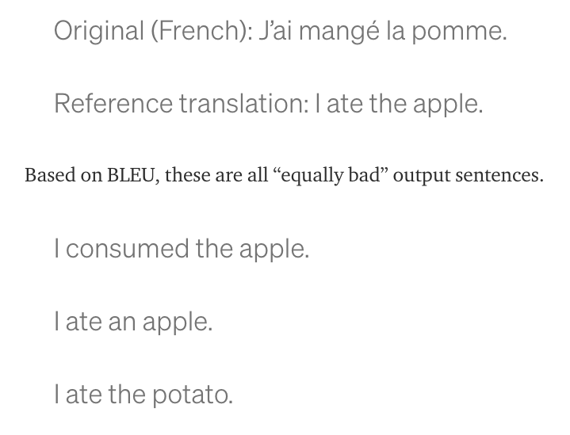
BLEU: Bilingual Evaluation Understudy
https://towardsdatascience.com/evaluating-text-output-in-nlp-bleu-at-your-own-risk-e8609665a213
Notes:
Purpose of clipping: “MT systems can overgenerate “reasonable” words, resulting in improbable, but high-precision, translations. Intuitively the problem is clear: a reference word should be considered exhausted after a matching candidate word is identified.”

Slide 77
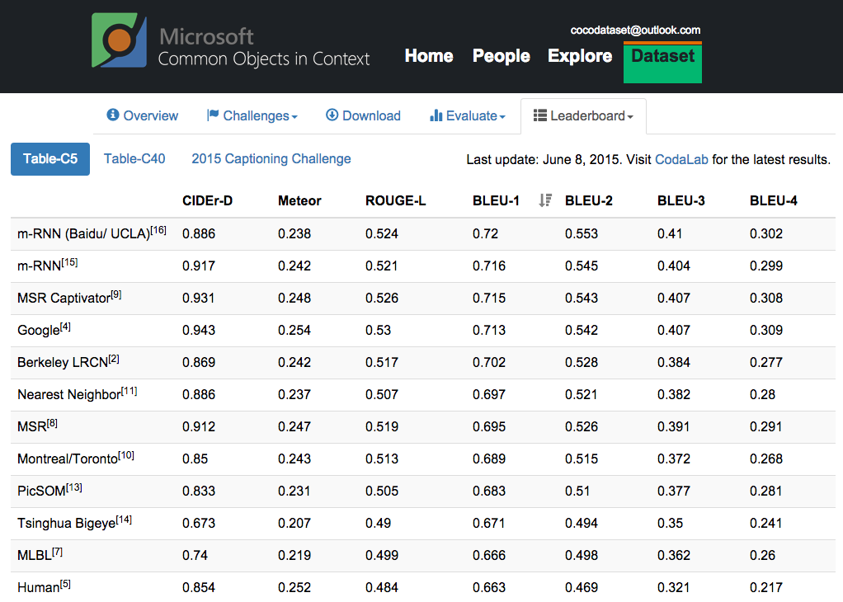
http://mscoco.org/dataset/#captions-leaderboard

Slide 78
