Slide 1
Last time: Encoder-decoder transformer
Encoder: receives entire input sequence and outputs encoded sequence of the same length
Decoder: predicts next token conditioned on encoder output and previously predicted tokens
A. Vaswani, N. Shazeer, N. Parmar, J. Uszkoreit, L. Jones, A. Gomez, L. Kaiser, I. Polosukhin, Attention is all you need, NeurIPS 2017

Slide 2
Encoder-decoder transformer for object detection
N. Carion et al. End-to-end object detection with transformers. ECCV 2020
Notes:
DETR uses a conventional CNN backbone to learn a 2D representation of an input image. The model flattens it and supplements it with a positional encoding before passing it into a transformer encoder. A transformer decoder then takes as input a small fixed number of learned positional embeddings, which we call object queries, and additionally attends to the encoder output. We pass each output embedding of the decoder to a shared feed forward network (FFN) that predicts either a detection (class and bounding box) or a “no object” class.

Slide 3
Encoder-only transformer: BERT
At each position, the entire sequence serves as context – full attention is used
Image source
J. Devlin, M.-W. Chang, K. Lee, K. Toutanova, BERT: Pre-training of Deep Bidirectional Transformers for Language Understanding, EMNLP 2018

Slide 4
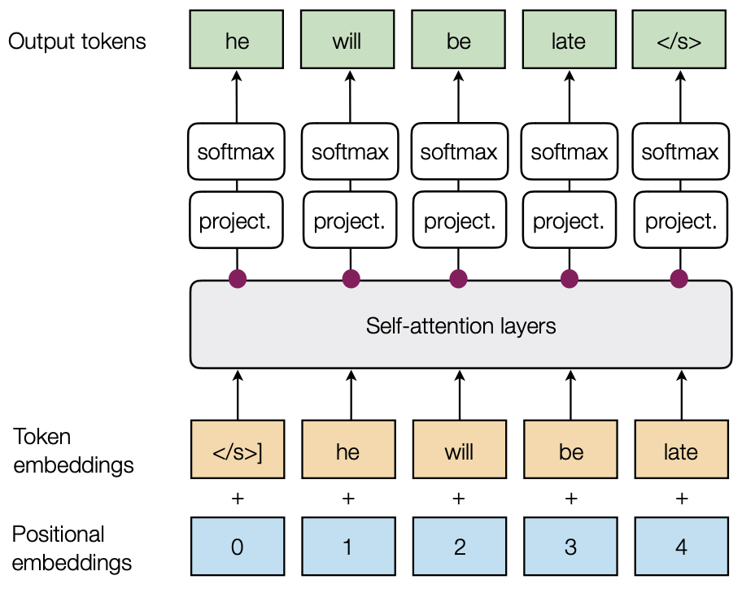
Decoder-only transformer: GPT
Task is next token prediction – only masked attention is used
A. Radford et al. Improving language understanding by generative pre-training. 2018
Image source

Slide 5
Decoder-only transformer: DALL-E
Decode to 256x256 image
Given: Text prompt encoding (256 tokens)
Predict: Image encoding (1024 = 32x32 tokens)
A. Ramesh et al., Zero-Shot Text-to-Image Generation, ICML 2021

Slide 6
Decoder-only transformer: Robot control
I. Radosavovic et al. Humanoid Locomotion as Next Token Prediction. arXiv 2024

Slide 7
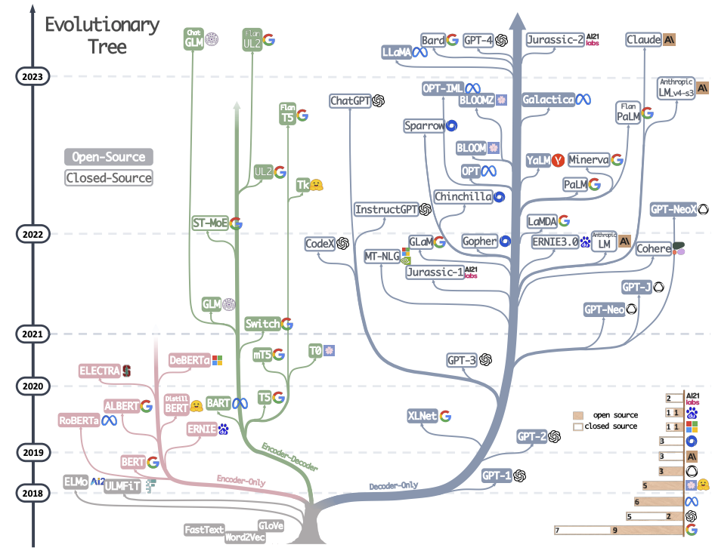
Large language models
Source

Slide 8
Self-supervised language modeling with transformers
Download A LOT of text from the internet
Train a giant transformer using a suitable pretext task
Fine-tune the transformer on desired NLP task (optional)

Slide 9
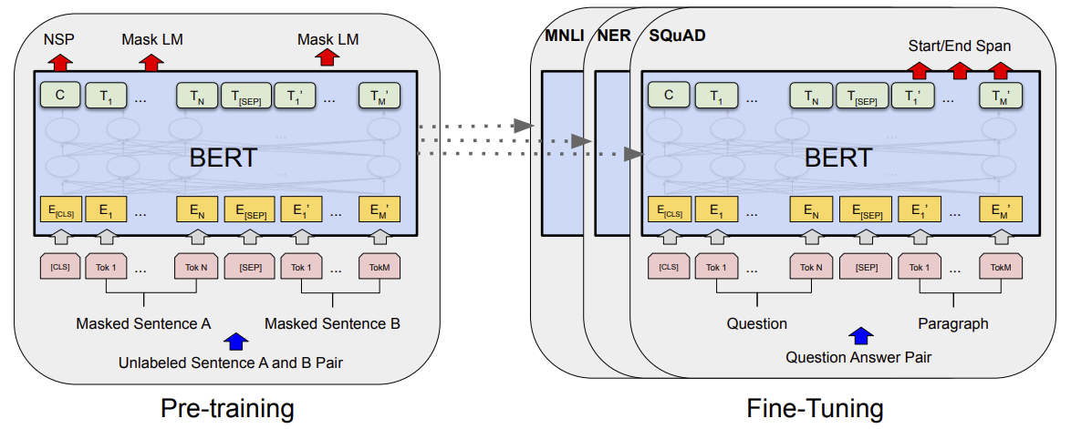
Bidirectional encoder representations from transformers (BERT)
J. Devlin, M.-W. Chang, K. Lee, K. Toutanova, BERT: Pre-training of Deep Bidirectional Transformers for Language Understanding, EMNLP 2018

Slide 10
BERT: Pretext tasks
Masked language model (MLM)
Randomly mask 15% of tokens in input sentences, goal is to reconstruct them using bidirectional context
Image source

Slide 11
BERT: Pretext tasks
Next sentence prediction (NSP)
Useful for Question Answering and Natural Language Inference tasks
In the training data, 50% of the time B is the actual sentence that follows A (labeled as IsNext), and 50% of the time it is a random sentence (labeled as NotNext).
Predict likelihood that sentence B belongs after sentence A
Image source

Slide 12
BERT: More detailed view
WordPiece (from GNMT)
Trained on Wikipedia (2.5B words) + BookCorpus (800M words)
Image source

Slide 13
BERT: Evaluation
General Language Understanding Evaluation (GLUE) benchmark (gluebenchmark.com)

Slide 14
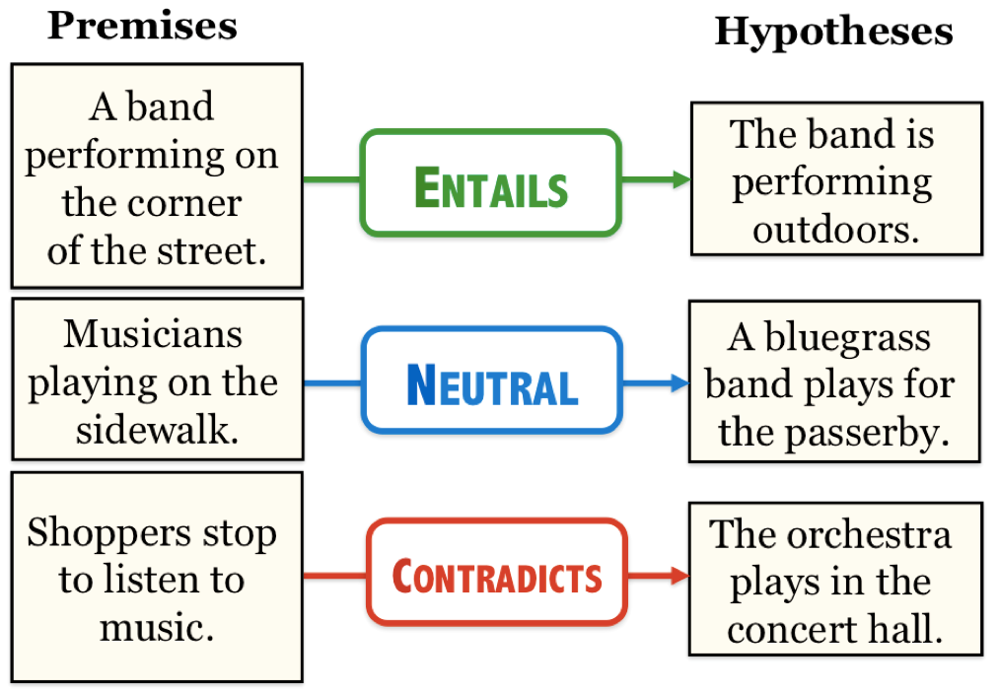
BERT: Downstream tasks
Textual entailment
Source: J. Hockenmaier
Entailment, textual equivalence and similarity

Slide 15
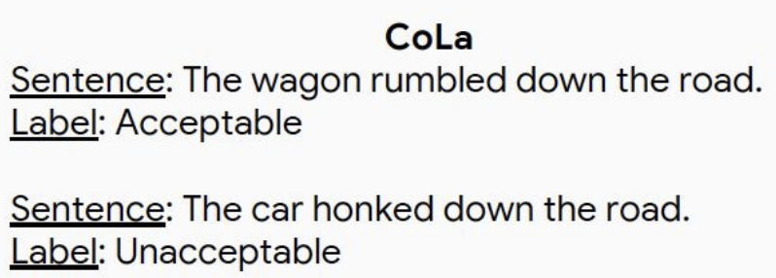
BERT: Downstream tasks
Sentiment classification, linguistic acceptability
Image source

Slide 16
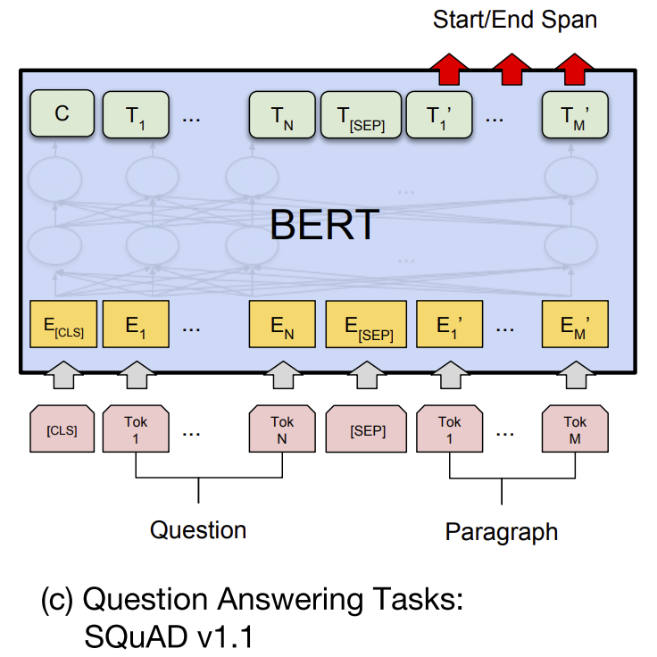
BERT: Downstream tasks
Find span in paragraph that contains the answer
Source: SQuAD v1.1 paper

Slide 17
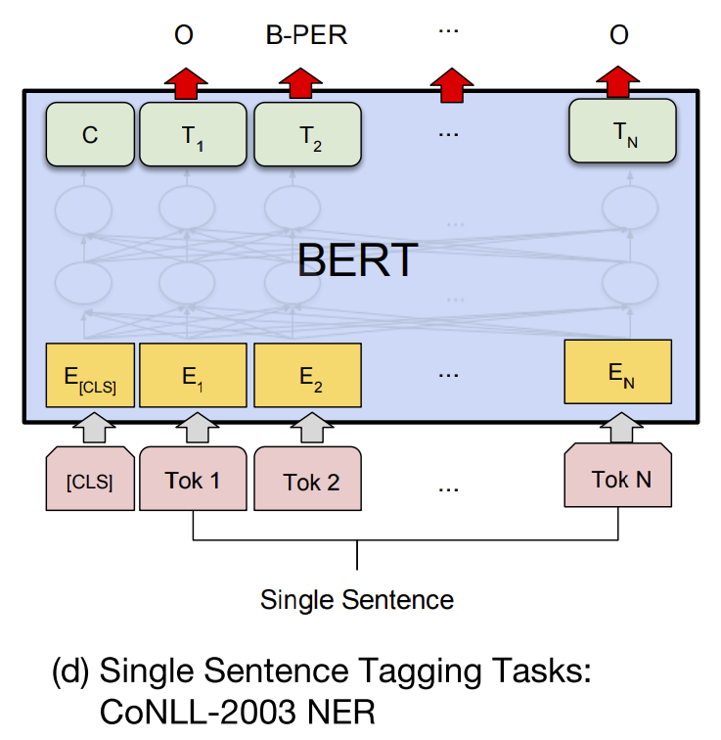
BERT: Downstream tasks
Image source
Named entity recognition

Slide 18
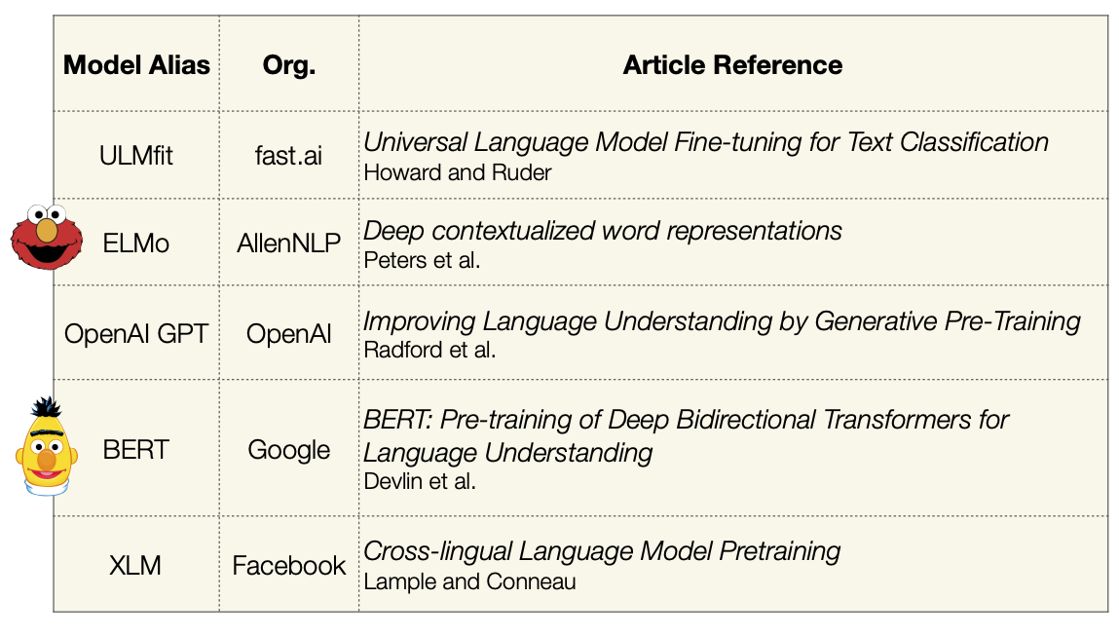
Other early language models
Image source

Slide 19
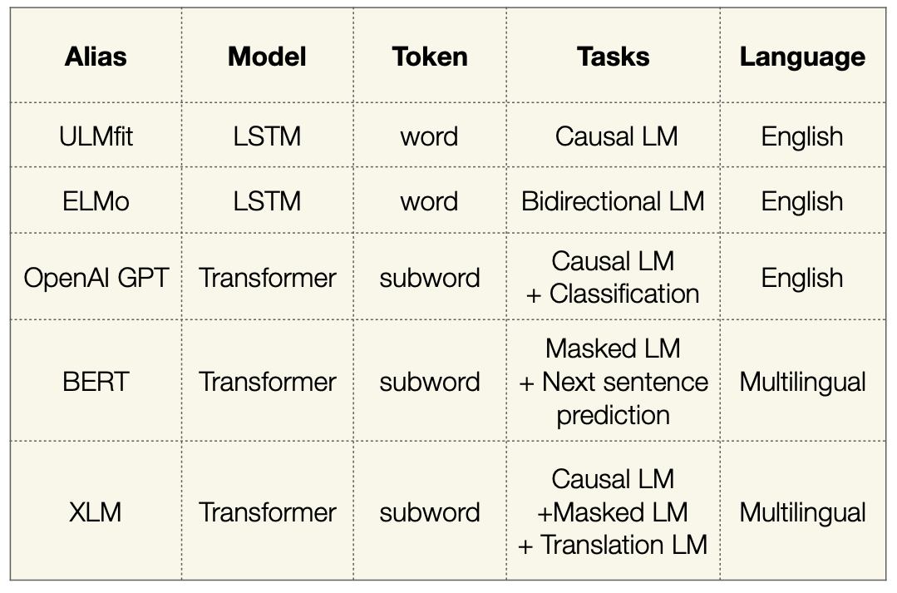
Other early language models
Image source

Slide 20
OpenAI GPT (Generative Pre-Training)
Pre-training task: next token prediction (causal language modeling)
A. Radford et al. Improving language understanding by generative pre-training. 2018
Image source

Slide 21
Scaling up transformers
Source: J. Johnson
Model | Layers | Hidden dim. | Heads | Params | Data | Training
Transformer-Base | 12 | 512 | 8 | 65M |  | 8x P100 (12 hours)
Transformer-Large | 12 | 1024 | 16 | 213M |  | 8x P100 (3.5 days)
Vaswani et al. Attention is all you need. NeurIPS 2017 (Google)

Slide 22
Scaling up transformers
Source: J. Johnson
Model | Layers | Hidden dim. | Heads | Params | Data | Training
Transformer-Base | 12 | 512 | 8 | 65M |  | 8x P100 (12 hours)
Transformer-Large | 12 | 1024 | 16 | 213M |  | 8x P100 (3.5 days)
BERT-Base | 12 | 768 | 12 | 110M | 13 GB | 4x TPU (4 days)
BERT-Large | 24 | 1024 | 16 | 340M | 13 GB | 16x TPU (4 days)
Devlin et al. BERT: Pre-training of Deep Bidirectional Transformers for Language Understanding. EMNLP 2018 (Google)

Slide 23
Scaling up transformers
Source: J. Johnson
Model | Layers | Hidden dim. | Heads | Params | Data | Training
Transformer-Base | 12 | 512 | 8 | 65M |  | 8x P100 (12 hours)
Transformer-Large | 12 | 1024 | 16 | 213M |  | 8x P100 (3.5 days)
BERT-Base | 12 | 768 | 12 | 110M | 13 GB | 4x TPU (4 days)
BERT-Large | 24 | 1024 | 16 | 340M | 13 GB | 16x TPU (4 days)
XLNet-Large | 24 | 1024 | 16 | ~340M | 126 GB | 512x TPU-v3 (2.5 days)
RoBERTa | 24 | 1024 | 16 | 355M | 160 GB | 1024x V100 GPU (1 day)
Yang et al. XLNet: Generalized Autoregressive Pretraining for Language Understanding. 2019 (Google, CMU)
Liu et al. RoBERTa: A Robustly Optimized BERT Pretraining Approach. 2019 (FAIR, UW)

Slide 24
Scaling up transformers
Source: J. Johnson
Model | Layers | Hidden dim. | Heads | Params | Data | Training
Transformer-Base | 12 | 512 | 8 | 65M |  | 8x P100 (12 hours)
Transformer-Large | 12 | 1024 | 16 | 213M |  | 8x P100 (3.5 days)
BERT-Base | 12 | 768 | 12 | 110M | 13 GB | 4x TPU (4 days)
BERT-Large | 24 | 1024 | 16 | 340M | 13 GB | 16x TPU (4 days)
XLNet-Large | 24 | 1024 | 16 | ~340M | 126 GB | 512x TPU-v3 (2.5 days)
RoBERTa | 24 | 1024 | 16 | 355M | 160 GB | 1024x V100 GPU (1 day)
GPT-2 | 48 | 1600 | ? | 1.5B | 40 GB
Radford et al. Language models are unsupervised multitask learners. 2019 (OpenAI)

Slide 25
Scaling up transformers
Source: J. Johnson
Model | Layers | Hidden dim. | Heads | Params | Data | Training
Transformer-Base | 12 | 512 | 8 | 65M |  | 8x P100 (12 hours)
Transformer-Large | 12 | 1024 | 16 | 213M |  | 8x P100 (3.5 days)
BERT-Base | 12 | 768 | 12 | 110M | 13 GB | 4x TPU (4 days)
BERT-Large | 24 | 1024 | 16 | 340M | 13 GB | 16x TPU (4 days)
XLNet-Large | 24 | 1024 | 16 | ~340M | 126 GB | 512x TPU-v3 (2.5 days)
RoBERTa | 24 | 1024 | 16 | 355M | 160 GB | 1024x V100 GPU (1 day)
GPT-2 | 48 | 1600 | ? | 1.5B | 40 GB
Megatron-LM | 72 | 3072 | 32 | 8.3B | 174 GB | 512x V100 GPU (9 days)
~$430,000 on Amazon AWS
Shoeybi et al. Megatron-LM: Training Multi-Billion Parameter Languge Models using Model Parallelism. 2019 (NVIDIA)

Slide 26
Scaling up transformers
Source: J. Johnson
Model | Layers | Hidden dim. | Heads | Params | Data | Training
Transformer-Base | 12 | 512 | 8 | 65M |  | 8x P100 (12 hours)
Transformer-Large | 12 | 1024 | 16 | 213M |  | 8x P100 (3.5 days)
BERT-Base | 12 | 768 | 12 | 110M | 13 GB | 4x TPU (4 days)
BERT-Large | 24 | 1024 | 16 | 340M | 13 GB | 16x TPU (4 days)
XLNet-Large | 24 | 1024 | 16 | ~340M | 126 GB | 512x TPU-v3 (2.5 days)
RoBERTa | 24 | 1024 | 16 | 355M | 160 GB | 1024x V100 GPU (1 day)
GPT-2 | 48 | 1600 | ? | 1.5B | 40 GB
Megatron-LM | 72 | 3072 | 32 | 8.3B | 174 GB | 512x V100 GPU (9 days)
Turing-NLG | 78 | 4256 | 28 | 17B | ? | 256x V100 GPU
Microsoft. Turing-NLG: A 17-billion parameter language model by Microsoft. 2020

Slide 27
Scaling up transformers
Source: J. Johnson
Model | Layers | Hidden dim. | Heads | Params | Data | Training
Transformer-Base | 12 | 512 | 8 | 65M |  | 8x P100 (12 hours)
Transformer-Large | 12 | 1024 | 16 | 213M |  | 8x P100 (3.5 days)
BERT-Base | 12 | 768 | 12 | 110M | 13 GB | 4x TPU (4 days)
BERT-Large | 24 | 1024 | 16 | 340M | 13 GB | 16x TPU (4 days)
XLNet-Large | 24 | 1024 | 16 | ~340M | 126 GB | 512x TPU-v3 (2.5 days)
RoBERTa | 24 | 1024 | 16 | 355M | 160 GB | 1024x V100 GPU (1 day)
GPT-2 | 48 | 1600 | ? | 1.5B | 40 GB
Megatron-LM | 72 | 3072 | 32 | 8.3B | 174 GB | 512x V100 GPU (9 days)
Turing-NLG | 78 | 4256 | 28 | 17B | ? | 256x V100 GPU
GPT-3 | 96 | 12288 | 96 | 175B | 694 GB | ?
~$4.6M, 355 GPU-years
(source)
Brown et al. Language Models are Few-Shot Learners. NeurIPS 2020 (OpenAI)

Slide 28
Scaling up transformers
Source: J. Johnson
Model | Layers | Hidden dim. | Heads | Params | Data | Training
Transformer-Base | 12 | 512 | 8 | 65M |  | 8x P100 (12 hours)
Transformer-Large | 12 | 1024 | 16 | 213M |  | 8x P100 (3.5 days)
BERT-Base | 12 | 768 | 12 | 110M | 13 GB | 4x TPU (4 days)
BERT-Large | 24 | 1024 | 16 | 340M | 13 GB | 16x TPU (4 days)
XLNet-Large | 24 | 1024 | 16 | ~340M | 126 GB | 512x TPU-v3 (2.5 days)
RoBERTa | 24 | 1024 | 16 | 355M | 160 GB | 1024x V100 GPU (1 day)
GPT-2 | 48 | 1600 | ? | 1.5B | 40 GB
Megatron-LM | 72 | 3072 | 32 | 8.3B | 174 GB | 512x V100 GPU (9 days)
Turing-NLG | 78 | 4256 | 28 | 17B | ? | 256x V100 GPU
GPT-3 | 96 | 12,288 | 96 | 175B | 694 GB | ?
GOPHER | 80 | 16,384 | 128 | 280B | 10.55 TB | 4096x TPUv3 (38 days)
$3,768,320 on Google Cloud (eval price)
J. Rae et al. Scaling Language Models: Methods, Analysis, & Insights from Training Gopher. arXiv 2021 (DeepMind)

Slide 29
Scaling up transformers
Source: J. Johnson
Model | Layers | Hidden dim. | Heads | Params | Data | Training
Transformer-Base | 12 | 512 | 8 | 65M |  | 8x P100 (12 hours)
Transformer-Large | 12 | 1024 | 16 | 213M |  | 8x P100 (3.5 days)
BERT-Base | 12 | 768 | 12 | 110M | 13 GB | 4x TPU (4 days)
BERT-Large | 24 | 1024 | 16 | 340M | 13 GB | 16x TPU (4 days)
XLNet-Large | 24 | 1024 | 16 | ~340M | 126 GB | 512x TPU-v3 (2.5 days)
RoBERTa | 24 | 1024 | 16 | 355M | 160 GB | 1024x V100 GPU (1 day)
GPT-2 | 48 | 1600 | ? | 1.5B | 40 GB
Megatron-LM | 72 | 3072 | 32 | 8.3B | 174 GB | 512x V100 GPU (9 days)
Turing-NLG | 78 | 4256 | 28 | 17B | ? | 256x V100 GPU
GPT-3 | 96 | 12,288 | 96 | 175B | 694 GB | ?
GOPHER | 80 | 16,384 | 128 | 280B | 10.55 TB | 4096x TPUv3 (38 days)
PaLM | 118 | 18,432 | 48 | 540B | ? | 6144x TPUv4
A. Chowdhery et al. PaLM: Scaling Language Modeling with Pathways. arXiv 2022 (Google)

Slide 30
Source
(2013)

Slide 31
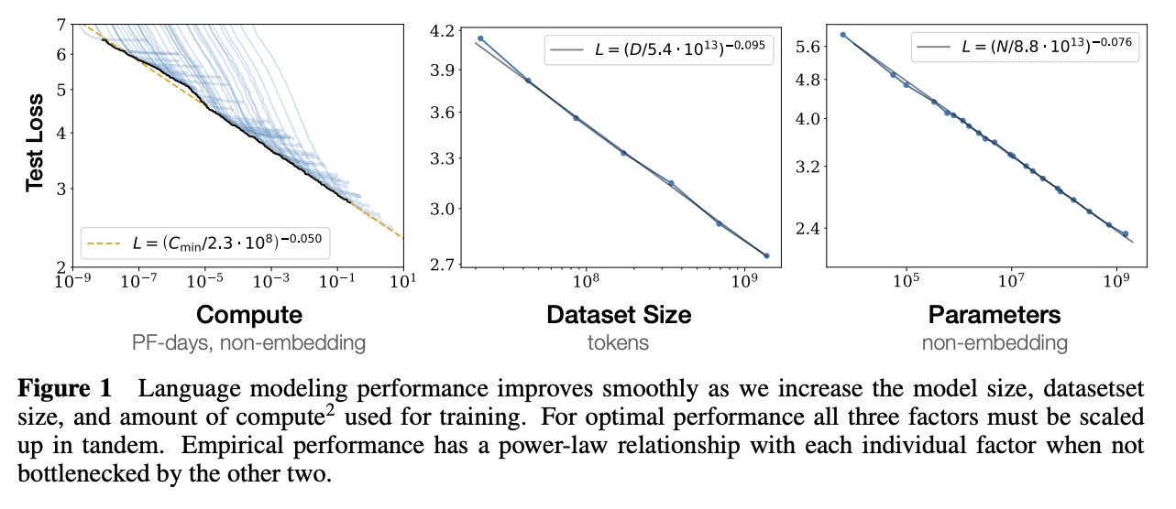
Scaling behavior of large language models
J. Kaplan et al. Scaling Laws for Neural Language Models. arXiv 2020

Slide 32
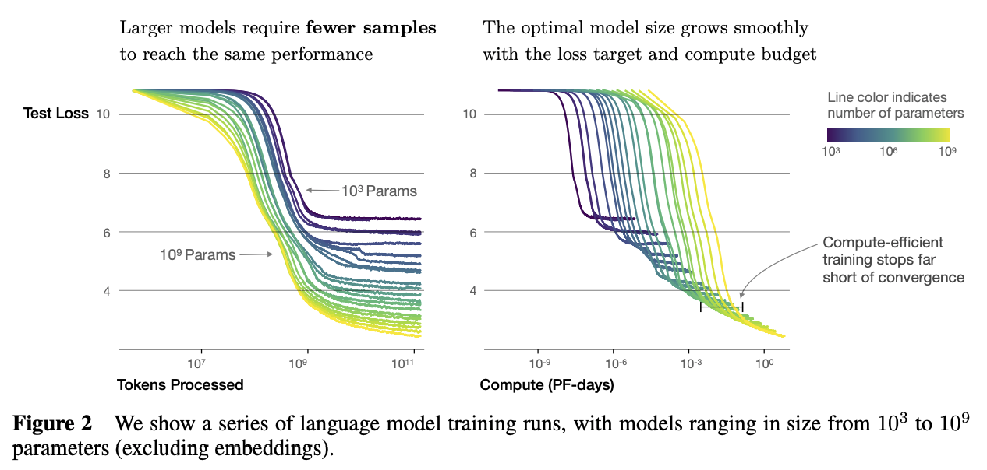
Scaling behavior of large language models
J. Kaplan et al. Scaling Laws for Neural Language Models. arXiv 2020

Slide 33
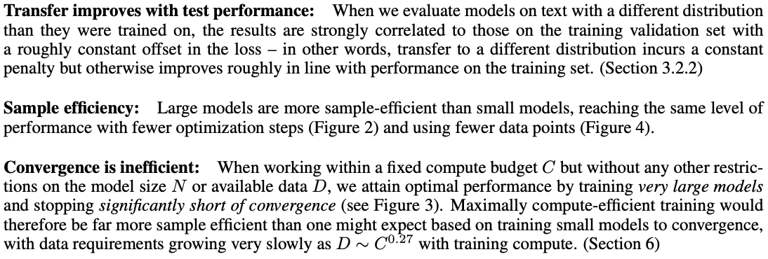
Scaling behavior of large language models
J. Kaplan et al. Scaling Laws for Neural Language Models. arXiv 2020

Slide 34
OpenAI GPT (Generative Pre-Training)
Pre-training task: next token prediction (causal language modeling)
A. Radford et al. Improving language understanding by generative pre-training. 2018
Image source

Slide 35
GPT-2 and GPT-3
Key idea: if the model and training datasets are big enough, model can adapt to new tasks without fine-tuning
Model | Layers | Hidden dim. | Heads | Params | Dataset
GPT-2 | 48 | 1600 | ? | 1.5B | WebText: 40GB
GPT-3 | 96 | 12288 | 96 | 175B | CommonCrawl (cleaned up): 694GB
GPT-2: A. Radford et al., Language models are unsupervised multitask learners, 2019
GPT-3: T. Brown et al., Language models are few-shot learners, NeurIPS 2020 (Best Paper Award)
Notes:
From the GPT-2 abstract: Natural language processing tasks, such as question answering, machine translation, reading comprehension, and summarization, are typically approached with supervised learning on task-specific datasets. We demonstrate that language models begin to learn these tasks without any explicit supervision when trained on a new dataset of millions of webpages called WebText. When conditioned on a document plus questions, the answers generated by the language model reach 55 F1 on the CoQA dataset - matching or exceeding the performance of 3 out of 4 baseline systems without using the 127,000+ training examples. The capacity of the language model is essential to the success of zero-shot task transfer and increasing it improves performance in a log-linear fashion across tasks. Our largest model, GPT-2, is a 1.5B parameter Transformer that achieves state of the art results on 7 out of 8 tested language modeling datasets in a zero-shot setting but still underfits WebText.
From the GPT-3 abstract: we show that scaling up language models greatly improves task-agnostic, few-shot performance, sometimes even reaching competitiveness with prior state-of-the-art finetuning approaches. Specifically, we train GPT-3, an autoregressive language model with 175 billion parameters, 10x more than any previous non-sparse language model, and test its performance in the few-shot setting. For all tasks, GPT-3 is applied without any gradient updates or fine-tuning, with tasks and few-shot demonstrations specified purely via text interaction with the model. GPT-3 achieves strong performance on many NLP datasets, including translation, question-answering, and cloze tasks, as well as several tasks that require on-the-fly reasoning or domain adaptation, such as unscrambling words, using a novel word in a sentence, or performing 3-digit arithmetic. At the same time, we also identify some datasets where GPT-3’s few-shot learning still struggles, as well as some datasets where GPT-3 faces methodological issues related to training on large web corpora. Finally, we find that GPT-3 can generate samples of news articles which human evaluators have difficulty distinguishing from articles written by humans. We discuss broader societal impacts of this finding and of GPT-3 in general.

Slide 36
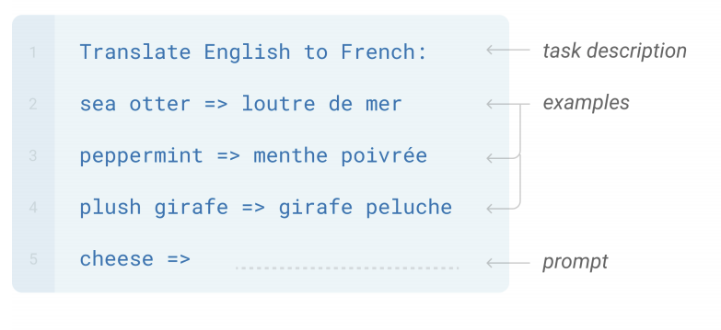
GPT-3
Key idea: if the model and training datasets are big enough, model can adapt to new tasks without fine-tuning
Few-shot learning: In addition to the task description, the model sees a few examples of the task
T. Brown et al., Language models are few-shot learners, NeurIPS 2020
Notes:
From the GPT-2 abstract: Natural language processing tasks, such as question answering, machine translation, reading comprehension, and summarization, are typically approached with supervised learning on taskspecific datasets. We demonstrate that language models begin to learn these tasks without any explicit supervision when trained on a new dataset of millions of webpages called WebText. When conditioned on a document plus questions, the answers generated by the language model reach 55 F1 on the CoQA dataset - matching or exceeding the performance of 3 out of 4 baseline systems without using the 127,000+ training examples. The capacity of the language model is essential to the success of zero-shot task transfer and increasing it improves performance in a log-linear fashion across tasks. Our largest model, GPT-2, is a 1.5B parameter Transformer that achieves state of the art results on 7 out of 8 tested language modeling datasets in a zero-shot setting but still underfits WebText.
From the GPT-3 abstract: we show that scaling up language models greatly improves task-agnostic, few-shot performance, sometimes even reaching competitiveness with prior state-of-the-art finetuning approaches. Specifically, we train GPT-3, an autoregressive language model with 175 billion parameters, 10x more than any previous non-sparse language model, and test its performance in the few-shot setting. For all tasks, GPT-3 is applied without any gradient updates or fine-tuning, with tasks and few-shot demonstrations specified purely via text interaction with the model. GPT-3 achieves strong performance on many NLP datasets, including translation, question-answering, and cloze tasks, as well as several tasks that require on-the-fly reasoning or domain adaptation, such as unscrambling words, using a novel word in a sentence, or performing 3-digit arithmetic. At the same time, we also identify some datasets where GPT-3’s few-shot learning still struggles, as well as some datasets where GPT-3 faces methodological issues related to training on large web corpora. Finally, we find that GPT-3 can generate samples of news articles which human evaluators have difficulty distinguishing from articles written by humans. We discuss broader societal impacts of this finding and of GPT-3 in general.

Slide 37
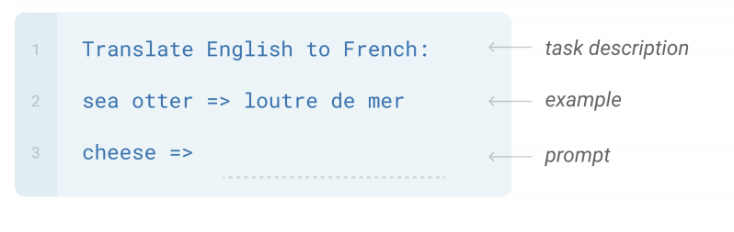
GPT-3
Key idea: if the model and training datasets are big enough, model can adapt to new tasks without fine-tuning
One-shot learning: In addition to the task description, the model sees a single example of the task
T. Brown et al., Language models are few-shot learners, NeurIPS 2020
Notes:
From the GPT-2 abstract: Natural language processing tasks, such as question answering, machine translation, reading comprehension, and summarization, are typically approached with supervised learning on taskspecific datasets. We demonstrate that language models begin to learn these tasks without any explicit supervision when trained on a new dataset of millions of webpages called WebText. When conditioned on a document plus questions, the answers generated by the language model reach 55 F1 on the CoQA dataset - matching or exceeding the performance of 3 out of 4 baseline systems without using the 127,000+ training examples. The capacity of the language model is essential to the success of zero-shot task transfer and increasing it improves performance in a log-linear fashion across tasks. Our largest model, GPT-2, is a 1.5B parameter Transformer that achieves state of the art results on 7 out of 8 tested language modeling datasets in a zero-shot setting but still underfits WebText.
From the GPT-3 abstract: we show that scaling up language models greatly improves task-agnostic, few-shot performance, sometimes even reaching competitiveness with prior state-of-the-art finetuning approaches. Specifically, we train GPT-3, an autoregressive language model with 175 billion parameters, 10x more than any previous non-sparse language model, and test its performance in the few-shot setting. For all tasks, GPT-3 is applied without any gradient updates or fine-tuning, with tasks and few-shot demonstrations specified purely via text interaction with the model. GPT-3 achieves strong performance on many NLP datasets, including translation, question-answering, and cloze tasks, as well as several tasks that require on-the-fly reasoning or domain adaptation, such as unscrambling words, using a novel word in a sentence, or performing 3-digit arithmetic. At the same time, we also identify some datasets where GPT-3’s few-shot learning still struggles, as well as some datasets where GPT-3 faces methodological issues related to training on large web corpora. Finally, we find that GPT-3 can generate samples of news articles which human evaluators have difficulty distinguishing from articles written by humans. We discuss broader societal impacts of this finding and of GPT-3 in general.

Slide 38
GPT-3
Key idea: if the model and training datasets are big enough, model can adapt to new tasks without fine-tuning
Zero-shot learning: The model sees the task description and no training examples
T. Brown et al., Language models are few-shot learners, NeurIPS 2020
Notes:
From the GPT-2 abstract: Natural language processing tasks, such as question answering, machine translation, reading comprehension, and summarization, are typically approached with supervised learning on taskspecific datasets. We demonstrate that language models begin to learn these tasks without any explicit supervision when trained on a new dataset of millions of webpages called WebText. When conditioned on a document plus questions, the answers generated by the language model reach 55 F1 on the CoQA dataset - matching or exceeding the performance of 3 out of 4 baseline systems without using the 127,000+ training examples. The capacity of the language model is essential to the success of zero-shot task transfer and increasing it improves performance in a log-linear fashion across tasks. Our largest model, GPT-2, is a 1.5B parameter Transformer that achieves state of the art results on 7 out of 8 tested language modeling datasets in a zero-shot setting but still underfits WebText.
From the GPT-3 abstract: we show that scaling up language models greatly improves task-agnostic, few-shot performance, sometimes even reaching competitiveness with prior state-of-the-art finetuning approaches. Specifically, we train GPT-3, an autoregressive language model with 175 billion parameters, 10x more than any previous non-sparse language model, and test its performance in the few-shot setting. For all tasks, GPT-3 is applied without any gradient updates or fine-tuning, with tasks and few-shot demonstrations specified purely via text interaction with the model. GPT-3 achieves strong performance on many NLP datasets, including translation, question-answering, and cloze tasks, as well as several tasks that require on-the-fly reasoning or domain adaptation, such as unscrambling words, using a novel word in a sentence, or performing 3-digit arithmetic. At the same time, we also identify some datasets where GPT-3’s few-shot learning still struggles, as well as some datasets where GPT-3 faces methodological issues related to training on large web corpora. Finally, we find that GPT-3 can generate samples of news articles which human evaluators have difficulty distinguishing from articles written by humans. We discuss broader societal impacts of this finding and of GPT-3 in general.

Slide 39
Task: Generate news article
Gray: human prompts, boldface: GPT-3 completions
(Three articles provided as training examples)

Slide 40
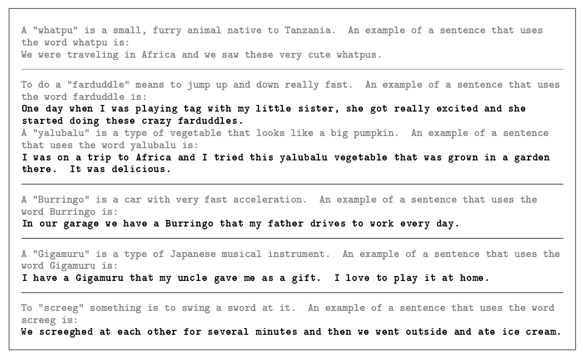
Task: Use new word in sentence
Gray: human prompts, boldface: GPT-3 completions

Slide 41
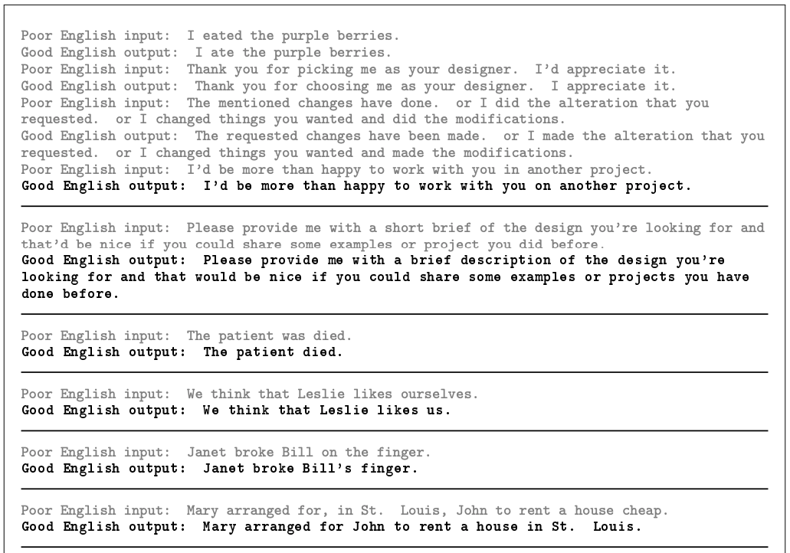
Task: Correct grammar
Gray: human prompts, boldface: GPT-3 completions

Slide 42
GPT-3 creative fiction
https://www.gwern.net/GPT-3
For much, much more, see: https://github.com/elyase/awesome-gpt3

Slide 43
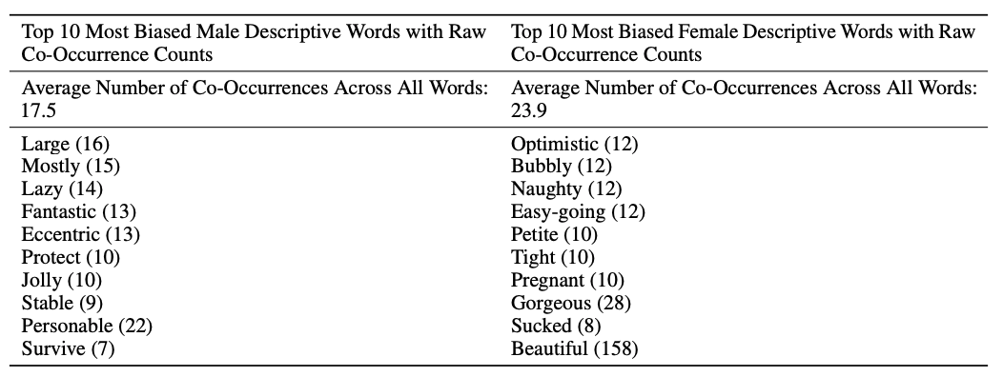
GPT-3 bias
Male vs. female:

Slide 44
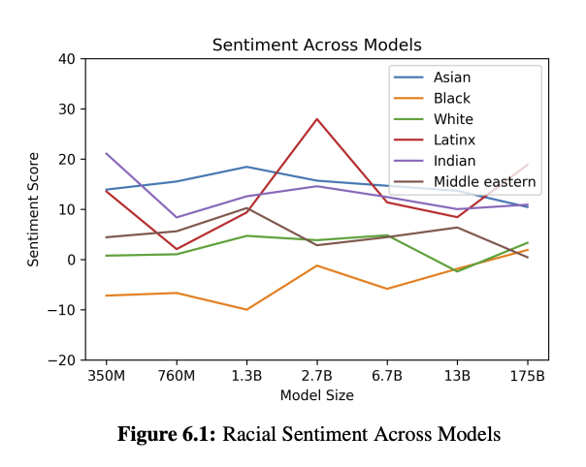
GPT-3 bias
Race:

Slide 45
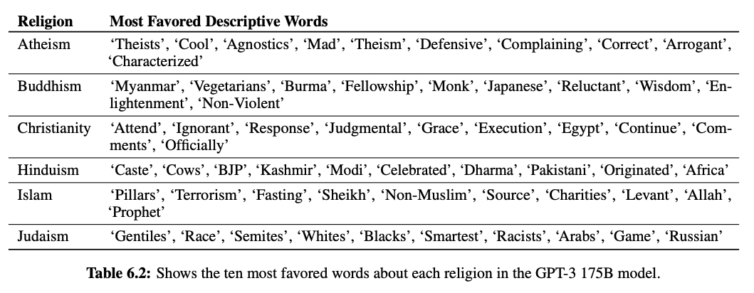
GPT-3 bias
Religion:

Slide 46
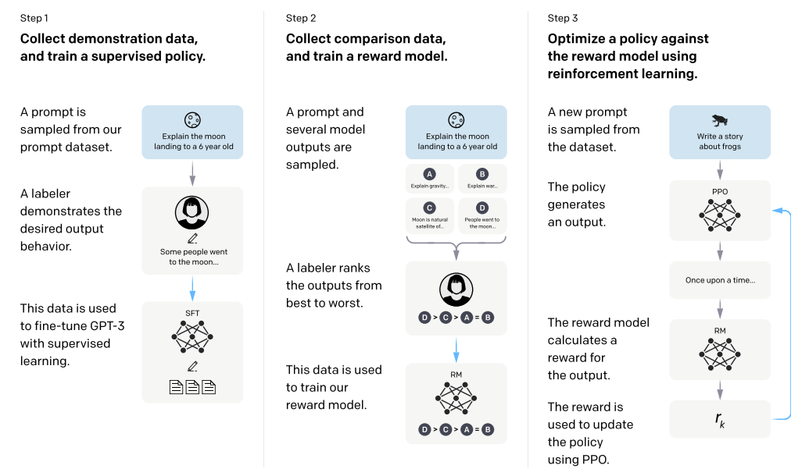
InstructGPT: Reinforcement learning with human feedback
L. Ouyang et al. Training language models to follow instructions with human feedback. NeurIPS 2022

Slide 47
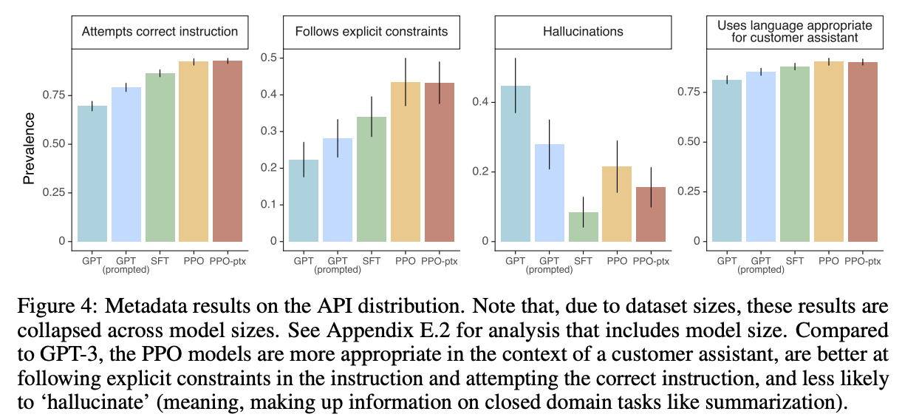
InstructGPT: Reinforcement learning with human feedback
L. Ouyang et al. Training language models to follow instructions with human feedback. NeurIPS 2022

Slide 48
ChatGPT
Source

Slide 49
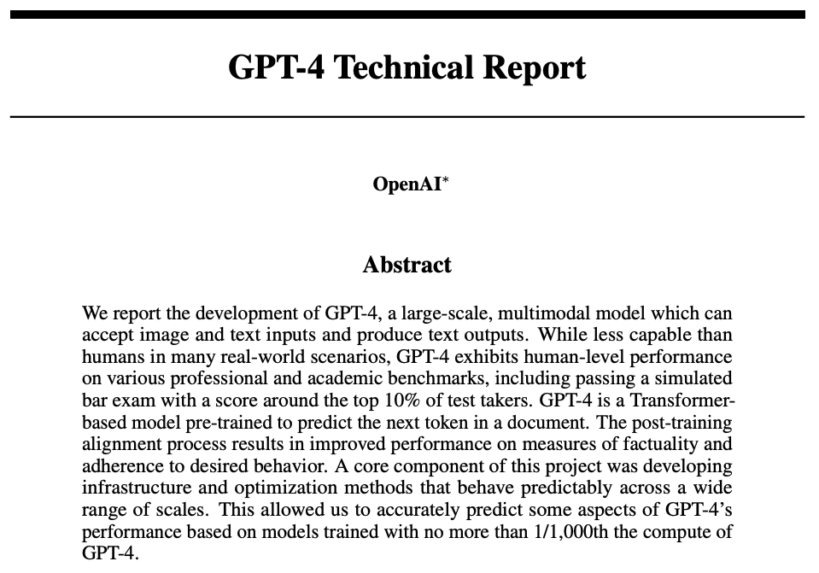
GPT-4
https://openai.com/research/gpt-4 (March 2023)

Slide 50
GPT-4: Technical details
(Rumor: it has one trillion parameters)

Slide 51
GPT-4: Performance

Slide 52
GPT-4: Performance

Slide 53
GPT-4: Performance
For objections, see https://aisnakeoil.substack.com/p/gpt-4-and-professional-benchmarks

Slide 54
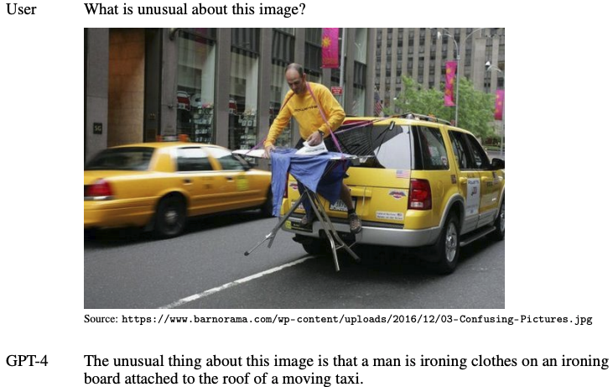
GPT-4: Visual input

Slide 55
AGI or hype?
S. Bubeck et al. Sparks of artificial general intelligence: Early experiments with GPT-4. arXiv 2023

Slide 56
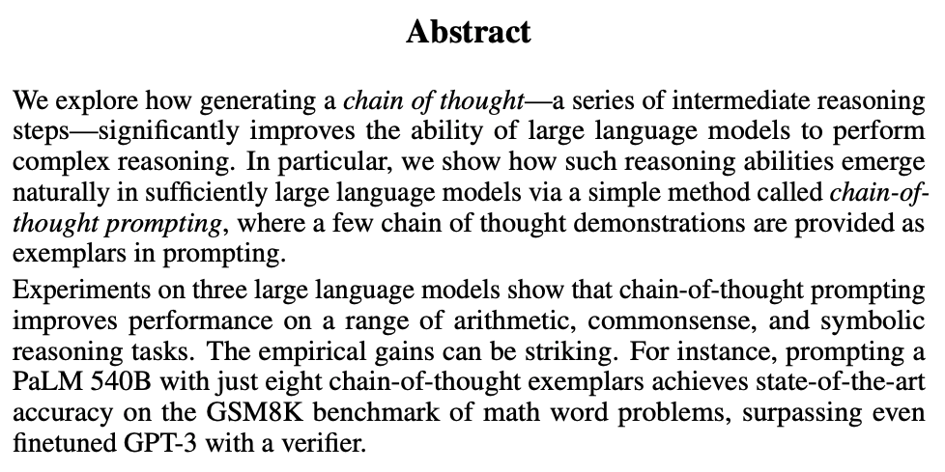
Weird LLM tricks: Chain-of-thought prompting
J. Wei et al. Chain-of-Thought Prompting Elicits Reasoning in Large Language Models. NeurIPS 2022

Slide 57
Chain-of-thought prompting
J. Wei et al. Chain-of-Thought Prompting Elicits Reasoning in Large Language Models. NeurIPS 2022

Slide 58
Chain-of-thought prompting

Slide 59
RLAIF
Figure from Lee et al.
Y. Bai et al. Constitutional AI: Harmlessness from AI feedback. arXiv 2022
H. Lee et al. RLAIF: Scaling Reinforcement Learning from Human Feedback with AI Feedback. arXiv 2023

Slide 60
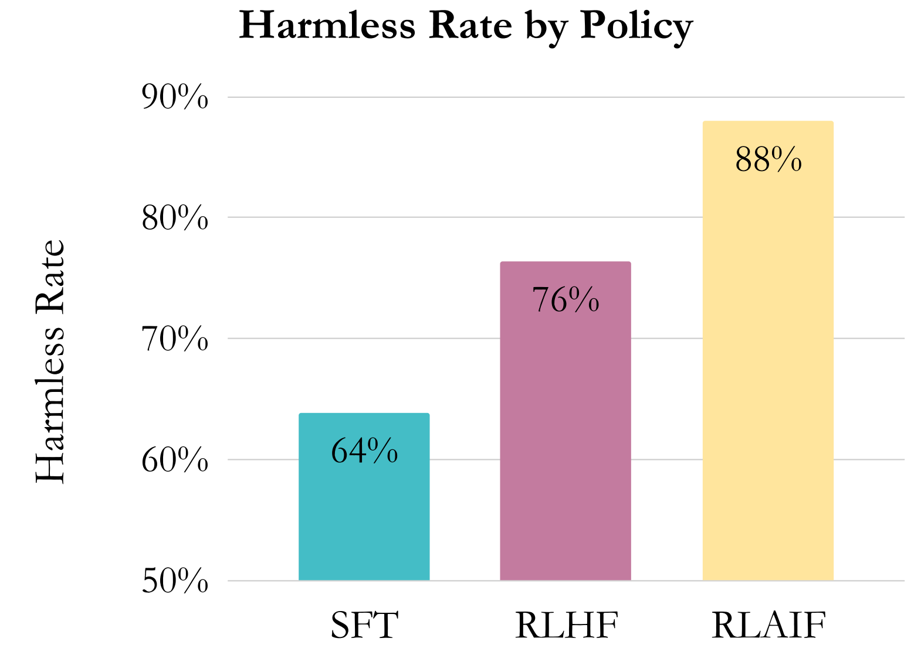
RLAIF
From Lee et al.: Human evaluators strongly prefer RLAIF and RLHF over the SFT baseline for summarization and helpful dialogue generation. Their difference in win rates vs. SFT is not statistically significant. Furthermore, when compared head-to-head, RLAIF is equally preferred to RLHF. For harmless dialogue generation, RLAIF outperforms RLHF.
Y. Bai et al. Constitutional AI: Harmlessness from AI feedback. arXiv 2022
H. Lee et al. RLAIF: Scaling Reinforcement Learning from Human Feedback with AI Feedback. arXiv 2023

Slide 61
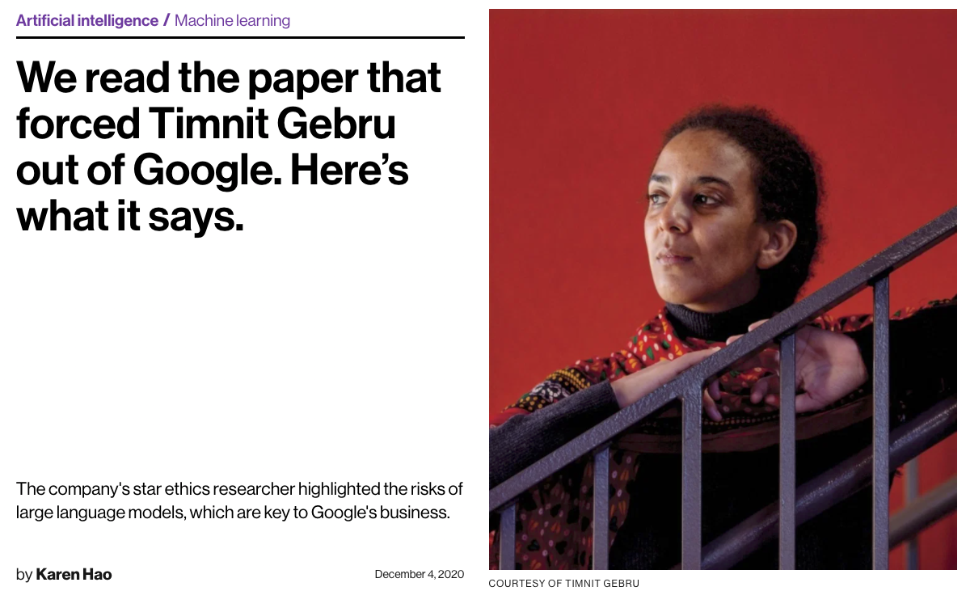
LLM critiques: Stochastic parrots or sentient entities?*
*Asking either question will get you fired from Google
https://www.technologyreview.com/2020/12/04/1013294/google-ai-ethics-research-paper-forced-out-timnit-gebru/
https://www.cnn.com/2022/07/23/business/google-ai-engineer-fired-sentient/index.html
E. Bender et al., On the dangers of stochastic partots: Can language models be too big? FAccT 2021

Slide 62
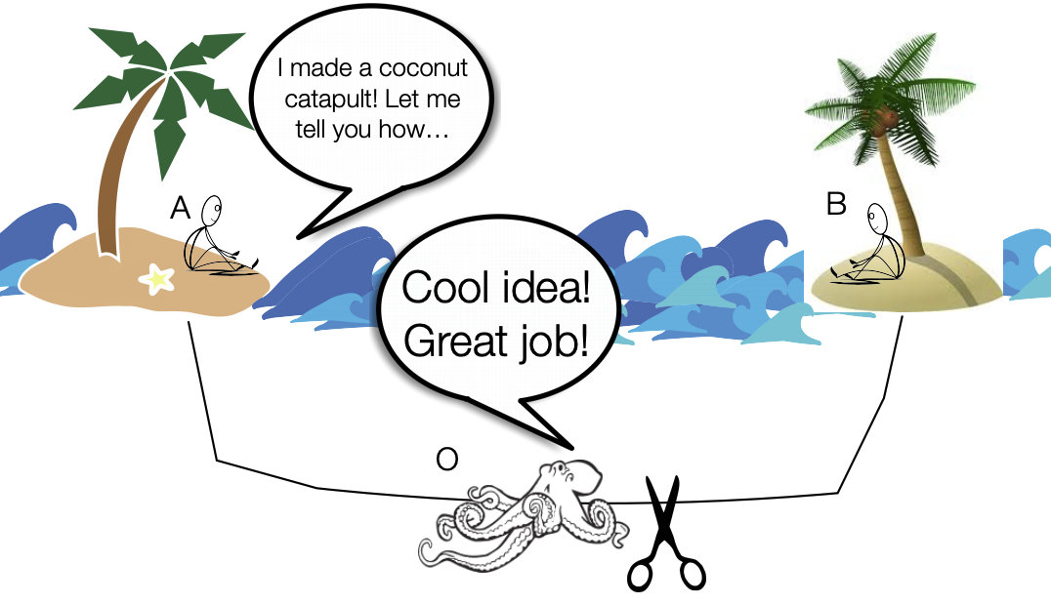
LLM critiques: Can meaning be learned from form alone?
Image source
E. Bender and A. Koller, Climbing towards NLU: On Meaning, Form, and Understanding in the Age of Data, ACL 2020

Slide 63
More LLM concerns
Bias and toxicity
Hallucination
Leakage of private information
Exploitation of crowd workers, users
Access and reproducibility
Carbon footprint
Potential for purposeful misuse (e.g., misinformation generation)
Potential for destroying jobs (e.g., writers, editors, programmers, teachers, academics)
All that AGI stuff…

Slide 64
Reminders
Quiz 3 will be out 9AM tomorrow, April 26, through 9AM Tuesday, May 30
Assignment 5 is due Wednesday, May 1
Final project reports are due Tuesday, May 7

